Slide 1
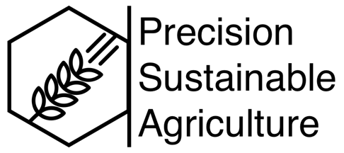
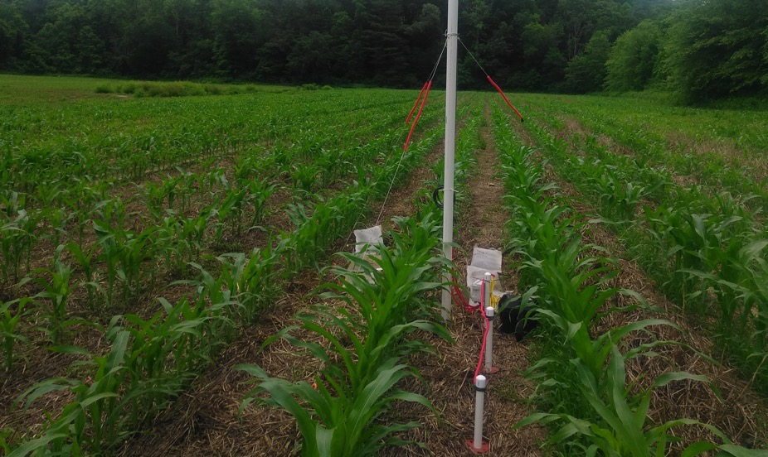
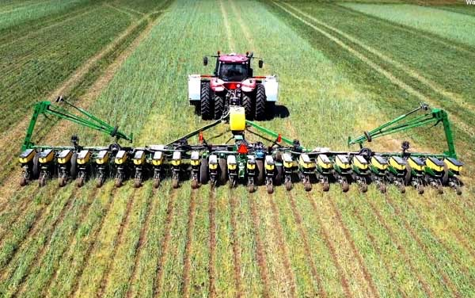
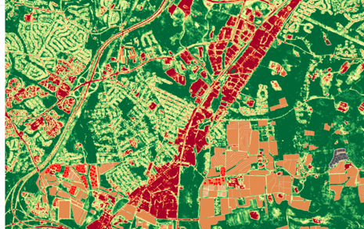
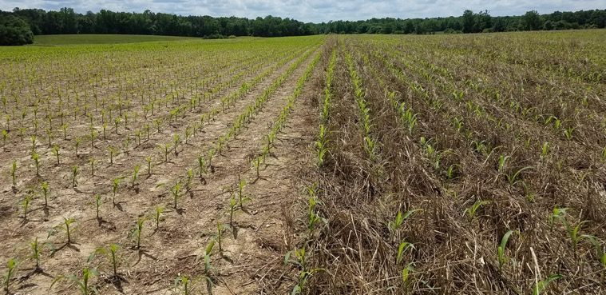
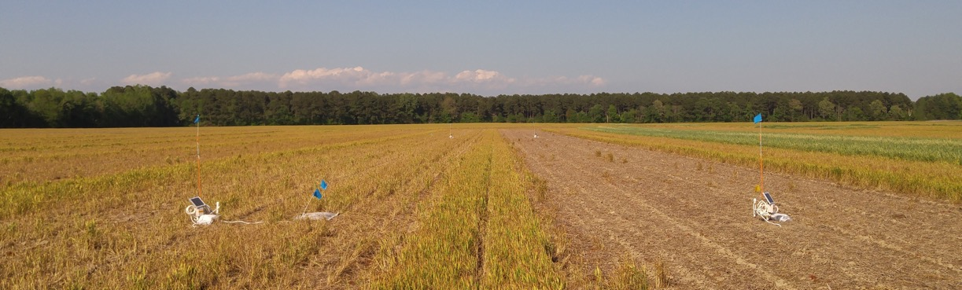
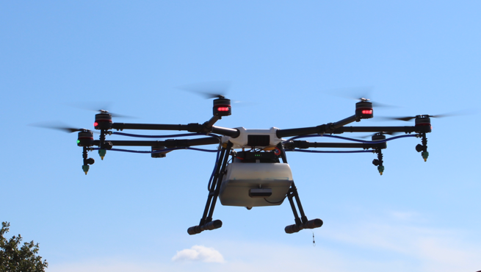
Operationalizing soil health through on-farm research networks
Steven Mirsky et al.
(USDA-ARS Sustainable Agricultural Systems Laboratory)

Slide 2
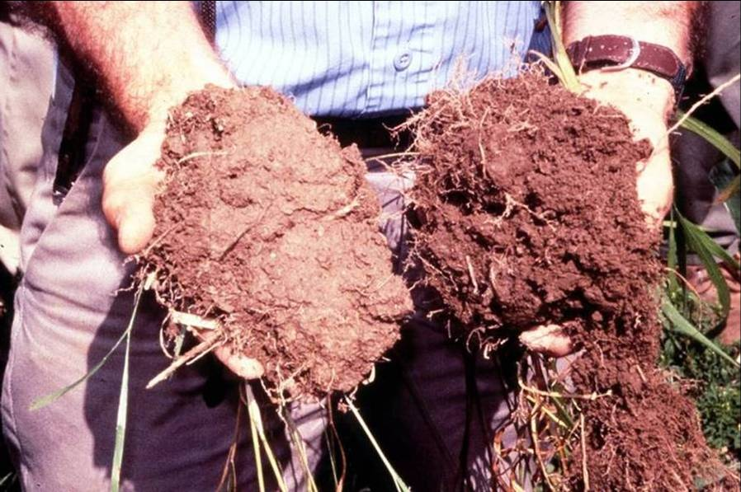
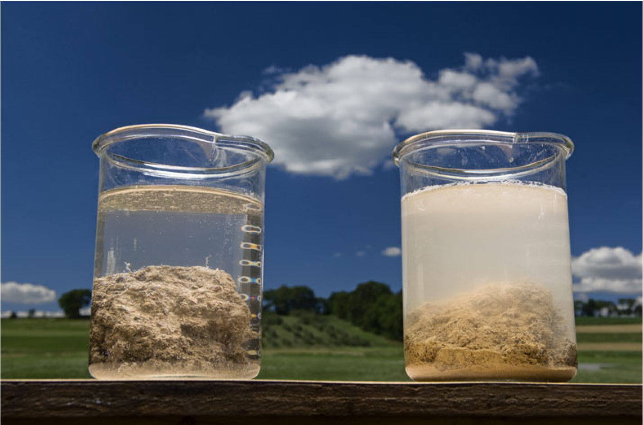
How are these soils different?

Slide 3

How are these soils different?

Slide 4
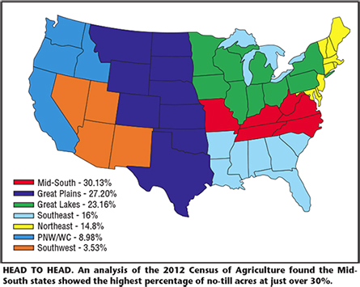
Farmers are constantly doing a multivariate
analysis in their head
Critical challenge: Manage weeds while conserving/regenerating soil resources
Glyphosate-resistant Weeds
No-till Acreage (%; 2012 census)
2012 Census of Agriculture
(% no-till acreage)
2018: 17 species; 38 states
©Dr. Kevin Bradley, University of Missouri

Slide 5
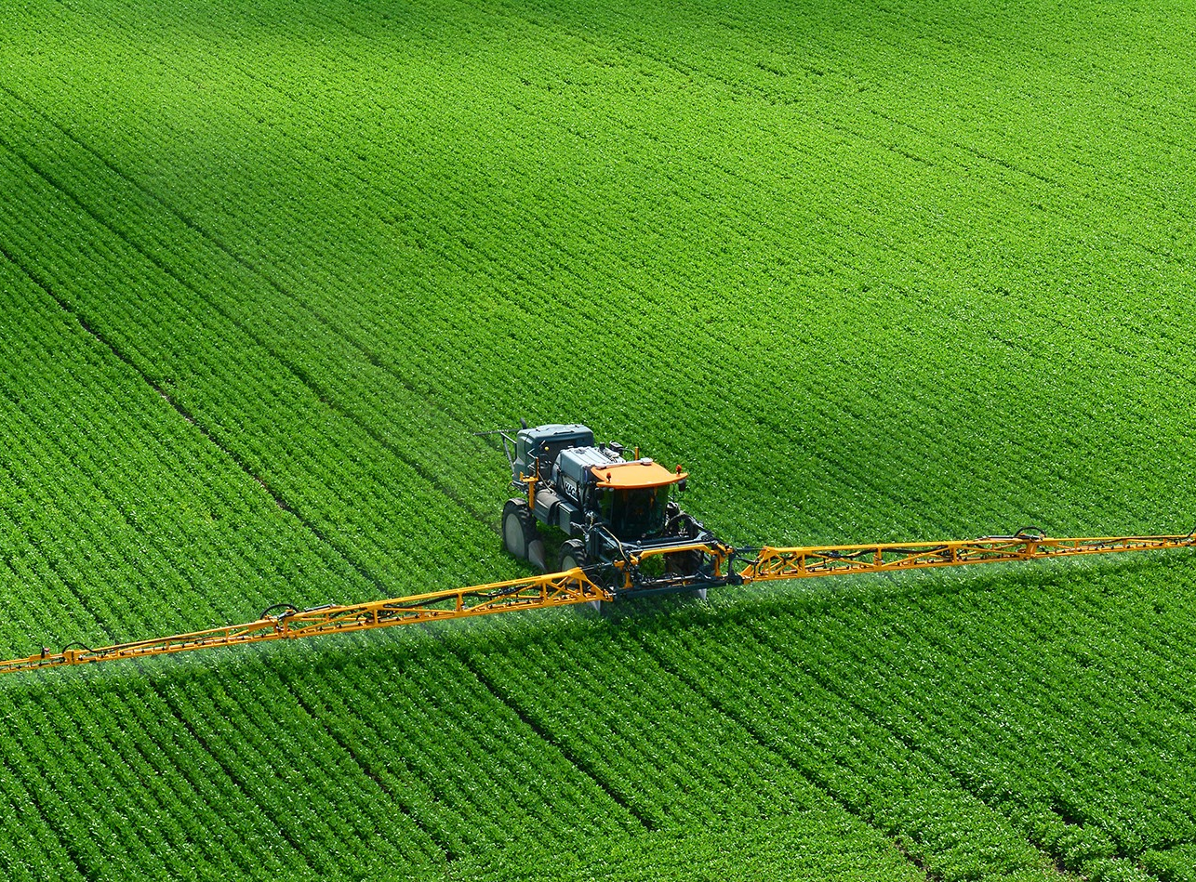
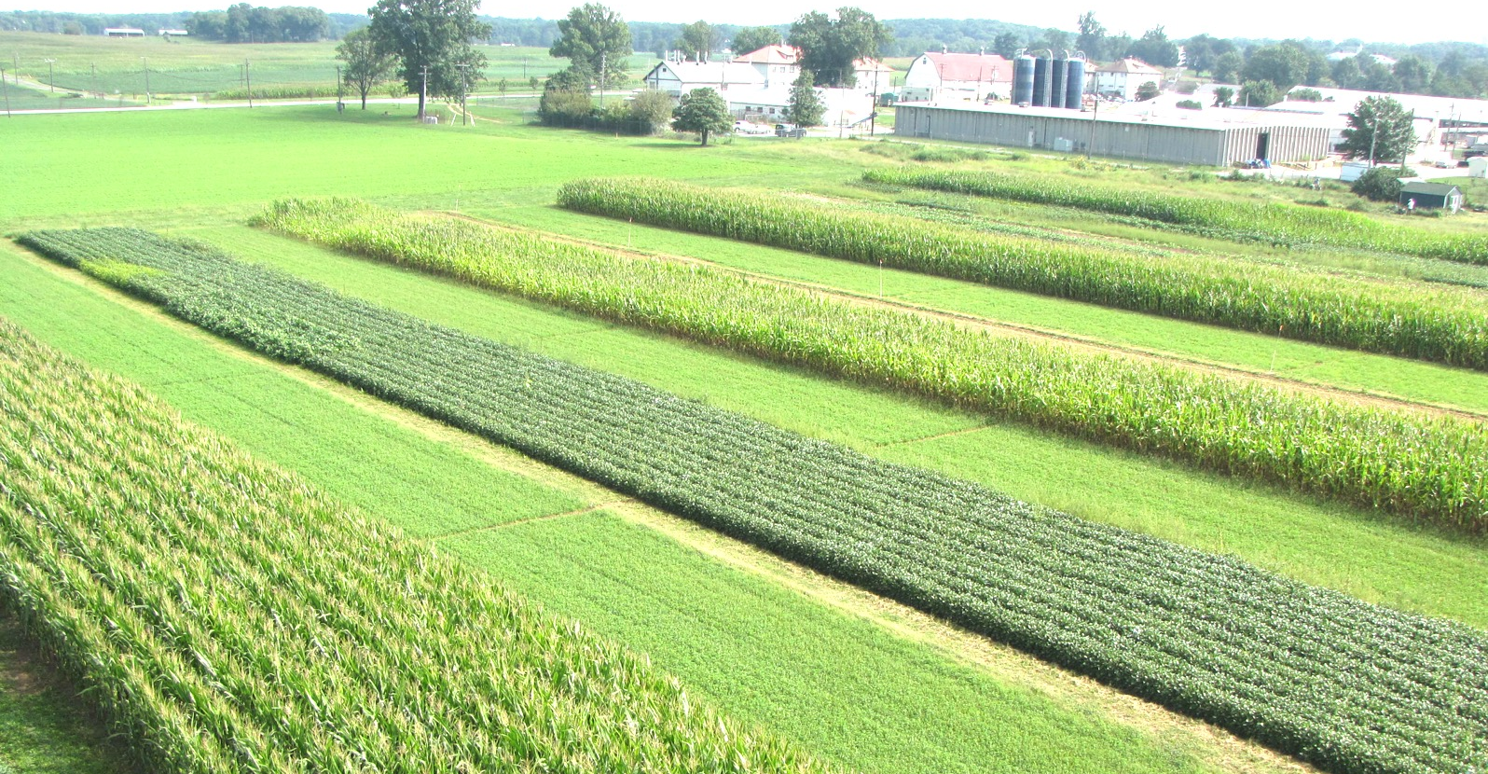
Sustainable Agricultural Practices
Crop rotation/diversity
Reduced tillage
Cover crops
Integrated Pest Management
Breeding

Slide 6
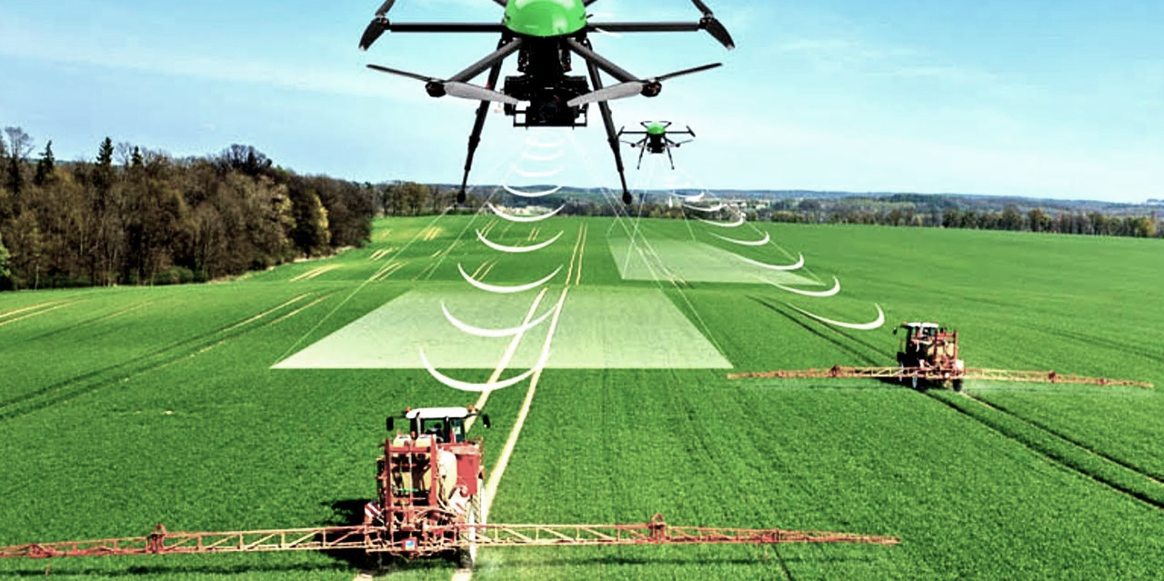
  Precision Agriculture
Photo credits: Mosaic
Credits to Pentoz

Slide 7
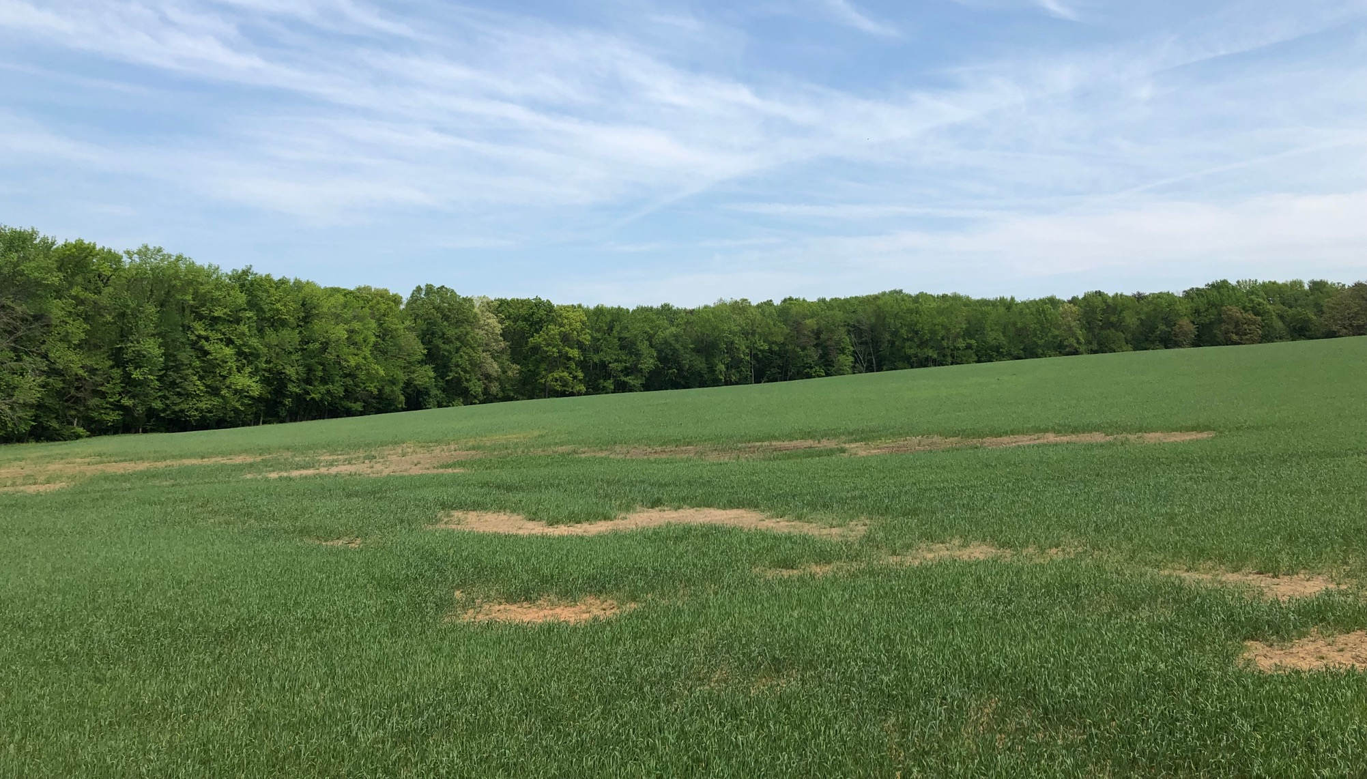
Precision sustainable agricultural is knowledge intensive
Build the knowledge to manage complexity
(climate, soil, and management)

Slide 8
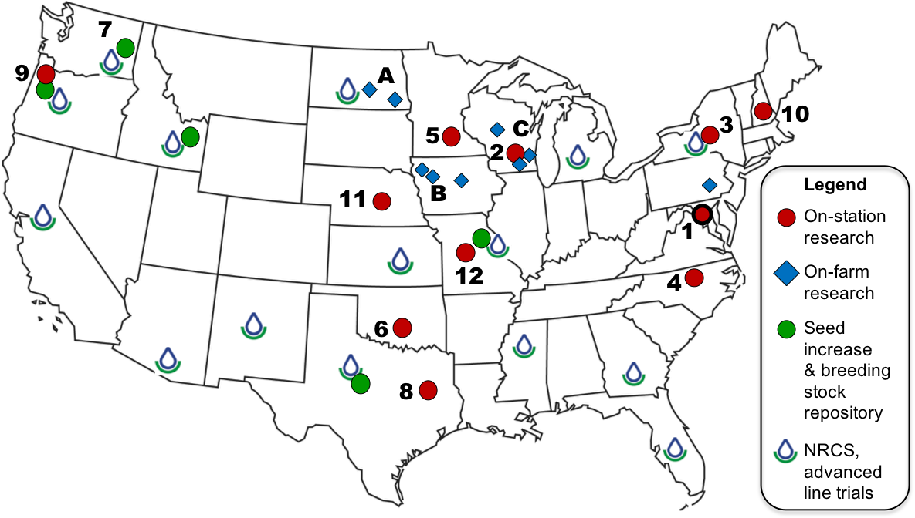
National Cover Crop Breeding Network

Slide 9
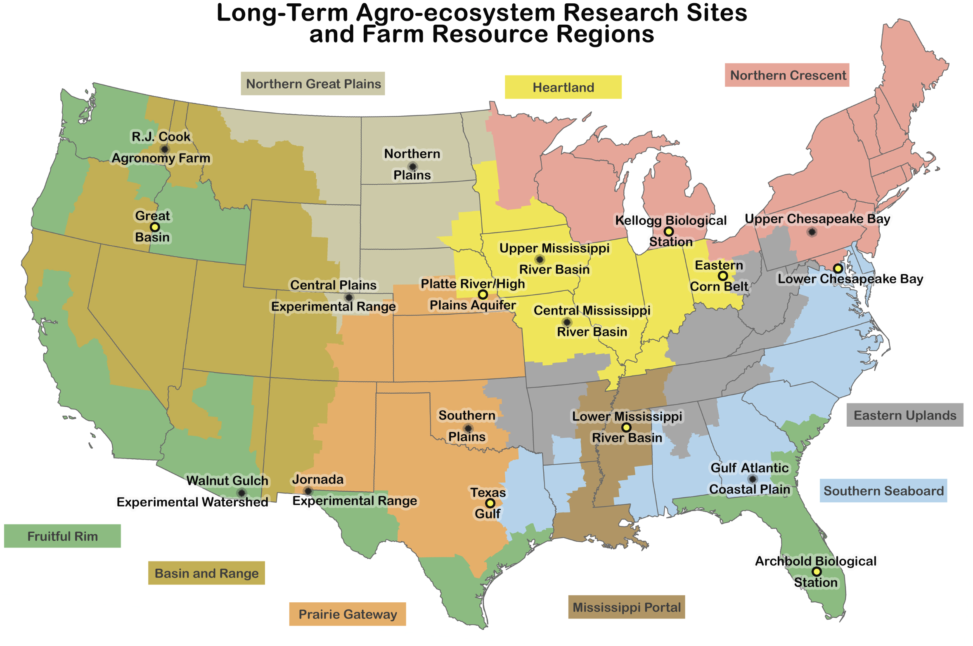
Long-Term Agricultural Research

Slide 10















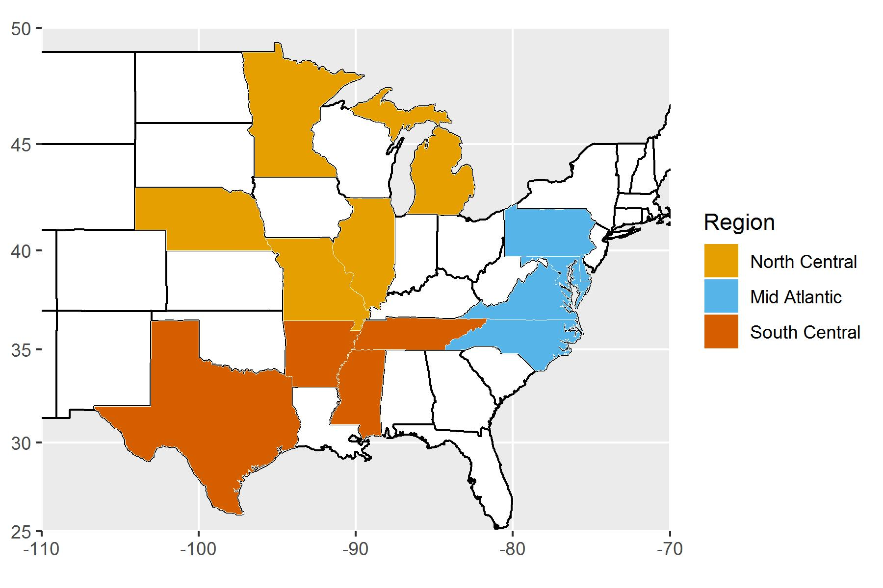
Integrated weed management team
(https://integratedweedmanagement.org)
Multi-tactic approach
  Crop rotation
  Herbicides
  Cover crops
  Harvest weed seed control

Slide 11

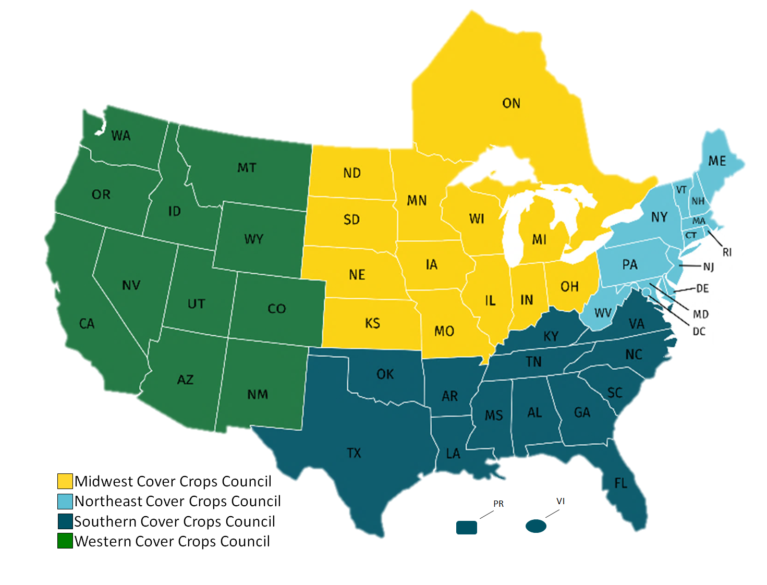



Cover Crop Councils: Staying Connected
Notes:
We continue to stay in contact with other regions about tool efforts. The cover crop council managers communicate via email, monthly meetings, and attending the regional conferences.

Slide 12
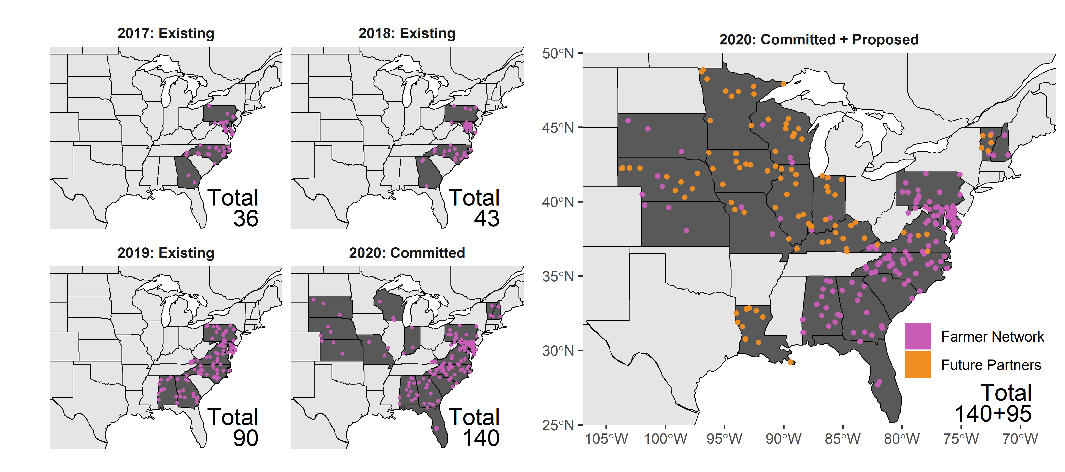
On-Farm Research and Monitoring
CIG On-Farm
Our ambitions are to get to 250+ farm fields across US
Water CAP: Cover crop real-time water and nitrogen
(CROWN)
SAS CAP: Precision Sustainable Agriculture team
(PSA)

Slide 13
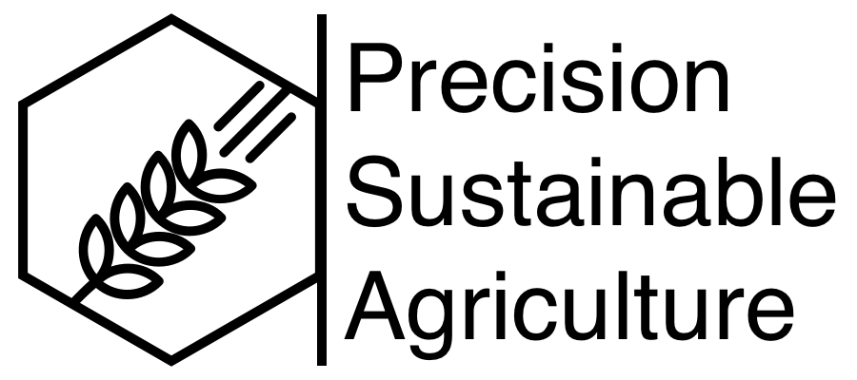
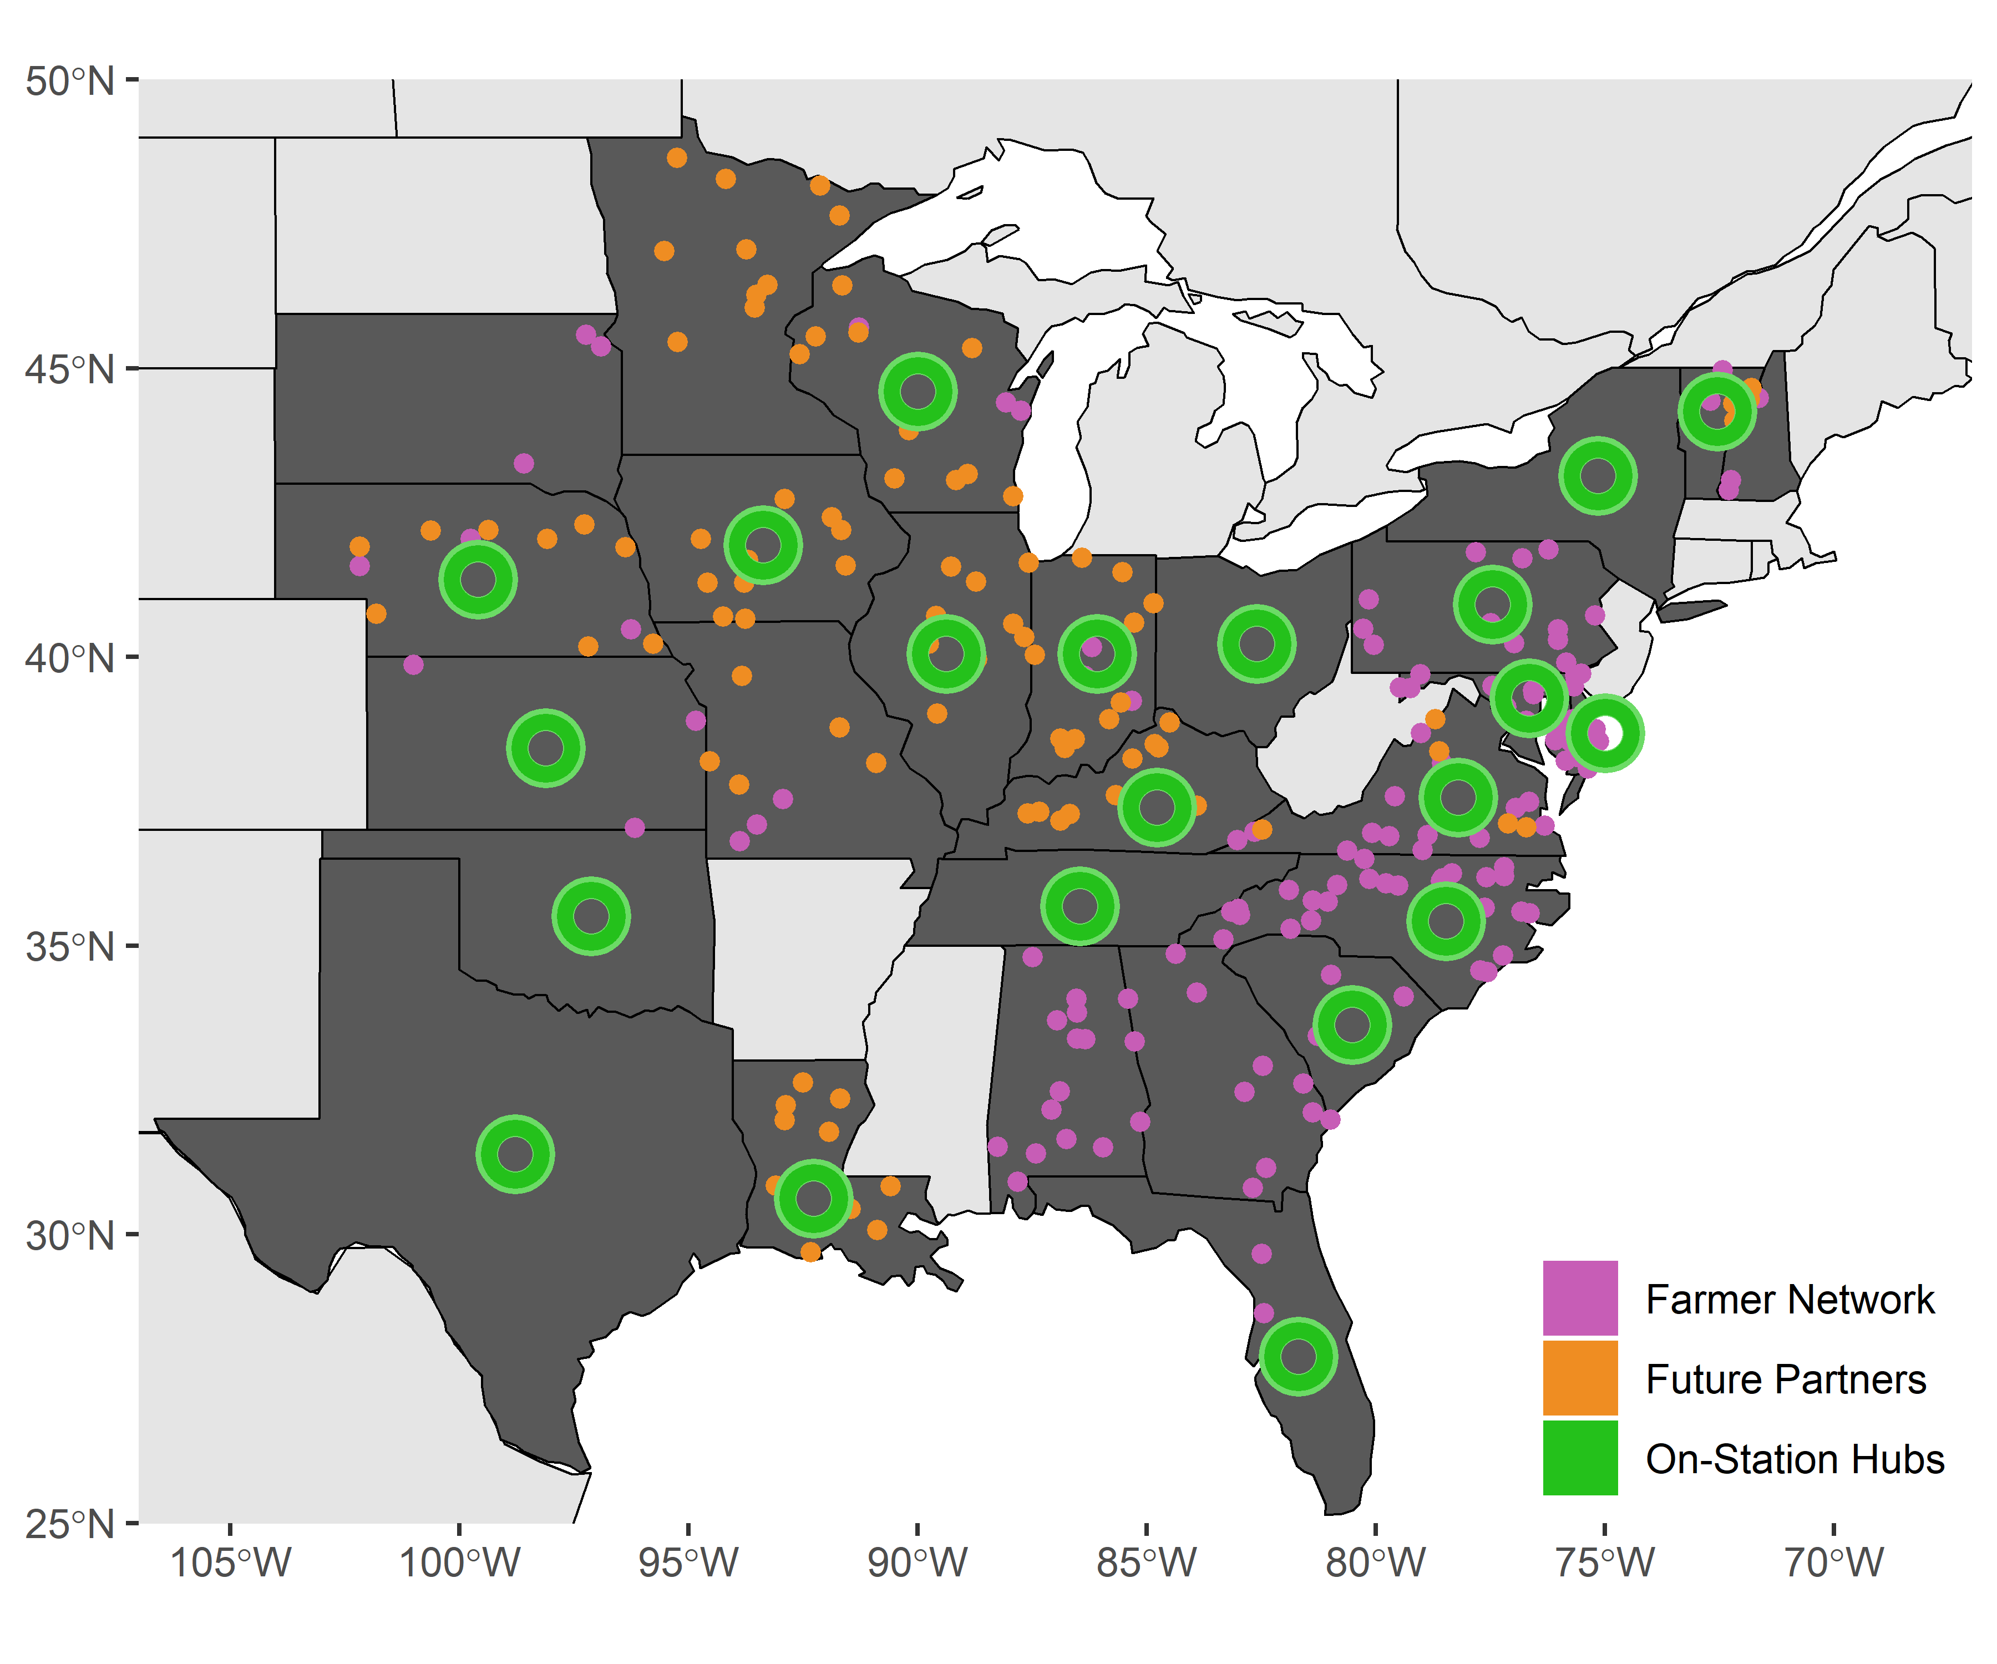
  ARS and University On-Farm and On-Station Network

Slide 14
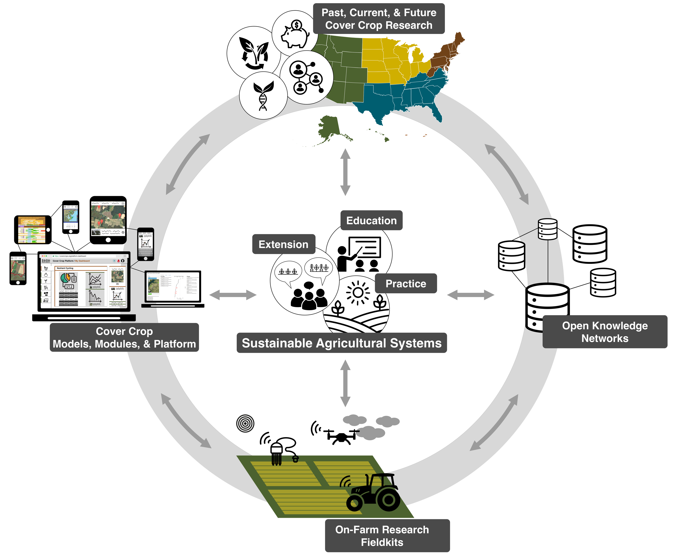
An Information Ecology for Precision Sustainable Agriculture
On-farm monitoring and on-station research
Technology (remote sensing, machine learning and low-cost sensors)
Decision support tools, models and analytical tools
Communication and data sharing platforms for research, extension and education
Network of researchers, farmers and agricultural professionals

Slide 15
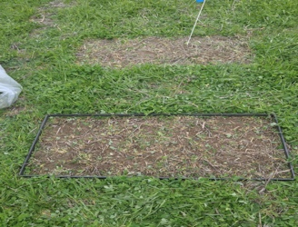
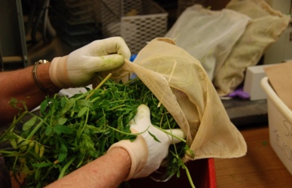
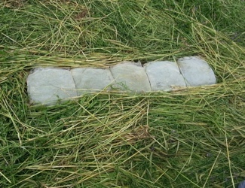
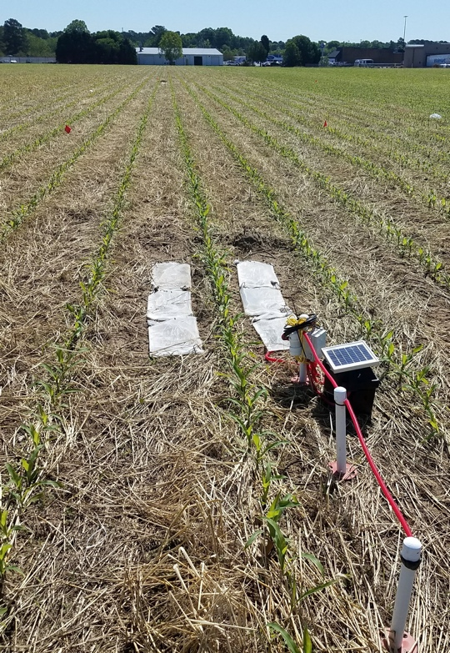
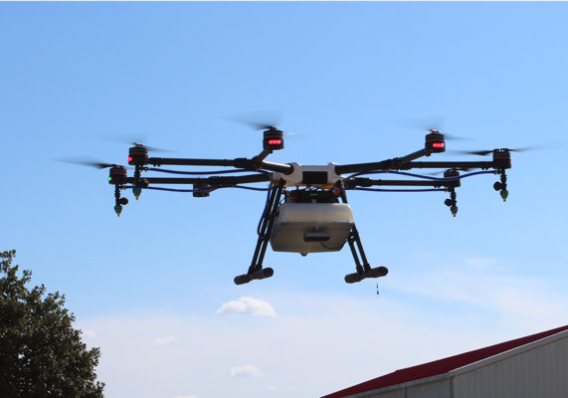
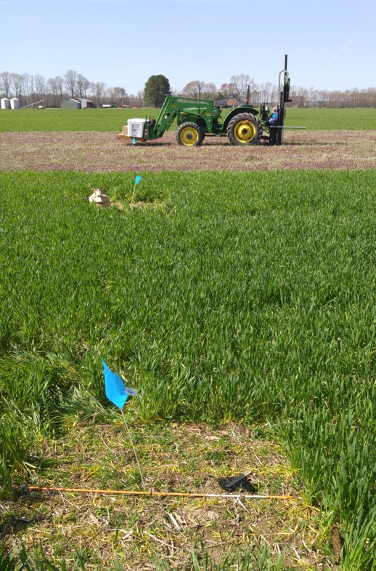
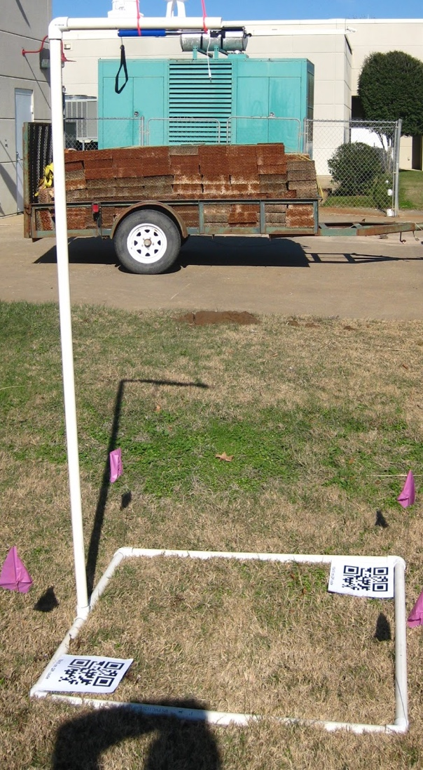
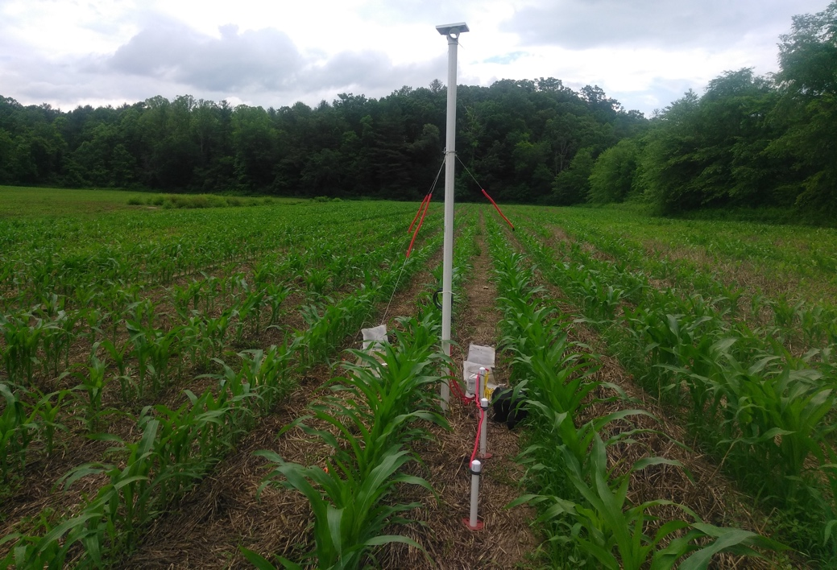
  ARS and University On-Farm and On-Station Network

Slide 16
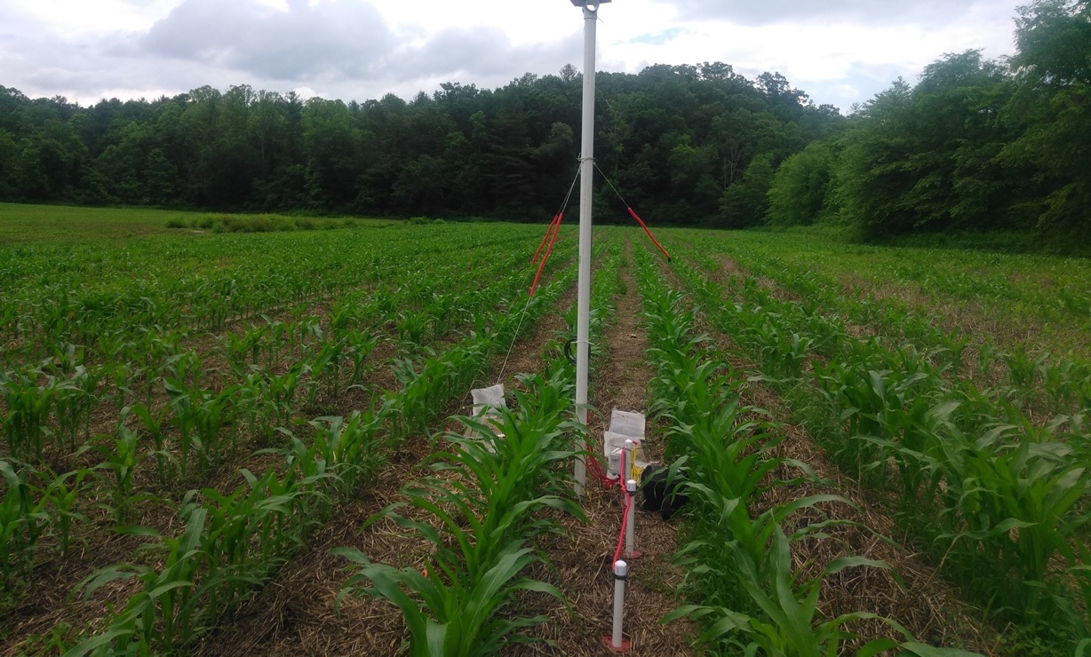
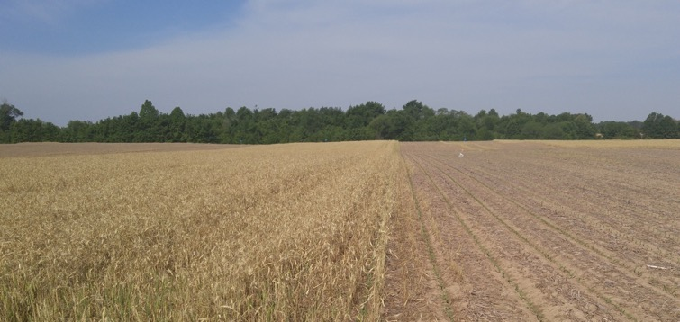
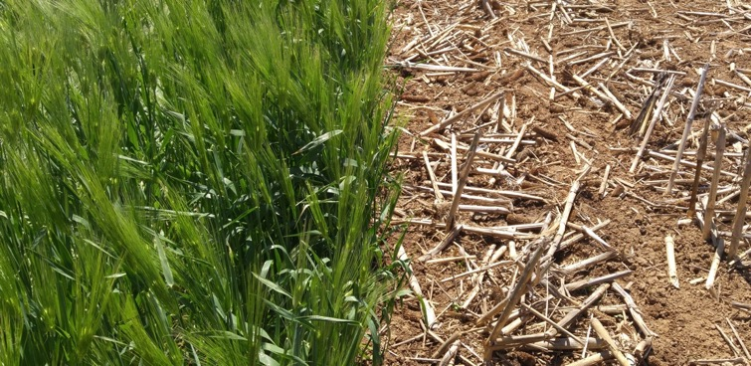

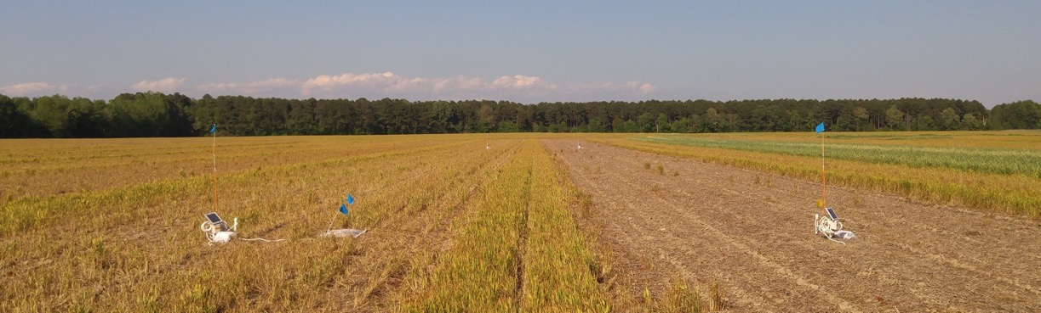

Slide 17

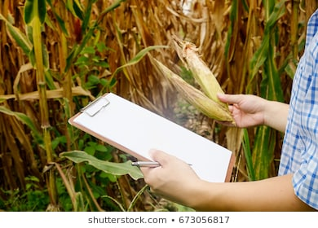
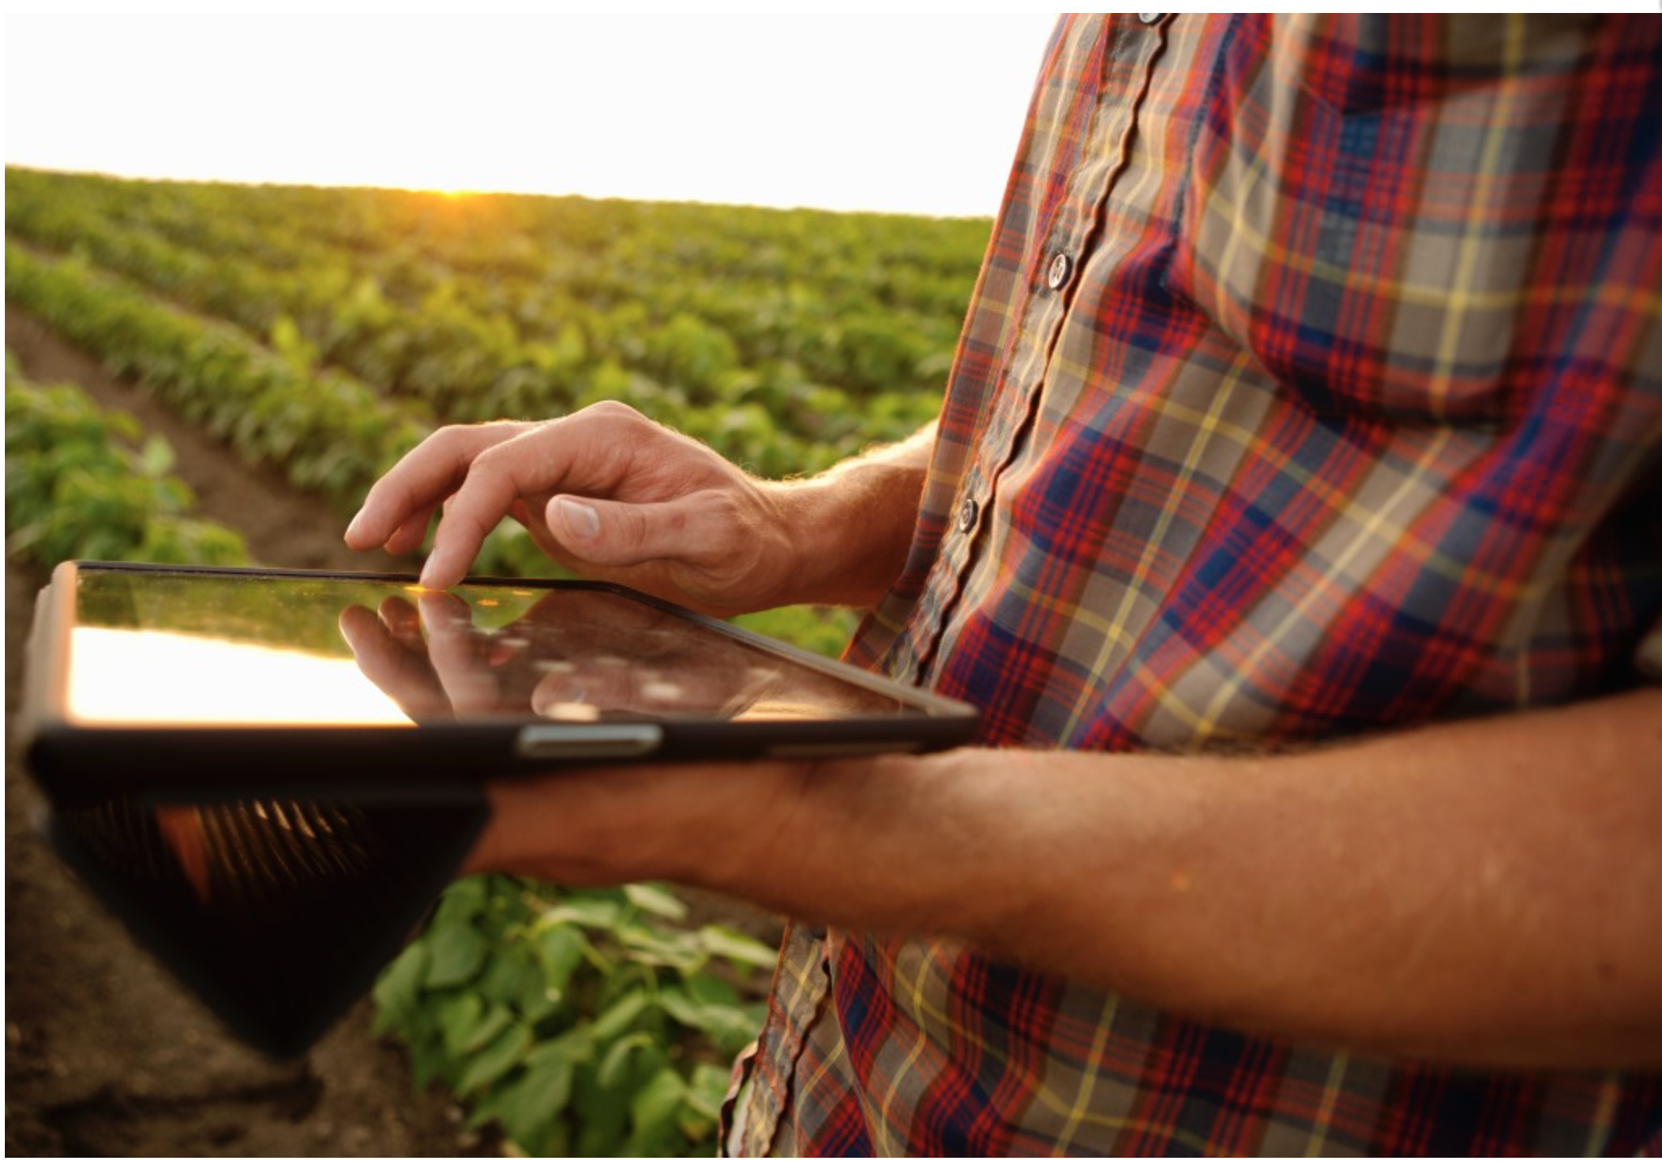

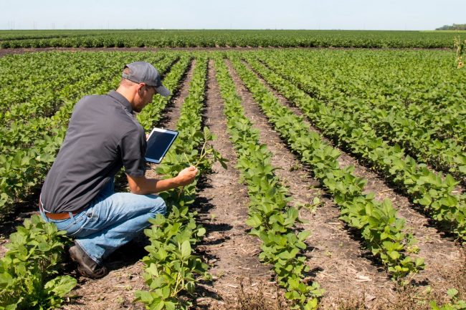
Just Say No To Paper

Slide 18
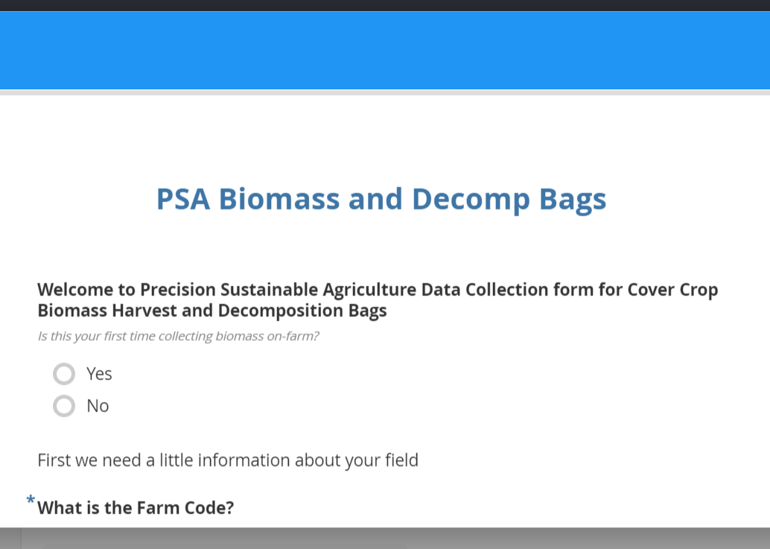
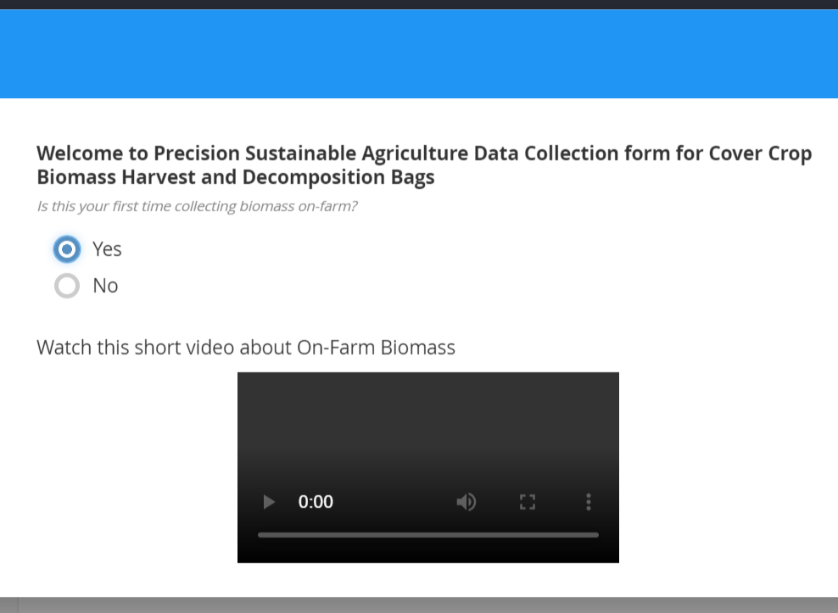
Example Protocol:
Biomass Harvest and Decomposition Bags
Welcome. Are you a new user?
Cascading logic:
If Yes, an instructional video appears
If No, nothing

Slide 19
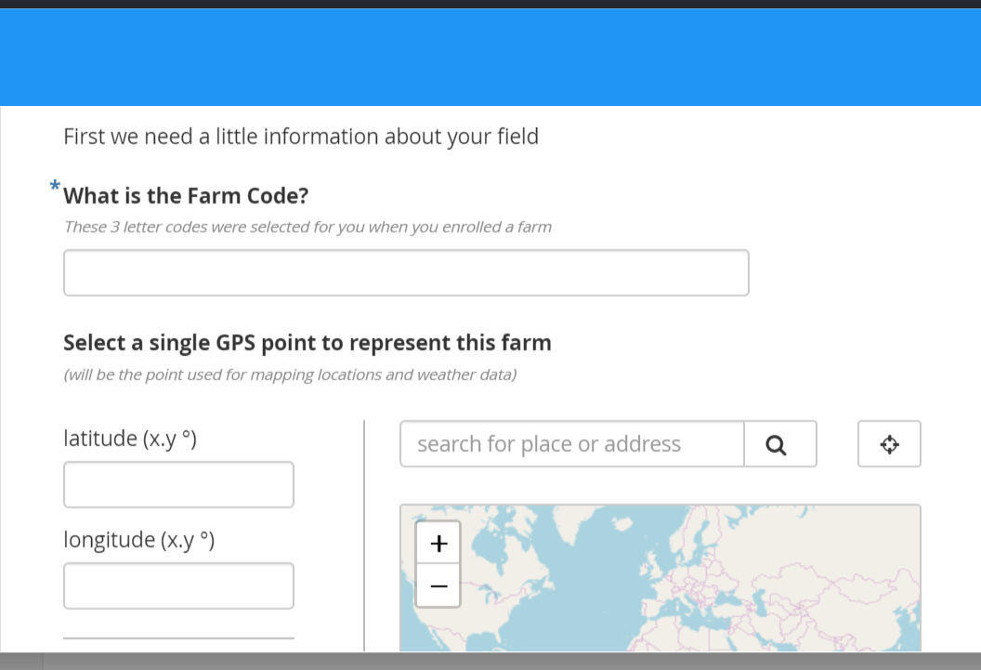
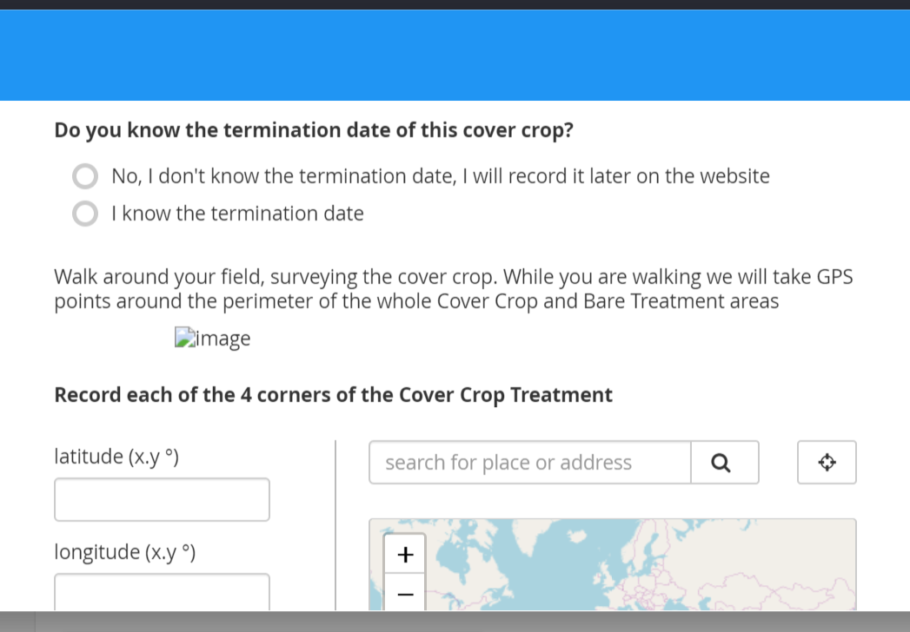
Example Protocol:
Biomass Harvest and Decomposition Bags
Required Fields
Previously missed metadata
Easy GPS
PSA uses Standardized Farm Codes across whole network.
Great way to collect metadata while collecting samples.

Slide 20
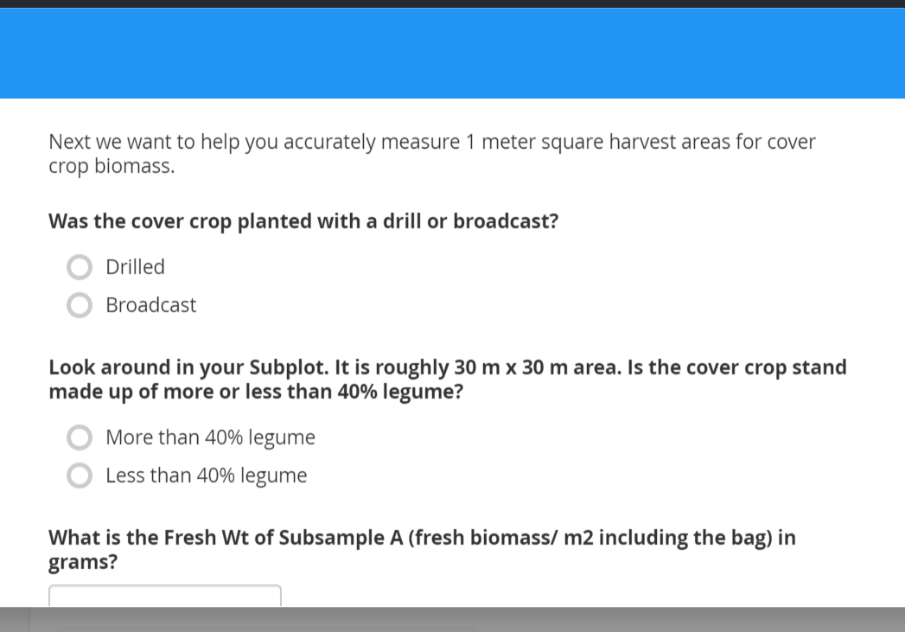
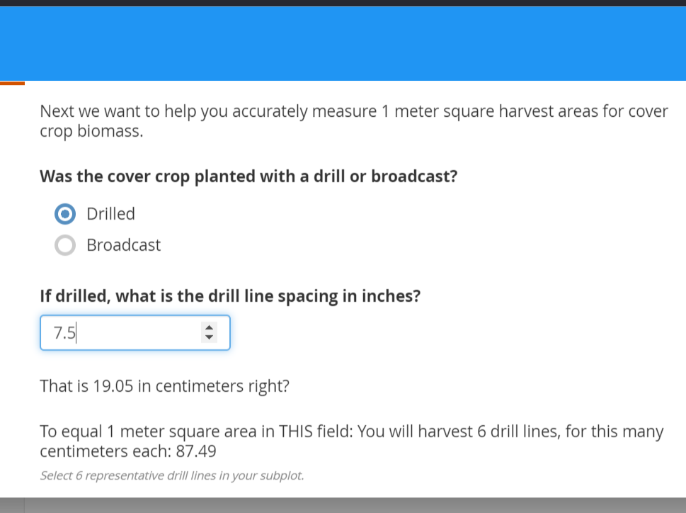
Example Protocol:
Biomass Harvest and Decomposition Bags
Protocol Instructions
Customized harvest area according to unique field variables
If ‘Drilled’, goes into a calculation screen.
If ‘Broadcast’, a different set of instructions.
Calculations on the fly.
Gets rid of user error and simplifies database management.

Slide 21
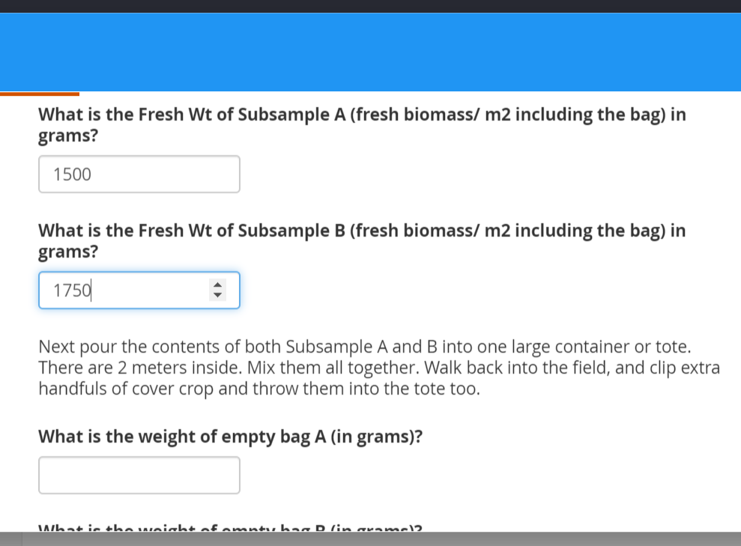
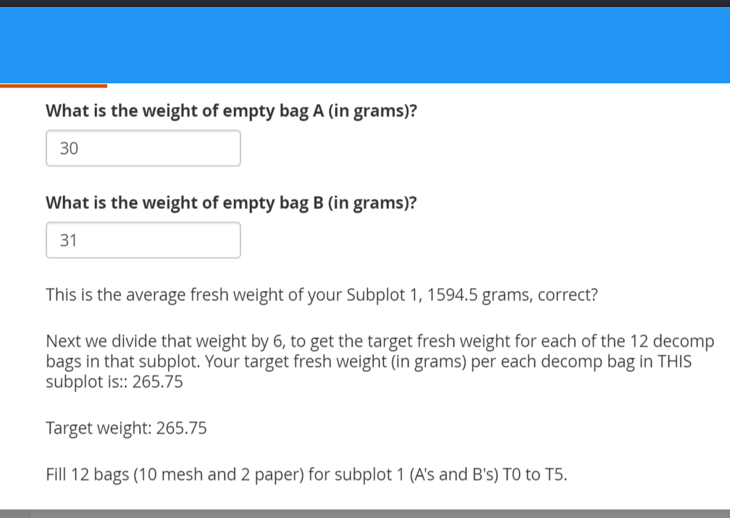
Example Protocol:
Biomass Harvest and Decomposition Bags
Next: Enter Fresh Biomass Weights
Make calculations in the form
Enter Weights on number pad
This was formerly a 12 page protocol with a spreadsheet to make calculations

Slide 22
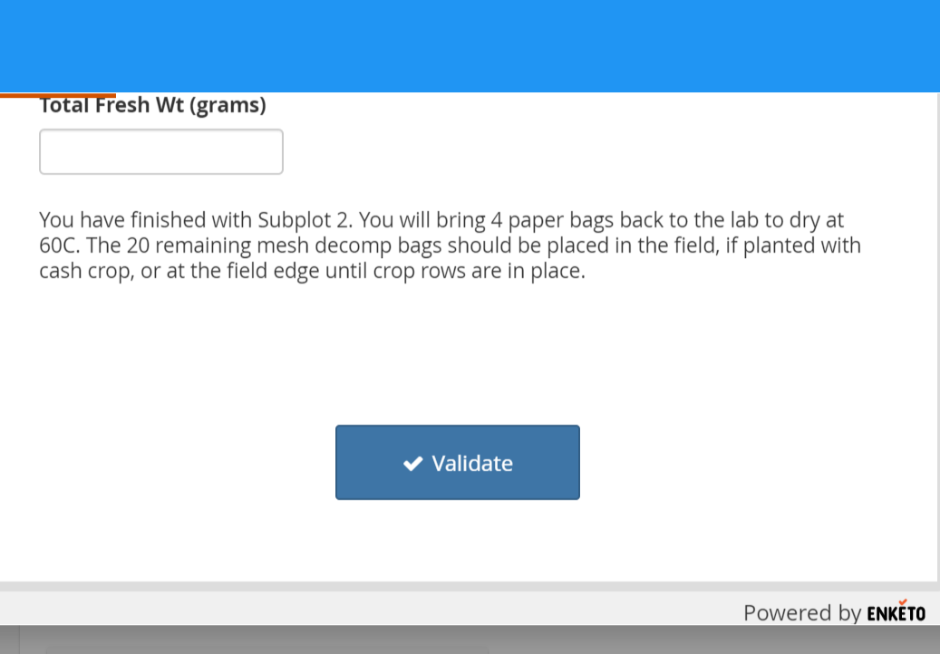
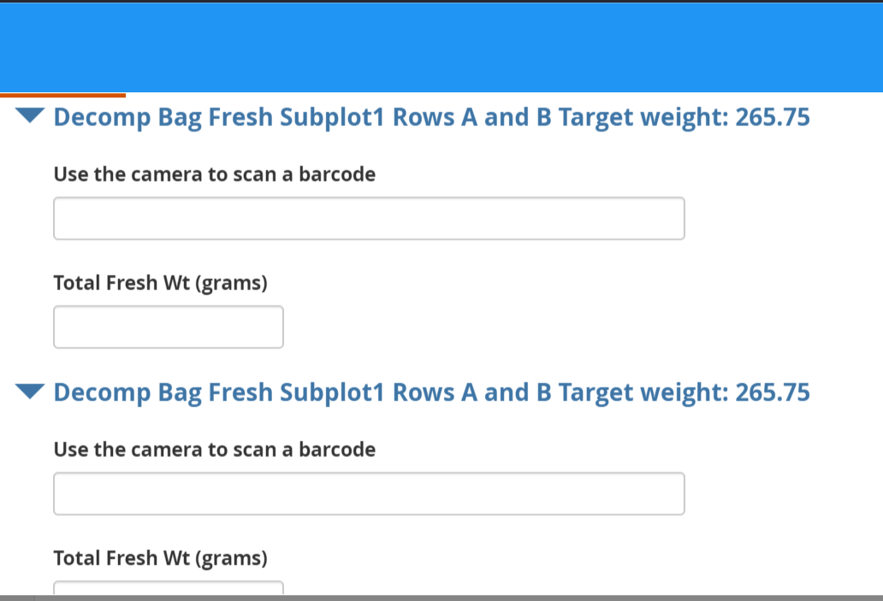
Example Protocol:
Biomass Harvest and Decomposition Bags
Use tablet camera to scan barcode
Finish, and instructions for sample handling
Visual reminders of target wts
Barcodes: uniform PSA labeling system for samples in database
Data Validation, at end of form, before submission, to confirm no mistakes, missing data

Slide 23
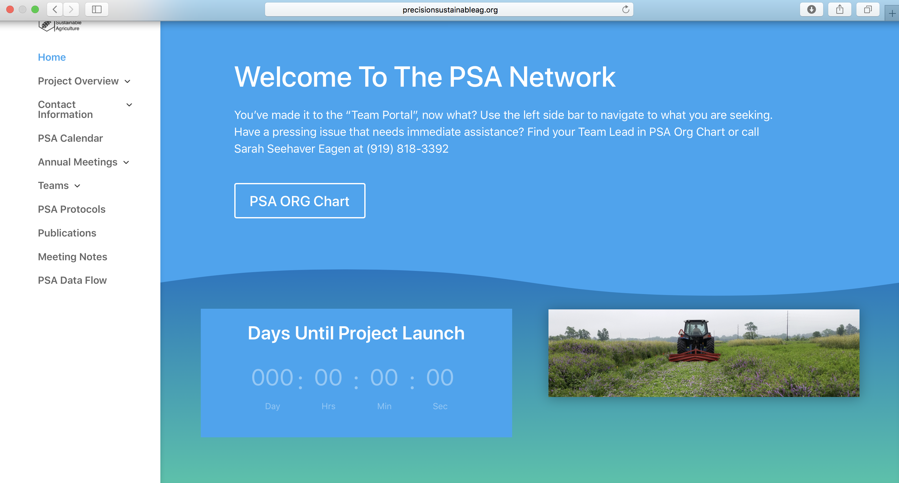
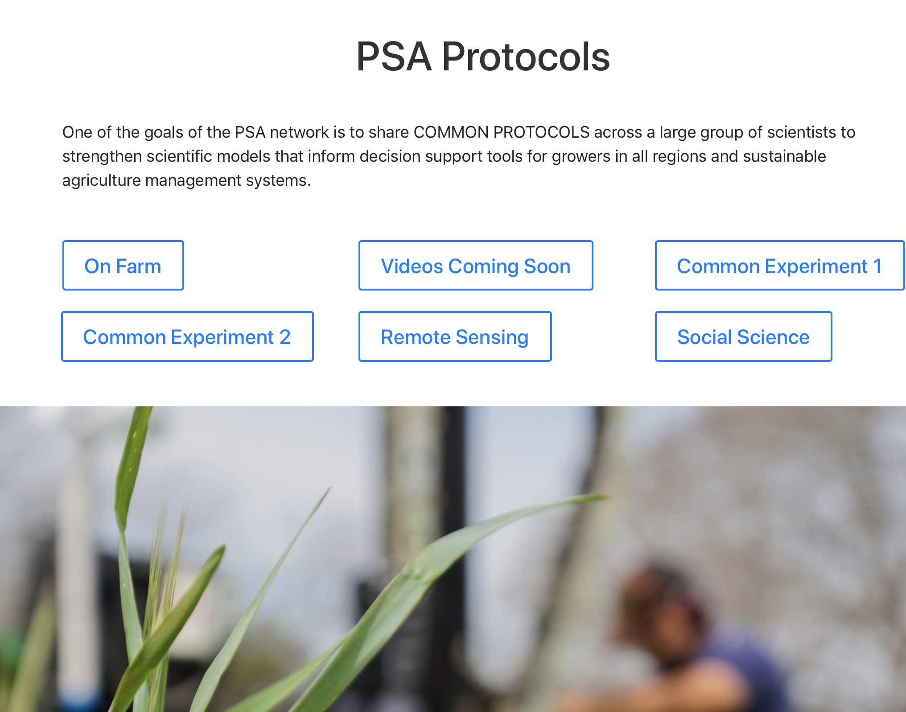

Slide 24
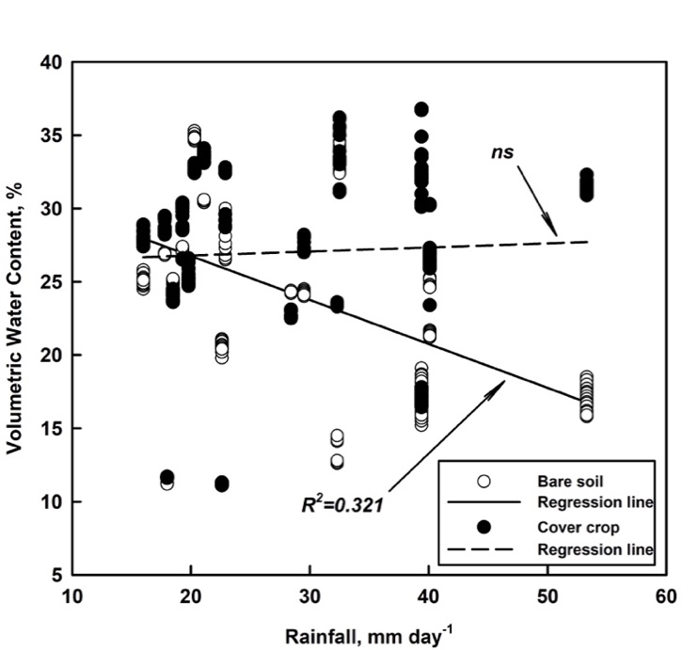
Effect of cover crops on water infiltration

Slide 25
Acknowledgements

