Slide 1
Introduction
drainage water management affects soil Quality?
Richard Cooke

Slide 2
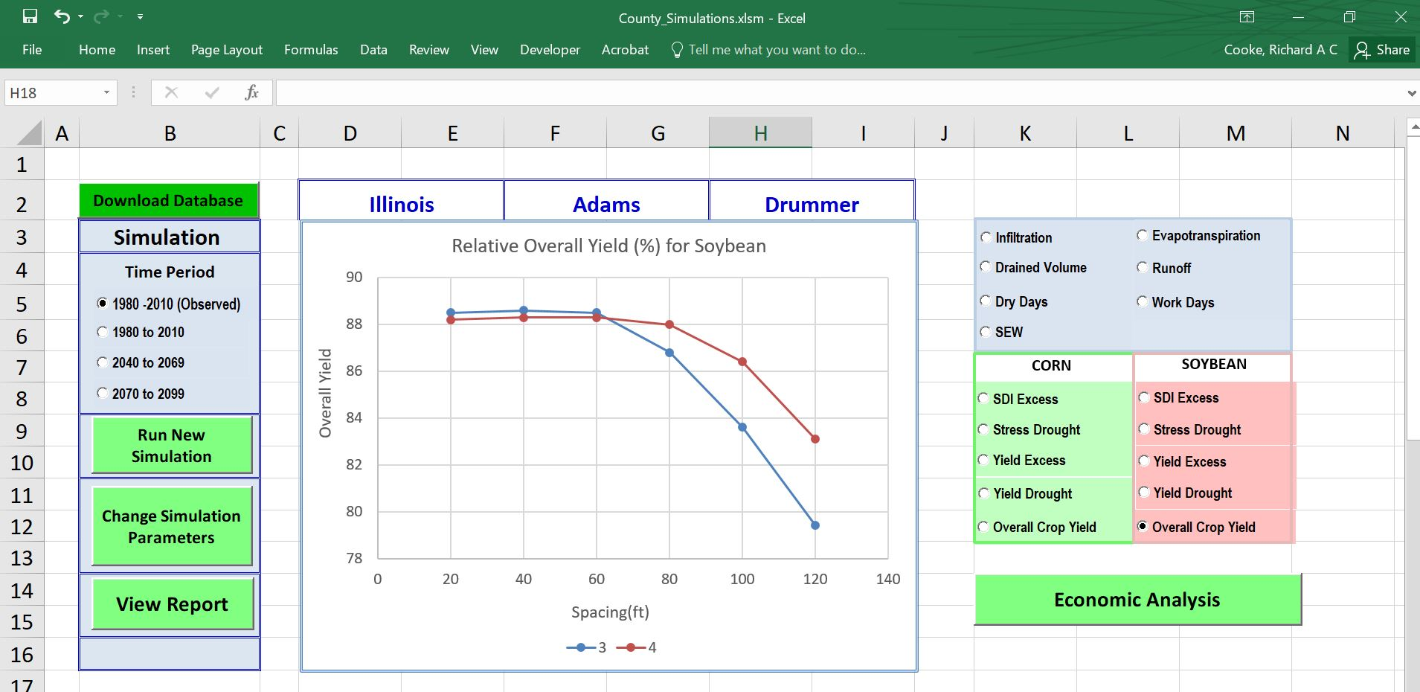

Slide 3
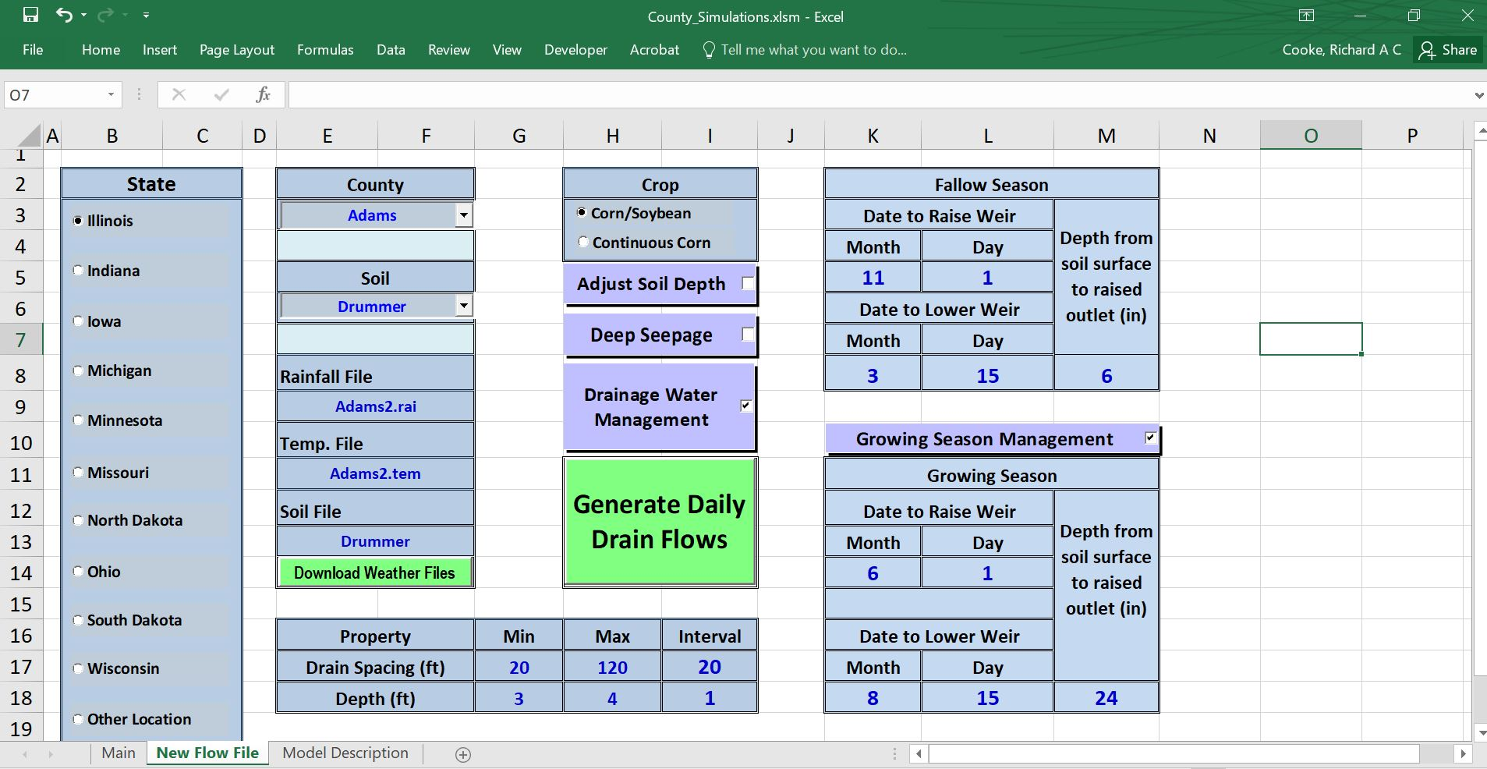

Slide 4
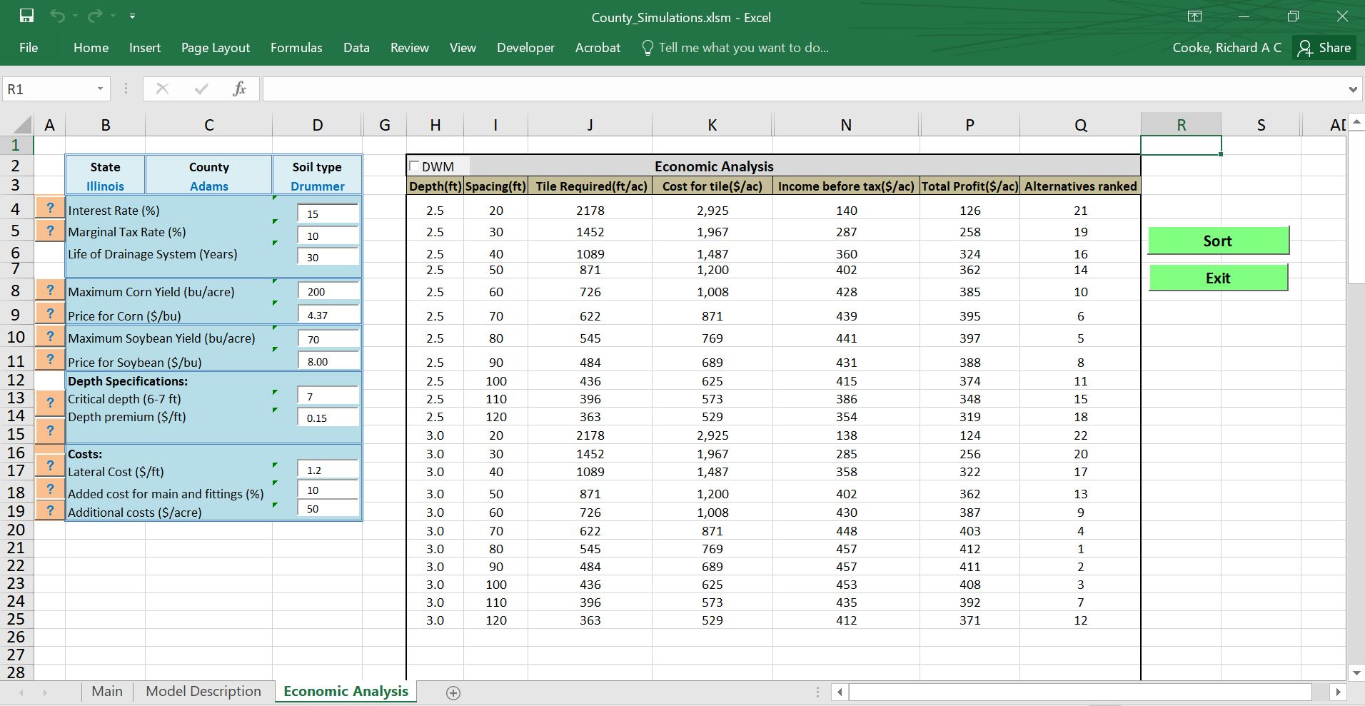

Slide 5
Drainage Water Management is not a recommended practice in the Illinois Nutrient Loss Reduction Strategy

Slide 6
One who knows and knows that he knows... His horse of wisdom will reach the skies.
One who knows, but doesn't know that he knows... He is fast asleep, so you should wake him up!
One who doesn't know, but knows that he doesn't know... His limping mule will eventually get him home.
One who doesn't know and doesn't know that he doesn't know... He will be eternally lost in his hopeless oblivion!
Ibn Yamin Faryumadi (1286-1368)

Slide 7
Known Knowns
Research
Collaboration
Known Unknowns
Unknown Knowns
Known Unknowns
Unknown Knowns

Slide 8
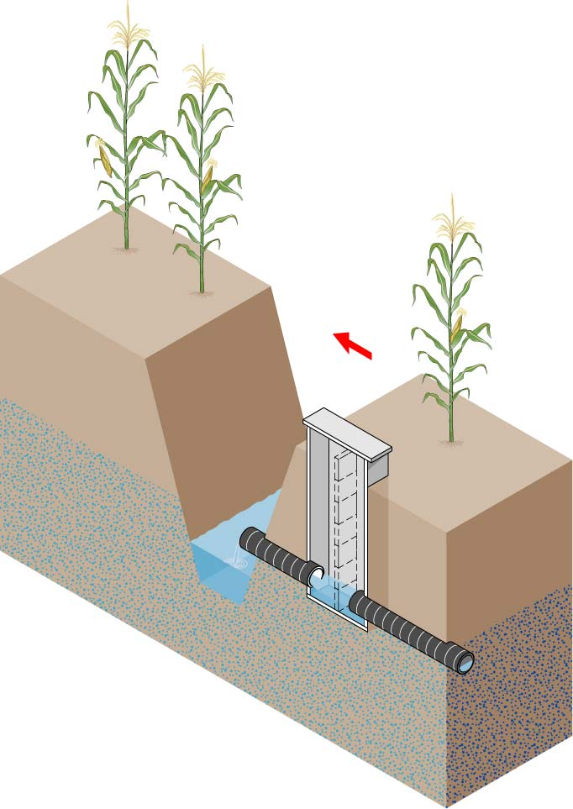
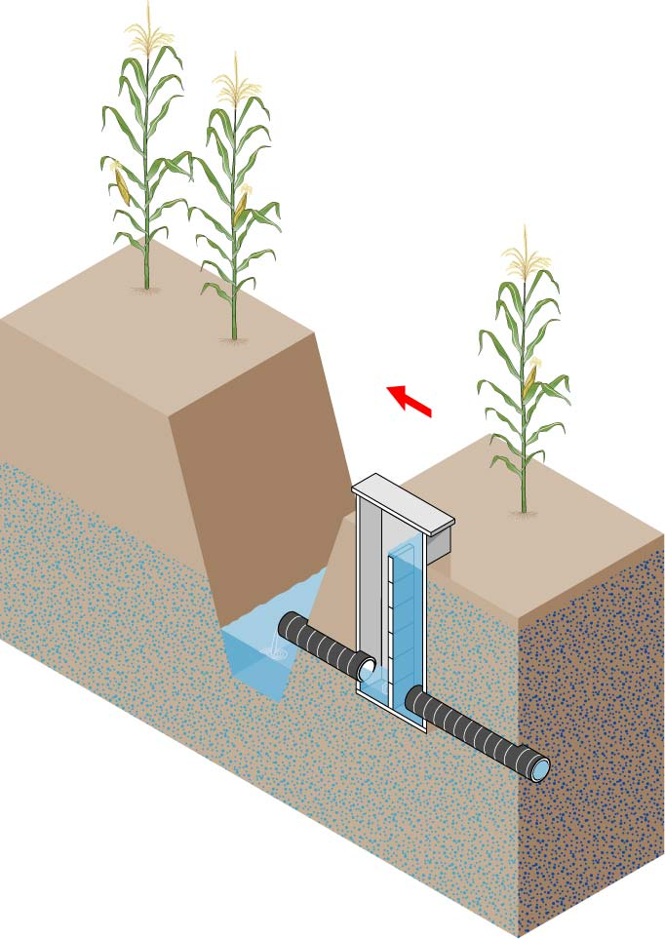
Drainage Water Management
(Controlled Drainage)

Slide 9
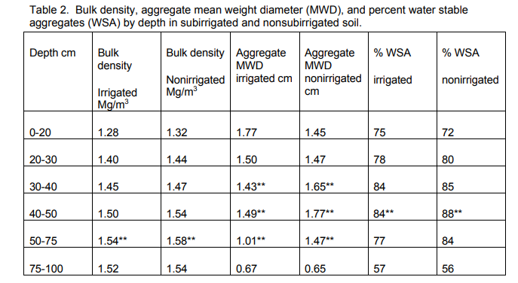
Effects of Subirrigation on Soil Properties
Norman R. Fausey
Barbara J. Baker

Slide 10
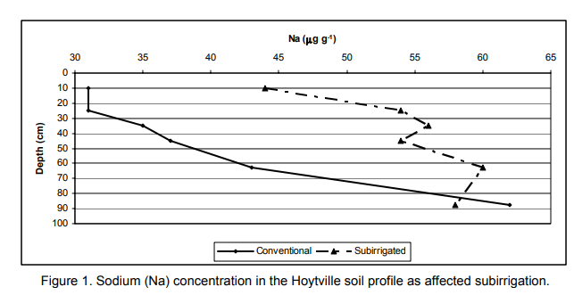
Effects of Subirrigation on Soil Properties
Norman R. Fausey
Barbara J. Baker

Slide 11
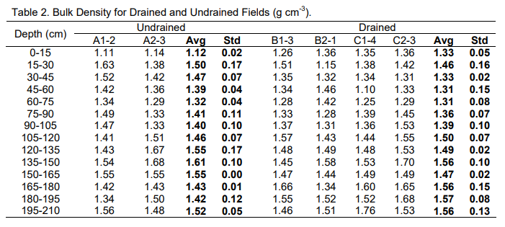
Change of soil hardness and soil properties due to tile
drainage in the Red River Valley of the North
Xinhua Jia, Thomas F. Scherer, Thomas M. DeSutter, Dean D. Steele

Slide 12
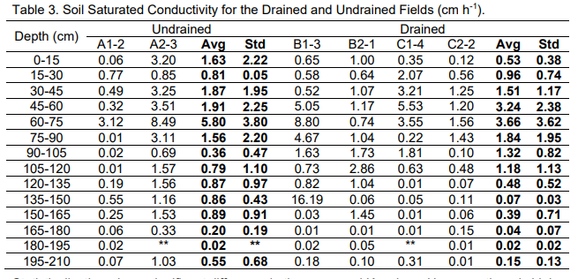
Change of soil hardness and soil properties due to tile
drainage in the Red River Valley of the North
Xinhua Jia, Thomas F. Scherer, Thomas M. DeSutter, Dean D. Steele

Slide 13
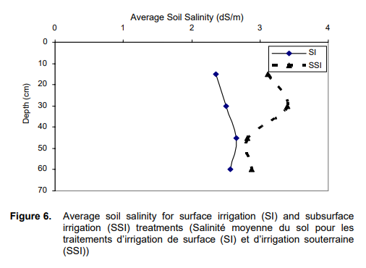
POTENTIAL IMPACT OF SUB-IRRIGATION ON SOIL PROPERTIES IN WEST DELTA
Abdel Ghaffer, M. A. Ragab

Slide 14
Controlled drainage — effects on drain outflow and water quality
Ingrid Wesstrom, Ingmar Messing, Harry Linner, Jan Lindstrom
The CWT system also affected the distribution and the total content of mineral nitrogen in the soil. In CWT, most (90–95%) of the mineral nitrogen present in the soil in the late autumn was retained in the soil over the winter. In Year 1, the reduction in mineral nitrogen content in soil over the winter corresponded quantitatively to the nitrogen losses in the drainage water in both CD and CWT. In Year 2, the difference in mineral nitrogen content in soil between late autumn and spring sampling was quantitatively smaller for CD than the amount of nitrogen recovered in the drain outflow from the plot during the same time period

Slide 15
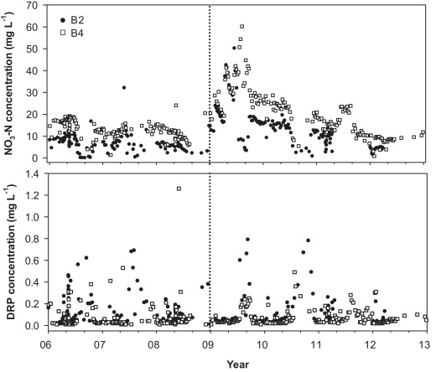
Drainage water management effects on tile discharge and water quality
M.R.Williams K.W.King N.R.Fausey

Slide 16
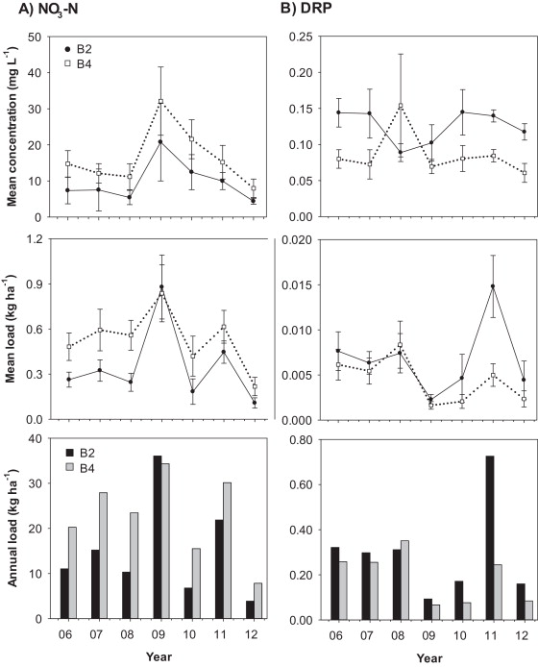

Slide 17
Outlet Ditch
3.3 ha
213 m
213 m
105 m
168 m
213 m
244 m
Outlet Ditch
4.9 ha
A
B
Ditch
61 m
244 m
207 m
183 m
160 m
61 m
91m
288 m
375 m
350 m
329 m
52 m
N
91 m
96 m
96 m
95 m
61 m
335 m
130 m
91 m
171 m
152 m
91 m
229 m
350 m
2.6 ha
335 m
County Road
200 m
County Main Tile
C
21 ha
G
Notes:
Layout of tile systems on selected sites.

Slide 18
Double Mass Curve Analysis
Regression Analyses of slope changes
ΔN = β₀ + β₁ΔF + α₁Z
N = Nitrate-N Load
β₀, β₁, α₁ = Constants
F = Flow Rate
Z = Dummy Variable
Cumulative Load
Regime Change
Cumulative Flow

Slide 19
DWM Structure Installed

Slide 20
Site A Phosphate Curve
DWM Structure Installed

Slide 21
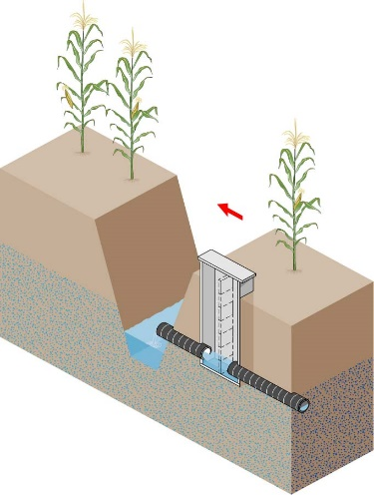
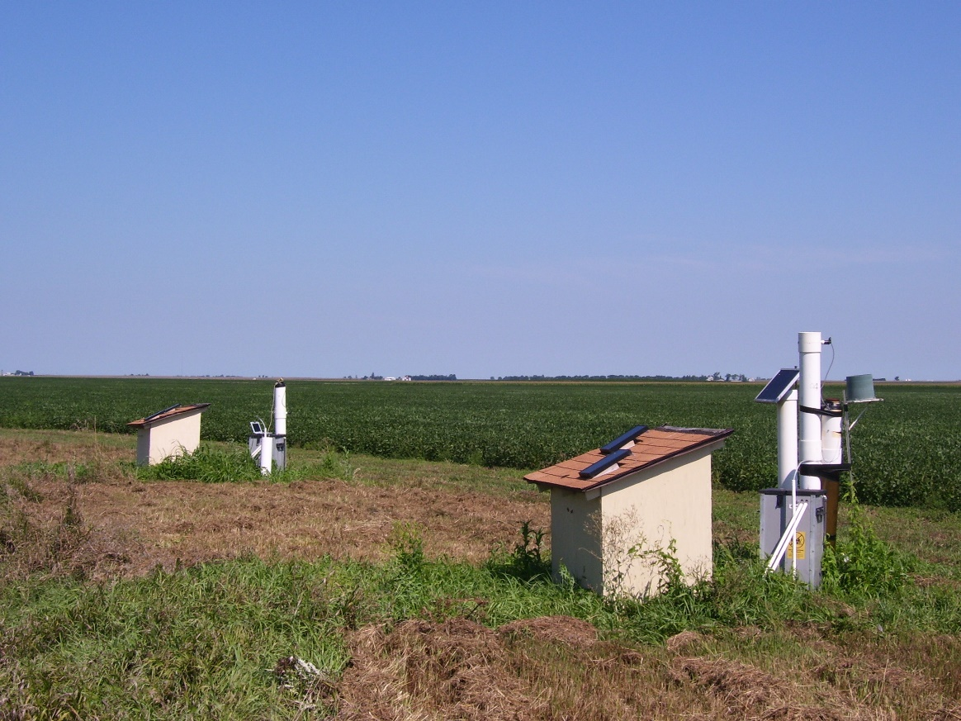
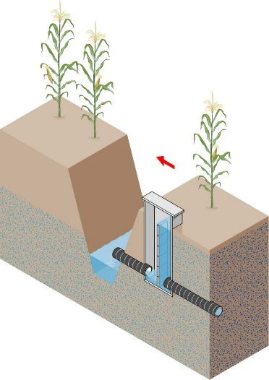
In this pair, one system is operated in free drainage mode, while the outlet of the other is raised to within 6 inches of the soil surface between November and March.
200 ft

Slide 22
Nitrate Concentrations at Hume North
2005

Slide 23
Nitrate Concentrations at Hume North
2008
Notes:
Nitrate concentrations continue to be lower on average for the managed drainage case.
They can still be above the MCL.

Slide 24
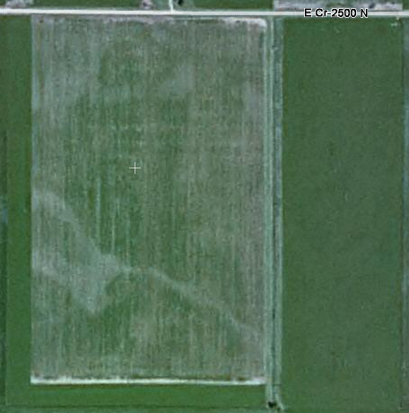
Managed Drainage
28 acres
100 ft Spacing
W
Free Drainage
31 acres
100 ft Spacing

Slide 25
Deland Site

Slide 26
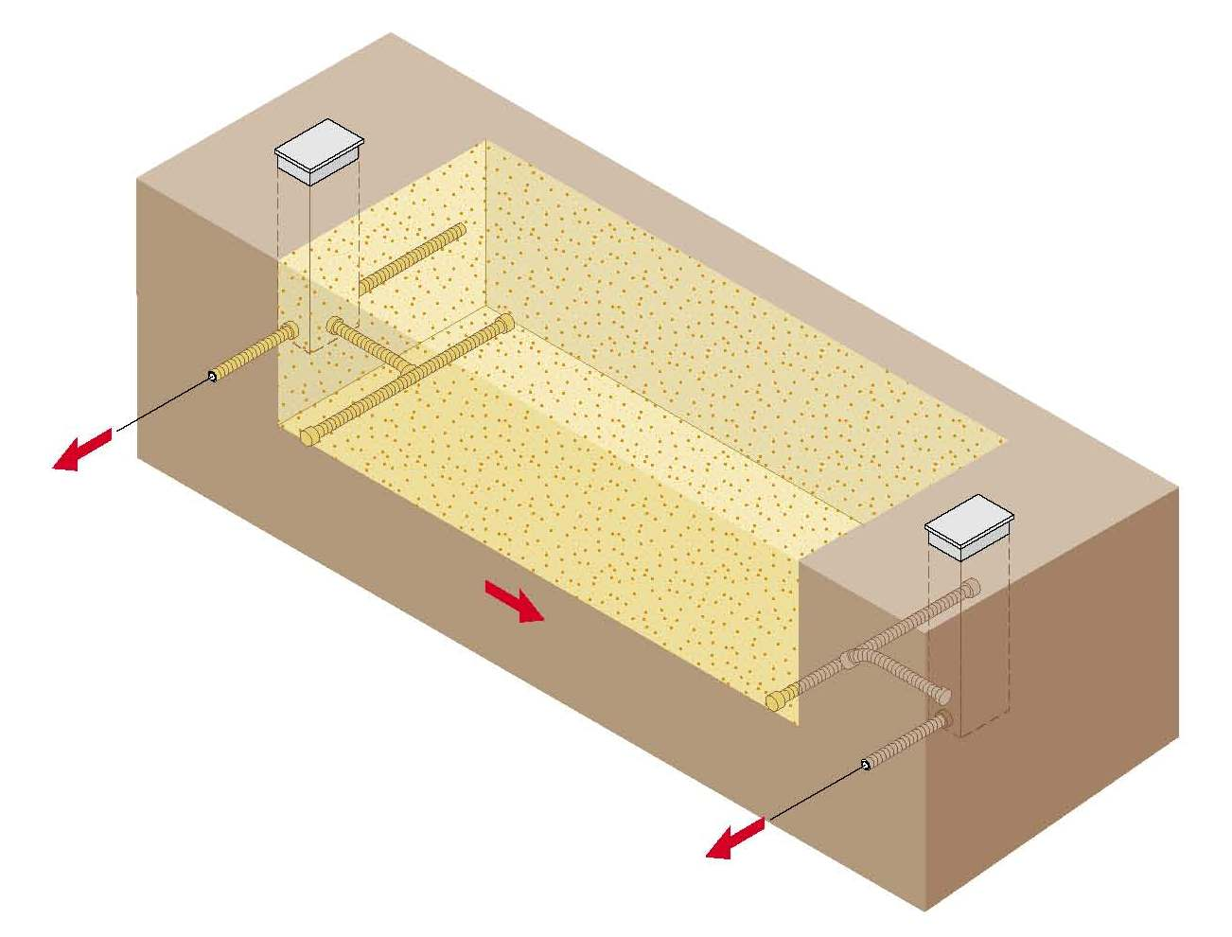
Bioreactor
Bioreactor
Diversion
Structure
Length/width dependent on
contributing area
5’ Soil
Backfill
Section
of perforated
tile
Trench bottom at the
tile invert level
Woodchips
Capacity
Control
Structure

Slide 27
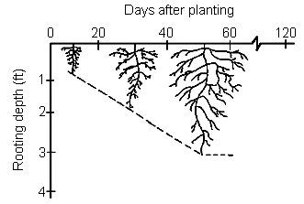
Combined DWM/Bioreactor System
10/31
12/31
2/28
4/15
5/18
7/7
8/26
10/15
0
Soil Surface
Outlet Depth
6
12
18
24
Outlet set to
Drainage Outlet Depth (in)
Planting
mirror root growth
30
Harvest
36
42
Potential water storage
during growing season
48
Subsurface Drain Depth
54

Slide 28
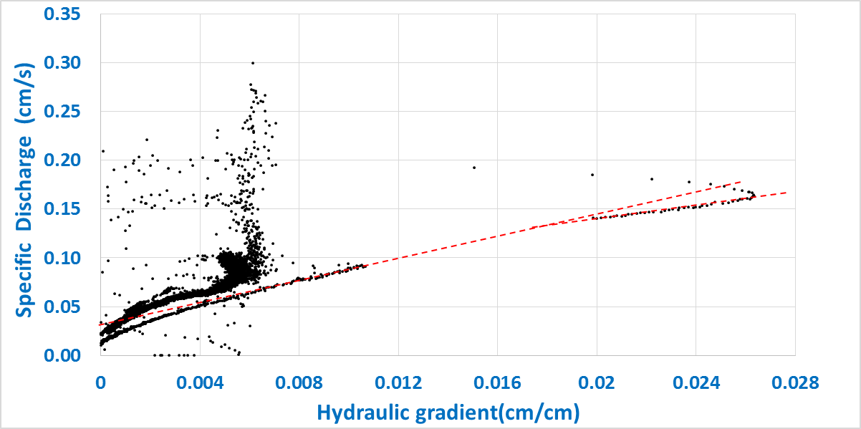
Specific Discharge
Hydraulic Conductivity

Slide 29
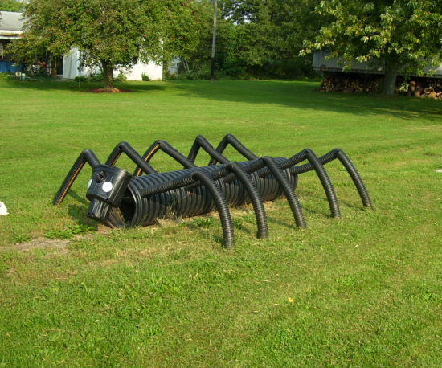
Thank You
Tilepherus Decapodia

