Slide 1
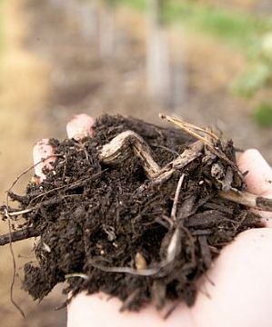
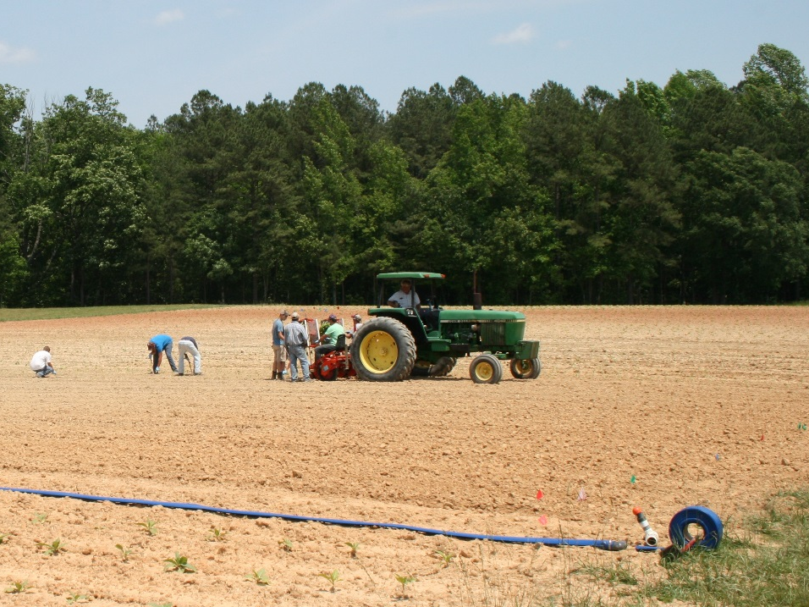
Soil Health and Soil Function:
A Wetland Ecologist’s Perspective
Christopher Craft
Indiana University

Slide 2
Indicators of Soil Health
Chemical | Physical | Biological
Base Saturation Cation Exchange Capacity Electrical Conductivity Nitrogen Micronutrients pH Phosphorus Potassium | Water Holding Capacity Bulk Density Infiltration Rate Erosion Rating Penetration Resistance Texture Water Stable Aggregation | Crop Yield Nitrogen Mineralization Organic Carbon Carbon Mineralization
Soil Health Institute
https://soilhealthinstitute.org/

Slide 3
Indicators of Soil Quality
Physical | Chemical | Biological
Structure Soil depth and rooting depth Infiltration Bulk density | pH Conductivity Extractable N, P, K | Microbial biomass C and N Potentially mineralizable N Soil respiration
SOM
https://www.nrcs.usda.gov/wps/portal/nrcs/detail/soils/health/assessment/?cid=stelprdb1237387

Slide 4
Organic Matter and Water: Essentials for Life
Soil Organic Matter
Soil Moisture/Water Table
Physical
Bulk Density
Porosity
Air / Water Movement
H₂O Holding Capacity
Nutritional
Cation Exchange
Nitrogen
Phosphorus
Redox Potential
Terminal Electron Acceptors
(O₂, NO₃, Fe³⁺, SO₄²⁻,
Humic compounds)
Decomposition
Carbon Sequestration
Nitrogen Storage
N Mineralization
Biological
Primary Production
Microbial Activity
Soil Fauna
Biogeochemistry
Denitrification
Phosphorus (Release)
Greenhouse Gases

Slide 5
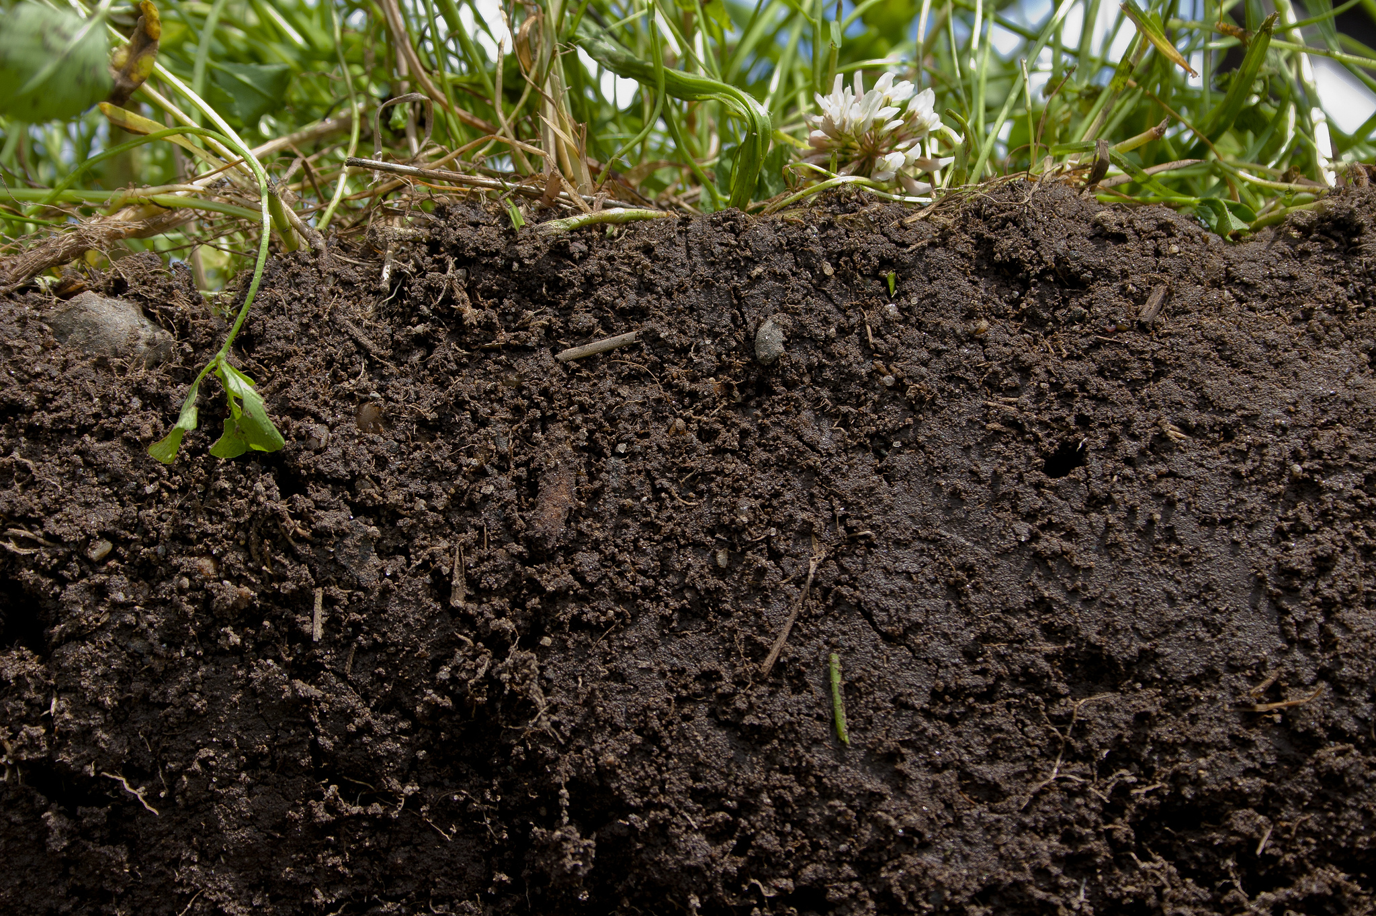
(Wetland) SOM = ʃ
Climate
Parent material
Topography
Organisms
Time
Net Primary Production
Decomposition
Modified from Jenny (1941)

Slide 6
Wetland Soils Sequester SOM

Slide 7
Soil Porosity Increases with SOM
From Franzluebbers et al. (2001)

Slide 8
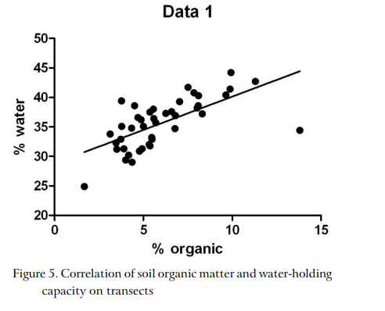
Soil Moisture Increases with SOM
From Robinson and Nabhani (2009)

Slide 9
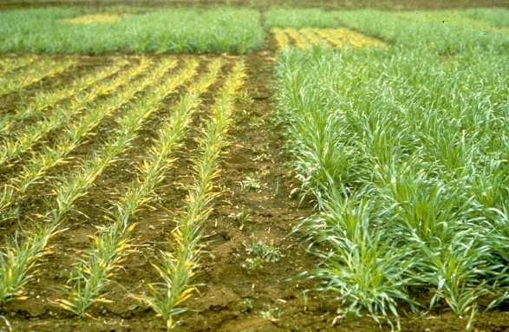
SOM and Nutrients

Slide 10
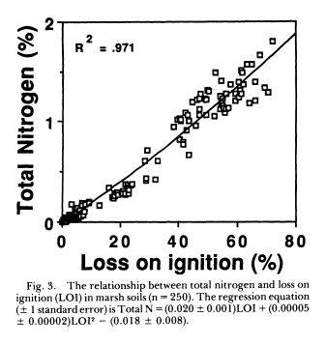
Soil Nitrogen Increases with SOM
From Craft et al. (1991)

Slide 11
Forms and Amounts of N Accumulation in Soil
From Craft (1997)

Slide 12
Forms and Accumulation of P in Soil
From Craft (1997)

Slide 13
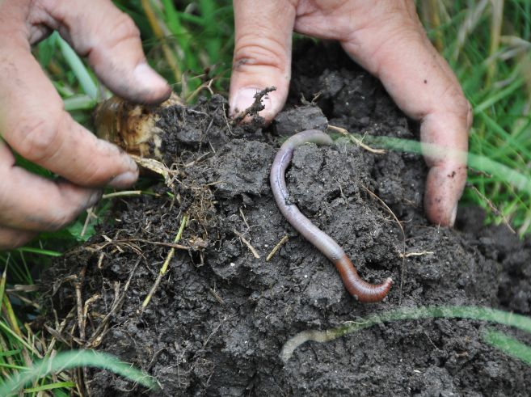
SOM and Biology
Notes:
http://soilhealth.ucdavis.edu/soil-challenges/low-organic-matter

Slide 14
SOM Supports Healthy Microbial and Fauna Populations

Slide 15
SOM and Microbial Activity
From Craft et al. (2003)

Slide 16
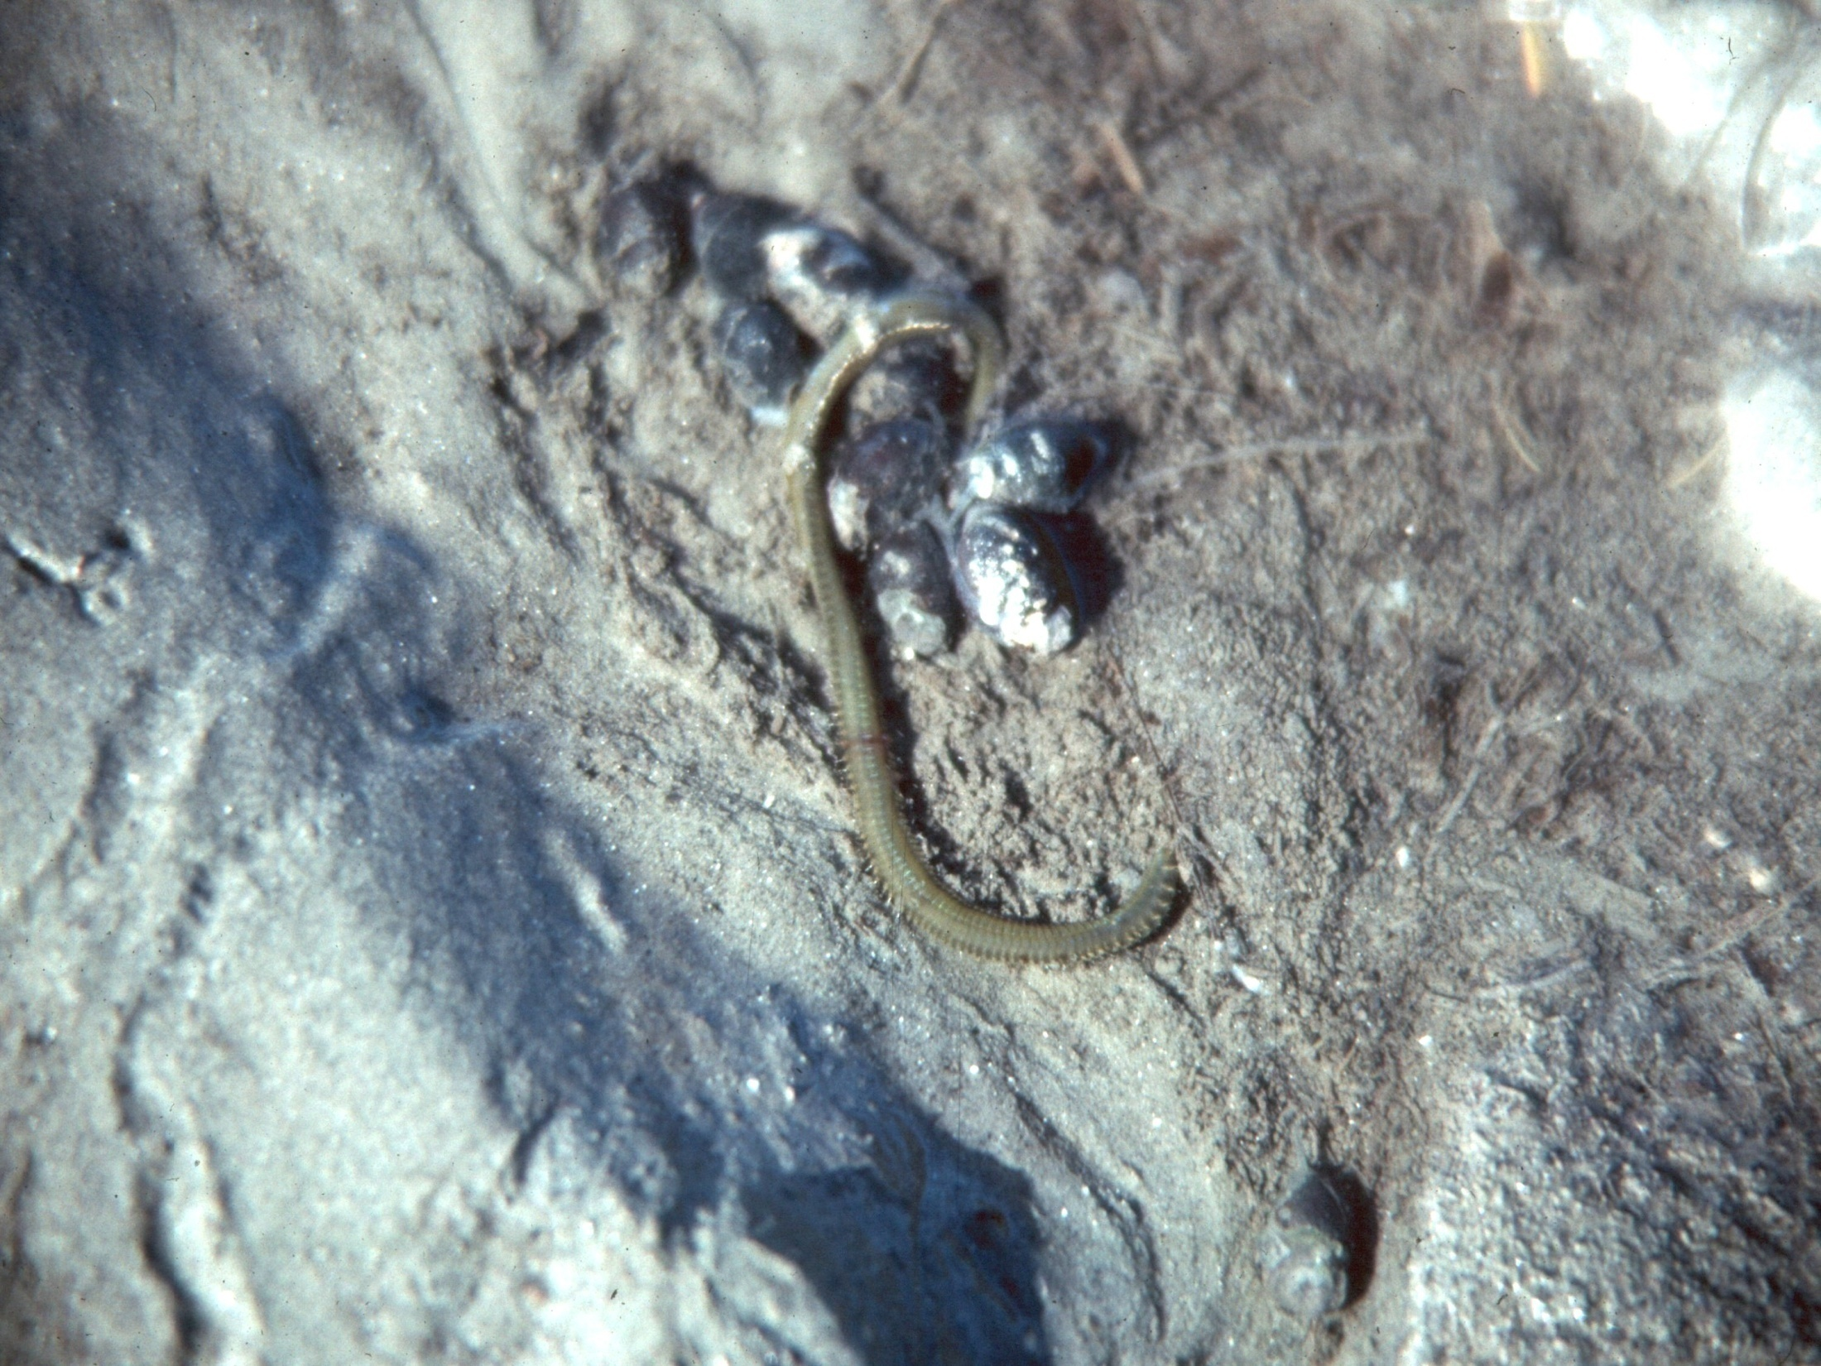

Slide 17
SOM and Soil Fauna
From Craft et al. (2003)

Slide 18
SOM and Fauna Diversity
From Craft et al. (2003)

Slide 19
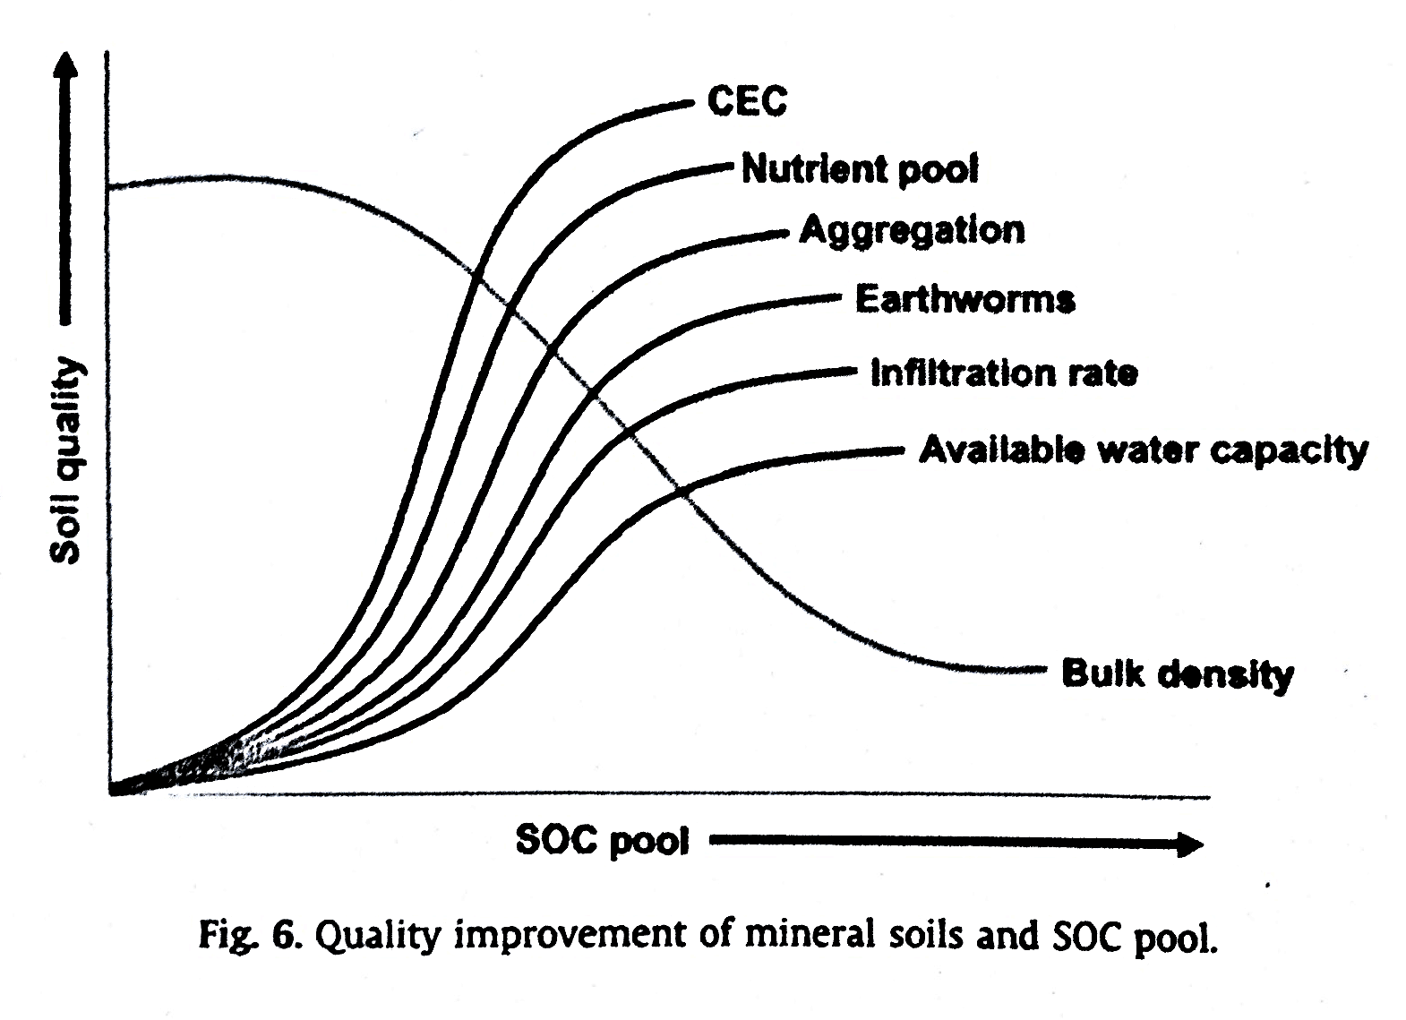
Benefits/Importance of Organic Matter
Lal, R. 2013. Food security in a changing climate. Ecohydrology & Hydrobiology 13:8-21.

Slide 20
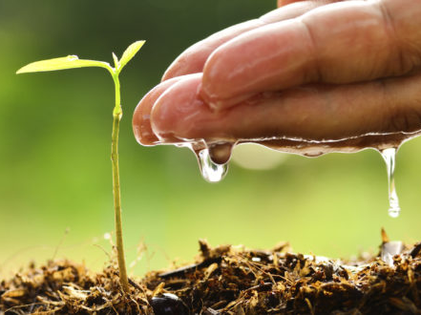
Soil Moisture / Water Table
Notes:
https://www.farmmanagement.pro/5-methods-of-manipulating-soil-moisture-levels/

Slide 21
A Typical Terrestrial Soil

Slide 22
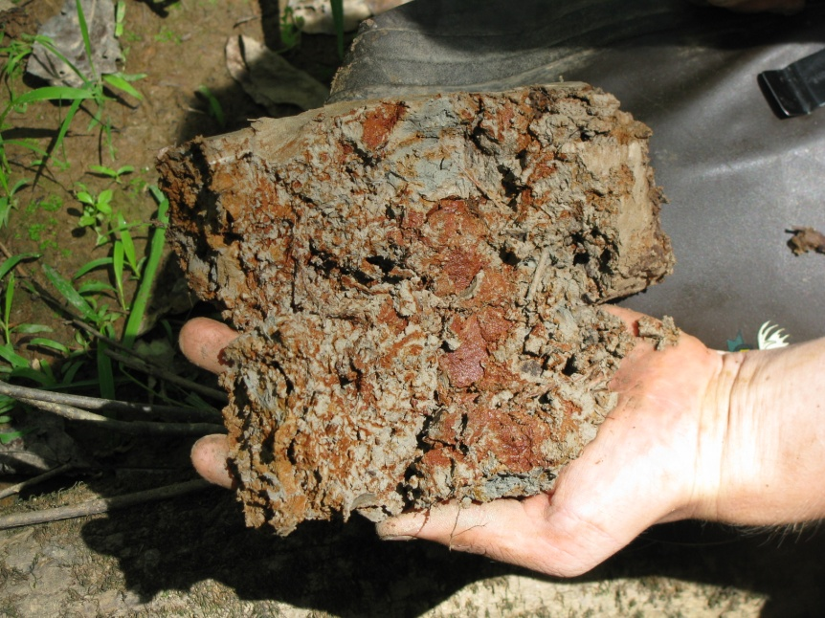
Mottled Soils: Fluctuating water level

Slide 23
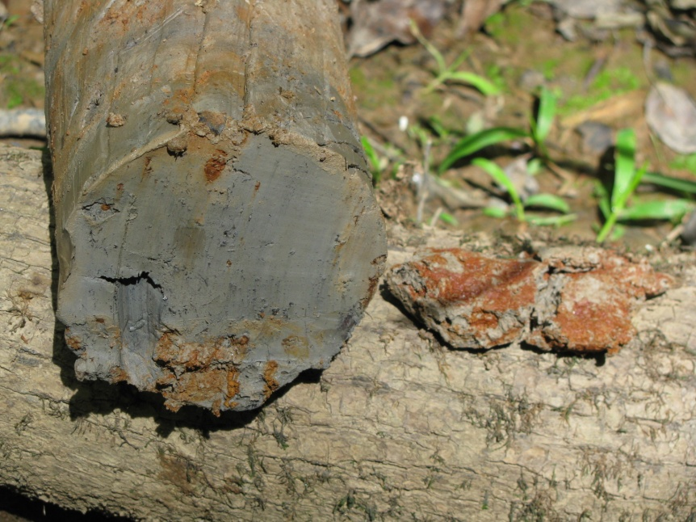
Gleyed Soils: Wet nearly all of the time

Slide 24
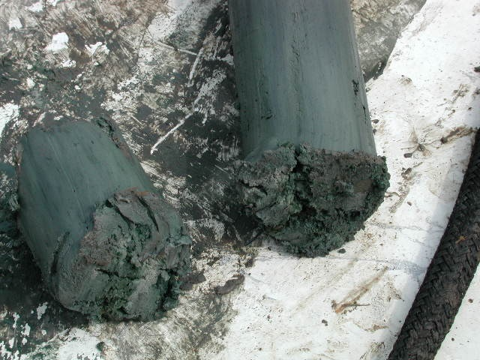
Blue & Green Soils: Never see daylight

Slide 25
Classical Terminal Electron Accepting Processes (TEAP)
Reduction
Oxygen reduction (Aerobic Respiration): O₂ → 2H₂O
Nitrate reduction (Denitrification): NO₃ → NO₂ ↔ N₂
Iron reduction: Fe(III) → Fe(II)
Sulfate reduction: SO₄ → H₂S
CO₂ reduction (Methanogenesis): CO₂ → CH₄
Oxidation

Slide 26
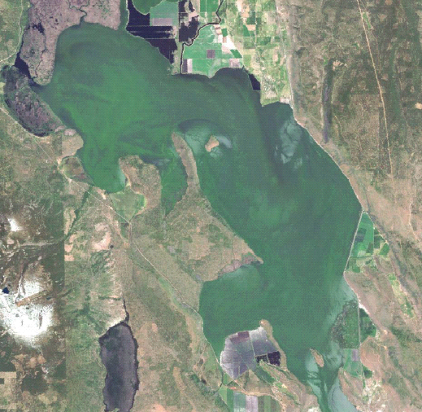
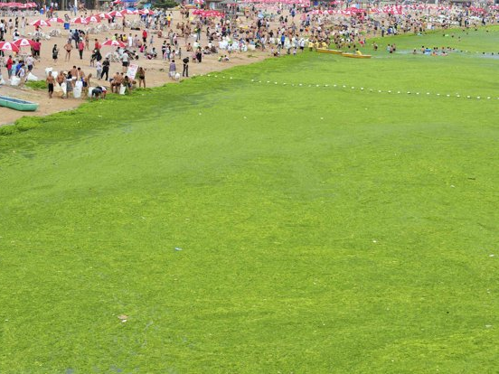
Denitrification NO₃⁻ ---> NO₂⁻ ---> NO ---> N₂O ---> N₂
Upper Klamath Lake, OR (2000)
Quingdao, China (2011)

Slide 27
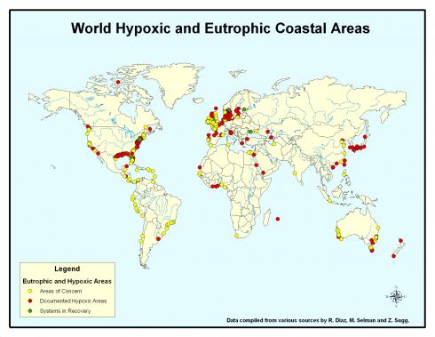

Slide 28
Denitrification
Is controlled by…
Soil moisture / wetness
Nitrate concentration
Soil organic carbon
Retention time

Slide 29
Adapted from Hanson
et al. (1994)

Slide 30
Adapted from White (1999)

Slide 31
Effect of Soil Organic Matter Content
From Craft et al. (2003)

Slide 32
Adapted from Nichols
and Higgins (2000)

Slide 33
Long term Sustainable N Removal
150
120
90
Denitrification
Nitrogen Removal (kg/ha/yr)
60
30
Organic matter accumulation
0
0.1
1
10
100
Time (Years)
From Craft (1997)

Slide 34
Long term (Un)- Sustainable P Removal
150
120
Organic matter
accumulation
90
Sorption &
Precipitation
Phosphorus Removal (kg/ha/yr)
60
30
Sedimentation
0
0.1
1
10
100
Time (Years)
From Craft (1997)

Slide 35
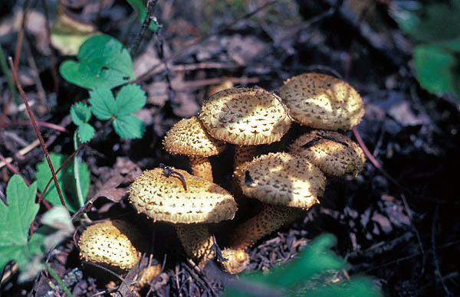
Decomposition

Slide 36
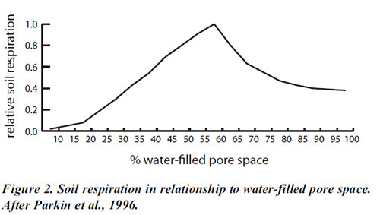
Decomposition Depends Soil Moisture
Wetland Soils

Slide 37
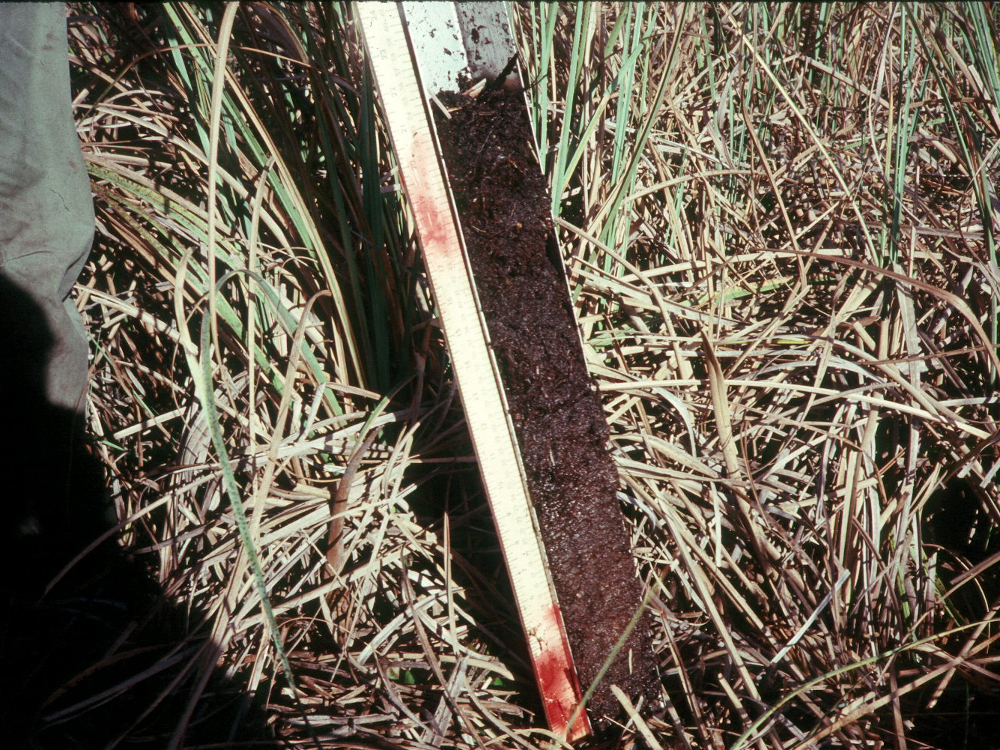
Peat: Soils produced by plants under permanently saturated conditions

Slide 38
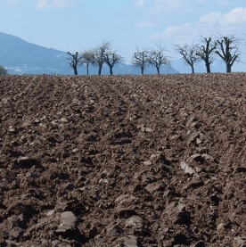
SOM and Long-term Cultivation

Slide 39
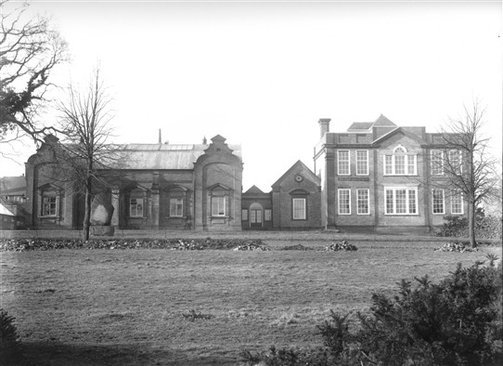
What are the temporal trends? (Is it increasing or decreasing?)
http://www.harpenden-history.org.uk/page_id__507.aspx?path=0p2p69p
http://www.era.rothamsted.ac.uk/pix.php?area=home&image=metadata/others/Woburn_Fields_Stackyard_750.jpg
Woburn Farm Experimental Fields,
Initiated in 1938.
Rothamsted Experimental Station UK:
Established 1843

Slide 40
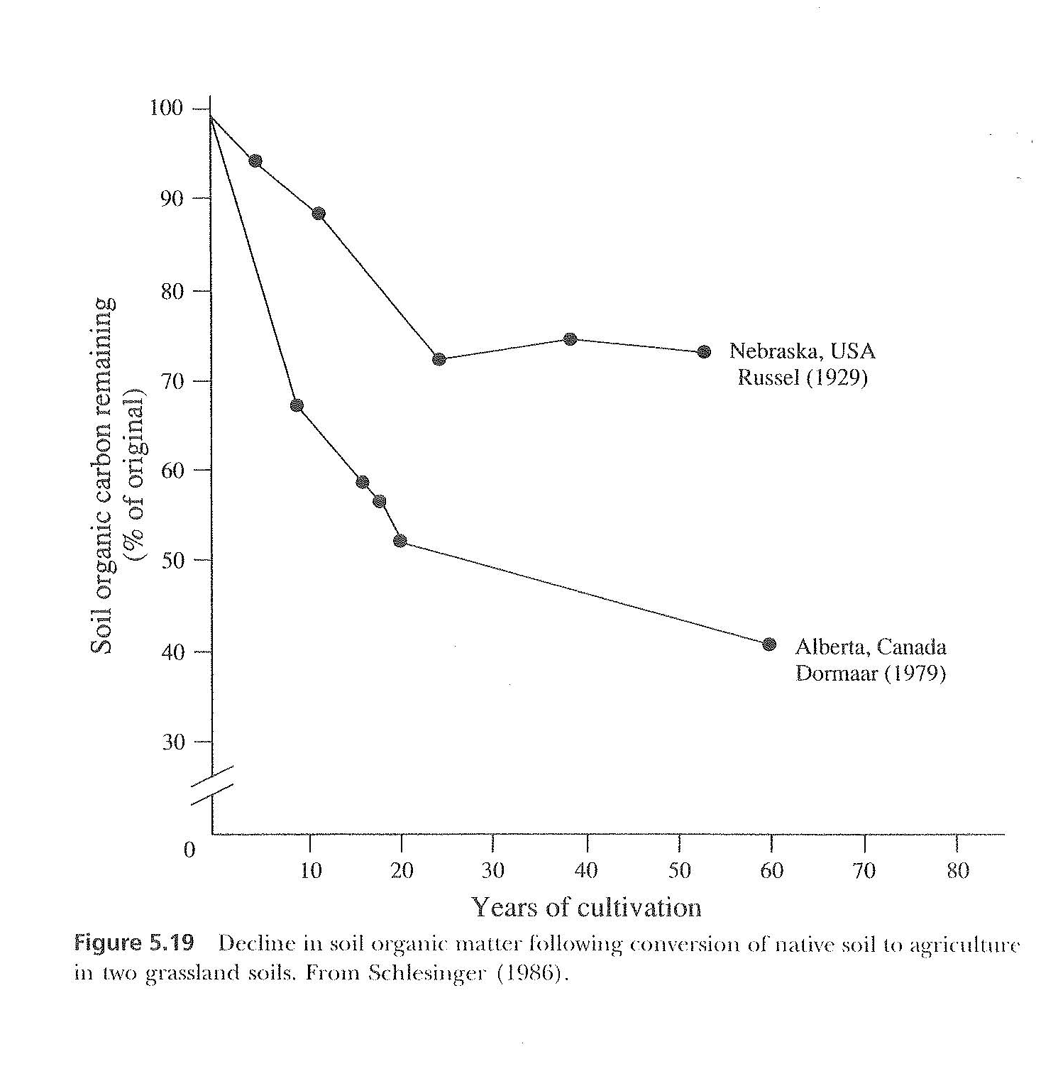
Effect of Cultivation on SOM

Slide 41
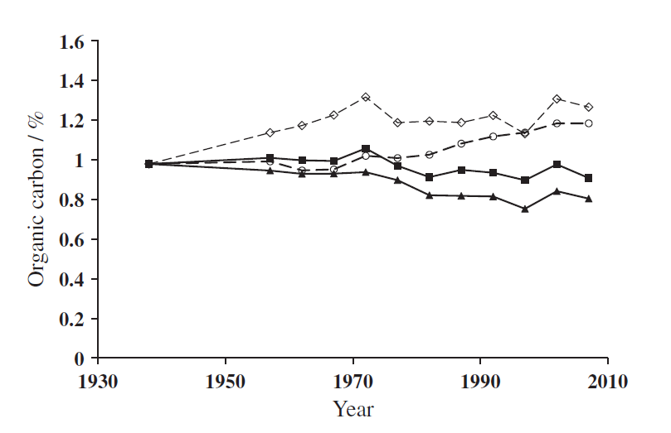
Long-Term Changes in Soil Carbon Under Different Cropping Regimes
- Arable Cropping
- Arable Cropping + fallow (grasses, legumes)
From Johnston et al. (2017)

Slide 42
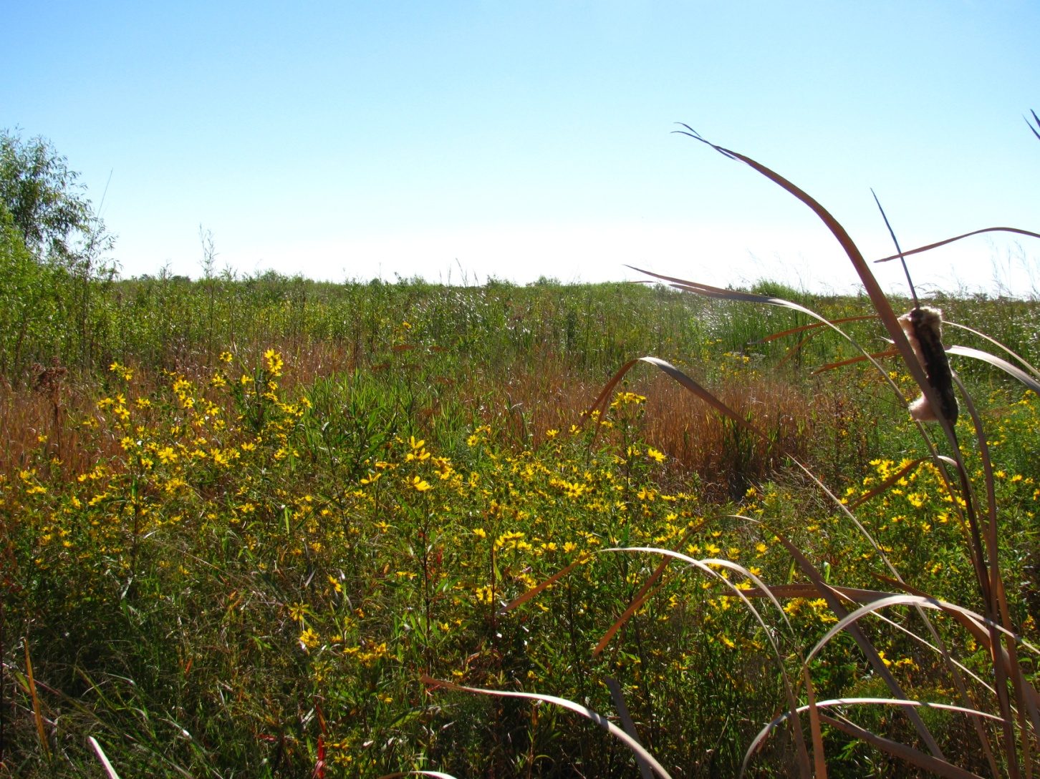
Restoring Freshwater Wetlands in Agricultural Landscapes:
Examples from the Corn Belt

Slide 43
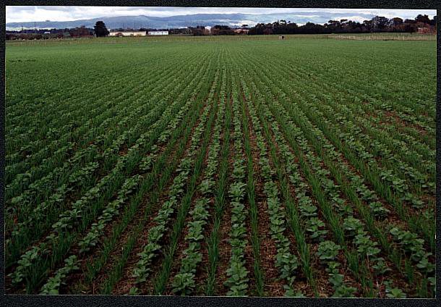
50-90% Net Wetland Loss
Glaciated Interior Plains
Notes:
During the past 200 years, much of the glaciated interior plains (GIP) has been drained for agriculture, resulting in a 50 – 90% net wetland loss with concurrent loss of habitat and biodiversity. Increased agricultural land-use in the region has led to nutrient enrichment with further declines in plant species diversity, and the loss of rare and uncommon species. These practices have led to a decline in essential wetland ecosystem services, including water quality improvement, nutrient processing, and biodiversity support.

Slide 44
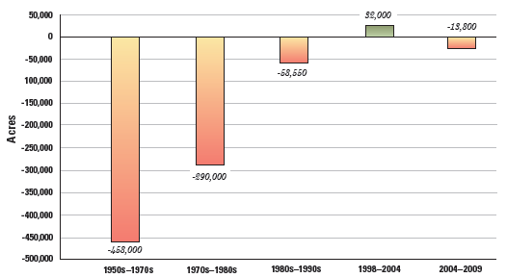
Change in Wetland Coverage (1950-2010)
Dahl, TE. 2011. U.S. DOI, Fish and Wildlife Service

Slide 45
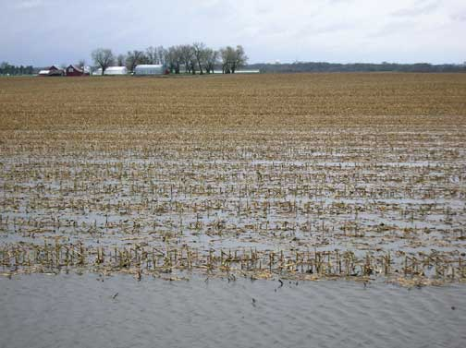
Wetland Restoration…

Slide 46
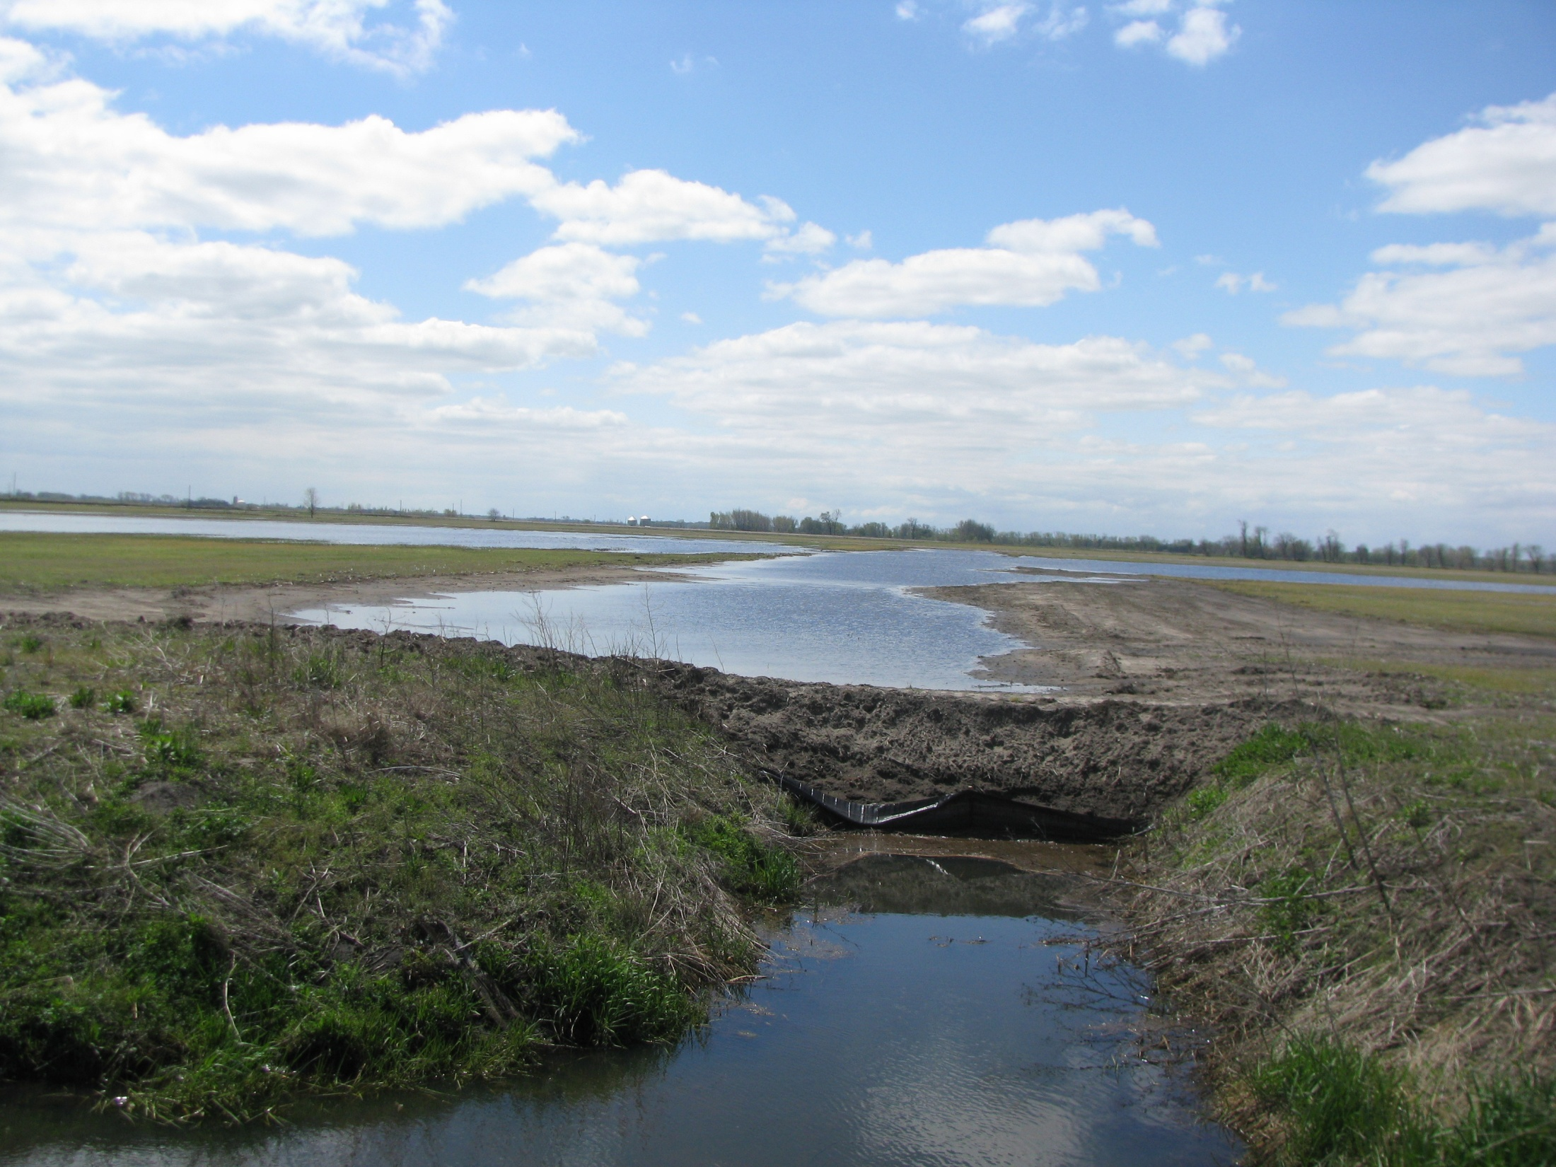
…means plugging ditches

Slide 47
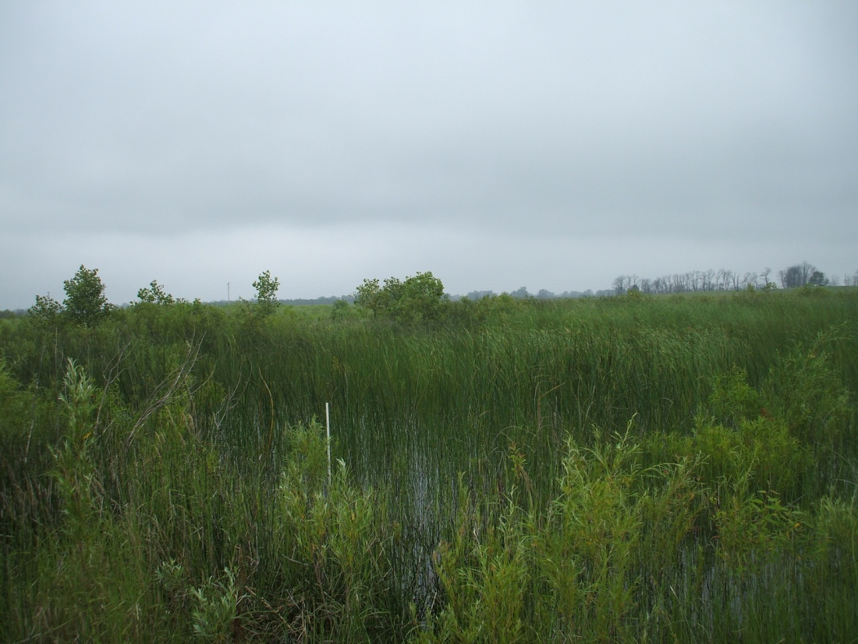
11 year-old WRP Restored Wetland

Slide 48
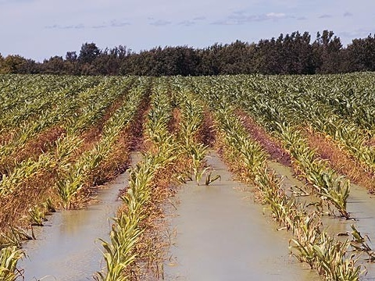
Riparian Restoration…

Slide 49
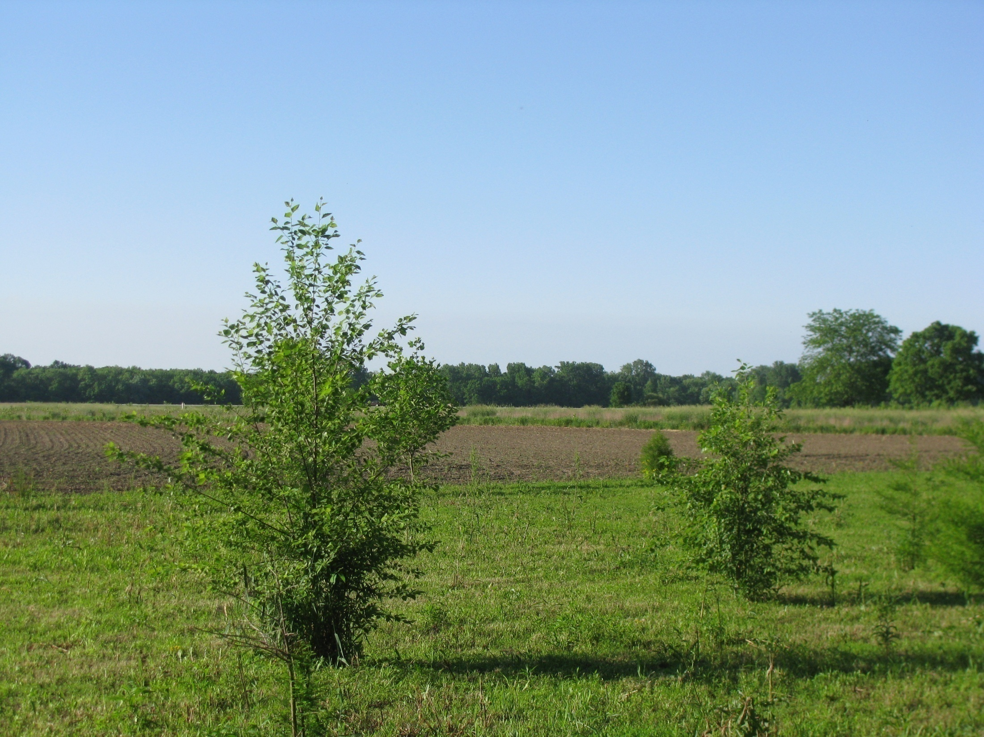
…means planting trees

Slide 50
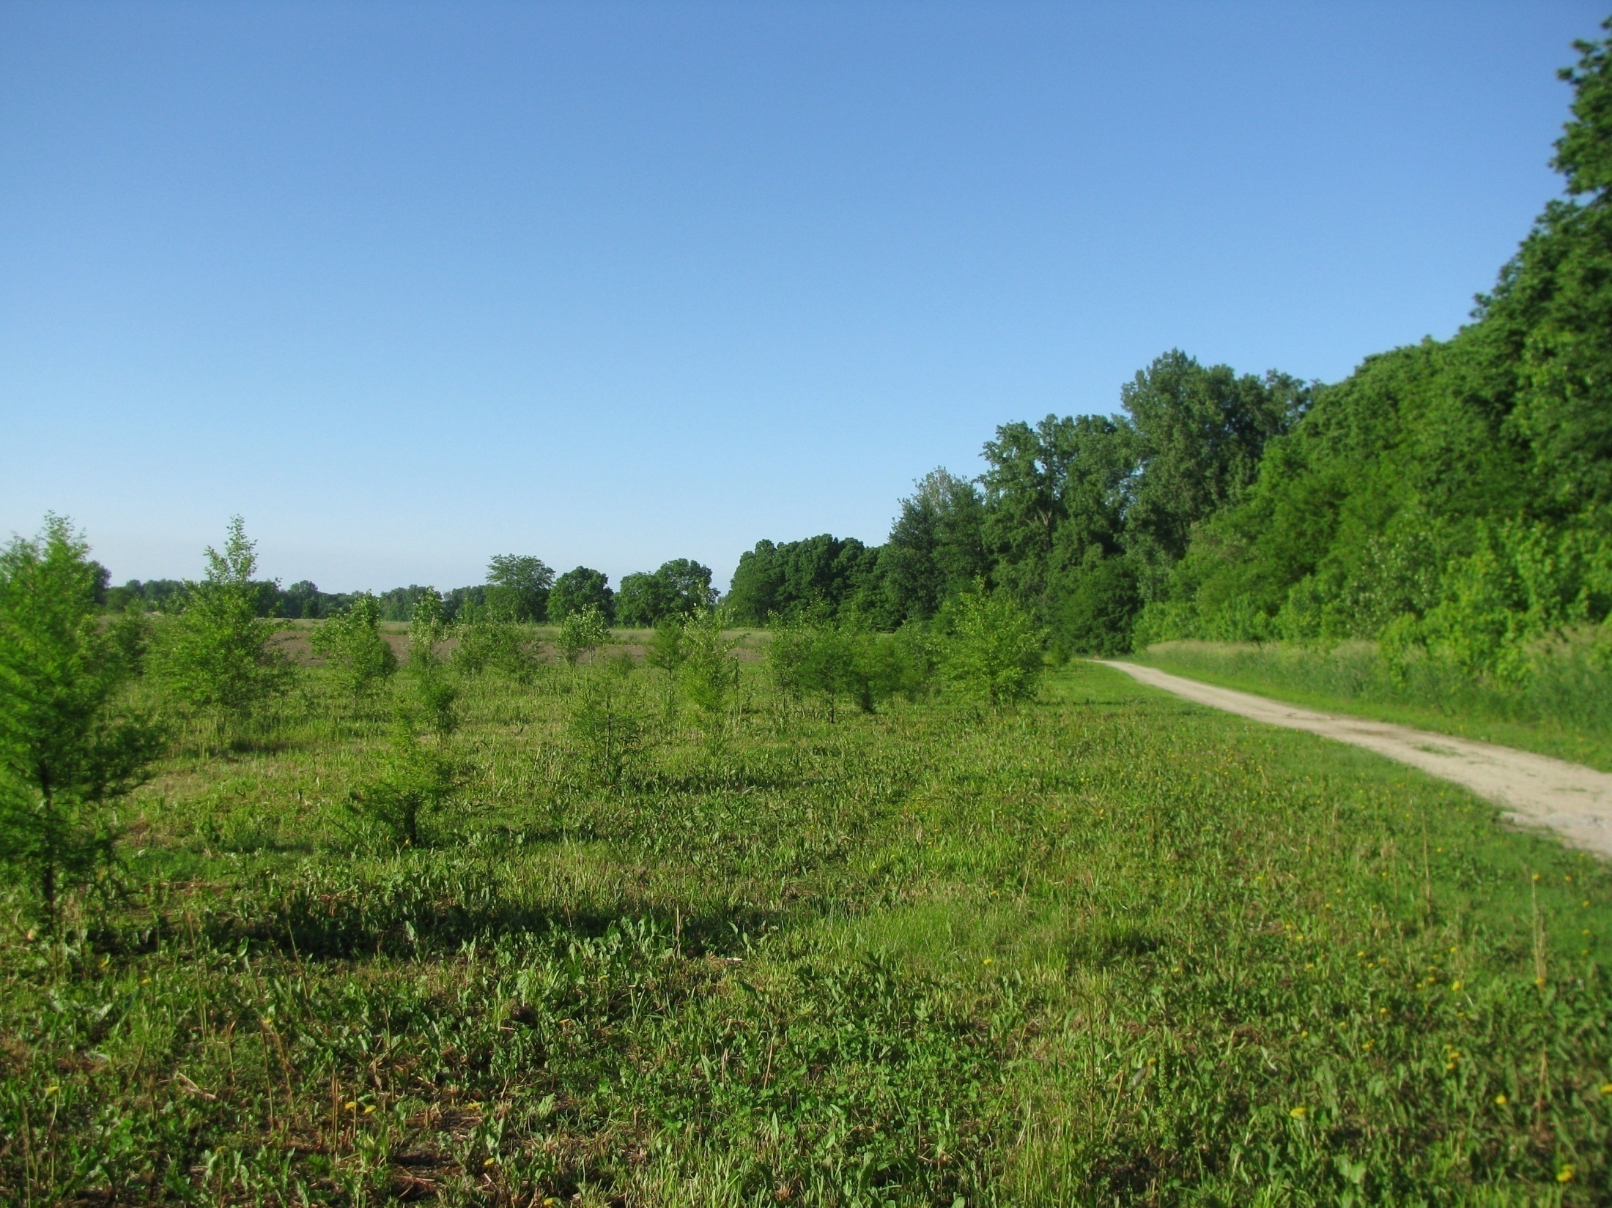
4 year-old Restored Riparian Buffer

Slide 51
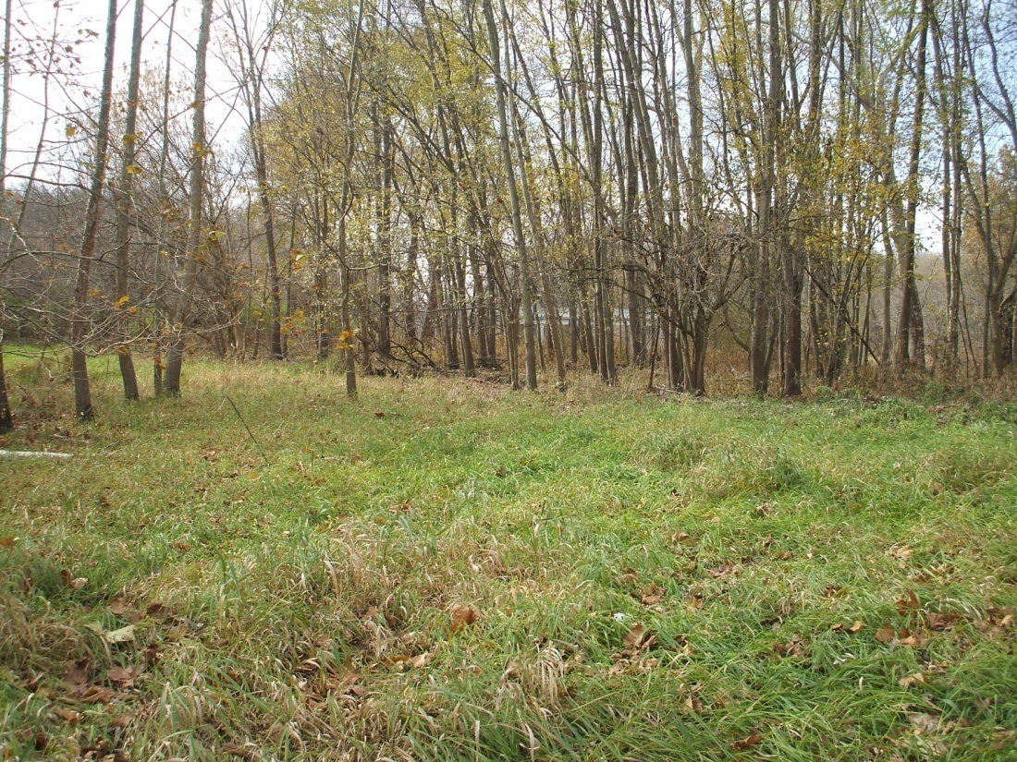
Forested Riparian Buffer

Slide 52
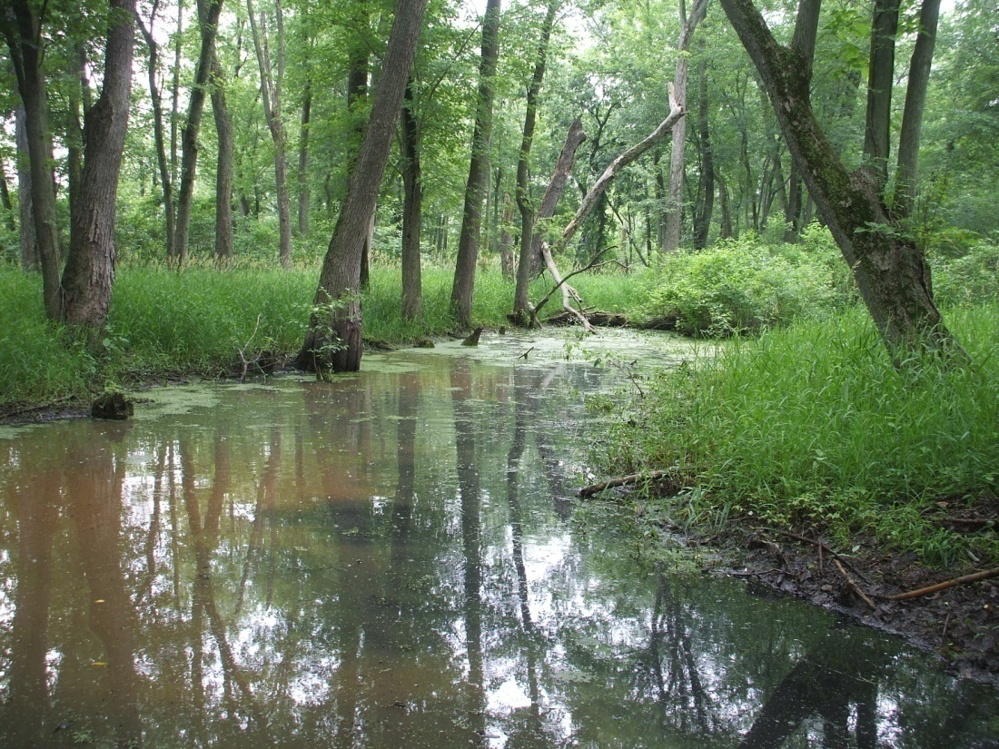
Are Restored Wetlands and Riparian Buffers Sinks for Nutrients (N&P) and Carbon?

Slide 53
Water Quality Improvement
(Denitrification)
Ambient
Potential

Slide 54
Water Quality Improvement
Phosphorus
Short-term P removal (sorption)
Phosphorus Sorption Index (PSI)
O
O
O
(+)
H
H
(+)
P
H
H
O
O
O
Al
Al
Al
Soil Surface

Slide 55
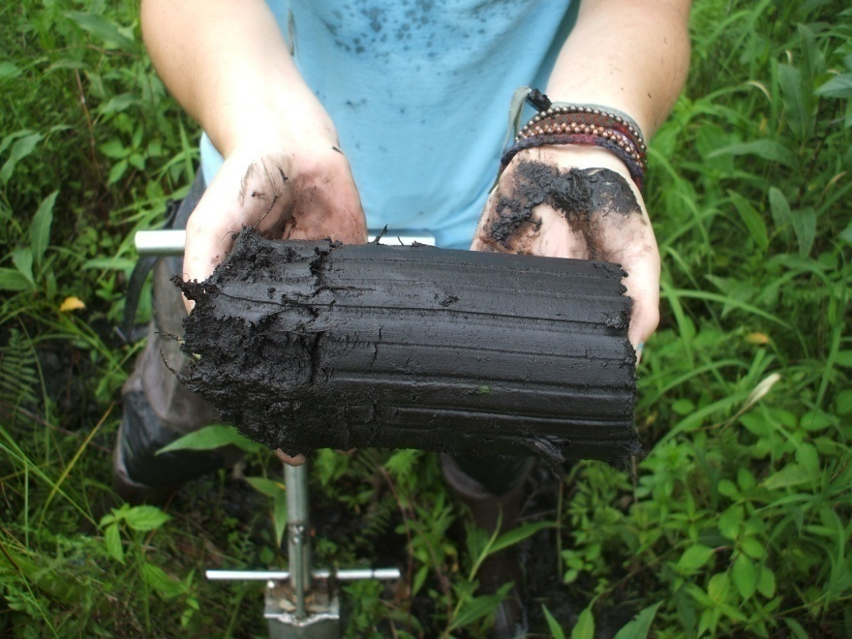
Water Quality
(P Removal)
A
B
B
Wetlands
C

Slide 56
Hydrologic Connectivity and C Sequestration, N, P Accumulation (Natural Wetlands)
Riparian
Riparian
Floodplain
Floodplain
Depression
Depression

Slide 57
Effect of Connectivity and Degree of Nutrient Enrichment
On Nitrogen Retention in Soil
Connected
Unconnected

Slide 58
Effect of Connectivity and Degree of Nutrient Enrichment
On Denitrification
Connected
Unconnected

Slide 59
Effect of Connectivity and Degree of Nutrient Enrichment
On Phosphorus Retention in Soil
Hydrologically Connected
Hydrologically Unconnected

Slide 60
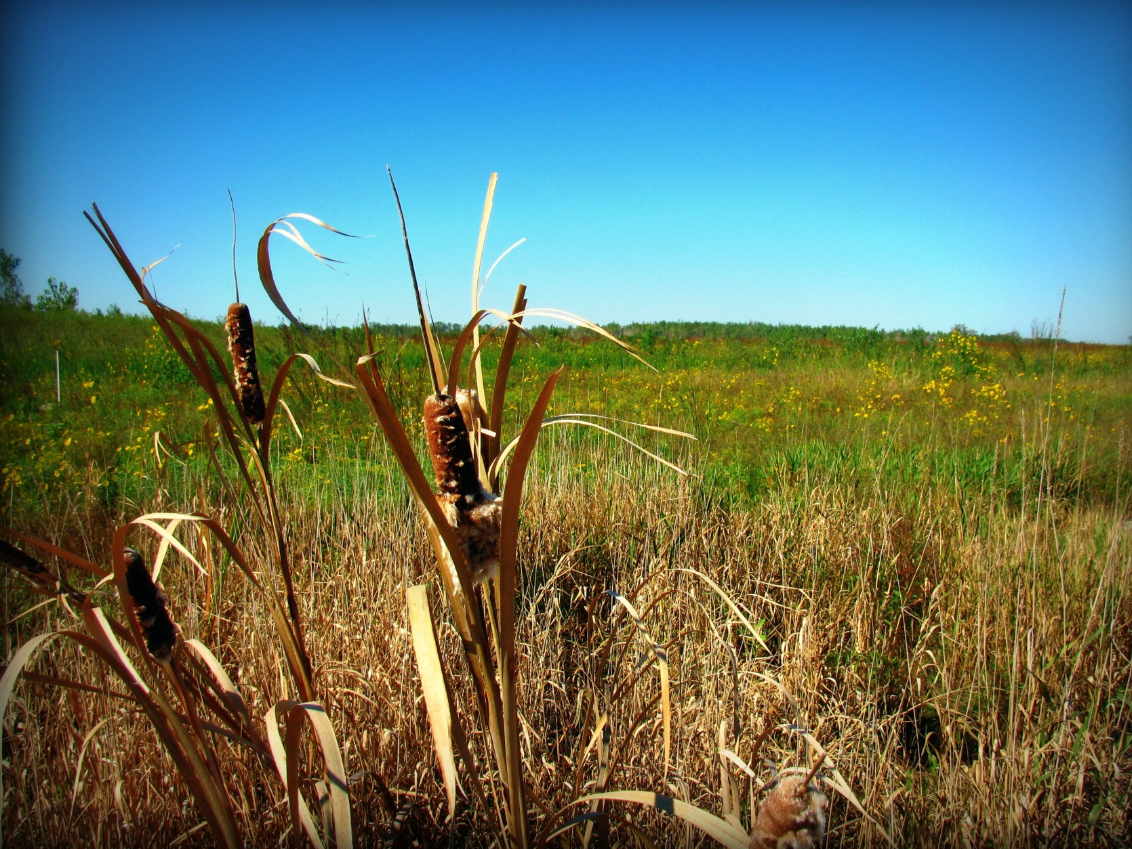
Do Restored Wetlands
Contribute to Global Warming?

Slide 61
Background
Wetlands are a source greenhouse gases (GHG)
CO₂, CH₄, and N₂O
Contribute 23% - 40% of global CH₄ (Ehhalt 2001)
GHG contribution is poorly quantified in
Fresh water mineral soil wetlands (FWMS)
Restored wetlands

Slide 62
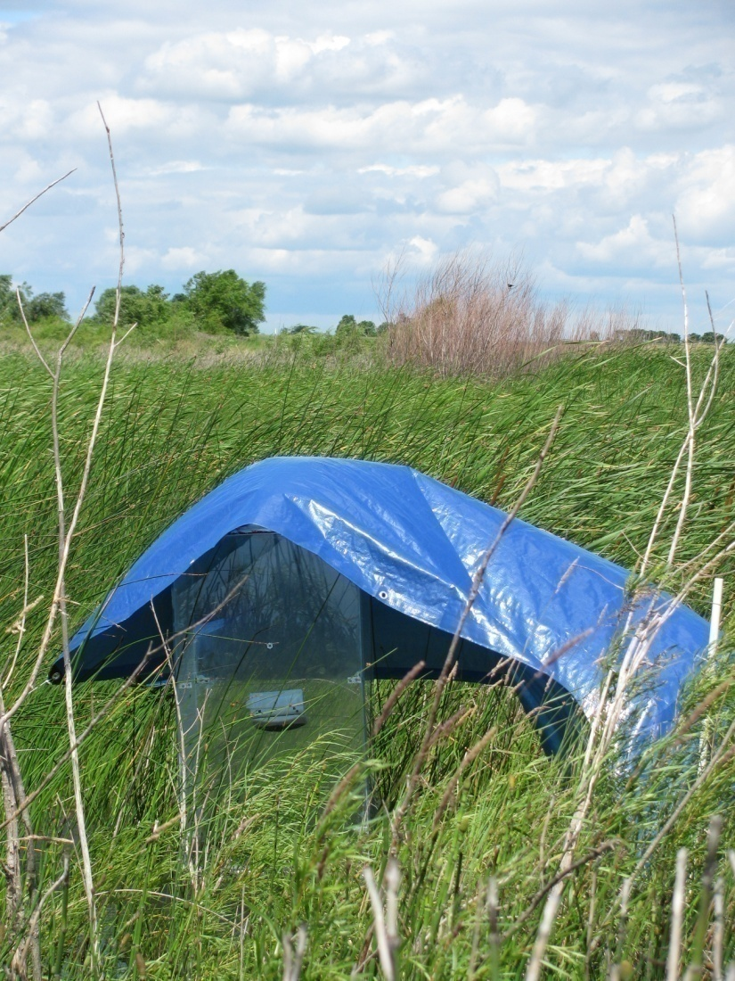
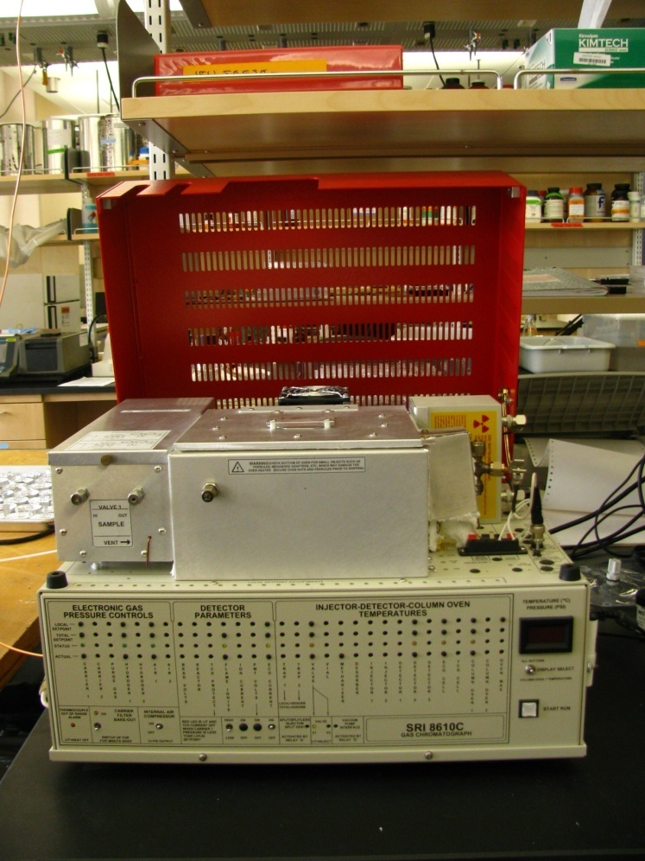
Anaerobic Incubations & Static Flux Chamber Measurements

Slide 63
Chamber- CO₂

Slide 64
Chamber- CH₄
A
B
A
B

Slide 65
Chamber- N₂O
B
A

Slide 66
Effects of Hydrology (Water-filled pore space – WFPS) on CH₄ and N₂O fluxes

Slide 67
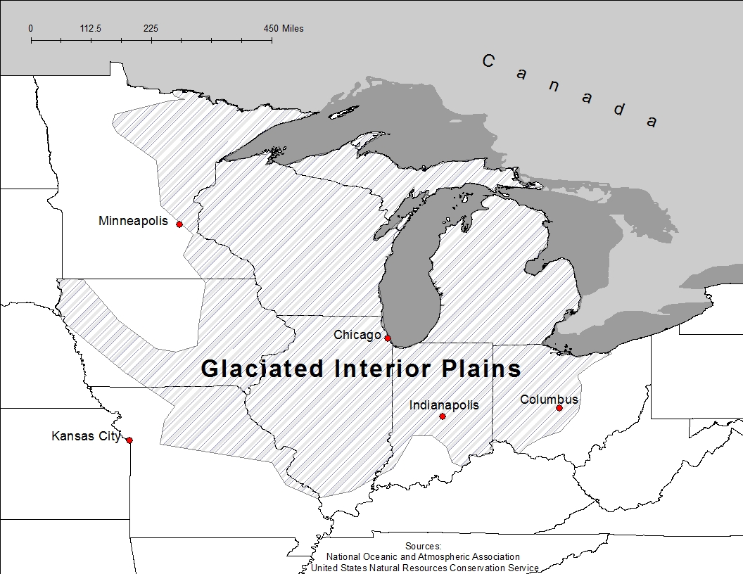
Global Warming Potential
Natural
1.9 Mg CO₂-equivalents/ha/yr
Restored
0.66 Mg CO₂-equivalents/ha/yr
GIP Restored Wetlands
72,270 Mg CO₂-C per year
0.72% of GHG’s from North American FWMS wetlands
(Bridgham et al 2006)

Slide 68
Conclusions
(Increasing) SOM leads to greater…
Porosity, water and air movement, and water storage.
Soil nitrogen, and cation exchange capacity.
Biological activity.
Increasing the water table increases…
SOM
SOM and water table increase microbial processes
that improve water quality.

