Slide 1
How are biological processes related to soil health being characterized and how might these indicators vary based on hydrodynamic conditions?
How does agricultural management impact the soil environment in the vadose zone to influence nutrient use efficiency and other soil characteristics?
What are the opportunities and challenges to model these dynamics in a changing climate?

Slide 2
1. How are biological processes related to soil health being characterized and how might these indicators vary based on hydrodynamic conditions?
What are biological soil health indicators?

Slide 3
https://www.nrcs.usda.gov/wps/portal/nrcs/detail/soils/health/assessment/?cid=stelprdb1237387

Slide 4
1. How are biological processes related to soil health being characterized and how might these indicators vary based on hydrodynamic conditions?
What controls these soil health indicator pools?

Slide 5
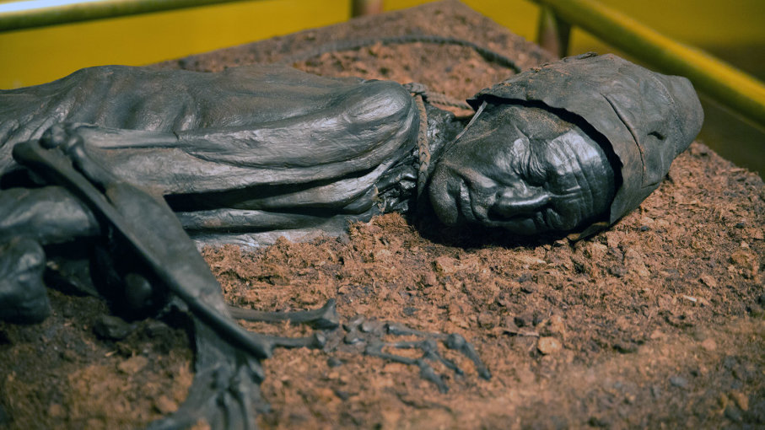
https://www.smithsonianmag.com/science-nature/europe-bog-bodies-reveal-secrets-180962770/

Slide 6
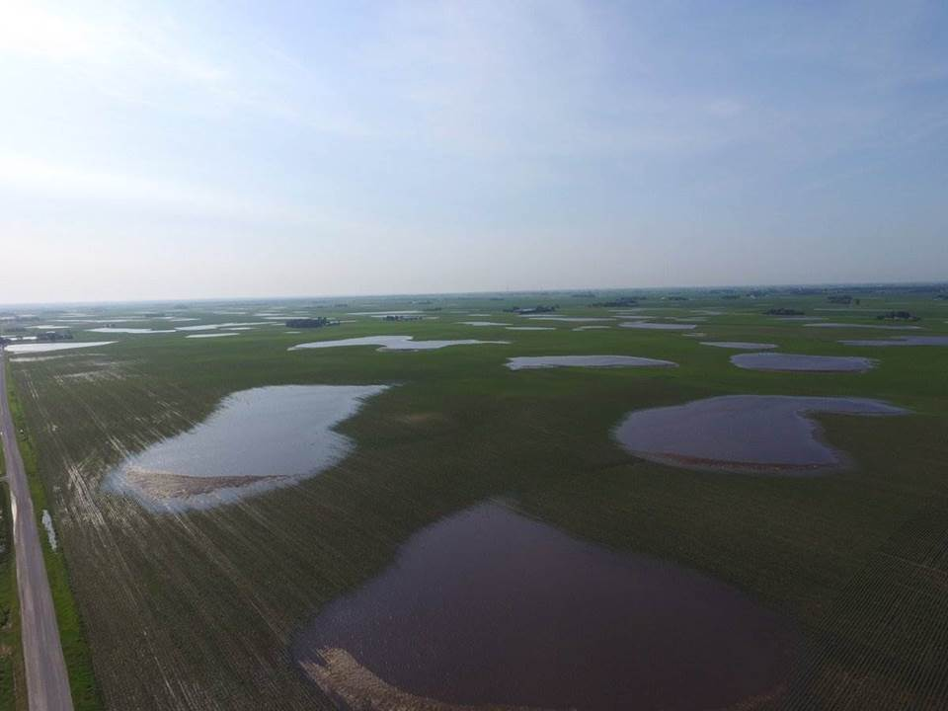

Slide 8
2. How does agricultural management impact the soil environment in the vadose zone to influence nutrient use efficiency and other soil characteristics?
Crop Rotation
Residue Management
Drainage

Slide 9
3. What are the opportunities and challenges to model these dynamics in a changing climate?

Slide 10
3. What are the opportunities and challenges to model these dynamics in a changing climate?

Slide 11
3. What are the opportunities and challenges to model these dynamics in a changing climate?

Slide 13
How are biological processes related to soil health being characterized and how might these indicators vary based on hydrodynamic conditions?
Pools – not processes
Environment and scale are critical
How does agricultural management impact the soil environment in the vadose zone to influence nutrient use efficiency and other soil characteristics?
In wet environments, practices that reduce SOM may increase nutrient use efficiency
What are the opportunities and challenges to model these dynamics in a changing climate?
Subsoil pools and processes
We can’t manage for the average

