Slide 1

Drainage Water Management: For what purpose?
Linking Soil and Watershed Health to
In-field and Edge-of-Field Water Management
Dr. Ray B. Bryant, Research Soil Scientist
USDA-ARS Pasture Systems and Watershed Management Research Unit
University Park, PA
2020 STAC Workshop

Slide 2
How does tile drainage affect soil health?
Increases aeration of the rooting zone
  Allows growth of beneficial crops that are not wetland tolerant
Increases rate of oxidation of organic matter in the surface horizon
Decreases reduction of nitrate, manganese and iron
  Nitrate remains available for leaching to tile drains
  Iron that stays in oxide form sorbs phosphorus
Decreases water storage capacity at field and landscape scale
Increases rate of water release (reduced residence time)
  Increases potential for downstream flooding

Slide 3
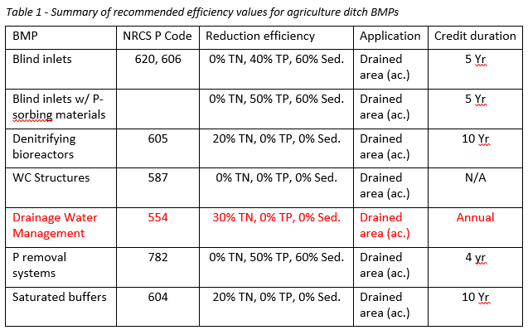
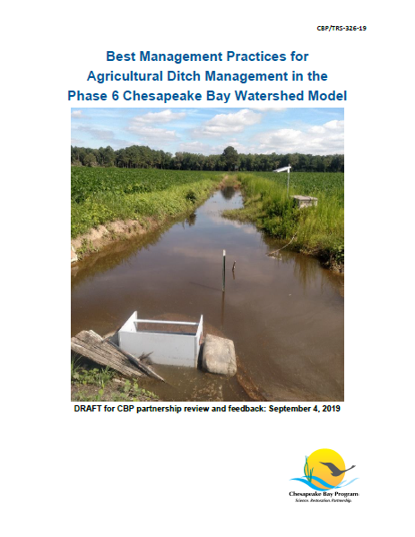
Drainage Water Management
NRCS CP 554
30% TN, 0% TP, 0% Sed.

Slide 4
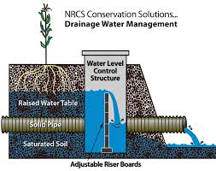
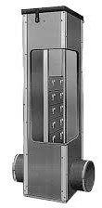
NRCS Conservation Solutions…
Drainage Water Management
“park your drain”
Dam
Reservoir
Water Level Control Structure
Sponge
Healthy Soil, Bigger sponge
Raised Water Table
Saturated Soil
Adjustable Riser Boards

Slide 5
How does drainage water management reverse adverse effects of drainage?
Decreases aeration of the rooting zone
  Will have negative effects on cover crops that are not water tolerant
Decreases rate of oxidation of organic matter in the surface horizon
Increases reduction of nitrate, manganese and iron
  Nitrate undergoes denitrification to atmospheric nitrogen
  Iron oxides may reduce and release phosphorus into solution
Increases water storage capacity at field and landscape scale
Decreases rate of water release (increased residence time)
  Decreases potential for downstream flooding unless heavy rain falls on a saturated soil

Slide 6
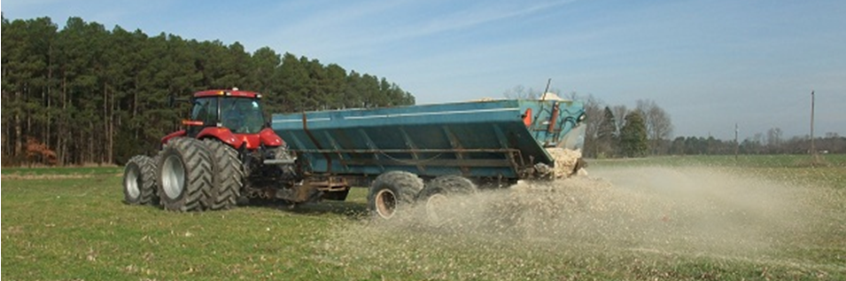
Conservation Practice Standard Code 333:
Amending Soil Properties with Gypsiferous Products

Slide 7
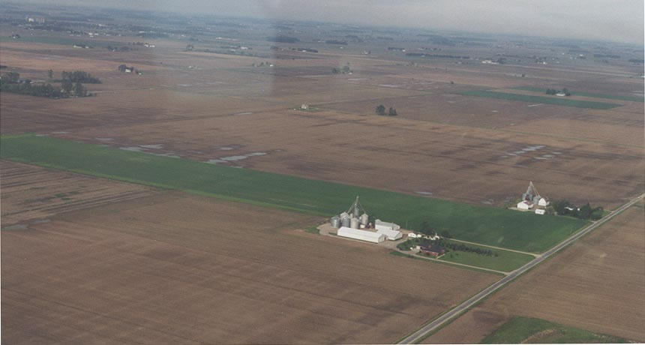
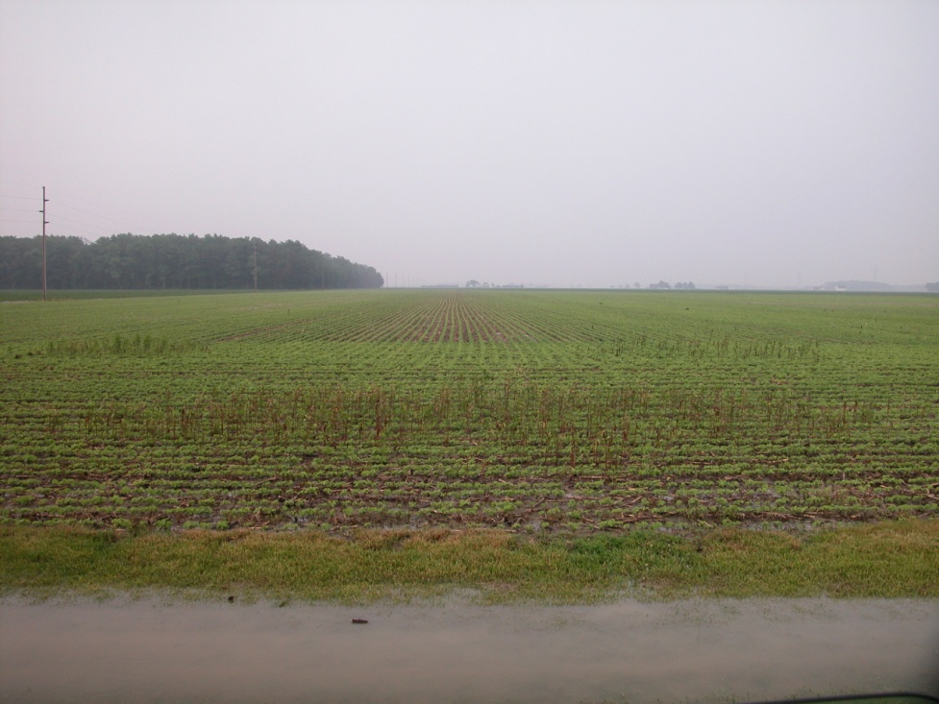
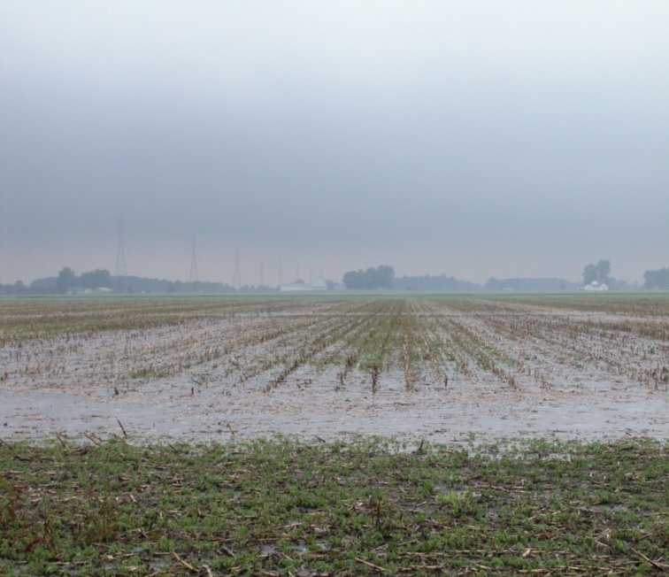
Purpose: Improve soil physical/chemical properties to increase infiltration and reduce soil erosion
Additional Criteria:
Apply 1.5 tons/acre of gypsum.
Ponding/Redox
Photo courtesy of Darrell Norton
Not Treated
Treated w/ FGD
Treated
Not Treated
Agricultural Research Service

Slide 8
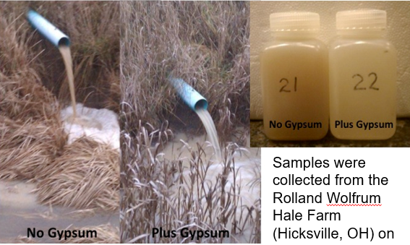

Slide 9
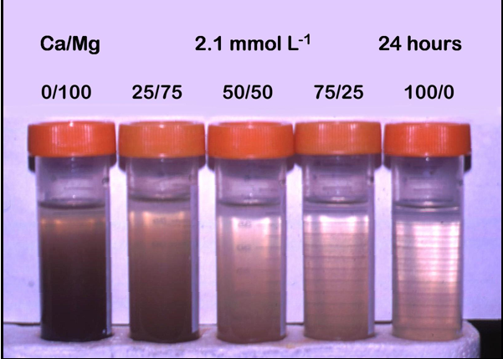
6/1

Slide 10
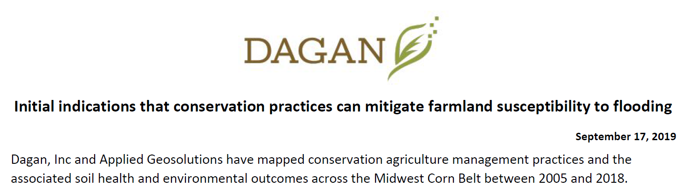
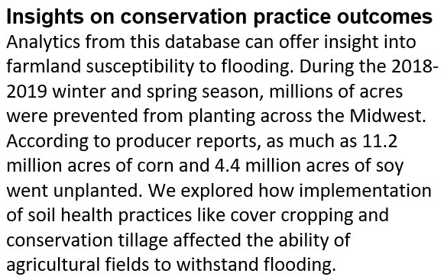
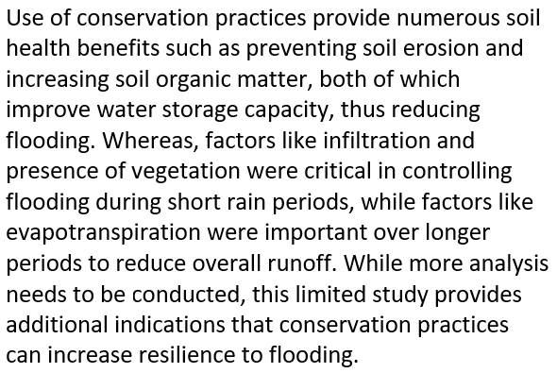
INTRODUCTION
CONCLUSIONS

Slide 11
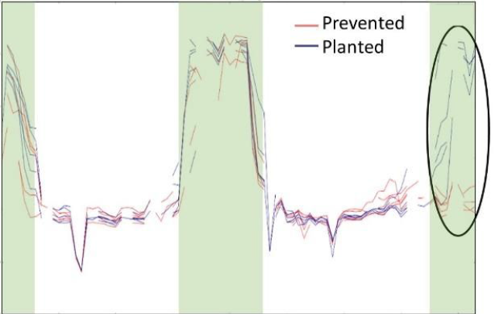
NDVI
SUMMER 2018
SUMMER 2019

Slide 12
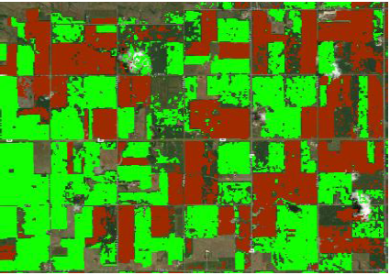
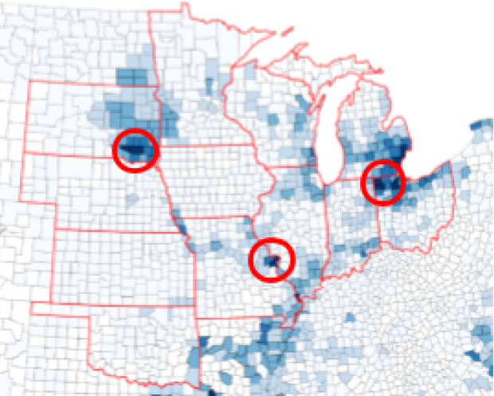
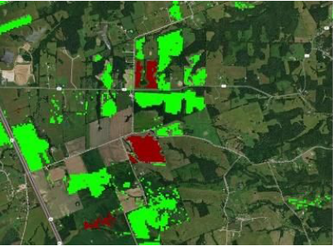
Prevented Planting Areas
Hutchinson County, SD
Lincoln County, MS

Slide 13

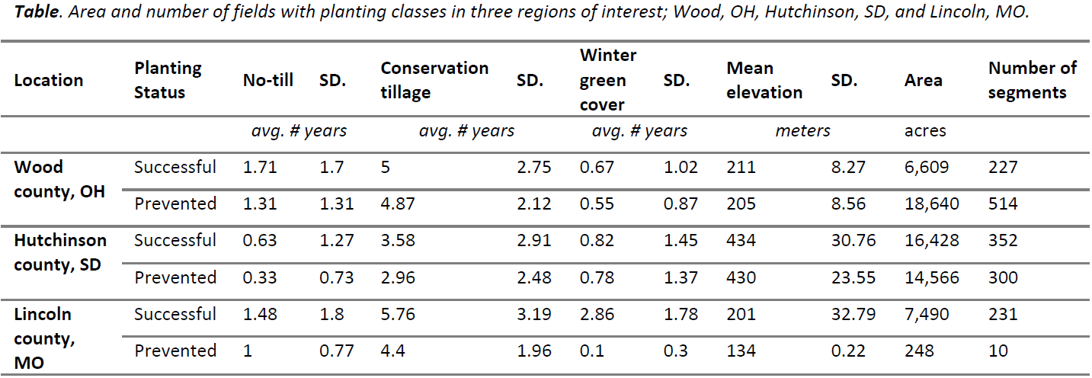

Slide 14
Prevented Planting Areas
Hutchinson County, SD
Lincoln County, MS

Slide 15
NRCS Conservation Solutions…
Drainage Water Management
“Dynamic drainage water management”
Dam
Reservoir
Water Level Control Structure
Sponge
Healthy Soil, Bigger sponge
Raised Water Table
Saturated Soil
Adjustable Riser Boards

Slide 16
Closing Questions
Can drainage water be managed “dynamically” to reduce risks of downstream flooding?
Is downstream flooding a problem in the Chesapeake Bay Watershed?
What are the effects of “parking your drain” on cover crops?
What are the effects of “dynamic” drainage water management on cover crops?
Do we need different cover crops for use under “park your drain” management?
What is the fate of phosphorus under drainage water management?

