Slide 1
Drying and wetting cycles of normally wet soils impact soil respiration and health
François Birgand¹, Augustin Thomas⁶, Bryan Maxwell¹, Louis Schipper⁴, Laura Christianson², Matt Helmers³, Mohamed Youssef¹, Shiying Tian¹, David Williams⁵, George Chescheir^{1,} Wenlong Liu¹
1
2
3
4
5
6
NIFA Award #: 2016-67019-25279 Multistate S1063

Slide 2
What are woodchip bioreactors?
Agricultural BMP
Intercept tile drainage
Targets nitrate removal
~20 year lifespan
NRCS approved
2-22 g N m⁻³ d⁻¹ in field
Mainly seen in Midwest
Christianson and Helmers, 2011

Slide 3
From the literature
Reported nitrate removal efficiencies varying from less than 10% to more than 90%
Decrease of removal efficiency within 1 to 5 years from >60% to <20%

Slide 4
Research questions
Can we find a practical way to increase denitrification in woodchip bioreactors?
What are the impacts of Draining ReWetting cycles on respirations to normally saturated soils?
Can we identify the microbial pathways in bioreactors?
Are microbiologically driven reactions slow or rapid in soils?
Are we learning something new from high resolution aqueous and gaseous concentration data?
Could we use simplistic soil models to learn the role of DOC quantity and quality to soil health?

Slide 5
Hypotheses
Drying and ReWetting (DRW) cycles can ’rejuvenate’ woodchip bioreactor
Gaseous emission data will provide information on the microbial pathways during DRW

Slide 6
Black Box

Slide 7
Objectives
Track and quantify the fate of water, nitrate, and DOC to reconstruct the apparent functioning
Measure in the lab and in the field the aqueous and gaseous removals and emissions associated with the use of bioreactors
Find solutions to ’rejuvenate’ woodchip bioreactor
Identify the microbial pathways using isotopic signatures
Integrate this new knowledge into 2D biogeochemical computer models
Use the models to explore and define novel and optimized design and management guidelines

Slide 8
Method
Use high resolution instruments to measure gaseous and aqueous concentrations
Lab column experiments
2-5 week long experiments in field bioreactors in North Carolina, Iowa, New Zealand
Process-based modeling

Slide 9
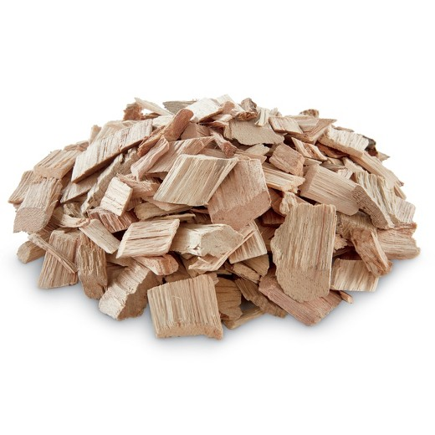
What are drying-rewetting cycles?
Cycle between dry/wet conditions
Gradient of conditions
Dry
Unsaturated
Wet
Saturated
Based on literature:
Stimulates respiration
Increases mineralization of C & N
Changes in microbial community

Slide 10
Experimental Hypothesis
Do drying-rewetting cycles in woodchip bioreactors significantly improve treatment performance by increasing nitrate removal rates?
+ Carbon
denitrification…
Aerobic breakdown
increases available carbon
DENITRIFICATION!!!

Slide 11
Materials and methods
Eight woodchip-filled columns
Continuous upflow (~8 hr HRT) for 297 days.
Two treatment groups (n=4)
DRW 2017
297 days
SAT – Constant saturation
8 h DRW – Drained once a week, unsaturated for 8 hours.
Experiment #1
Outlet [NO₃] measured every 2 h using small-volume MPS
DRW
SAT

Slide 12
Materials and methods
Same columns used in previous experiment.
Continuous upflow (~8 hr HRT) for 105 days.
Four treatment groups (n=2)
DRW 2017
297 days
SAT – Constant saturation
2 h DRW – Unsaturated for 2 h
8 h DRW – Unsaturated for 8 h
24 h DRW – Unsaturated for 24 h
Experiment #1
Outlet [NO₃] measured every 2 h using small-volume MPS
DRW 2018
105 days
Experiment #2
24 h DRW
8 h DRW
2 h DRW
SAT

Slide 13
Upflow columns
36 cm head space
OUTFLOW
50 cm of 6-year-old woodchips
Nylon mesh separating gravel and woodchips
Washed gravel underbed
INFLOW: peristaltic pump

Slide 14
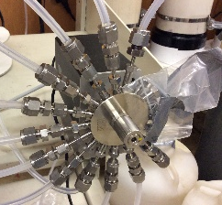
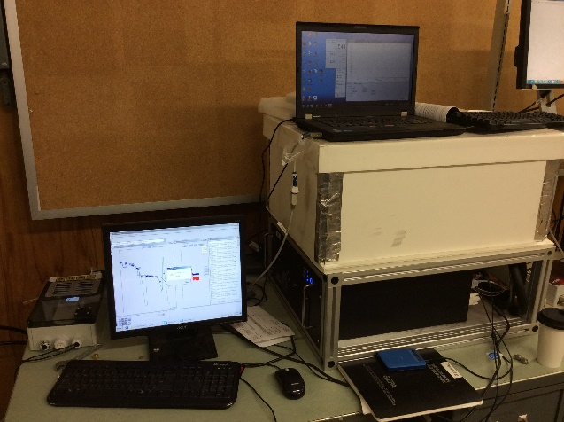
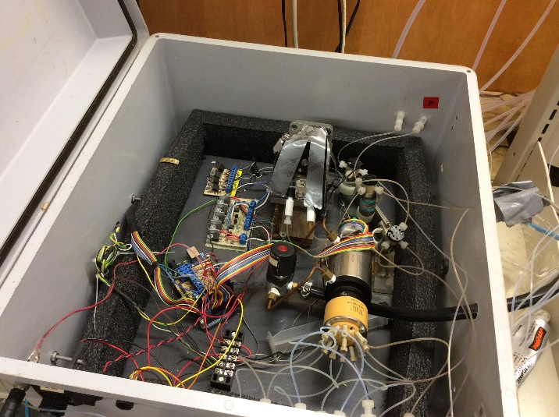
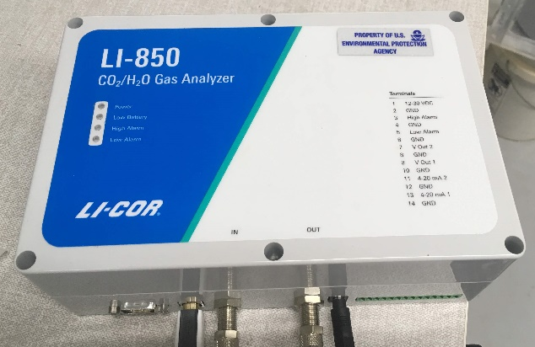
Multiplexed high frequency measurements
Aqueous
Gaseous
CO₂
N₂O + isotopes: 1 Hz -> hourly
NO₃⁻ + DOC: 2-hourly
OUTFLOW WQ
QCL
QCL
Maxwell et al.,
HESS, 2018
Lab microvolume MPS
INFLOW rates: bidaily

Slide 15
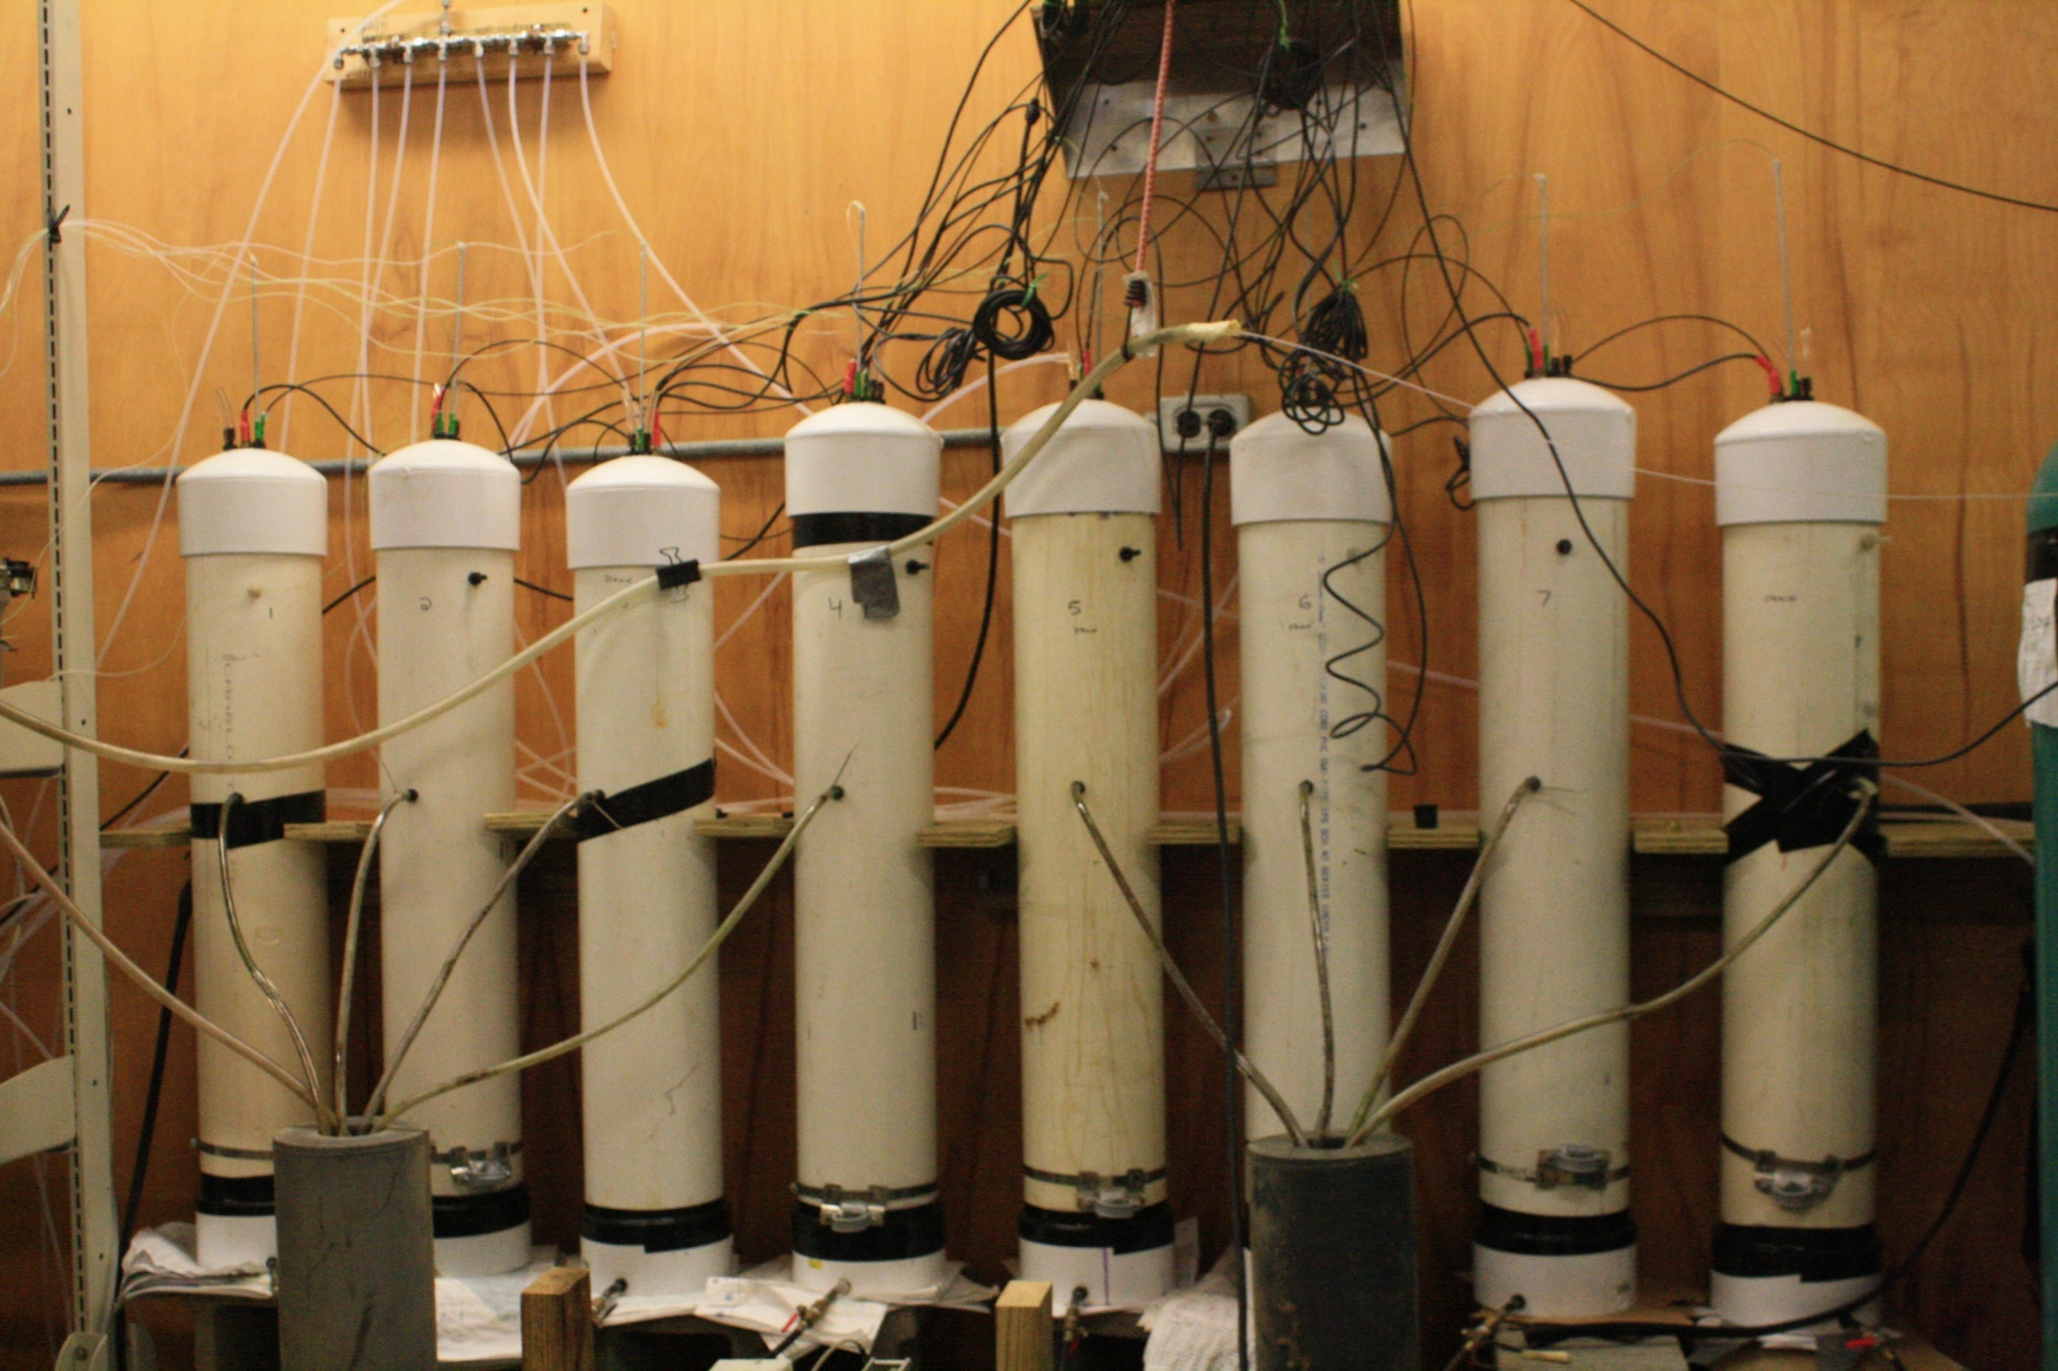
Materials and methods: Lab column set-up

Slide 16
Water quality results

Slide 17
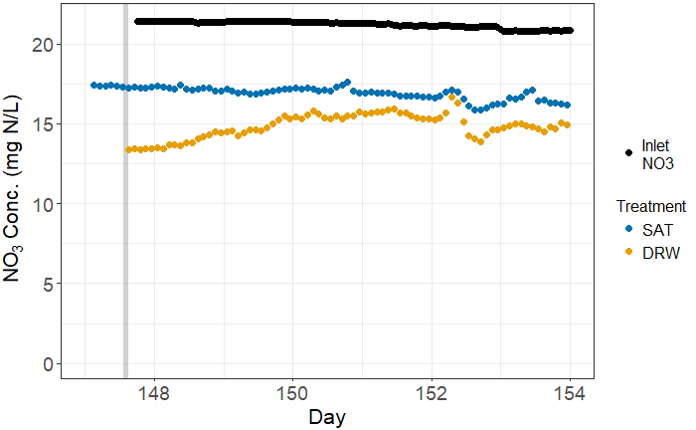
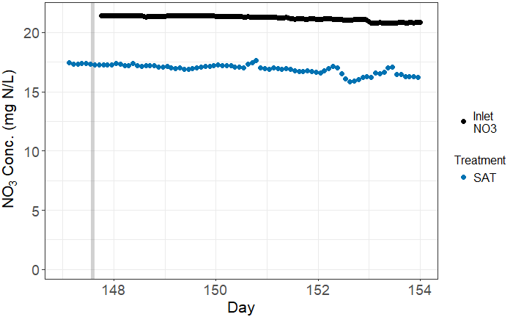
Results, DRW 2017 : High frequency data
84 measurements per column per week
8 h DRW

Slide 18
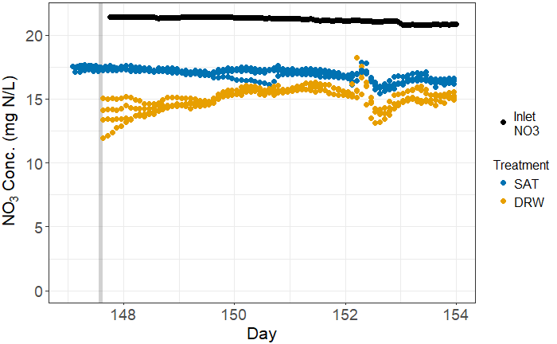
Results, DRW 2017 : High frequency data
640 measurements per week for all columns
8 h DRW

Slide 19
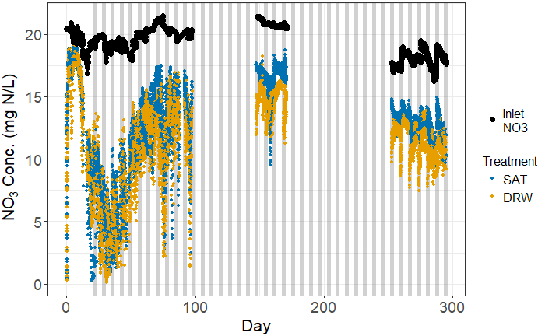
Results, DRW 2017 : High frequency data
8 h DRW
Weekly DRW cycle

Slide 20
Volumetric Removal and Production rates
R_{NO3} = mass removed / volume of bioreactor / time
P_{DOC} = mass added / volume of bioreactor / time

Slide 21
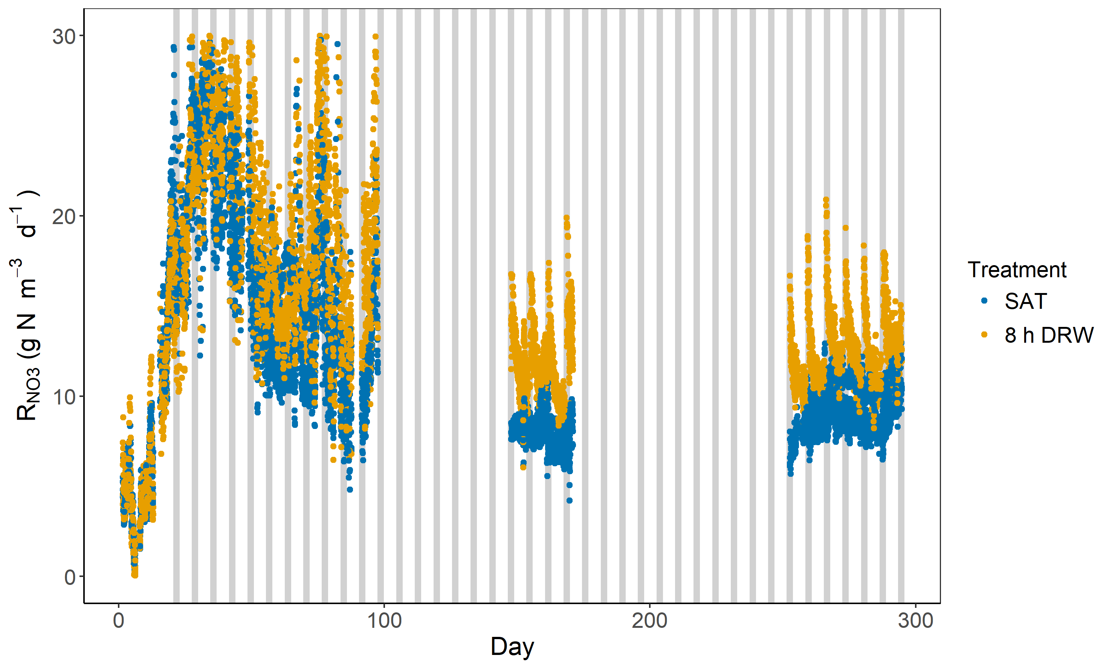
Results, DRW 2017 : Nitrate removal rates, R_{NO3}
Significant differences in R_{NO3} between groups after the 2nd DRW cycle.

Slide 22
Rapid and Large response to DRW cycles
R_{NO3}
P_{DOC}

Slide 23
Slow or rapid reactions in soils?
Suggestion:
There is a potentially very rapid component of microbially mediated processes in soils

Slide 24
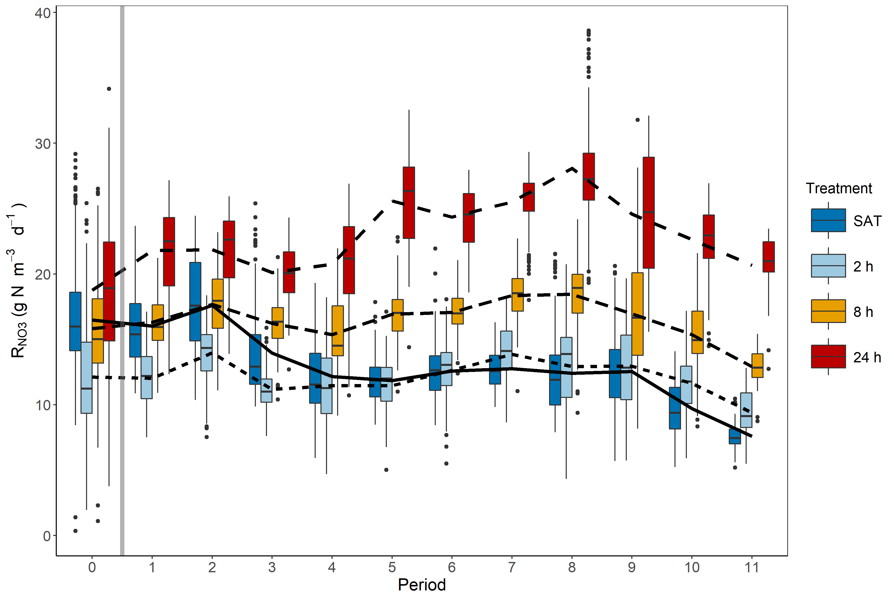
Results, DRW 2018 : Volumetric NO₃ removal rates
Weekly DRW period

Slide 25
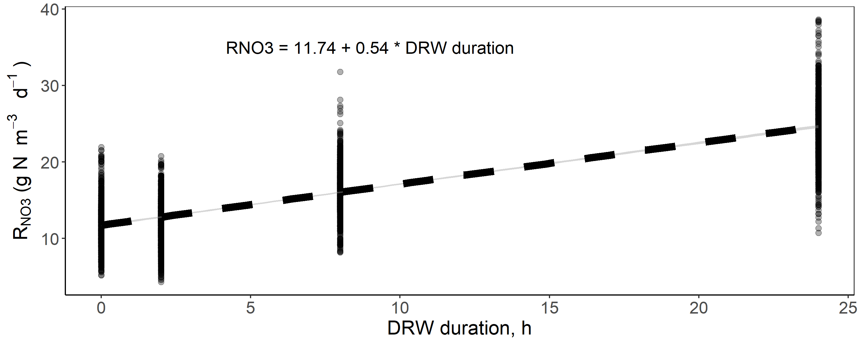
Results, DRW 2018 : Volumetric NO₃ removal rates

Slide 26
DRW cycles increase nitrate removal
90% to 172% increase for 24 hr DRW cycle; 8 h DRW increased by 35 – 70%
Increase in R_{NO3} by ~5 percentage points for every hour woodchips were unsaturated

Slide 27
What causes the increased nitrate removal?

Slide 28
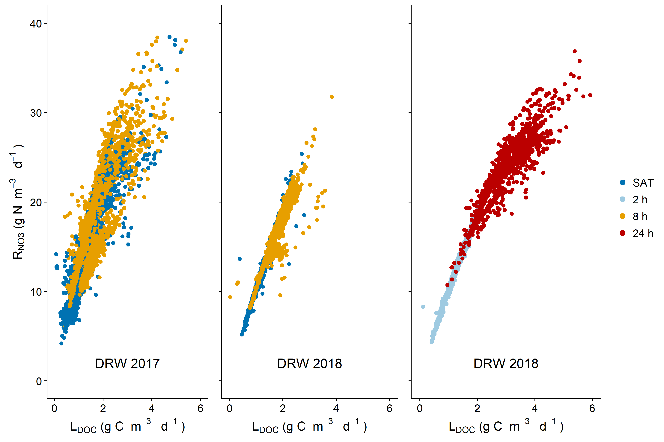
Increased DOC production fuels increased NO₃⁻ removal

Slide 29
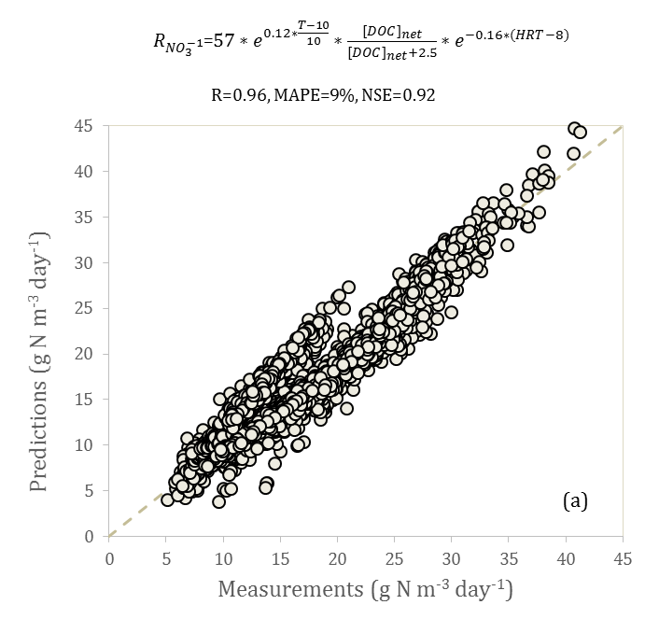
$R_{{NO}_{3}^{−}}$=$R_{ref}∗e^{k_{Tem}∗\frac{Tem−10}{10}}∗\frac{L_{DOC}}{L_{DOC}+k_{DOC}}\text{∗} e^{k_{HRT}∗\left(HRT−8\right)}$
T°C effect + P_{DOCnet} +
Negative HRT
T°C effect
T°C effect + P_{DOCnet}
Predicted R_{NO3} (g N/m³/d)
Measured R_{NO3} (g N/m³/d)
Measured R_{NO3} (g N/m³/d)
Measured R_{NO3} (g N/m³/d)

Slide 30
Water quality take home points
Yes! DRW have the potential to ’rejuvenate’ nitrate removal efficiency, at least in the lab
DRW cycles seem to generate higher quantity (and quality?) of labile carbon, which fuel nitrate removal

Slide 31
Gaseous emission results

Slide 32
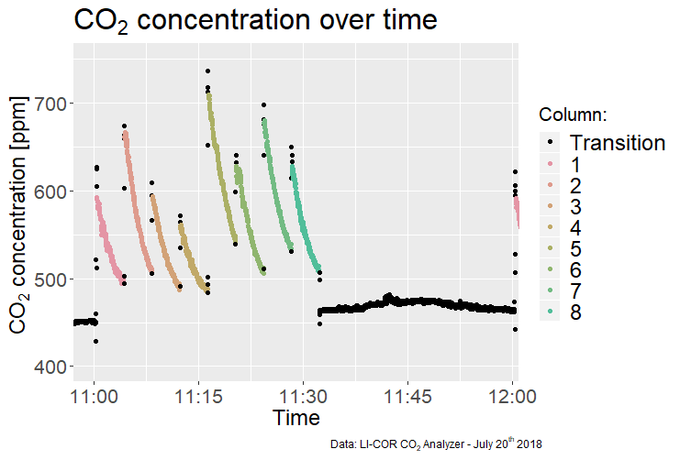
A system opened to the atmosphere

Slide 33
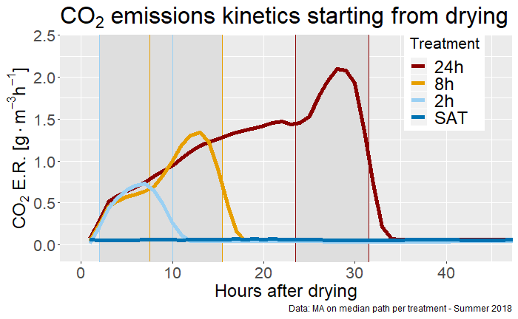
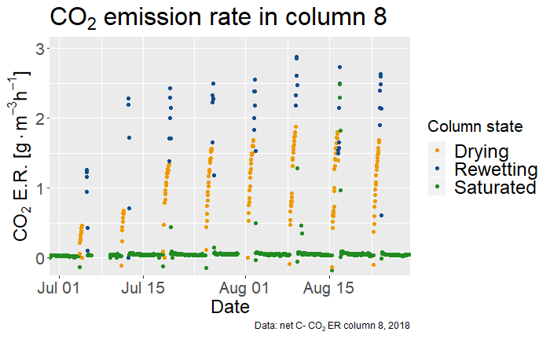
Bulk CO₂ values, a clear typology
Notes:
Shoe typology for CO2, not so for N2O

Slide 34
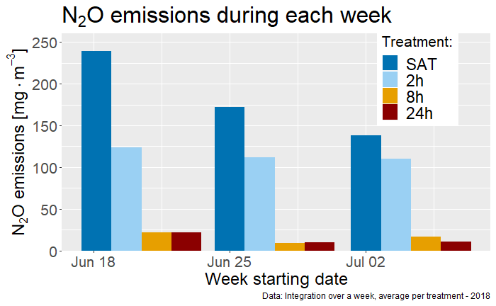
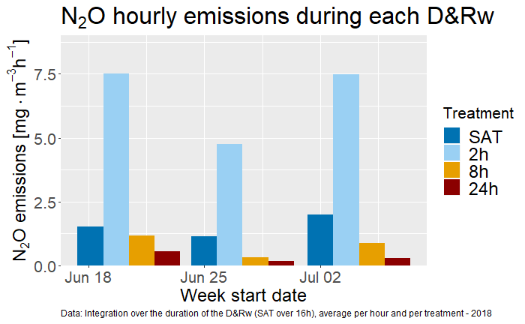
Long DRW cycles diminish N₂O emissions

Slide 35
Small percentage of N lost as N₂O emissions
In the water, removal rate of: ${10 gN−NO_{3}^{−}}/{{m^{3}}/{day}}$
In the air, emission of: ${20 mgN− N_{2}O}/{{m^{3}}/{day}}$
0.2 % of denitrified N is emitted as N₂O
BUT, we expect most of the N₂O to remain dissolved over the length of the experiment

Slide 36
Bulk CO₂ values, a clear typology
Notes:
Shoe typology for CO2, not so for N2O

Slide 37
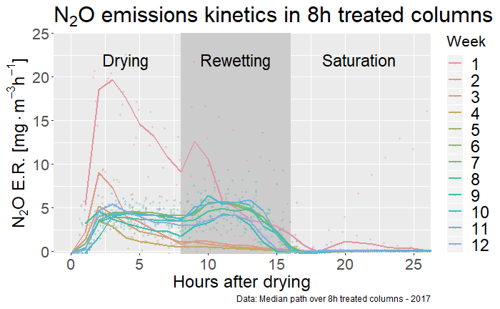
An evolution in $N_{2}O$ emission pathway over the weeks

Slide 38
Concluding remarks
DRW cycles have the potential to largely increase nitrate removal rates in woodchip bioreactors
Linear increase in removal rates as a function of DRW duration
Aerobic-based processes stimulate higher quantity (+ quality?) of DOC which fuels denitrification
Rapid response (hours) : due to the rapid actuation of extracellular enzymes in soils?
Slower response (weeks): adaptation by microbes/fungi to predictable DRW cycles?
What if the DRW cycles are not predictable?
Several stage microbial adaptation process?

Slide 39
Concluding remarks
Are we learning something new from high resolution aqueous and gaseous concentration data?
Gives unprecedented chances to improve our models
Gives opportunities to see new things

Slide 40
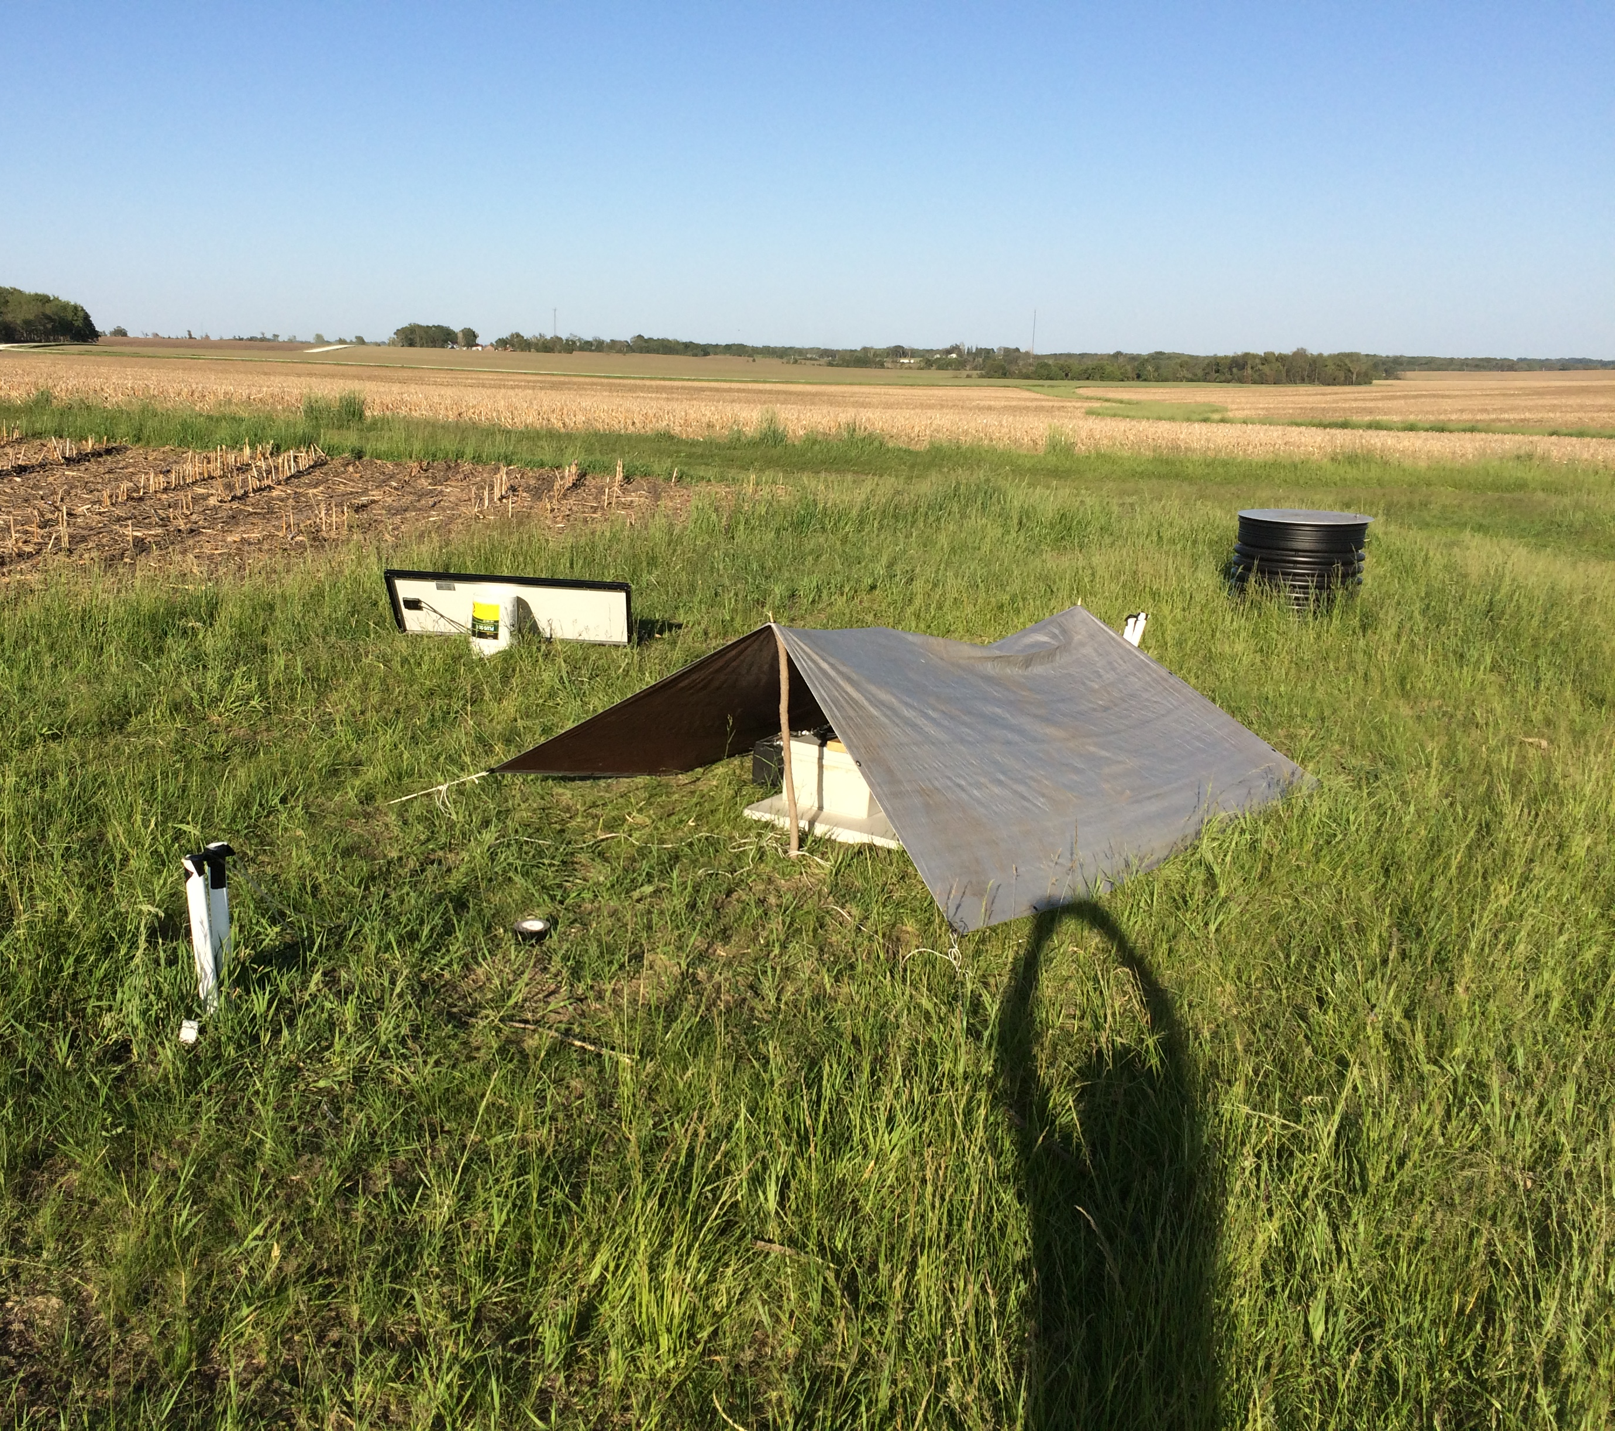
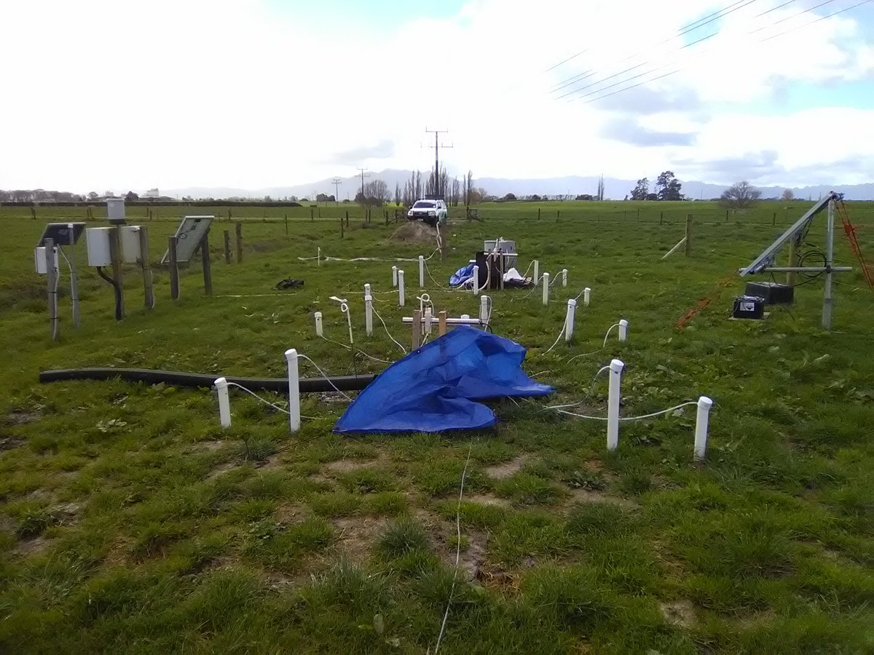
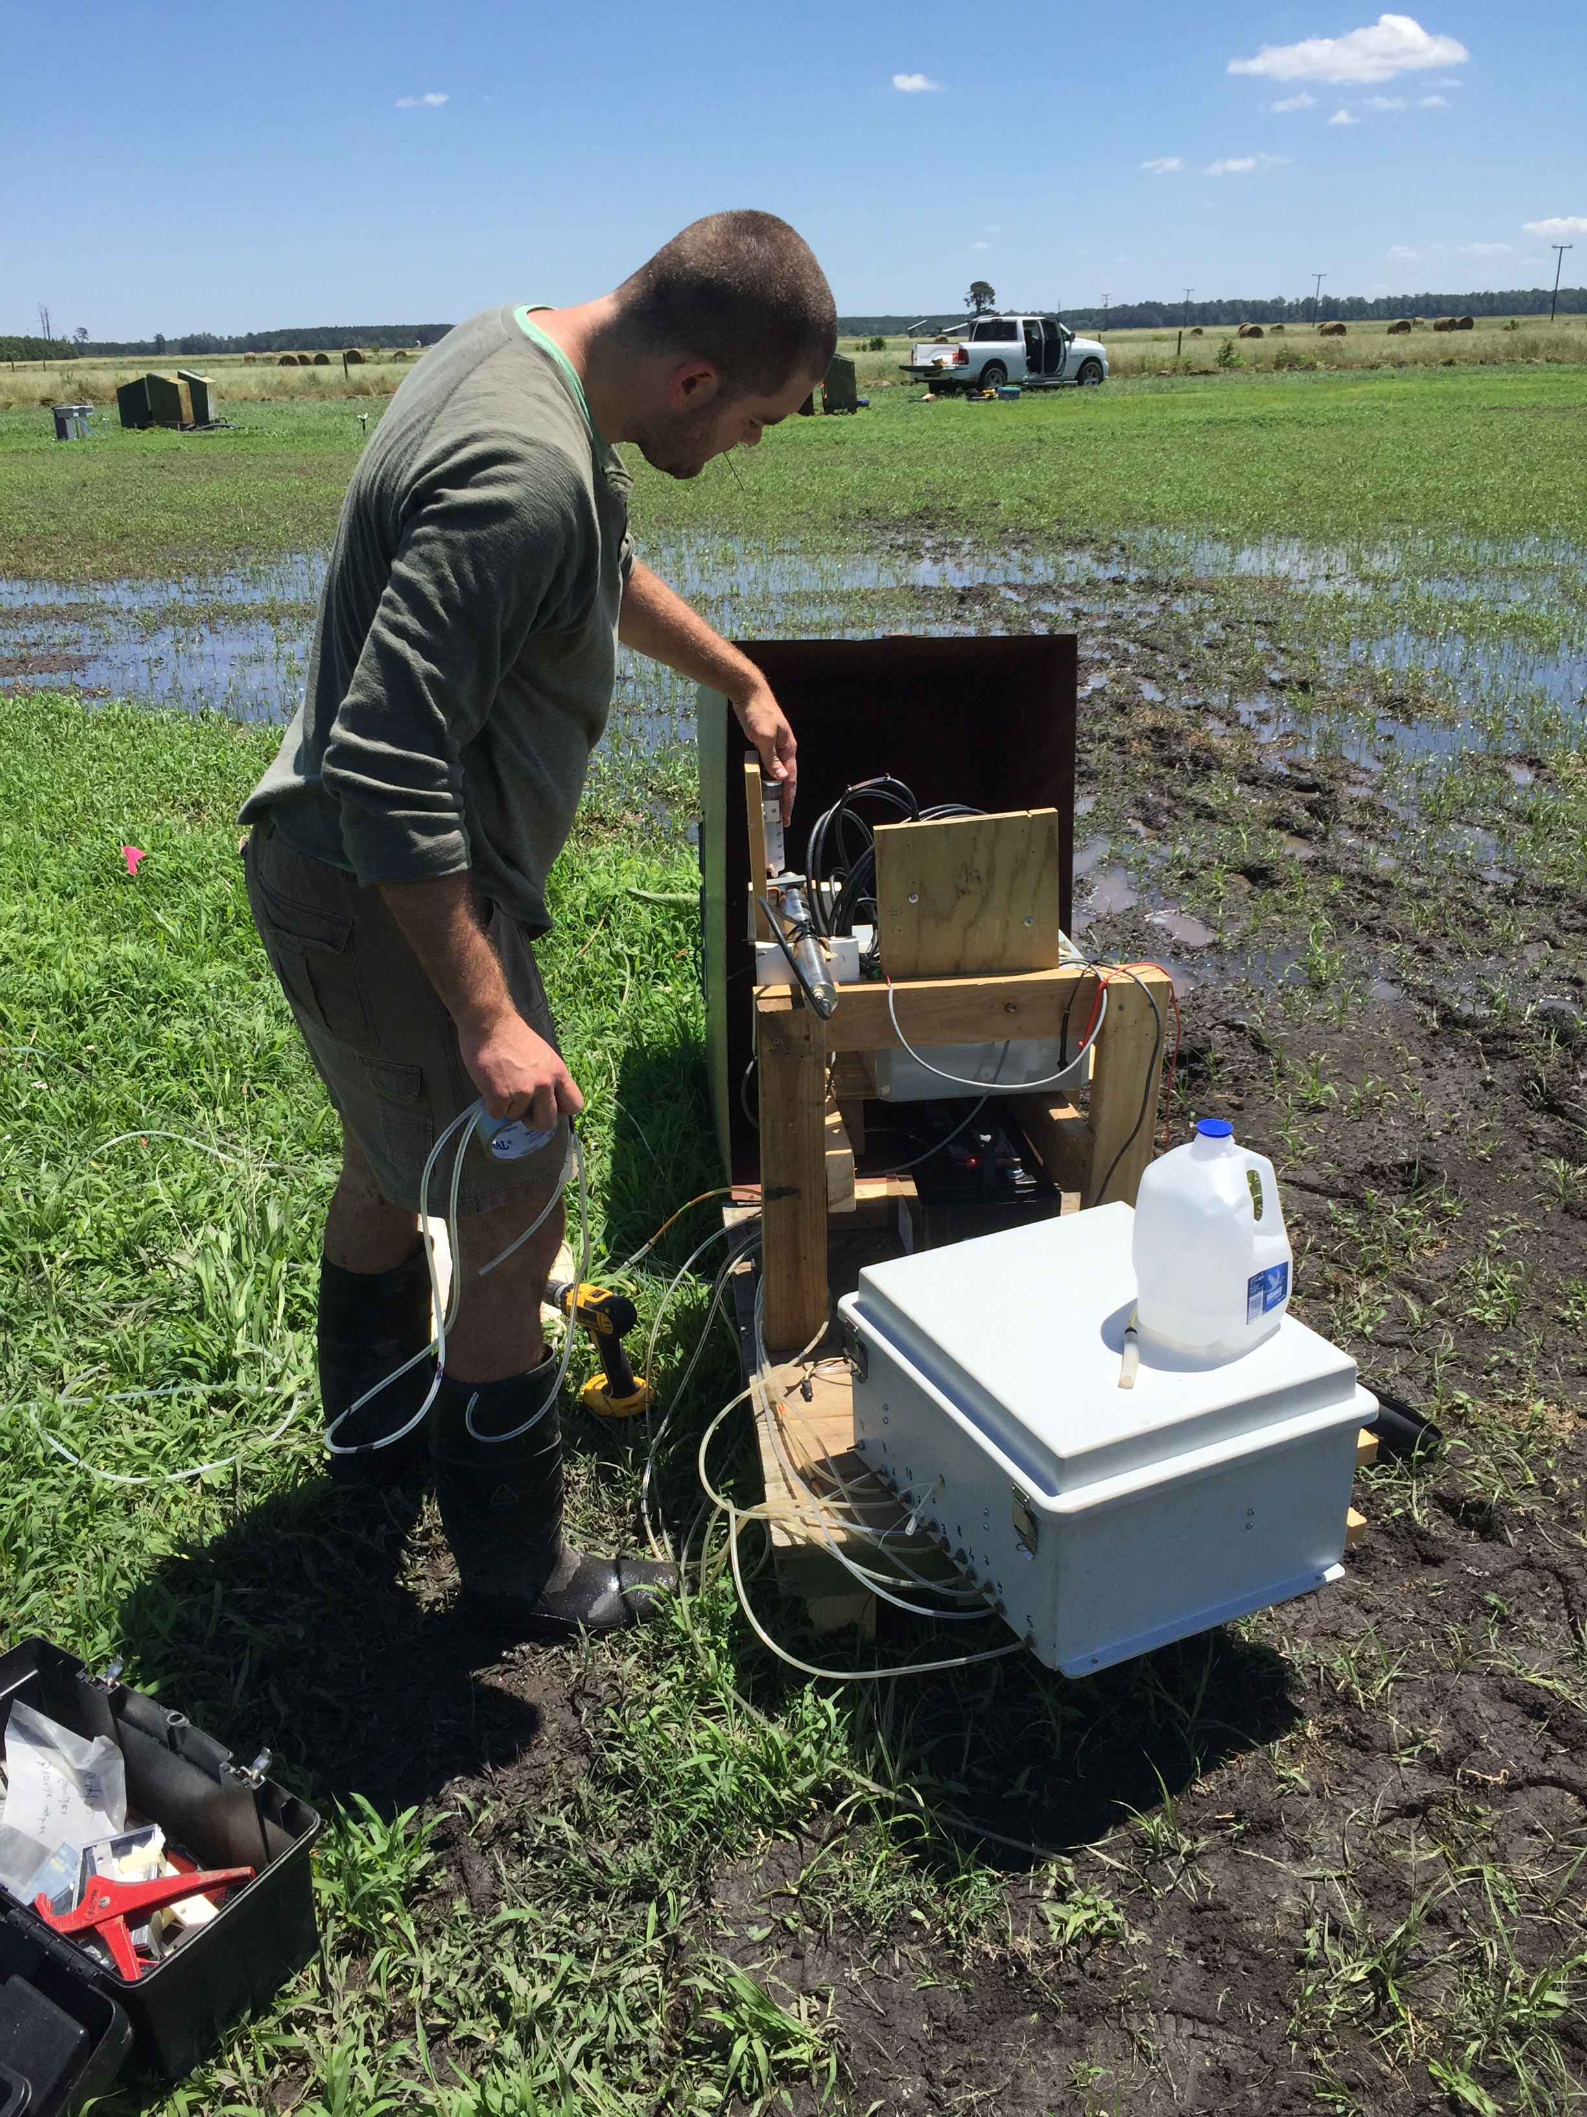
High spatio-temporal resolution data in the field
Plymouth, NC
Nashua, IA
Tatanui, NZ

Slide 41
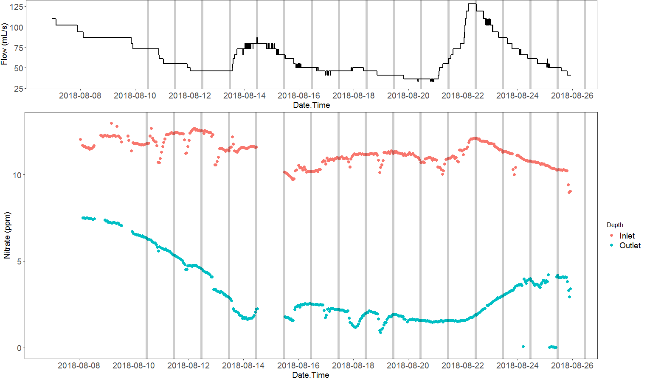

Slide 42
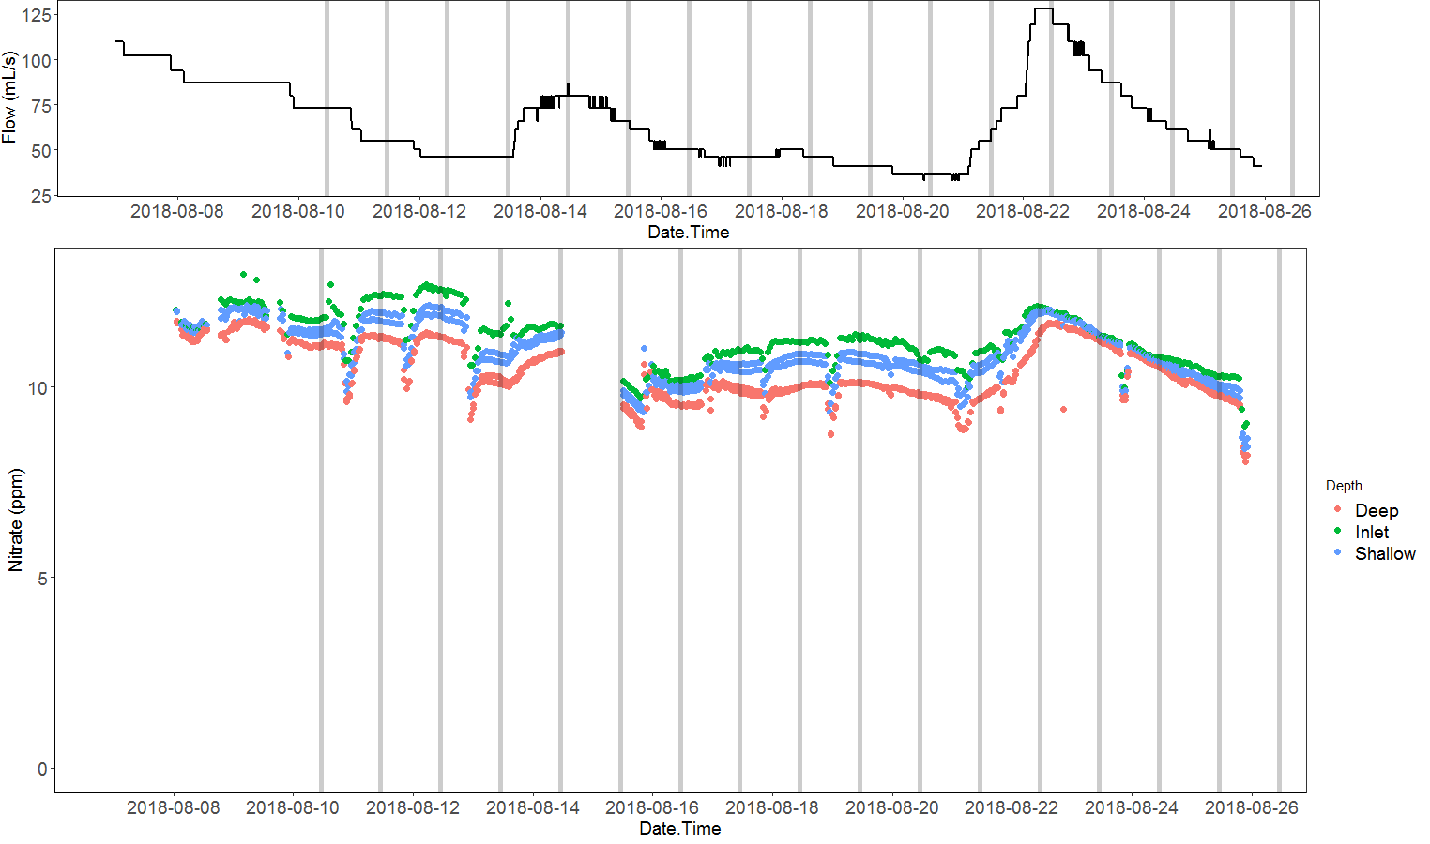
Wells at 0.5 m from inlet

Slide 43
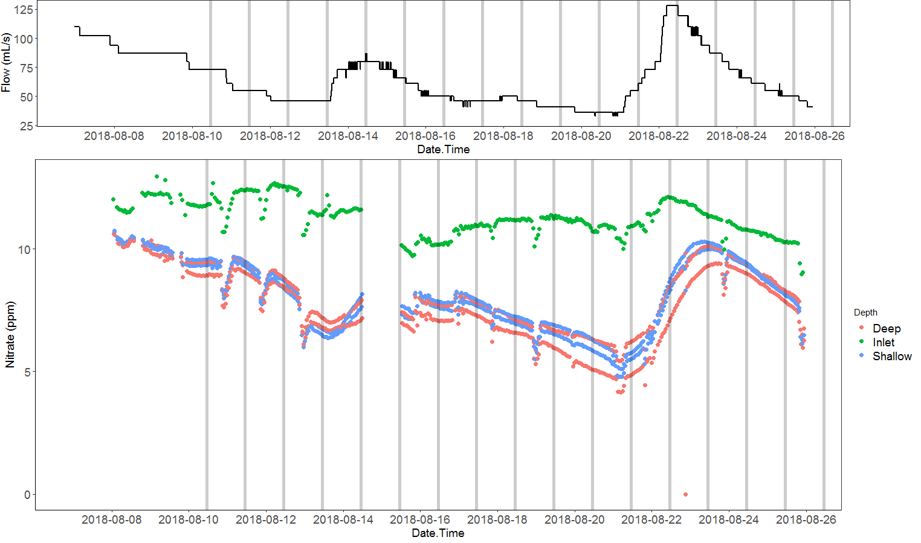
Wells at 3.2 m from inlet

Slide 44
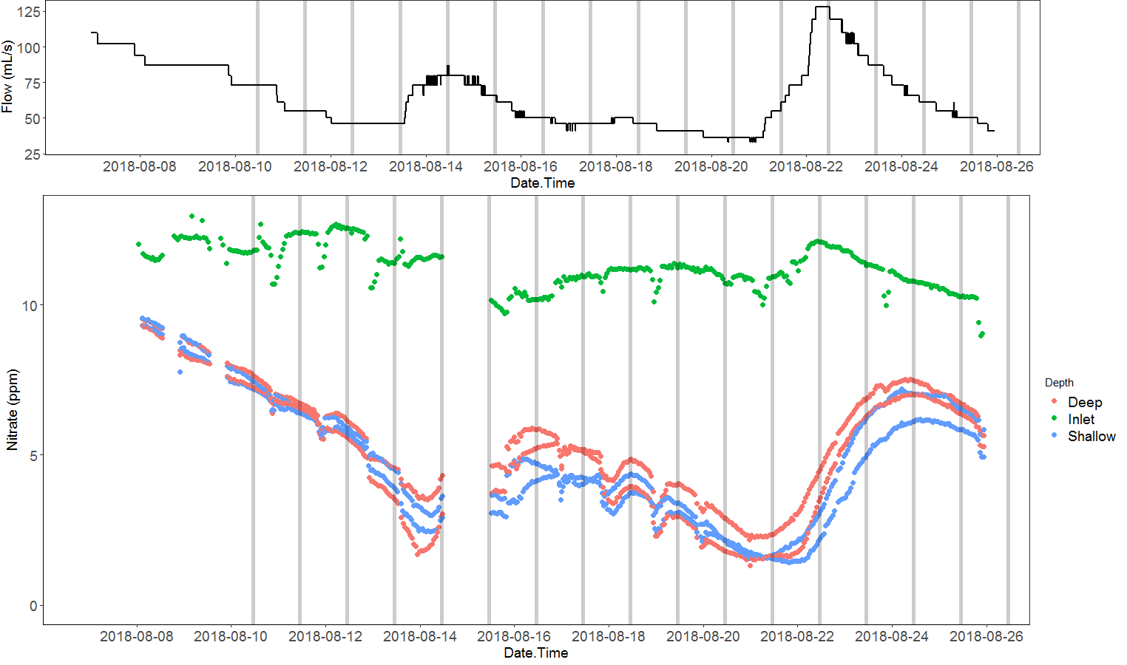
Wells at 5.9 m from inlet

Slide 45
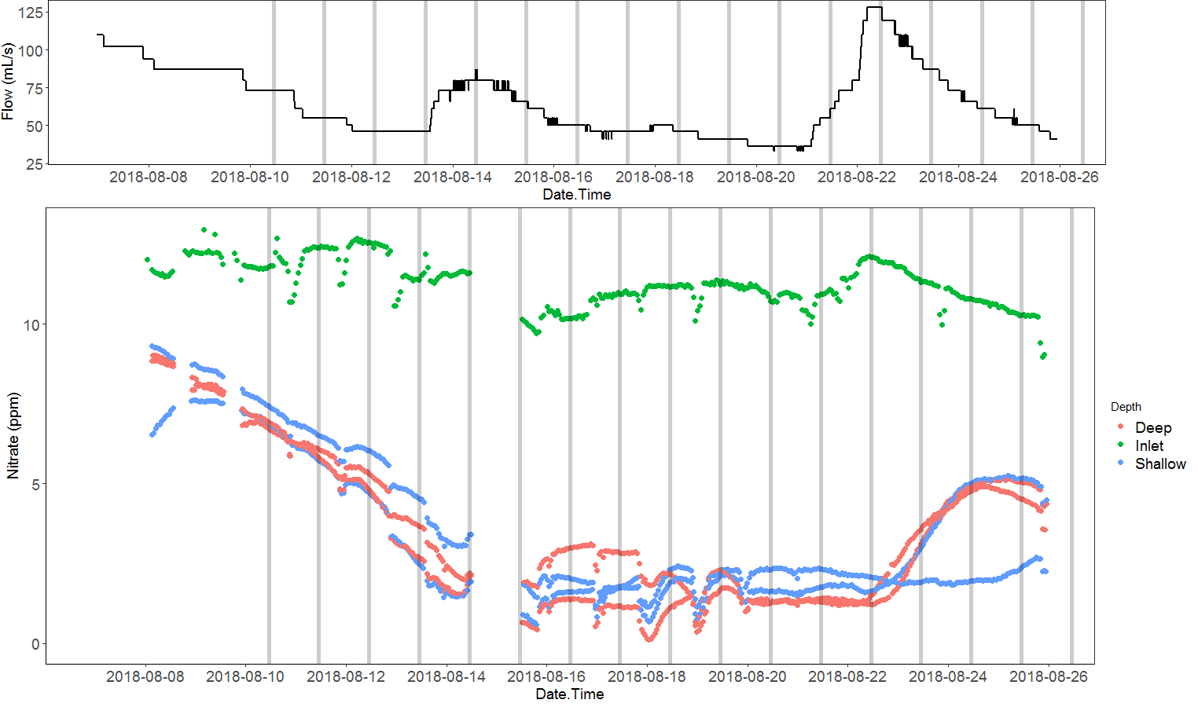
Wells at 8.5 m from inlet

Slide 46
Concluding remarks
Could we use simplistic soil models to learn the role of DOC quantity and quality to soil health?
I think so!
Using woodchip bioreactors as a simplistic model is very attractive:
Homogeneous source of carbon (simpler microbiome?)
Large redox gradients from aerobic to anaerobic conditions
Can be used in the lab and in the field
Access to water to measure all sorts of indicators at a high resolution

Slide 47
Acknowledgements
Funding Source
Facilities and Lab Analysis
Microbial Analysis

