Slide 1
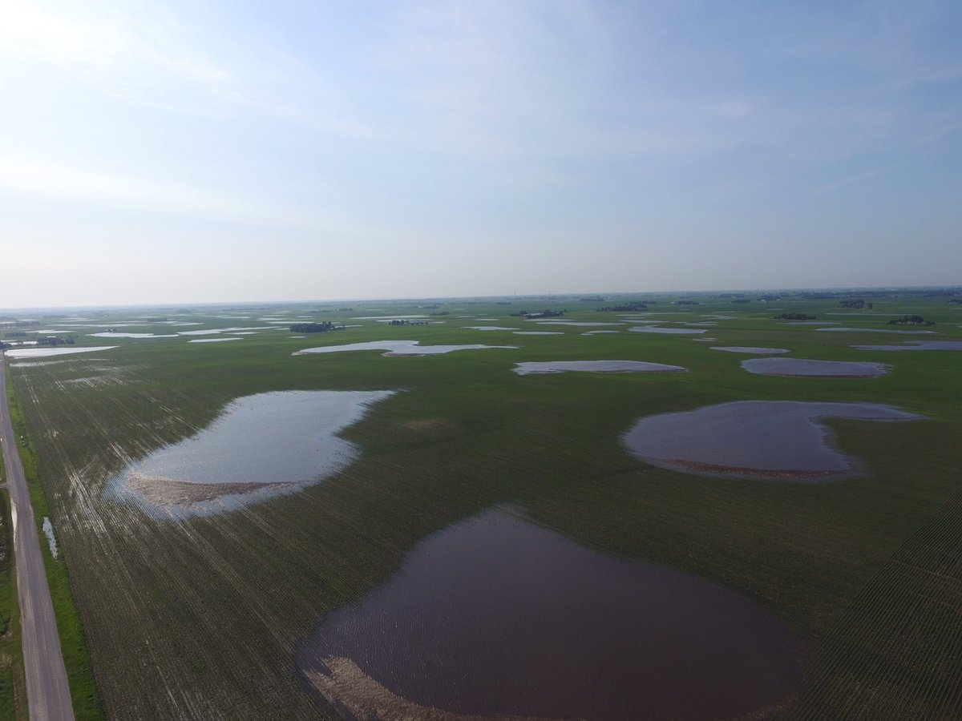
Modeling shallow water tables impacts on productivity and soil health in the US Midwest
Sotirios Archontoulis
Associate Professor of Integrated Cropping Systems
Iowa State University, Department of Agronomy
Jan 23, 2020
sarchont@iastate.edu

Slide 2
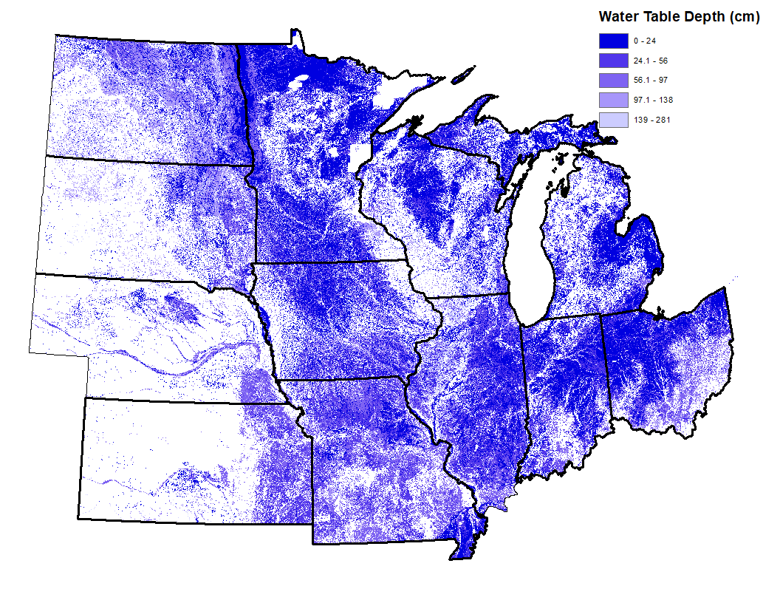
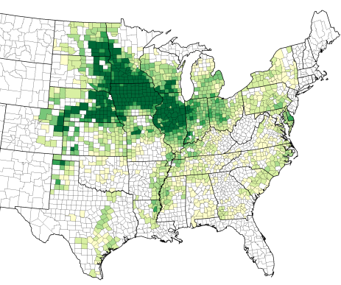

The entire Corn Belt is at a top of a shallow water table
2017 Corn Yields
Source: gSSURGO
Source: USDA NASS
Notes:
55% of IA soils have WT < 2m; 61% IL, 56% IN.

Slide 3
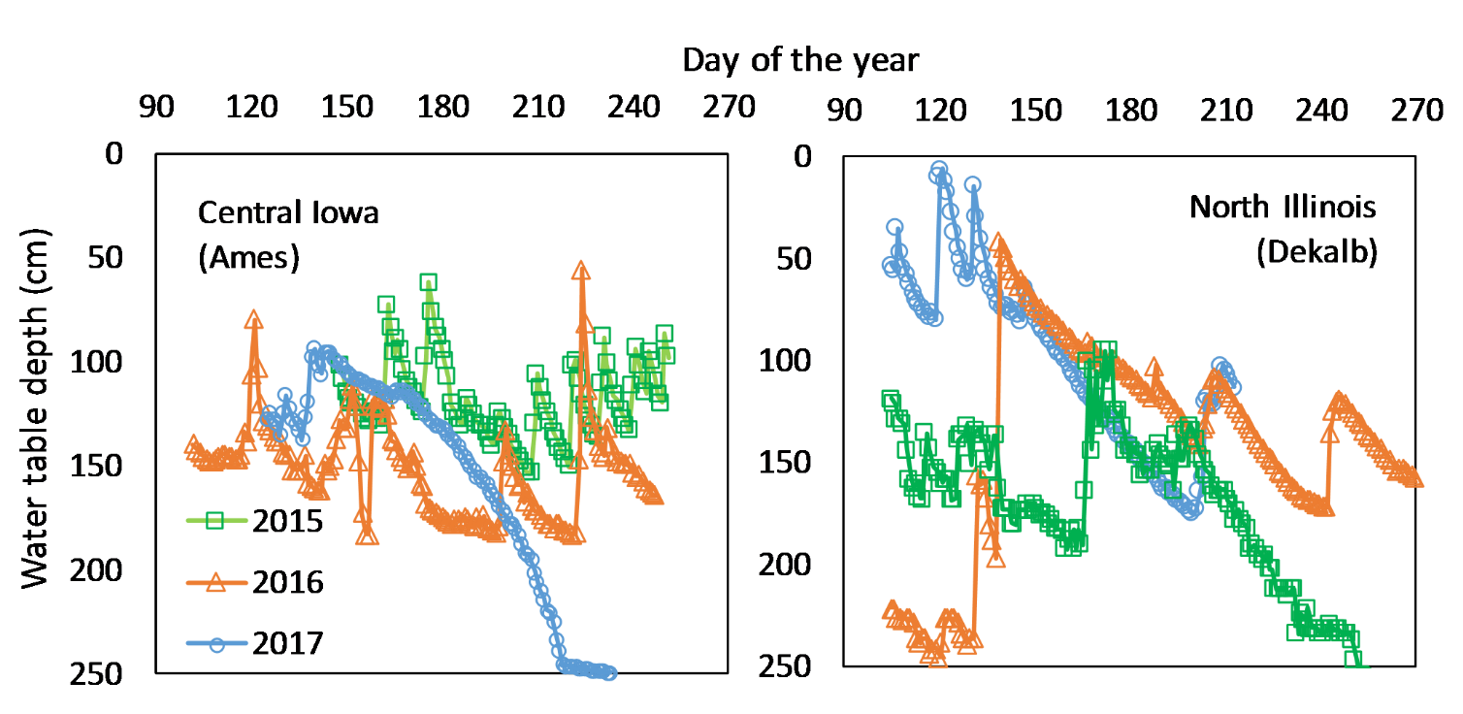
The water table is very dynamic with both positive and negative impacts on production & soil health even within a year
5 feet

Slide 4
2017 FFAR New Innovator Award
Improving simulation of soil water dynamics and crop yields in the US Corn Belt
Objectives and Products
Develop new scalable protocols to simulate fluctuated water tables in crop models
Enhance crop models by adding waterlogging functions [roots, photosynthesis, fixation, …]
Upscale and apply crop models to assist decision-making

Slide 5
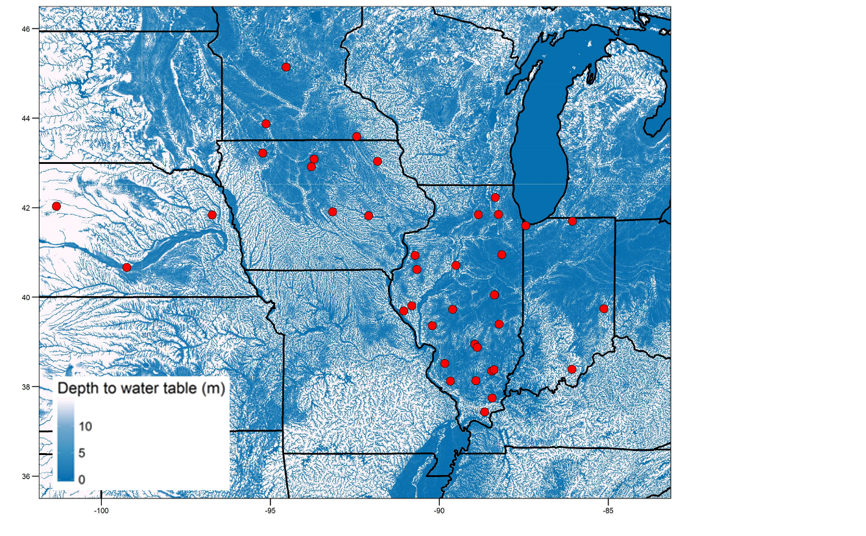
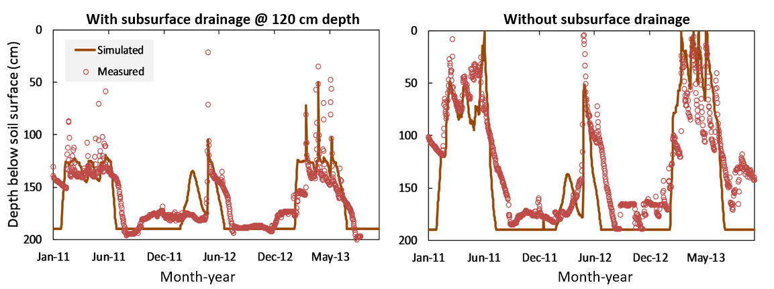
Data to develop protocols to model water tables across locations
Dataset I
35 locations; Bare soil or grass
10 to 40 years; Daily to monthly
Dataset II
10 locations; corn or soybean crops
5 years; Daily to hourly
Dataset III
? locations; corn or soybean crops
Water quality plots
Data source: USGS, WARM, FACTS

Slide 6
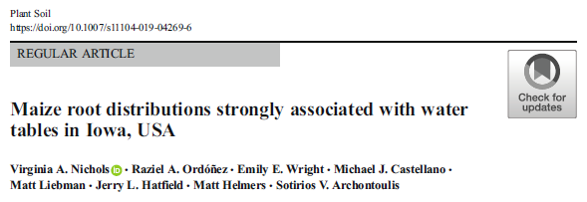
2017 FFAR New Innovator
Improving simulation of soil water dynamics and crop yields in the US Corn Belt
Objectives and Products
Develop new scalable protocols to simulate fluctuated water tables in crop models
Enhance crop models by adding waterlogging functions [roots, photosynthesis, fixation, …]
Upscale and apply crop models to assist decision-making
Ebrahimi-Mollabashi et al., 2019 Field Crops Research
Credit
Credit
Penalty and Credit

Slide 7
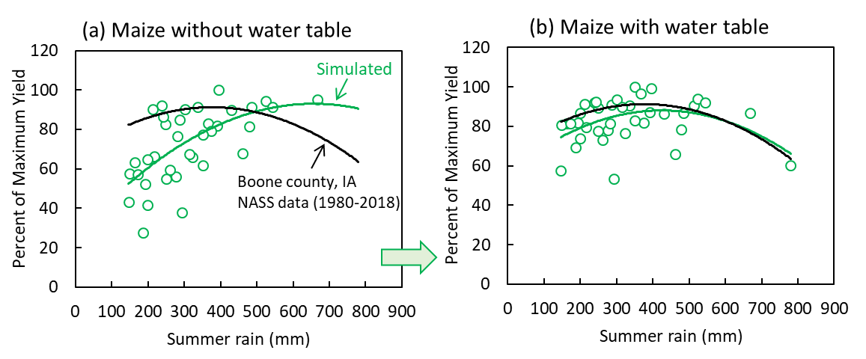
Improved yield prediction
12% yield increase on average
Water table decreases inter-annual yield variability up to 40%
Water table buffers up to 50% of the variability in summer precipitation
Archontoulis et al 2020
Crop Science

Slide 8
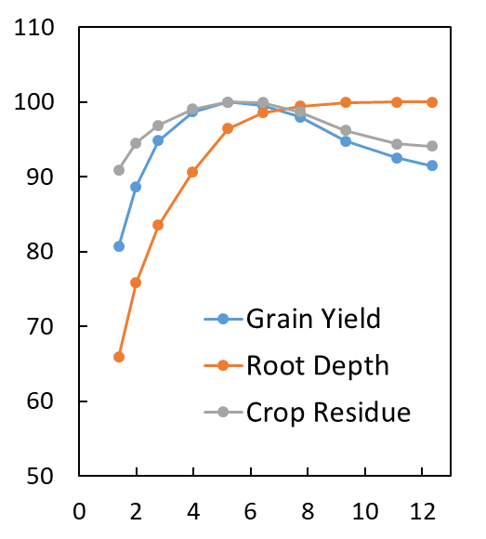
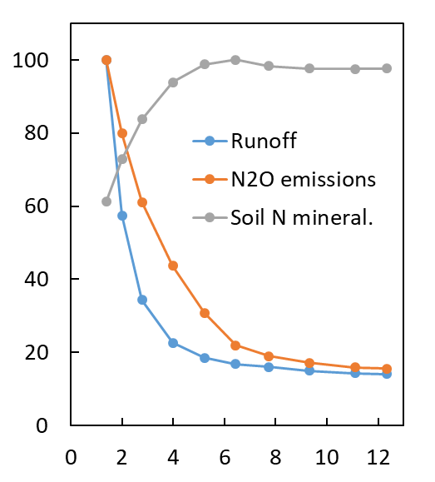
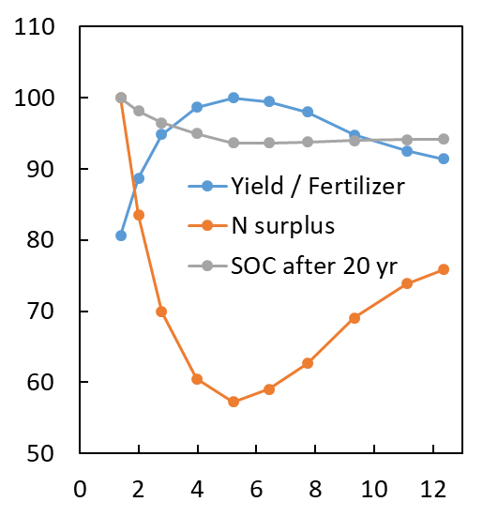
Modeling insights:
The case for corn in central Iowa – field without tiles
How does climate affect the shape of these responses?
% of max value
Water table depth from soil surface (feet)
20 yrs average values; APSIM model (Archontoulis et al unpublished)

Slide 9
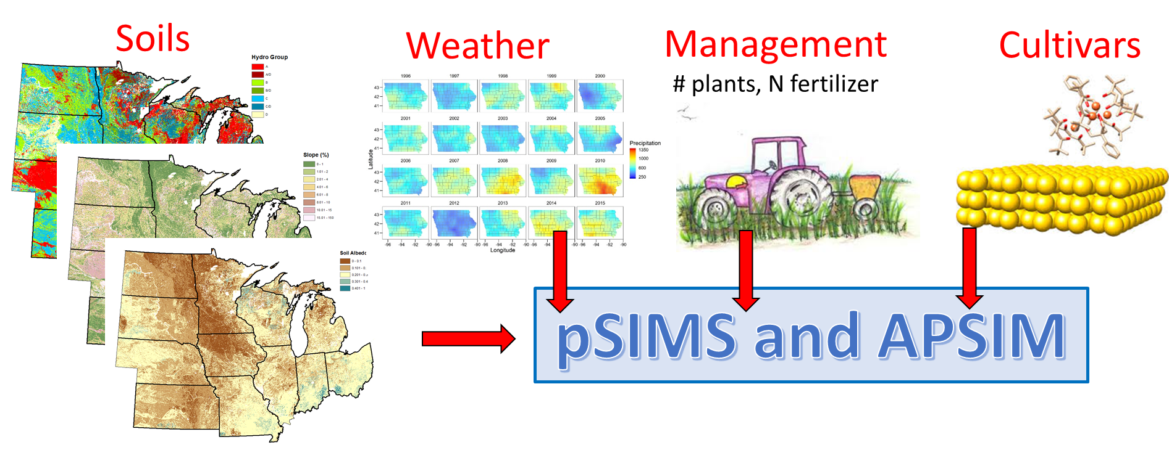
From field to regional scale
Resolution = 30 fields per county; 7,600 fields for IA + IL + IN

Slide 10
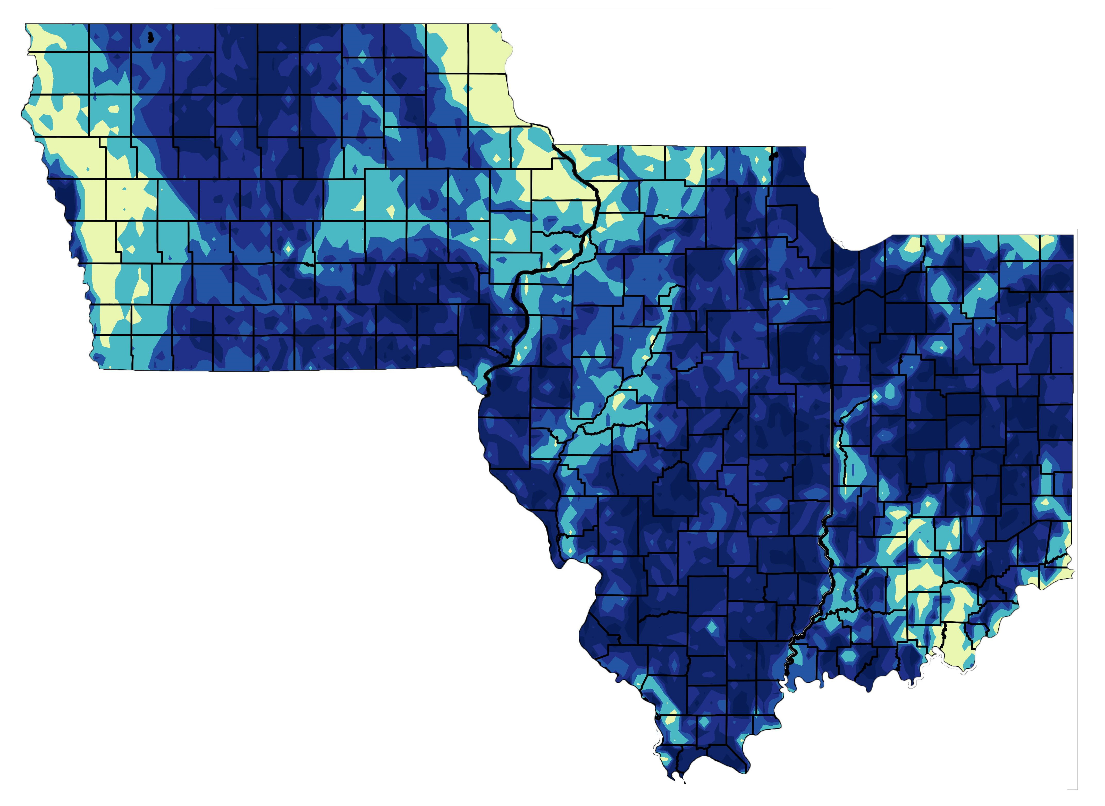
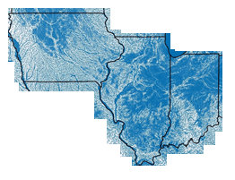
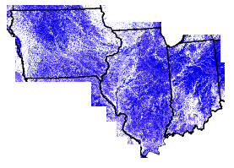
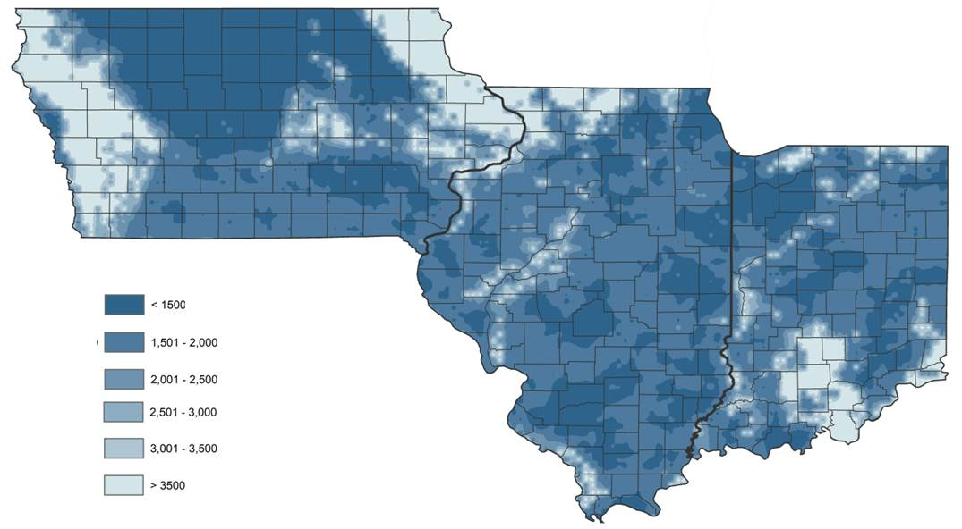
Comparison of models
pSIMS – APSIM
Field scale crop model
Fan et al. 2013 – Science
Regional scale hydrological model
gSSURGO database
The darker the color the shallower the water table

Slide 11
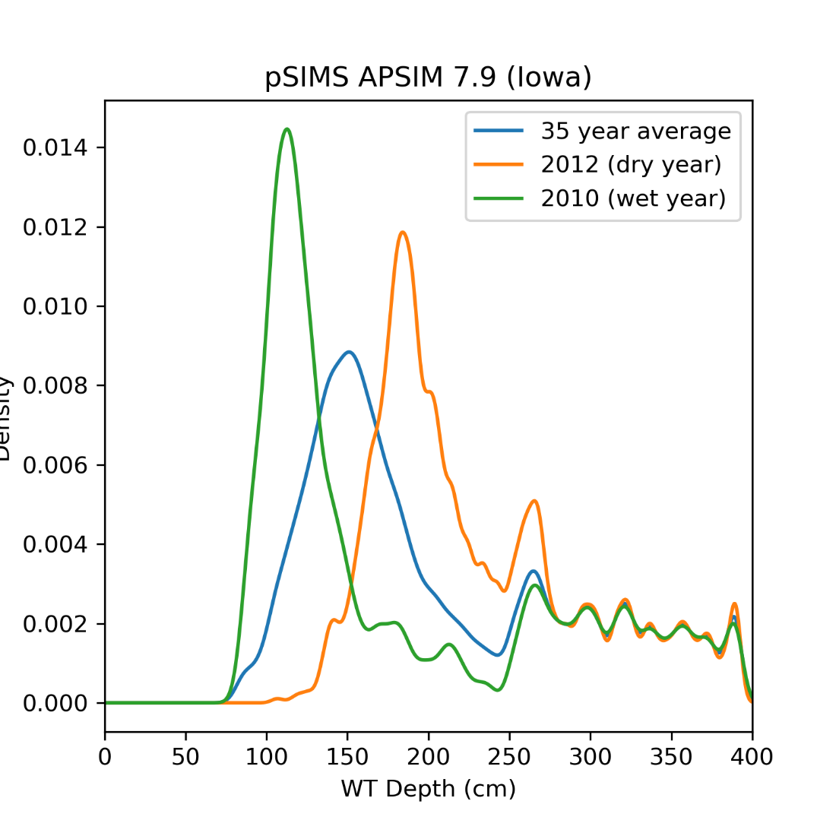
Simulated mean annual water table depth
Density
Annual average water table depth (cm)

Slide 12
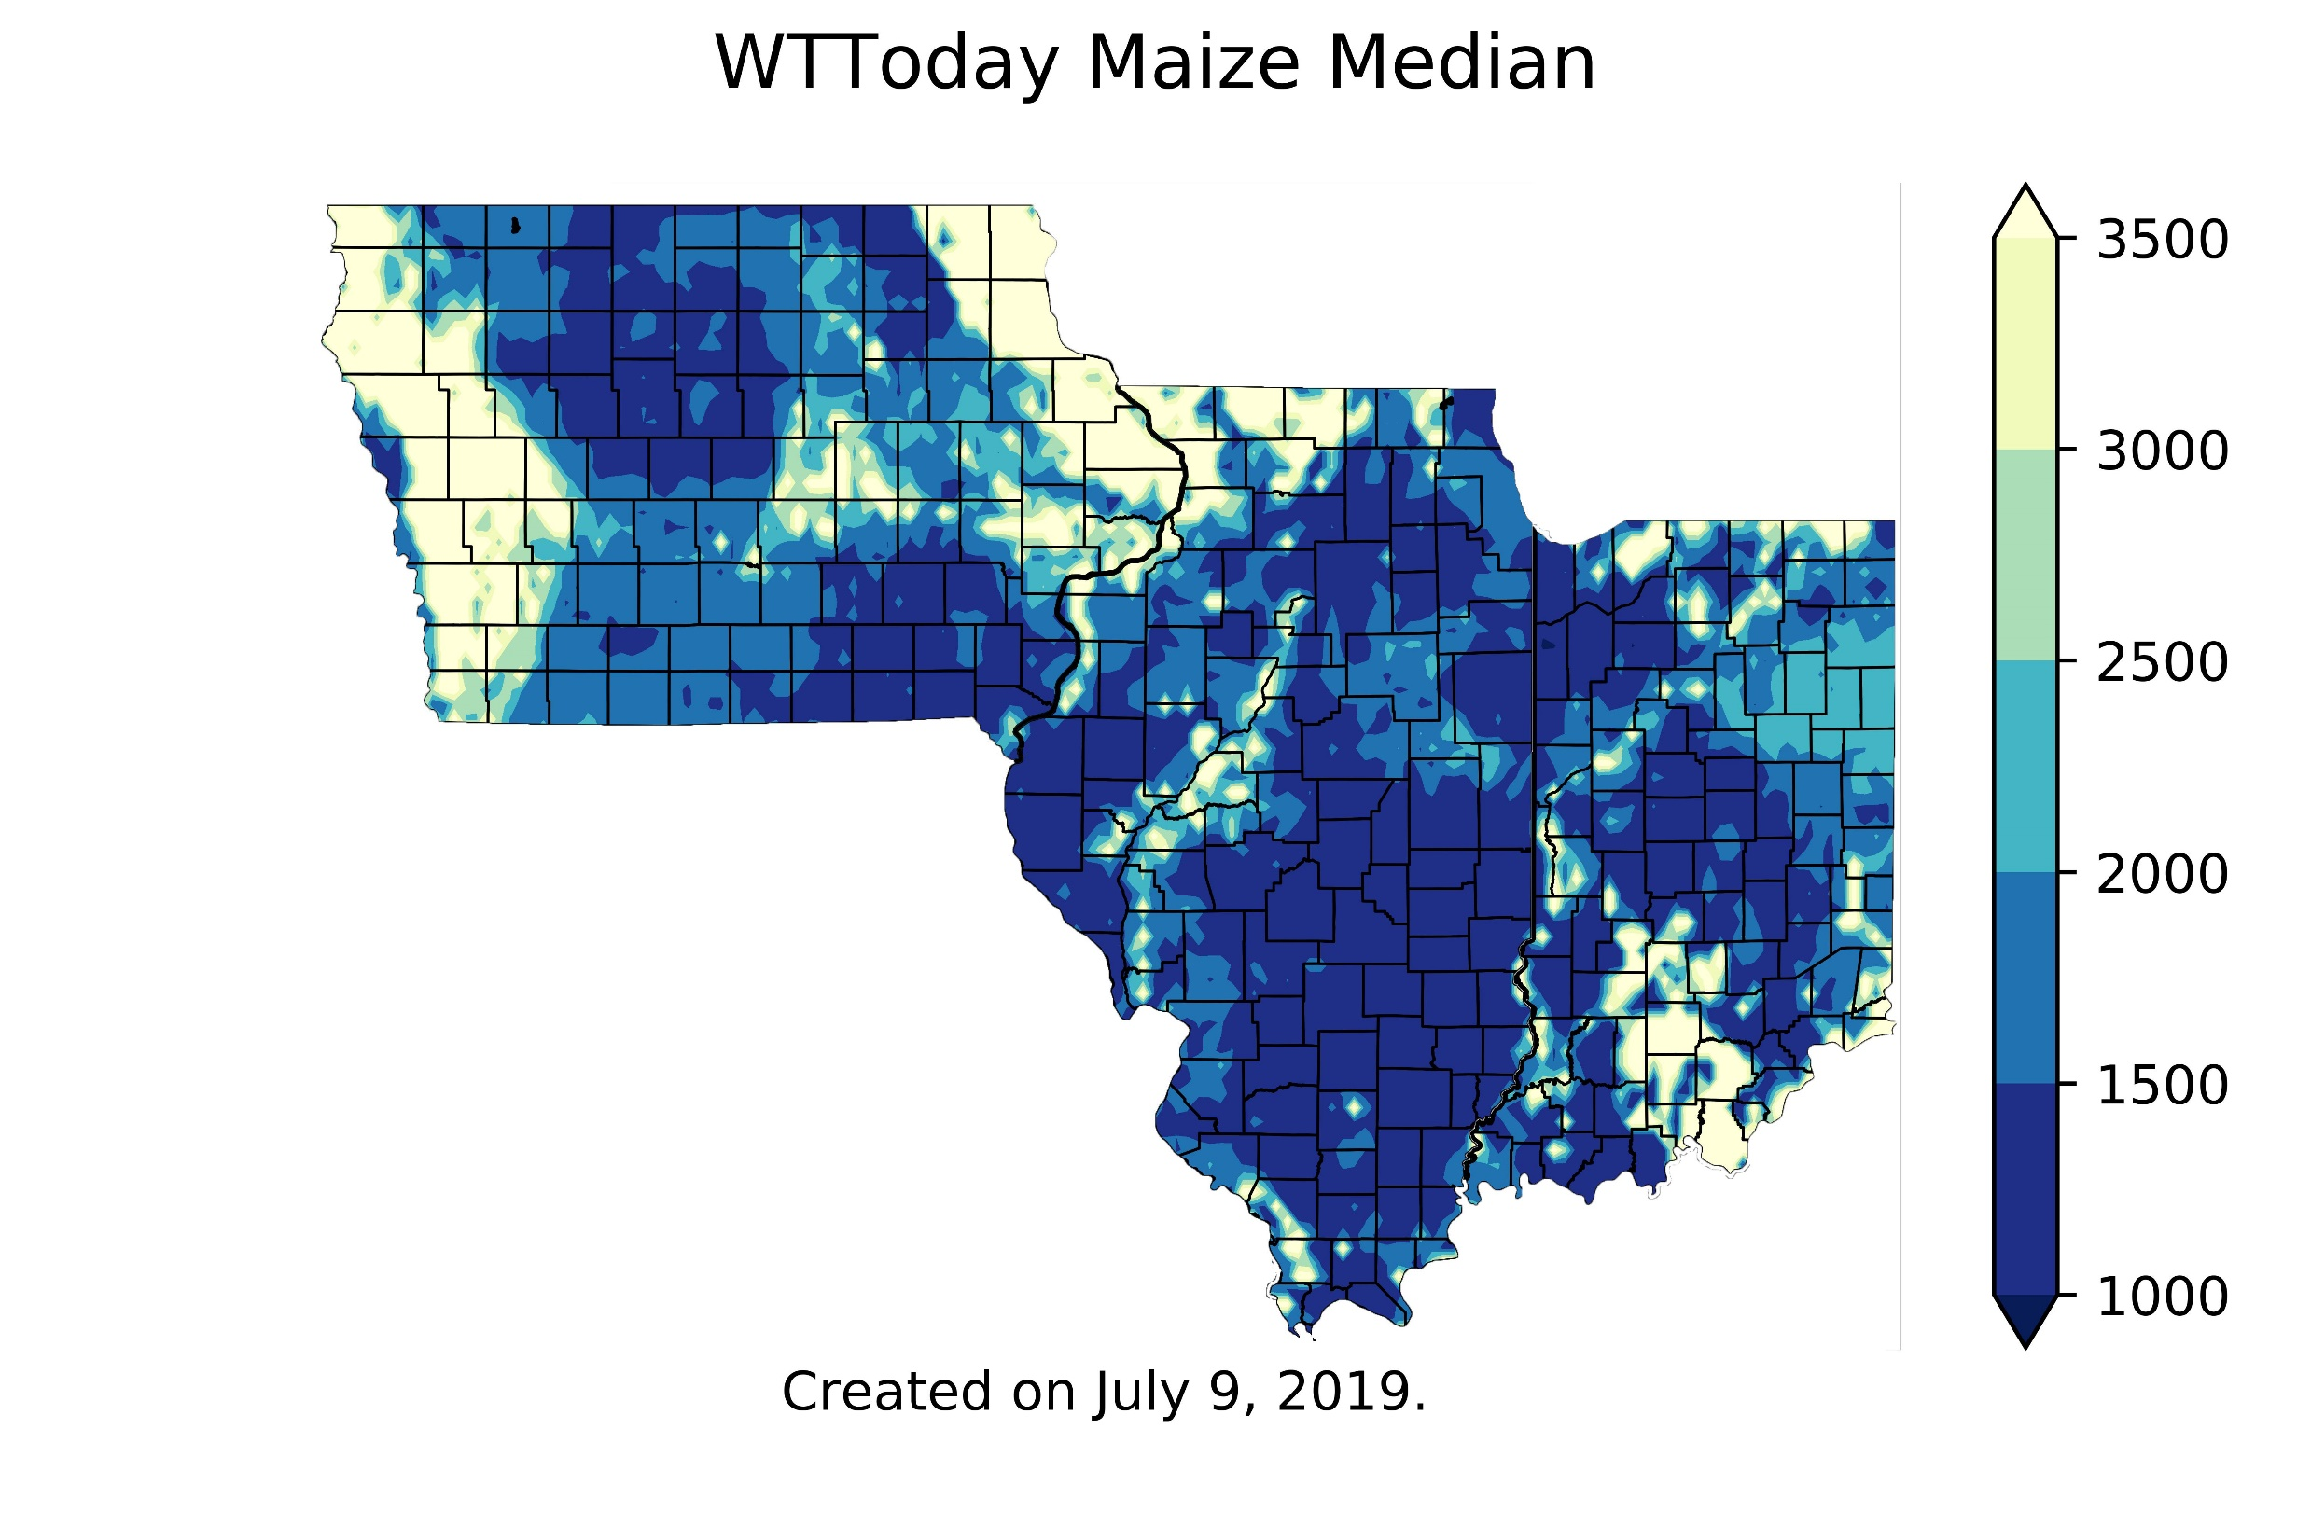
Simulated depth to the water table from soil surface (mm)
Iowa
(11’)
Illinois
Jul 09
2019
Indiana
The darker the color the shallower the water table
(3.2’)
https://crops.extension.iastate.edu/facts/

Slide 13
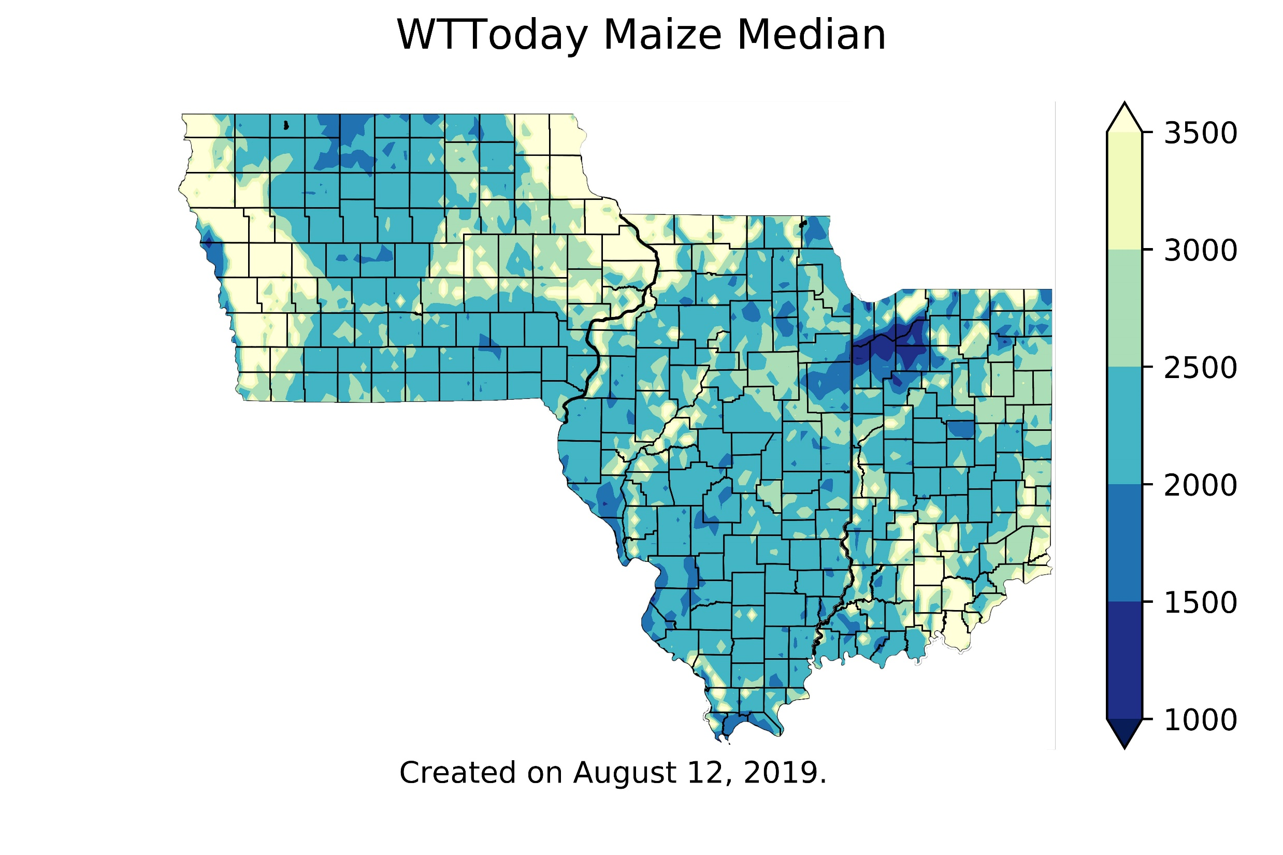
Simulated depth to the water table from soil surface (mm)
Iowa
(11’)
Illinois
Aug 12
2019
Indiana
(3.2’)
https://crops.extension.iastate.edu/facts/

Slide 14
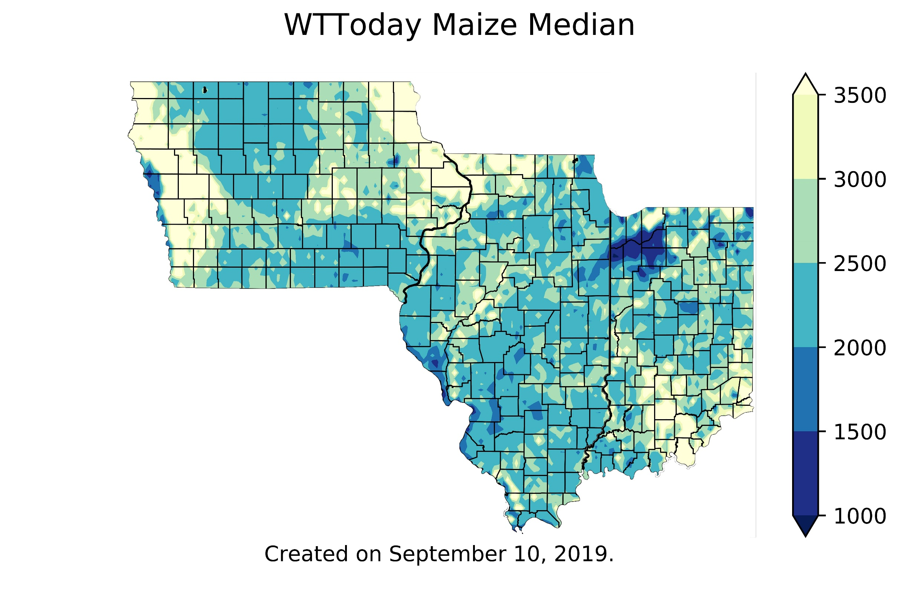
Simulated depth to the water table from soil surface (mm)
Iowa
(11’)
Illinois
Sep 10
2019
Indiana
(3.2’)
https://crops.extension.iastate.edu/facts/

Slide 15
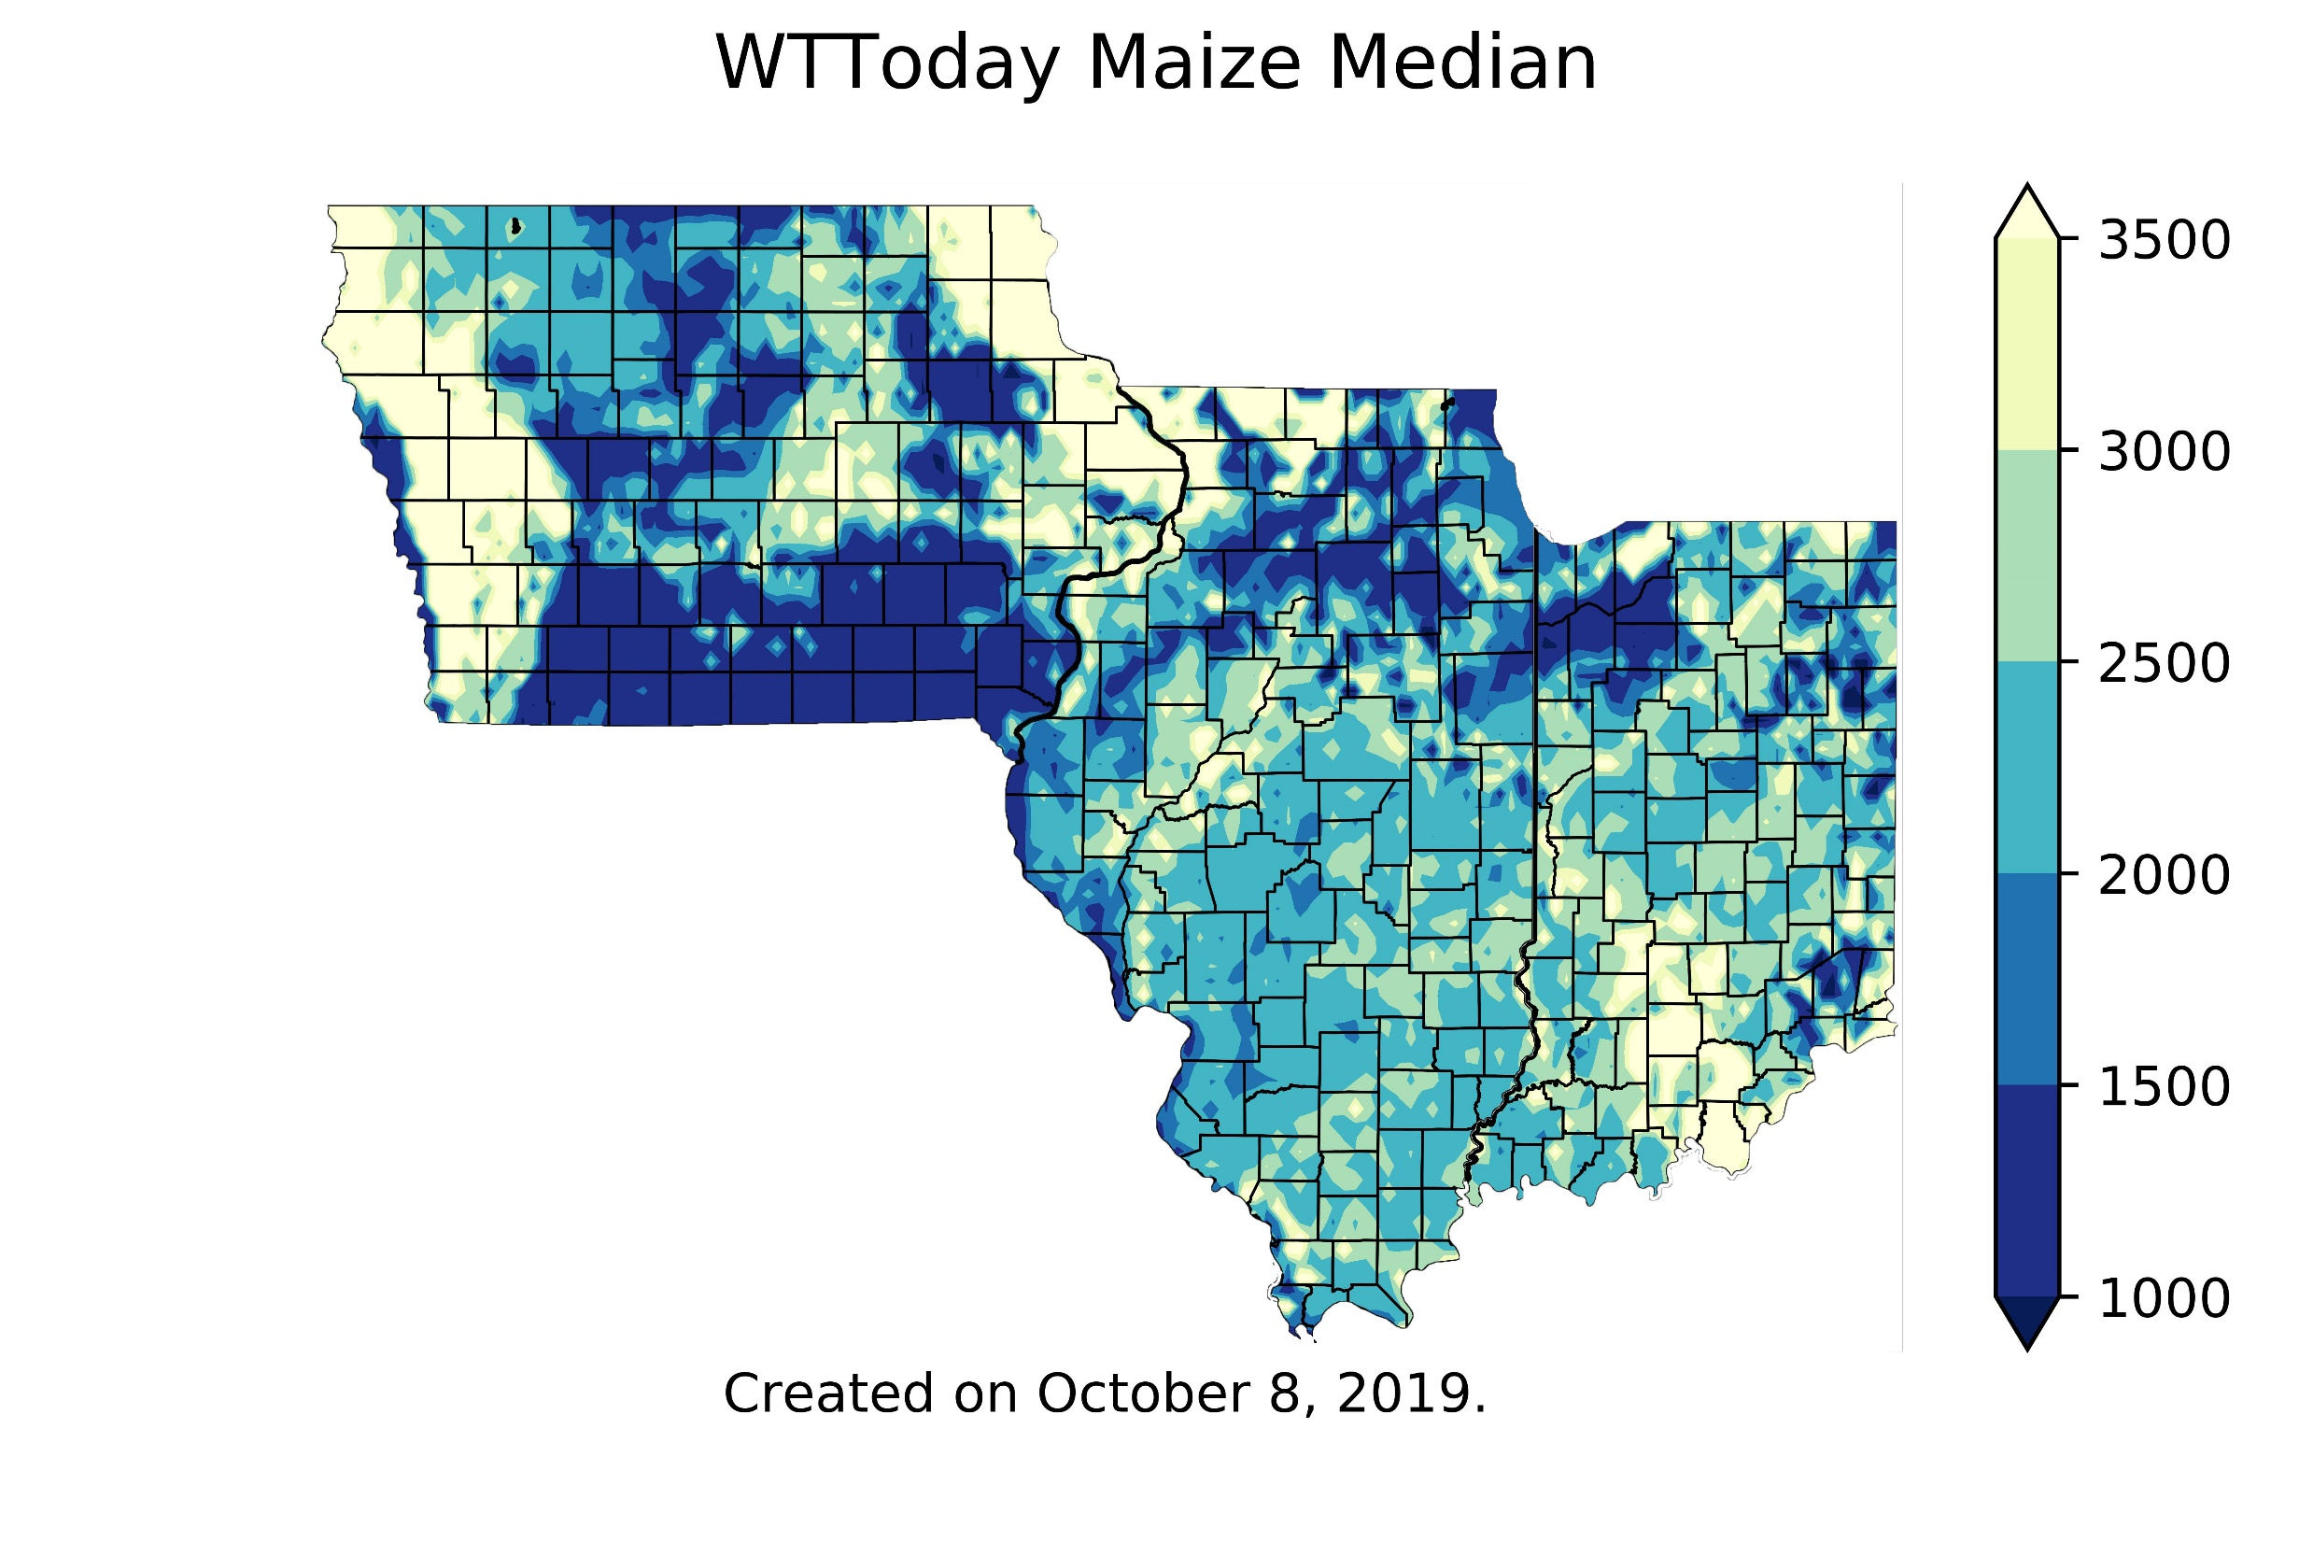
Simulated depth to the water table from soil surface (mm)
Iowa
(11’)
Illinois
Oct 08
2019
Indiana
(3.2’)
https://crops.extension.iastate.edu/facts/

Slide 16
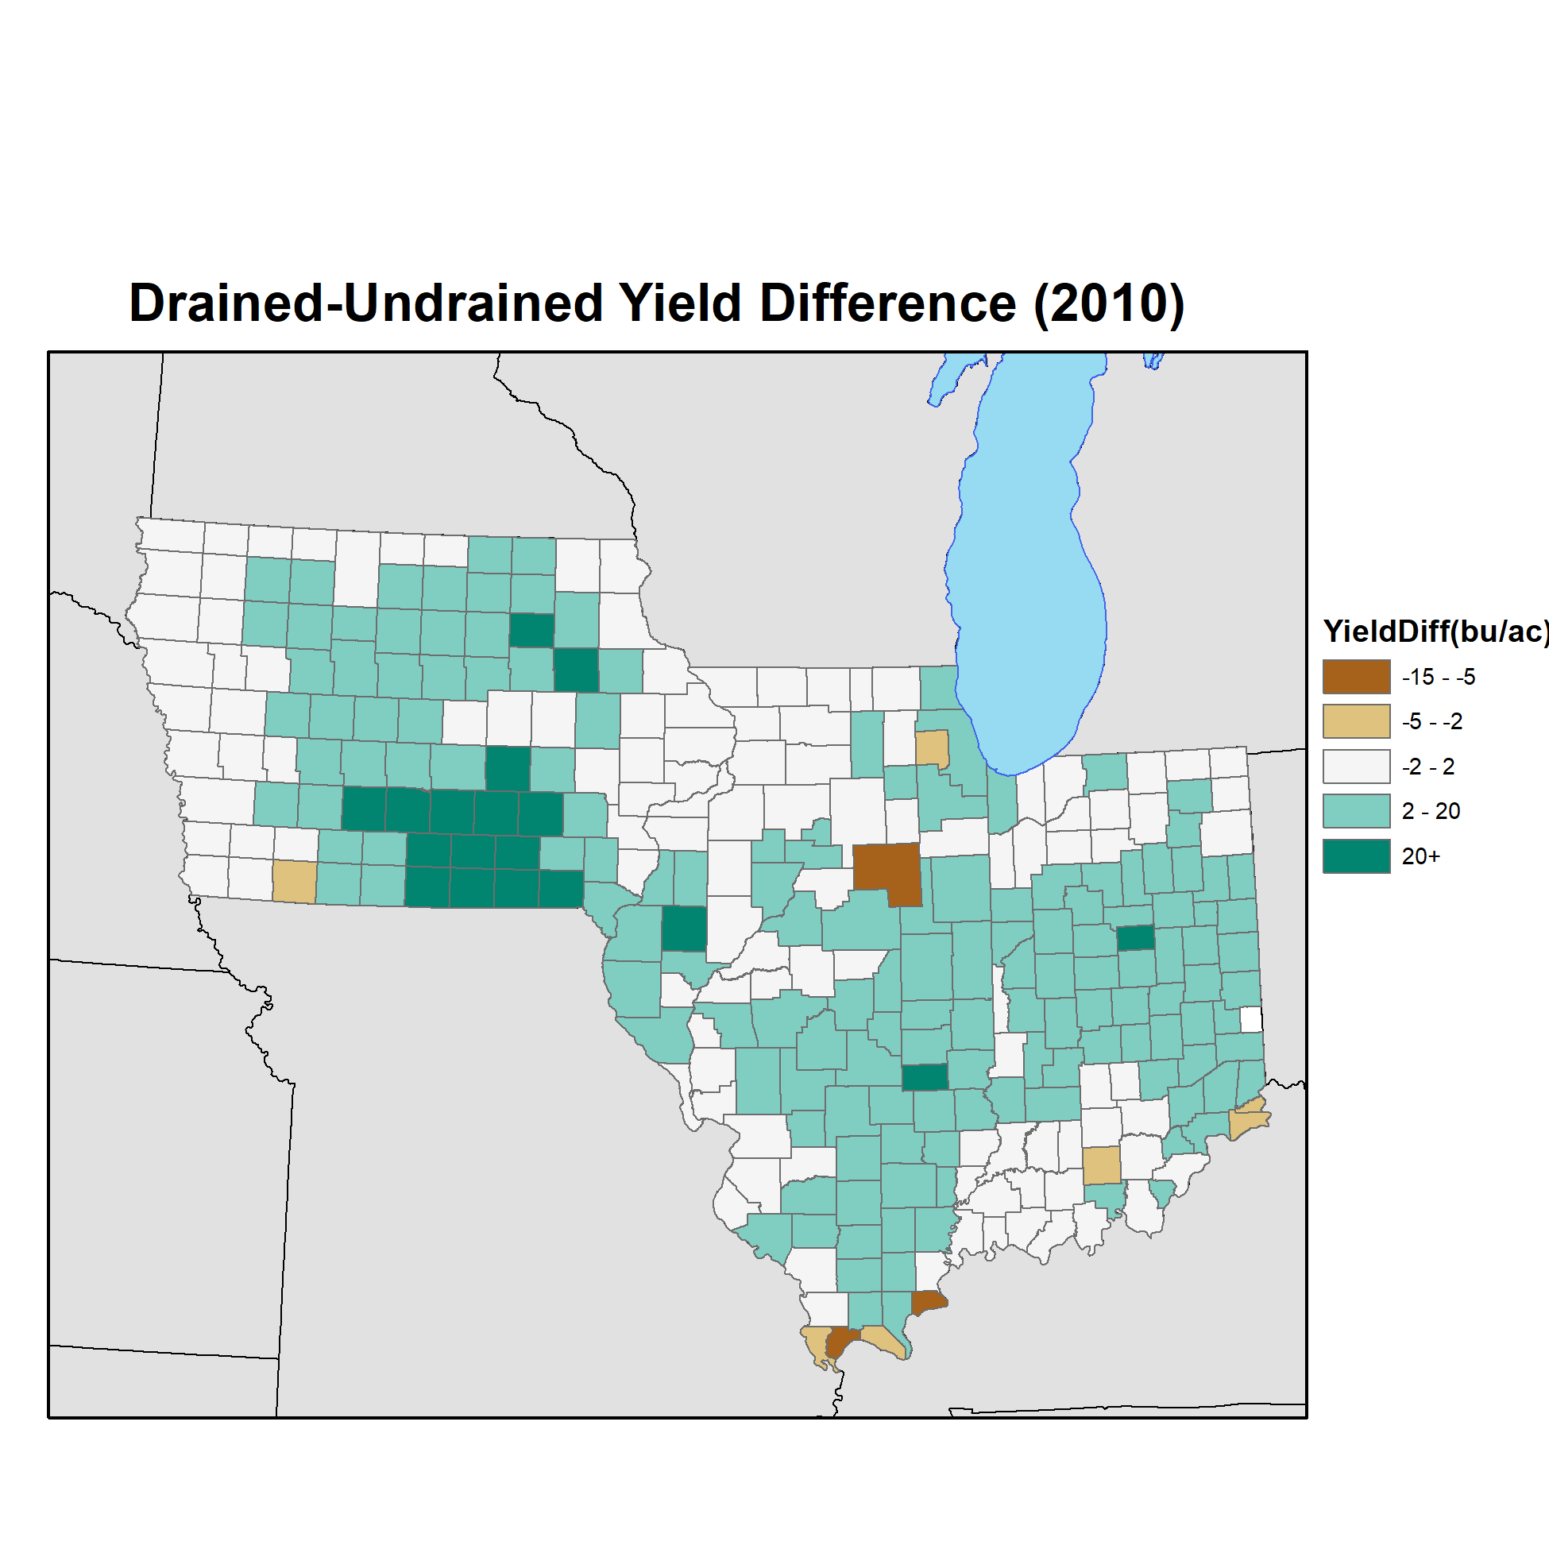
How can the developed system help with decision-making?
e.g. tile drainage impacts on corn yield
2010 wet year
Drain = 3.5’ depth x 65’ spacing
Undrain = 2.3’ depth x 110’ spacing
Work in progress
Archontoulis et al.

Slide 17

Concluding remarks
Large impacts (positive and negative) of water tables on production and environmental aspects
Think more and work towards dynamic solutions
Knowledge gaps:
Tiles in the landscape
Subsoil properties (> 5 feet)
Subsoil processes
Denitrification
SOM vs excess water
Rain
ET
Runoff
Subsurface drainage
Water table

Slide 18
