Slide 1
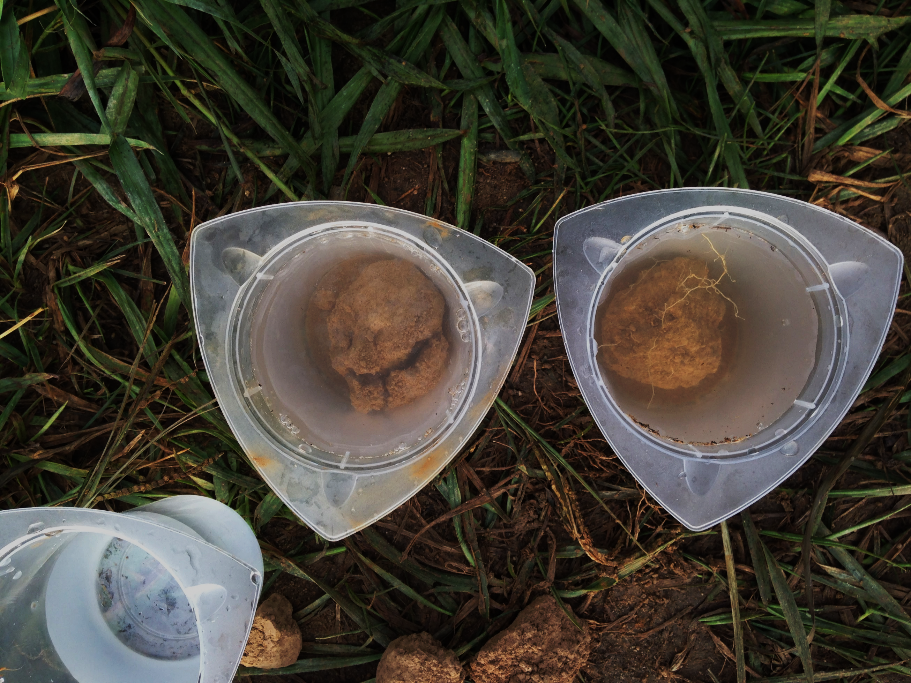
Hydrologic implications of using cover crops to build soil health
Ryan D. Stewart
School of Plant and Environmental Sciences
Virginia Tech
Image: Land O’Lakes, Inc.

Slide 2
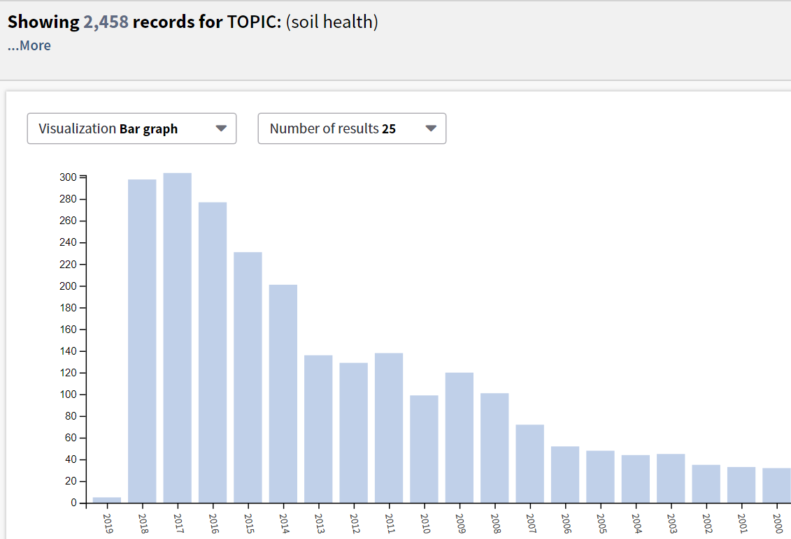
Soil Health
Source: Web of Science

Slide 3
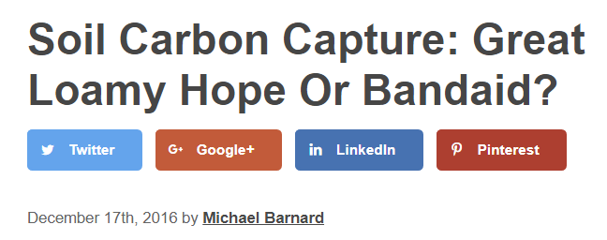
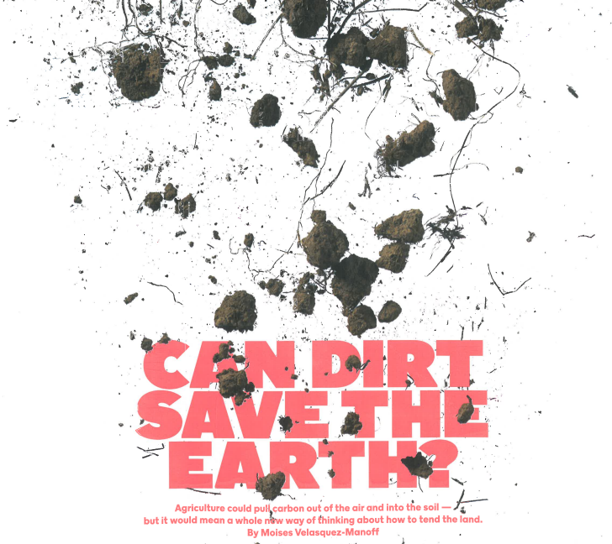
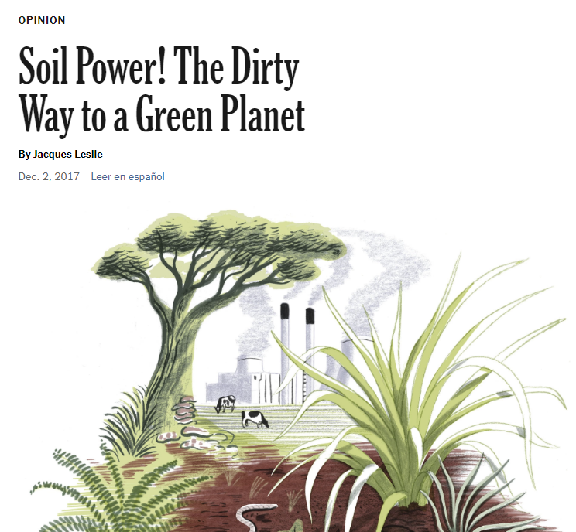

Slide 4
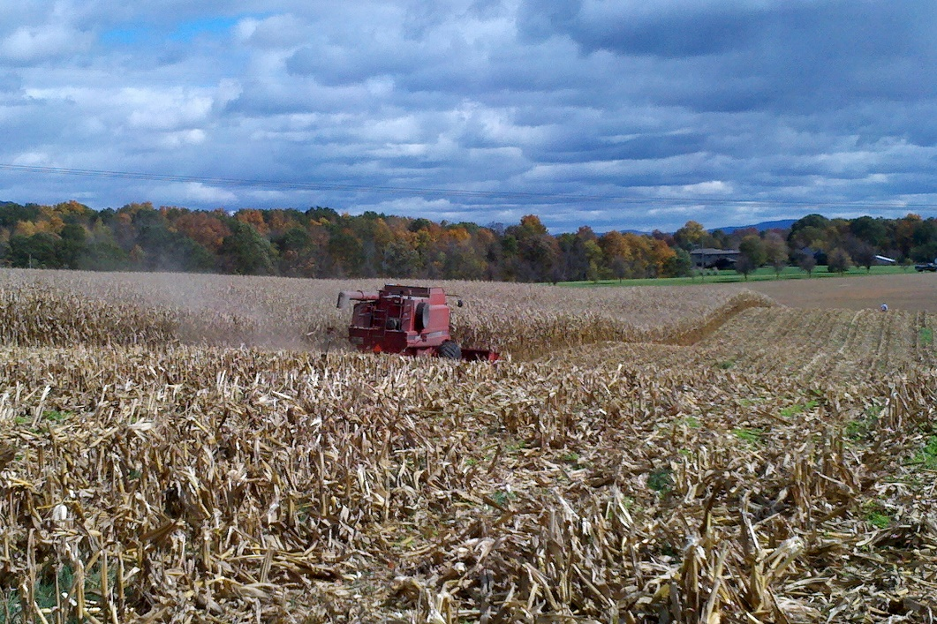
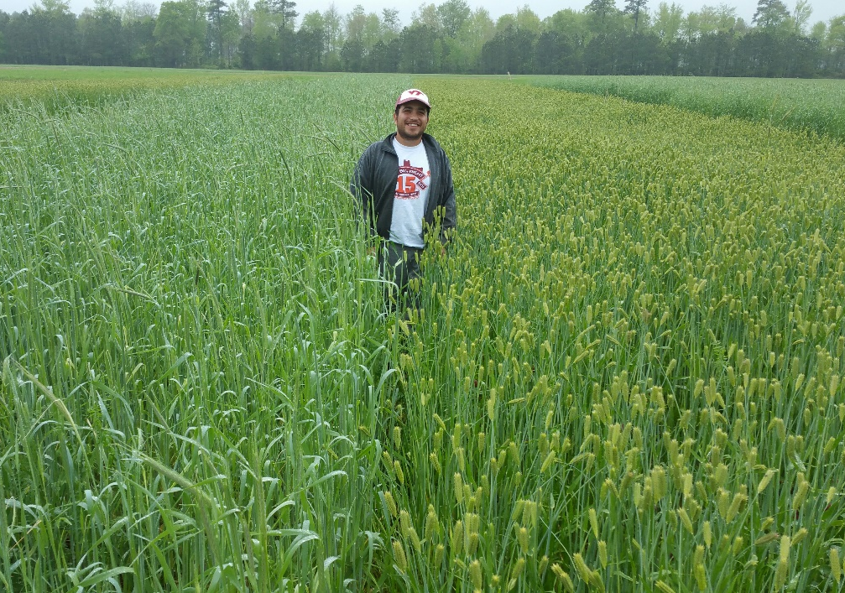
Soil Health Management Practices
Reduced tillage
Cover crops
Notes:
Soil tillage intensity rating – conservation tillage mulch tillage- no greater than 60
No-till ~15, strip till ~30
Cover crop benefits – 60% cover, biomass – 2700 lb/acre

Slide 5
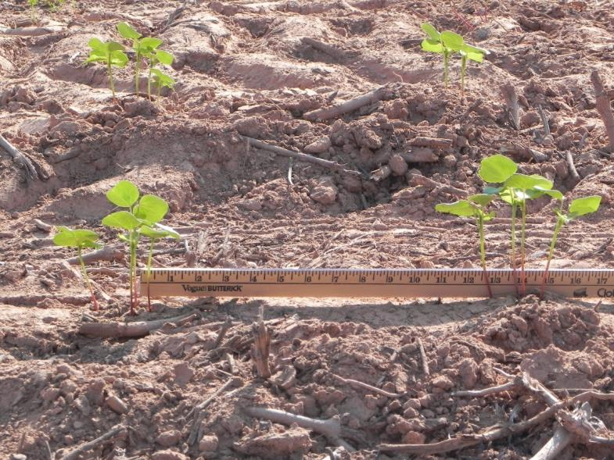
Can We Measure Soil Health?
Quantify
Source: Sarah Peterman
Source: Gemplers.com

Slide 6
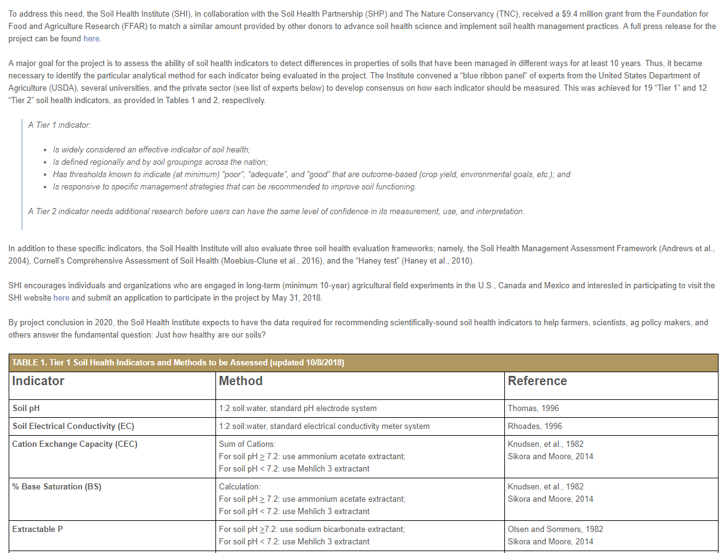
A Tier 1 indicator:
Is widely considered an effective indicator of soil health;
Is defined regionally and by soil groupings across the nation;
Has thresholds known to indicate (at minimum) “poor”, “adequate”, and “good” that are outcome-based (crop yield, environmental goals, etc.); and
Is responsive to specific management strategies that can be recommended to improve soil functioning.

Slide 7
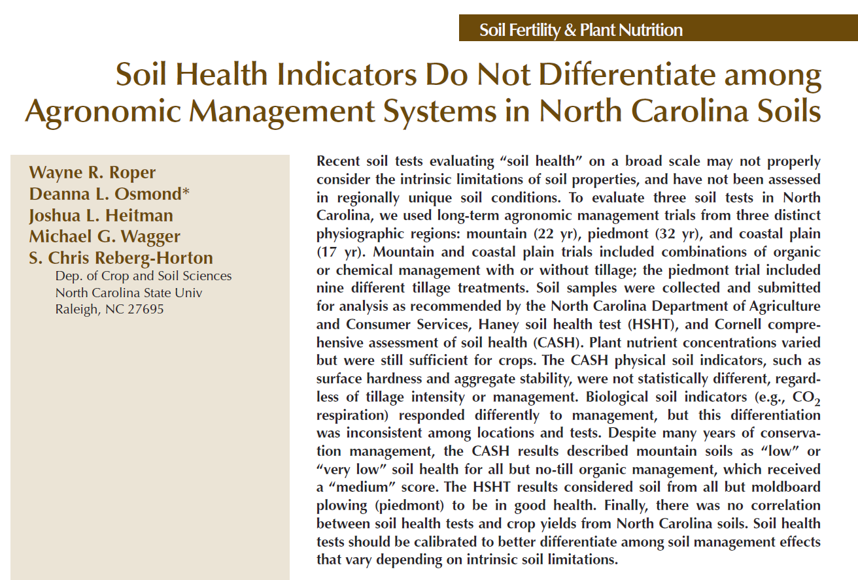
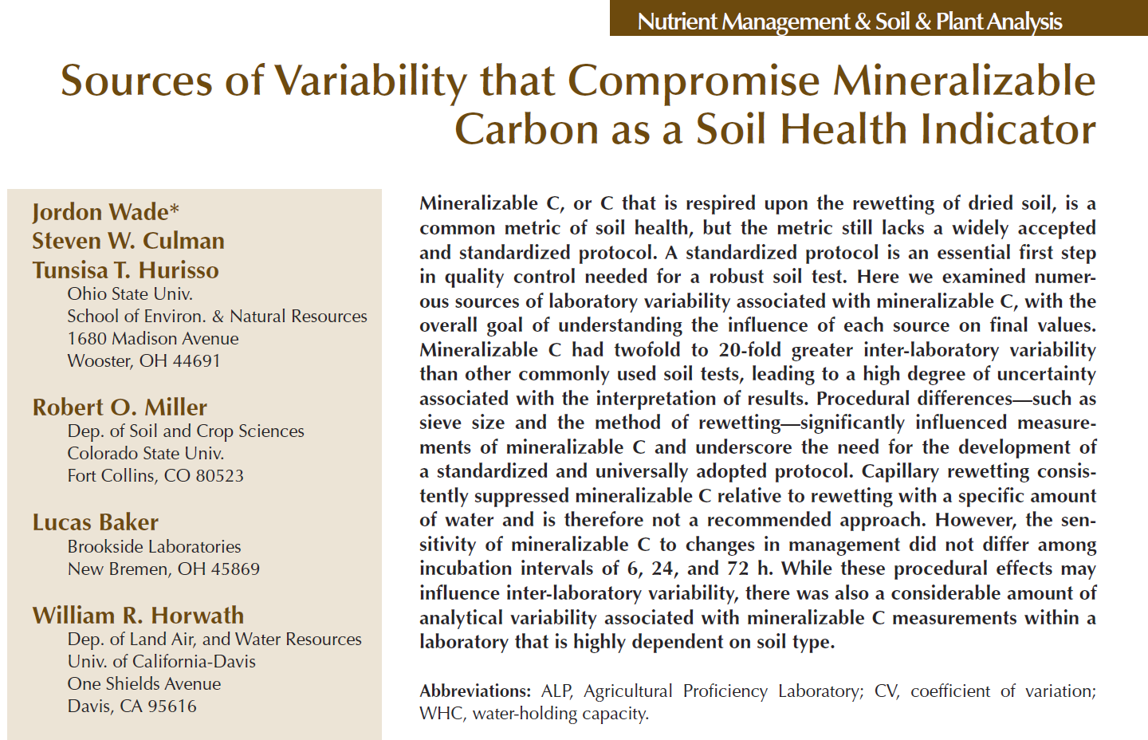
Soil Health
Mineralizable C had twofold to 20-fold greater inter-laboratory variability than other commonly used soil tests…
physical soil indicators… were not statistically different, regardless of tillage intensity or management
Biological soil indicators… differentiation
was inconsistent among locations and tests
Indicators
…also a considerable amount of analytical variability associated with mineralizable C measurements within a laboratory…
there was no correlation between soil health tests and crop yields from North Carolina soils
Source: iStockphoto

Slide 8
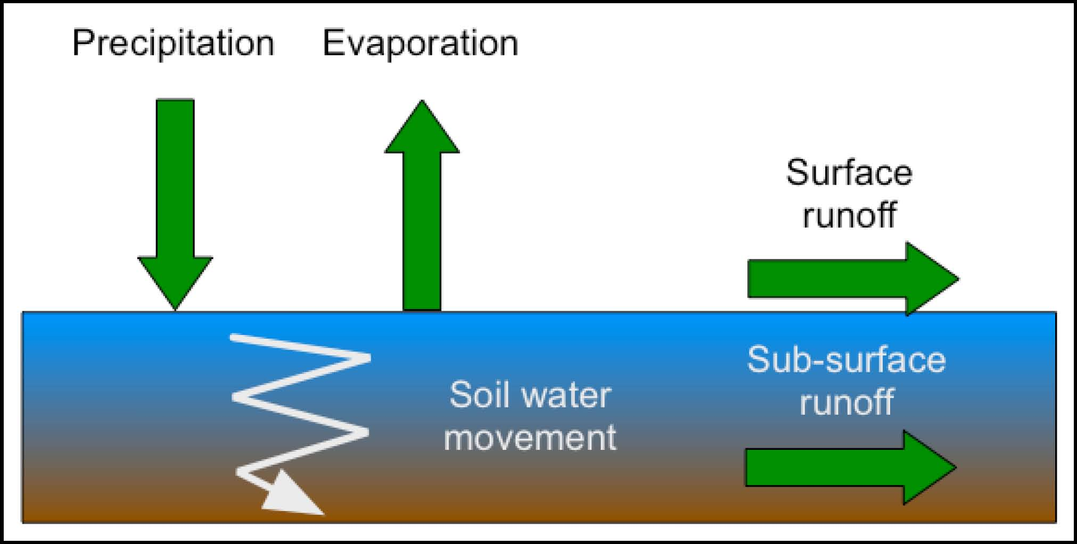
Water Balance
ucar.edu

Slide 9
Objectives
Using meta-analysis, identify soil health indicators that respond to cover crops over 1-3 year periods
Quantify how cover cropping affects the soil water balance across studies
Assess whether water table depth influences soil health response to cover cropping

Slide 10
Meta-Analyses
Soil Texture
Jian et al. (2020). Soil Biology & Biochemistry (in revision).
SoilHealthDB
Data compiled from 350+ sites
Currently 5,900 rows of data

Slide 11
Soil Health Indicators
Soil Health Institute
#1: Texture
#2: Soil carbon
#3: Bulk Density
7/42 indicators reported > 25%
Stewart et al. (2018). Agricultural & Environmental Letters. doi:10.2134/ael2018.06.0033

Slide 12
Dynamic Soil Health Indicators
Response Ratio:
R_{r} = ln[cover crop/control]
Considered dynamic if |R_{r}| ≥ 0.1 after 1-3 yrs
13/42
indicators
11/42
indicators
Stewart et al. (2018). Agricultural & Environmental Letters. doi:10.2134/ael2018.06.0033

Slide 13
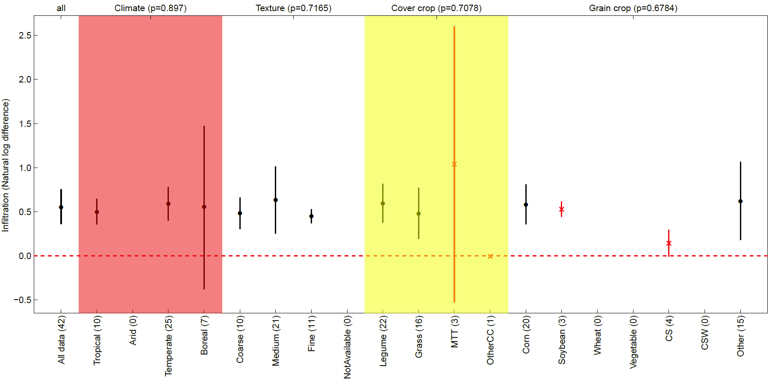
Water Balance Terms
Infiltration rates (n = 42) increase with cover cropping
Climate
Texture
Cover Crop
Crop Rotation

Slide 14
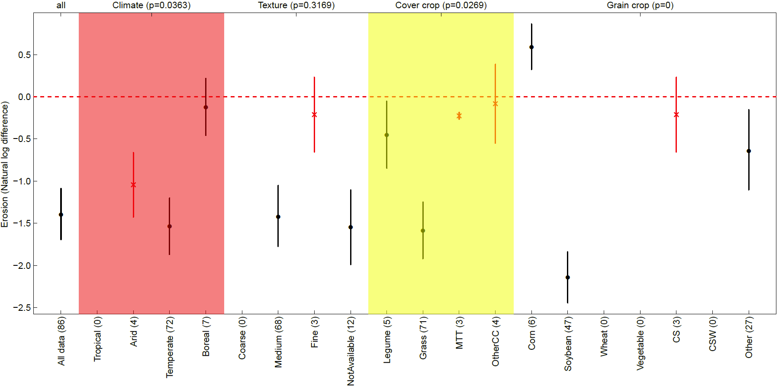
Water Balance Terms
Surface runoff (n = 122) and Erosion (n = 86)
decrease with cover cropping
Climate
Texture
Cover Crop
Crop Rotation

Slide 15
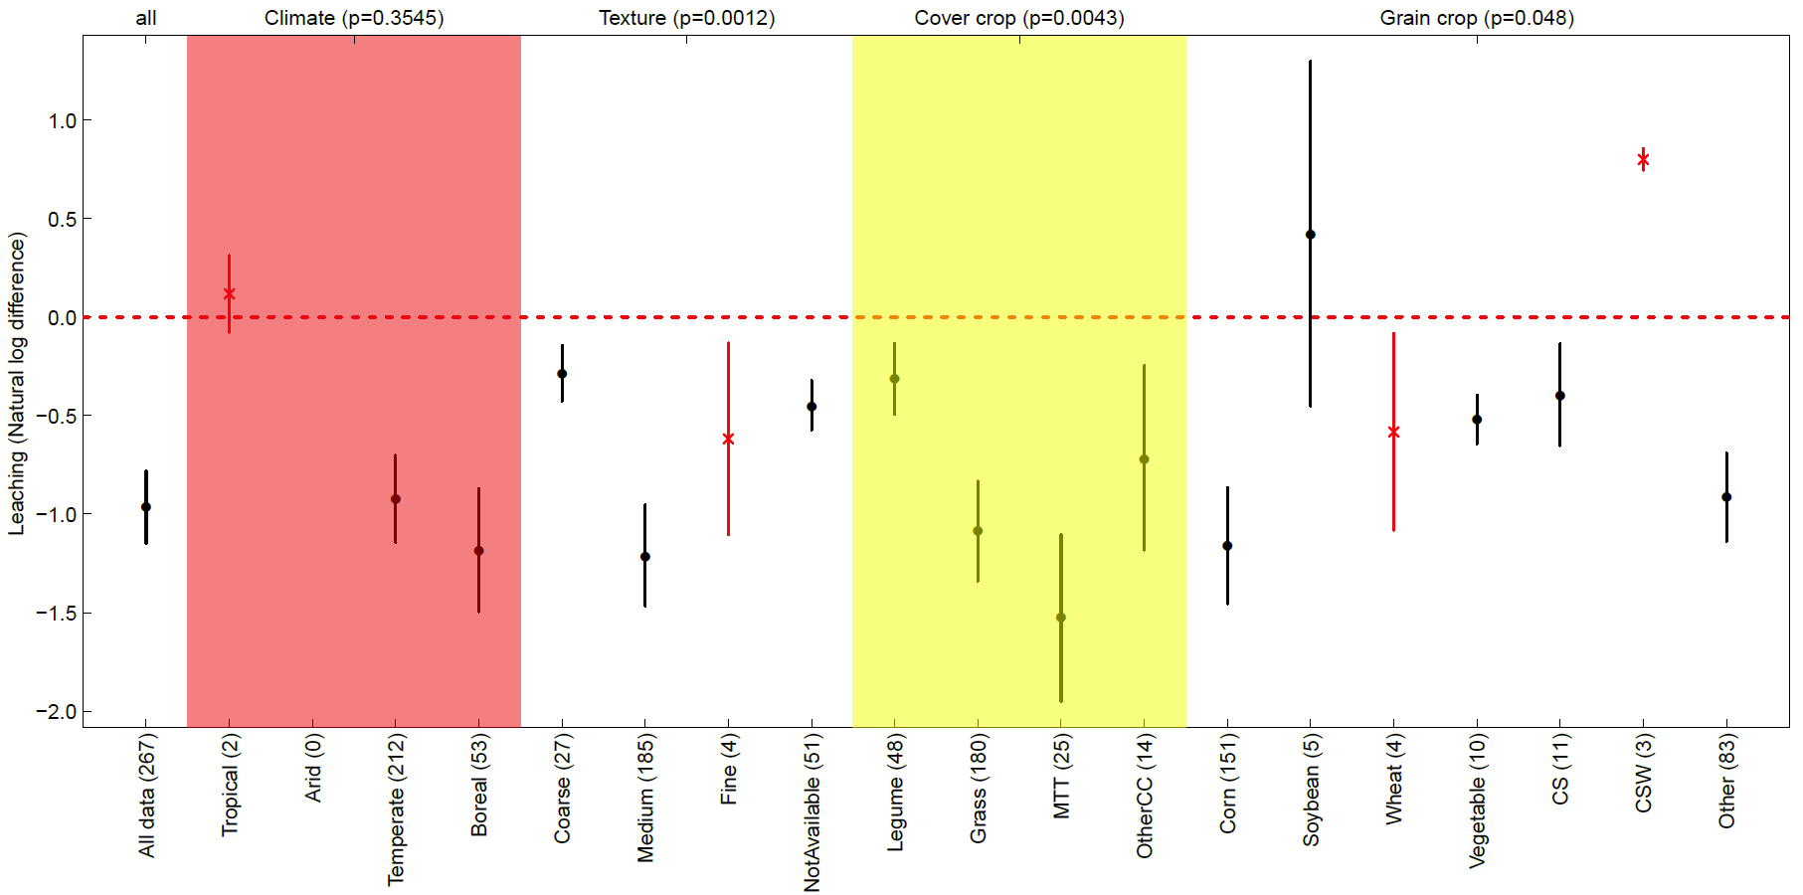
Water Balance Terms
Subsurface leaching (n = 267) decreases with cover cropping
Climate
Texture
Cover Crop
Crop Rotation

Slide 16
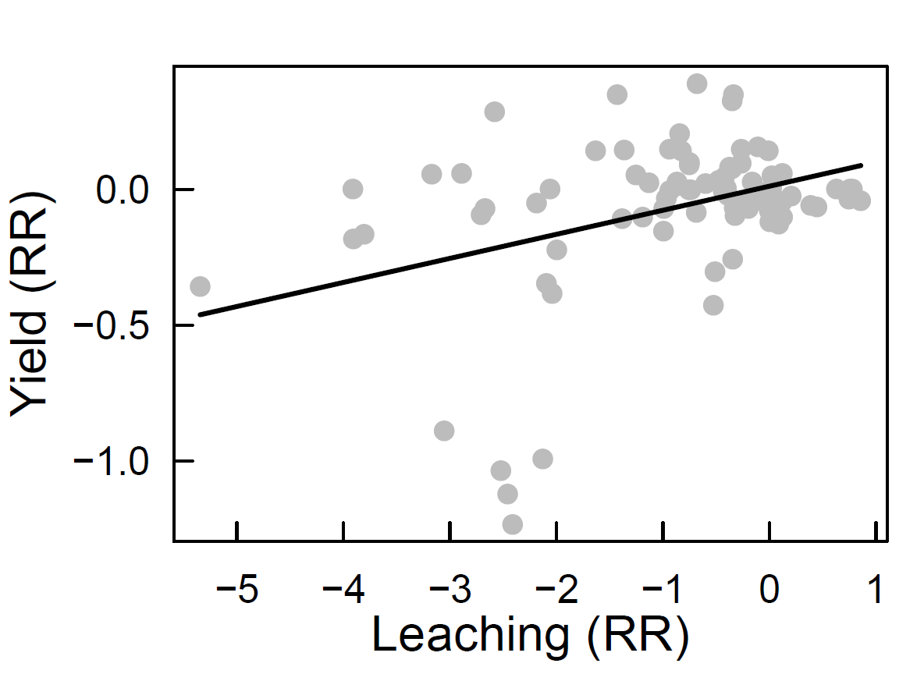
Leaching correlations

Slide 17
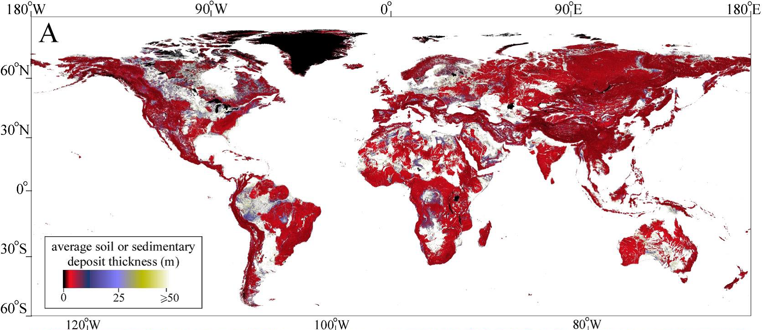
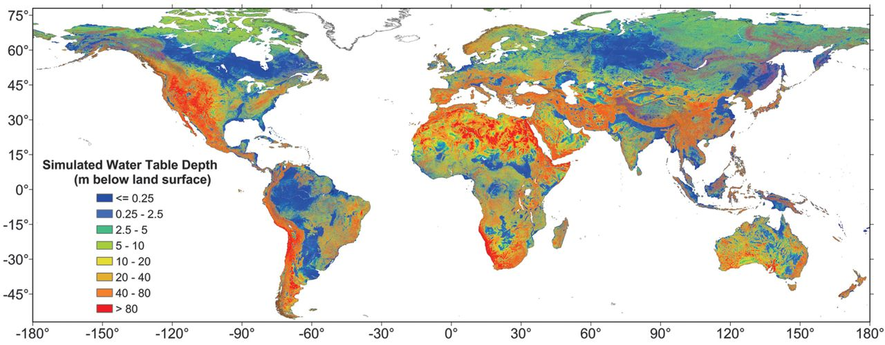
What about water table depth?
Pelletier et al., (2016)
Fan et al., (2013)

Slide 18
What about water table depth?

Slide 19
Conclusions
Numerous methods to measure soil health, yet no clear baselines
To be most useful, we need to develop relative context
Cropping systems, soil type, climate
Cover cropping can affect nearly all terms in the water balance
Infiltration ↑ , surface runoff & leaching ↓
ET and/or soil water storage ↑ ?
Water table depth may have limited effect on soil responses to cover cropping
Global-scale analysis overlooks nuances and site-specifics

Slide 20
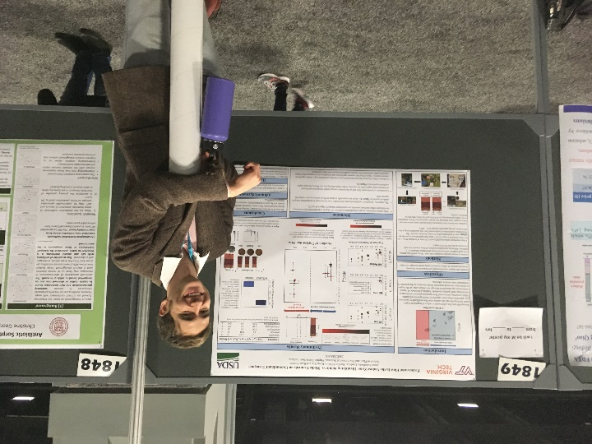
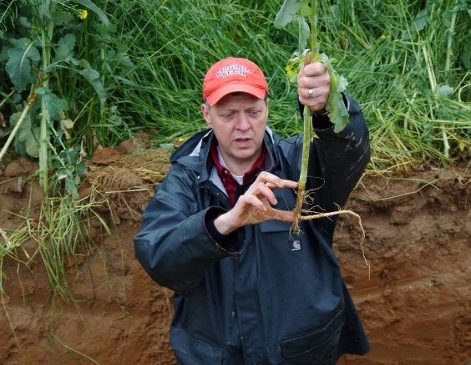
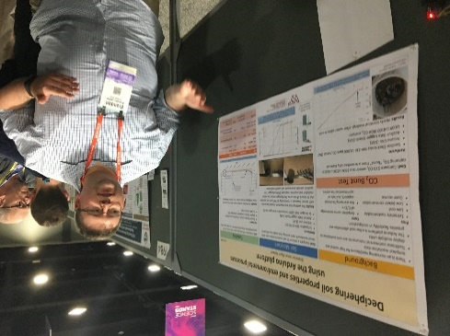
Collaborators
Dr. Jinshi Jian
Dr. Jesse Radolinski
Dr. Ayush Gyawali
Dr. Jingjing Chen
Dr. Brian Badgley
Dr. Mike Strickland
Dr. Mark Reiter
Dr. Wade Thomason
Mr. Brandon Lester

Slide 21
Acknowledgments
Virginia Agricultural Experiment Station
USDA Hatch Program
USDA NRCS Conservation Innovation Grant #69-3A75-14-260
Contact Info:
rds@vt.edu
@CriticalZoneLab

Slide 22
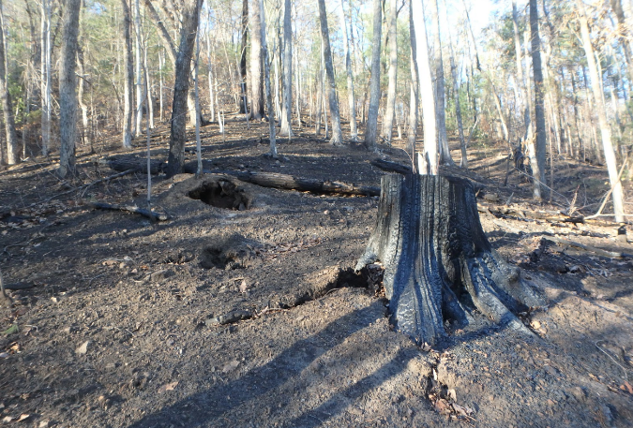
Conclusions
Wildfires appear to have substantial hydrologic effect in the Southeastern region
It is not yet clear how long these effects will persist
Overland flow, erosion and sediment movement may all increase, but linkages are not yet fully understood

Slide 23
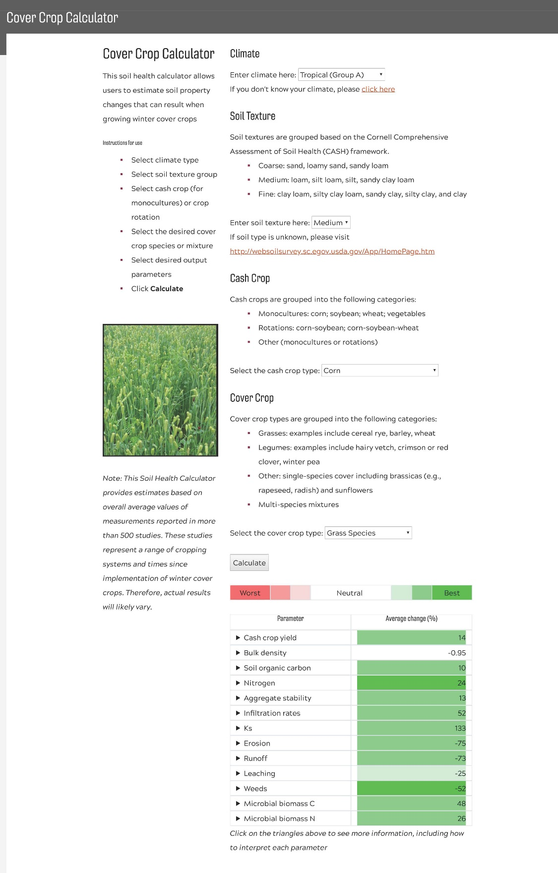
Translating Results
Jian et al. (2020). Soil & Tillage Research (in press).
https://soilhealth.spes.vt.edu/CoverCropCalculator.html

Slide 24
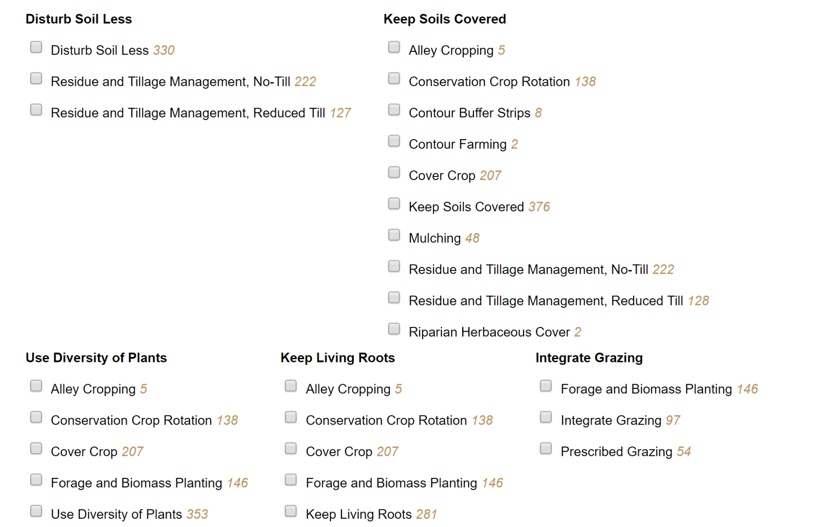
Study methods
Soil Health Institute: Research Landscape Tool
Cover crops: 86 peer-reviewed studies
No-Till: 106 peer-reviewed studies
Source: Sarah Peterman
http://www.soilhealthinstituteresearch.org/Home/Search#

Slide 25
Study locations
Stewart et al. (2018). Agricultural & Environmental Letters. doi:10.2134/ael2018.06.0033

Slide 26
Mean number of indicators reported:
1970 - 2015
Stewart et al. (2018). Agricultural & Environmental Letters. doi:10.2134/ael2018.06.0033

Slide 27
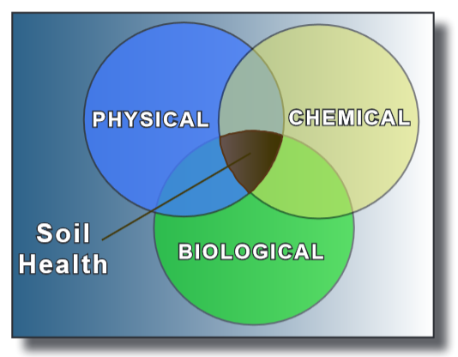
What is Soil Health?
…the maintenance of soil ecology and properties aimed at sustaining plants, animals, and humans (NRCS, 2018)
…reflects optimized physical, chemical, and biological soil properties
…may be associated with:
Improved farm productivity
Greater sustainability & environmental quality
Source: Cornell Soil Health Team

Slide 28
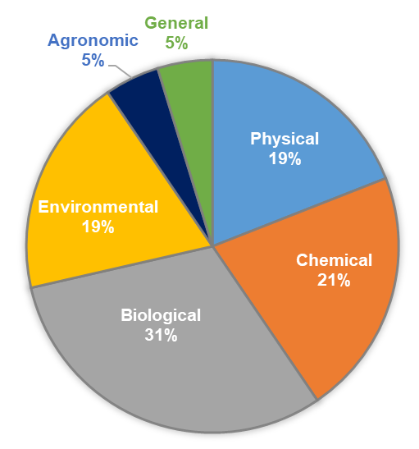
Soil Health Indicators
42 indicators in total, divided between:
Physical (e.g., infiltration)
Chemical (e.g., soil N)
Biological (e.g., CO₂ burst)
Environmental (e.g., N₂O fluxes; soil water content)
Agronomic (e.g., yield)
General (e.g., soil quality indicators)

Slide 29
Dynamic Soil Health Indicators
Response Ratio:
R_{r} = ln[cover crop/control]
Considered dynamic if |R_{r}| ≥ 0.1 after 1-3 yrs
13/42
indicators
11/42
indicators
Stewart et al. (2018). Agricultural & Environmental Letters. doi:10.2134/ael2018.06.0033

Slide 30
What is Soil Health?

Slide 31
Results
Number of studies per year:
1970 - 2015
Average number of indicators reported in all studies from a given year:
Stewart et al. (2018). Agricultural & Environmental Letters. doi:10.2134/ael2018.06.0033

Slide 32
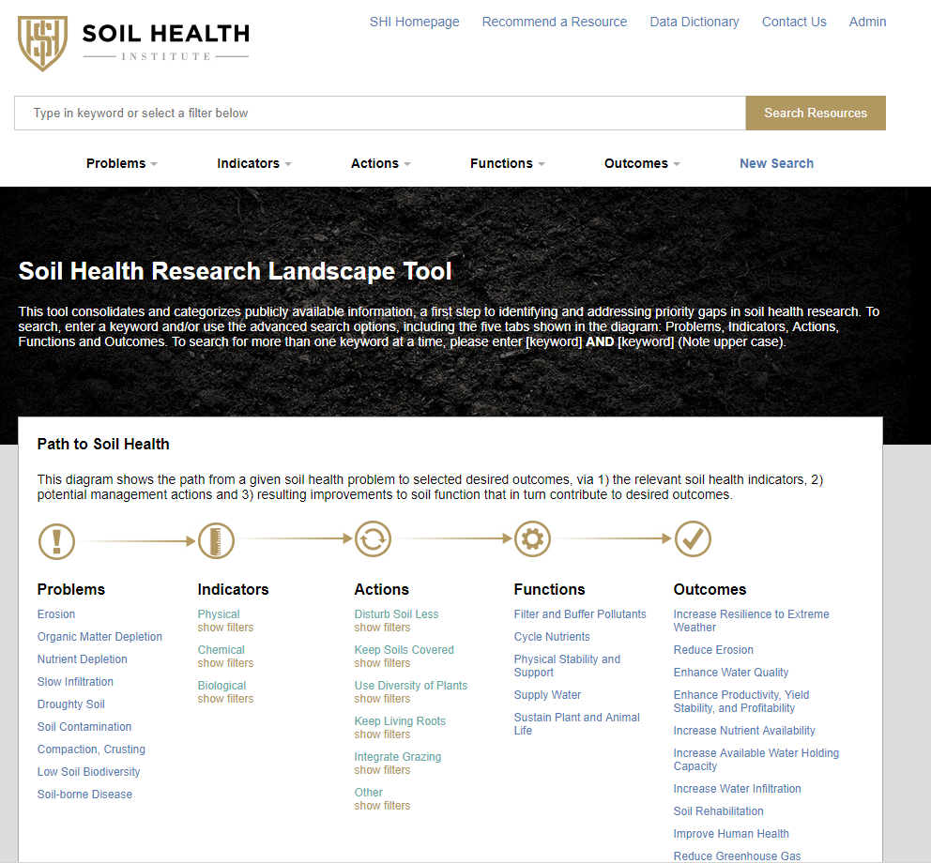

Slide 33
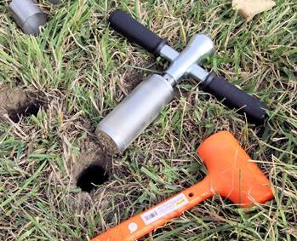
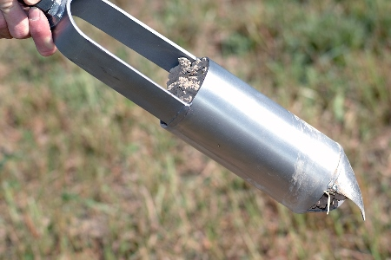
Soil Sampling Characteristics
AMS-samplers.com
Stewart et al. (2018). Agricultural & Environmental Letters. doi:10.2134/ael2018.06.0033

Slide 34
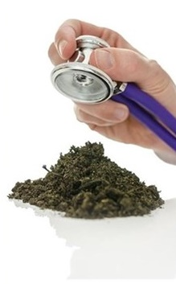
Looking Forward
The soil health community should:
Continue pursuing dynamic indicators that respond to management practices
Consider soil health in absolute AND relative terms
3) Develop indicator baselines
4) Standardize sampling protocols
5) Develop a common framework for information sharing to ensure:
Reproducible outcomes
Accessible results
Reporting of all data
mozgokratia.ru
www.cafepress.com/

Slide 35
Carbon Uptake Rate
where SOC_{CC} and SOC_{NC} are the respective soil carbon stocks under cover crops and no cover controls, and y is the time after cover crop implementation
C_{rate} = (SOC_{CC} – SOC_{NC})/y
Bootstrap resampling
Jian et al. (2020). Soil Biology & Biochemistry (in revision).

Slide 36
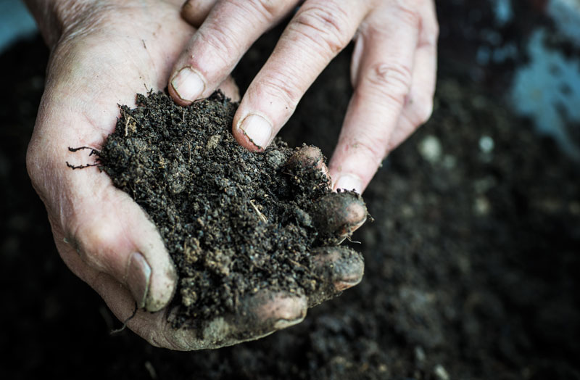
Potential Carbon Sequestration
C_{sequestration} = C_{rate} x A x f
where A represents the global cropland area, and f is the proportion of cropland being managed with cover crops.
Jian et al. (2020). Soil Biology & Biochemistry (in revision).

