Slide 1
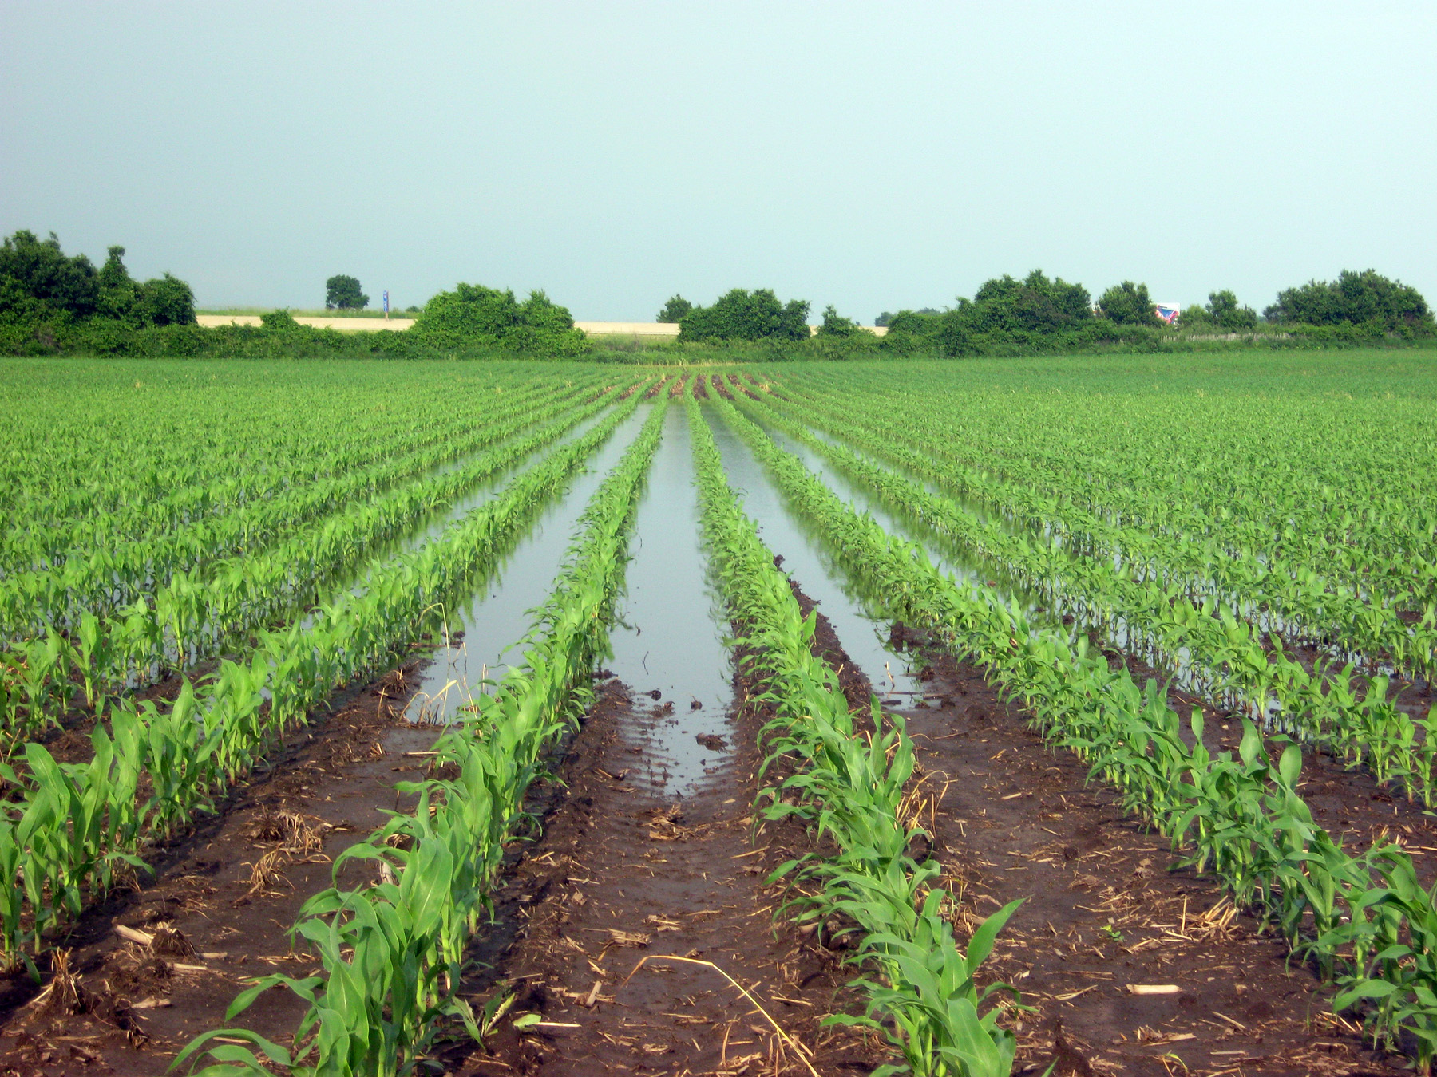
Crop yield response to water table depth,
soil texture, and weather variability
Sam Zipper, Kansas Geological Survey
samzipper@ku.edu
samzipper.com
@ZipperSam

Slide 2
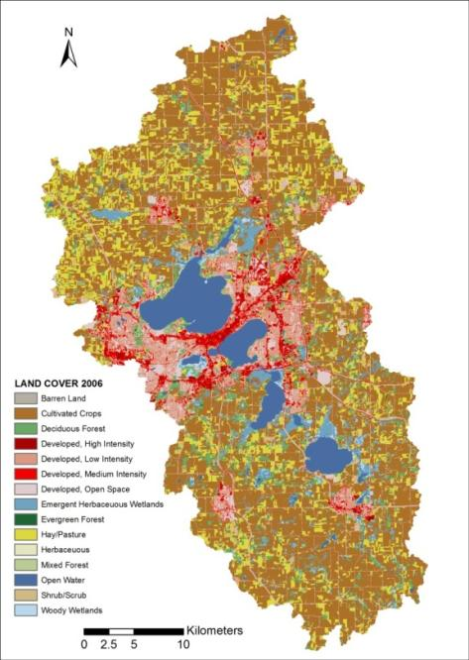
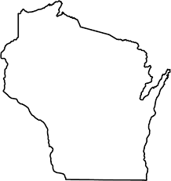
Groundwater impacts on ecosystem services
Yahara River Watershed, WI
A multifunctional landscape
Food production
Agricultural watershed
with expanding
urban core
Pasture production
Freshwater supply
Microcosm for agricultural areas worldwide
Flood regulation
Groundwater quality
Surface water quality
Soil retention
Carbon sequestration
Complex relationships between groundwater and ecosystem services
Zipper et al., 2015; Booth et al., 2016; Qiu et al., 2019

Slide 3
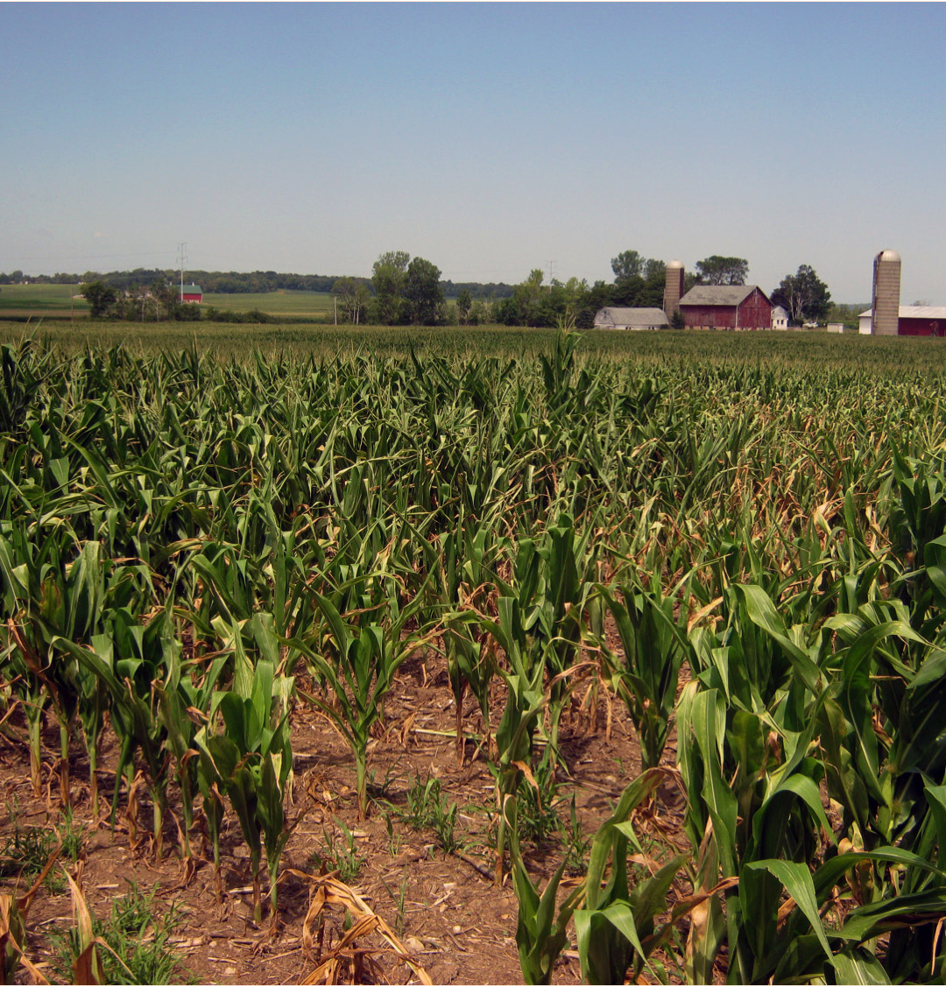
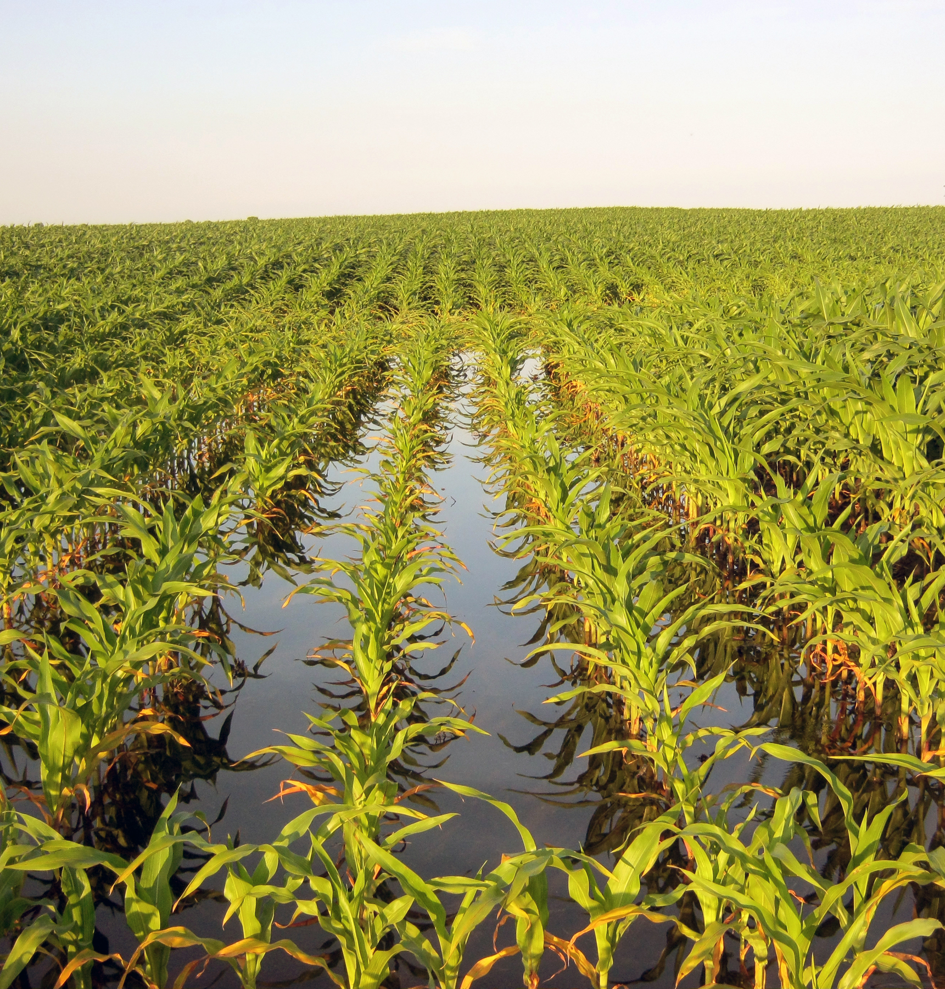
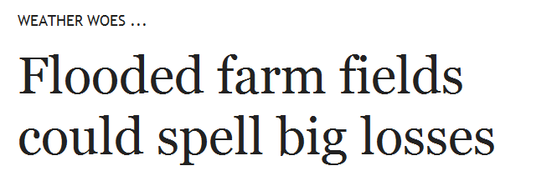
How does shallow groundwater interact with
soil texture and weather to influence rainfed corn yield?
2012: Severe Drought
2013: Wet Year
Notes:
Some patterns are the same – linear bands extending from southern edge of field, corresponding to higher elevation areas (deeper GW and coarser soil)
Some patterns are different – channel-like feature in SW part of field, corresponding to low-lying area (shallow GW and finer soil)

Slide 4
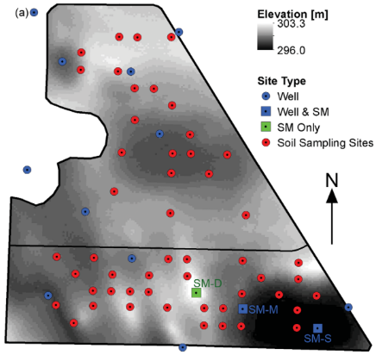
How does shallow groundwater interact with
soil texture and weather to influence rainfed corn yield?
Elevation
600 m
Zipper et al., 2015 WRR
Zipper et al., 2015 WRR
Notes:
Some patterns are the same – linear bands extending from southern edge of field, corresponding to higher elevation areas (deeper GW and coarser soil)
Some patterns are different – channel-like feature in SW part of field, corresponding to low-lying area (shallow GW and finer soil)

Slide 5
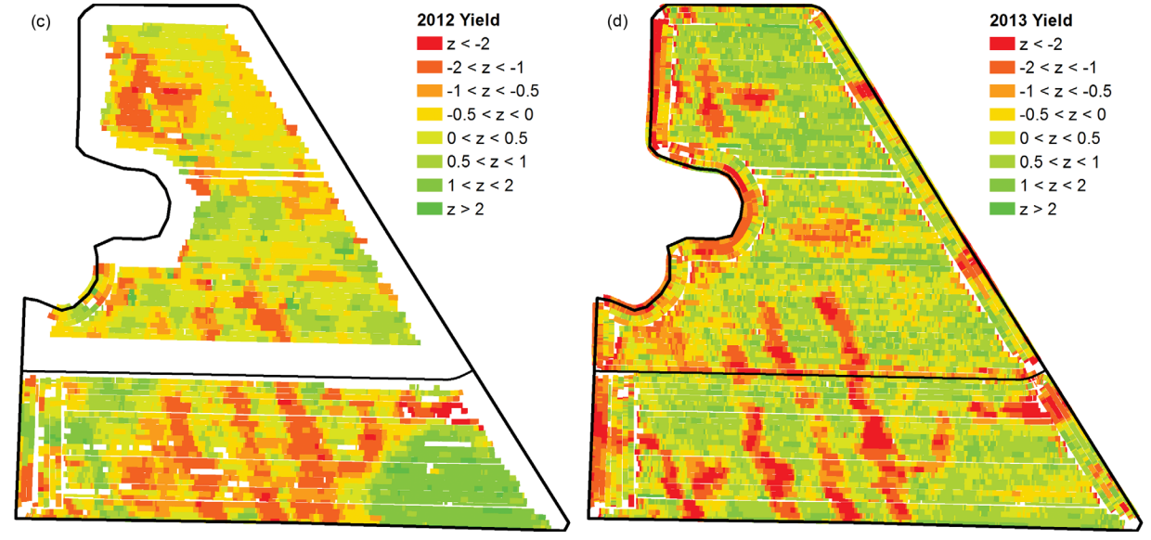
How does shallow groundwater interact with
soil texture and weather to influence rainfed corn yield?
Elevation
2012: Severe Drought
2013: Wet Year
Low
High
600 m
Zipper et al., 2015 WRR
Zipper et al., 2015 WRR
Notes:
Some patterns are the same – linear bands extending from southern edge of field, corresponding to higher elevation areas (deeper GW and coarser soil)
Some patterns are different – channel-like feature in SW part of field, corresponding to low-lying area (shallow GW and finer soil)

Slide 6
How does shallow groundwater interact with
soil texture and weather to influence rainfed corn yield?
Elevation
2012: Severe Drought
2013: Wet Year
Low
High
600 m
Zipper et al., 2015 WRR
Zipper et al., 2015 WRR
Notes:
Some patterns are the same – linear bands extending from southern edge of field, corresponding to higher elevation areas (deeper GW and coarser soil)
Some patterns are different – channel-like feature in SW part of field, corresponding to low-lying area (shallow GW and finer soil)

Slide 7
How does shallow groundwater interact with
soil texture and weather to influence rainfed corn yield?
Elevation
2012: Severe Drought
2013: Wet Year
Low
High
600 m
Zipper et al., 2015 WRR
Zipper et al., 2015 WRR
Notes:
Some patterns are the same – linear bands extending from southern edge of field, corresponding to higher elevation areas (deeper GW and coarser soil)
Some patterns are different – channel-like feature in SW part of field, corresponding to low-lying area (shallow GW and finer soil)

Slide 8
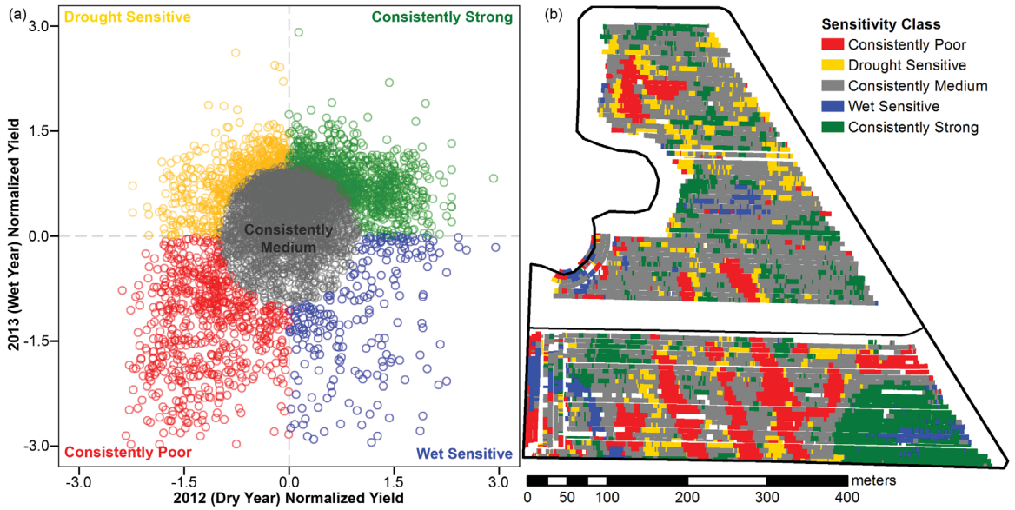
Zipper et al., 2015 WRR
Zipper et al., 2015 WRR
Notes:
Some patterns are the same – linear bands extending from southern edge of field, corresponding to higher elevation areas (deeper GW and coarser soil)
Some patterns are different – channel-like feature in SW part of field, corresponding to low-lying area (shallow GW and finer soil)

Slide 9
Zipper et al., 2015 WRR
Zipper et al., 2015 WRR
Notes:
Some patterns are the same – linear bands extending from southern edge of field, corresponding to higher elevation areas (deeper GW and coarser soil)
Some patterns are different – channel-like feature in SW part of field, corresponding to low-lying area (shallow GW and finer soil)

Slide 10
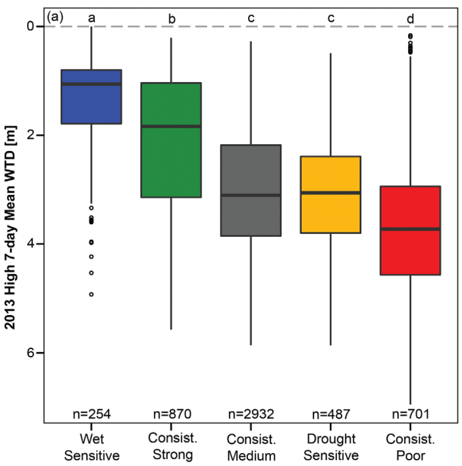
Zipper et al., 2015 WRR
Zipper et al., 2015 WRR
Notes:
Three primary data sources: soil texture measurements

Slide 11
Shallow GW→ Wet sensitive → Groundwater yield penalty
Zipper et al., 2015 WRR
Zipper et al., 2015 WRR
Notes:
Three primary data sources: soil texture measurements

Slide 12
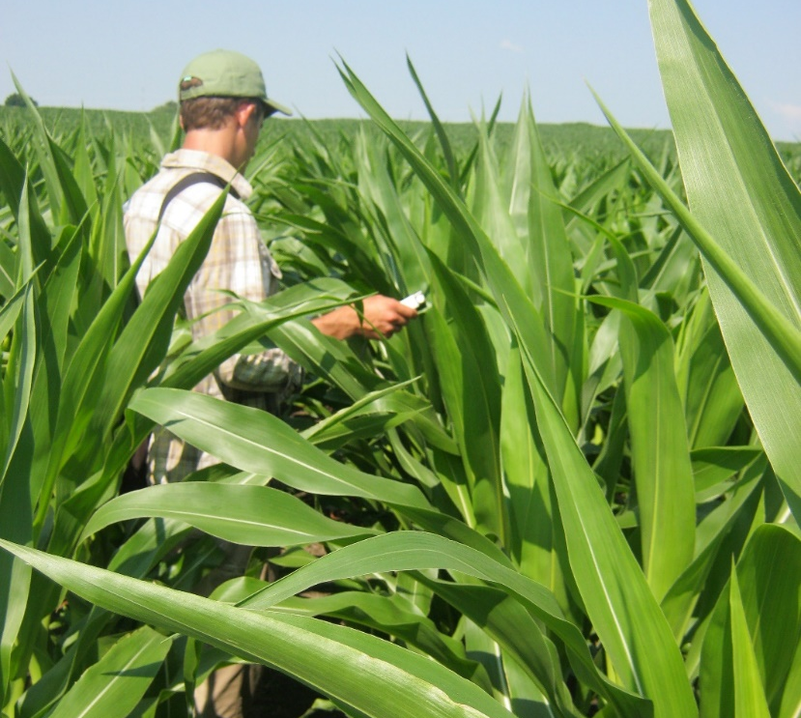
Shallow GW→ Wet sensitive → Groundwater yield penalty
Intermediate GW → Consistently strong → Groundwater yield subsidy
Zipper et al., 2015 WRR
Zipper et al., 2015 WRR
Notes:
Three primary data sources: soil texture measurements

Slide 13
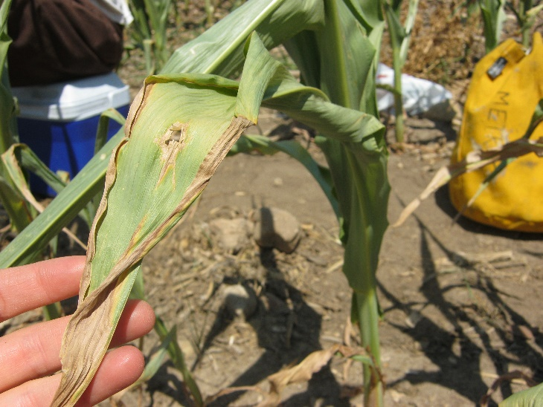
Shallow GW→ Wet sensitive → Groundwater yield penalty
Intermediate GW → Consistently strong → Groundwater yield subsidy
Deep GW → Consistently poor → No groundwater influence
Zipper et al., 2015 WRR
Zipper et al., 2015 WRR
Notes:
Three primary data sources: soil texture measurements

Slide 14
Shallow GW→ Wet sensitive → Groundwater yield penalty
Intermediate GW → Consistently strong → Groundwater yield subsidy
Deep GW → Consistently poor → No groundwater influence
…what about soil texture?
Zipper et al., 2015 WRR
Notes:
Three primary data sources: soil texture measurements

Slide 15
Model: Agro-IBIS agroecosystem model
28x growing seasons (1986-2013)
3x soil textures (silt loam, loam, sandy loam)
38x WTD (0.10-4.75 m + free drainage)
=3192 unique weather/soil/WTD combinations
Zipper et al., 2015 WRR
Zipper et al., 2015 WRR
Notes:
Three primary data sources: soil texture measurements

Slide 16
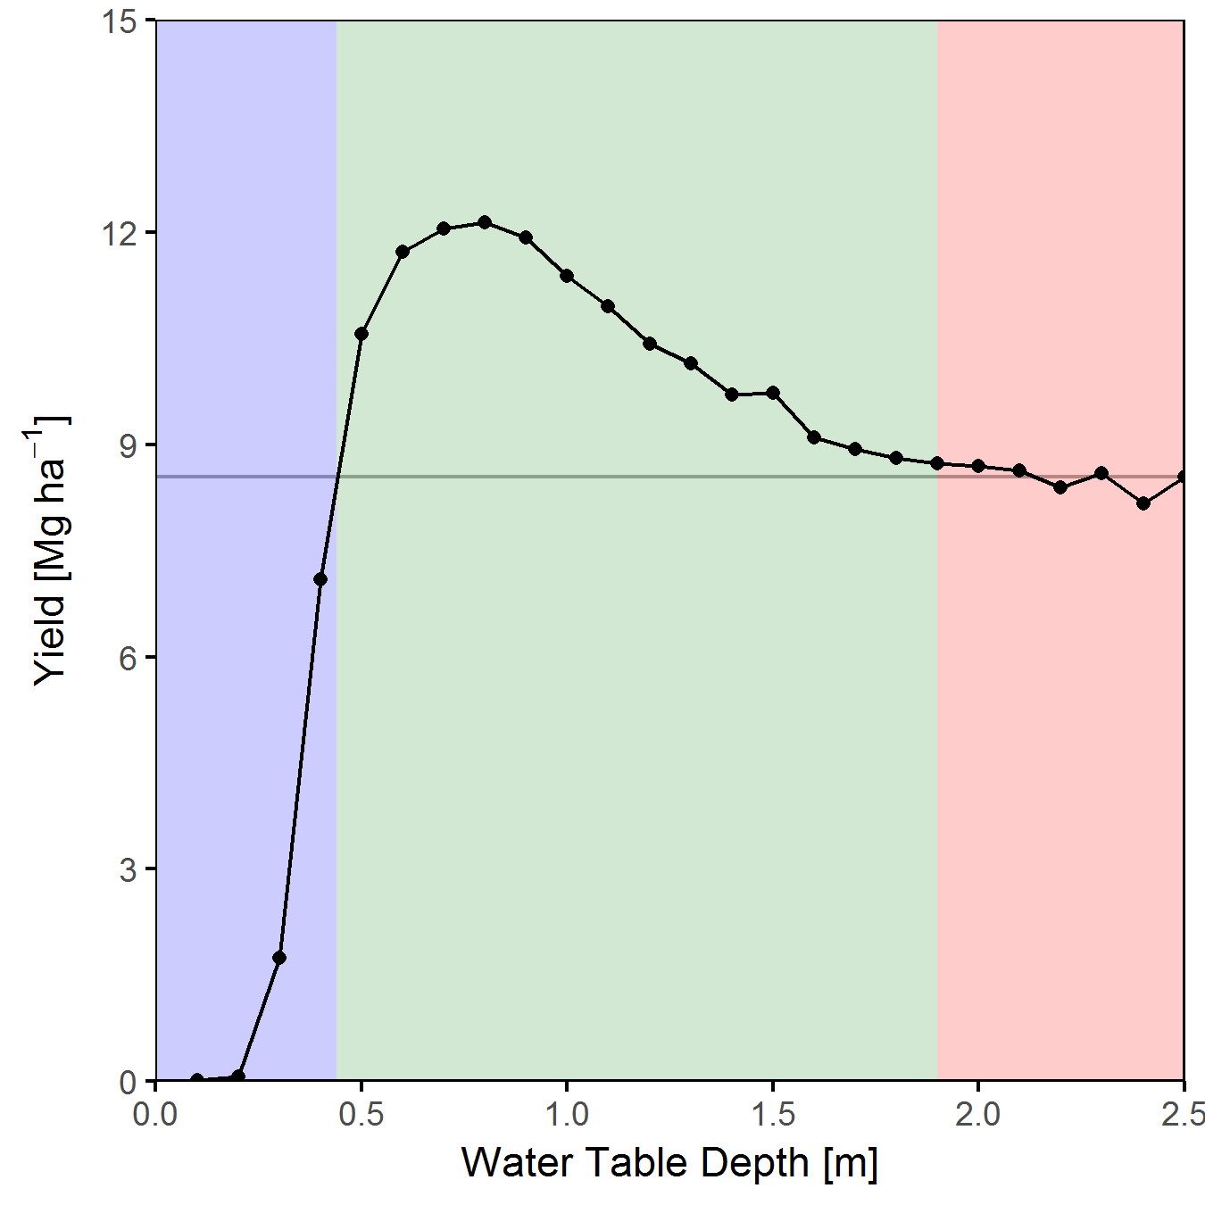
Year: 2012 | Soil: Loam
Shallow GW → Groundwater yield penalty
Medium GW → Groundwater yield subsidy
Deep GW → No groundwater influence
Optimum WTD = WTD with peak yield
Yield with no GW
Optimum WTD
Zipper et al., 2015 WRR
Zipper et al., 2015 WRR
Notes:
Three primary data sources: soil texture measurements

Slide 17
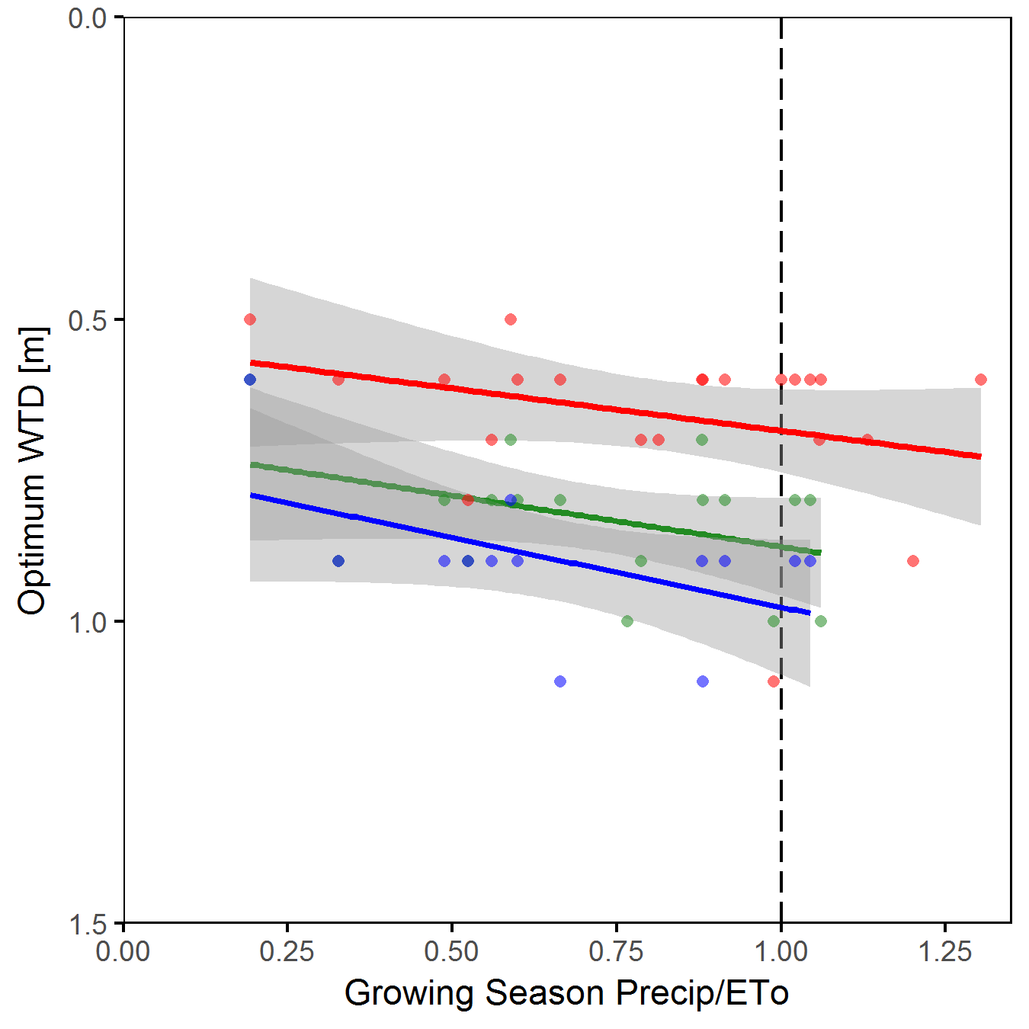
Shallow GW → Groundwater yield penalty
Medium GW → Groundwater yield subsidy
Deep GW → No groundwater influence
Optimum WTD = WTD with peak yield
Deeper in fine soils
Deeper in wet years
Drier
Year
Coarser Soil
Wetter
Year
Finer Soil
Sandy loam
Loam
Silt loam
Zipper et al., 2015 WRR
Zipper et al., 2015 WRR
Notes:
Three primary data sources: soil texture measurements

Slide 18
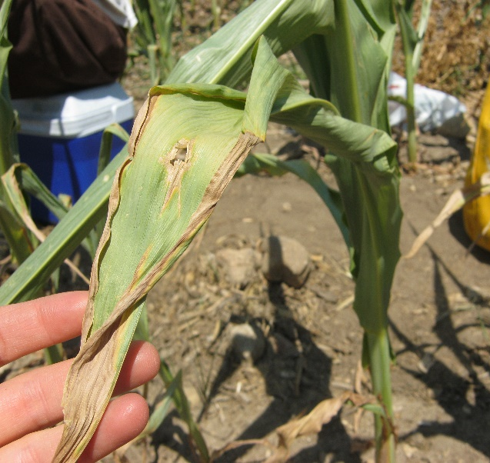
How does shallow groundwater interact with
soil texture and weather to influence rainfed corn yield?
Water Supply
Water Stress
Growth limited by water availability
Optimum WTD
GW available when soil water depleted
Oxygen Stress
Roots unable to respire
Flood Attenuation
No GW Influence
GW Yield Subsidy
GW Yield Penalty
Finer Soil/
Wetter Year
Crop Production
Coarser Soil/
Drier Year
WTD
Many other ecosystem services are also dependent on GW availability

Slide 19
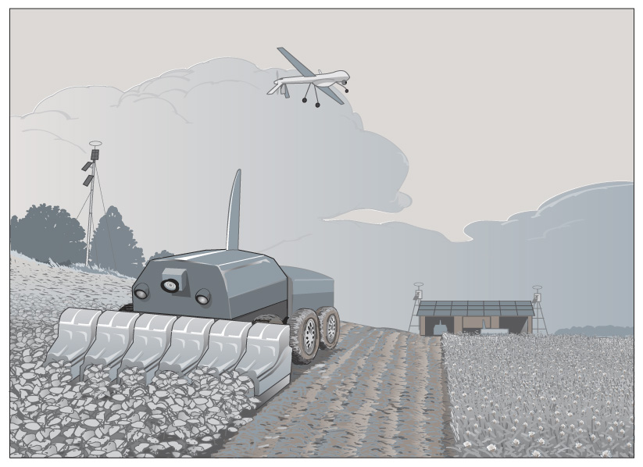
Opportunities and Knowledge Gaps
Drainage for tomorrow’s climate and land use
More frequent droughts? More extreme rainfall?
Within-season active water table management
Near-term forecasting
Requires improved understanding of temporal WTD-GW interactions
Source: Yahara2070.org
Flexibility and adaptability need to be built into drainage

Slide 20
Thank you for your attention!
Sam Zipper, Kansas Geological Survey
samzipper@ku.edu
samzipper.com
@ZipperSam

