Slide 1
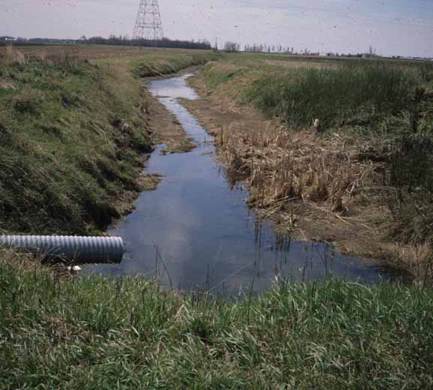
Drainage intensity effects on water/nitrate flow and crop growth
Eileen Kladivko
Agronomy Dept.
Purdue University
January 23-24, 2020
Soil x Water Workshop
Morgantown, WV

Slide 2
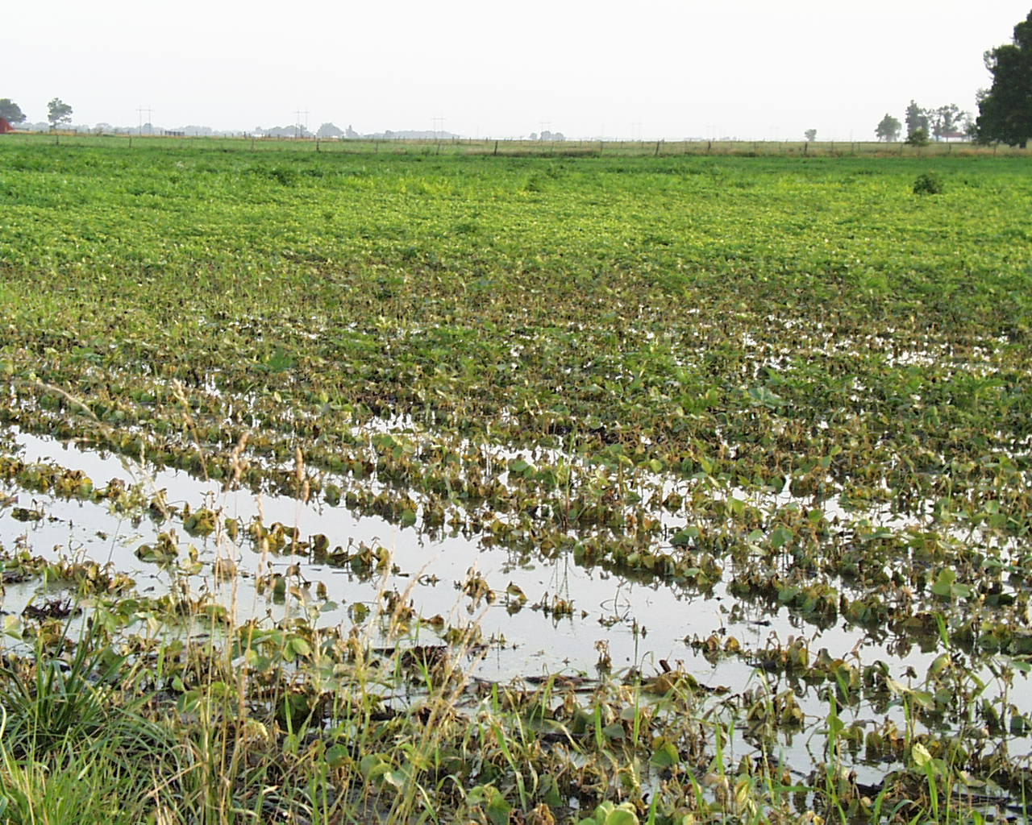
Naturally poorly-drained soils present many challenges for crop production.

Slide 3

Naturally poorly-drained soils present many challenges for crop production.
Terminology
“poorly drained” means “naturally poorly drained”, ie naturally high water table
Soil science has 4 main drainage classes, reflecting natural water table depth and duration (PD, SPD, MW, W)
Be careful of folks mistakenly thinking “poorly-drained” means “poorly-tiled” (therefore I usually say “naturally poorly drained” in talks)

Slide 4
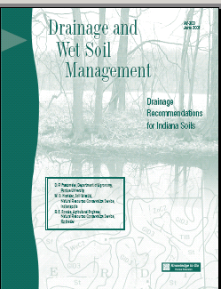

We design different drainage intensities
Not simply “yes” or “no” for tile drains
Designing for:
How fast to remove water
How deep will the water table then be
Spacing and depth of tiles as main design factors
Soil properties affect design
Drainage Recommendations for Indiana Soils
(AY-300) by Don Franzmeier, Bill Hosteter, and Roger Roeske (NRCS).

Slide 5
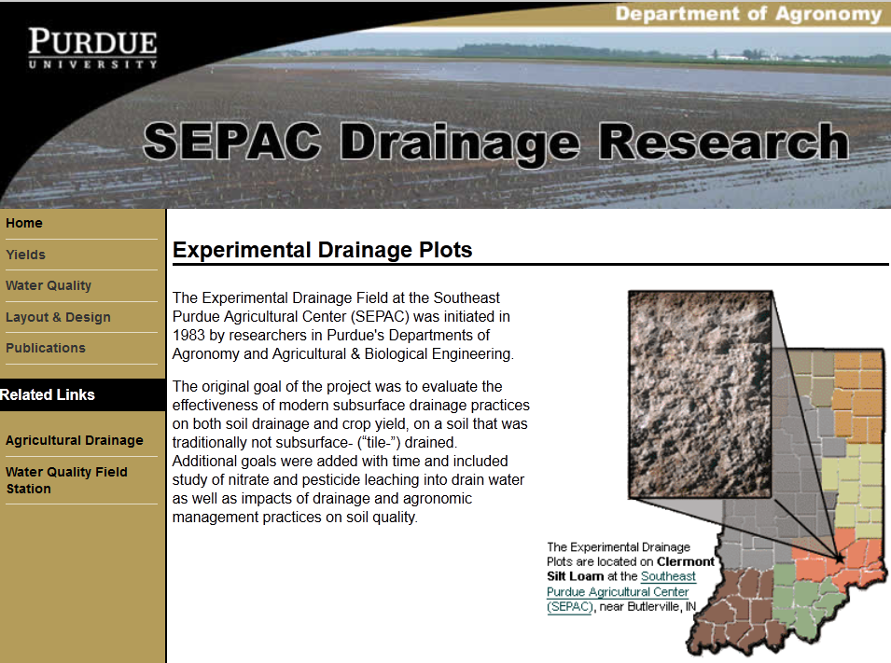
https://www.agry.purdue.edu/drainage/

Slide 6
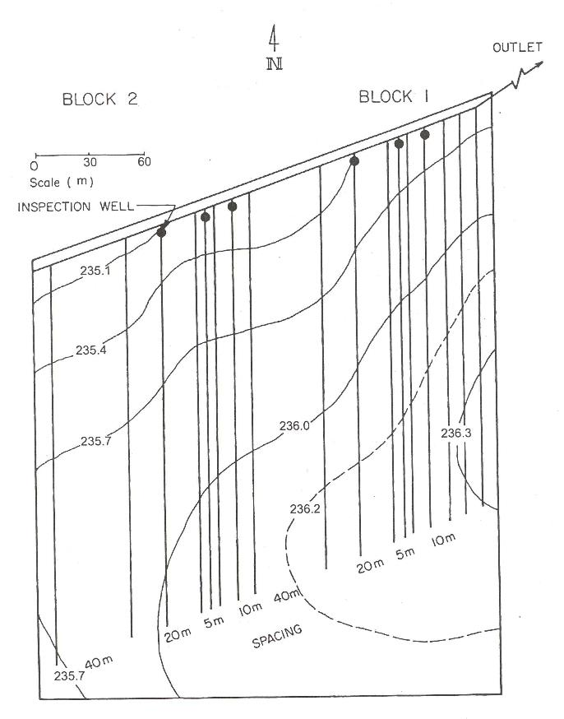

SEPAC drainage research site
Drainage installed at four spacings to research spacing effect on yield.
5m, 10m, 20m, 40 m
(16 ft, 33 ft, 66 ft, 132 ft)
2.5-3 ft depth (75-90 cm)
4-inch plastic drain tube, no sock or filter

Slide 7
Effects vary year by year -- Continuous Corn Yield and Timeliness at SEPAC over first 10 years
My21 Ap22 Ap30 Ap28 My02 My18 My29 My01 My05 My10
+11 +2 +0 +2 +3 +15 +3 +2 +3 +1
Delay→
See https://www.agry.purdue.edu/drainage. Or Kladivko 2005 Agron. J.
Notes:
This slide shows the variation between years, and also illustrates timeliness. During the first 10 years, tillage was done, and each plot was tilled when ready. (If the 16-foot plot dry enough to be tilled he did that.)
Date below is the date that the narrowest spacing planted. Days of delay for undrained to be planted.
only 3 years were planted after May 10, traditionally the date yield is expected to be impacted by delayed planting.
only 2 years had appreciable delay, when it rained in between.

Slide 8
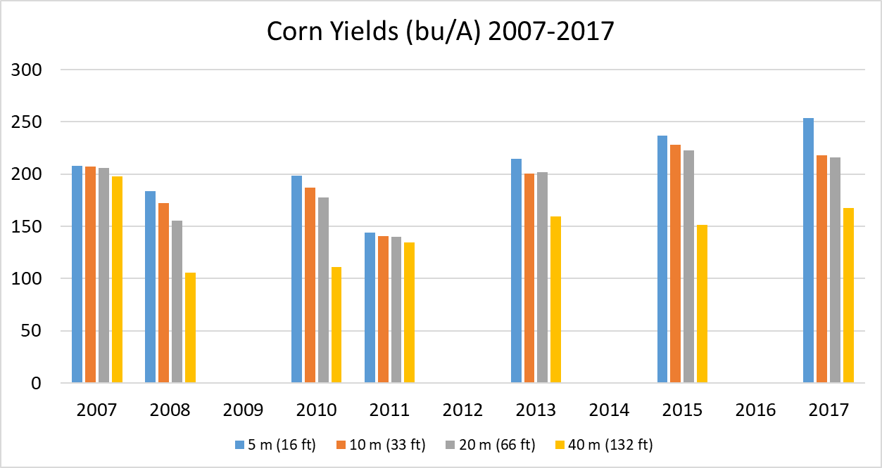

SEPAC Drainage Spacing Corn Yields (bu/A)
More wet years—so undrained is much lower than other spacings

Slide 9
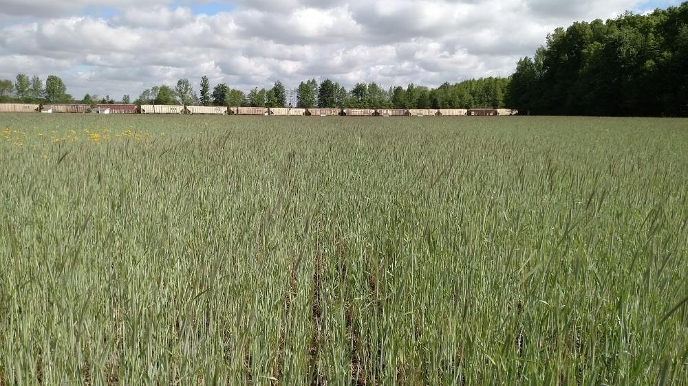
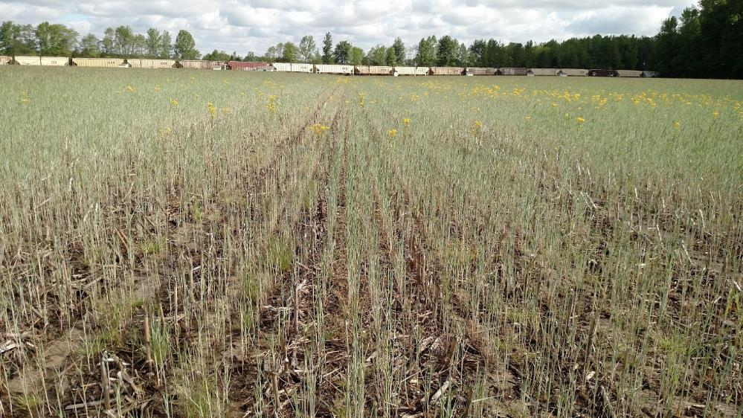
May 13, 2016
Cereal rye cover crop
Tiled
~3500 kg biomass/ha
Untiled
~780 kg biomass/ha

Slide 10
Agronomic management plots
Cover crops, manure application, no-till, and rotation with hay crops, generally improved soil physical properties, earthworm populations, and crop yields, on this low organic matter, poorly structured soil, when adequate drainage was present.
A good drainage system is a necessary first step to improving soil health and crop production. Agronomic practices alone are not likely to make up for an inadequate drainage system.

Slide 11
Drainflow greater with narrower drain spacings
112 cm rain
124 cm rain
Greater flow with increased rainfall

Slide 12
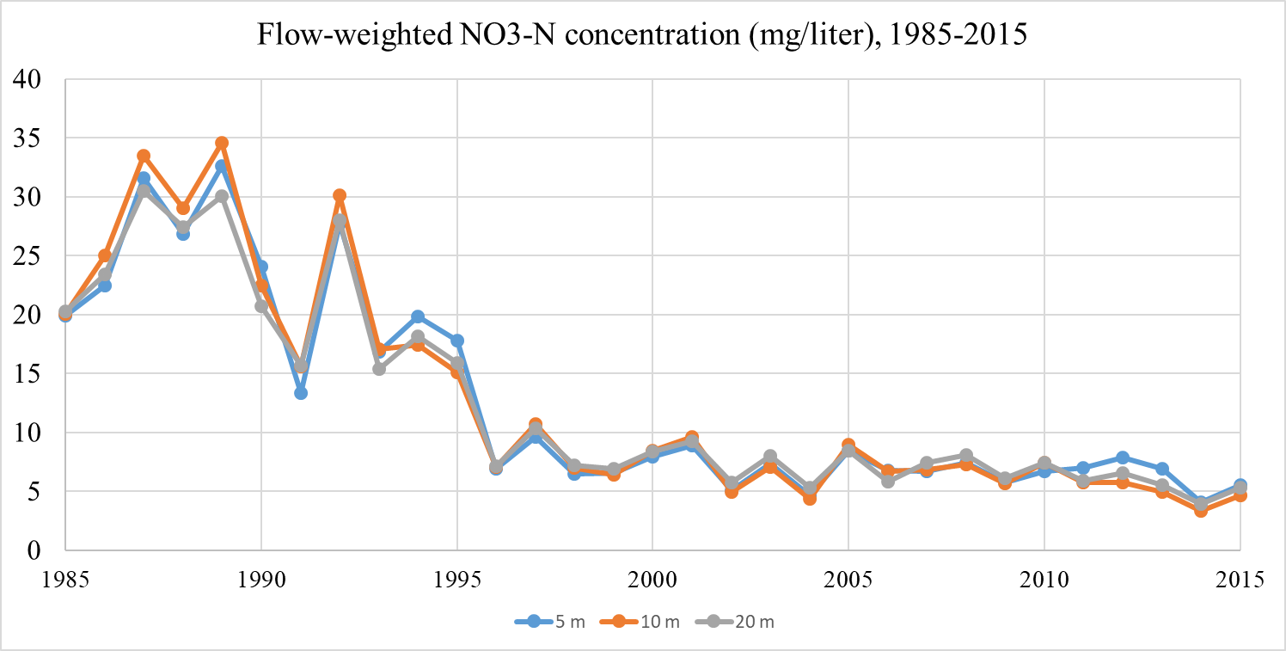
SEPAC Drainage Site
Concentrations dropped due to addition of cover crops and reduction of fertilizer N rate over time.
All 3 spacings had similar concentrations.
(See JEQ 2004)

Slide 13
Narrower spacing gives higher N loads
Increased flow gave higher N loads (at same conc)
Reduced concentrations gave lower N loads

Slide 14

Bottom line
Drain spacing matters
Rainfall (excess) matters
N fertilizer rate and form matter
Cover crops reduce NO3-N concentrations, loads
Perhaps some development of this soil from drain installation, no-till, or other.
If we intensify drainage, then we should also intensify management of other aspects of that system, such as cover crops and controlled drainage, to reduce the “leakiness” of the system.

Slide 15
Seasonality varies with location
Many locations have most of their flow and nitrate losses in winter/early spring (normally “fallow” seasons)
Further north locations have “no” flow in winter (frozen; dryer), and all flow Apr-June
(citations—Goss. Randall and Goss. Others. Kladivko JEQ)

Slide 16

1986-1999
Relatively uniform rainfall distribution across months
Most drainage (and N loads) occurring Dec - April
2000-2015
Most drainage occurring Dec - May

Slide 17
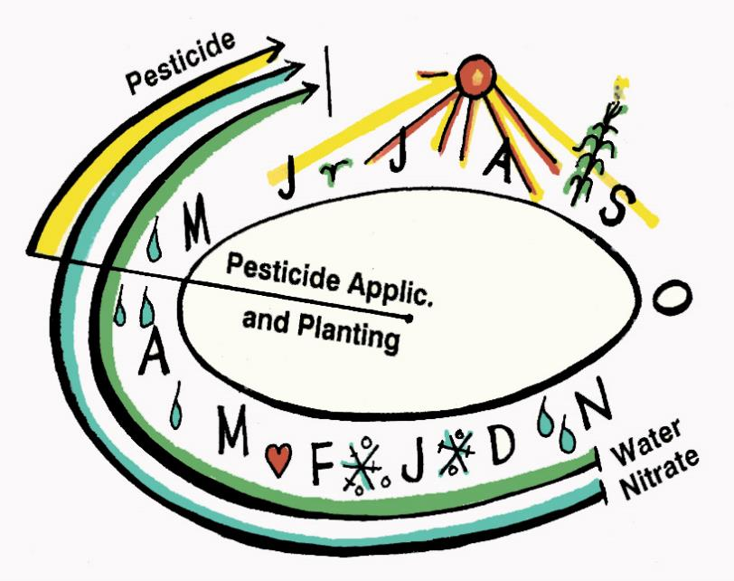

Corn-soybean system normally fallow from Oct – April.
A winter cover crop takes up (or “traps”) some of the nitrate that otherwise leaches out during fallow season
Majority of drainflow and N-loads occur in fallow season (at SEPAC)
(64% Nov. – March; 80% Nov. – April)

Slide 18
Questions
How much drainage is “adequate”, for crop growth, cover crop growth, soil health?
Questions about earthworms, soil biology, are frequent from avid no-till farmers, when suggesting controlled drainage
Remember seasonality of flow, and different “needs” when consider “fallow season” processes (soil biology, cover crops), vs. “growing season” processes

Slide 19
Some references
Kladivko et al. 2004. Nitrate leaching to subsurface drains as affected by drain spacing and changes in crop production system. J. Environ. Qual. 33:1803-1813.
Kladivko et al. 2005. Corn growth and yield response to subsurface drain spacing on Clermont silt loam soil. Agron. J. 97:1419-1428.
Kladivko et al. 2006. Drainage, tillage, and cover crop effects on soil properties and maize yields. Proc. 17th International Soil Tillage Research Organization (ISTRO) Conf., Kiel, Germany
Goss et al. 1993. Losses of nitrate-nitrogen in water draining from under autumn-sown crops established by direct drilling or mouldboard ploughing. J. Soil Sci. 44:35-48.
Randall and Goss. 2001. Nitrate losses to surface water through subsurface tile drainage. Pp. 95-122. In Follett and Hatfield (eds.), Nitrogen in the Environment: Sources, problems, and management. Elsevier, Amsterdam.

Slide 20
Thank you!
Thanks to many folks who have worked on this project over the years:
SEPAC Farm Crew
Graduate students and post-docs
Faculty colleagues
NRCS colleagues
Purdue Agricultural Research Programs, for financial and moral support!

