Slide 1
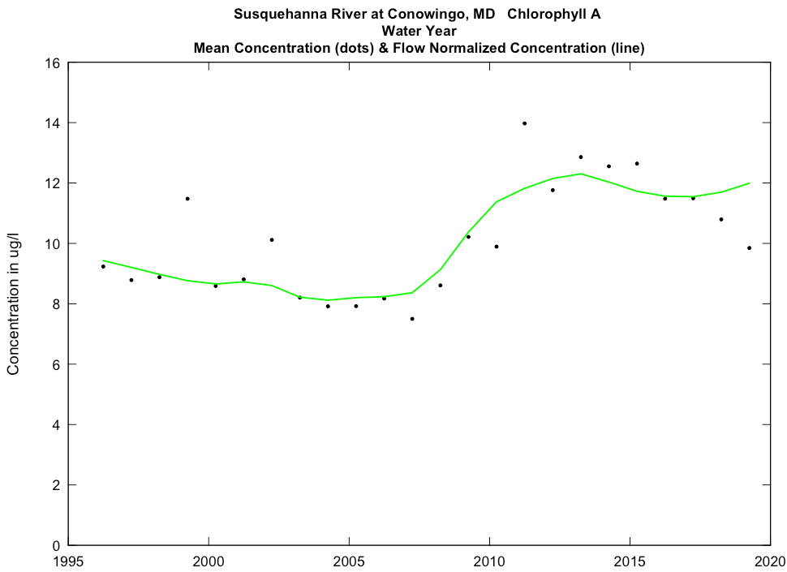
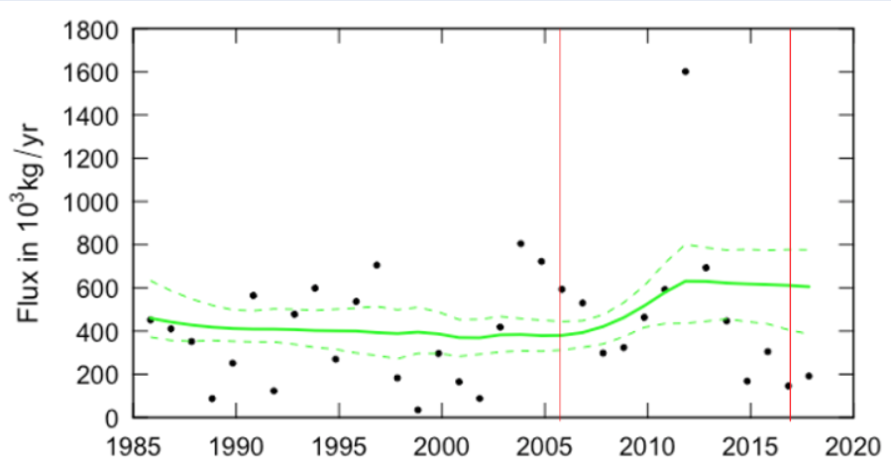
Susquehanna River at Conowingo, MD Chlorophyll-A
Chlorophyll-A concentration
Chlorophyll A concentration trends are commensurate with observed PO4 flux increased
Trends are focused on changes on low to mid-range flows
Given the observed ecological response in Conowingo Reservoir, one must expect a similar response occurred in the upper freshwater Chesapeake
Dissolved PO4 Flux
From: R. Hirsch

Slide 2
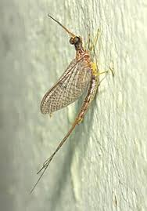
Ecological Changes In Conowingo Reservoir
Emergence of SAV beds (early 2000’s?)
Fall die off
Increase in Mayfly swarms
(Timeframe undocumented)
Photos: J. Blomquist, Oct 9, 2013
Photo: Wikipedia

Slide 3
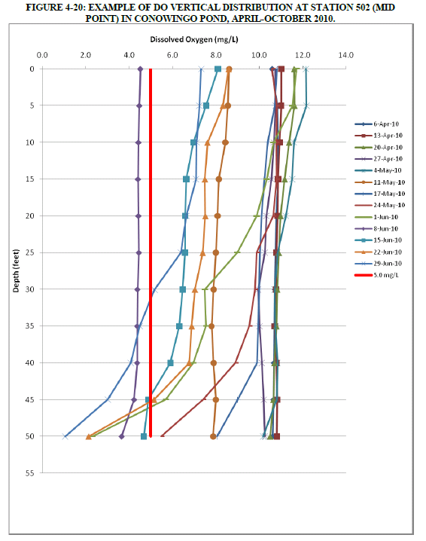
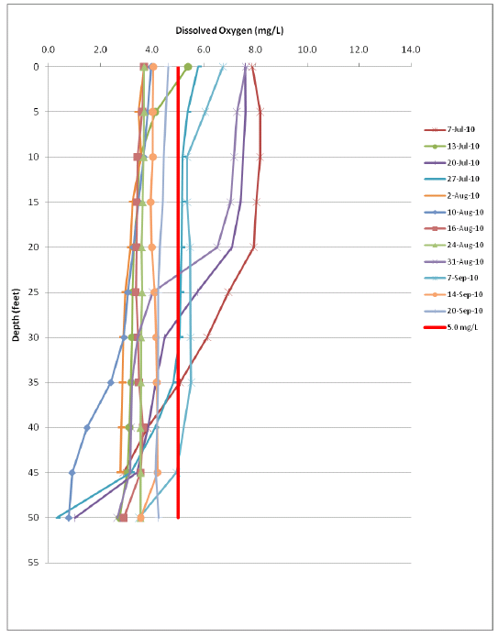
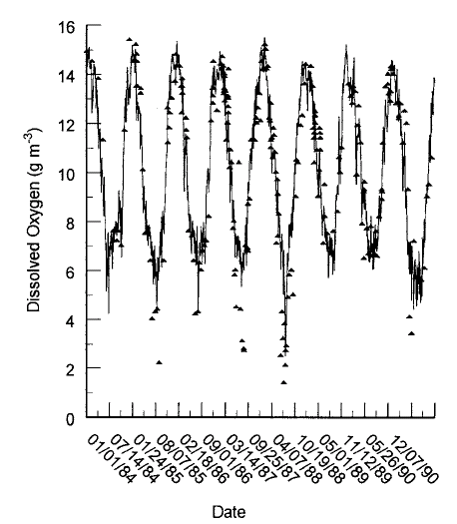
Hypoxia does exist in the reservoir, but not when DIP increasing
Deliman and Gerald 2002
Normandeau 2011

Slide 4
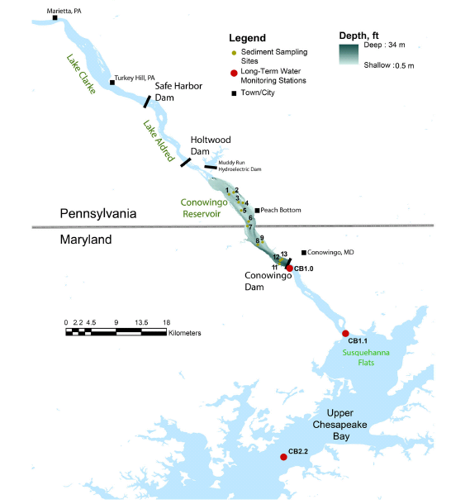
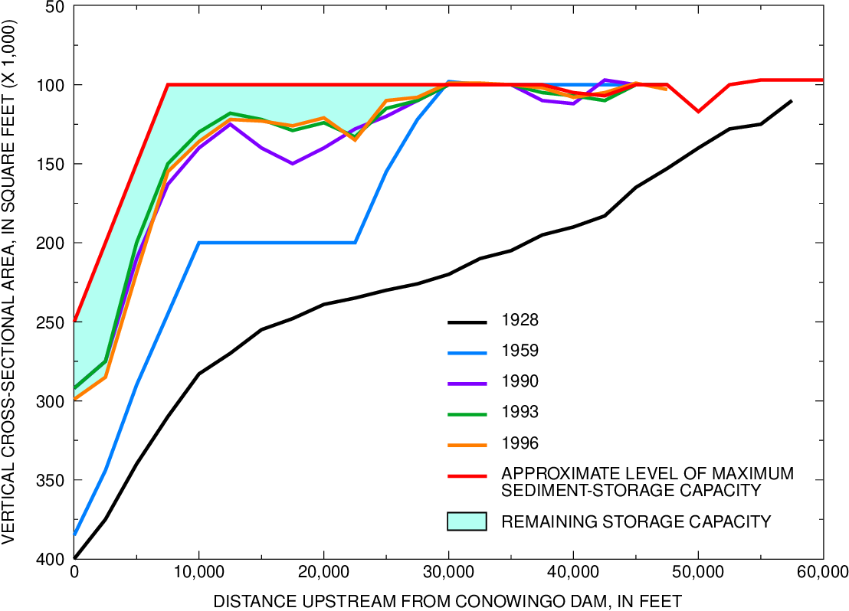
Palinkas et al. 2019
Langland and Hainly 1997

Slide 5
Hi Jeremy,
I have been looking over some references on resuspension and phosphorus fluxes, and I’ll try to summarize my overall impressions here. This summary is not exact or detailed, but I think it captures the essence of what has been found. I am biased by the work that my students Miao-Li Chang and Elka Porter have done, with no apologies because that is what I know best! See below for my list of references.
There are essentially two endpoints of resuspension effects on P fluxes. The first is when a depositional basin with high P concentrations in the sediment is disturbed by episodic resuspension. In this case, resuspension acts to enhance P fluxes from the sediments to the water column by direct injection of high particulate P into a relatively low DIP water column, resulting in DIP release from the resuspended particles before they redeposit. Time in suspension obviously matters a lot for this case. Generally speaking, resuspension has be found to enhance but seldom outweigh sediment-water biogeochemical fluxes and the factors that affect them in these environments, integrated over time. Long periods of deposition between resuspension events also allow resistance to subsequent erosion to increase through consolidation.
The second endpoint is when deposition of “new” high particulate P is delayed or inhibited by chronic resuspension. In this case, resuspension short-circuits sediment diagenesis in favor of water column transformations. This case often involves an intermediate, thin floc layer of relatively fresh particles that regularly cycle back and forth between the sediment surface and the water column. Because it is regularly disturbed, the floc layer only consolidates slowly and is easier to resuspend.
In a reservoir like Conowingo, the first case would tend to be more likely early on when there is excess capacity for sediment and the second case would be more likely as dynamic equilibrium is approached. Of course, the real world is somewhere in between these two endpoints, but they are useful for discussion. It is important to point out that the residence time of particles in the reservoir is much longer early on and much shorter later; the more time particles remain in suspension, the faster they are flushed out. It is also important to point out that I am really talking about fine silts and clays (mud), not sand. When there is a mix of sand and mud, over time the sand displaces the mud on the bottom and the residence time of fine particles further decreases.
Channeling Elka, it is also important to point out that many indirect interactions are also important. For example, chronic resuspension increases turbidity and decreases light at the sediment surface, which decreases microphytobenthos and associated nutrient cycling.
Does this make sense? I wrote it sort of stream of consciousness, so please let me know if something doesn’t make sense. I have also avoided all of that mysterious biogeochemistry stuff, which I will leave to you and Jeff!
Best,
Larry

