Slide 1
Watershed Group
State of the Science
State of the Science
Scientific Gap Analysis
Scientific Gap Analysis
Assessment of System Response
Assessment of System Response
Evaluation of System Response
Evaluation of System Response
Update

Slide 2
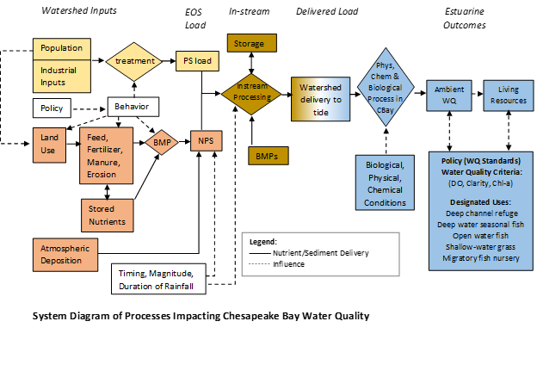
Science Gap/Uncertainty Issues: Watershed Group

Slide 3
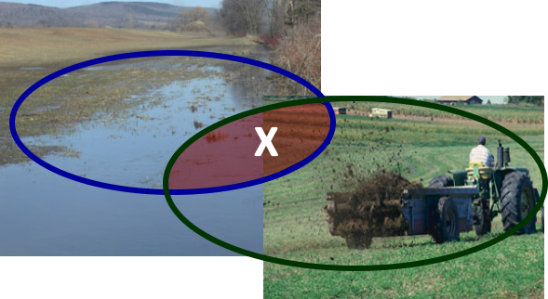
Science Gaps/Uncertainties Identified by Watershed Group
Effectiveness of Nonpoint Source Management Efforts
  Legacy Nutrients
  Nutrient Mass Balance
  BMP Nutrient/ Sediment Removal Effectiveness
Climate Change
Behavioral Responses to Existing Policies
Timing, Delivery, and Speciation
Targets other than TN and TP?
Nonpoint Sources

Slide 4
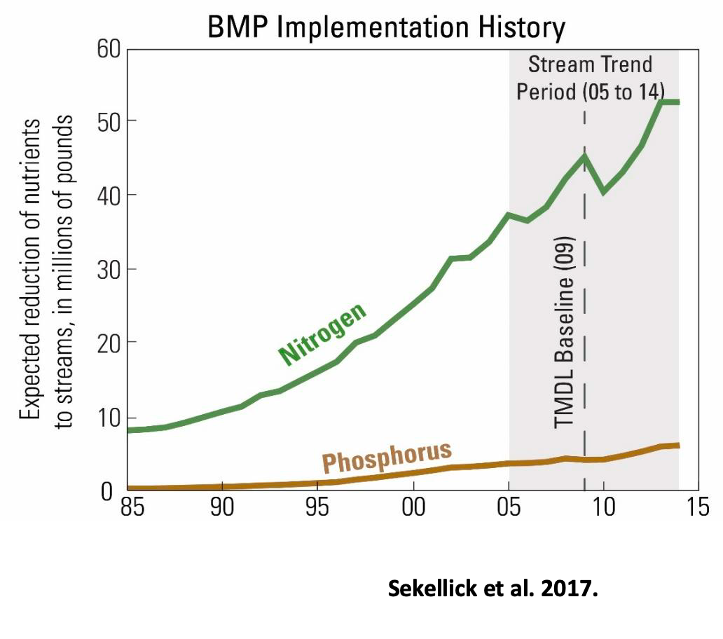
Effectiveness of Nonpoint Source Management Efforts
Achievement of remaining nutrient/ sediment reduction goals rests primarily with agricultural/NPS sources
Mixed signals in monitoring data of effectiveness of NPS management efforts (2018 STAC report found relatively little change in nonpoint source loads between 1992-2012 in the ambient monitoring data)
What is responsible for divergence between expected and observed NPS loads?

Slide 5
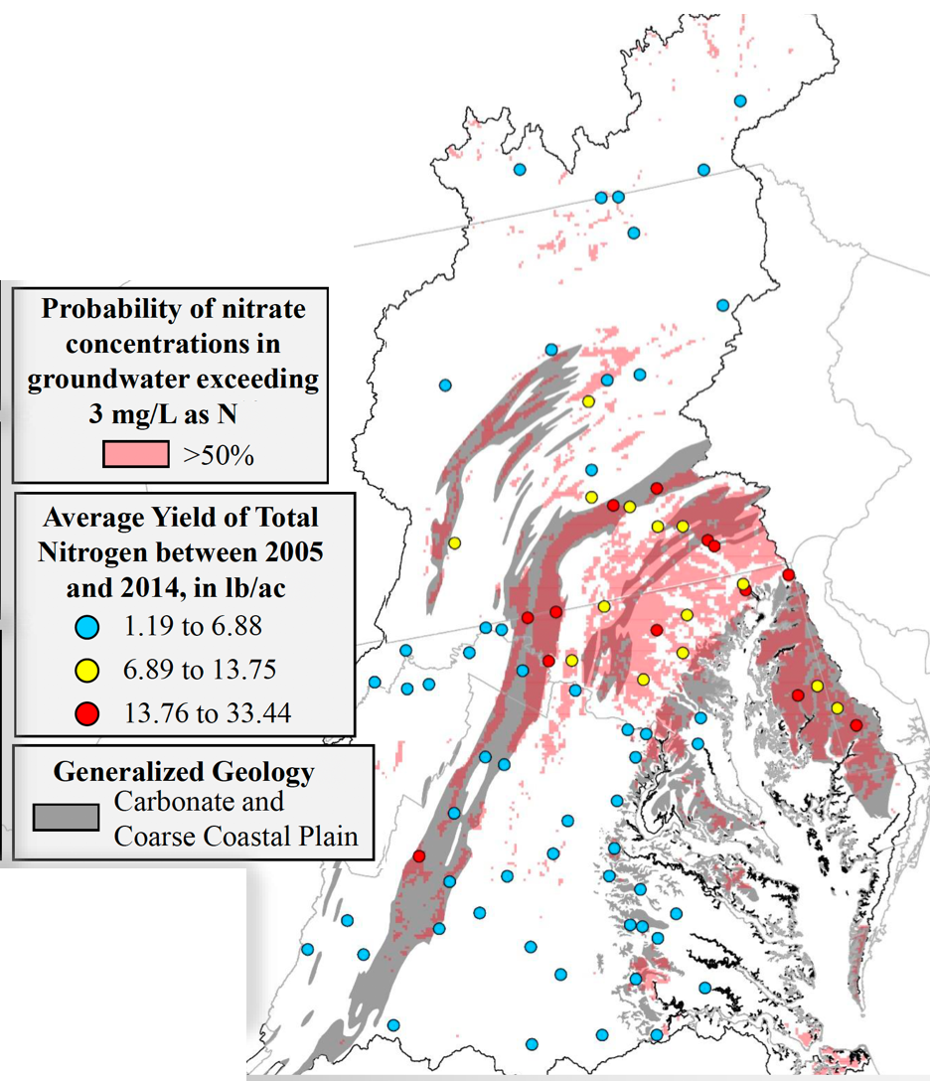
Legacy Nutrients
Large stores of N and P in soils and groundwater exist throughout the watershed
Under the most optimistic assumptions, the drawdown in P and N levels from soils and groundwater could take decades
Source: Jimmy Webber USGS, STAC workshop presentation Dec 2017.

Slide 6
Legacy Nutrients
To what extent are legacy nutrients masking the effectiveness of nonpoint source management actions?
Are the magnitude and timing of delivery to surface waters understood and reflected in our estimates of nutrient delivery to the Bay?
Are there BMPs that can address legacy sources?

Slide 7
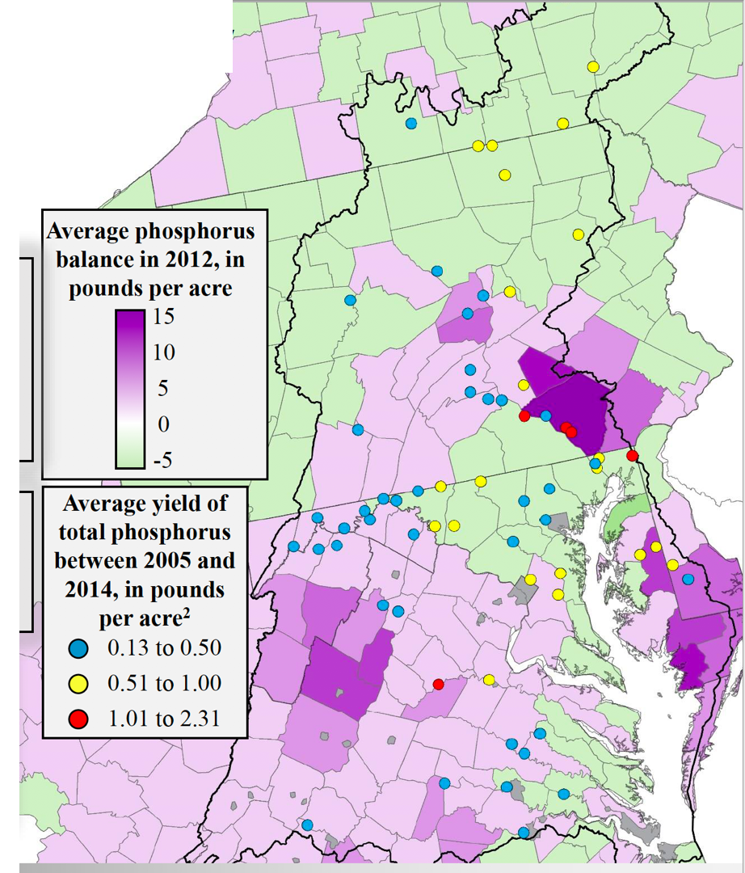
Nutrient Mass Balance
Large mass balance issues exist in many agricultural dominated regions (inputs of feed and fertilizer exceeding assimilative capacity)
Continued growth in intensive animal agriculture has compounded this issue and represent large potential source of nutrients in the system
There is evidence of significant heterogeneity in nutrient use efficiency (nutrient mass imbalances) across livestock operations.
Moyer et al. 2107, Webber, 2017

Slide 8
Nutrient Mass Balance
Have we adequately characterized the extent and size of these regional mass imbalances?
Are the loads from areas with large manure stores adequately reflected in our estimates of nutrient delivery?
What is the distribution of manure application and are the outcomes of this behavior reflected in our understanding of the system?

Slide 9
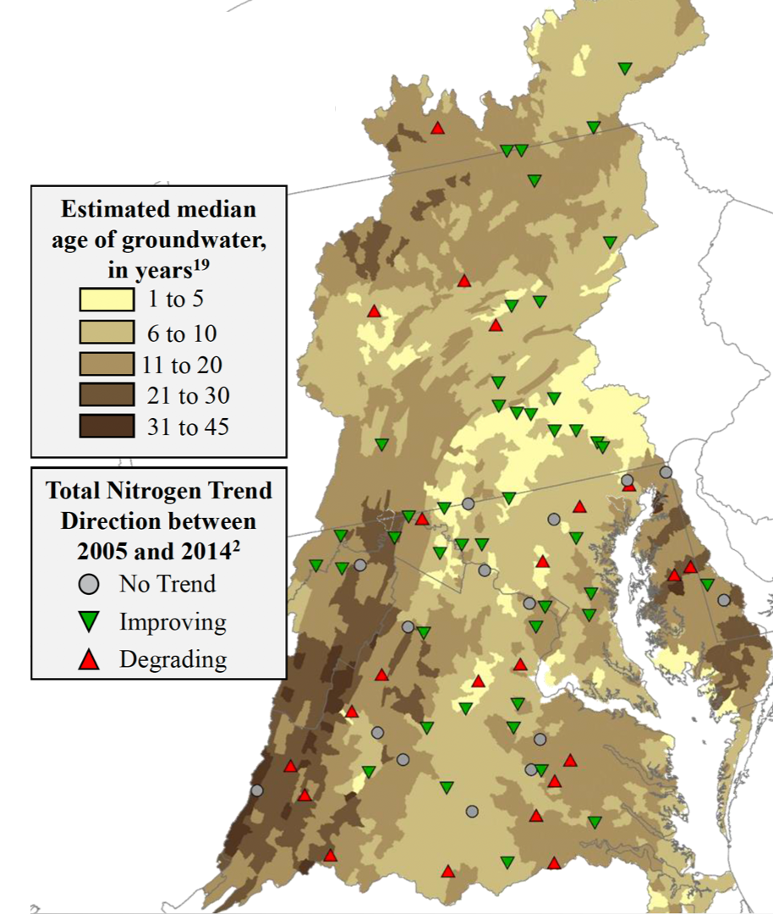
BMP Effectiveness
Uncertainty regarding BMP efficiencies
  Constant assumed effectiveness over BMP lifetime
  Constant removal efficiencies across storms
Lag times
Monitoring and modeling is insufficient to detect a signal
  BMPs may be effective but we cannot detect or isolate the signal
Baseflow nitrogen from decades old groundwater may be masking BMP effects
Moyer et al. 2017; Bhatt et al. 2017

Slide 10
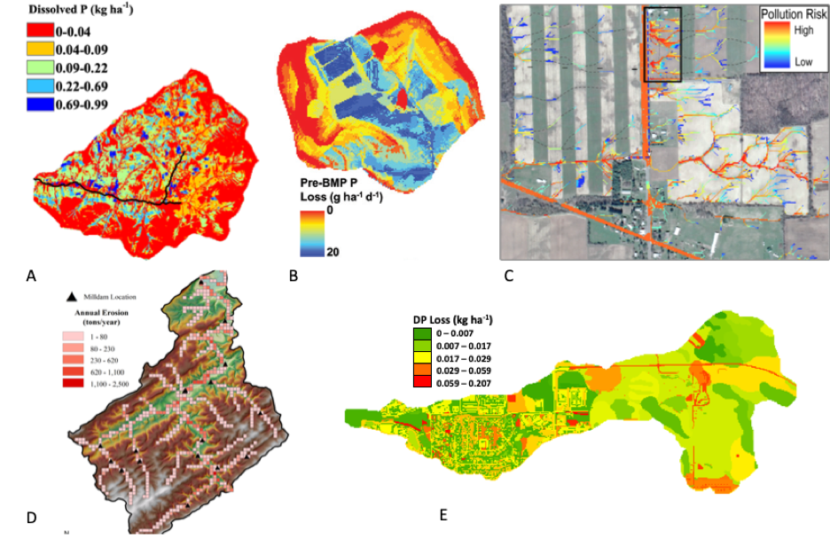
BMP Effectiveness
Areas of high nutrient loss are site specific and highly localized
  If BMPs tend to get applied in lower risk areas rather than targeted to areas where nutrient loads are more likely to originate, nutrient load reduction effectiveness will be overestimated
  BMPs may not target the dominant source or transport pathways
Easton et al. 2019

Slide 11
BMP Effectiveness
Do we have reliable information regarding sources of nutrient loads and the effectiveness of targeting to improve water quality?
Are participants adopting BMPs that have different “nutrient profiles” than non-adopters?
Notes:
conservation ethic differs between participants and nonparticipants

Slide 12
Issues on our radar, but we have not yet unpacked...

Slide 13
Adapting to an Uncertain Future
Climate Change
  Load and management effectiveness given changing annual & extreme precipitation, temperature, sea level rise.
Land Use/Population
  Forms of urbanization, types of agriculture (including changing preferences for ag products)
Atmospheric deposition
  Changing electric power, transportation sectors

Slide 14
Timing, Delivery, and Speciation
TMDL framework focuses on TN and TP, yet we know it is the bioavailable constituents that pose the most significant impact to achieving water quality criteria.
Uncertainties related instream processing, storage, and transport
  Conowingo

Slide 15
Behavioral Responses
A substantial portion of planned reductions come from voluntary technical and financial assistance programs
What are the limits to participation under existing technical assistance and financial assistance programs? To what extent do alternative incentive and regulatory programs produce more reduction and more cost-effective outcomes (more reductions given fixed budget)
How effective are stakeholder engagement and communication processes at encouraging adoption of effective practices?
Notes:
Note: this isn’t the same thing as explaining the effectiveness of BMP investments (gaps in expected vs realized outcomes). This is about what are the limits about the extent to which existing voluntary programs can generate the response needed?

Slide 16
Issues | Level of Impact¹ | Level of Understanding² | Level of Control³ | Ease of Implementation⁴
Effectiveness of Nonpoint Source Management Efforts
Legacy Nutrients
Nutrient Mass Balance
BMP Nutrient/ Sediment Removal Effectiveness | H | M | M | M
Timing, Delivery, and Speciation
Other Issues
Climate change
Targets (other than TN and TP)
Behavioral Response
¹ Level of Impact: To what extent would addressing the issue improve system response to management efforts (i.e., achieving WQ criteria).
² Level of Understanding: How well do we understand the issue.
³ Level of Control: How much control does the CBP and partners have over the issue.
⁴ Ease of Implementation: How costly and/or difficult is implementing/addressing this issue.
Notes:
Level of understanding is M bc BMPs perform differently in space and time, there are lags on effectiveness, and huge variability
Level of control is M bc these programs are voluntary thus, one cannot dictate who participates
Ease of Implementation is M for the same reason, voluntary programs

Slide 17
Where are we Heading
How big is the relative contribution to the gap from each issue
What are the science and management needs that arise from each issue

