Slide 1
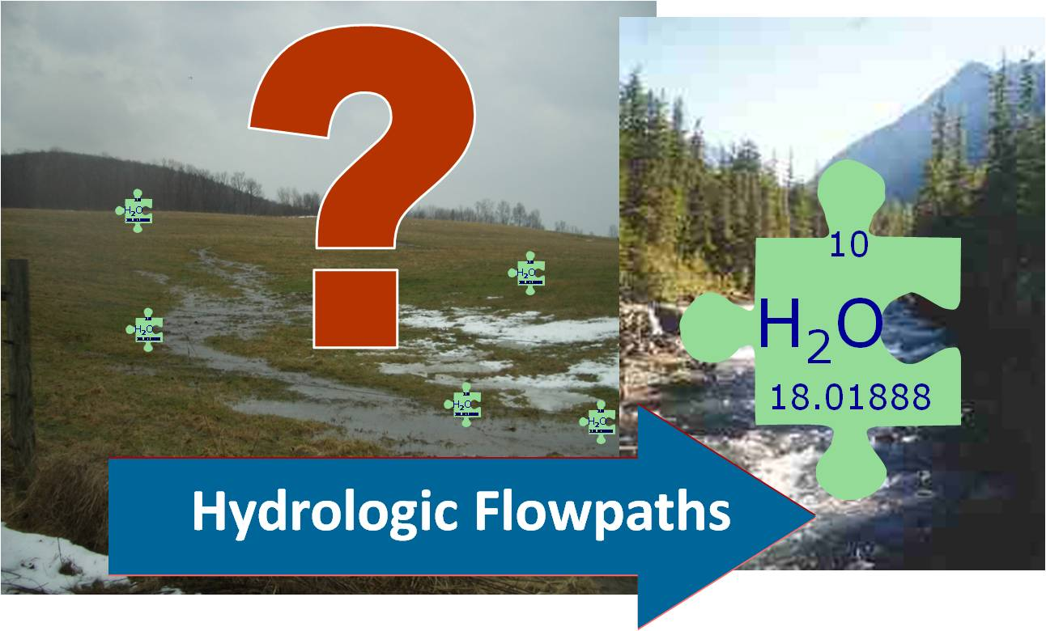
Increasing Effectiveness and Reducing the Cost of NPS BMP Implementation: Is Targeting the Answer?

Slide 2
Workshop Objectives
Review effectiveness of existing BMP implementation strategies
Review the evidence of effectiveness of targeting to improve water quality outcomes and lower costs
Identify the approaches, opportunities, and barriers to targeting in the Chesapeake Bay
What would more effective nonpoint source targeting look like in the Chesapeake Bay?
  Near and long-term recommendation
  What is required from CBP to accomplish this with respect to both policy and modeling?

Slide 3
Targeting:
Identifying the right locations, right people, right treatment options

Slide 4
Introductions
Who is here:
Industry/source sectors, geographic representation, implementation experience (local to state), disciplinary expertise, program evaluation, funders

