Slide 1
Pilot-Testing
Pay-for-Performance Conservation:
Design Issues and Lessons Learned
Jonathan Winsten, Ph.D.
Winrock International
November 12th, 2019
Notes:
Ag economist
Working with Winrock since 2001
Been working on PFP around US and in Canada
Dad had a dairy farm
Live in Shelburne
VT Ag is important to me, as is Lake Champlain

Slide 2
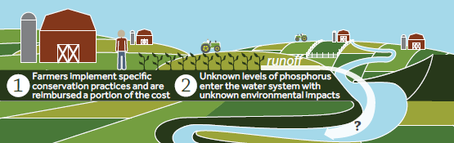
Current Approach:
“Pay-for-Practice” Conservation
USDA spends >$5 Billion/Year on practices
Outcomes are not quantified
Does not motivate farmers to solve problem
Notes:
2
Effectiveness is not monitored and largely unknown.
Pay-for practice made sense b/c nonpoint source pollution, that which does not come out of the end of a pipe, is very expensive to measure or monitor.
This approach does not motivate farmers.
It lacks clear goals
Farmers pay a % of the cost
It does not harness the farmers’ knowledge

Slide 3
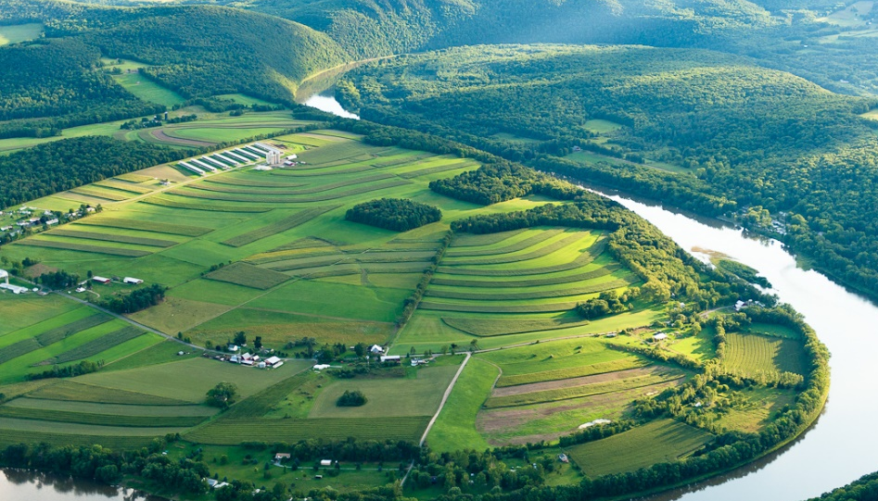
Landscape is Diverse:
Field-Specific Information is Essential
Notes:
-Land is heterogeneous
-Practices will have significantly different impact on nutrient loading depending on where they are applied.
However, the perf of any given BMP will vary greatly across the landscape due to:
Slope
Soils
Proximity to surface water
Crop management system
Using an average becomes meaningless when variation is so great.

Slide 4
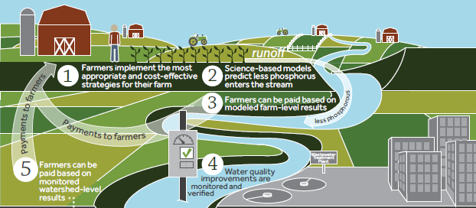
Pay-for-Performance Conservation
“Model-at-the-farm, measure-at-the-watershed” pay-for-performance conservation
Notes:
4
New approach uses scientific advances in simulation modeling and outcome-based incentives.
Pays farmers for achieving nutrient reduction goals;
Farmers choose how to best reduce nutrient loss from their specific fields;
Incentivizes farmers to choose the most cost-effective actions BECAUSE becoming more cost-effective increases net farm income.

Slide 5
Model at the Farm –
Measure at the Watershed
Modeling farm performance
  Triggers primary incentive payment
Measuring watershed performance
  Provides a focal point and real report card
  Triggers a secondary incentive payment
  Farmer-to-farmer peer pressure for participation
Winner of U.S. Nutrient Challenge (2015)

Slide 6
Why PFP?
Motivate farmers
  Create goals
  Get environmental performance incorporated into farm business planning
Quantify outcomes
Meet WQ goals given budget constraints
Notes:
Markets imply the existence of prices
Producers and consumers use prices to make decisions

Slide 7
Key Program Design Questions:
What, How, and Where?
What ecosystem service(s) do we target?
How do we quantify environmental performance?
Where do we quantify environmental performance?
Need performance measures that are closely related to ultimate water quality concern AND directly influenced by farm management decisions.

Slide 8
Performance Measures –
In the Lake, Bay, or Ocean
Notes:
Size of dead zone in Gulf of Mexico

Slide 9
Performance Measures –
In the River
Notes:
Load of P in the Missisiquoi

Slide 10
Performance Measures –
On the Farm
Notes:
Each farm is inherently different:
soils
slopes
proximity to surface water

Slide 11
Key Program Design Questions:
What, How, and Where?
What ecosystem service(s) do we target?
How do we quantify environmental performance?
Where do we quantify environmental performance?
Need performance measures that are closely related to ultimate water quality concern AND directly influenced by farm management decisions.

Slide 12
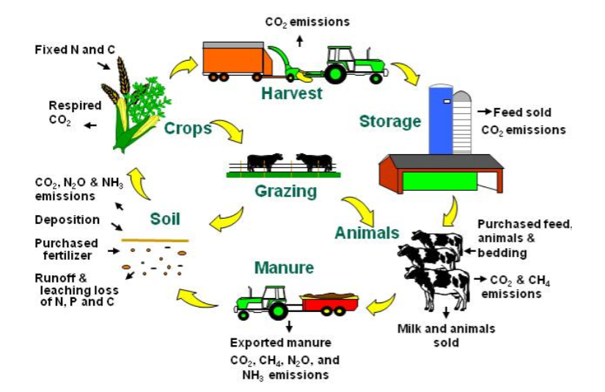
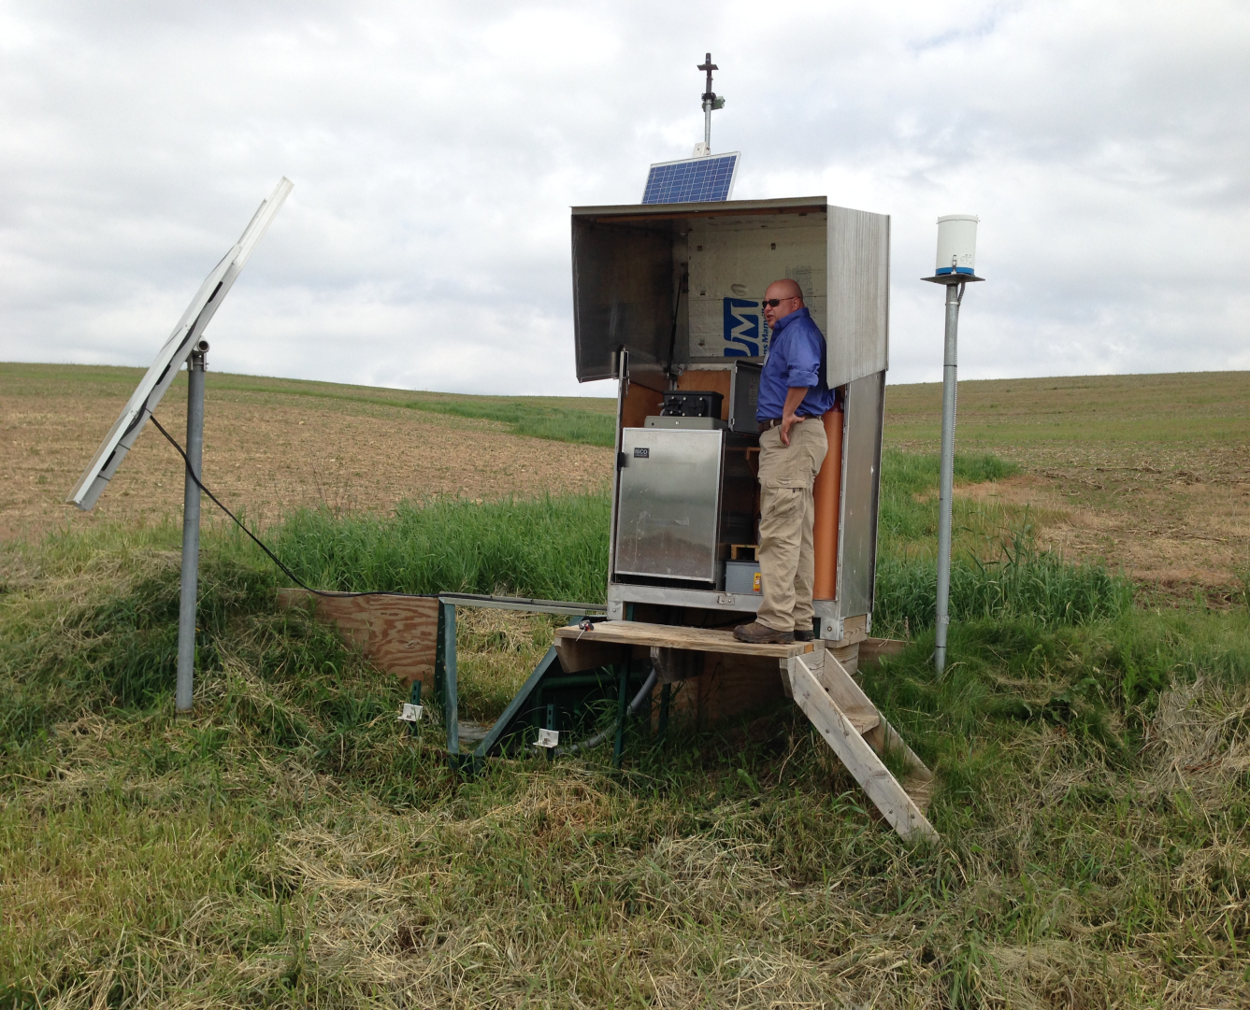
Measured vs. Modeled Performance
Certainty for farmer
Uncertainty for environment
Certainty for environment
Uncertainty for farmer

Slide 13
Desirable Model Characteristics
Based on current and sound science
Flexible
User friendly
Multiple ecosystem services
Wide geographic applicability

Slide 14

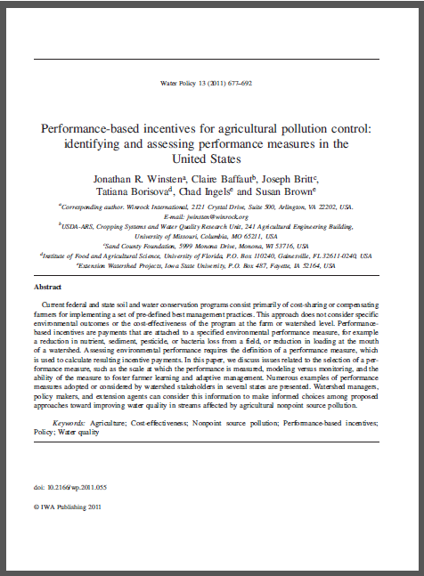
For More on Quantifying Performance

Slide 15
Add’l Program Design Questions
What do we pay for?
  Reduced losses vs stewardship levels
How much do we pay?
  Setting the appropriate incentive level
Where will the funding come from?
  More efficient use of current spending
  Regulated entities downstream
  Private sector investments
Notes:
Reduced losses
Less fair to conservationists
Imputes value into vulnerable fields
More cost-effective
Paying based on stewardship levels
More fair
Imputes value into less vulnerable land and approp prod’n systems
Less cost-effective and may not get us to the goal quickly
Can we have both? Needs careful design.
Paying for reduced losses:
baseline = farm’s previous losses
field-by-field (averaged over crop rotation)
summed across fields (weighted by field size)
Payment per unit of emissions reduced (e.g. per lb of P loss reduced from baseline)
Most cost-effective for achieving reductions
Seemingly unfair to producers who took earlier actions
Paying for a specified level of losses:
rewards producers for having average losses (from across the farm) at or below specified levels
payment per acre based on average level of losses
All farms are different
Less cost-effective, but more fair
Each farm is inherently different:
Soils, slopes, proximity to surface water, etc.
Paying for achieving threshold losses imputes additional value to less environmentally sensitive land
How much do we pay?
Enough to induce reduced losses to rectify impairments.
Valuation of ecosystem services are important, but difficult and imprecise.
Need incentives that induce cost-effective reductions, but do not break the bank.

Slide 16
Winrock Pilot-Testing Projects
Iowa, Vermont, Wisconsin, Ohio
    Focus on P loss; also N loss (Ohio)
Models: P Index, Snap-Plus, NTT
WQ Measurement (Ohio)
Notes:
Reduced losses
Less fair to conservationists
Imputes value into vulnerable fields
More cost-effective
Paying based on stewardship levels
More fair
Imputes value into less vulnerable land and approp prod’n systems
Less cost-effective and may not get us to the goal quickly
Can we have both? Needs careful design.
Paying for reduced losses:
baseline = farm’s previous losses
field-by-field (averaged over crop rotation)
summed across fields (weighted by field size)
Payment per unit of emissions reduced (e.g. per lb of P loss reduced from baseline)
Most cost-effective for achieving reductions
Seemingly unfair to producers who took earlier actions
Paying for a specified level of losses:
rewards producers for having average losses (from across the farm) at or below specified levels
payment per acre based on average level of losses
All farms are different
Less cost-effective, but more fair
Each farm is inherently different:
Soils, slopes, proximity to surface water, etc.
Paying for achieving threshold losses imputes additional value to less environmentally sensitive land
How much do we pay?
Enough to induce reduced losses to rectify impairments.
Valuation of ecosystem services are important, but difficult and imprecise.
Need incentives that induce cost-effective reductions, but do not break the bank.

Slide 17
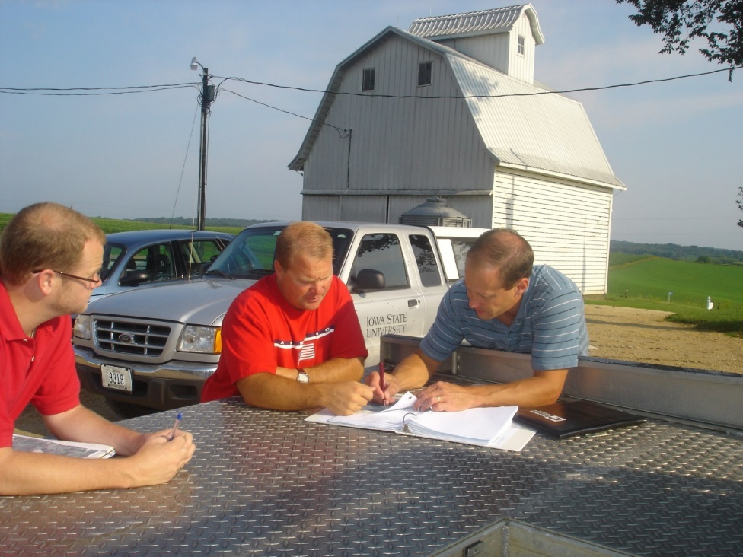
Work with Farmers to Help Develop Ideas
and Provide Information
Steps:
Identify actions for specific fields (scenarios)
Estimate nutrient loss reductions and costs
Provide information to farmers for decision-making
Notes:
17
We work with local partners who spend time with each participating farmer to:
collect needed information for each field
estimate the baseline level of loss
identify actions that could reduce nutrient loss and that the farmer is open to considering
We then use simulation models to calculate amount of nutrient loss reduction and the full economic cost to the farmer.
Farmer uses results, including amount of resulting incentive payment, to make informed business decisions about reducing nutrient losses. They are motivated to find and implement the most cost-effective actions.

Slide 18
Information Created for Farmer Decision-Making
Table and graphs
  Nutrient loss reduction
  Payment
  Full economic cost
      Profit or loss

Slide 19
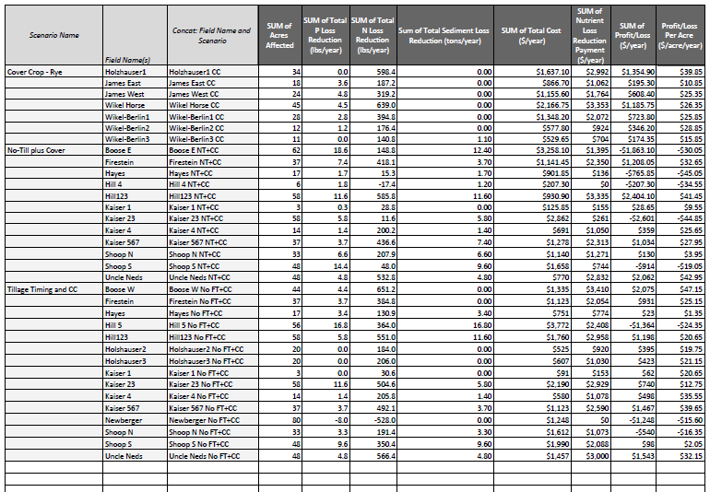
Results of Each Scenario on Each Field
Notes:
Each scenario by field
Reductions, Cost, Payment, Profit

Slide 20
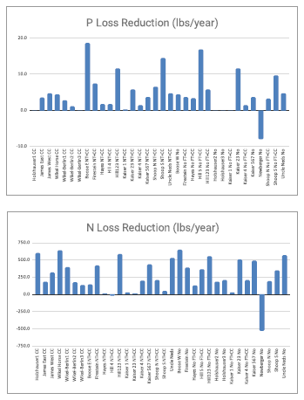
Provide Results to Each Farmer:
P and N Loss Reductions

Slide 21
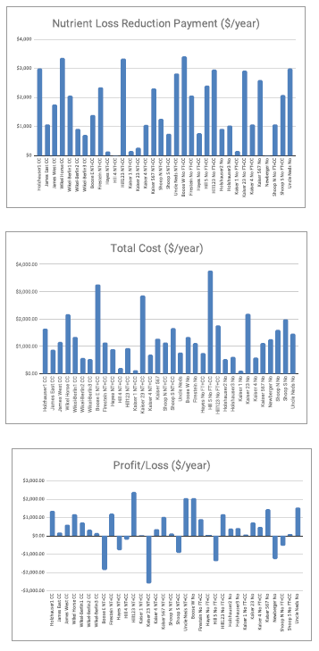
Provide Results to Each Farmer:
Payment, Cost, and Profit/Loss

Slide 22

One-Page Sign-up Form
Ohio Project

Slide 23
Cost-effectiveness ($/lb P loss reduction) Scenario Results Across Vermont Farms
Notes:
Explain our PT project approach:
Use of VT P Index to quantify field-specific P loss.
Goal was to see if performance-based incentives could reduce P loss cost-effectively
Sought voluntary participation in selected watersheds
Needed to figure out an appropriate price, given budget constraint
On each farm, we:
brainstormed with producer about changes they would be willing to do if the price were right
ran scenarios through the P Index
calculated total costs for each change and cost per lb P reduced
Some of the farmers interested in participating were the most active conservationists
They had already picked the low-hanging fruit (did not have many cost-effective actions remaining)
We did not want to penalize them for being good stewards
We designed an alternative “stewardship” payment
Based on weighted average P loss per acre across the farm
If P loss<0.5 lbs/acre = $2/ac
If P loss<0.1 lbs/acre = $5/ac
All prices were based on our budget constraint
The technical- AND cost-effectiveness of BMPs varies greatly from farm-to-farm AND from field-to-field.
There is great variation across types of BMPS, as expected, but also for any given BMP.
Take the example of cover crops. In our Vermont pilot-testing, cover crops ranged from costing $29 to $842 per lb of P loss reduction.
The most cost-effective change was a fertilizer tweak. {Explain this change}. This is not that kind of change that our current programs incentive farmers to do, even though they can be done through some of the EQIP practice standards.

Slide 24
Cost-effectiveness ($/lb P loss reduction) Scenario Results Across Iowa Farms

Slide 25
Results of Good Business Decisions
Watershed | P Loss Reduced (lbs/acre/yr) | Farm Cost ($/lb P) | Farm Profit ($/lb P) | Sediment Loss Reduced (tons/acre/yr)
Iowa | 0.88 | -$0.61 | $10.61 | 1.58
Vermont | 0.26 | $4.86 | $20.14 | 1.01

Slide 26
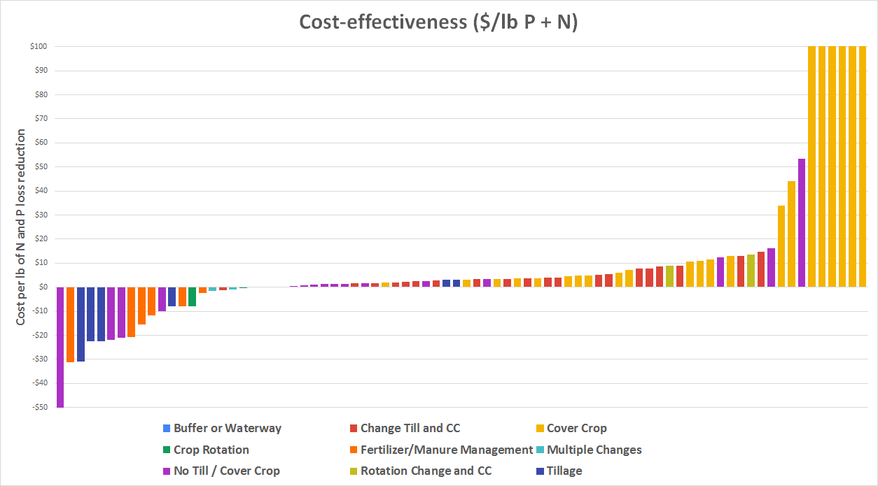
Old Woman Creek, Ohio
Results (2018)
Notes:
Using NTT
Pasting info in CAT
Better to disaggregate the BMPs, but takes more time and effort

Slide 27
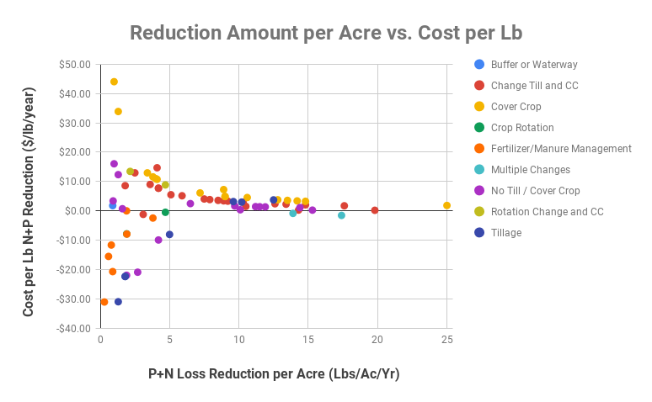
Scatter Plot of Scenario Results Ohio Farms
Notes:
Shows which BMPs can reduce a lot per acre at a lower cost per pound
Generally greater reduction/acre will mean lower cost/lb (like an economy of scale)
HIGHLY VARIABLE ACROSS AND WITHIN BMP CATEGORIES
HIGH VARIABILITY MAKES AVERAGES MEANINGLESS
IF WE WANT TO ACHIEVE WQ GOALS WITHIN A BUDGET, CONSERVATION PLANNING NEEDS TO BE FIELD-SPECIFIC AND USE SCIENCE AND ECONOMICS

Slide 28
Lessons Learned
Low-hanging fruit remains
Perf-based incentives inspire new ideas
Farmer motivation varies
Boots on the ground is essential
Transaction Costs < Program Benefits
Models: a necessary evil??
Policy change is slow
Notes:
28

Slide 29
Critical Needs
More WQ monitoring stations
Modeling tools that:
  Efficient to use
  Scientifically robust
  Address multiple ES
Enhanced farmer motivation
Available technical assistance
Notes:
29

Slide 30

Pay-for-Performance Conservation:
A How-To Guide
Describes steps and data needs
Goals:
  Reduce transaction costs
  Create opportunities for scale
Funded by Great Lakes Protection Fund
https://www.winrock.org/project/running-off-pollution-paying-midwestern-farmers-to-improve-water-quality/

Slide 31
Contact Information
  Jon Winsten
  Email: jwinsten@winrock.org
  Tel: (802) 343-3037
Notes:
31

Slide 32
Cost Analysis Tool (CAT)
Spreadsheet-based tool
Relatively quick for the technician
Describe changes in one row
Paste in nutrient loss from model
CAT calculates:
                Full economic cost: /acre, /field, /pound
                Payment and profit/loss
                Produces table and graphs
                Allows analysis across farms

Slide 33
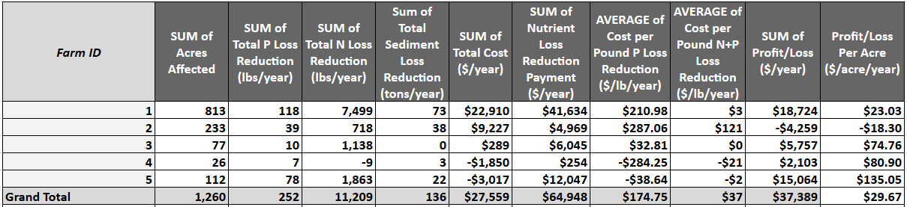
Results by Farm (Profit Focus)

Slide 34
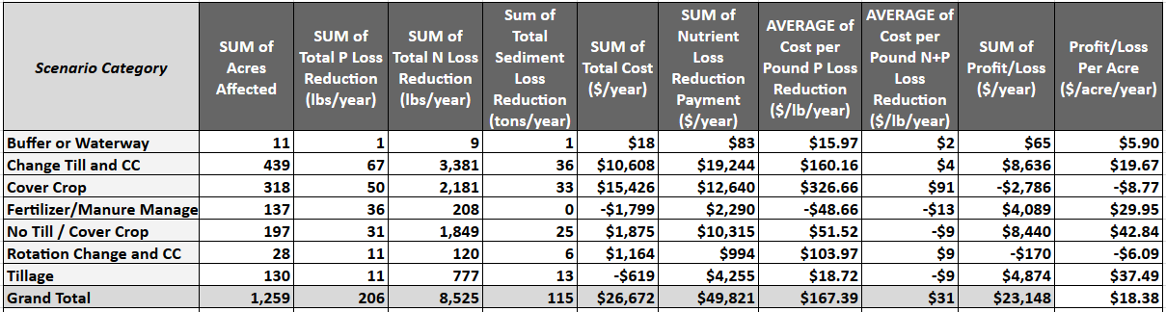
Results by BMP

Slide 35
Presentation Overview
Theory and concept
Design issues
Pilot-testing and results
Lessons learned
Ideas to ponder

Slide 36
Motivation 101
Motivation: Process that initiates, guides and maintains goal-oriented behaviors
Humans have a drive to reach a clearly defined goal
Appropriate goals are often missing from our current conservation programs
Goals need to have:
  Proximity - reached within a reasonable time period
  Difficulty - Not too hard to achieve, but not too easy either

Slide 37
Motivation 201
Intrinsic and extrinsic motivation
Intrinsic motivation
  Belief that we can be effective agents of change
  Interest to see how good our performance can get
  Derive gratification from the challenge
Extrinsic motivation
  Seeking an external reward
  Competition to be better than others
  Coercion to change behaviors

Slide 38
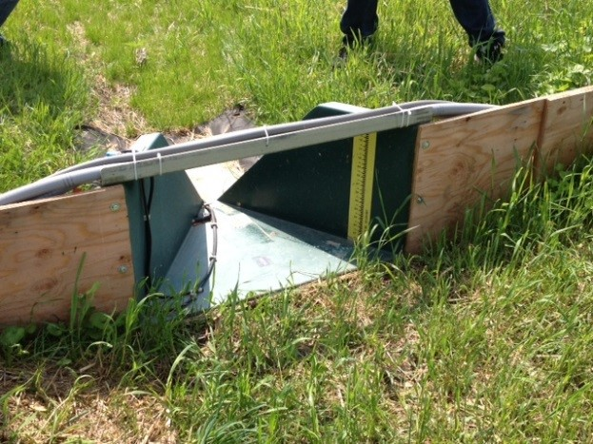
Edge of Field Monitoring
Notes:
Not practical to have everywhere

Slide 39
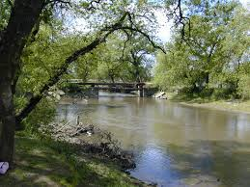
In-stream Monitoring
Notes:
Automated samplers
Doable, but still costly; too far from farm?

Slide 40
Simulation Modeling
Notes:
Using science to take into account characteristics of each field
Not going to be accurate in most years, but in the ball park?

Slide 41



Measured vs. Modeled Performance:
Pros and Cons
Measured performance
  Real data from actual conditions
  Volatile weather makes planning difficult
  Is measurement practical at the farm-level?
  Use of proxy variables
Modeled performance
  Allows for scenario analysis – before actions are taken.
  Is it accurate enough?
    In a given year?
    Over the long-term?
  Is it simple enough to use?
    Trade-offs between simplicity and accuracy?

Slide 42
Ideas to Ponder
Need clear goals to motivate farmers
Cost-effectiveness vs. fairness
Model-at-farm, measure-at-watershed
Tweaks vs. transformations
Notes:
42

Slide 43
Tweaks vs. Transformations
Environmental improvements can be made on every farm, if farmer is interested:
Tweaks:
  Simple field/crop management change to reduce P loss
Transformations:
  Restructuring production system to improve soil health and produce a set of ESs.
Ideally both improve the farms bottom line
  If not, payments will need to be on-going

Slide 44
Tweaks vs. Transformations
Issues to consider:
  Participation rate
  Initial costs
  Costs and benefits over time
  Single vs multiple ecosystem services

Slide 45
Model-at-the-farm,
Measure-at-the-watershed
Notes:
45
New approach uses scientific advances in simulation modeling and outcome-based incentives.
Pays farmers for achieving nutrient reduction goals;
Farmers choose how to best reduce nutrient loss from their specific fields;
Incentivizes farmers to choose the most cost-effective actions BECAUSE becoming more cost-effective increases net farm income.

