Slide 1
STAC Workshop Report-Out
Zach Easton
Kurt Stephenson
Dec 18 2019

Slide 2
Increasing Effectiveness and Reducing the Cost of Non-Point Source Best Management Practice (BMP) Implementation: Is Targeting the Answer?
Nov 12 & 13 NVRC, Fairfax VA
33 invited attendees representing 4 states, agencies, academia, technical service providers, implementers, and funders
Steering Committee: Easton (chair) Stephenson (co-chair), Amy Collick, Patrick Fleming, Elliott Kellner, James Martin, Marc Ribaudo, and Gary Shenk

Slide 3
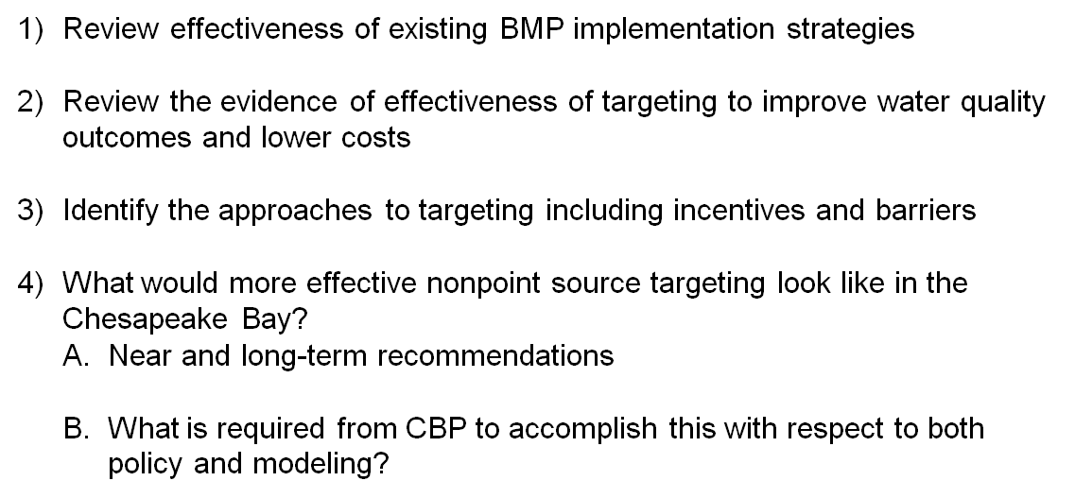
Workshop Objectives

Slide 4
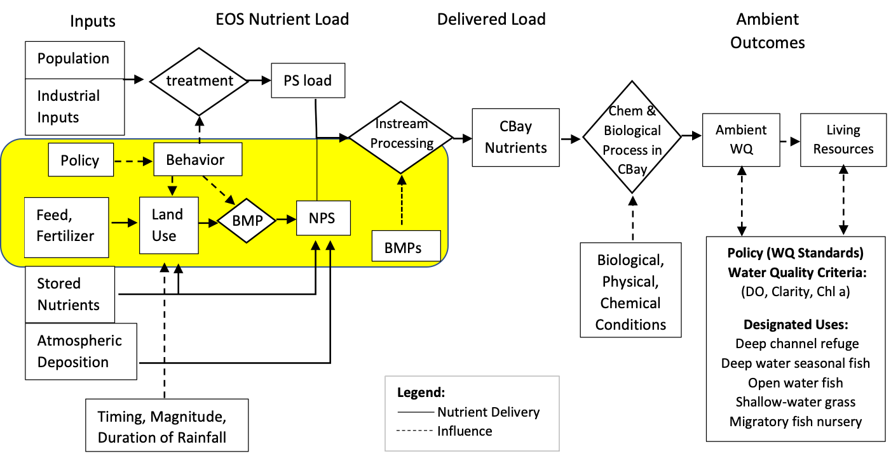

Slide 5
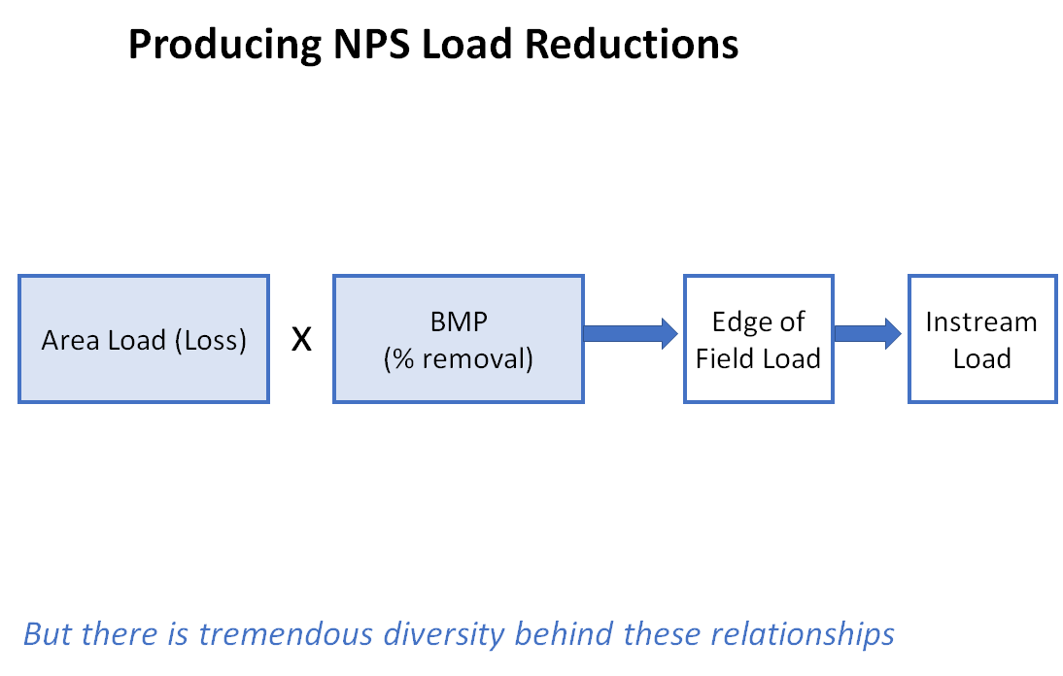

Slide 6
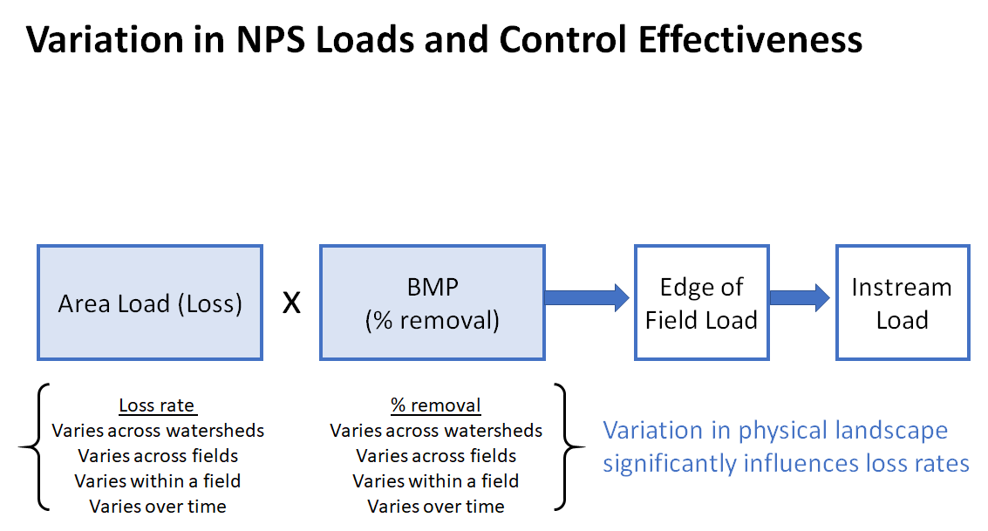

Slide 7
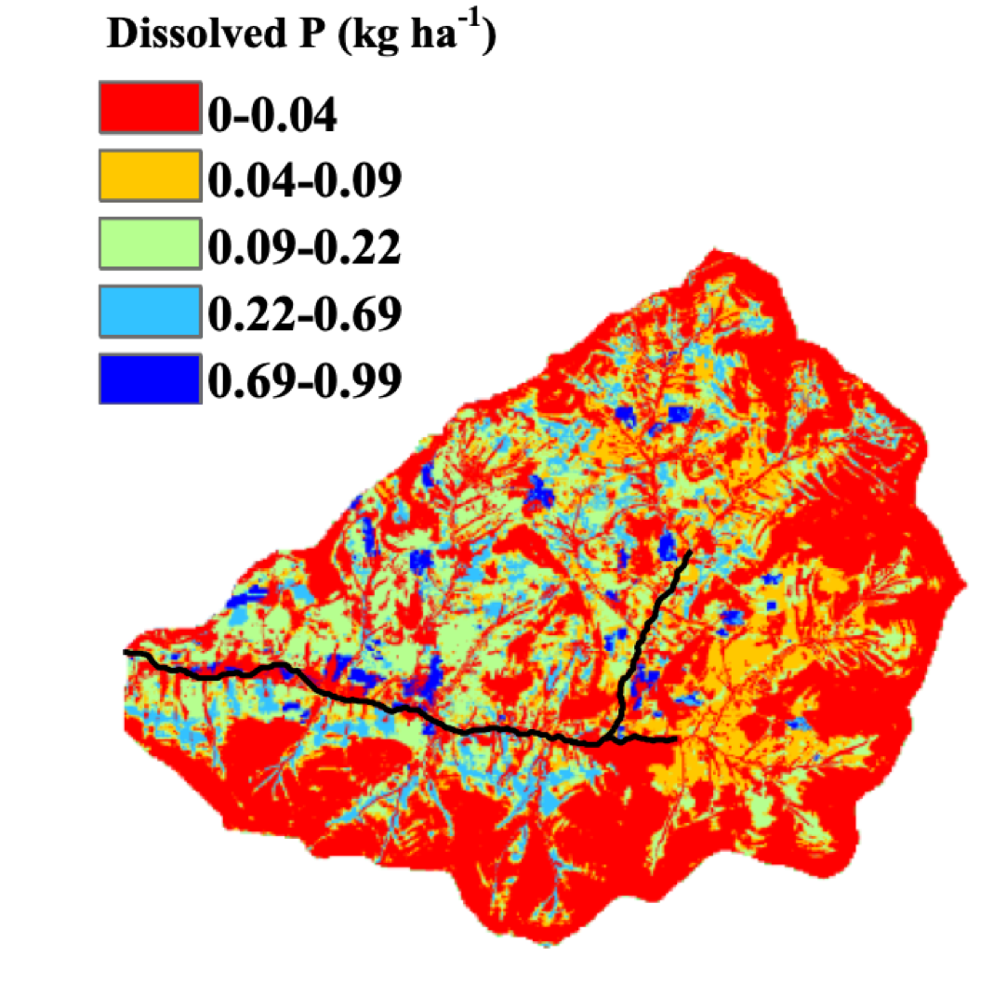
Scale
9,000 acre sub-watershed

Slide 8
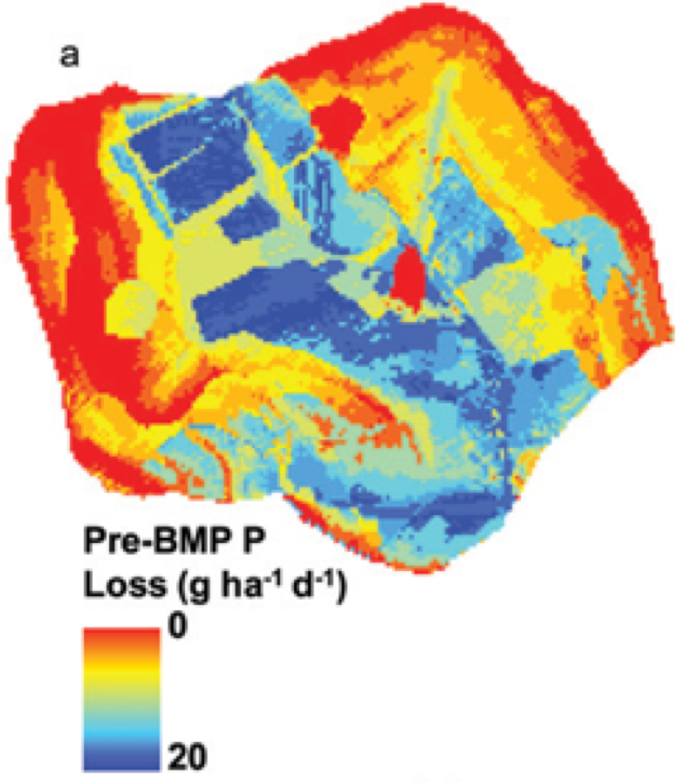
400 acre farm

Slide 9
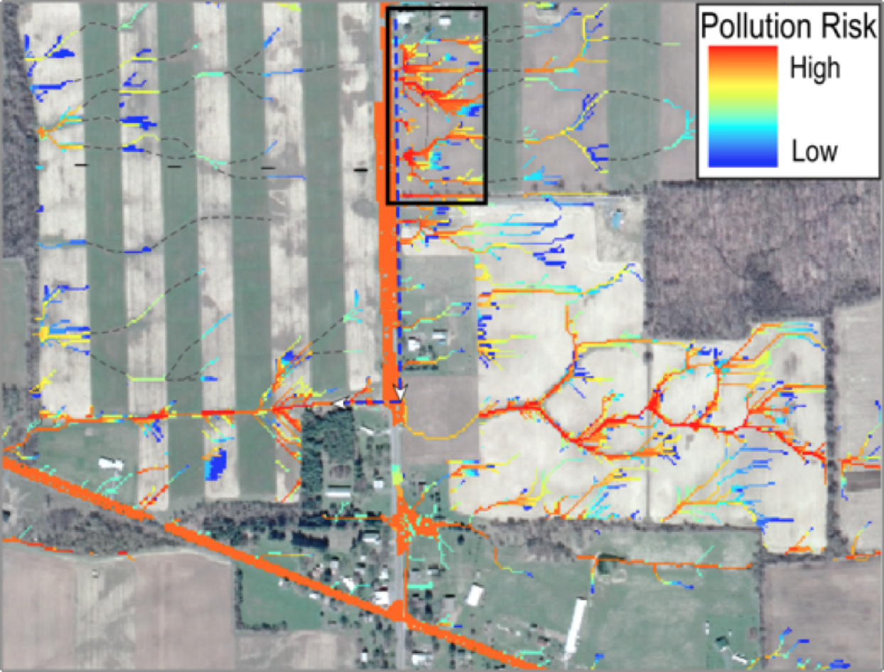
15 acre parcel

Slide 10
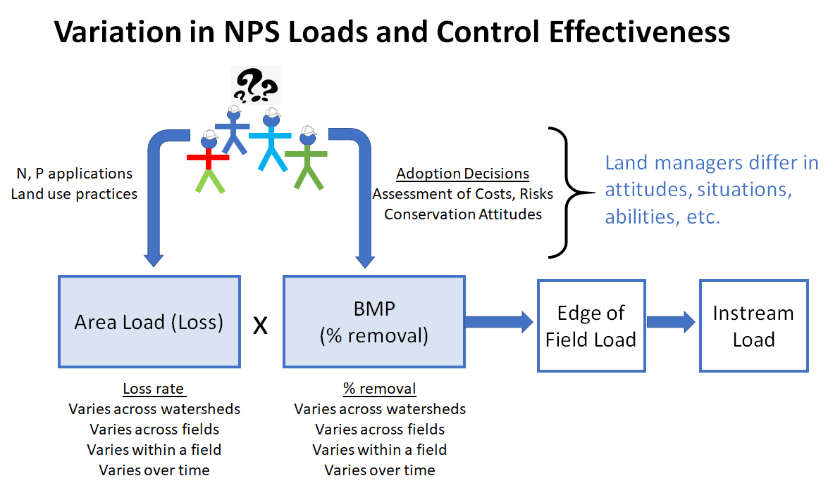

Slide 11
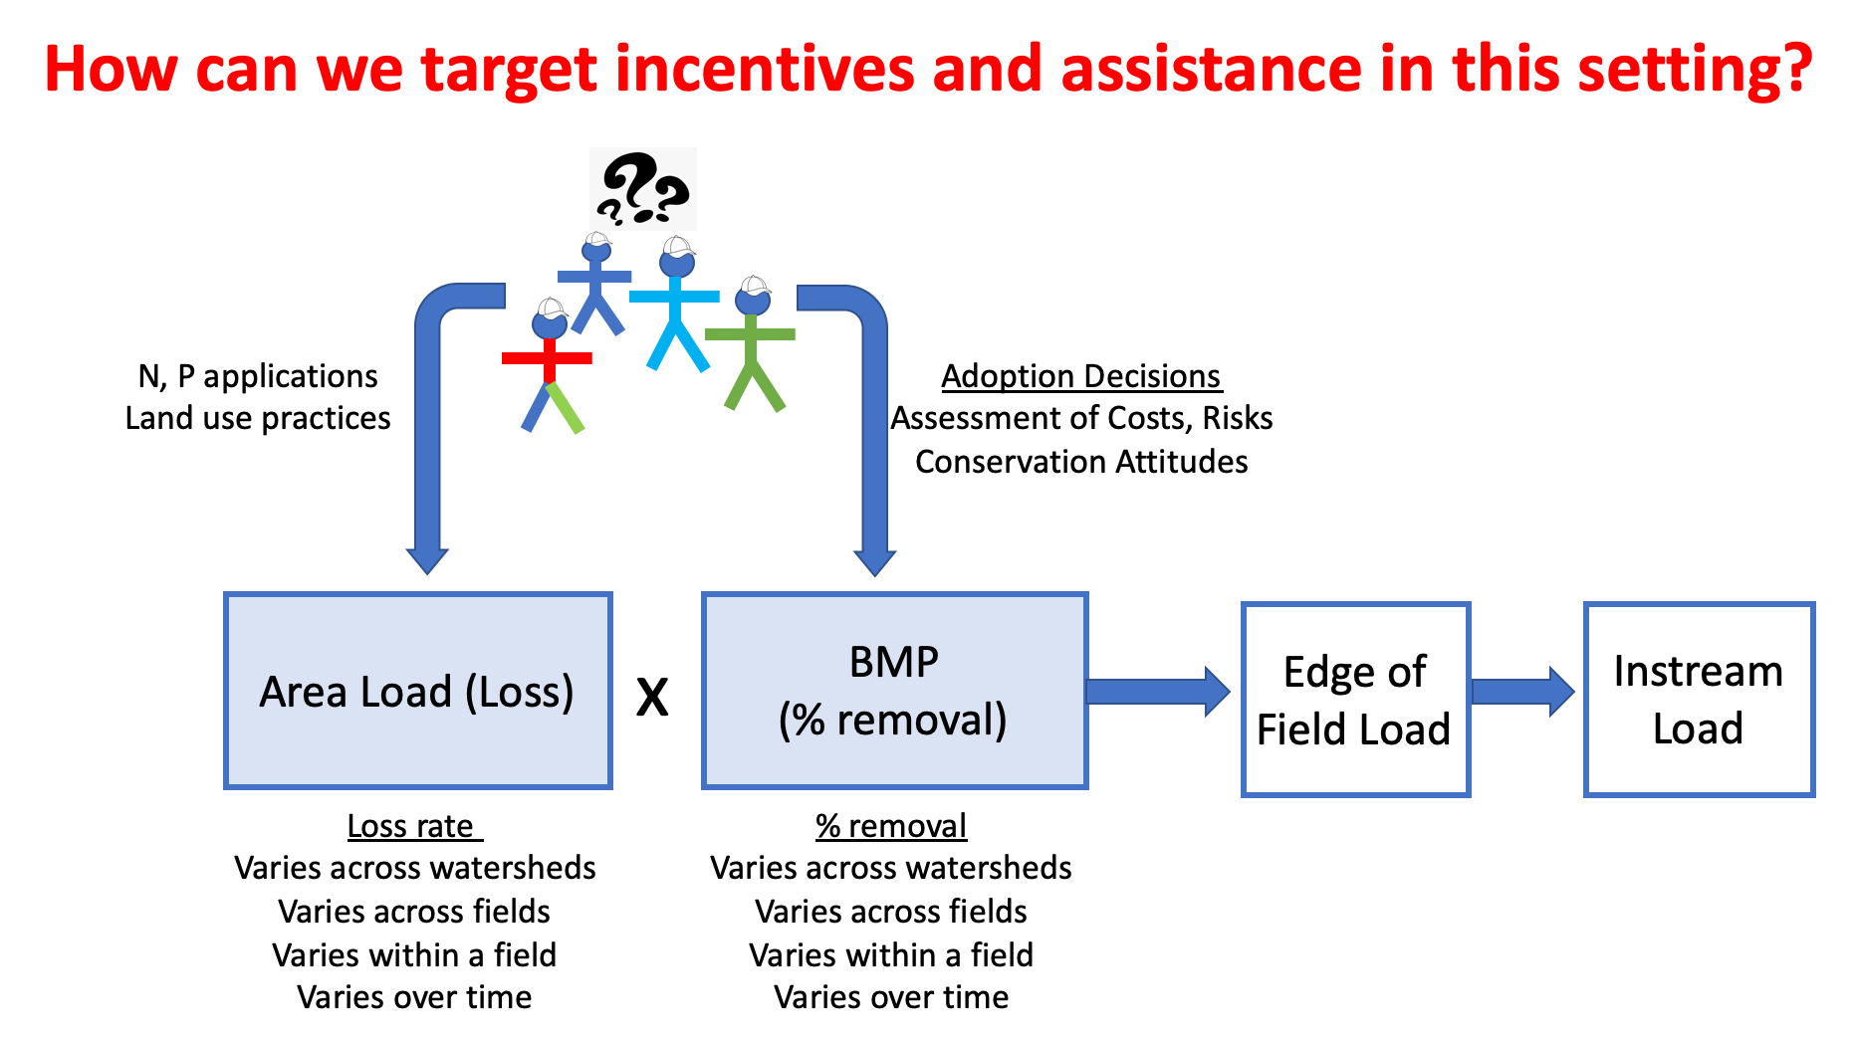

Slide 12
Workshop Agenda and Structure
Pre-Workshop Background Paper
Morning Day 1: Presentations on:
Overview of motivation/content of workshop and CBP programs(Martin, Shenk, Easton & Stephenson)
Case study alternatives (next slide)
Afternoon Day 1:
Panel discussion of opportunities/challenges
Breakout groups to identify opportunities and challenges for CBay
Morning Day 2:
Group discussion on consensus from Day 1
Breakout groups to develop recommendations

Slide 13
Workshop Agenda and Structure (cont)
Morning Day 1: Presentations by Jonathan Winsten, Joe Sweeny, Alan Collins illustrating different case applications/approaches:
Program | Targeting Approaches | Incentive Systems
Winrock Programs (Winsten) | Field level modeling of P reduction | Payments for performance (lbs reduced)
PA Legacy Sediment (Sweeny) | Use of remote sensing to identify high sediment loss areas with restoration potential
WVA Group Payments (Collins) | Ambient monitoring of small watershed (Cullers Run) | Group payment scheme based on ambient outcomes

Slide 14
Workshop Agenda and Structure (cont)
Early afternoon Day 1:
Panel Discussion of Lessons Learned:
Mark Ribaudo (ERS, analysis of targeting potential, incentive design)
Leonard Shabman (Resources for the Future, Florida Payment for Environmental Services program)
Jonathan Winsten (Winrock International, pilot programming for nonpoint source pay-for-performance

Slide 15
Workshop Outcomes
Broad consensus on:
There are opportunities to increase the amount of NPS reductions we can achieve for every dollar spent.
There is recognition that some areas produce disproportionate NPS loads and that BMP effectiveness varies across the landscape.
More effective methods for identifying spatial variation in pollutant source areas and BMP effectiveness will increase the effectiveness of programs.
Increasing flexibility in how we incentivize land managers (ex cost share for practice vs pay for outcomes) can improve NPS program effectiveness (more load reduction per program dollar spent, less uncertainty).

Slide 16
Workshop Recommendations
Improve the spatial prediction capability of the CBP TMDL accounting system:
  Develop finer scale modeling capacity to guide and inform targeting
  Continue to improve spatial resolution of datasets that drive the CBP models
  Allow for differential crediting of BMPs
Develop and test alternative incentives systems for targeting programs:
  Develop and support testbed watersheds to pilot and test targeting incentives
    Enhanced monitoring to support/evaluate targeting programs
  Support development nonfinancial approaches to encourage participation

Slide 17
Workshop Report Timeline
Draft report complete and under review by workshop steering committee
Distribute to workshop attendees for review in January
Report finalized in February
CBP incorporates all recommendations, 20XX?

Slide 18
