Slide 1
The Chesapeake Bay Program Partnership’s Watershed Model
Gary Shenk – USGS
Chesapeake Bay Program Office
STAC BMP targeting workshop 11/12/2019
This information is being provided to meet the need for timely best science. The information is provided on the condition that neither the U.S. Geological Survey nor the U.S. Government shall be held liable for any damages resulting from the authorized or unauthorized use of the information.

Slide 2
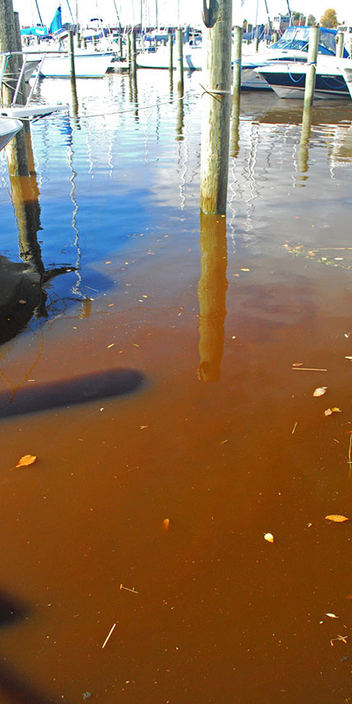
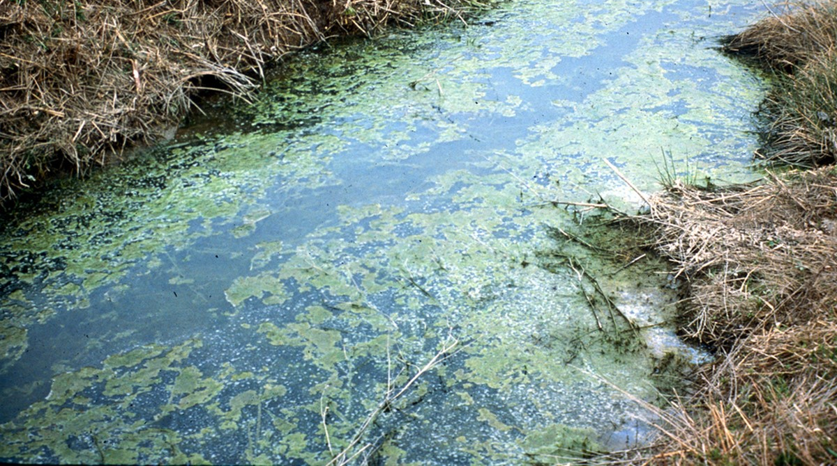
Less of this…
Less of This

Slide 3

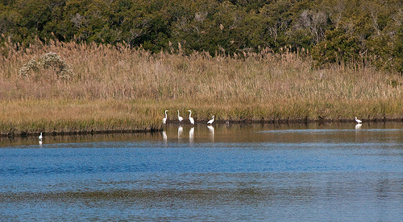
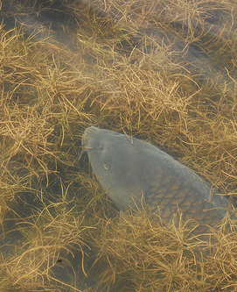
More of this…
More of This

Slide 4
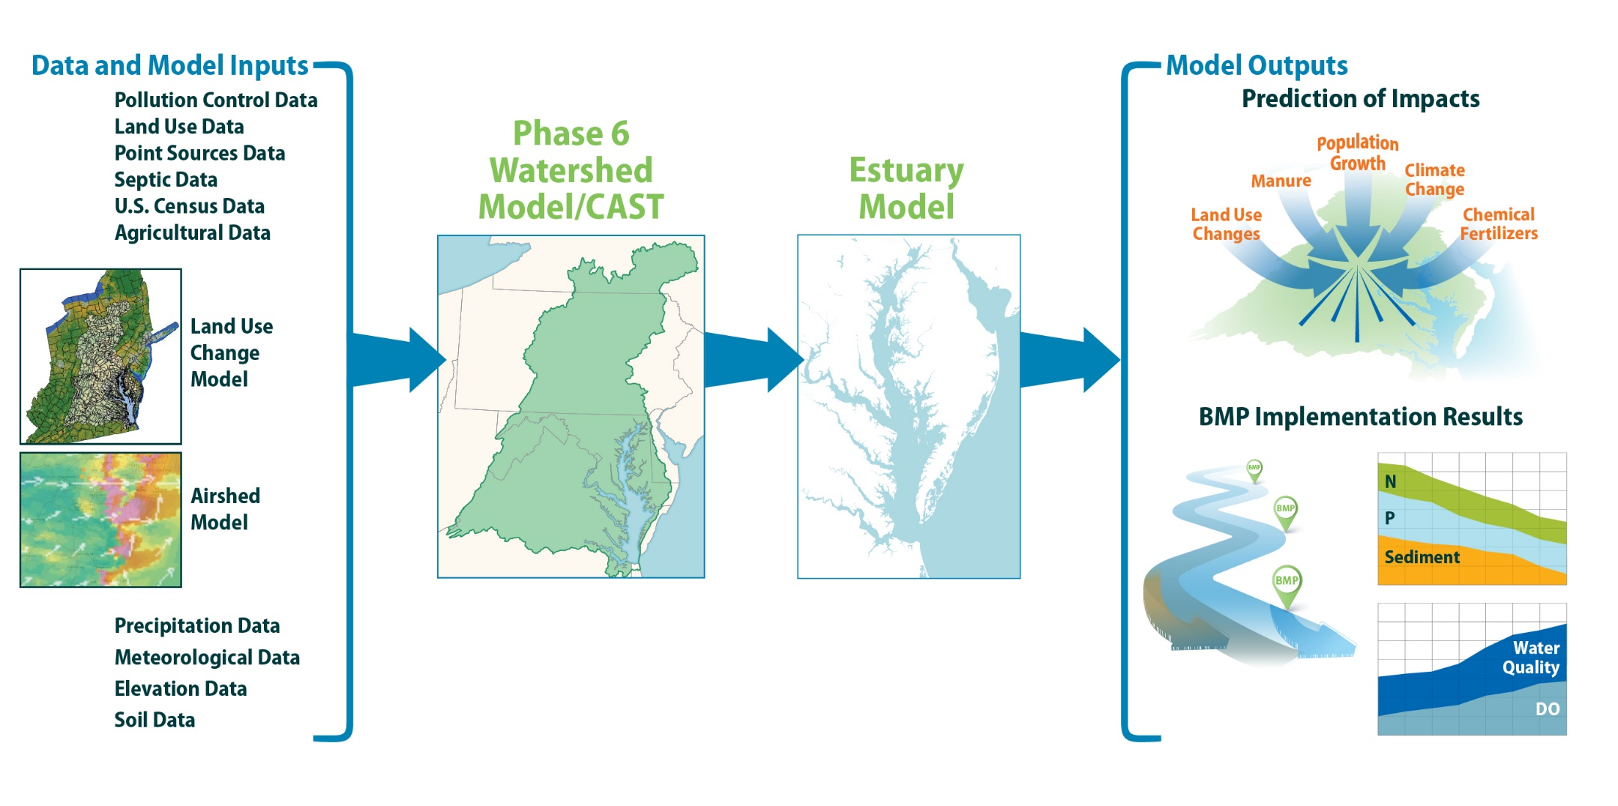

Slide 5
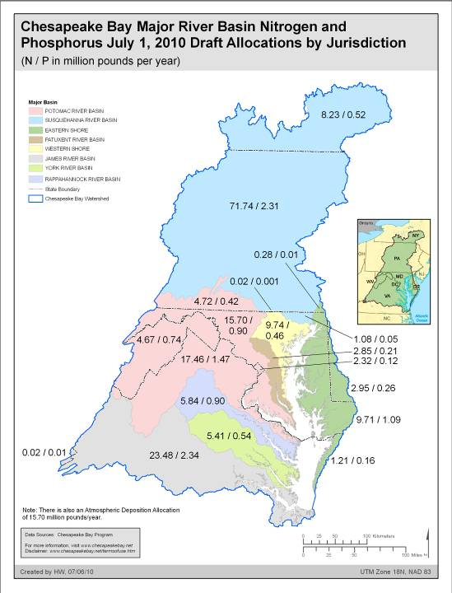
State-basin allocations
Nitrogen and Phosphorus
Million pounds per year

Slide 6
Guidelines for Planning Targets
Effort
Increasing relationship between Relative Effectiveness and Effort
Effectiveness
Notes:
6

Slide 7
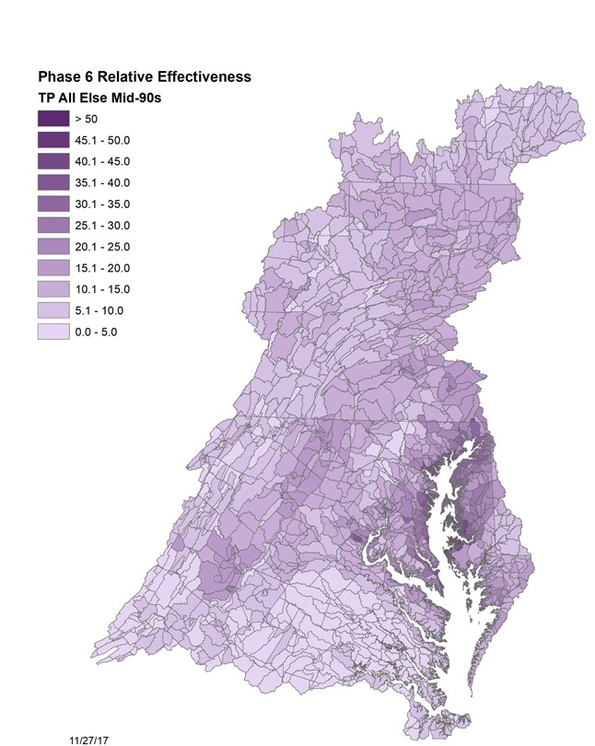
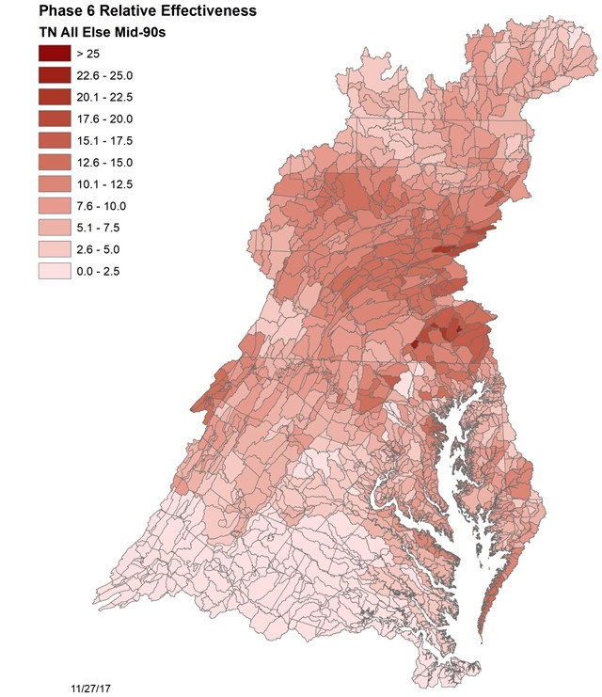
More Impact, Do More
Dissolved Oxygen effect per pound of nutrient released in the watershed
Nitrogen
Phase 6 Phosphorus

Slide 8


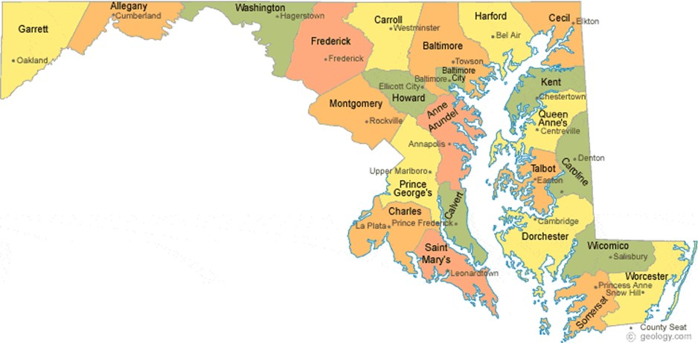
Target Process
“local”

Slide 9
WIP Process
“local”

Slide 10
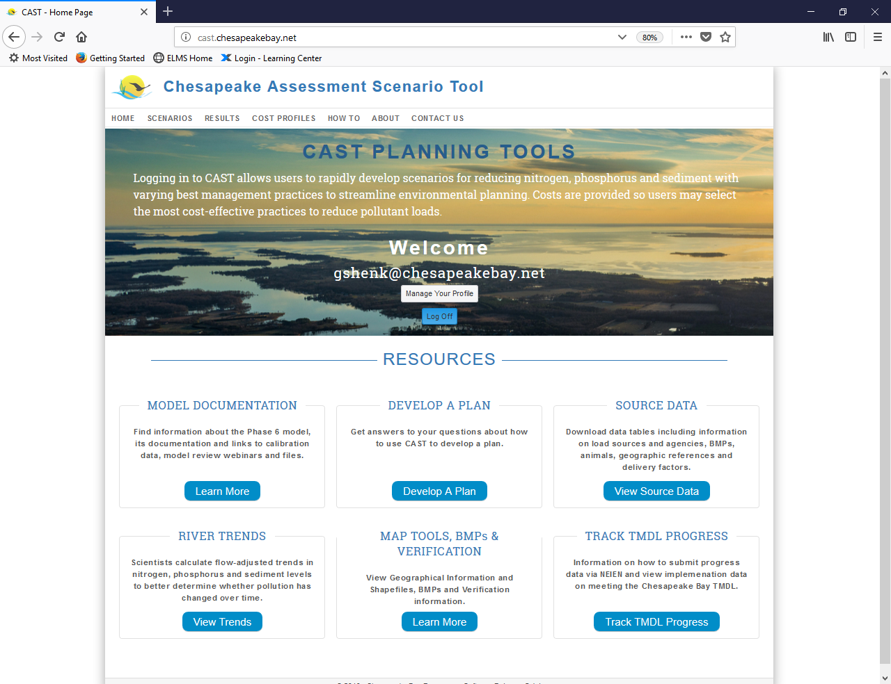
Cast.chesapeakebay.net
1000s of scenarios in 2018

Slide 11
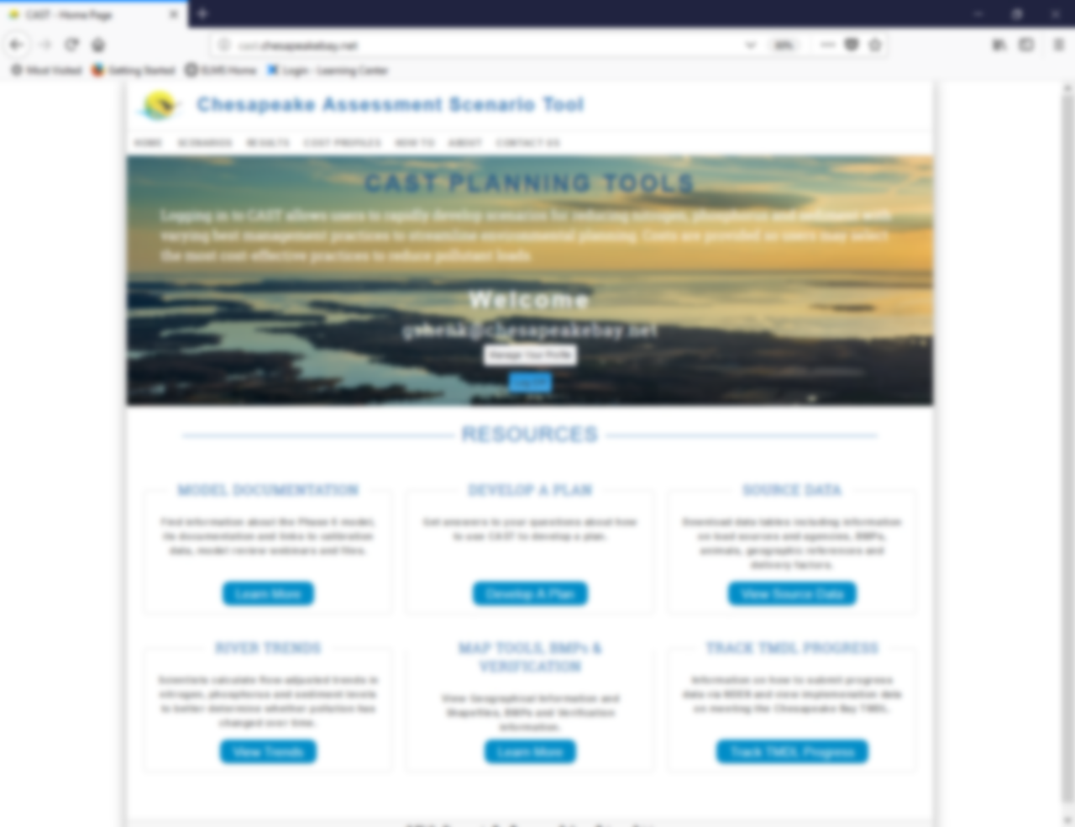
CAST
Cast.chesapeakebay.net
Download and analyze CBP Scenarios
Develop scenarios
Get Documentation
  Maps
  BMP panel reports
  Input data
  Technical documentation
Get trained to use CAST and develop a plan
Compare to observations
1000s of scenarios in 2018

Slide 12
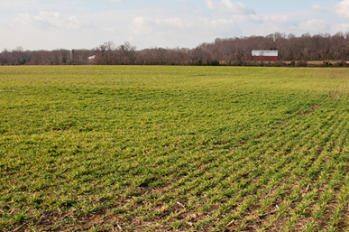
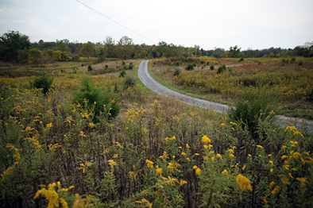
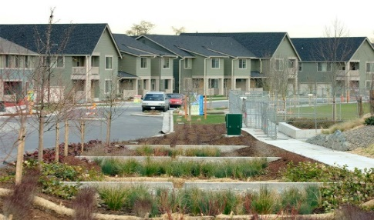
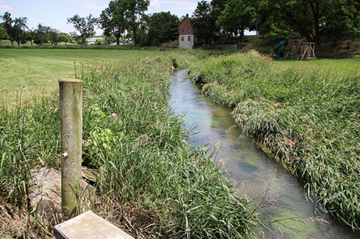
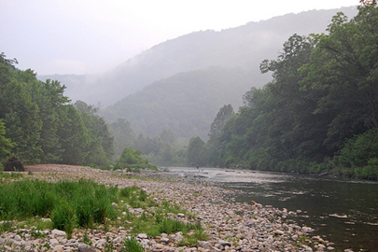
Phase 6
Phase 6 Model Structure
Average Load + Inputs * Sensitivity
Land Use Acres
BMPs
Land to Water
Stream Delivery
River Delivery
*
*
*
Direct Loads
*
*

Slide 13
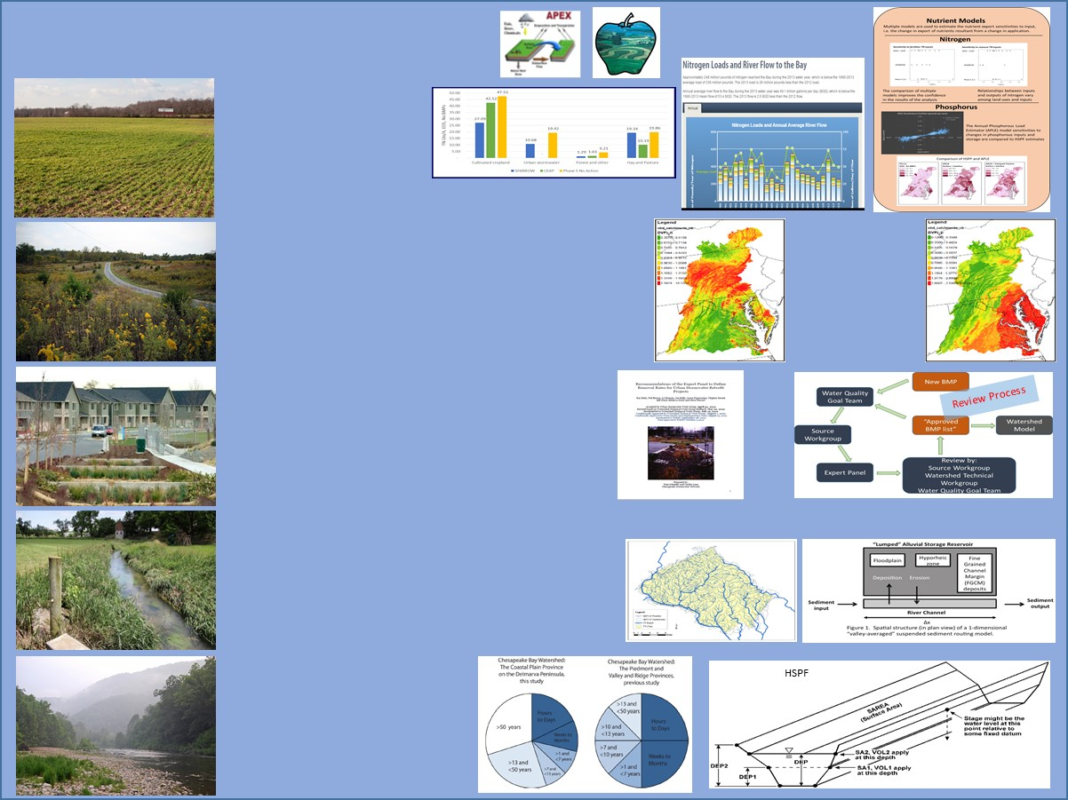
Keep It Simple
Include Everything
Average Load + Inputs * Sensitivity
Land Use Acres
BMPs
Land to Water
Stream Delivery
River Delivery
*
*
*
Direct Loads
*
*

Slide 14
Include Everything
Finished
Phase 6 Beta 1 Processes and Dependencies
Potentially Finished
Planned Update in 2016
Climate Models
Planned Update in 2015
Area of Concern
Meteorological Data
Hydrology
Sediment
Rainfall, Temp, PET
Temperature
P6 Segmentation
EOS Nutrients
Lag Nutrients
Atmospheric Deposition Data Set
Small Scale Factors
Insensitive hydrology parameters
Diversions
River
CMAQ
Land Use Types
HSPF PWATER
Point Source Flows
Grimm Atmospheric Deposition Data
Hydrology Calibration Routine
Calibrated Hydrology Parameters
Flow Data
Land Sediment Calibration Routine
TetraTech RUSLE2
Land Use Acreage
Sediment Targets
Land Data Team RUSLE2
Full files for
DETS and COVER
HSPF SEDMNT
SOLIDS
or
Phase 5 Sediment Targets
Calibrated Land Sediment Parameters
Land use Flow time series
Calibrated Temperature Parameters
Soil P history
APLE
Temperature Calibration Routine
HSPF PSTEMP
Soil P level
observations
Land use Sediment time series
Phase 5.3.2
Nutrient Targets
CEAP
Modeled Travel Time Distributions
Scenario Builder Nutrient Data
ALULRSC Ratios
Urban Ratios
Forest Ratios
or
Temporal Disaggregation
Sensitivities
Estimated Travel Time Distributions
Scenario land use loads
UNEC
rSAS
Sparrow
River WQ Calibration Routine
Calibrated Land use Loads
WQ data
Interconnectivity
WRTDS NTN Loads
Scenario Builder BMP data
EOS Nutrient Time Series
Wetland function
Calibrated RCHRES parameters
HSPF RCHRES
Land to water factors
Stream to River factors
Reservoir Specifications
Conowingo
Simulation
Point Source Loads
Urban Stream Source Ratio
Stream Geomorphic Mass Balance

Slide 15
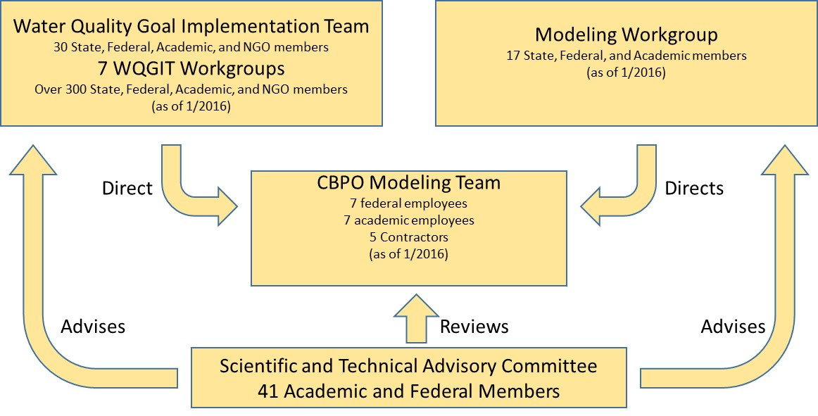
Include Everyone

Slide 16
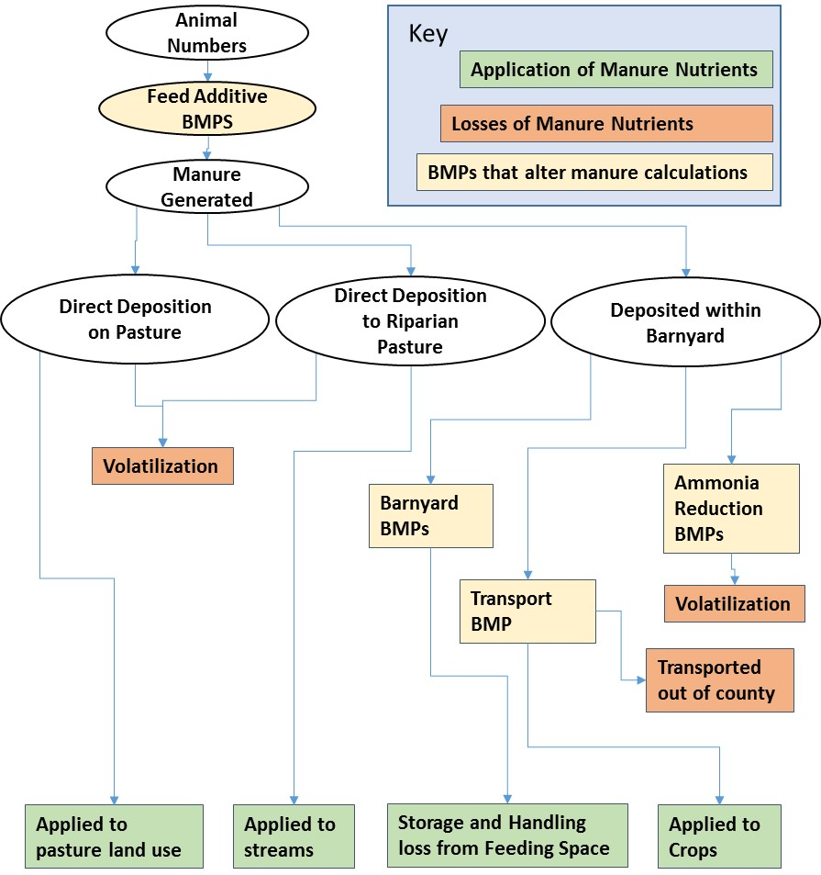
Some questions are management-related

Slide 17
Collaborative Stakeholder-Expert Processes – BMP effectiveness
Expert Panel to determine effectiveness of BMPs
Academics
Managers
Practitioners
CBP Water Quality
Goal Implementation Team
Agriculture,
Wastewater,
Urban, or
Forestry Workgroup

Slide 18
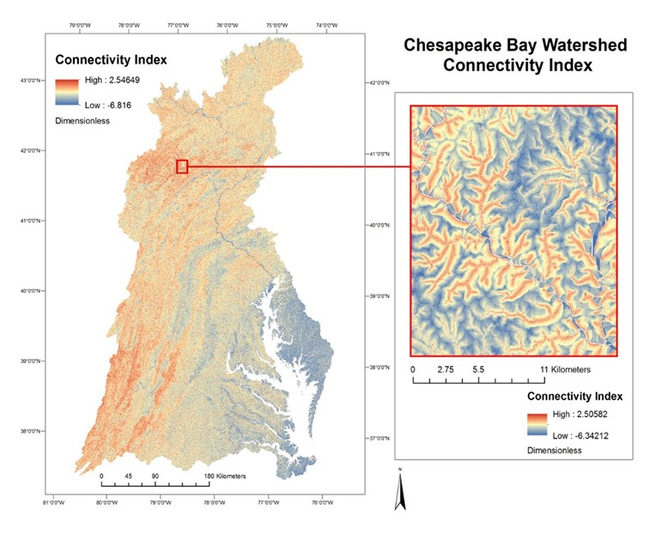
Fine-scale spatial analysis to improve sediment prediction
Some questions are more scientific

Slide 19
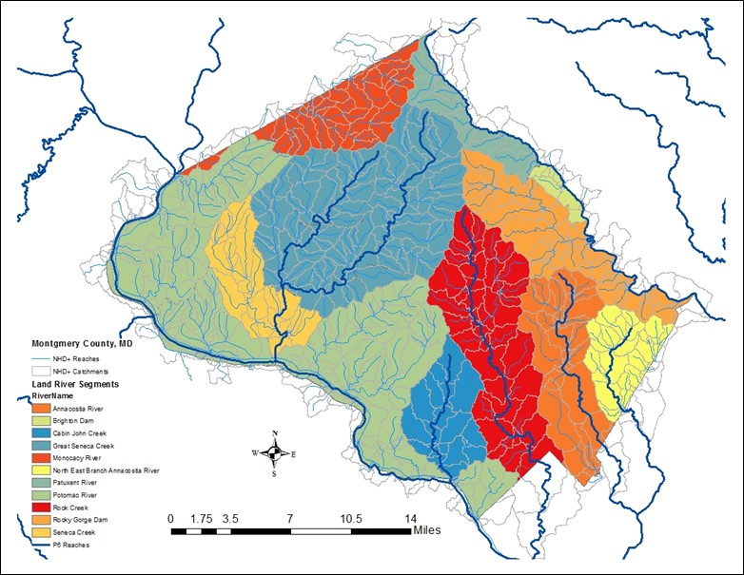
Montgomery County, Maryland
SCALE
NHD streams
Simulated Watersheds

Slide 20
Scale of inputs
CB watershed
  Fertilizer inputs
Geomorphic region
  Management practice effectiveness
County
  Cropping systems
  Manure inputs
  Agricultural management practices
River Segment ~100 square km
  Large river attenuation
  Land use
NHD catchment ~ 3 sq km
  nitrogen and phosphorus delivery
10-meter pixel
  Land cover
  Sediment loss
Point
  Developed land management practices

Slide 21
Tools for targeting
Criterion | CAST | Something else
Accessible | Yes | Yes
Consistent with Chesapeake TMDL | Yes | No
Field-scale | No | Yes

Slide 22
Tools for targeting
Criterion | CAST | Something else
Accessible | Yes | Yes
Consistent with Chesapeake TMDL | Yes | No, but maybe that’s not your only goal
Field-scale | No, but it is actually any worse in predicting loads | Yes

Slide 23
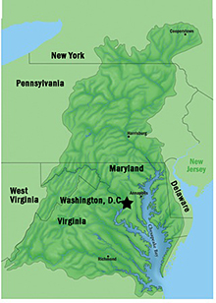
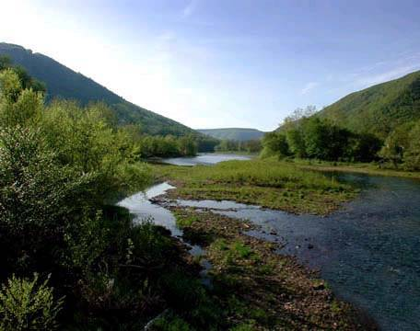





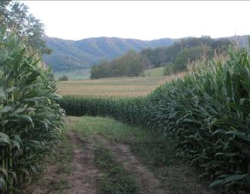
Questions

