Slide 1
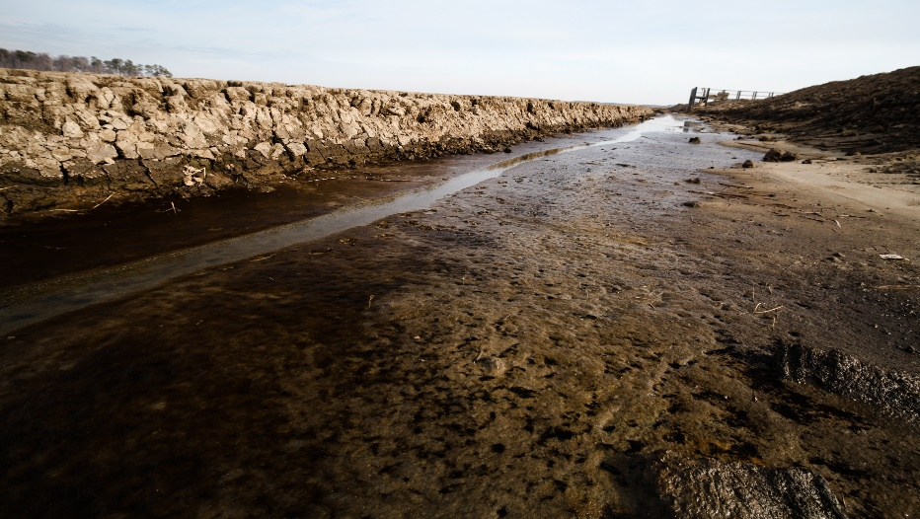
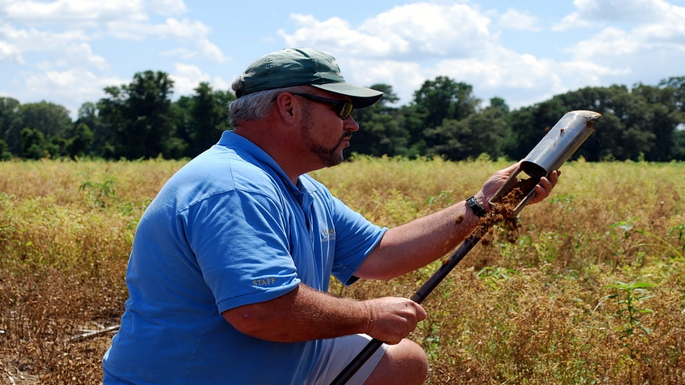


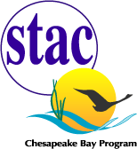


Save the Date!
January 23-24, 2020
  Erickson Alumni Center, WVU
  Morgantown, WV
Linking Soil and Watershed Health to In-Field and Edge-of-Field Water Management Workshop
You are invited to participate in a two-day workshop exploring linkages among water management, crop yields, soil conditions and field hydrology to identify research and informational gaps. This activity will convene researchers and field experts from a range of interrelated disciplines to discuss cutting-edge advances in their fields and to explore linkages that could lead to innovative drainage management. Your partnership in this effort will further define the best opportunities to advance regenerative soil health and water security.
For more information, visit:
Usually we would include STAC’s website page here
Contact STAC Staff Meg Cole to RSVP:
p: 410-798-1283 or e: colem@chesapeake.org

