Slide 1

Preliminary Estimates of Future Climate Change Influence On Water Quality In Chesapeake Bay Using CH3D-ICM
STAC Workshop: Climate Change Modeling 2.0
September 24, 2018
Richard Tian, Carl Cerco, Lewis Linker and CBPO Modeling Team
Chesapeake Bay Program
Science, Restoration, Partnership

Slide 2
Outline
Improved sea level rise simulation
Corrections to air to water heat flux inputs
Updated nutrient loading from the watershed
Refinements to open ocean boundary
Preliminary results

Slide 3
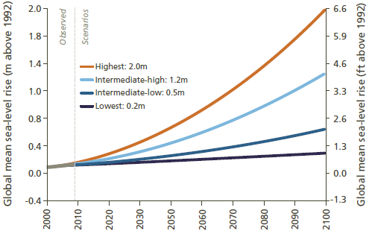
Following the recommendations of the CBP Climate Resiliency Workgroup, 0.5 m, 0.3 m and 0.17 m of sea level rise were estimated for 2050 moderate, 2025 high, and 2025 moderate, respectively (compared to TMDL baseline of 1995 SL, i.e., mid 1991-2000).
Sea Level Rise Estimates
Linear interpolation and extrapolation for 2035 (0.3 m), 2045 (0.43 m), 2055 (0.57 m) and 2065 (0.7 m).
Climate Resiliency Workgroup will provide best CBP estimates of 2035 and 2045 in 2019.
2025: 0.3 m
2050: 0.5 m
2025: 0.17 m
From Parris et al. (2012). Global Sea Level Rise Scenarios for the United States National Climate Assessment. NOAA Technical Report OAR CPO-1. (1992 used as the starting year)

Slide 4
Sea level rise simulation
Base
Sea level rise
Sea level rise
Hypoxia volume in CB4
Change the grid
Change the open boundary
MSL
2.13 m
2.30 m
2.13 m
1.52 m
1.52 m
1.52 m
1.52 m
1.52 m
1.52 m

Slide 5
ICM Meteorological Forcing for Heat Transfer From Air to Tidal Waters
AIR TEMPERATURE
DEW POINT
WIND
SKY COVER
Climate Change +ΔT_{air(2025)} = 1.05 °C
Dew point recomputed assuming relative humidity constant
Hex program
Equilibrium T (TE)
Heat exchange coefficient (KT)
Relative humidity (RH) remains approximately constant on climatological time scales and planetary space scales (IPCC, 2014)
ΔT=KE(TE-T)/(Cp•V)

Slide 6
Changes in river discharge and nutrient loading in the 2025 and 2050 climate change scenarios
River discharge
Nitrogen loading
Phosphorus loading
From Gopal Bhatt

Slide 7
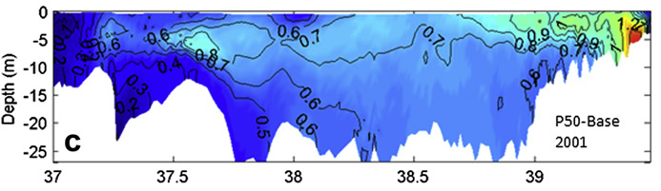
2050 salinity adjustment at the the ocean open boundary
Constant salinity in vertical profile: +0.4 psu based on Hong and Shen, 2012, supported by Seba et al., 2016 for 2050.
For 2025 0.14 psu (= 0.4 x 0.17/0.5)
0
0
Depth (m)
Depth (m)
200
Hong and Shen
25
Seba et al. 2016
Hong & Shen 2012

Slide 8
Temperature adjustment at the open boundary
Sep 1, 1993
Nov 15, 1993
ΔT_{water}=1.0•ΔT_{air} • T_{water}/T_{surface}
ΔT_{water}=0.6•ΔT_{air} • T_{water}/T_{surface}
Morrill et al 2014:
An increase in water temperature of about 0.6-1.0°C for every 1°C increase in air temperature.

Slide 9
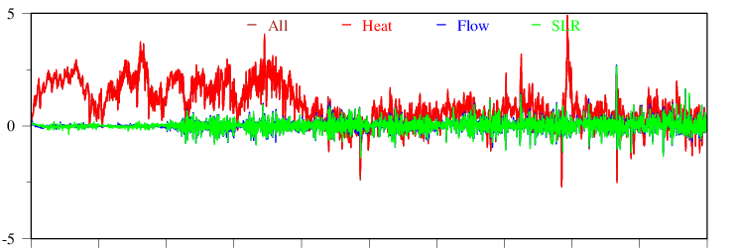
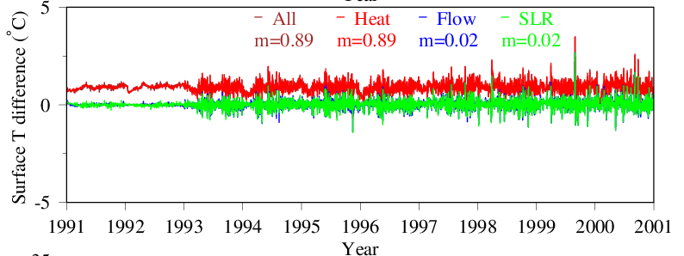
Surface temperature difference between climate change scenarios and the base case, Station CB4.3C.
Erroneous ΔT (°C)

Slide 10
Surface water T change under 2025 and 2050 CC
Thomas et al 2017: data 1982-2014, 0.3 °C per decade;
Preston 2004: Data 1949-2002: 0.185 °C per decade;
Irby et al., 2018: 1.75 °C for 2050.
2050 Air T increase 1.85
2025 Air T increase 1.05
Bay Head
Bay Mouth

Slide 11
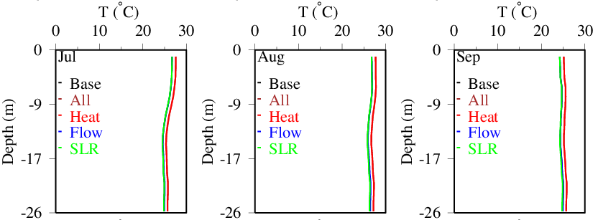
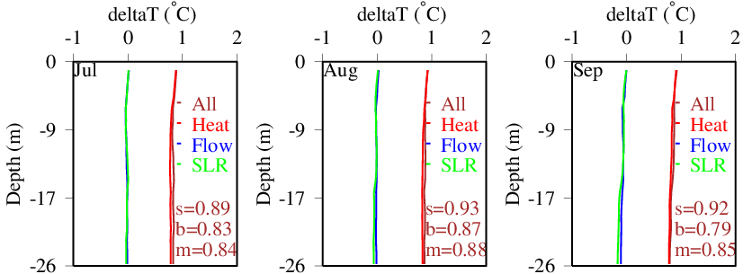
T and ΔT profile at CB4.3C under 2025 CCC
4
Annual
2
ΔT (°C/30yr)
0
-2
4
Summer
2
ΔT (°C/30yr)
0
Andrew Sommerlot
-2
0
10
20
30
Depth (m)
S: surface; b: bottom; m: vertical average over 10 years.

Slide 12
Monthly air T change and surface T simulation at CB4.3C
2025 Air T increase 1.05
2050 Air T increase 1.85

Slide 13
+16%
+1.8%
+7.5%
+4.1%
+6.3%
+5.6%
-5%
-14%
+10%
+20%

Slide 14
Temperature effects
Dissolved oxygen solubility: a 0.9 °C increase in temperature decreases dissolved oxygen solubility by 0.13 mg/l, or 1.7%.
Biological rates: increase 6% over 0.9 °C (Q₁₀=2)
Stratification (physics)

Slide 15
Sensitivity analysis of T modified DO-saturation and biological rate and stratification on water quality, CB4MH, deep channel
Contribution
49%
35%
16%
Change
+3.7%
+2.7%
+1.2%
DO < 1 mg/l summer 1991-2000
DO non-attainment in CB4 DC

Slide 16
Cross-transect water mass fluxes
Base case versus sea level rise (SLR)
Summer 1993-1995
CB2/CB3
Transect
CB3/CB4
Transect
CB4/CB5
Transect
Below Potomac
Transect
1,356
1,352
2,318
2,336 (1%)
5,311
5,891 (11%)
7,235 Base
7,577 SLR (5%)
782
785
1,908
1,979 (4%)
4,743
5,328 (12%)
6,492 Base
6,854 SLR (6%)
Toward Head of Bay
Toward Ocean
Base = Beta 2 Calibration. SLR = 0.5m Sea Level Rise Scenario representing relative Chesapeake sea level riser from 1995 to 2050. Units in mean cubic meters per second (m³/s) for summer 1993 to 1995 hydrodynamics.

Slide 17
Estimated DO water quality attainment in the Deep Channel CB4MH under the WIP condition

Slide 18
Conclusions:
Temperature is the most sensitive variable in controlling hypoxia under estimated 2025 and 2050 climate change conditions, followed by sea level rise and nutrient loading.
Increased temperature increases hypoxia whereas sea level rise improves DO in the Deep Channel, with the combined effect of an increase in 1.8% non-attainment in CB4 Deep Channel under the WIP condition with estimated 2025 future climate risk.
Sea level rise magnitude: linear interpolation for 2035 and 2045; Waiting for final recommendation from Climate Change Resiliency WG.
Investigation of air to water factor for temperature
at the open ocean boundary ongoing.
Chesapeake Bay Program
Science, Restoration, Partnership

Slide 19
Annex

Slide 20
AR5 global mean sea level (m) increase projections[7]
 | 2046–2065 | 2081–2100
Scenario | Mean and | Mean and
 | likely range | likely range
RCP2.6 | 0.24 (0.17 to 0.32) | 0.40 (0.26 to 0.55)
RCP4.5 | 0.26 (0.19 to 0.33) | 0.47 (0.32 to 0.63)
RCP6.0 | 0.25 (0.18 to 0.32) | 0.48 (0.33 to 0.63)
RCP8.5 | 0.30 (0.22 to 0.38) | 0.63 (0.45 to 0.82)
ICPP AR5 2014
AR5 global warming increase (°C) projections[7]
 | 2046–2065 | 2081–2100
Scenario | Mean and | Mean and
 | likely range | likely range
RCP2.6 | 1.0 (0.4 to 1.6) | 1.0 (0.3 to 1.7)
RCP4.5 | 1.4 (0.9 to 2.0) | 1.8 (1.1 to 2.6)
RCP6.0 | 1.3 (0.8 to 1.8) | 2.2 (1.4 to 3.1)
RCP8.5 | 2.0 (1.4 to 2.6) | 3.7 (2.6 to 4.8)

Slide 22
Cross-transect water fluxes (m3/s)
Base case versus sea level rise (0.5m)
Summer 1993-1995
CB3/CB4
Transect
CB4/CB5
Transect
Below Potomac
Transect
2,315
2,328
2,388
5,296
5,877
5,874
7,215 Base
7,653 SLR
7,525 SLR NBCC
1,919
1,985 (3%)
1,994
4,741
5,329 (12%)
5,325
6,483 Base
6,849 SLR (6%)
6,811 SLR NBCC
Toward Head of Bay
Toward Ocean
Base = Beta 4 TMDL SLR = 0.5m Sea Level Rise Scenario representing relative Chesapeake sea level rise from 1995 to 2050. Units in mean kg DO per second (m³/s) for summer ()Jun-Sept) 1993 to 1995; NBCC: No Boundary Change.

Slide 23
Surface temperature difference between climate change scenarios and the base case, Station CB4.3C.
Erroneous ΔT (°C)
ΔT (°C)
m: average over 10 years
Year

Slide 24
Changes in surface T simulation by alter open boundary from 0.6 to 1 times of ΔT_{air}
Hypoxia volume in CB4 under 2025 CC condition
Open boundary has more influence in deeper layer than in the surface

Slide 25
CB2.1
CB2.2
18 stations along the main stem were analyzed
CB3.2
CB3.3C
CB4.1C
CB4.2C
CB4.3C
CB4.4
CB5.1
CB5.2
CB5.3
CB5.4
CB5.5
CB6.2
CB7.2
CB7.3
CB7.4
CB8.1E

Slide 26
DO saturation as a function of temperature (Garcia and Gordon, 1992)
0.13
0.9

Slide 27
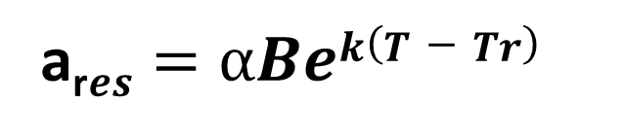
Effect of temperature increase on biological rates
a_{r}$es=αBek(T−Tr)$
a_{res}: Respiration or remineralization rate; B: Biomass;
Tr: Reference temperature; α: rate at reference temperature;
k: Exponential coefficient of temperature effect (0.069; Q₁₀=2)
Irby et al. 2018: Q₁₀=2.1
Londas et al., 2002. Microbial processes and temperature in Chesapeake Bay:

Slide 29
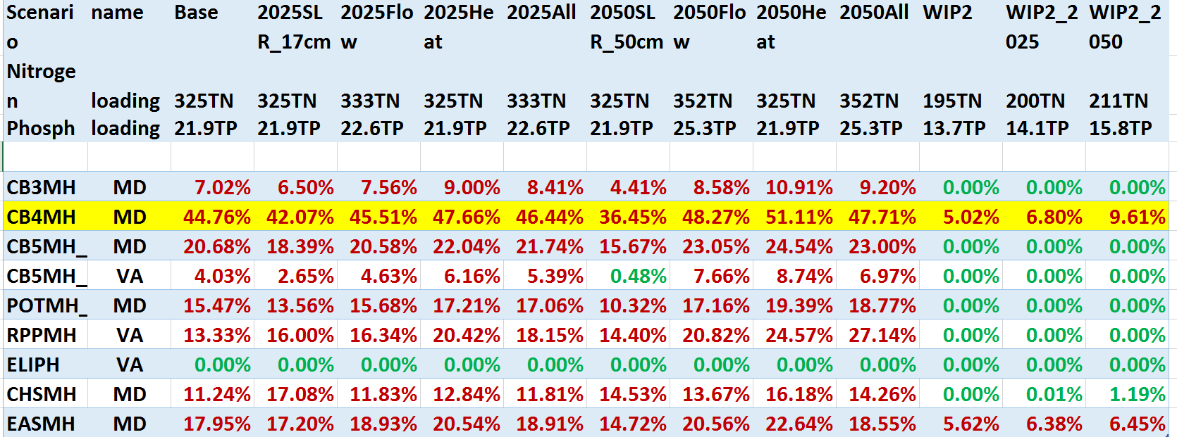
Estimate on water quality attainment in the Deep Channel Designated Use

Slide 30
Diagnosis on Climate Change Scenarios, CB4, average 1991-2000
30

