Slide 1
Overview of Climate Impact Assessment Framework and Implementation
Gary Shenk CBPO
STAC Workshop
Chesapeake Bay Program Climate Change Modeling 2.0
9/24/2018

Slide 2
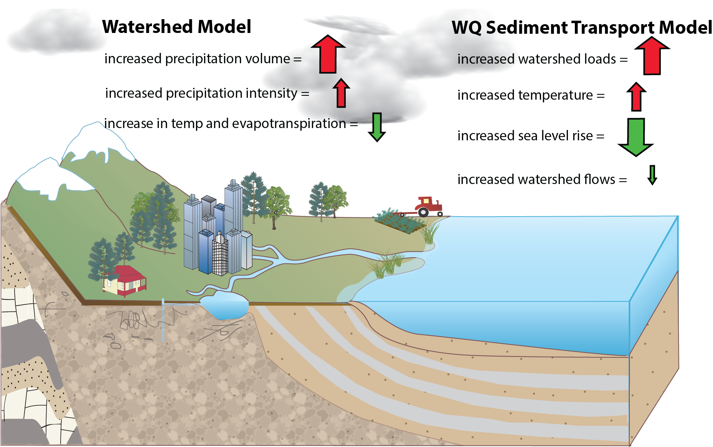
Accounting for Changing Conditions
Cumulative Assessment of Bay Low Dissolved Oxygen Impacts

Slide 3
Watershed Group
RCP selection
Estuarine Group
Framework Group
GCM Selection Process
Downscaling Method
Observed Trends
Creation of future climate scenarios
Human responses to climate change
Process-based response of flow and sediment
Specified response to flow and sediment
Estuarine Process-based model
Effect on water quality standards
Management Effort Adjustment

Slide 4
Chesapeake Bay Program
Modeling for TMDL Water Quality Standards based on 1991-2000 hydrology
Project to 2025 (30 years) and 2050 (55 years)
Presented to Principals’ Staff Committee in 2017. PSC asked for additional analysis to be completed in 2019

Slide 5
Watershed Group
RCP selection
Estuarine Group
Framework Group
GCM Selection Process
Downscaling Method
Observed Trends
Creation of future climate scenarios
Human responses to climate change
Process-based response of flow and sediment
Specified response to flow and sediment
Estuarine Process-based model
Effect on water quality standards
Management Effort Adjustment

Slide 6
Watershed Group
RCP selection
Estuarine Group
Framework Group
GCM Selection Process
Downscaling Method
Downscaling Method
Observed Trends
Creation of future climate scenarios
2016 STAC workshop The Development of Climate Projections for Use in Chesapeake Bay Program Assessments (Johnson et al. 2016).
2025: Use long-term observed trends for precipitation
2050 precipitation and all temperature: Use an ensemble of existing downscaling of CMIP5 models
Carefully consider evapotranspiration
Use RCP 2.6, 4.5, and 8.5

Slide 7
Watershed Group
RCP selection
Estuarine Group
Framework Group
GCM Selection Process
Downscaling Method
Downscaling Method
Observed Trends
Creation of future climate scenarios
Observed Precipitation Trends
1927-2014 PRISM precipitation data
Aggregated to annual values of a county
OLS regression to determine slope
30 years of slope applied to each month of 1991-2000 rainfall data

Slide 8
Watershed Group
RCP selection
Estuarine Group
Framework Group
GCM Selection Process
Downscaling Method
Downscaling Method
Observed Trends
Creation of future climate scenarios
Used RCP 4.5 for scenario run through the full modeling system and shown to PSC
Found significant overlap with RCP 2.6 and 8.5

Slide 9
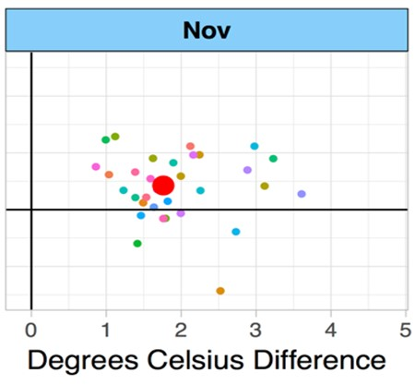
Watershed Group
RCP selection
Estuarine Group
Framework Group
GCM Selection Process
Downscaling Method
Downscaling Method
Observed Trends
Creation of future climate scenarios
GCM selection
Used the same group of models and model runs that were used in NOAA’s Climate Resilience Toolkit
Precipitation Difference

Slide 10
Watershed Group
RCP selection
Estuarine Group
Framework Group
GCM Selection Process
Downscaling Method
Downscaling Method
Observed Trends
Creation of future climate scenarios
Downscaling methods:
Bias Corrected Spatial Disaggregation (BCSD) - used for runs in 2017
Investigating Multivariate Adaptive Constructed Analogs (MACA)
Investigating Localized Constructed Analogs (LOCA)
Literature exists to support the idea that all are reasonable approaches

Slide 11
Watershed Group
RCP selection
Estuarine Group
Framework Group
GCM Selection Process
Downscaling Method
Downscaling Method
Observed Trends
Creation of future climate scenarios
Ensemble Method
Used the median temperature and precipitation change from the ensemble for each month for the primary run.
Used the corners of the 90th percentile ‘box’ to investigate uncertainty
Precipitation Difference

Slide 12
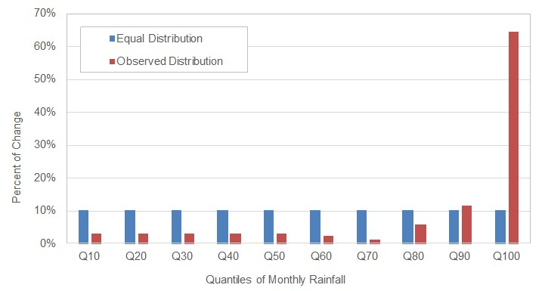
Watershed Group
RCP selection
Estuarine Group
Framework Group
GCM Selection Process
Downscaling Method
Downscaling Method
Observed Trends
Creation of future climate scenarios
Literature shows that the increases in precipitation over the previous century have primarily occurred in the highest precipitation events.
Two methods of rainfall addition
Multiply all rainfall events by the same factor
Multiply rainfall events within a decile by a factor such that the top decile increases a greater percentage as shown

Slide 13
Watershed Group
RCP selection
Estuarine Group
Framework Group
GCM Selection Process
Downscaling Method
Downscaling Method
Observed Trends
Creation of future climate scenarios
CO₂
IPCC 5 Working Group 1
 | RCP 2.6 | RCP 4.5 | RCP 8.5
1995 | 363 | 363 | 363
2025 | 421 | 423 | 432
2050 | 443 | 487 | 541

Slide 14
Watershed Group
RCP selection
Estuarine Group
Framework Group
GCM Selection Process
Downscaling Method
Downscaling Method
Observed Trends
Creation of future climate scenarios
PET
Use Hargreaves-Samani to calculate change in PET
Function of temperature and extraterrestrial radiation
Apply the change in PET to the Base PET used in the Phase 6 model

Slide 15
Watershed Group
RCP selection
Estuarine Group
Framework Group
GCM Selection Process
Downscaling Method
Observed Trends
Creation of future climate scenarios
Human responses to climate change
Process-based response of flow and sediment
Specified response to flow and sediment
Estuarine Process-based model
Effect on water quality standards
Management Effort Adjustment

Slide 16
Watershed Group
Estuarine Group
Framework Group
Creation of future climate scenarios
Process-based response of flow and sediment
Specified response to flow and sediment

Slide 17
Creation of future climate scenarios
Watershed Group
Estuarine Group
Framework Group
Process-based response of flow and sediment
Specified response to flow and sediment

Slide 18
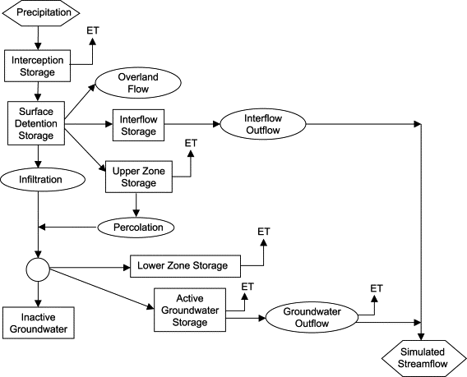
Creation of future climate scenarios
Watershed Group
Estuarine Group
Framework Group
Process-based response of flow and sediment
Specified response to flow and sediment
HSPF simulation of hydrology is sensitive to:
Precipitation
PET
CO2
Temperature (snowfall and snowmelt)

Slide 19
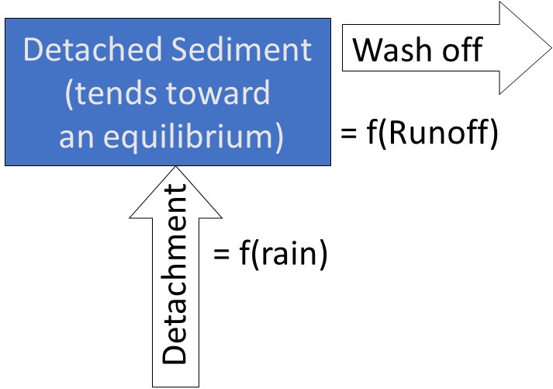
Creation of future climate scenarios
Watershed Group
Estuarine Group
Framework Group
Process-based response of flow and sediment
Specified response to flow and sediment
HSPF simulation of sediment is sensitive to:
Precipitation
Runoff
  PET, temperature, CO2, precip

Slide 20
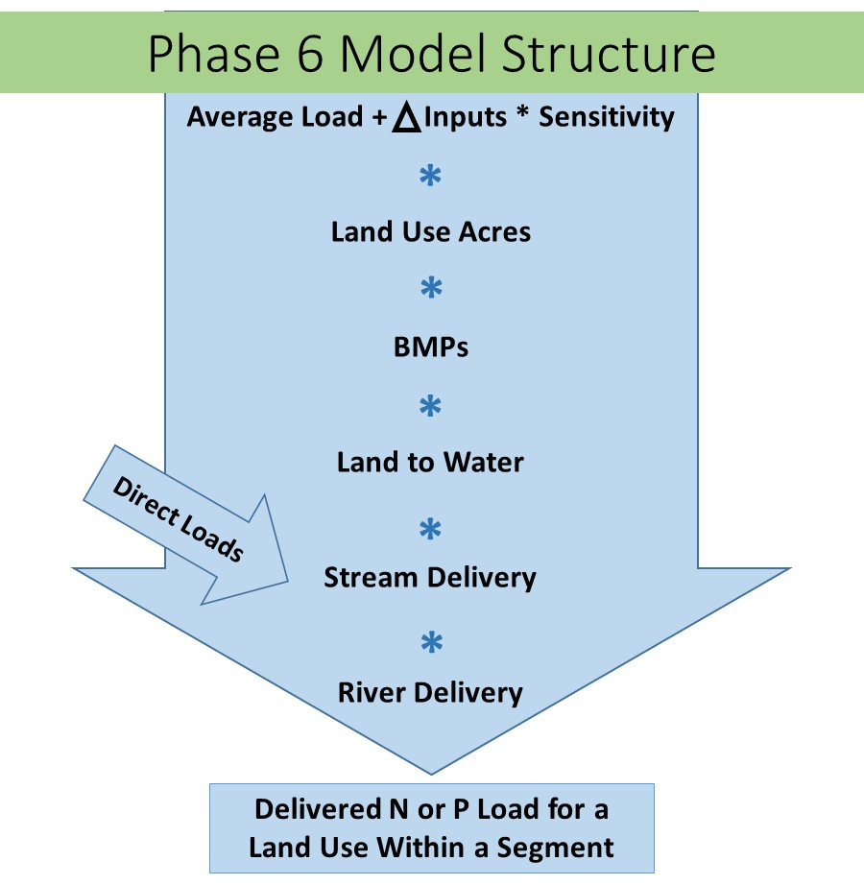
Creation of future climate scenarios
Watershed Group
Estuarine Group
Framework Group
Process-based response of flow and sediment
Specified response to flow and sediment
Phase 6 model is time-averaged for N and P from the land
Sensitivity to climate must be specified

Slide 21
Creation of future climate scenarios
Watershed Group
Estuarine Group
Framework Group
Process-based response of flow and sediment
Specified response to flow and sediment
Nitrogen Sensitivities
Agriculture
  Fertilizer
  Manure
  Atmospheric Deposition
  Fixation
  Crop Cover
  Uptake
Nitrogen Sensitivities
Developed
  Fertilizer
  Atmospheric Deposition
  Crop Cover
  Uptake
Natural
  Atmospheric Deposition
Delivery
  Available water capacity
  Groundwater recharge
  Piedmont carbonate

Slide 22
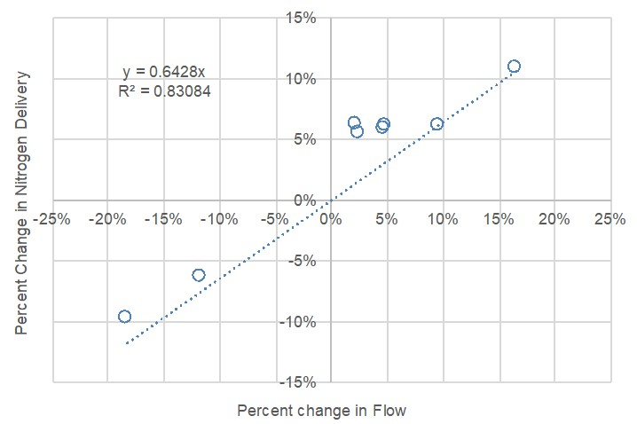
Creation of future climate scenarios
Watershed Group
Estuarine Group
Framework Group
Process-based response of flow and sediment
Specified response to flow and sediment
Nitrogen assumption:
  No changes to the concentrations
  proportional change in load to a change in flow.
Phase 5.3.2
  Nitrogen change = 64% of flow change

Slide 23
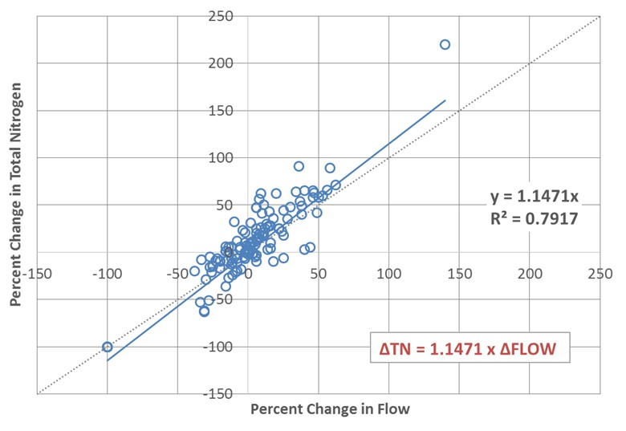
Creation of future climate scenarios
Watershed Group
Estuarine Group
Framework Group
Process-based response of flow and sediment
Specified response to flow and sediment
Nitrogen assumption:
  No changes to the concentrations
  proportional change in load to a change in flow.
‘20 watersheds’ study
  Nitrogen change = 115% of flow change

Slide 24
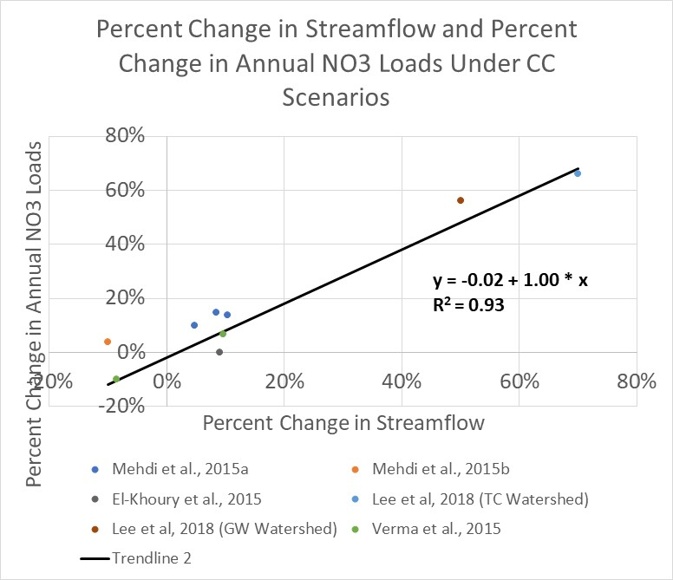
Creation of future climate scenarios
Watershed Group
Estuarine Group
Framework Group
Process-based response of flow and sediment
Specified response to flow and sediment
Nitrogen assumption:
  No changes to the concentrations
  proportional change in load to a change in flow.
CBPO literature review
  Nitrate change = 100% of flow change

Slide 25
Creation of future climate scenarios
Watershed Group
Estuarine Group
Framework Group
Process-based response of flow and sediment
Specified response to flow and sediment
Phosphorus Sensitivities
Agriculture
  Soil P
  Applied Water Extractable P
  Stormflow
  Sediment Washoff
Developed
  Fertilizer
Natural
  Stormflow
  Sediment Washoff
Delivery
  Well-drained soils

Slide 26
Creation of future climate scenarios
Watershed Group
Estuarine Group
Framework Group
Process-based response of flow and sediment
Specified response to flow and sediment
River Delivery is simulated by HSPF
Scour and deposition of sediment nutrients simulated in rivers greater than 100 cfs

Slide 27
Watershed Group
RCP selection
Estuarine Group
Framework Group
GCM Selection Process
Downscaling Method
Observed Trends
Creation of future climate scenarios
Human responses to climate change
Process-based response of flow and sediment
Specified response to flow and sediment
Estuarine Process-based model
Effect on water quality standards
Management Effort Adjustment

Slide 28
Watershed Group
Estuarine Group
Framework Group
Human responses to climate change

Slide 29
Watershed Group
Human responses to climate change
Estuarine Group
Framework Group
Sensitivities are built in, but need to know how they change in response to human actions
Nitrogen Sensitivities
Agriculture
  Fertilizer
  Manure
  Atmospheric Deposition
  Fixation
  Crop Cover
  Uptake
Nitrogen Sensitivities
Developed
  Fertilizer
  Atmospheric Deposition
  Crop Cover
  Uptake
Natural
  Atmospheric Deposition
Phosphorus Sensitivities
Agriculture
  Soil P
  Applied Water Extractable P
  Stormflow
  Sediment Washoff
Developed
  Fertilizer
Natural
  Stormflow
  Sediment Washoff

Slide 30
Watershed Group
RCP selection
Estuarine Group
Framework Group
GCM Selection Process
Downscaling Method
Observed Trends
Creation of future climate scenarios
Human responses to climate change
Process-based response of flow and sediment
Specified response to flow and sediment
Estuarine Process-based model
Effect on water quality standards
Management Effort Adjustment

Slide 31
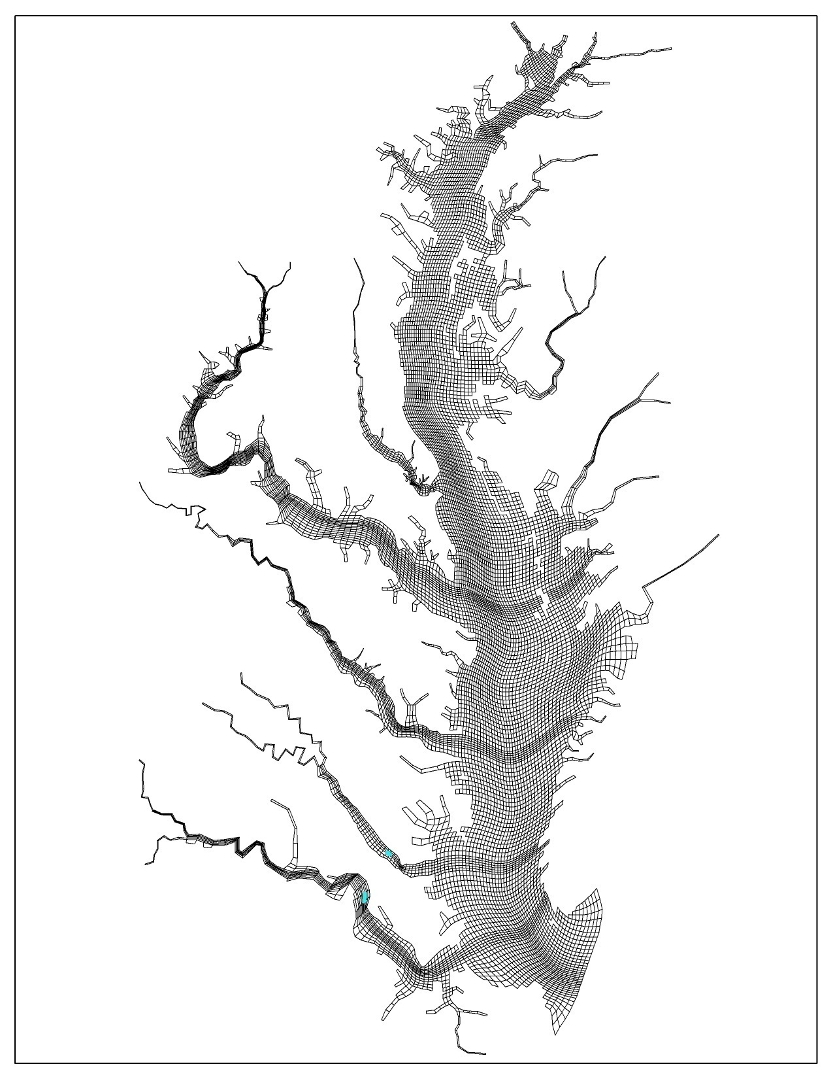
Watershed Group
Estuarine Process-based model
Estuarine Group
Framework Group
CH3D hydrodynamic
CE-QUAL-ICM WQ
  Sediment biogeochemistry
  Sediment Transport
  Living Resources
    SAV
    Oysters
    Menhaden

Slide 32
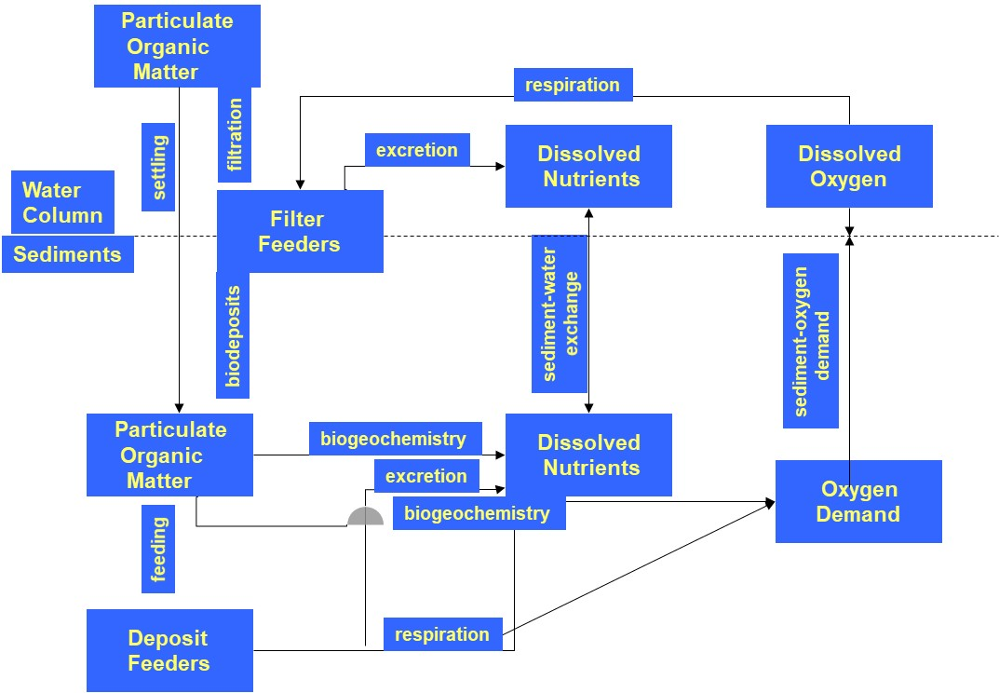
Watershed Group
Estuarine Process-based model
Estuarine Group
Framework Group

Slide 33
Watershed Group
Estuarine Process-based model
Estuarine Group
Framework Group
Considerations
  Sea level Rise
  Surface Temperature
  Ocean Boundary Condition
  Flow, Nutrients, Sediment, Heat from the watershed

Slide 34
Watershed Group
RCP selection
Estuarine Group
Framework Group
GCM Selection Process
Downscaling Method
Observed Trends
Creation of future climate scenarios
Human responses to climate change
Process-based response of flow and sediment
Specified response to flow and sediment
Estuarine Process-based model
Effect on water quality standards
Management Effort Adjustment

Slide 35
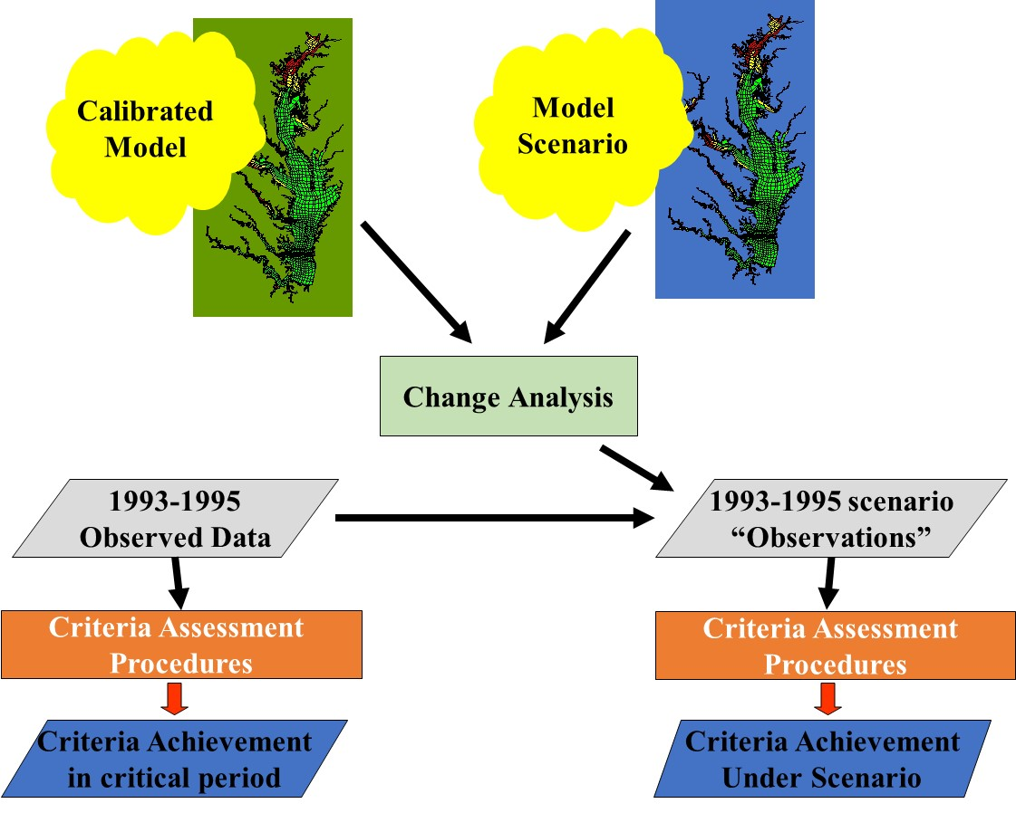
Watershed Group
Effect on water quality standards
Management Effort Adjustment
Estuarine Group
Framework Group

Slide 36
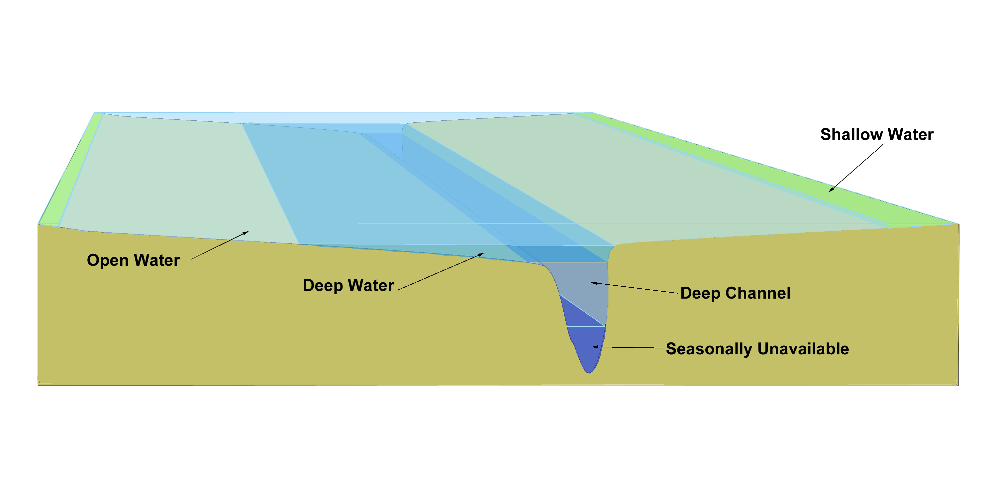
Watershed Group
Effect on water quality standards
Management Effort Adjustment
Estuarine Group
Framework Group
One regression for each point and each month

Slide 37
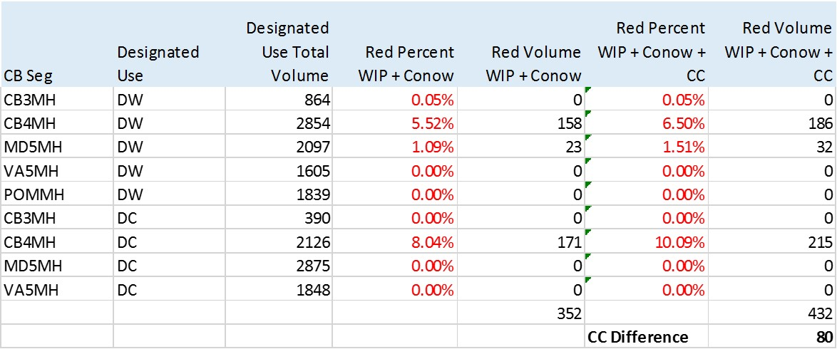
Calculate Climate Effect
Watershed Group
Effect on water quality standards
Management Effort Adjustment
Estuarine Group
Framework Group
December 2017 results
Volume Weighted means a ‘red area’ increase of 80 million cubic meters

Slide 38
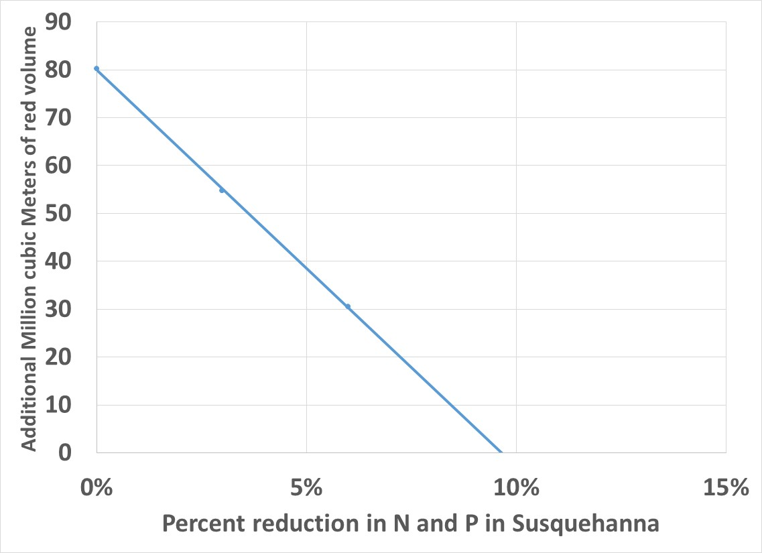
Ran Scenarios with 3% and 6% reduction in Susquehanna N and P
Watershed Group
Effect on water quality standards
Management Effort Adjustment
Estuarine Group
Framework Group
December 2017 results
Climate Effect is 9.6% reduction in N and P from the Susquehanna
7.5 Mlbs of N and 0.33 Mlbs of P
The 7.5 million N and .33 million P from the Susquehanna converts to
9.1 million N and 0.49 P Basin-Wide

Slide 39
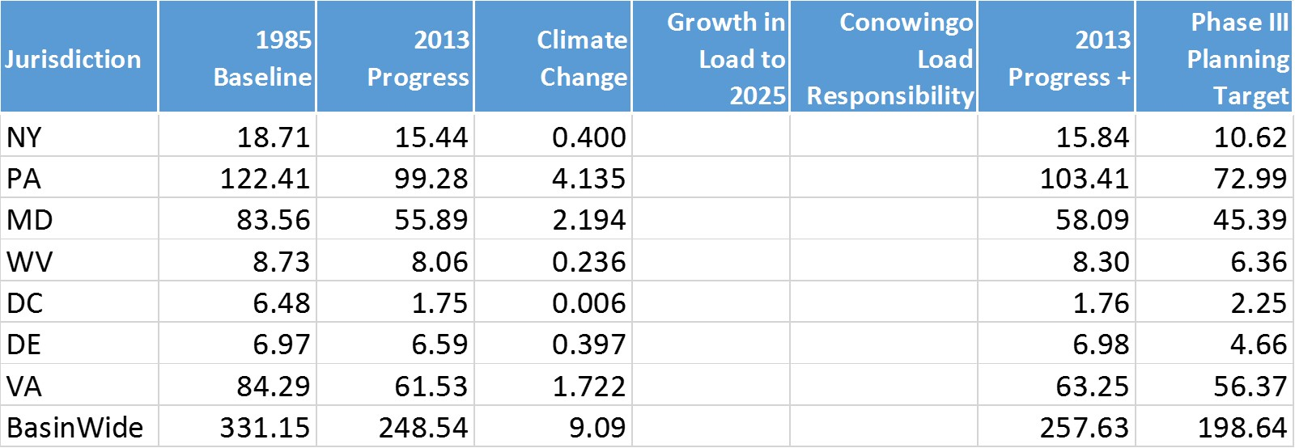
Climate Change Loads: Nitrogen
Watershed Group
Effect on water quality standards
Management Effort Adjustment
Estuarine Group
Framework Group
December 2017 results
*Units: millions of pounds

Slide 40
Watershed Group
RCP selection
Estuarine Group
Framework Group
GCM Selection Process
Downscaling Method
Observed Trends
Creation of future climate scenarios
Human responses to climate change
Process-based response of flow and sediment
Specified response to flow and sediment
Estuarine Process-based model
Effect on water quality standards
Management Effort Adjustment

