Slide 1
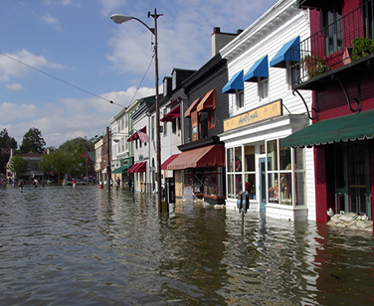
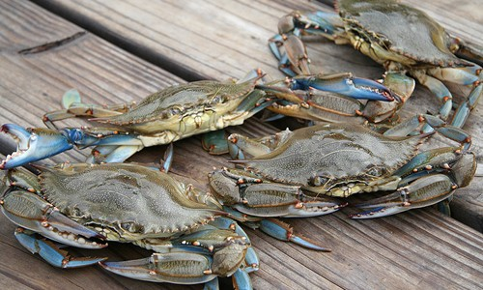
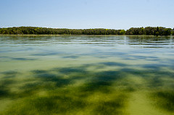
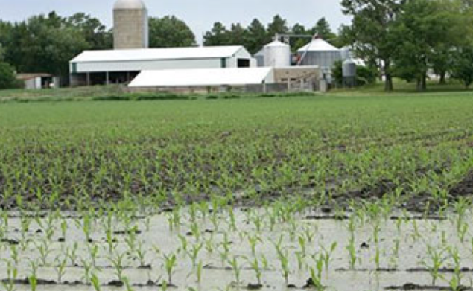
Chesapeake Bay Program Climate Change Modeling 2.0
Scientific and Technical Advisory Committee Workshop
September 24-25, 2018
Notes:
Welcome
Very pleased to be here today
Thank you to the Invited guests – We need your thinking, your innovation, your feedback
Thank the Water Quality Goal Team, the Climate Resiliency Workgroup and the modeling Workgroup for moving this forward
– recognize co-chiars James Davis Martin, Mark bennet, Dave Montali in the Room
Thank you to STAC for their support and recognizing the need for this workshop
Thank you to the Planning Committee! – Raleigh for his continued leadership
Make sure folks have Materials and agenda.
Any logistics that need to be addressed? Make announcements throughout the day. Lunch, room check in, etc
Comment on pictures – Climate change impacts to people and resources

Slide 2
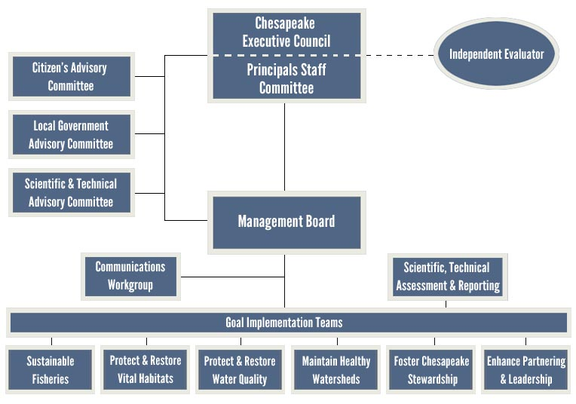
Motivation for this Workshop
Notes:
Stems from recent decision of the Principals’ Staff Committee
PSC is made up of key Partnership decision makers
The Principals’ Staff Committee works on behalf of the Executive Council to translate the restoration vision into policy and implementation actions
They create consensus based policy for Chesapeake Bay restoration.
In 2018, they agreed
Each State Phase III Watershed Implementation Plans (WIPs) will include a climate change framework to address impacts in jurisdictions
Further work is needed to account for additional nutrient and sediment pollutant loads
Next is background on how this fits together

Slide 3
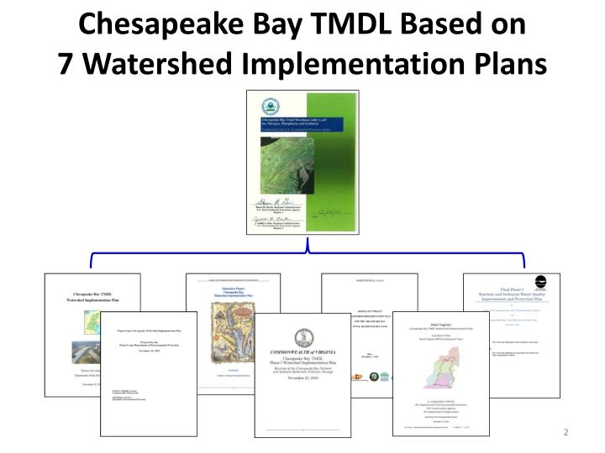
Background:
Chesapeake Bay TMDL Accountability Framework
Notes:
Established by EPA
TMDL sets limits for N, P and Sediment Bay water quality standards
7 Watershed Implementation Plans (WIPs) describe what amount, how, where, and when.
Phase I in 2010
Phase II in 2012
Phase III in 2019
2-Year Milestones ensure short term progress
60% by 2017, 100% of practices in place by 2025
Federal actions for inadequate progress

Slide 4
Background:
Phase III WIP Expectations
Released by EPA in June 2019 after extensive partnership review
Top 5
  Programmatic and numeric implementation commitments for 2018-2025
  Strategies for engagement of local, regional and federal partners in implementation
  Account for changed conditions: climate change and growth
  Develop, implement local planning goals below the state-major basin scales
  Consideration of co-benefits

Slide 5
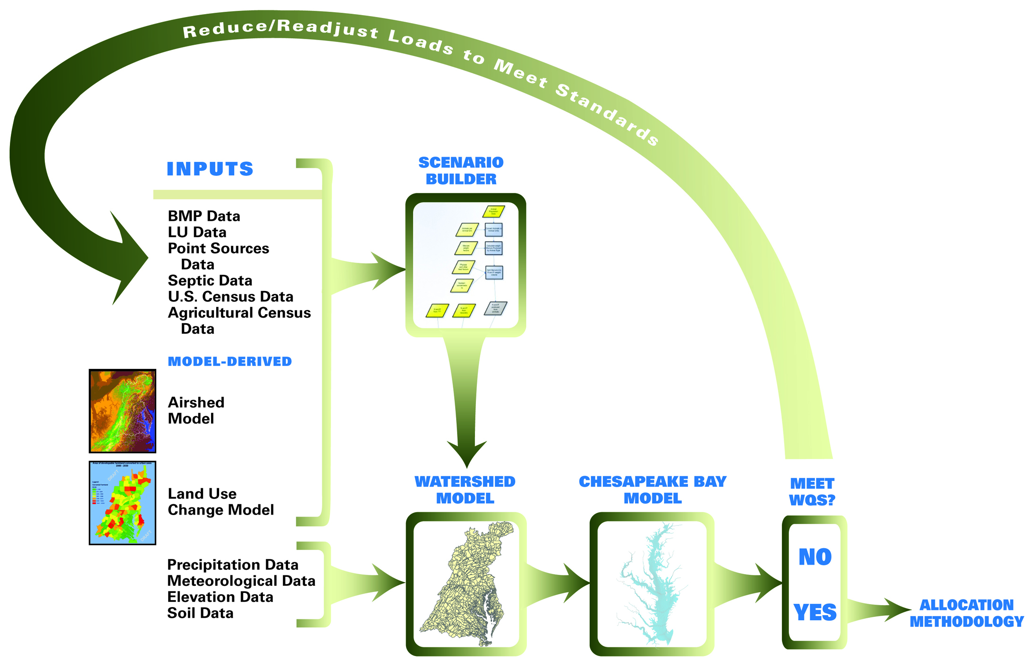
Phase 6 Suite of Partnership Models Approved by PSC and are in use in Phase III WIP
Notes:
Used to assign N, P and Sed targets to each jurisdiction
Evaluation of pollution reduction strategies
Estimate watershed loading and Bay response to climate change
You will hear the modeling team members talk about each of these models today

Slide 6
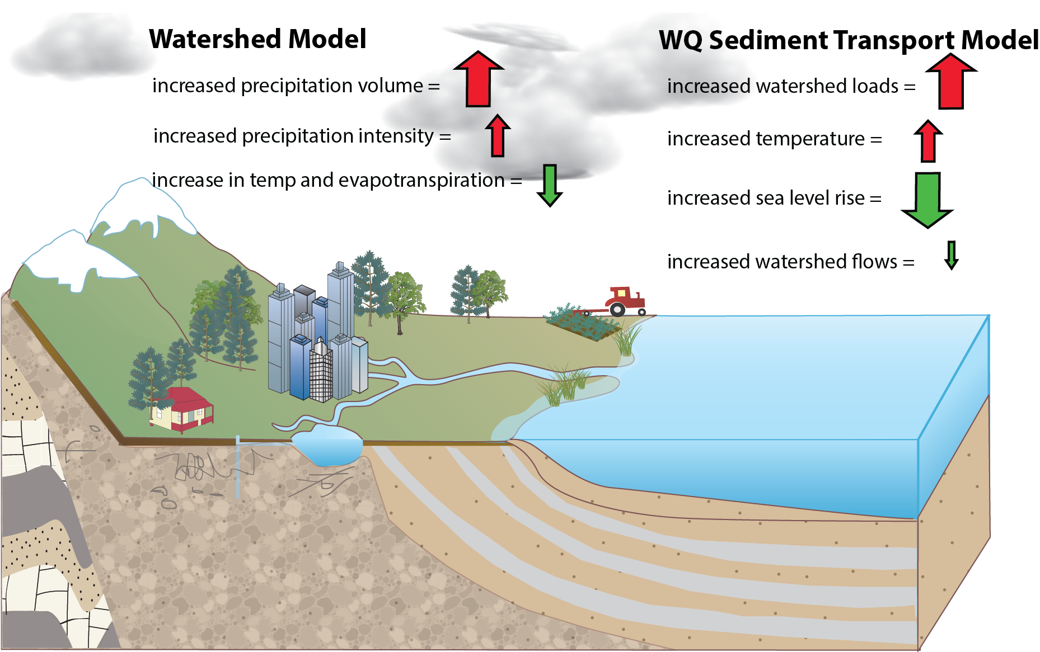
2017 Climate Assessment to PSC
Notes:
Talking Points
Assessment results changed throughout 2017. STAC input improved science.
In Phase III WIP, accounting for 2025 climate change is about a 9 million lb Nitrogen impact. More than a $ billion issue.
Small change in overall watershed but affect of nutrient species important
Total nitrogen and phosphorus are expected to stay about the same
Dissolved nitrate and phosphate have a strong effect on dissolved oxygen and increase with climate change
Ammonia decreased as a percentage, but the absolute amount is small
Organic nutrients decrease, but they have a weak effect on dissolved oxygen
Details on changes
Partnership originally used a predicted sea level rise of 30 centimeters (1 foot) between the 1990s and 2025
Better scientific understanding brought forth by Partners
NOAA released new sea level rise projections for the Chesapeake Bay
VIMS also provided updated sea level rise projections
Based on new science, the CBP Climate Resiliency Workgroup recommended using a projection of 17 centimeters
Consistent with long term trends at the Sewells Point, VA tide gauge at Bay mouth
Result: less influx of colder, oxygen-rich ocean water causing less ventilation of low dissolved oxygen waters in the deepest portions of the Bay

Slide 7
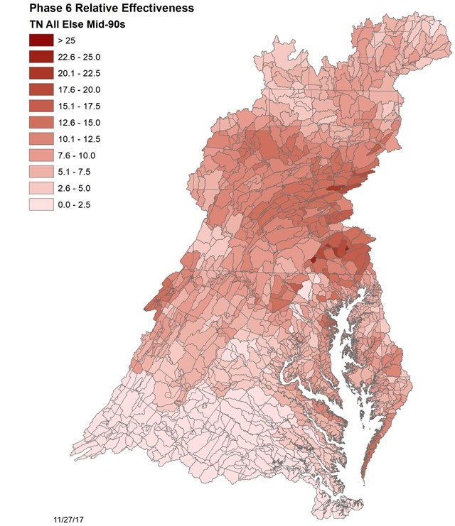
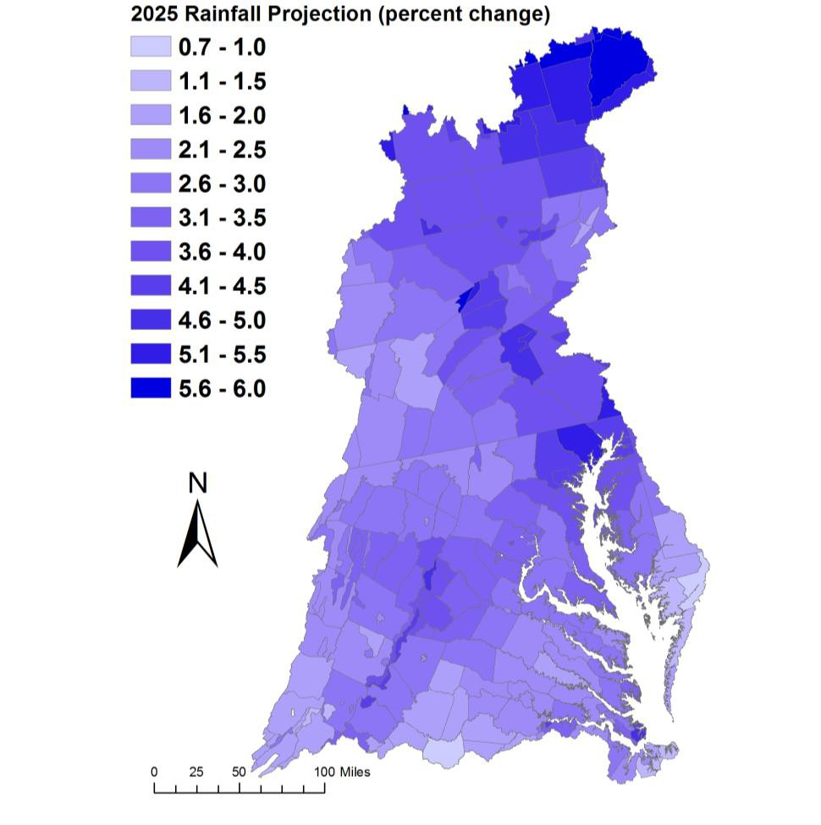
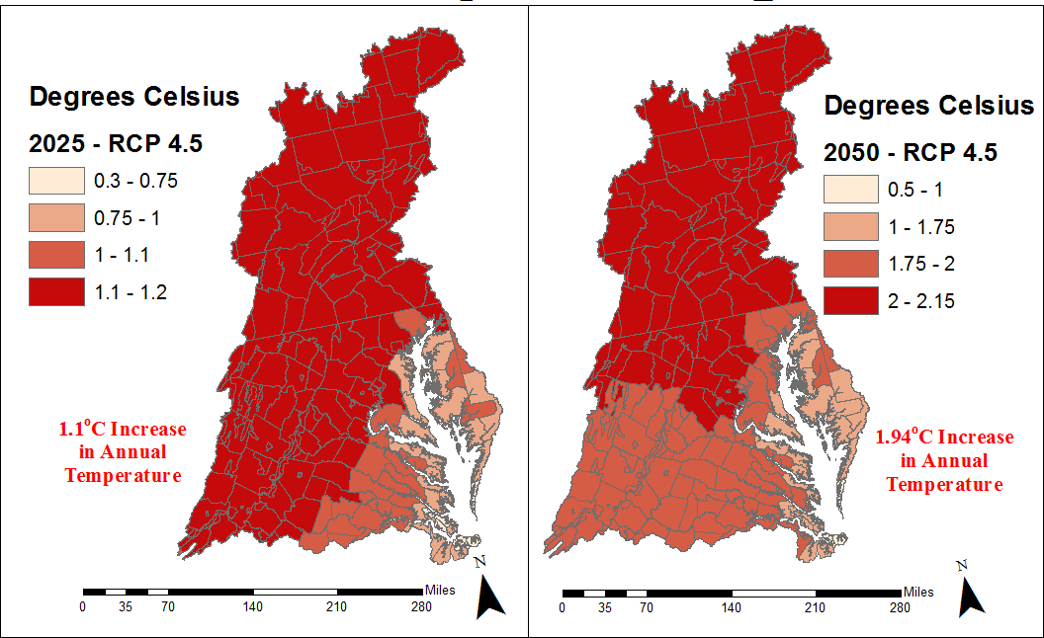
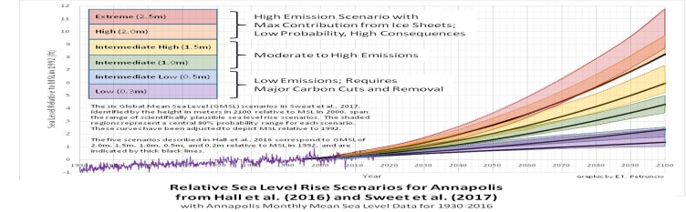
PSC will need to determine how additional reductions will be assigned
1995-2025
1995-2050
1.98° F / 1.1° C Increase in Average Annual Temp
3.5° F / 1.94° C Increase in Average Annual Temp
Notes:
PSC is responsible for reaching consensus across 7 jurisdictions
Current approach uses the principle that areas that have more impact do more.
How does this translate to climate change?

Slide 8

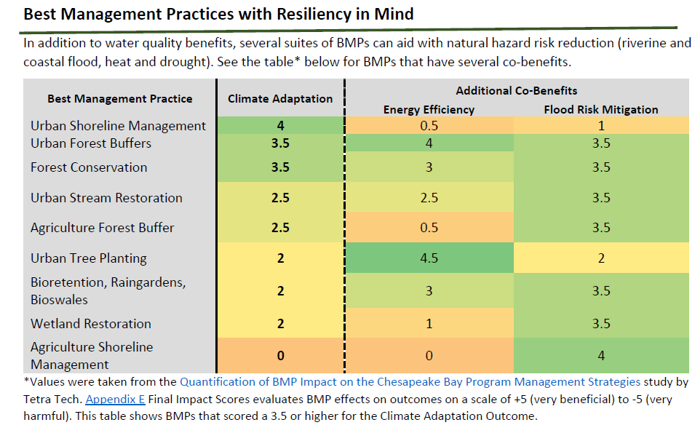
PSC looking for the “best” solutions?
Notes:
How will our current selection of BMPs respond to climate change?
How should we think differently about climate resilient solutions?
While the focus is on N, P and Sed reductions the need is much more.
Changing vegetation leads to planning for nurseries
Watershed practices vs estuarine solutions

Slide 9
PSC Agreement – 3 Step Approach
Incorporate Climate Change in the Phase III WIPs
Understand the Science
Incorporate into Two-year Milestones starting with the 2022-2023 milestones
Notes:
PSC agreed to the following in “Understand the Science”
By refining the climate modeling and assessment framework, continue to sharpen the understanding of the science, the impacts of climate change, and any research gaps and needs.
Develop an estimate of pollutant load changes (nitrogen, phosphorus, and sediment) due to 2025 climate change conditions.
Develop a better understanding of BMP responses, including new, enhanced and resilient BMPs, to better address climate change conditions such as increased storm intensity.
In March 2021, the CBP partnership will consider results of updated methods, techniques, and studies and refine estimated loads due to climate change for each jurisdiction.
In September 2021, jurisdictions will account for additional nutrient and sediment pollutant loads due to 2025 climate change conditions in a Phase III WIP addendum and/or two-year milestones beginning in 2022.

Slide 10
Translating the PSC Decision into a Workplan
Factor Climate Change Impacts into the Phase III WIPs
2018
STAC Workshop to examine current results, assess lessons-learned and recommend next steps.
2019
Following the direction of the PSC the Modeling and Climate Resiliency Workgroups, working with other key Chesapeake Bay Program groups, will develop and implement a complete and fully operational model of climate change assessment by 2019.
2020
In 2020 the CBP partners will complete a technical review and process for approval of the new refined model and its findings.
2021
In 2021, the policy implications for including targets adjusted for the influence of climate change into the 2022-2023 milestones will be considered by the partnership.
Jurisdictions provide narrative in PhIII WIPs on climate strategies
CRWG will incorporate actions in its 2018-2020 workplan to develop a better understanding of BMP responses, including new or other emerging BMPs, to climate change conditions.
By the close of 2021 the refined findings on climate change will be implemented into the 2022-2023 milestones.
Notes:
See Attachment 1 in your materials
Arrow indicates where we are today
Circle show a key deliverable, the revised assessment.

Slide 11
… And Assess the CBP Climate Framework
Implications past 2025, out to 2050
Synthesis
Notes:
Synthesis
State of the science
Gaps
make recomendations

Slide 12
Our Broad Plan
Over the Next Two Days
Notes:
Provide a very brief summary below, Mark will go into more detail on the structure of the workshop, the breakout groups and the specific questions.
We will
Provide a Global Perspective on climate change
More details on Intro, Purpose and format
Hear from CBP Model Leads
BMP Roundtable
Breakout Groups, Cross Cutters and Report out
We’ve got a full agenda and a lot planned for you.
Privlage and honor to Introduce Don Boesch with UMCES, an internationally recognized climate expert,
He will talk with us about
Global Perspectives on the Effects of Climate Change on Coastal Eutrophication

