Slide 1



Global Perspectives on Effects of Climate Change on Coastal Eutrophication
Don Boesch
Chesapeake Bay Program Climate Change Modeling 2.0
September 24, 2018

Slide 2
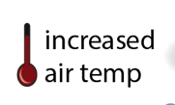
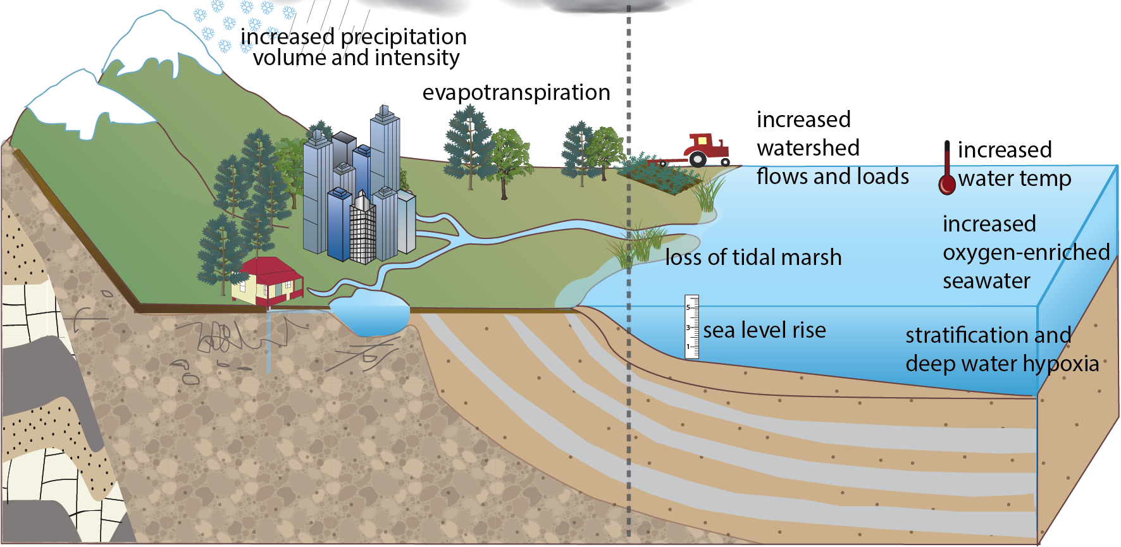
Effects of Climatic Changes on Hypoxia
Arrows indicate effect on decreasing ⬇ or increasing ⬆ hypoxia
?

Slide 3
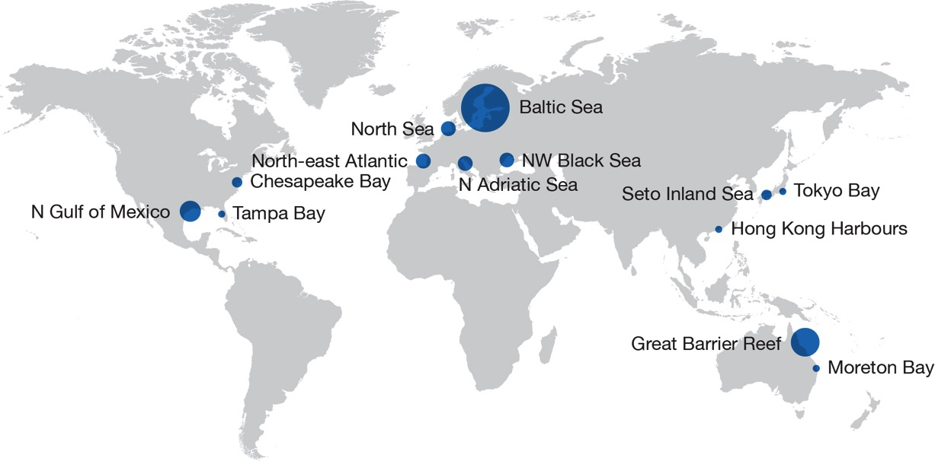
Campaigns to Abate Coastal Eutrophication
Boesch (submitted)

Slide 4
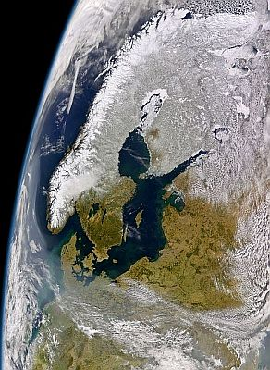



Baltic Sea: Chesapeake’s Big Sister
2008
2015

Slide 5
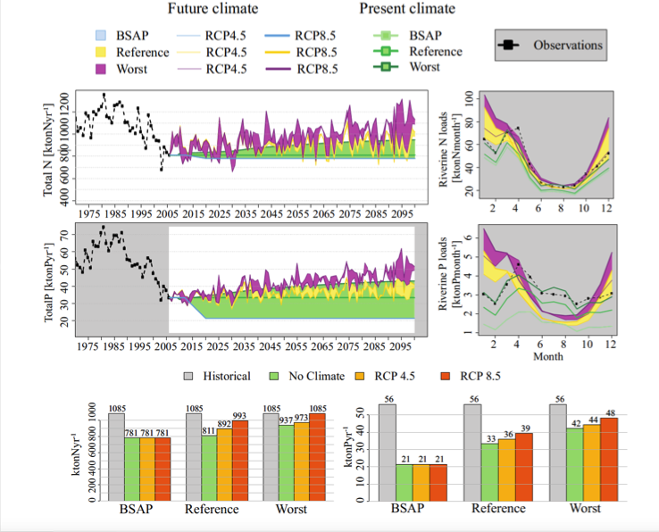
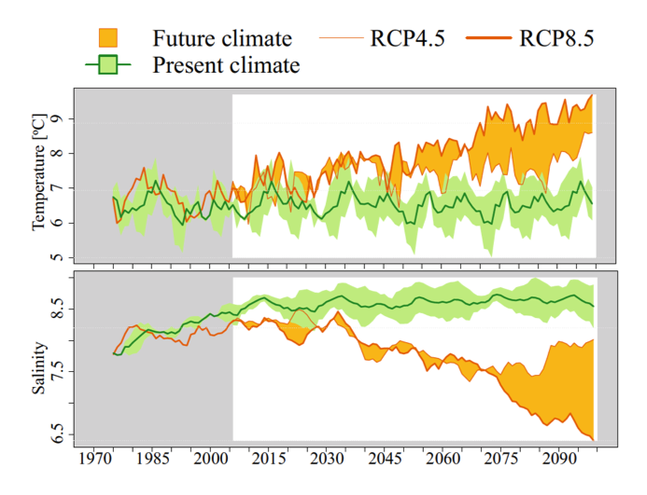
Baltic Sea: Changes in Nutrient Delivery, T, S
Saraiva et al. 2018 Climate Dynamics

Slide 6
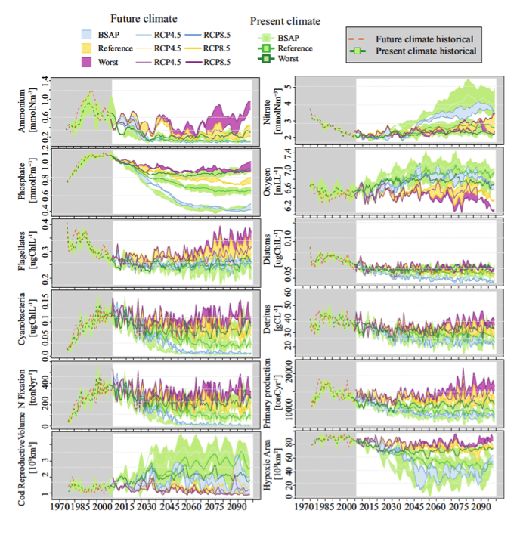
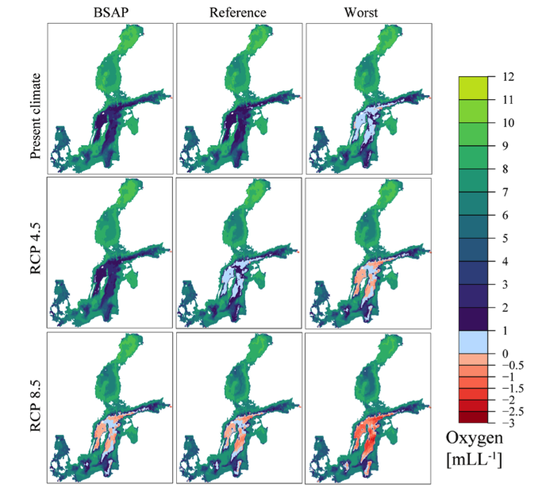
Baltic Sea: Changes in Nutrient Delivery, T, S
Saraiva et al. 2018 Climate Dynamics

Slide 7
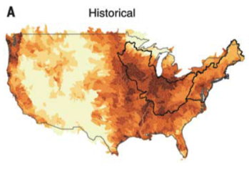
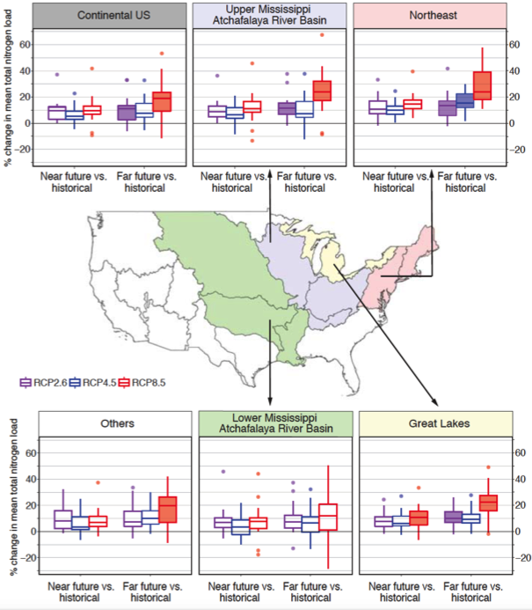
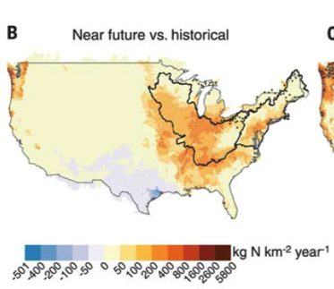
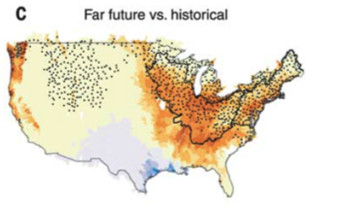
Precipitation-driven N losses
2100
BAU scenario
Offsetting increase in N loading would require 33 ± 24% reduction
Sinha et al. 2017 Science

Slide 8
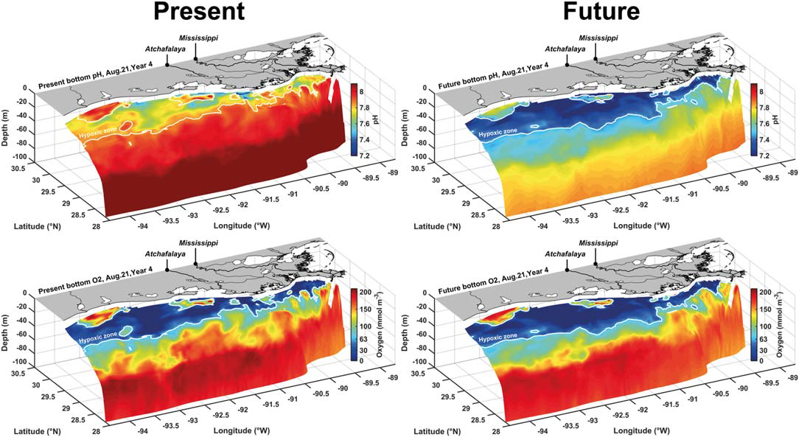
Hypoxia and pH on Louisiana Shelf
pH
2100
+10% flow
Same N&P
O₂
Laurent et al 2018. JGR Oceans

Slide 9
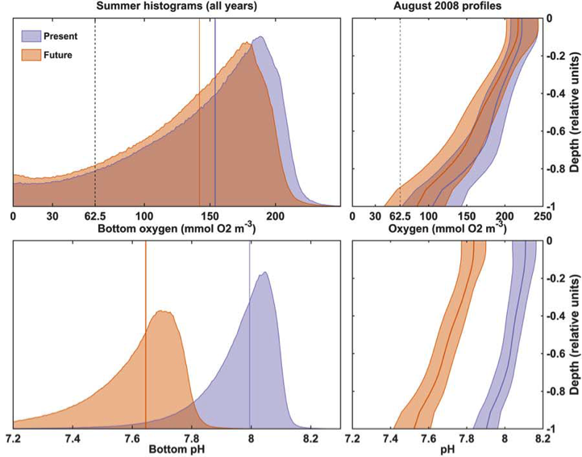
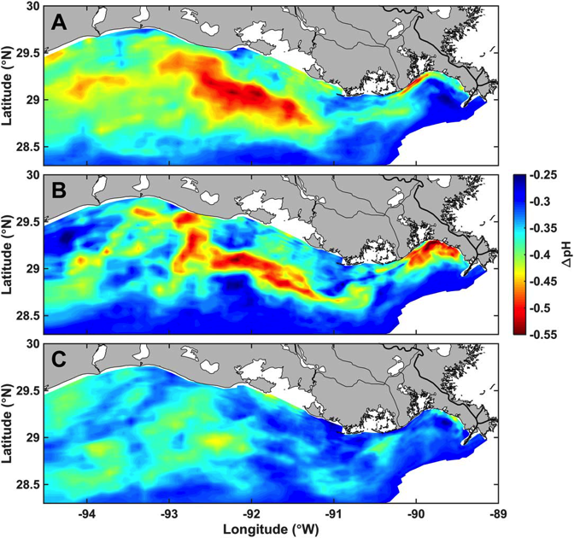
Hypoxia and pH on Louisiana Shelf
O₂
Upwelling
Downwelling
pH
Strong winds
Laurent et al 2018. JGR Oceans

Slide 10
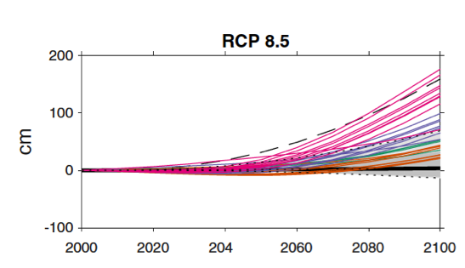
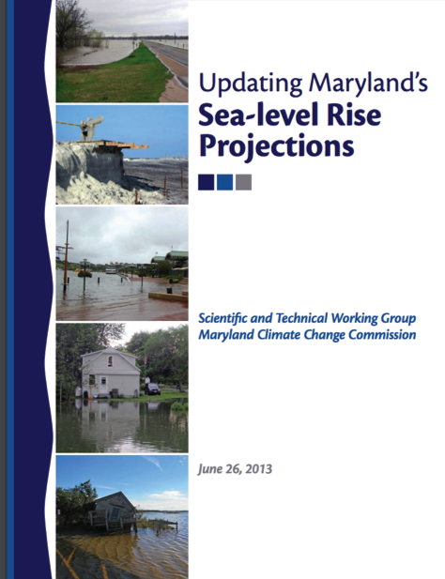
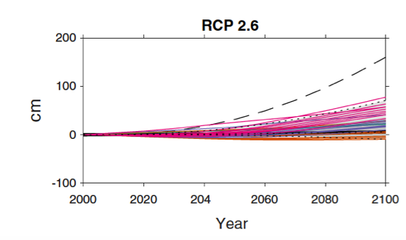
2018 Update of SLR Projections for MD
SPR Expert Group
Don Boesch
Bill Boicourt
John Boon
Richard Cullather
Tal Ezer
Gerald Galloway
Zoë Johnson
Hali Kilbourne
Mat Kirwan
Bob Kopp
Sasha Land
Ming Li
William Nardin
Chris Sommerfield
Billy Sweet
To be updated
Nov. 2018
Probabilistic projections
Kopp et al. 2017. Earth’s Future

Slide 11
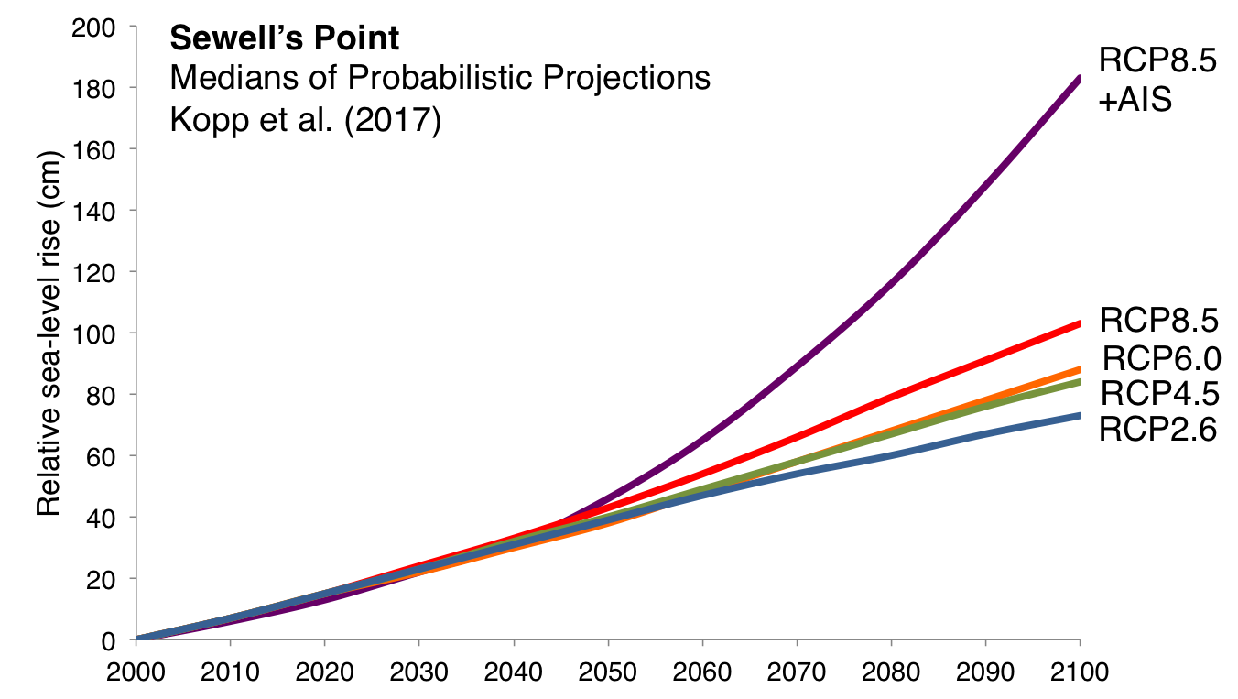
Sea-Level Rise by Model
2025 | 0.24 m
2050 | 0.44-0.51 m
2080 | 0.60-1.16 m

Slide 12
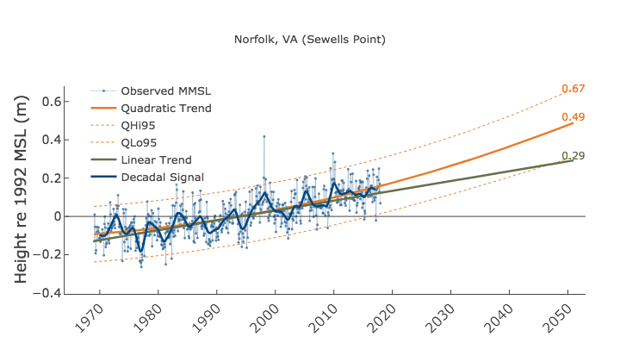
Sea-Level Rise by Extrapolation
CBP modeling first used 0.30 m, then used 0.17 m RSLR by 2025.
 | 2025 | 2050
Linear | 0.16 | 0.29
Quadratic | 0.23 | 0.49
Boon and Mitchell. 2015
J. Coastal Res. 36, 1295
www.vims.edu/research/products/slrc/localities/norfolkva/index.php

Slide 13
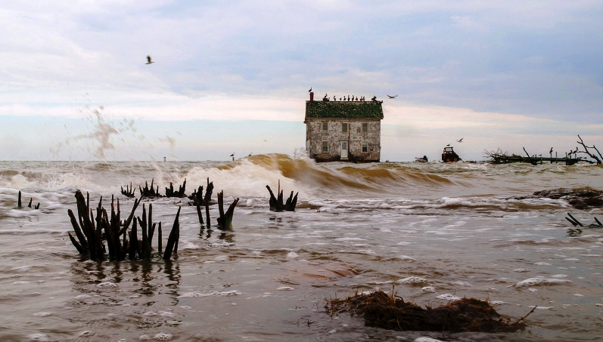

boesch@umces.edu
www.umces.edu/don-boesch
@DonBoesch

