Slide 1



Chesapeake Bay Program
Climate Change Modeling 2.0
Mark Bennett, U.S. Geological Survey
CBP Climate Resiliency Workgroup Co-Chair

Slide 2
Outcomes of December 2017 PSC Meeting
Directed the CBP to update the methods, techniques, and studies and revisit existing estimated loads due to climate change to determine if any updates to those load estimates are needed
Expected that jurisdictions will account for additional nutrient and sediment pollutant loads due to 2025 climate change conditions in a Phase III WIP addendum and/or 2-year milestones beginning in 2022

Slide 3
Initial Questions
How does the CBP Watershed Model (WSM) and Water Quality Sediment Transport Model (WQSTM) response to future climate forcing compare to other comparable modeling efforts and frameworks?
What additional or different climate change approaches and methods should be incorporated into the WSM and WQSTM?
How can CBP modeling efforts account for potential impacts of larger landscape-level changes (e.g., changes in land use or agricultural systems) on nutrients and sediments loads?
What ranges of inputs should be used for the WQSTM for water column temperature and ocean boundary changes?
How does the relative rate of increasing precipitation, temperature, and sea level rise influence Chesapeake water quality in 2030, 2035, 2040, and other future years? In other words, are trends in the impacts of climate change increasing or changing going forward beyond 2025?
What new and/or refined methods and modeling techniques could be used to better assess projected impacts on watershed loads and estuarine impacts for a range of future scenarios?
What improvements could be made to the methodology used to develop jurisdiction-specific nutrient pollutant loads due to 2025 climate change conditions and beyond?
What are the remaining research gaps and highest priority information needs (e.g., data, research, modeling methods and techniques, programmatic efforts)?

Slide 4
Breakout Groups
Group 1: Simulation of Climate Change Processes and land management in the Phase 6 Watershed Model Influencing Chesapeake Water Quality
Group 2: Simulation of Climate Change Processes in the WQSTM Influencing Chesapeake Water Quality
Group 3: Assessment of the overall CBP framework of climate change analysis

Slide 5
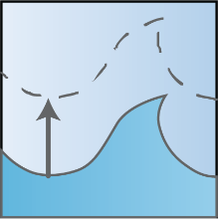


Major Climate Variables: 2025 Projections
Extrapolation of NOAA observed sea level trends (Swells Point, VA)
17 centimeters
Relative Sea Level Rise
Downscaled climate projections (RCP 4.5)
1.98° F / 1.1° C Increase
Temperature Increase
Observed trends in 88-years of annual PRISM^{[1]} data
3.1% Increase
Precipitation Change

Slide 6
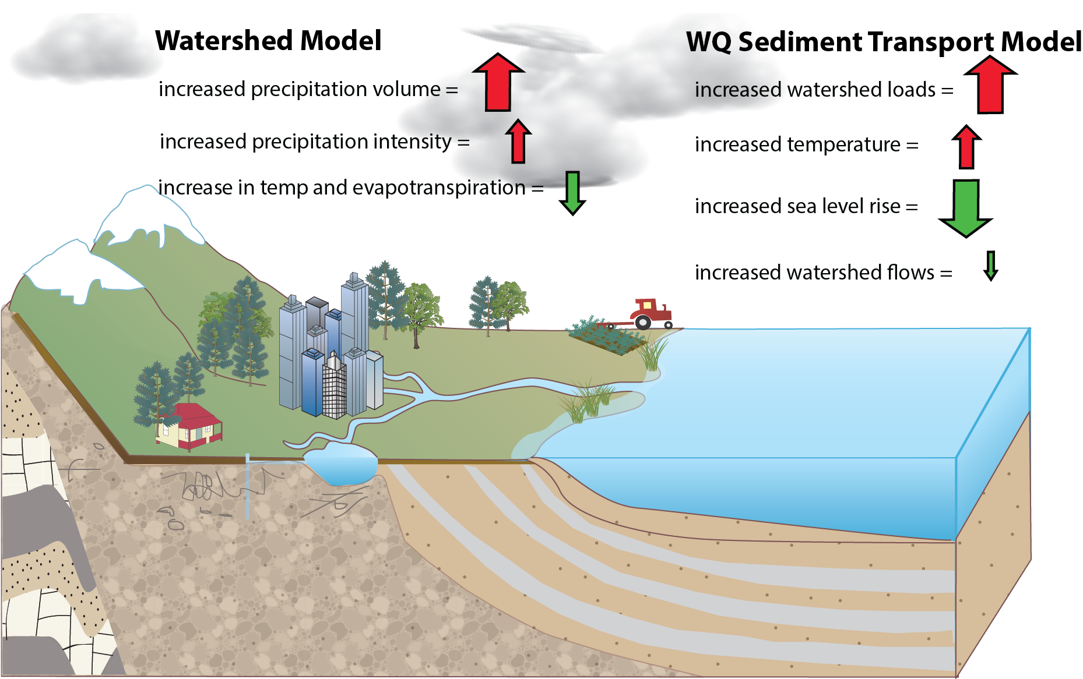
Accounting for Changing Conditions Cumulative Assessment of Bay Low Dissolved Oxygen Impacts

Slide 7
In the Summer of 2017 Our Message was Climate Change Effects by 2025 were Projected to be Minimal as the Different Effects were Largely Counteracting Each Other

Slide 8

Summer 2017 Assessment: Deep Water Dissolved Oxygen in Balance
Watershed Loads
Increase
Sea Level Rise
Increases
Water Temperature
in Bay Increases
Decreased Oxygen In Deep Waters of the Bay
Increased Oxygen In Deep Waters of the Bay

Slide 9
So What Changed Between the Summer 2017 Assessment of Projected Climate Change Impacts and what was Presented to the PSC at the December 19-20 Meeting?

Slide 10
Estimated Sea Level Rise Decreased
Partnership originally used a predicted sea level rise of 30 centimeters (1 foot) between the 1990s and 2025
Better scientific understanding brought forth by Partners
NOAA released new sea level rise projections for the Chesapeake Bay
VIMS also provided updated sea level rise projections
Based on new science, the CBP Climate Resiliency Workgroup recommended using a projection of 17 centimeters
Consistent with long term trends at the Sewells Point, VA tide gauge at Bay mouth
Result: less influx of colder, oxygen-rich ocean water causing less ventilation of low dissolved oxygen waters in the deepest portions of the Bay
Notes:
MSL in 2000 = MSL in 1992 + .092957 ft (based on averages of monthly data)

Slide 11
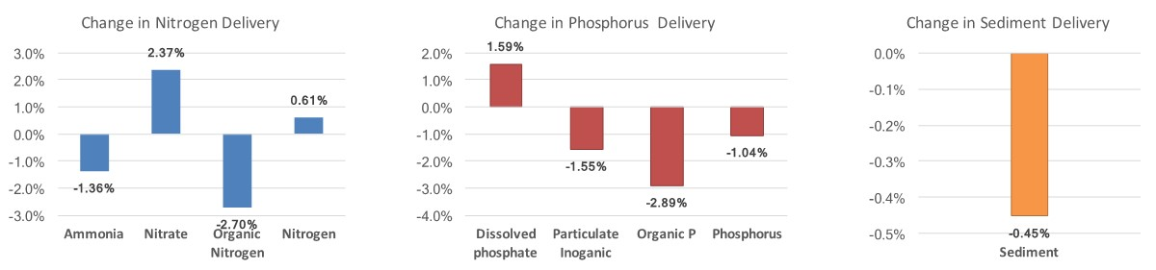
Climate Change Effects on Loading of Different Types of Nutrients Better Understood
Total nitrogen and phosphorus are expected to stay about the same
Dissolved nitrate and phosphate have a strong effect on dissolved oxygen and increase with climate change
Ammonia decreased as a percentage, but the absolute amount is small
Particulate and organic nutrients decrease, but they have a weak effect on dissolved oxygen

Slide 12

December 2017 Assessment: Deep Water Dissolved Oxygen Not in Balance
Watershed Loads
Increase
Sea Level Rise
Increases
Water Temperature
in Bay Increases
Decreased Oxygen In Deep Waters of the Bay
Increased Oxygen In Deep Waters of the Bay

Slide 13
Nutrient Load Reductions Needed to Account for Reduced Oxygen Due to Climate Change
We can choose to reduce nitrogen, phosphorus, or both
Since most BMPs apply to both nutrients, a balanced approach is more efficient than just focusing on one or the other
Raising the level of effort for all jurisdictions using the approved planning target method results in an estimate of 9.1 million pounds of nitrogen and 490,000 pounds of phosphorus basin-wide
Those are the nutrient loads reductions necessary to counteract the projected climate change induced lower oxygen conditions

Slide 14
Climate Change Loads: Nitrogen
Jurisdiction | 1985 Baseline | 2013 Progress | Climate Change | Phase III Planning Target
NY | 18.71 | 15.44 | 0.400 (3.8%) | 10.62
PA | 122.41 | 99.28 | 4.135 (5.7%) | 72.99
MD | 83.56 | 55.89 | 2.194 (4.8%) | 45.39
WV | 8.73 | 8.06 | 0.236 (3.7%) | 6.36
DC | 6.48 | 1.75 | 0.006 (0.3%) | 2.25
DE | 6.97 | 6.59 | 0.397 (8.5%) | 4.66
VA | 84.29 | 61.53 | 1.722 (3.1%) | 56.37
Basinwide | 331.15 | 248.54 | 9.09 (4.6%) | 198.64
*Units: millions of pounds

Slide 15
Climate Change Loads: Phosphorus
Jurisdiction | 1985 Baseline | 2013 Progress | Climate Change | Phase III Planning Target
NY | 1.198 | 0.710 | 0.014 (2.9%) | 0.491
PA | 6.282 | 3.749 | 0.141 (4.7%) | 3.012
MD | 7.495 | 3.942 | 0.114 (3.2%) | 3.553
WV | 0.902 | 0.617 | 0.019 (3.9%) | 0.493
DC | 0.090 | 0.062 | 0.001 (0.8%) | 0.120
DE | 0.225 | 0.116 | 0.006 (5.1%) | 0.116
VA | 14.244 | 6.751 | 0.193 (3.0%) | 6.411
Basinwide | 30.44 | 15.95 | 0.489 (3.4%) | 14.20
*Units: millions of pounds

Slide 16
December 19-20 PSC Policy Decisions
1. Incorporate Climate Change in the Phase III WIPs
Include a narrative strategy in the Phase III WIPs that describes the jurisdictions current action plans and strategies to address climate change, as well as the jurisdiction-specific nutrient and sediment pollution loadings due to 2025 climate change conditions, while incorporating local priorities and actions to address climate change impacts.
2. Understand the Science
Address the uncertainty by documenting the current understanding of the science and identifying research gaps and needs.
3. Incorporate into Milestones
Starting with the 2022-2023 milestones, determine how climate change will impact the BMPs included in the WIPs and address these vulnerabilities in the two-year milestones.

Slide 17
Understanding the Science: Proposed Next Steps
2018
STAC Workshop to examine current results, assess lessons-learned and recommend next steps.
2019
Following the direction of the PSC, the Modeling and Climate Resiliency Workgroups, working with other key Chesapeake Bay Program groups, will develop and implement a complete and fully operational climate change modeling and assessment system in 2019.
2020
In 2020, the CBP partners will complete a technical review and process for approval of the new refined climate change modeling and assessment system as well as the scientific and technical findings from its management applications.
2021
In 2021, the policy implications for including targets adjusted for the influence of climate change into the 2022-2023 milestones will be considered by the Partnership.
Climate Resiliency Workgroup will incorporate actions in its 2018-2020 workplan to develop a better understanding of BMP responses, including new or other emerging BMPs, to climate change conditions.
By the close of 2021, the refined findings on climate change will be implemented into the jurisdictions’ 2022-2023 milestones.

Slide 18
Today’s Requested Policy Decisions
Approve the proposed next steps and overall schedule for addressing uncertainty by documenting the current understanding of the science and identifying research gaps and needs

Slide 19
Today’s Requested Policy Decisions
Agree to use our current estimated nutrient and sediment load reductions needed to address projected climate change impacts on Bay water quality by 2025 as the starting point for proceeding forward the Partnership multi-year schedule for factoring changing climate conditions into the jurisdictions’ Phase III Watershed Implementation Plans

