Slide 1

Monitoring & Assessment, Adaptation Outcomes
STAC Meeting - September 2018
Climate Resiliency Working Group
Mark Bennett, USGS
Co-Chair

Slide 2
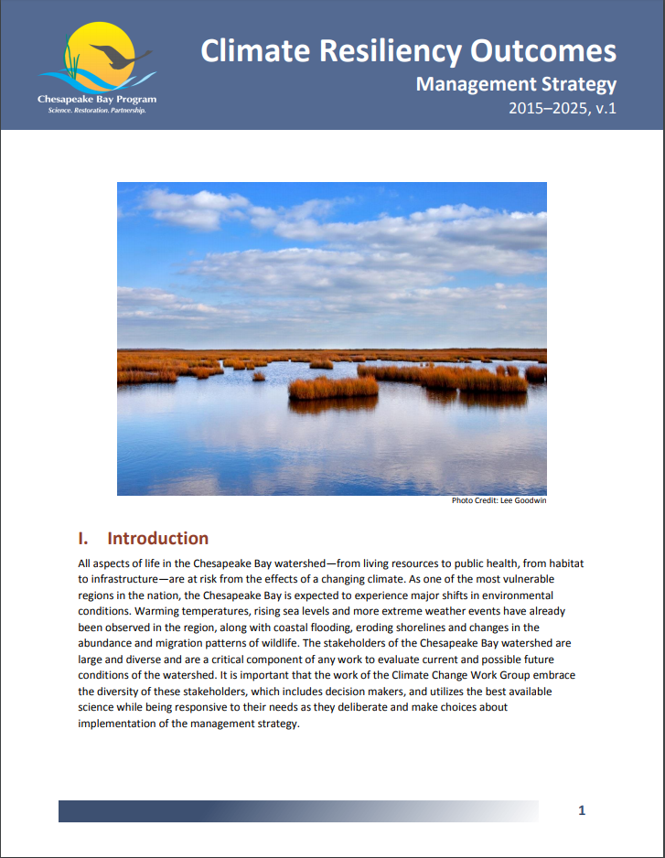
Through the Chesapeake Bay Watershed Agreement, the Chesapeake Bay Program has committed to…
Goal:
Increase the resiliency of the Chesapeake Bay watershed, including its living resources, habitats, public infrastructure and communities, to withstand adverse impacts from changing environmental and climate conditions.
Monitoring & Assessment Outcome:
Continually monitor and assess the trends and likely impacts of changing climatic and sea level conditions on the Chesapeake Bay ecosystem, including the effectiveness of restoration and protection policies, programs and projects.
Adaptation Outcome:
Continually pursue, design and construct restoration and protection projects to enhance the resiliency of Bay and aquatic ecosystems from the impacts of coastal erosion, coastal flooding, more intense and more frequent storms and sea level rise.
Relevant Photo

Slide 3

What We Want
To have the Management Board support our efforts in:
Addressing recommendations for BMP Siting and Design data/research needs
Developing a prioritized list of specific data needs for use by Citizen Science Programs
Promoting utilization of the Chesapeake Bay Program Climate Smart Framework & Decision-Support Tool
Incorporating climate change into the Phase III WIPs
Notes:
Addressing recommendations for data/research needs associated with the results of the “Monitoring and Assessing Impacts of Changes in Weather Patterns and Extreme Events on BMP Siting and Design” STAC Workshop:
“Starting with the 2022-2023 milestones, determine how climate change will impact the BMPs included in the WIPs and address these vulnerabilities in the two-year milestones”
Communicating monitoring priorities to nontraditional partners and Citizen Science programs.
These priorities should include climate-related monitoring needs. MB (with input from CRWG and GITs) will develop a priority list of specific (space & time) data needs for this purpose.
Promoting utilization of the Chesapeake Bay Program Climate Smart Framework & Decision-Support Tool –
Encourage GIT chairs and coordinators to utilize this decision making tool in their workgroup decisions.
Jurisdiction, WQGIT input and support re: WIP narrative guidance- a qualitative approach for incorporating climate change into the phase III WIPs

Slide 4
Setting the Stage:
What are our assumptions?
1

Slide 5
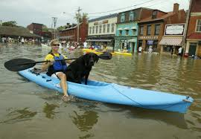
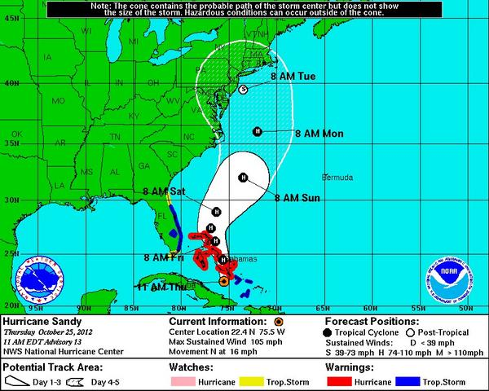
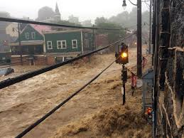
Climate Change:Real Consequences
Annapolis 2003 Balt Sun
Extreme Events, such as Hurricane Isabel 2003, or higher intensity storm events (Ellicott City 2018) foreshadow the Watersheds vulnerability to climate change
Ellicott City 2018 NY Times

Slide 6
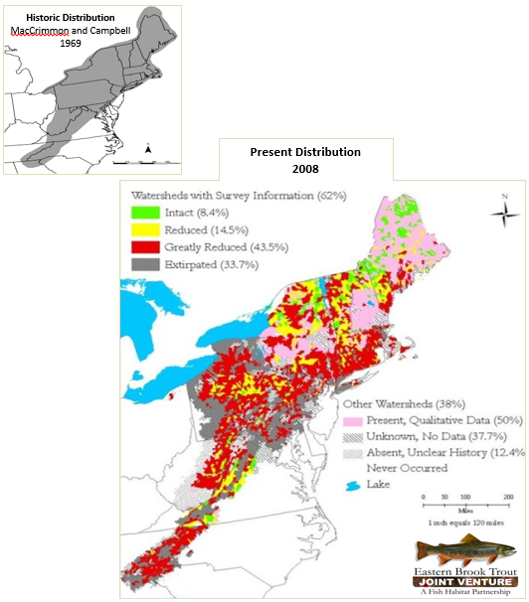
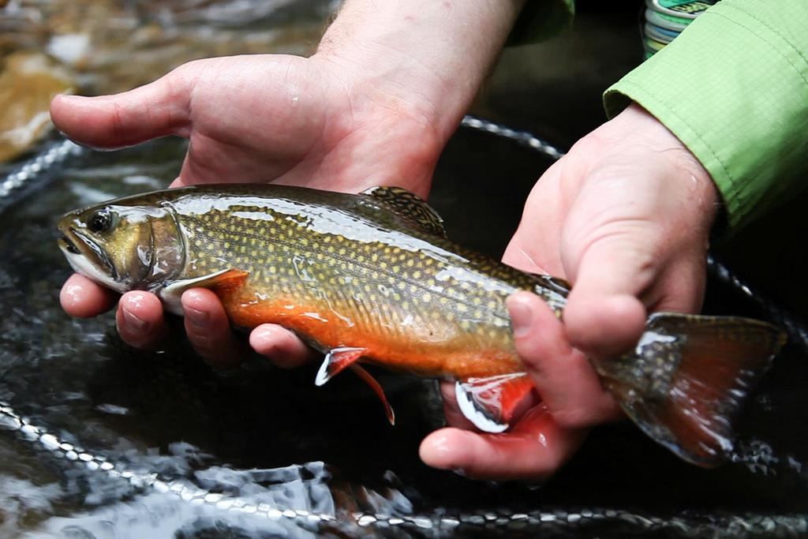
Cross-Outcome
Considerations
Stream Temperature Change – Habitat Change Influences Living Resources (Geographic) Distributions in the Chesapeake Bay Region
Notes:
climate impacts many outcomes

Slide 7










Agreement Goals and Outcomes
Sustainable Fisheries
Vital Habitats Goal
Blue Crab Abundance
Blue Crab Management
Oyster
Forage Fish
Fish Habitat
Wetlands
Black Duck
Stream Health
Brook Trout
Fish Passage
Submerged Aquatic Vegetation (SAV)
Forest Buffer
Tree Canopy
Water Quality Goal
Toxic Contaminants Goal
2017 Watershed Implementation Plans (WIP)
2025 WIP
Water Quality Standards Attainment and Monitoring
Toxic Contaminants Research Toxic Contaminants Policy and Prevention
Healthy Watersheds Goal
Stewardship Goal
Healthy Waters
Citizen Stewardship
Local Leadership
Diversity
Land Conservation Goal
Public Access Goal
Protected Lands
Land Use Methods and
Metrics Development
Land Use Options Evaluation
Public Access Site Development
Environmental Literacy Goal
Climate Resiliency Goal
Student
Sustainable Schools
Environmental Literacy Planning
Monitoring and Assessment
Adaptation Outcome
Green = Climate Change links
Notes:
Fostering Stewardship Goal/Diversity Outcome
Cross outcome considerations – could always use more data relating to environmental justice
used climate information to determine mapping layers to use (?)
Healthy Watersheds Goal/Outcome
How they plan to adapt/planned action – develop a clear path forward related to climate change
Public Access Goal
List Addressing Sea Level Rise and Climate Change Issues as “Factors Influencing”
Sustainable Fisheries Goal/Forage Fish Populations Outcome
Cross outcome considerations – support efforts to minimize climate change impacts(Chesapeake Atlantis Model demonstrated a negative correlation between increasing temperatures and forage)
Sustainable Fisheries and Vital Habitats Goals/Fish Habitat Conservation and Restoration Outcome
Lessons Learned: We will need to include climate changes if we are building resiliency into our management efforts and project where investments will be most effective according to risk of climate change impacts.
Cross outcome considerations – work with climate change experts to analyze climate change impacts on fish habitat
Toxic Contaminants Goal
Cross Outcome considerations - Pilot for climate resiliency method (CRWG)
Vital Habitats Goal/SAV Outcome
Cross outcome considerations – held workshops with Climate Resiliency Workgroup
Vital Habitats Goal/Brook Trout Outcome
Are we doing what we said we would be doing/Current effort – consider climate change and emerging stressors in determining restoration priorities
Water Quality Goal/WIPS outcomes:
Cross outcome considerations – better understanding of climate resilient BMPs
Challenges – developing an approach to account for changed conditions due to climate change
Water Quality Goal/Monitoring Outcome:
Management approach – better predict future pop growth and climate change impacts
Cross outcome considerations – maintaining the networks supports ‘factors’ data supporting proposed priority climate impacts and resiliency indicators
Diversity, Public Access and Brook Trout highlight climate actions in their work plans

Slide 8
Logic Behind Our Outcome
Factors Influencing Success
Current Efforts and Gaps
Management Approaches

Slide 9
Logic Behind Our Outcome
Following the Decision Framework:
Factors Influencing Success:
Gaps:
Management Approaches:
Scientific Capabilities: data availability and accessibility
Variability across the watershed
Collaboration among Goal Implementation Teams
Consistent incorporation of climate into jurisdiction efforts
Indicators to inform decision making
Impact of climate on BMPs
Continually monitor and assess the trends and likely impacts of changing climatic and sea level conditions on the Chesapeake Bay ecosystem
Continually pursue, design and construct restoration and protection projects to enhance the resiliency of Bay and aquatic ecosystems from the impacts of coastal erosion, coastal flooding, more intense and frequent storms and sea level rise
Notes:
Monitoring data, research. Across the partners, there’s a wide range of efforts of climate incorporation into their programs. But there is a need for consistency across these efforts.
The CRWG spent 2 year gathering insights from the partnership on possible indicators to inform decision-making. The Original list of needs was 210 topics, 122 metrics. We are publishing 6 this year. Efforts for the top 21 (and maybe the 150+)Have been captured. The remaining 200ish items of interest is one set of gaps we might reference here.
our workplan was too broad, including all partners’ efforts. Going forward, CRWG will narrow focus that the workgroup can impact. Sets the stage for revisions.

Slide 10
Progress:
Are we doing what we said we would do?
2

Slide 11
What is our progress?
Compendium of Climate Change Research and Adaptation Efforts (2016)
Technical Recommendations to Modeling Workgroup: Guidance on climate projections & scenarios - sea level rise, temperature, precipitation “Recommendations on Incorporating Climate-Related Data Inputs and Assessments: Selection of Sea Level Rise Scenarios and Tidal Marsh Change Models”
STAC Workshops: BMP and The Development of Climate Projections for Use in the Chesapeake Bay Program Assessments
Development of Climate Change Indicators and Progress Measures for the Chesapeake Bay Program
Three, One-Day Workshops for SAV, Blue Crabs, and Oysters: “An Analytical Framework for Aligning Chesapeake Bay Program Monitoring Efforts to Support Climate Change Impact and Trend Analyses and Adaptive Management”

Slide 12
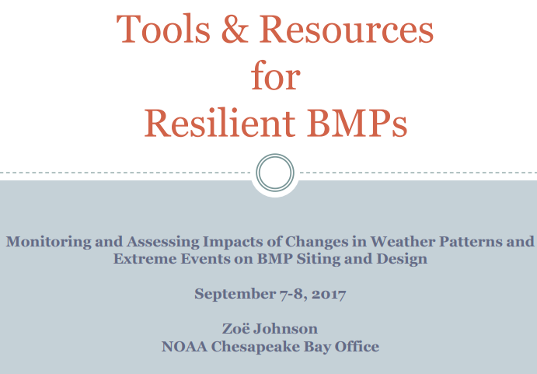
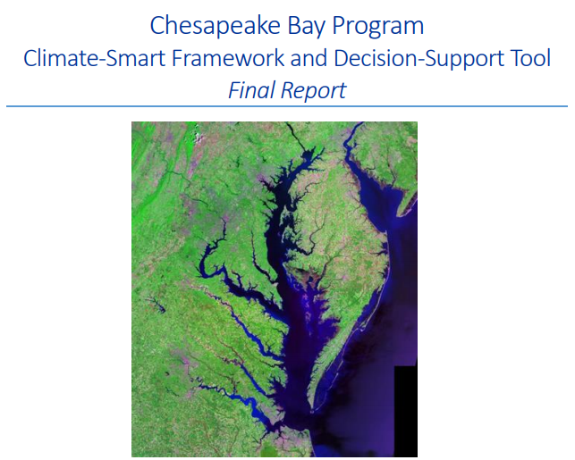
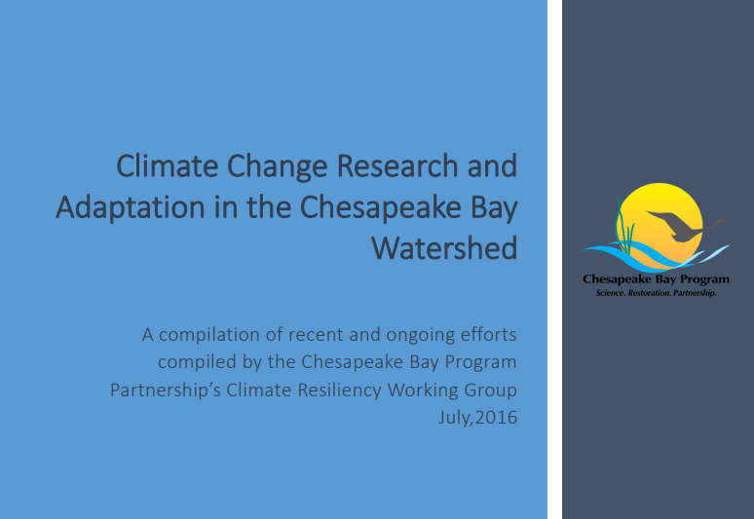
What is our progress?
Implementation of STAC Workshop “Monitoring and Assessing Impacts of Changes in Weather Patterns and Extreme Events on BMP Siting and Design”(September 2017)
Climate Smart Framework & Decision-Support Tool Workshops with Toxic Contaminant, SAV, Tidal Wetlands workgroups
Inform policy implementation of the Phase III Watershed Implementation Plans (WIPs) – 2017 mid-point assessment

Slide 13
Analysis
    Which management actions will be the most critical to your progress in the future?
      STAC Workshop in September 2018: Chesapeake Bay Program Climate Change Modeling 2.0: Developing recommendations for new/refined methods for modeling techniques to assess future impacts of projected climate change on watershed loads and estuarine processes
      Research related to the impact of climate change on BMPs – “Starting with the 2022-2023 milestones, determine how climate change will impact the BMPs included in the WIPs and address these vulnerabilities in the two-year milestones”

Slide 14
Challenges:
Are our actions having the expected effect?
3

Slide 15
Challenges
What scientific, fiscal or policy-related developments or lessons learned (if any) have changed your logic or assumptions about your Outcome?
Fiscal challenges associated with monitoring recommendations
Uncertainty of climate science
Lack of quantitative endpoints
Notes:
The last two bullets require awareness. This is a challenge in measuring progress. This will require more narrow focus in efforts going forward.

Slide 16
Adaptations:
How should we adapt?
4

Slide 17
Based on what we’ve learned, we plan to…
What (if anything) would you recommend changing about your management approach at this time? Will these changes lead you to add, edit or remove content in your work plan?
Modify work plan format and narrow the work plan focus into four main areas:
  Shoreline condition and response;
  Climate change on BMPs;
  Inland and urban flooding;
  Stream health condition
Potentially narrow the focus of the work plan to report on those activities that the Climate Resiliency Working Group directly impact

Slide 18
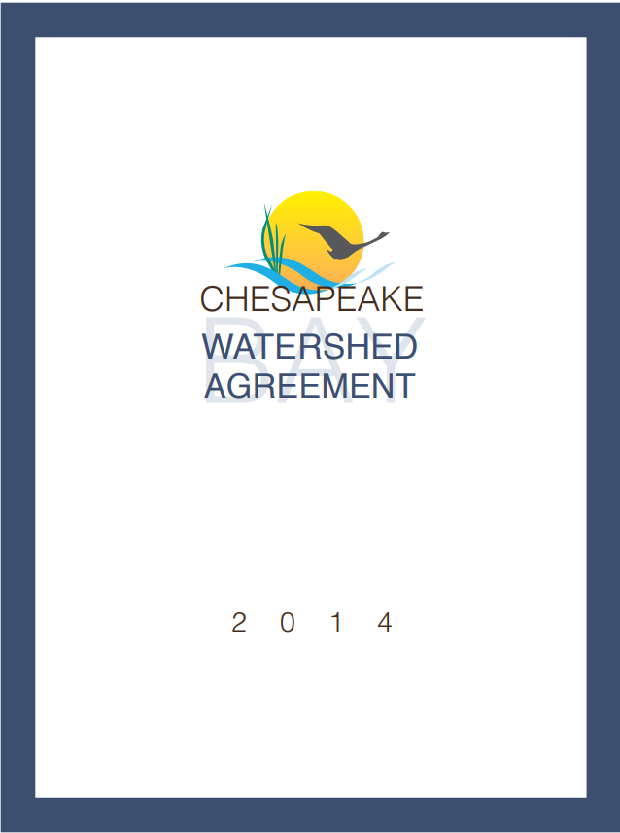
Cross-Outcome
Considerations
Continue to focus on climate change impacts to:
Black Duck
Wetlands
SAV
Brook Trout
Water Quality
Fish Habitat
Forest Buffer
Healthy Watersheds
Stream Health
Diversity
Notes:
Reiteration of cross-outcome connections. Can be tied to previous slide by continuing to work with other workgroups on the topics listed

Slide 19
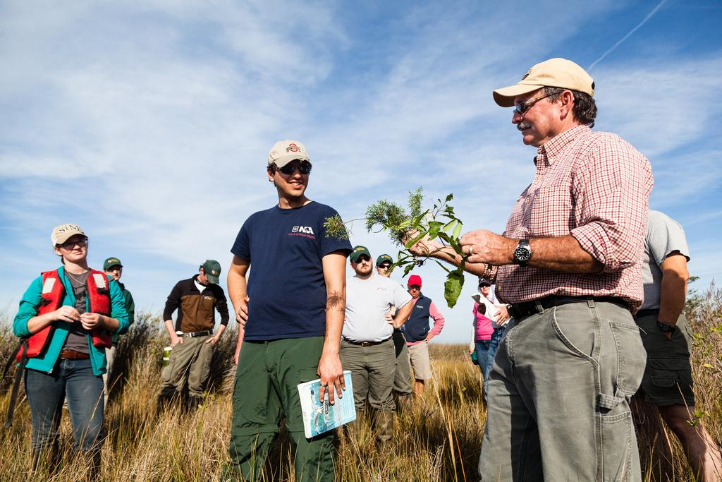
What We Want
To have the Management Board support our efforts in:
Addressing recommendations for BMP Siting and Design data/research needs -currently working to address this
Developing a prioritized list of specific data needs for use by Citizen Science Programs - Management Board to address this March 2019
Promoting utilization of the Chesapeake Bay Program Climate Smart Framework & Decision-Support Tool Management Board to address this March 2019
Incorporating climate change into the Phase III WIPs - currently working to address this
Notes:
The Management Board is expected to approve a Citizen Science and Nontraditional Partner Memorandum of Understanding in July. It might be worth explaining whether and how that agreement—which will support the use of citizen science and nontraditional partner data in monitoring water quality—is is or could be related to this ask. (2) Management Board does not need to approve these indicators. Financial support of *future* indicators would seem to more directly address an existing gap. (3) What does “adopting climate considerations” mean? Would this further our Climate Monitoring and Assessment Outcome, our Climate Adaptation Outcome, or both? Should *all* outcomes adopt climate considerations? Are there some that are a higher priority than others? Is the Climate Resiliency Workgroup willing to help GITs refine their strategies and work plans?

Slide 20
Discussion
Presentation template by SlidesCarnival.
Notes:
This presentation (with two outcomes) will have two presentations’ worth of discussion time.

