Slide 1
Hi there!
Michelle Williams
WQGIT Staffer
WWTWG, USWG, Toxic Contaminants Workgroup

Slide 2
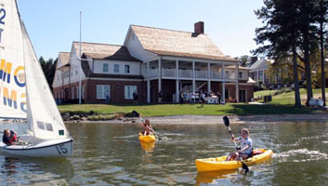
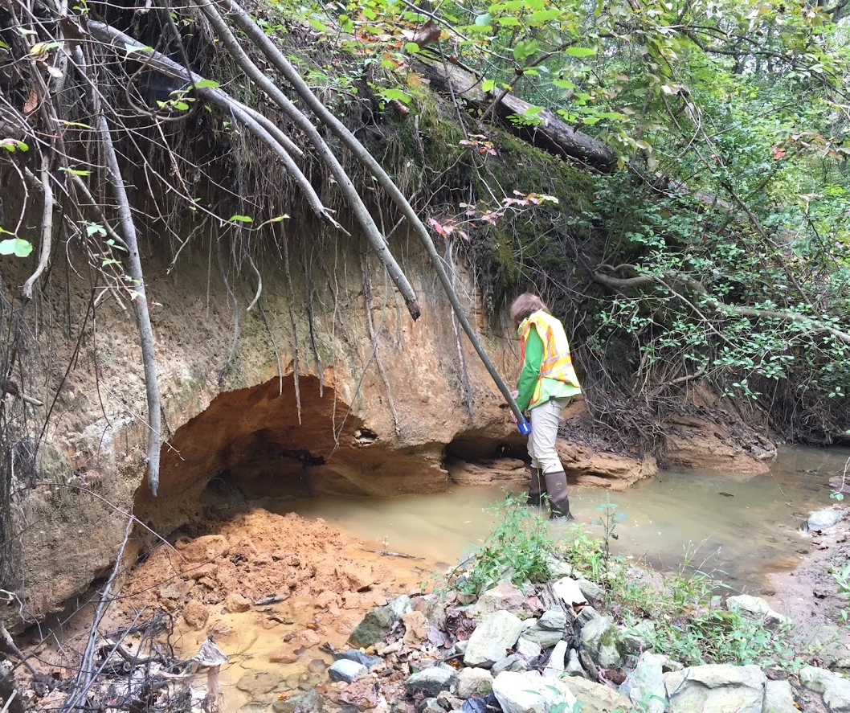
A little about me…
B.A., Biology from St. Mary’s College of Maryland (2016)
  Minor: environmental studies
  Aka summer camp with homework
Chesapeake Conservation Corps, Anne Arundel County Watershed Protection and Restoration Program (2016 – 2017)
  Stormwater BMPs
  Stream restoration
WQGIT staffer since February 2017
Forever concerned with social equity
  Aka really fun at parties

Slide 3
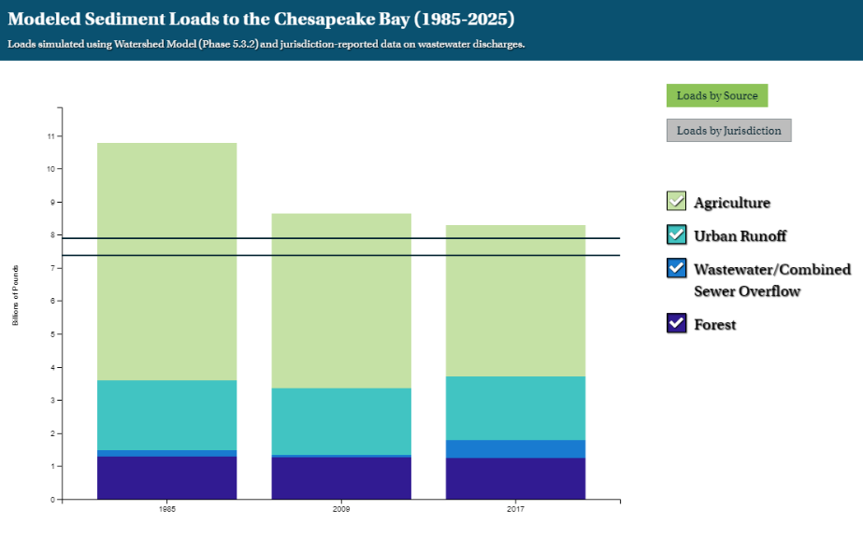
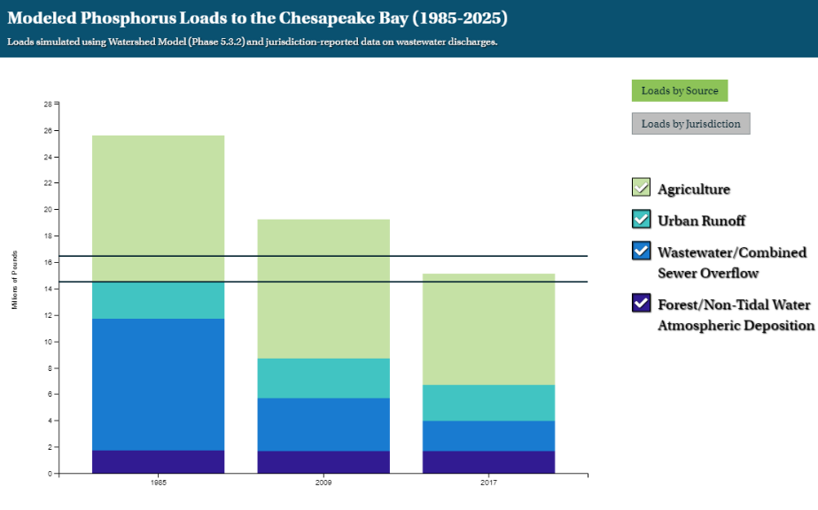
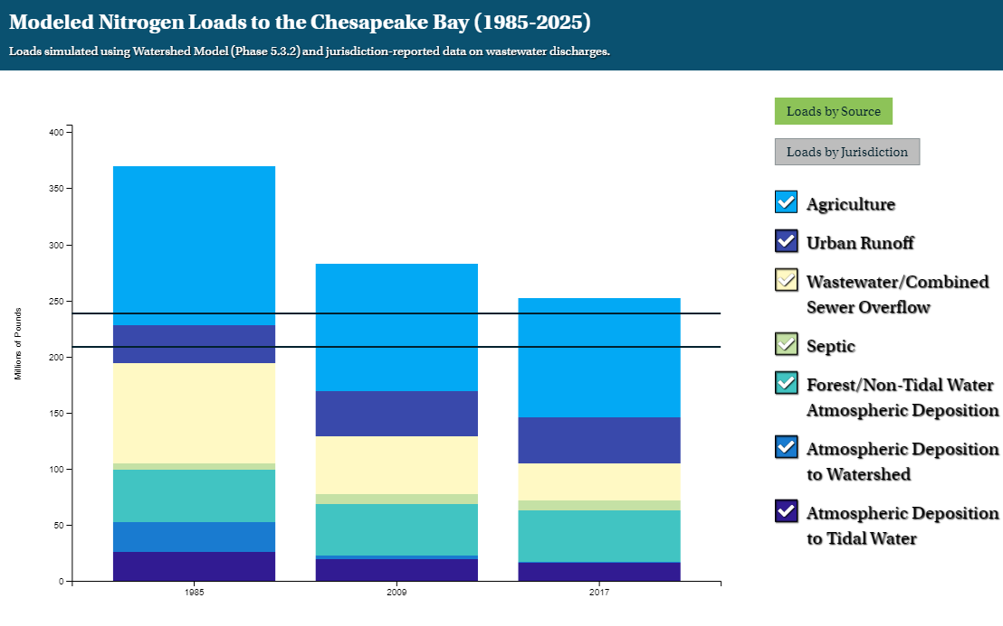
WQGIT Highlights
Water Quality Goal Implementation Team:
  Midpoint Assessment
  Phase 6 Modeling Tools, CAST
  Phase III Planning Targets and Phase III WIP development

Slide 4
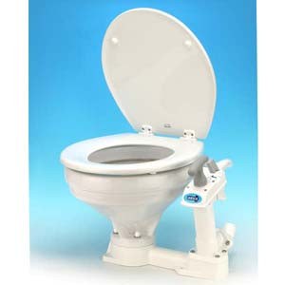
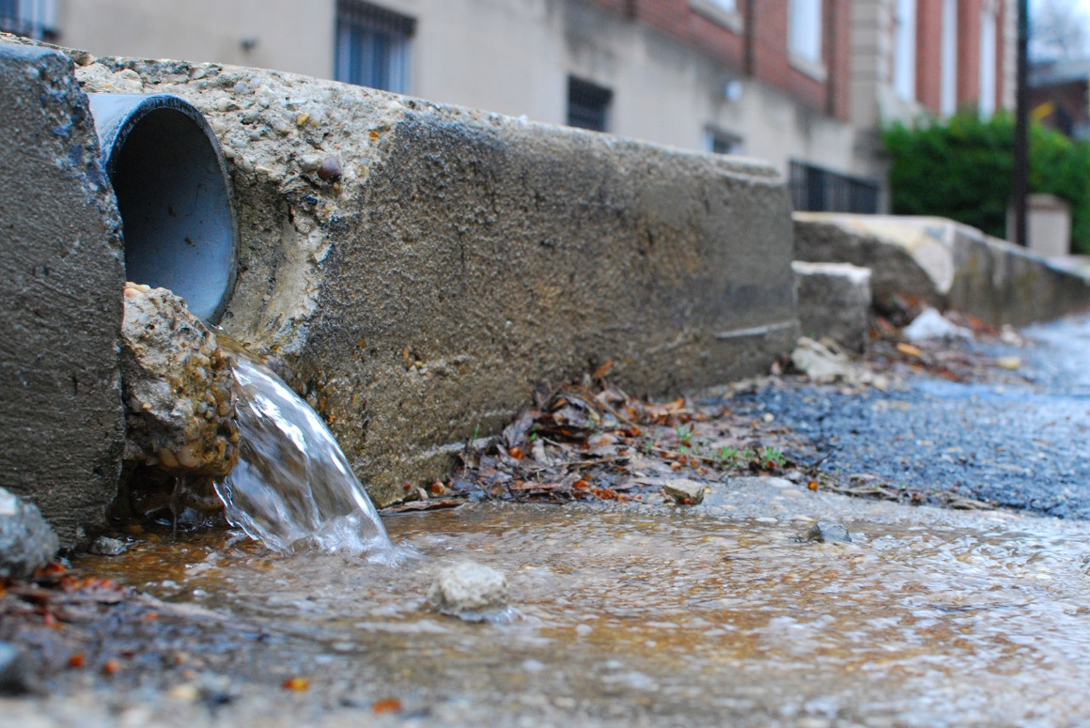
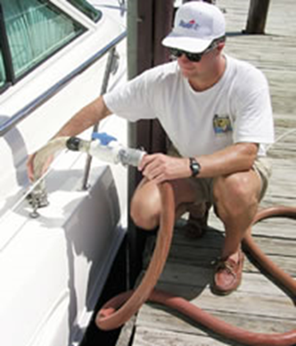

Workgroup Highlights
Wastewater Treatment Workgroup
  2025 Wastewater scenarios for Phase III WIPs
  Crediting boat pump-out practices in the Watershed Model
Urban Stormwater Workgroup
  Ecological aspects of stream restoration practices (Joint with Stream Health Workgroup)

Slide 5

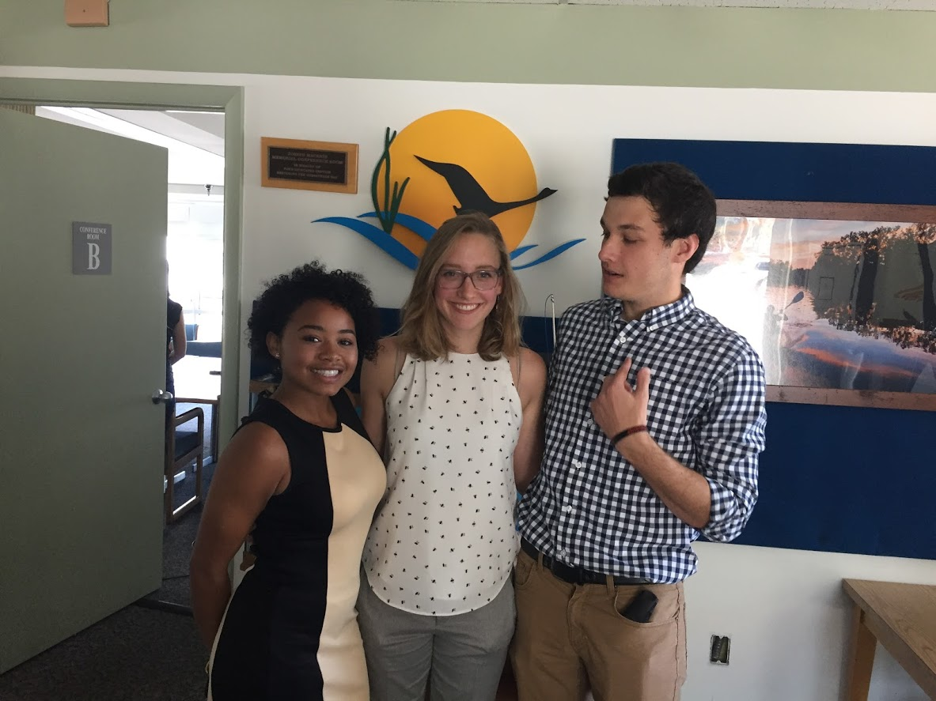
More Highlights
Toxic Contaminants Workgroup
  Outreach and education on PCB fish consumption advisories
    Excellent work from CRC StREAM summer interns (Ashley Duncan, Mackenzie Bodman, Ben Anderson)
  Contaminants of Emerging Concern (e.g. PFOS, endocrine-disrupting compounds, microplastics, etc)
  PCB Consortium proposal
  BMP effectiveness for PCB removal

Slide 6
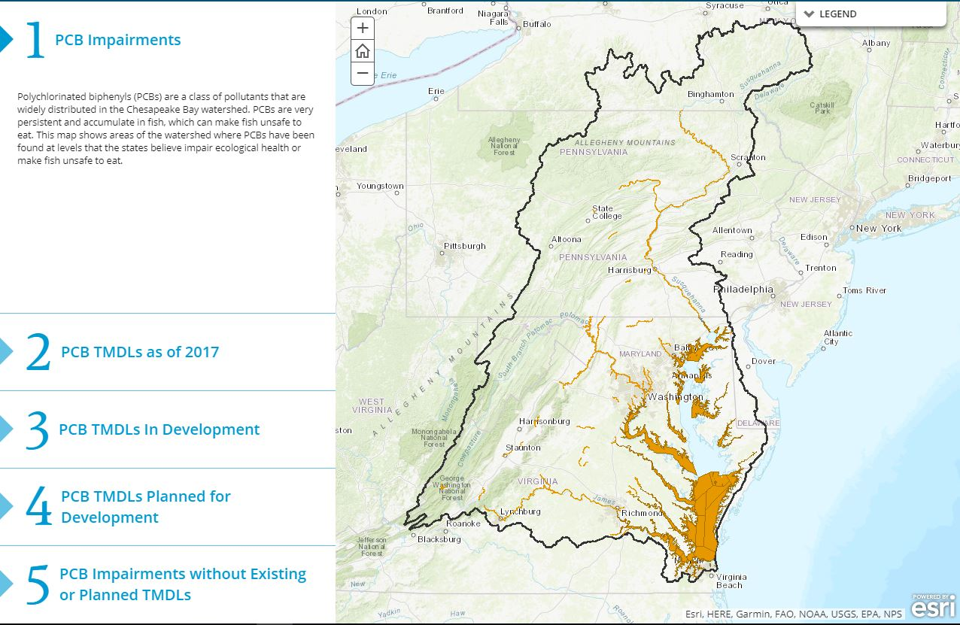
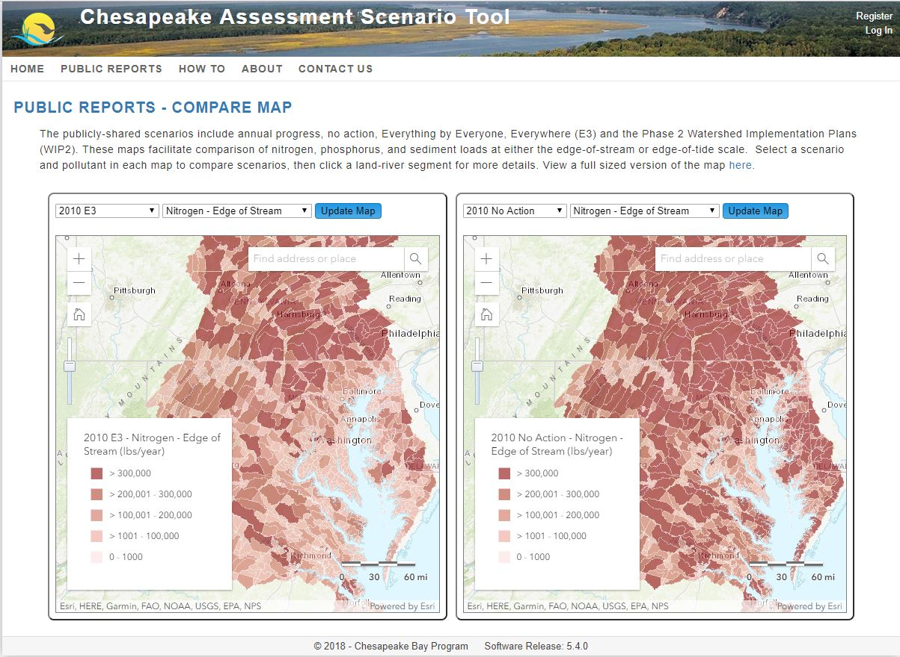
Professional Development
Spatial Data and GIS
  PCB TMDL story map: http://tinyurl.com/PCBStoryMap2018
CAST scenarios for BMP co-benefits
  Co-benefits scoring system as decision support for scenario development
  Use cases for Toxic Contaminants and SAV management
Interests in Toxic contaminants, public health, environmental justice
  Looking into EJ screen trainings, data science opportunities

Slide 7
What’s next?
The ongoing struggle for social justice
Grad school: Environmental health, policy and environmental justice
  Applying science for community health and sustainability
  Masters first,
  Possibly PhD? Stay tuned!

Slide 8
Thank you! Questions?
Michelle Williams
Williams.michelle@epa.gov
410-267-5758

