Slide 1


Analysis of Long-Term Hydrologic Records in the
Chesapeake Bay Watershed
Karen C. Rice^{1,2} and Douglas L. Moyer¹
¹U.S. Geological Survey
²University of Virginia

Slide 2

Previous Research: Rice and Hirsch (2012)
Discharge trends in the Chesapeake Bay watershed: 7-day low flow, mean flow, and 1-day high flow.
Spatial difference in some of these metrics between North and South in the Chesapeake Bay watershed.

Slide 3
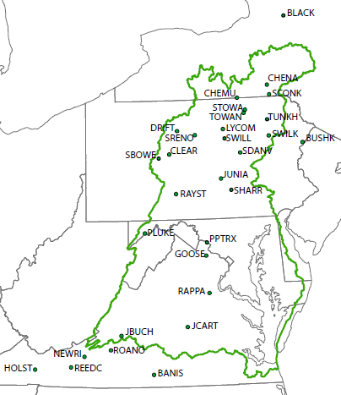
Previous Research
Dividing line was approximately the Maryland/Pennsylvania border

Slide 4
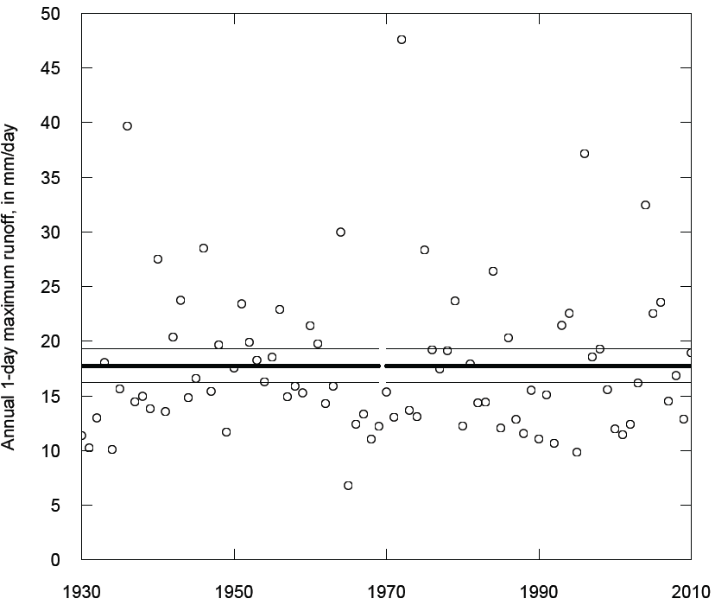
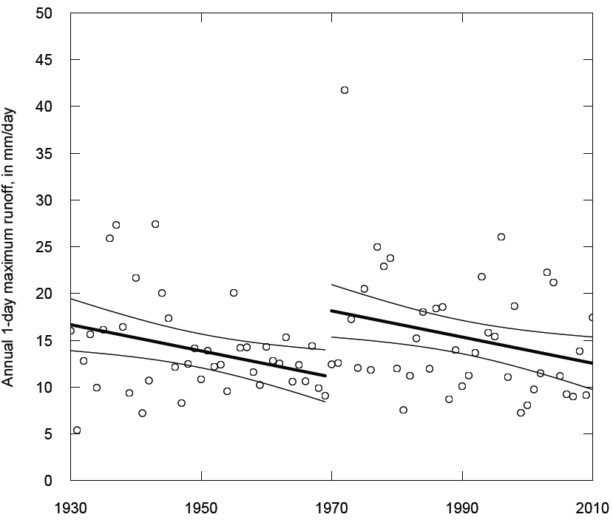
Mean 1-Day Maximum Runoff
1930-2010
North
South
Rice and Hirsch (2012)

Slide 5
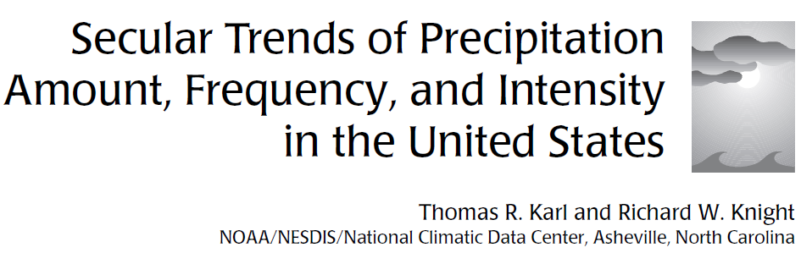
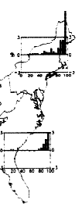

Bulletin of the American Meteorological Society, 1998

Slide 6
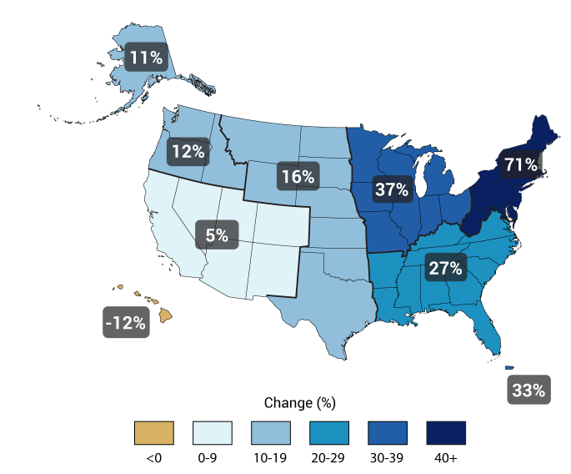
Observed Change in Very Heavy Precipitation
Percent increase in heaviest 1% of all daily events from 1958 to 2012 [in U.S. Climate Assessment (2014), from Karl et al. (2009)]

Slide 7
Objective
Use Historical Records in Precipitation (P) and Discharge (Q) to Compare Trends in the Chesapeake Bay Watershed
How are changes in P being manifested in Q?

Slide 8
Linear Regression Trends
1927-2014
27 Watersheds
Precipitation: (PRISM data, monthly)
Discharge: (USGS gages, daily)

Slide 9
Precipitation
Discharge
NORTH
SOUTH

Slide 10
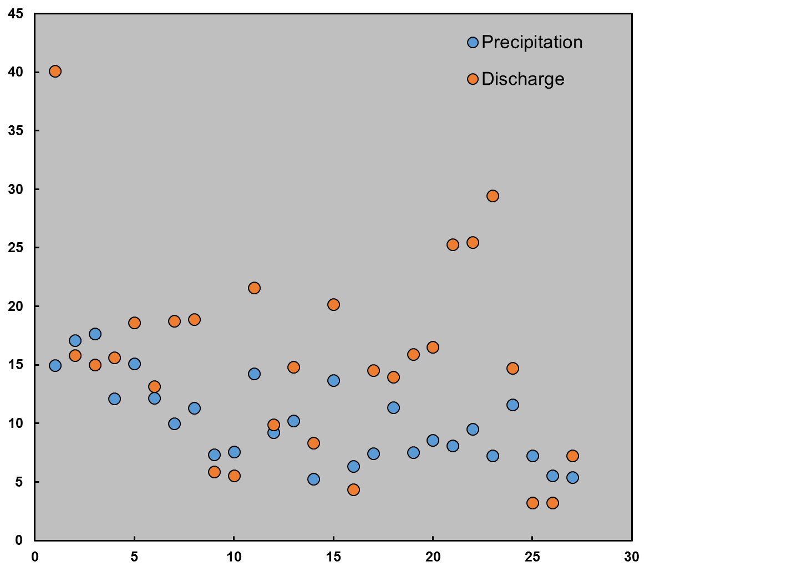
Percent Change from 1927 to 2014
Percent Change
Site Number, North to South

Slide 11
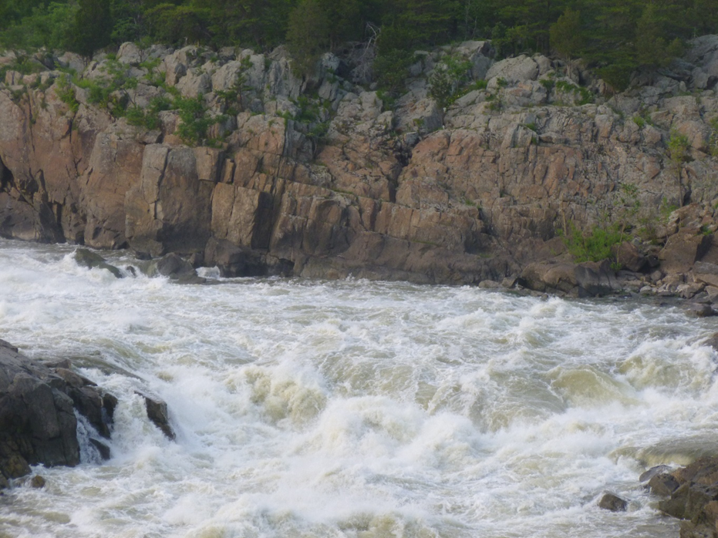
Specific Quantiles in P and Q

Slide 12
Methods
For each of the 27 watersheds:
Analyze annual distribution of:
monthly total precipitation
daily mean Q
Record P (cm) and Q (cfs) that corresponds to each decile (0th, 10th, 20th, …100th) for each year
Determine the slope of the linear regression line for the whole period for each decile

Slide 13
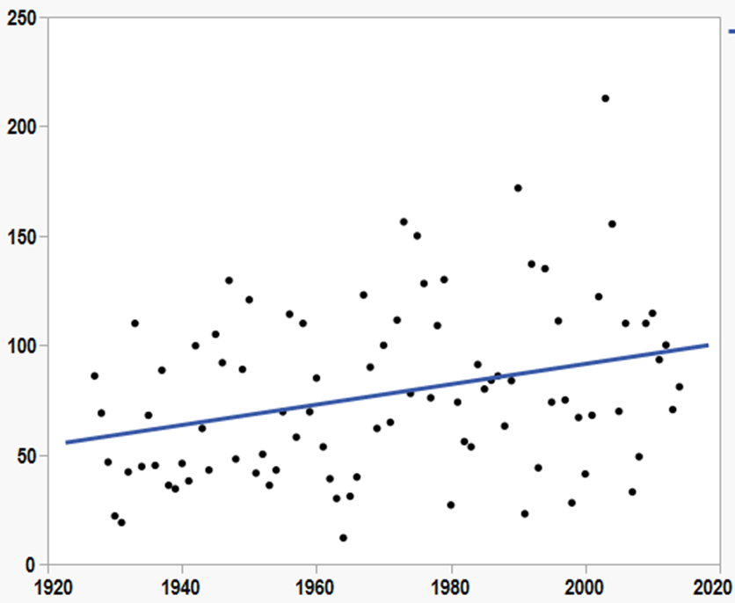
Q that corresponds to 30th decile for each year
at site 01550000
y = -840 + 0.47*Year
Slope = 0.4655; t-ratio = 2.98; p-value = 0.0038

Slide 14
Comparison of Trends
in P and Q
by Decile
Northern Sites first, followed by Southern Sites

Slide 15
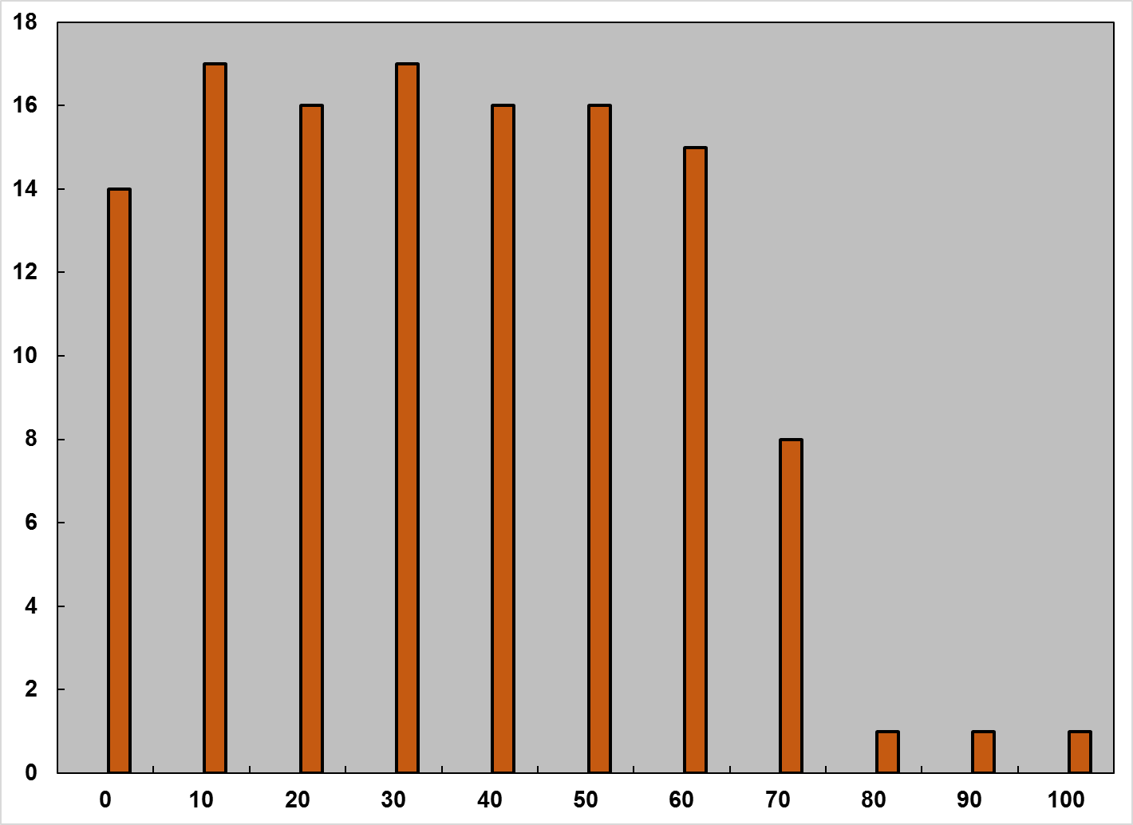
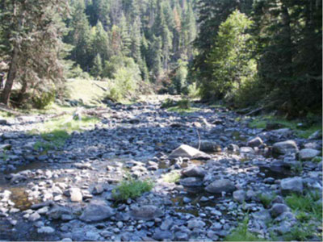
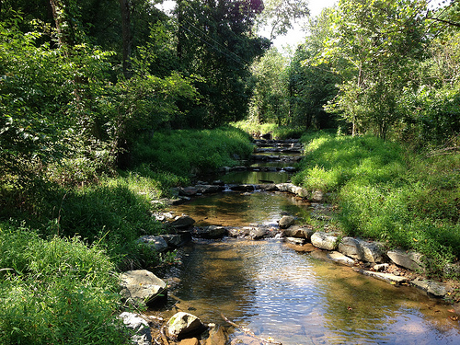
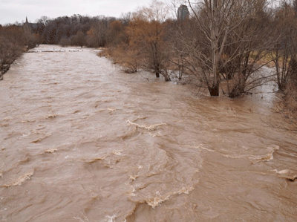
NORTH
Very low flow
Mid-flow
Number of Sites
Storm
flow
Decile

Slide 16
Northern Sites
1927-2014 Trends
0th decile
Precipitation
Discharge

Slide 17
Northern Sites
1927-2014 Trends
10th decile
Precipitation
Discharge

Slide 18
Northern Sites
1927-2014 Trends
20th decile
Precipitation
Discharge

Slide 19
Northern Sites
1927-2014 Trends
30th decile
Precipitation
Discharge

Slide 20
Northern Sites
1927-2014 Trends
40th decile
Precipitation
Discharge

Slide 21
Northern Sites
1927-2014 Trends
50th decile
Precipitation
Discharge

Slide 22
Northern Sites
1927-2014 Trends
60th decile
Precipitation
Discharge

Slide 23
Northern Sites
1927-2014 Trends
70th decile
Precipitation
Discharge

Slide 24
Northern Sites
1927-2014 Trends
80th decile
Precipitation
Discharge

Slide 25
Northern Sites
1927-2014 Trends
90th decile
Precipitation
Discharge

Slide 26
Northern Sites
1927-2014 Trends
100th decile
Precipitation
Discharge

Slide 27
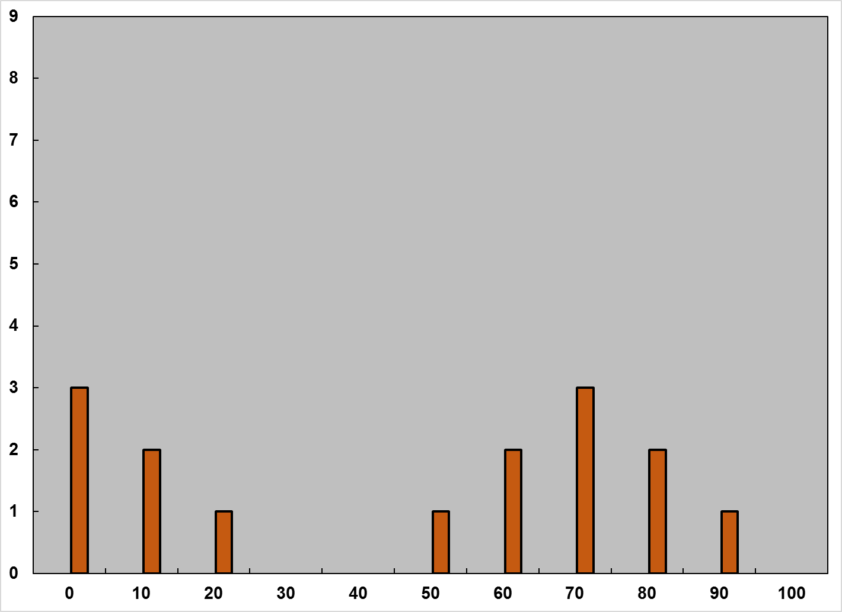
SOUTH
Very low flow
Mid-flow
Number of Sites
Storm
flow
Decile

Slide 28
Southern Sites
1927-2014 Trends
0th decile
Precipitation
Discharge

Slide 29
Southern Sites
1927-2014 Trends
10th decile
Precipitation
Discharge

Slide 30
Southern Sites
1927-2014 Trends
20th decile
Precipitation
Discharge

Slide 31
Southern Sites
1927-2014 Trends
30th decile
Precipitation
Discharge

Slide 32
Southern Sites
1927-2014 Trends
40th decile
Precipitation
Discharge

Slide 33
Southern Sites
1927-2014 Trends
50th decile
Precipitation
Discharge

Slide 34
Southern Sites
1927-2014 Trends
60th decile
Precipitation
Discharge

Slide 35
Southern Sites
1927-2014 Trends
70th decile
Precipitation
Discharge

Slide 36
Southern Sites
1927-2014 Trends
80th decile
Precipitation
Discharge

Slide 37
Southern Sites
1927-2014 Trends
90th decile
Precipitation
Discharge

Slide 38
Southern Sites
1927-2014 Trends
100th decile
Precipitation
Discharge

Slide 39
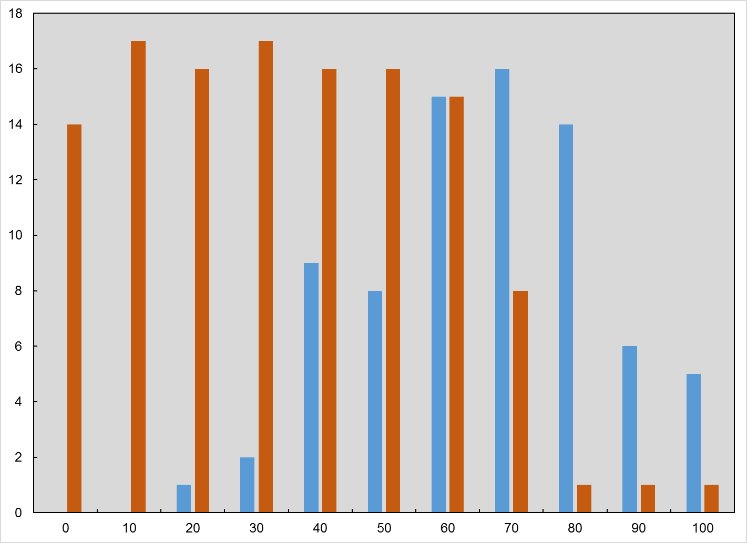
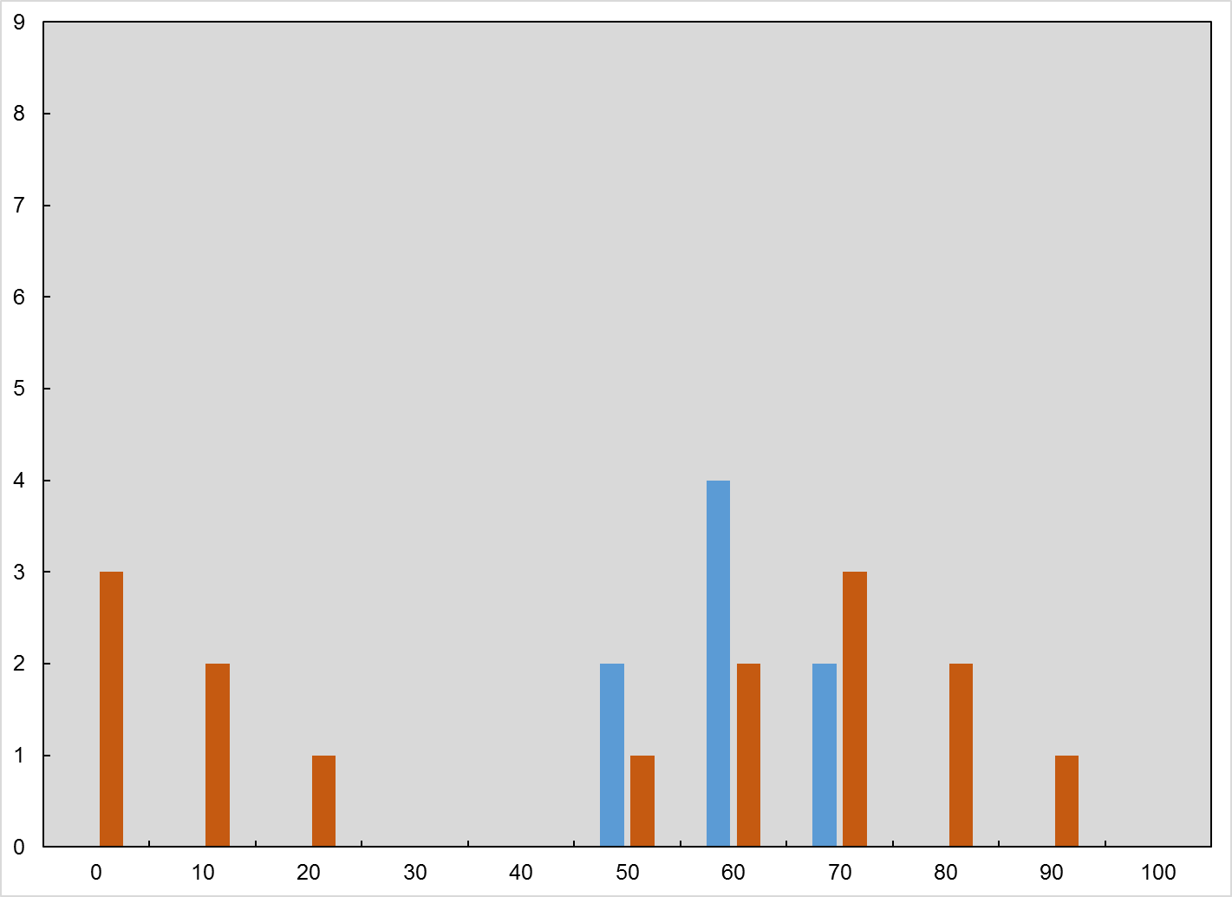

Number of Significant Positive Trends in each Decile
North
South
Decile
Decile

Slide 40
From North to South:
Linkage in P & Q decreases
Trends in P have lower slopes
Fewer significant P & Q trends
Significance of trends decreases
Fewer significant trends in P&Q deciles

Slide 41
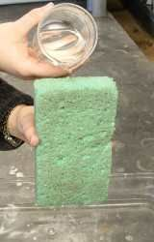
Watershed Storage
Sponge like:
Lag times, travel times
Land use:
Urban, Ag, Forest
Wetlands
Dams
Withdrawals
Snow pack and timing of snowmelt
Antecedent conditions & ET
P ≠ Q

Slide 42
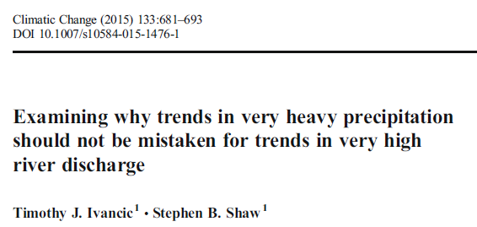
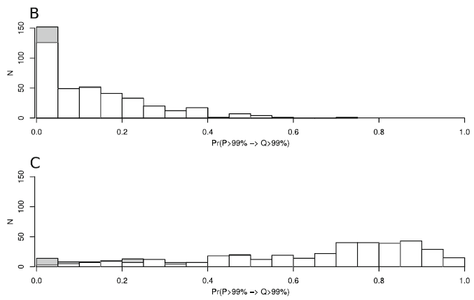
Number of sites with the probability that a 99th percentile precipitation event results in a 99th percentile discharge event
Soil moisture less than the median value
P ≠ Q
Soil moisture greater than the median value

Slide 43
Trends in Runoff Ratio (Q/P)
1927-2014
North
South
P ≠ Q

Slide 44
What about the period specific to the WSM?
1985-2014

Slide 45
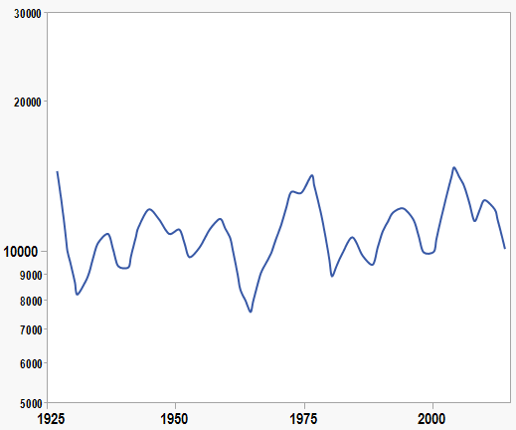
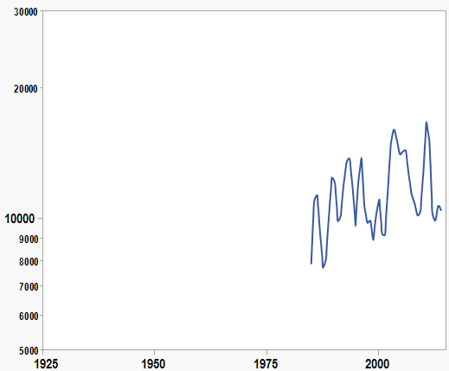
Daily Mean Discharge: Site 01531500
1927-2014
1985-2014
Q = -31,124 + 21.3*year
Q = -167,466 + 89.5*year

Slide 46
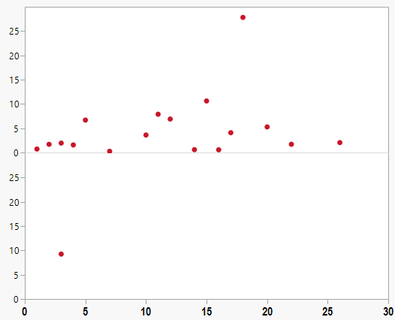
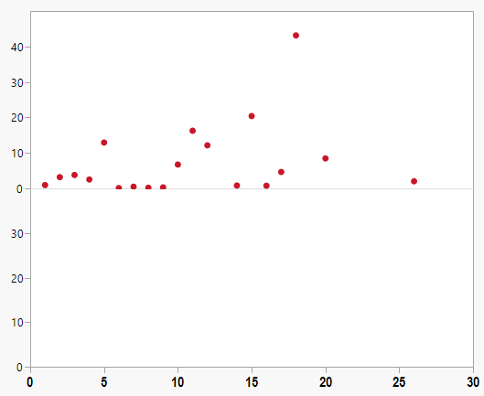
Significant slopes at 0th
decile
Significant slopes at 10th
decile
1927-2014
1927-2014
Slope of Linear Trendline
Slope of Linear Trendline
1985-2014
1985-2014
Site Number
Site Number

Slide 47
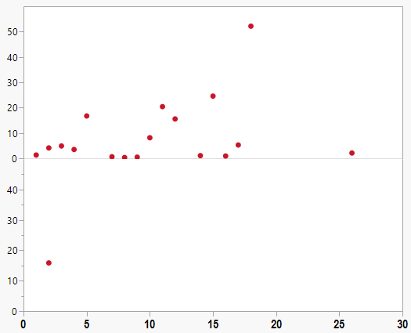
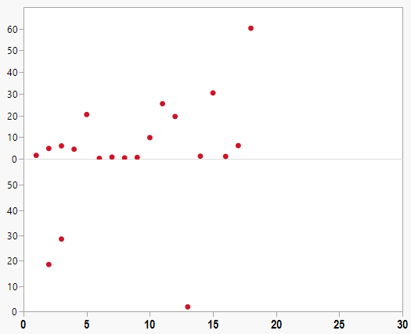
Significant slopes at 20th
decile
Significant slopes at 30th
decile
1927-2014
1927-2014
Slope of Linear Trendline
Slope of Linear Trendline
1985-2014
1985-2014
Site Number
Site Number

Slide 48
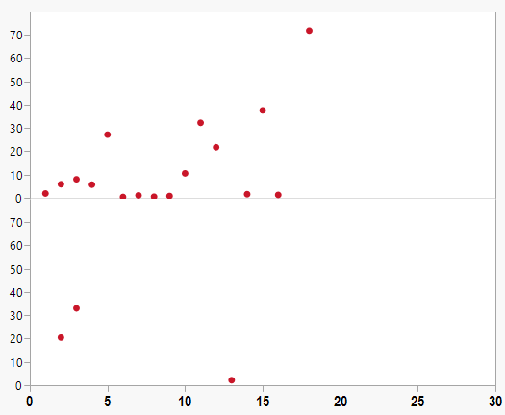
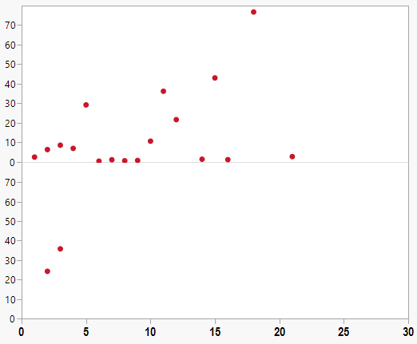
Significant slopes at 40th
decile
Significant slopes at 50th
decile
1927-2014
1927-2014
Slope of Linear Trendline
Slope of Linear Trendline
1985-2014
1985-2014
Site Number
Site Number

Slide 49
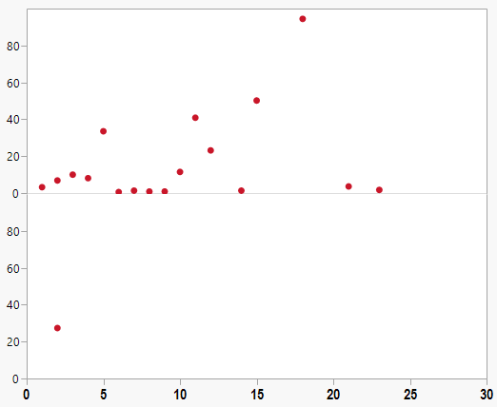
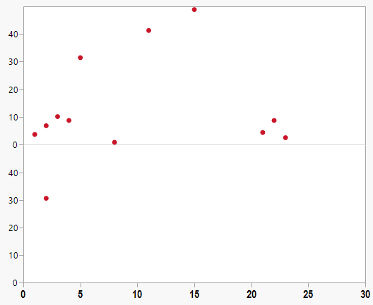
Significant slopes at 60th
decile
Significant slopes at 70th
decile
1927-2014
1927-2014
Slope of Linear Trendline
Slope of Linear Trendline
1985-2014
1985-2014
Site Number
Site Number

Slide 50
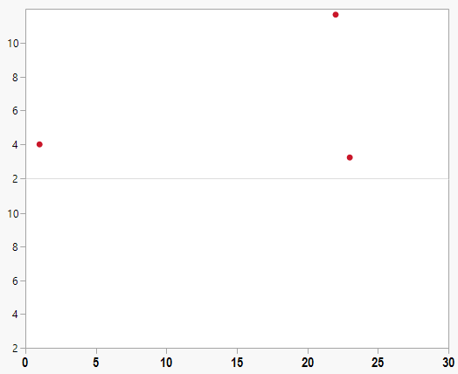
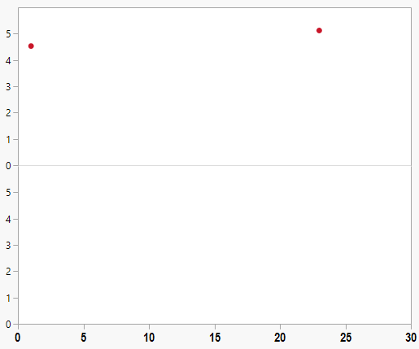
Significant slopes at 80th
decile
Significant slopes at 90th
decile
1927-2014
1927-2014
Slope of Linear Trendline
Slope of Linear Trendline
1985-2014
1985-2014
Site Number
Site Number

Slide 51
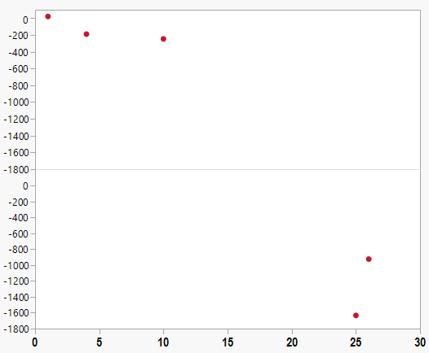
Significant slopes at 100th
decile
1927-2014
Slope of Linear Trendline
1985-2014
Site Number

Slide 52
Why is the number of significant slopes
different between
1927-2014 and 1985-2014?
139 (47%)
14 (4.7%)

Slide 53

Definition of the quantitative power of a linear trend test:
Power = f (b/s * n^{1.5}),
where b is the trend slope, s is the standard deviation of the error, and n is the number of observations.

Slide 54
Long-Term Observations Necessary
“In a nonstationary world, continuity of observations is critical.” (Milly et al., 2008, Science)
“The idea here is that we must use long-term hydrologic observations to help us evaluate, on an ongoing basis, how the changing atmosphere is changing hydrologic processes.” (Milly et al., 2015, Water Resour. Res.)

Slide 55
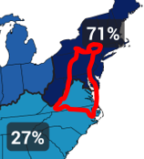
Diverse Watershed
Complicating Factors:
Land Use
Wetlands
Dams
Withdrawals
Hurricanes
Atmospheric Forcings

Slide 56
Summary
1) P ≠ Q
2) North ≠ South
3) Trends in
1985-2014 ≠ 1927-2014
Analyses have not been reviewed or approved by USGS; please do not cite or quote

Slide 58
Is the flow variability in the upper deciles so high that it is masking
the ability to detect a linear trend?
Addressed by:
log₁₀ transforming
ranking
non-parametric Spearman’s rho

Slide 59
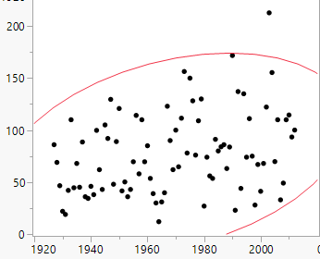
Q that corresponds to 30th decile for each year
at site 01550000
Parametric:
Linear Regression
Non-parametric:
Spearman rho
y = -840 + 0.47*Year
Slope = 0.4655; t-ratio = 2.98; p-value = 0.0038
Spearman rho = 0.2958; p-value 0.0051

Slide 60
Comparison of Methods
1927-2014 Trends
0th quantile
North
South

Slide 61
Comparison of Methods
1927-2014 Trends
10th quantile
North
South

Slide 62
Comparison of Methods
1927-2014 Trends
20th quantile
North
South

Slide 63
Comparison of Methods
1927-2014 Trends
30th quantile
North
South

Slide 64
Comparison of Methods
1927-2014 Trends
40th quantile
North
South

Slide 65
Comparison of Methods
1927-2014 Trends
50th quantile
North
South

Slide 66
Comparison of Methods
1927-2014 Trends
60th quantile
North
South

Slide 67
Comparison of Methods
1927-2014 Trends
70th quantile
North
South

Slide 68
Comparison of Methods
1927-2014 Trends
80th quantile
North
South

Slide 69
Comparison of Methods
1927-2014 Trends
90th quantile
North
South

Slide 70
Comparison of Methods
1927-2014 Trends
100th quantile
North
South

Slide 71
Summary of Comparison of Four Methods
Number of Significant Slopes for each Quantile
*Two of the slopes are negative

Slide 72
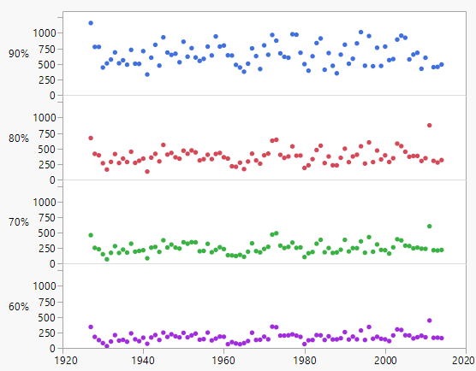
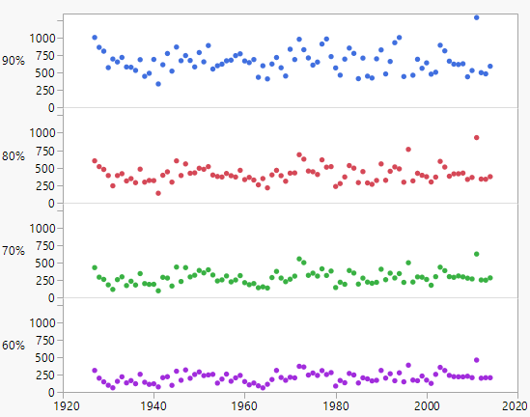
Plots of Individual Deciles
01532000
01550000
NS
NS
NS
NS
NS
Sig.
Sig.
Sig.

