Slide 1
Climate change in the
Northeast US: Past, Present, and Future
Raymond Najjar
Department of Meteorology
The Pennsylvania State University
Chesapeake Climate Projections Workshop March 7-8, 2016

Slide 2
Outline
Global climate change context
Historical climate change in the Northeast U.S.
Future climate change in the Northeast U.S.

Slide 3
Take-home messages
The Northeast US has gotten warmer and wetter; precipitation has become more intense
These trends will continue in the coming decades
There is a large sensitivity to the emissions scenario, but not until mid century
Natural variability is important, particularly for precipitation

Slide 4

Global context:
IPCC Fifth Assessment Report (2013)
The Physical Science Basis
“Warming of the climate system is unequivocal”
“Many of the observed changes since the 1950s are unprecedented over decades to millennia”
“It is extremely likely that human influence has been the dominant cause of the observed warming since the mid-20th century”

Slide 5
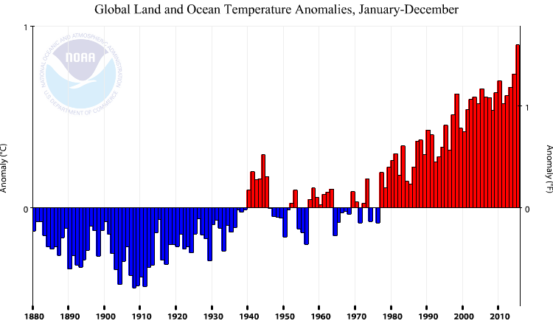
Earth’s mean surface temperature change over the past 135 years
1 ºC
2015 was the warmest year on record by a large margin
1 ºF
0 ºC
0 ºF
1890 1910 1930 1950 1970 1990 2010

Slide 6

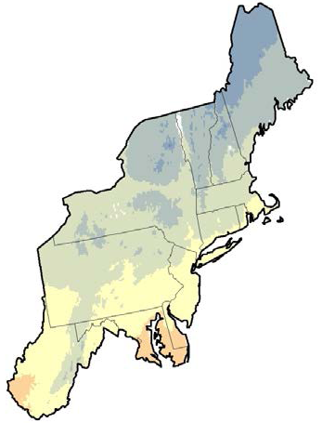

Mean temperature (°F)
40
NCA released in 2014
Northeast climate data and model analysis released January 2013
45
50
55
Kunkel et al. (2013)
Kenneth Kunkel

Slide 7
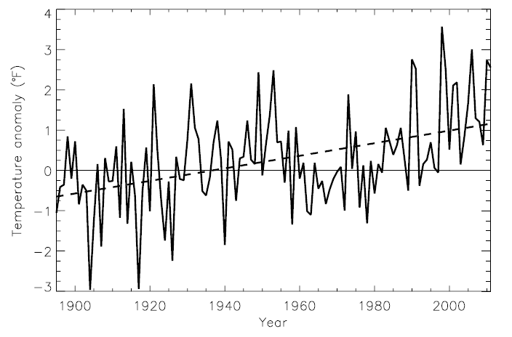
Temperature anomaly for the Northeast U.S.: 1985-2011
Hottest year: 1998
ΔT = 2.0 °F
Kunkel et al. (2013)
>95% significance annually and in all seasons

Slide 8
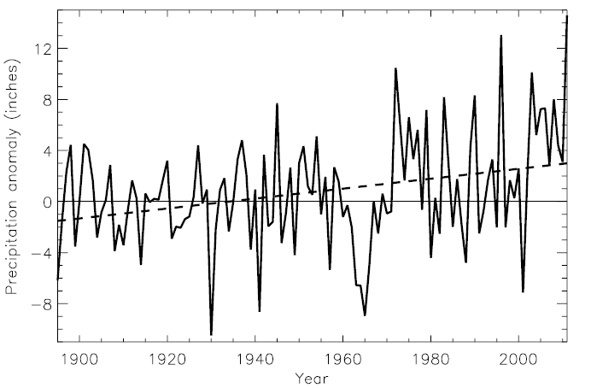
Annual precipitation anomaly for the Northeast U.S.
Wettest year: 2011
ΔP = 4.9 in
(~10%)
Kunkel et al. (2013)
>95% significance in annually and in the fall

Slide 9
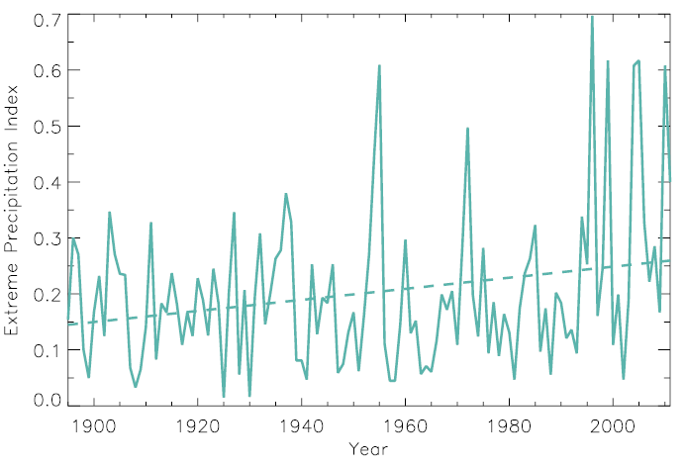
Extreme precipitation for the Northeast: 1985-2011
Based on daily precipitation events with a five-year recurrence interval
Δ = ~80%
Not >95% significance!
Kunkel et al. (2013)

Slide 10
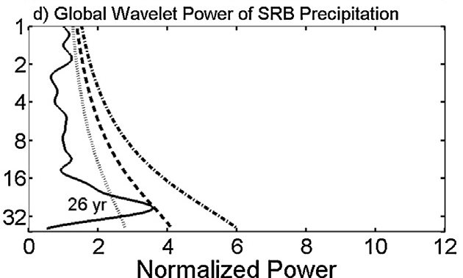

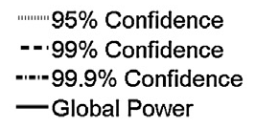
Natural variability is important
Global Wavelet Power of Susquehanna River Basin Precipitation
Significant power at a period of 20-30 years. Related to Pacific Ocean climate modes (PDO and ENSO).
Schulte et al. (2016)

Slide 11
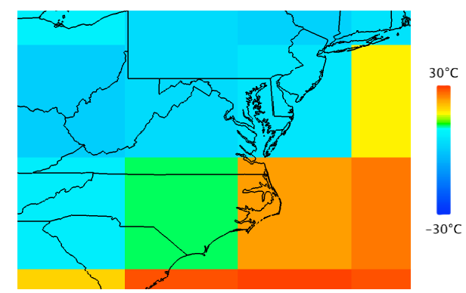
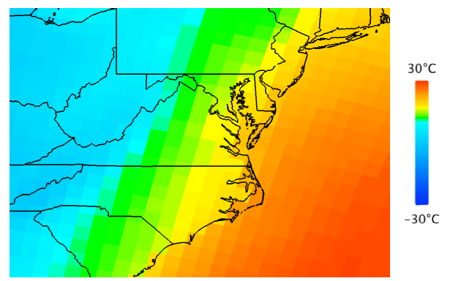
US Climate Projections
Surface air temperature
15 Global Climate Models (GCMs)
Coarse resolution, multiple emissions scenarios, full 20th-21st century
11 Regional Climate Models (RCMs)
finer resolution, single emissions scenario, late 20th / mid 21st century
GCM
RCM

Slide 12
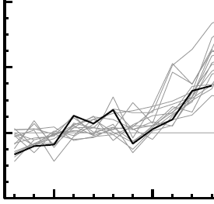
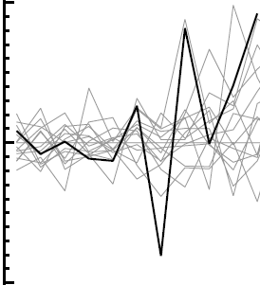
Observed and simulated temperature and precipitation change in the Northeast U.S.
4
10
observed
model
2
Temperature change (°F)
Precipitation change (%)
0
0
-2
-10
1905
1955
2005
1905
1955
2005
Year
Year
Decadal averages; deviation from 1901-1960 average
Kunkel et al. (2013)

Slide 13
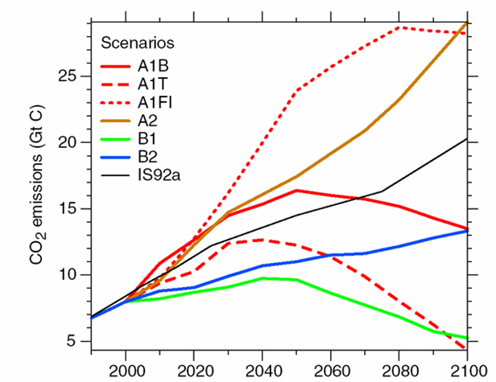
Future emissions scenarios
“High” emissions A2 scenario
Actual fossil fuel + land use emissions
Annual
“Low” emissions B1 scenario

Slide 14
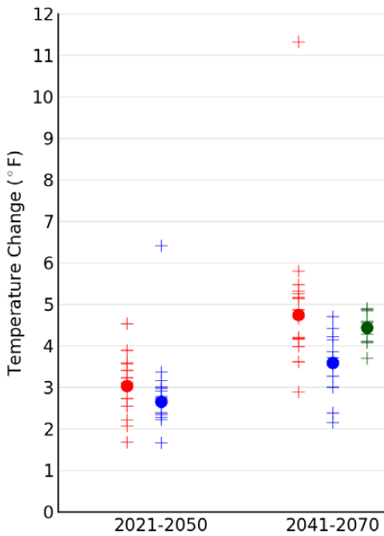
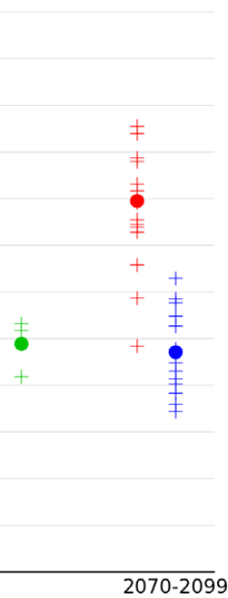
Projected 21st century temperature change from 15 global climate models under two climate scenarios
+ individual model
● multi-model average
A2 emissions
B1 emissions
Kunkel et al. (2013)

Slide 15
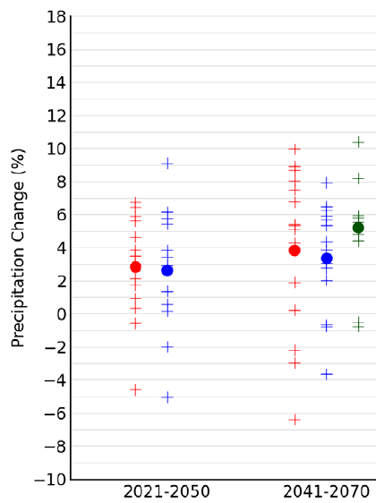
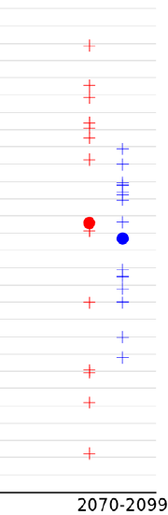
Projected 21st century precipitation change from 15 global climate models under two climate scenarios
+ individual model
● multi-model average
A2 emissions
B1 emissions
Kunkel et al. (2013)

Slide 16
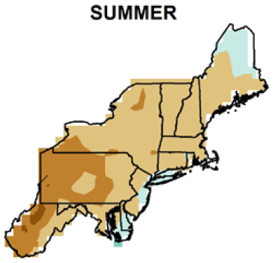
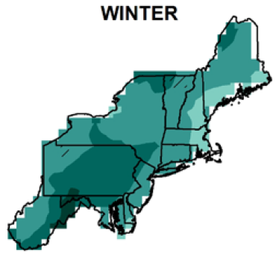

Projected precipitation change in the Northeast U.S. by 2041-2070 using RCMs (A2, multi-model average)
0
8
12
-4
16
Percent change
Kunkel et al. (2013)

Slide 17
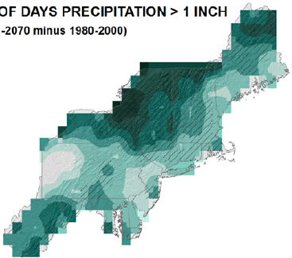

Change in extreme precipitation: number of days > 1 inch
Percent change
21
27
21
15
RCM multi-model average
2041-2070 minus 1980-2000
Kunkel et al. (2013)

Slide 18
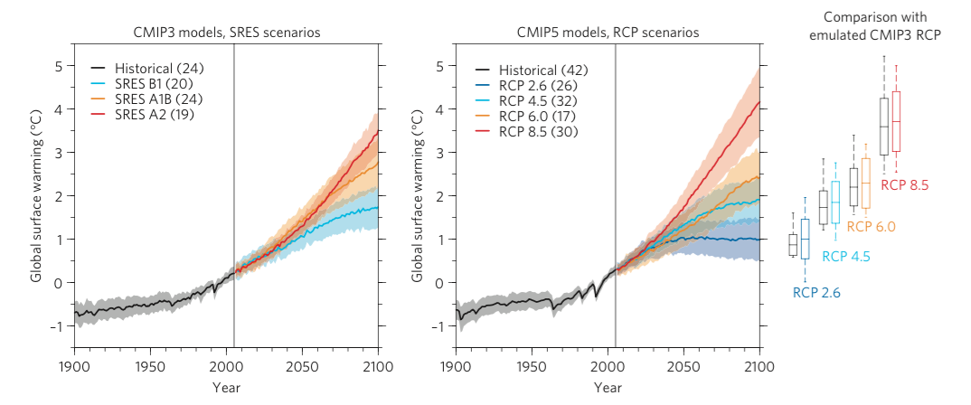
SRES and RCP Scenarios: Impact on global mean surface temperature
Knutti & Sedláček (2013)

Slide 19
Take-home messages
The Northeast US has gotten warmer and wetter; precipitation has become more intense
These trends will continue in the coming decades
There is a large sensitivity to the emissions scenario, but not until mid century
Natural variability is important, particularly for precipitation

Slide 20
References
IPCC, 2013. Summary for Policymakers. In: T.F. Stocker, D. Qin, G.-K. Plattner, M. Tignor, S.K. Allen, J. Boschung, A. Nauels, Y. Xia, V. Bex, P.M. Midgley (Editors), Climate Change 2013: The Physical Science Basis. Contribution of Working Group I to the Fifth Assessment Report of the Intergovernmental Panel on Climate Change. Cambridge University Press, Cambridge, United Kingdom and New York, NY, USA.
Knutti, R., Sedláček, J., 2013. Robustness and uncertainties in the new CMIP5 climate model projections. Nature Climate Change 3, 369-373.
Kunkel, K.E., Stevens, L.E., Stevens, S.E., Sun, L., Janssen, E., Wuebbles, D., Rennells, J., DeGaetano, A., Dobson, J.G., 2013. Regional Climate Trends and Scenarios for the U.S. National Climate Assessment, Part 1. Climate of the Northeast U.S., NOAA Technical Report NESDIS 142-1. U.S. Department of Commerce, Washington, D.C., 79 pp.
Schulte, J., Najjar, R.G., Li, M., 2016. The influence of climate modes on streamflow in the Mid-Atlantic Region of the United States. Journal of Hydrology: Regional Studies 5, 80-99.

Slide 21
Extra slides

Slide 22
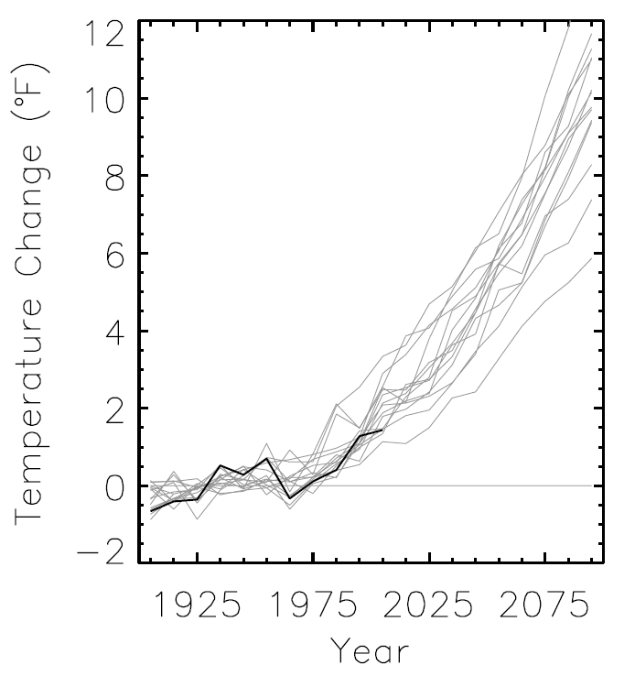
Observed and simulated (A2) temperature change in the Northeast U.S.
Deviation from 1901-1960 average
Kunkel et al. (2013)

Slide 23
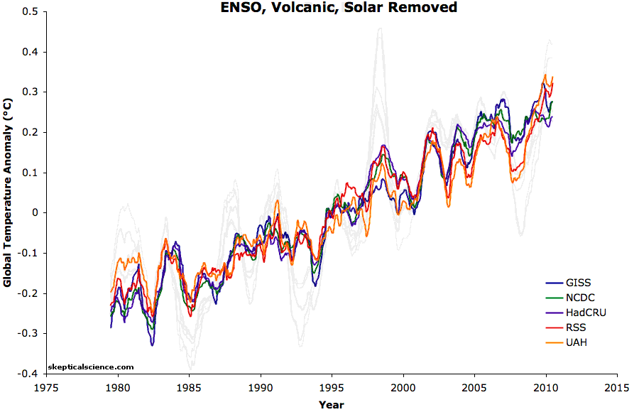
Five global temperature data sets (1979-2010) with and without natural factors removed
Foster and Rahmstorf (2011)

Slide 24
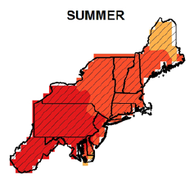
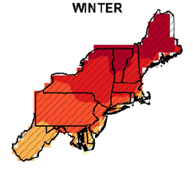

Model-average projected temperature change in the Northeast U.S. by 2041-2070
Degrees (F)

Slide 25
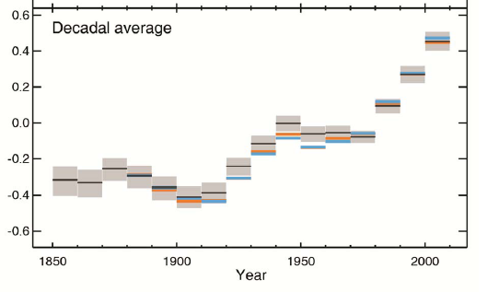
1. IPCC Fifth Assessment Report Summary for Policymakers
The Physical Science Basis
Warming of the climate system is unequivocal
Observed global mean surface air temperature anomaly (°C) with respect to the 1961-90 average
Lines: different data sets
Shading: uncertainty
IPCC (2013)

Slide 26
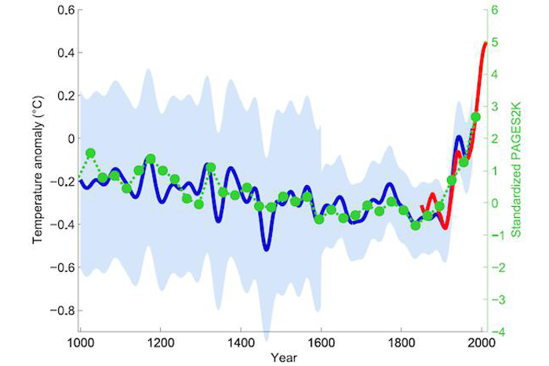
Many of the observed changes since the 1950s are unprecedented over decades to millennia
Observed (red) and reconstructed (blue & green) surface air temperature
Global mean HADCRUT4
Mann et al. (1999) NH land
with confidence interval
PAGES 2K (2013) Global land
S. Rahmstorf, thinkprogress.org

Slide 27
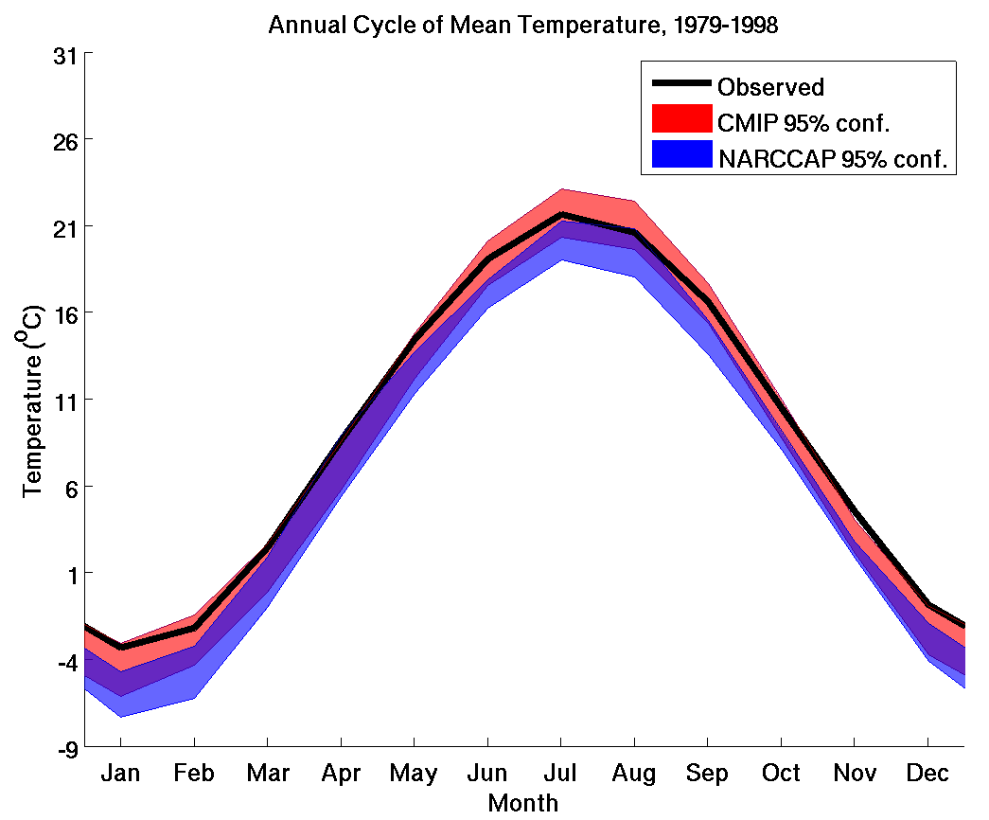


Climate model evaluation over PA
Global climate models
Observations
Andrew Ross
Regional climate models
Jim Shortle
Shortle et al. (2013)

Slide 28
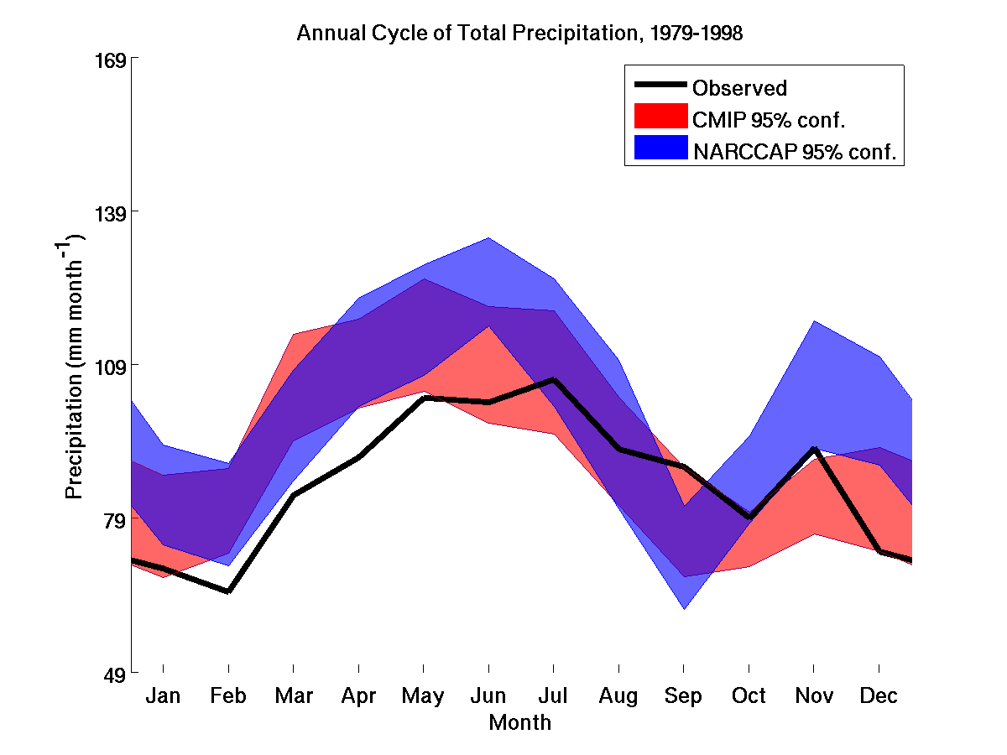
Climate model evaluation over PA: Precipitation
Global climate models
Regional climate models
Observations
Shortle et al. (2013)

Slide 29
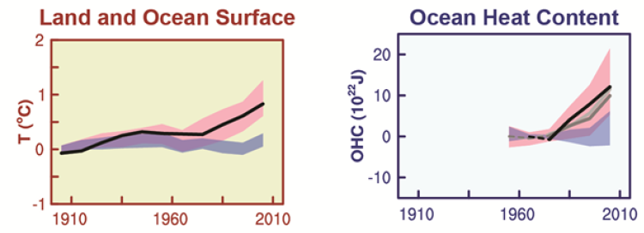
“It is extremely likely that human influence has been the dominant cause of the observed warming since the mid-20th century”
Year
Year
IPCC (2013)

Slide 30
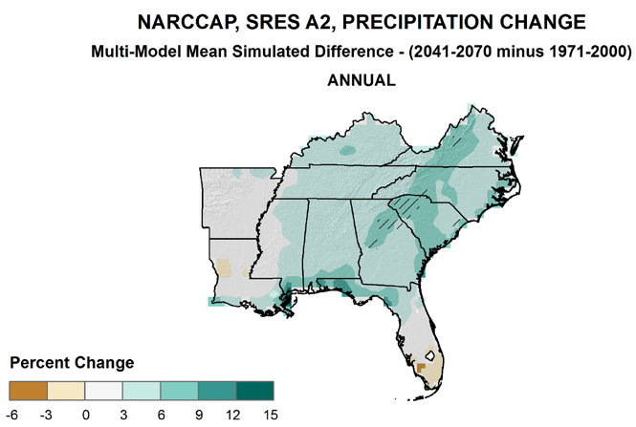
Southeast US

Slide 31
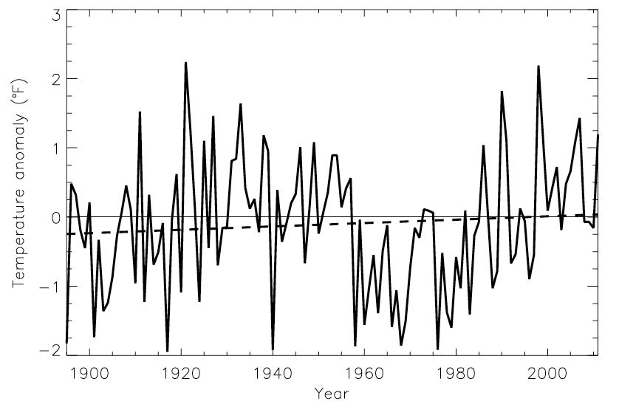
Temperature anomaly for the Southeast U.S.: 1985-2011
Hottest year: 1998
Kunkel et al. (2013)

Slide 32
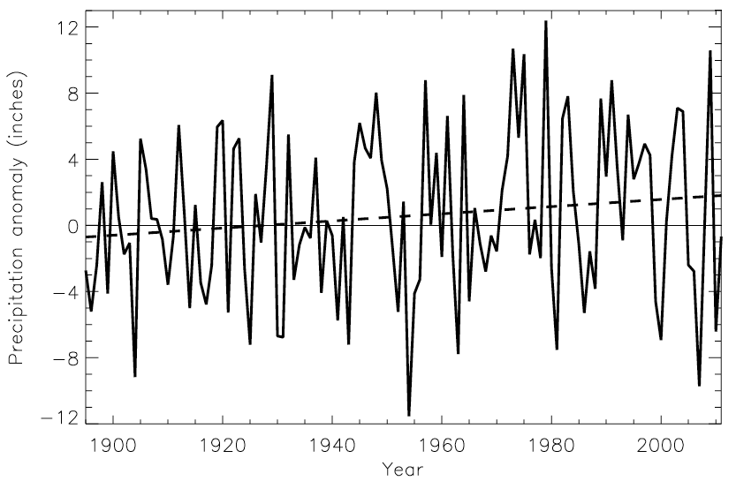
Annual precipitation anomaly for the Southeast U.S.
Kunkel et al. (2013)

Slide 33
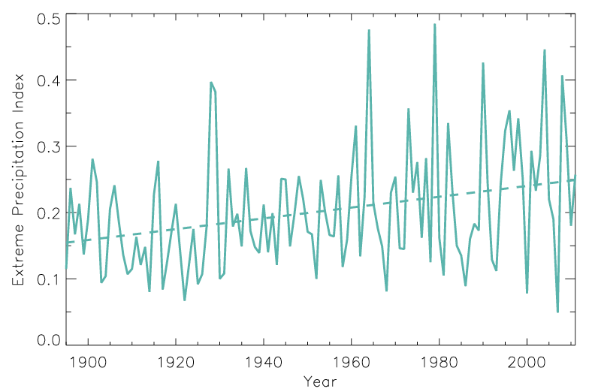
Extreme precipitation for the Southeast US: 1985-2011
Based on daily precipitation events with a five-year recurrence interval
Kunkel et al. (2013)

Slide 34
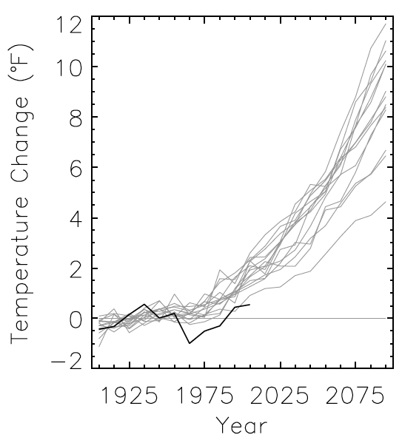
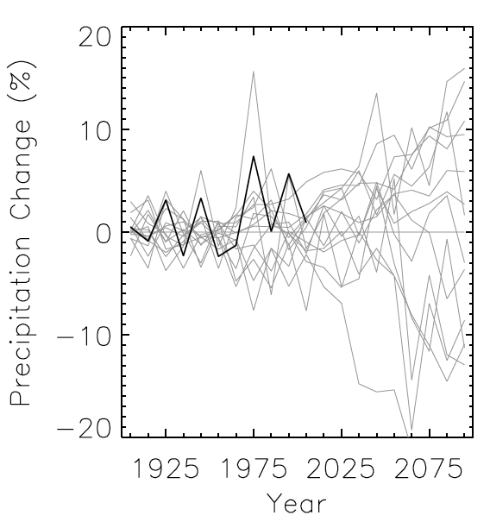
Observed and simulated temperature and precipitation change in the Southeast U.S.
observed
model
Decadal averages; deviation from 1901-1960 average
Kunkel et al. (2013)

Slide 35
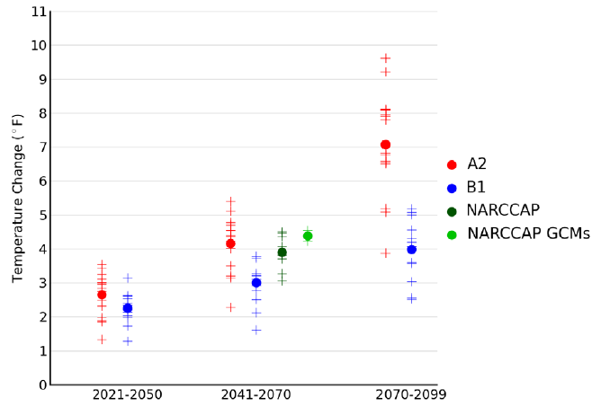
Projected 21st century temperature change in Southeast US from 15 global climate models under two climate scenarios
+ individual model
● multi-model average
Kunkel et al. (2013)

Slide 36
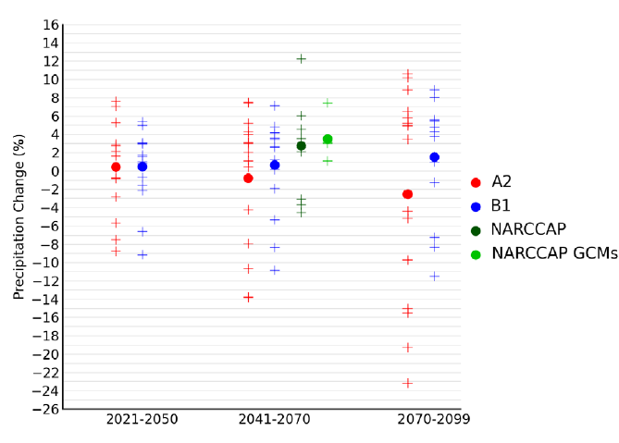
Projected 21st century precipitation change from 15 global climate models under two climate scenarios
+ individual model
● multi-model average
Kunkel et al. (2013)

Slide 37
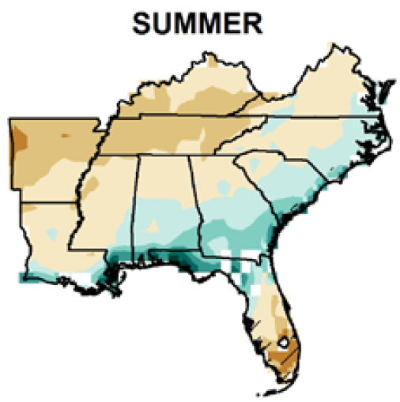
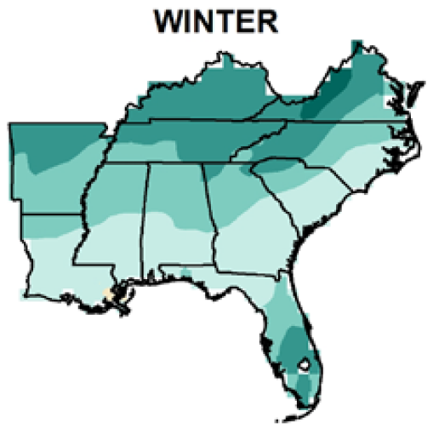
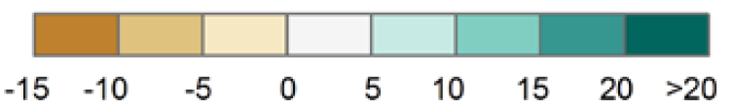
Projected precipitation change in the Southeast U.S. by 2041-2070 using RCMs (A2, multi-model average)
0
-4
Percent change
Kunkel et al. (2013)

Slide 38
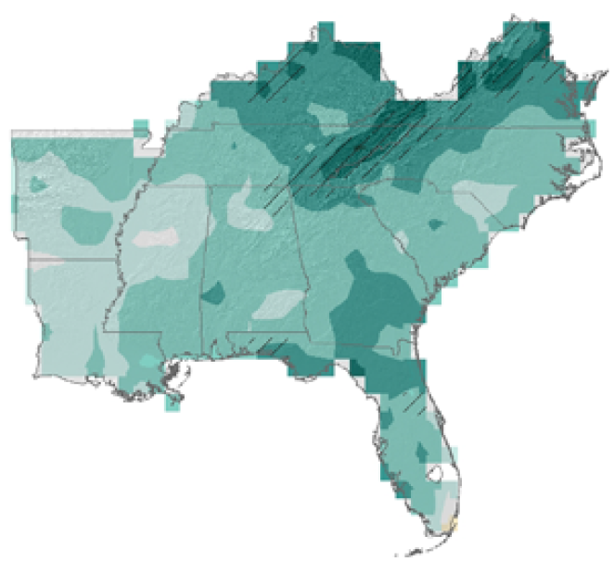
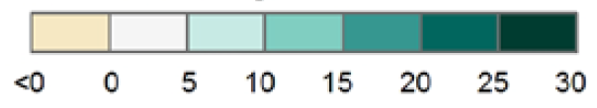
Change in extreme precipitation: number of days > 1 inch
Percent change
15
RCM multi-model average
2041-2070 minus 1980-2000
Kunkel et al. (2013)

Slide 39
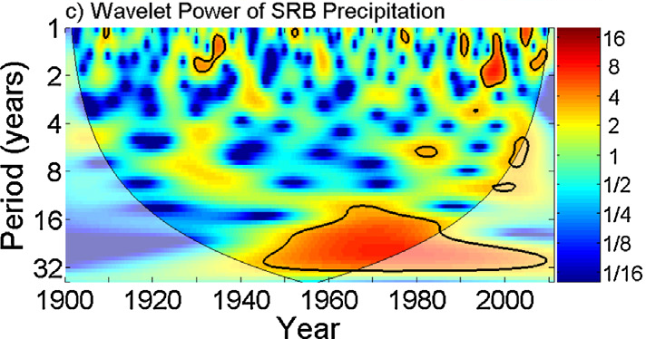
Natural variability is important
Wavelet Power of Susquehanna River Basin Precipitation
Significant power at a period of 20-30 years. Related to Pacific Ocean climate modes (PDO and ENSO).
Schulte et al. (2016)

Slide 40
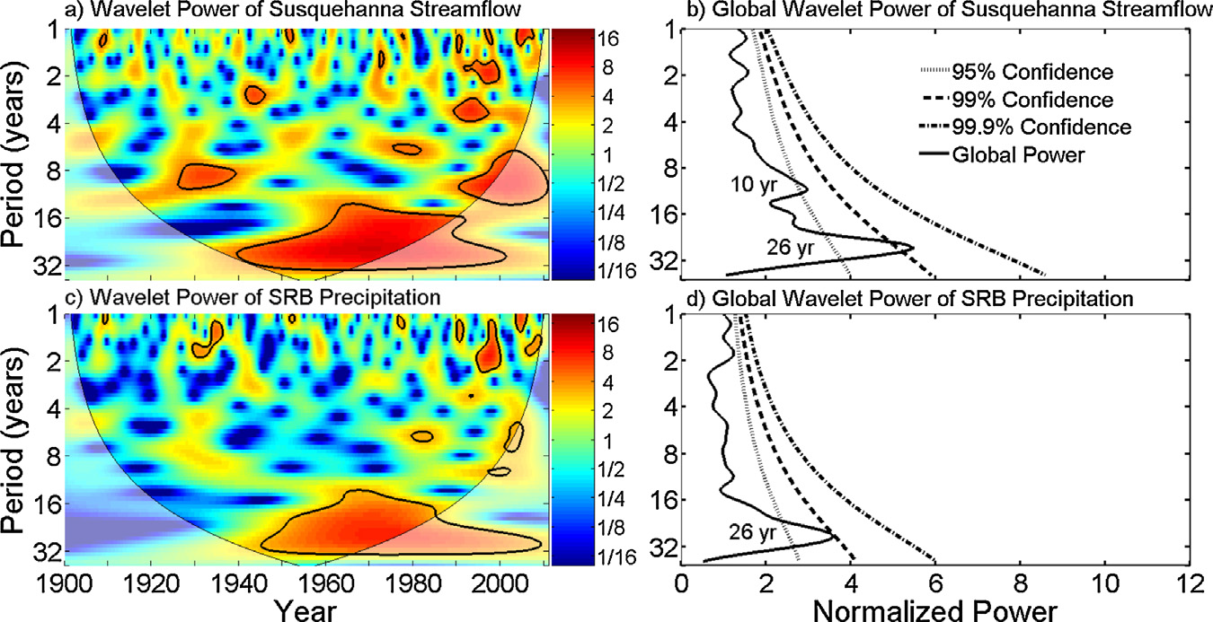

Slide 41
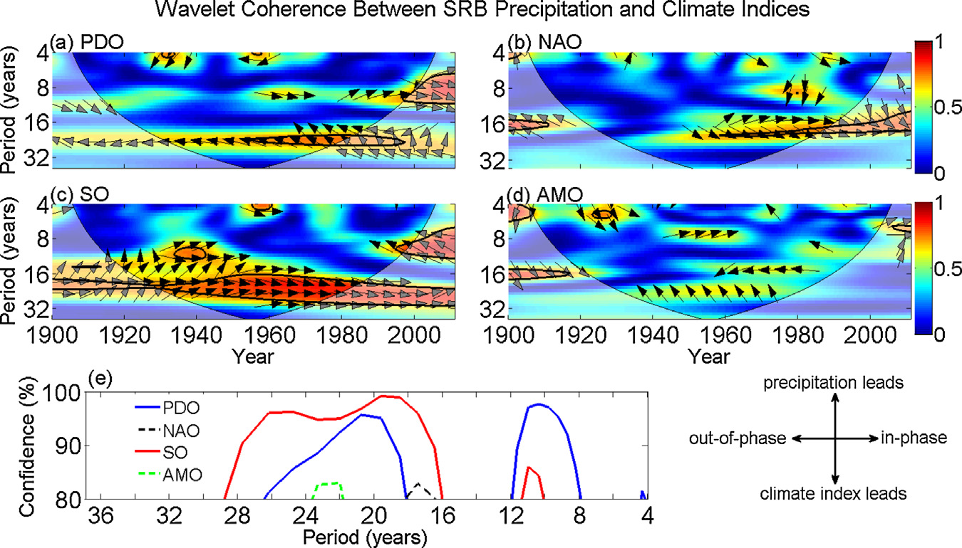

Slide 42
