Slide 1
Climate Change and Oysters in the Chesapeake Bay
Roger Mann and Ryan Carnegie
Virginia Institute of Marine Science
Gloucester Point, VA 23062
presentation to
STAC, Development of Climate Projections for Use in Chesapeake
Bay Program Assessments
Annapolis, March 2016
rmann@vims.edu, carnegie@vims.edu

Slide 2
Questions and answers in the context of Chesapeake Bay climate change.
Why bother with oysters anyway?
What is the impact of climate driven changes in temperature and/or salinity in isolation on oysters?
What is the impact of changing water chemistry on oysters?
What is the impact of diseases on the resident oyster population?
Can we proactively manage any of it?

Slide 3
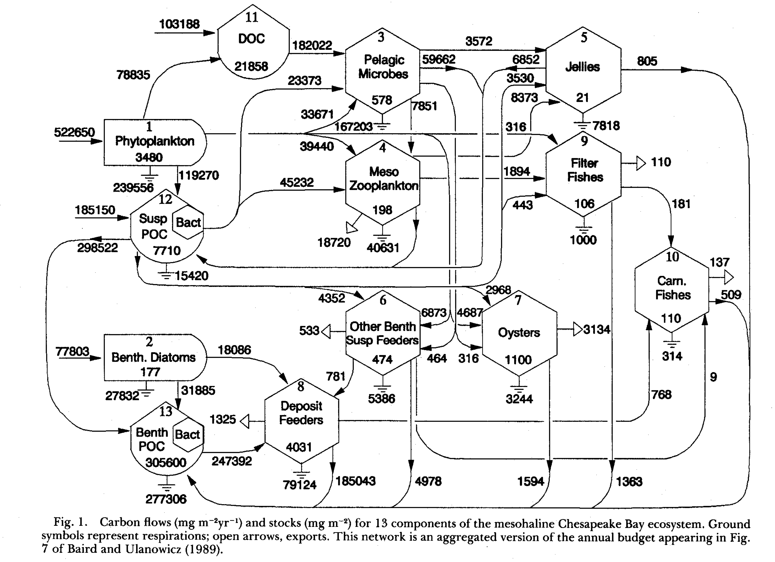
Why bother? Part 1: Oysters are central to the food web. (Ulanowicz and Tuttle 1992).

Slide 4
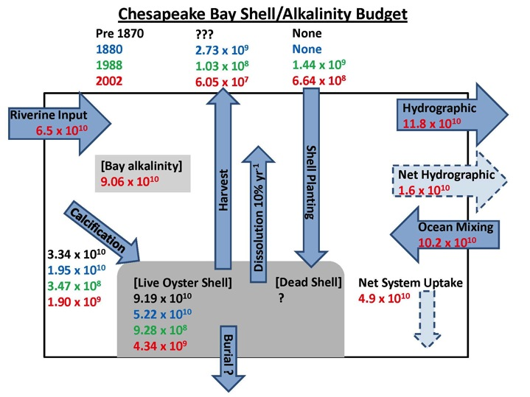
Why bother? Part 2: They create their own habitat (very unusual among bivalves), habitat for many other species, and in doing so are central to the Bay Alkalinity Budget.
All unit in Moles or mole equivalents (Waldbusser, Powell and Mann (2013) Ecology).
We use land-ocean interaction coastal zone (LOICZ) box model of Webb and Smith (1999).
Note the reduction in alkalinity “reserve” in 140 years.
Mann & Carnegie STAC 3/2016

Slide 5
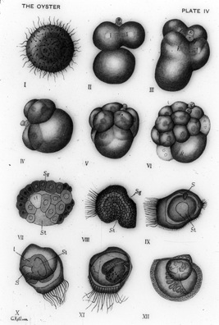
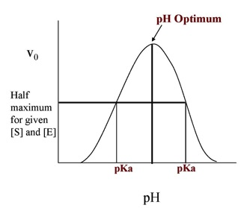
How does shell moderate conditions at the sediment water interface?
Water column organics fall to the interface where they produce acid that is neutralized by carbonate.
The literature portrayal: below the interface as a region of carbonate dissolution “attacking” shells of metamorphosed molluscs… but it is much more.
The typical invertebrate larval egg is between 75 and 300 microns diameter.
The swimming ciliated form approximates 300-1000 microns at metamorphosis: max size is all about Reynolds numbers and viscosity.
Its all about surface exchange properties, and enzyme pH optima.
This implicates all ciliated invertebrate larvae, and thus all estuarine food chains.
Graphic: W.K. Brooks (1905) The Oyster
Mann & Carnegie STAC 3/2016

Slide 6
Oyster reefs are complex biological, physical and geochemical structures: biogenic carbonate is added through growth, then transferred to the shell pool through mortality, recycled back to the water column through taphonomy, lost to burial, but also exhumed through feedback loops – but this is all driven by oyster population dynamics.
graphic from Waldbusser, Powell and Mann. (2013) Ecology 94(4): 895-903
Mann & Carnegie STAC 3/2016

Slide 7
Oysters, shell and processes; can we proactively manage them?
Addition process , loss processes
Fishing mortality, F, with loss of shell
Recruitment, R,
and growth:
S/R relationship
Live oyster population characterized
by density and demographics
Natural mortality, M, including disease adds shell to exposed pool
Substrate enhances recruitment
Replenishment, r
Exposed shell layer (brown shell)
– substrate for recruitment
Sea level rise: 3.5mm/y
Shell loss: 10% (MD), 30%/y (VA)
So the shell (gross) production rate must serve a reef accretion rate of 4.55 mm/y or 4.55 L/m²/y (10L = 1 cm thick layer). Between 20-50% of this volume is shell, ≈ 2.5-6 kg wet shell /m²/y.
Loss to burial, B
Loss to biological
degradation and
chemical dissolution, D,
salinity dependent
Reef structure - buried shell
mixed with sediment

Slide 8
Impact of climate driven changes in temperature and/or salinity on oysters?
Annual temperature ranges:
PEI (Charlottetown) NS: -1.1 – 18.3ºC
Chesapeake Bay: 4 - 30ºC
Key West FL: 21.5 – 31.5ºC
Galveston TX: 12.5 – 31.0ºC
Yucatan peninsula: 23.4 – 29.3ºC
Temperature projections alone do not represent a threat to the survival of oysters in the Chesapeake Bay. Salinity projections may modify upriver-downriver distributions, but only marginally.

Slide 9
Impact of changing water chemistry on oysters?
This is not about atmospheric CO2 driven changes in pH, its about watershed inputs (pollutants, anthropogenic toxins), eutrophication driven changes in pH (and HAB’s?) and, probably more so, carbonate saturation state.
”Ocean acidification results in co-varying inorganic carbon system variables. Of these, an explicit focus on pH and organismal acid-base regulation in has failed to distinguish the mechanism of failure in highly sensitive bivalve larvae. …..we show definitively that larval bivalve shell development and growth are dependent on seawater saturation state, and not on carbon dioxide partial pressure or pH. Although other physiological processes are affected by pH, mineral saturation state thresholds will be crossed decades to centuries ahead of pH thresholds due to the non-linear changes in the carbonate system variables as carbon dioxide is added. Our findings ….are consistent with a previous model of ocean acidification impacts due to rapid calcification in bivalve larvae, and suggest a fundamental ocean acidification bottleneck at early life-history for some marine keystone species.” (Waldbusser et al, Nature Climate Change, 2014)
We remain poorly informed in the context of the Chesapeake Bay, especially so with respect to oyster larvae……..
Notes:
Ryan’s comment: interactions of climate (increased precipitation frequency/intensity) with changing land use -> increases in pollutants, anthropogenic toxins; also HAB toxins; in general, what else besides acidification is challenging oyster health/performance?

Slide 10
Impact of diseases on oysters?
This is in two parts: climate on diseases and the disease-oyster interaction.
Diseases are moderated by temperature and salinity. This is a fluid situation as the native Dermo (Perkinsus marinus) evolves in response to competition with the introduced MSX (Haplosporidium nelsoni), and the oyster responds to both these changing disease challenges.
Summary of recent changes in disease.
Summary of “immediate” impact on oysters.
Long term predictions for impact on population dynamics of oysters… preserving ecological and economic services are all about population dynamics and demographics.
What do we need to know – new research questions.

Slide 11
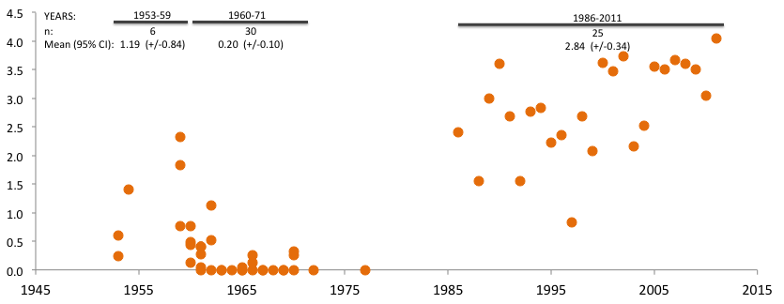
Increasing Dermo Disease
Dermo Weighted Prevalence
Dermo disease at historically high levels in recent years:
Emergence of a hypervirulent parasite phenotype
Environment increasingly favorable for disease (warm and salty)
Mann & Carnegie STAC 3/2016
Notes:
Dermo weighted prevalance maxima in fall in spring import deployments, 1950s to present

Slide 12
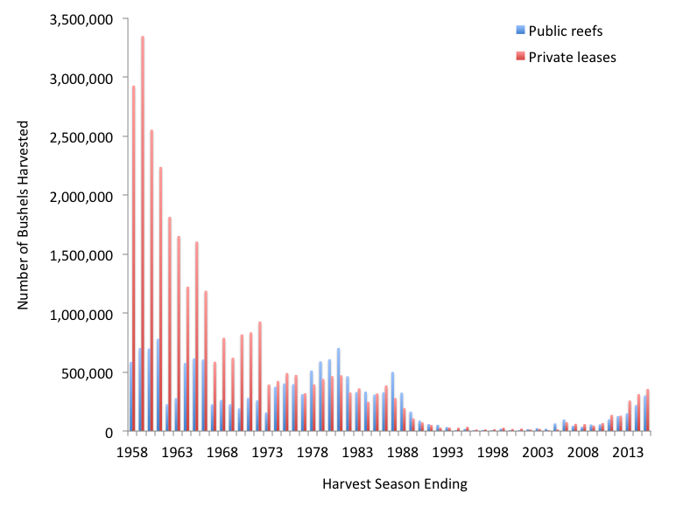
Haplosporidium nelsoni (MSX) emerges
Crash in oyster abundance followed Dermo intensification
Recent signs of recovery/adaptation
Changes in oyster demographics/reproduction may be key
What effects will continued climate change have?
Perkinsus marinus (Dermo) intensifies
Mann & Carnegie STAC 3/2016
Notes:
What effects? Continued intensification of dermo outpacing oyster capacity for response? Increased selective pressure for genuine resistance leaving oysters (somewhat paradoxically) better off?

Slide 13
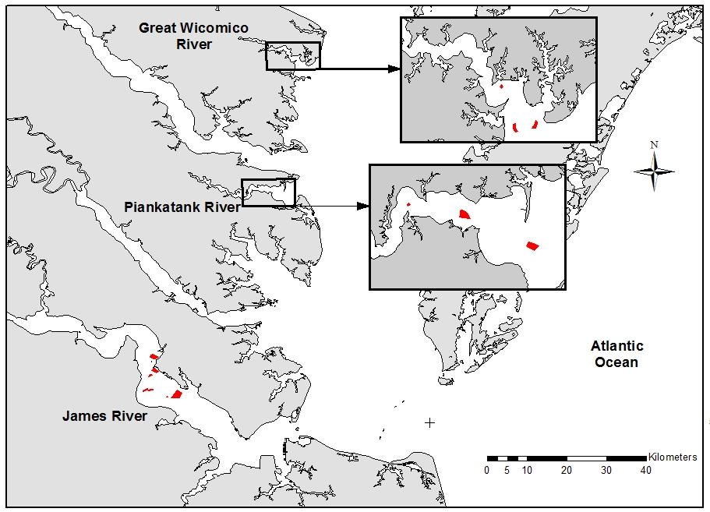
Are we observing changes in oyster reproduction and demographics?
The recent period of oyster expansion is coincident with a progression to earlier recruitment: Xo is the day of 50th percentile recruitment.
Over that same period the the median length of the YOY has increased.
Both are arguably related to progressive climate change impacts.
Mann & Carnegie STAC 3/2016
Notes:
Patent tong survey – Conducted every fall in late October into November. Stratified random design. Sample consists of a grab with a hydraulic patent tong – 1 m2 opening. For each sample obtain a length demographic by measuring (length, technically height, of distance from hinge to growing edge) all of the live oysters collected. This includes spat which are identified in the field as oysters that are growing flat along the shells surface (i.e. has not yet started to cup).

Slide 14
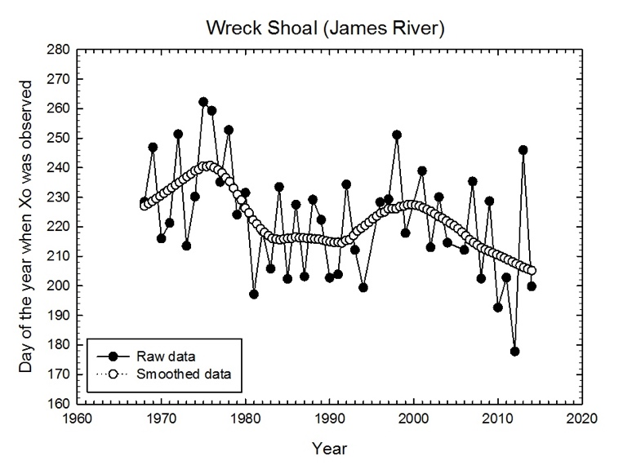

Slide 15
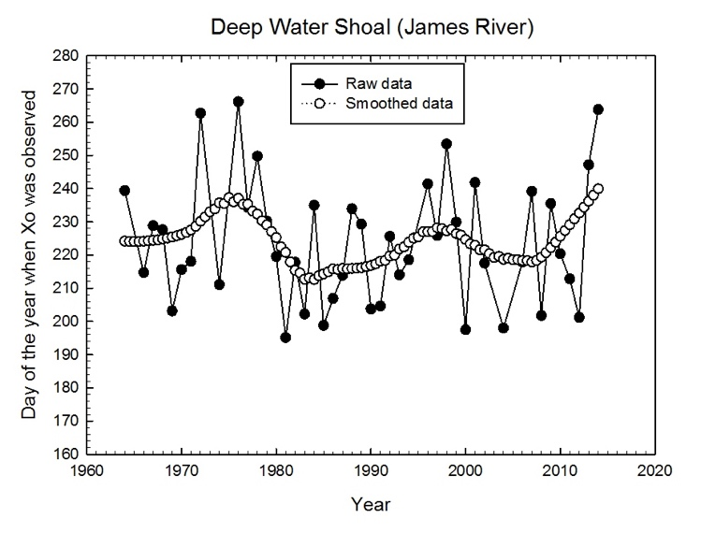
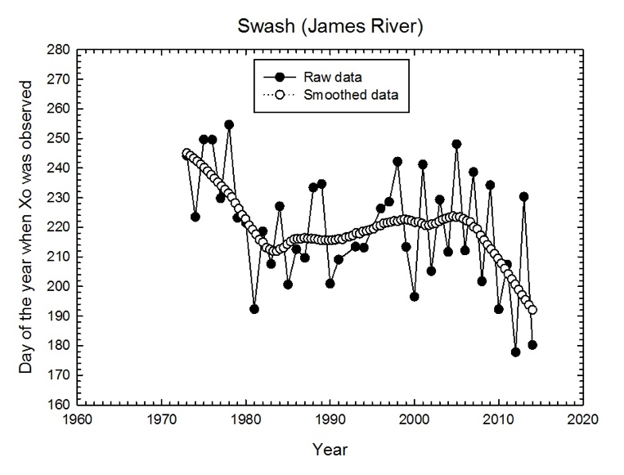
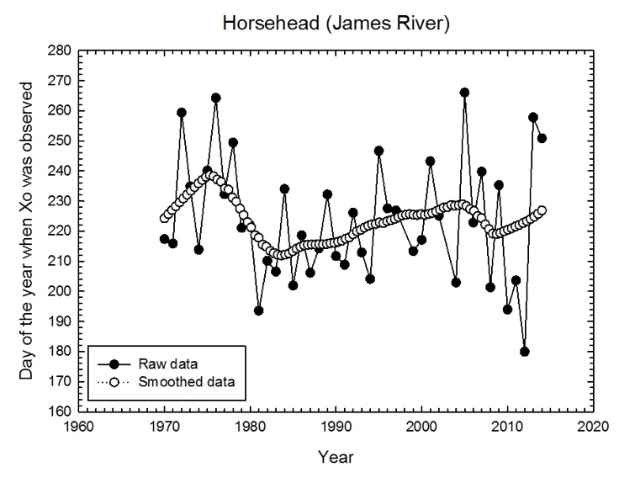
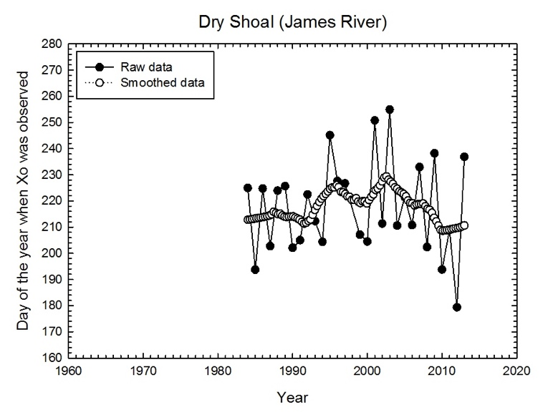
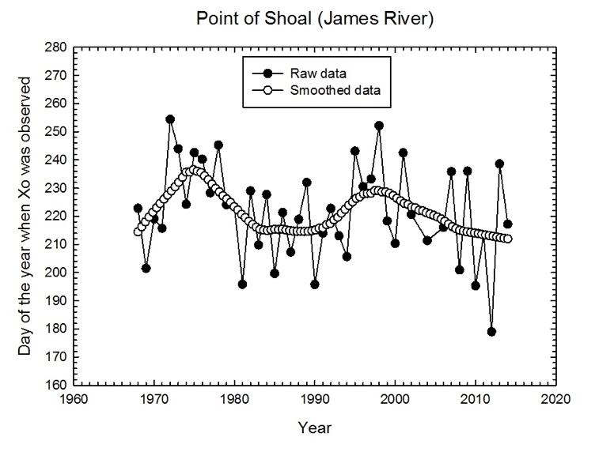

Slide 16
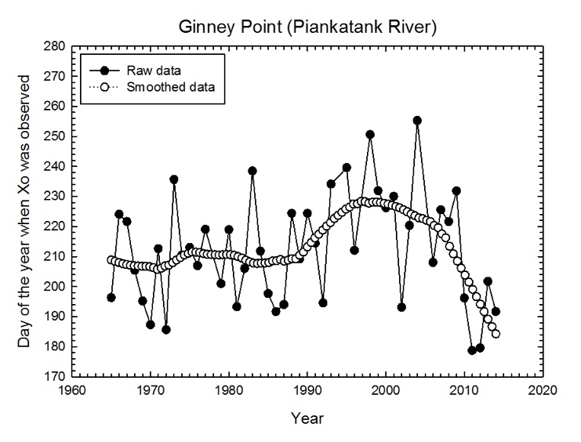
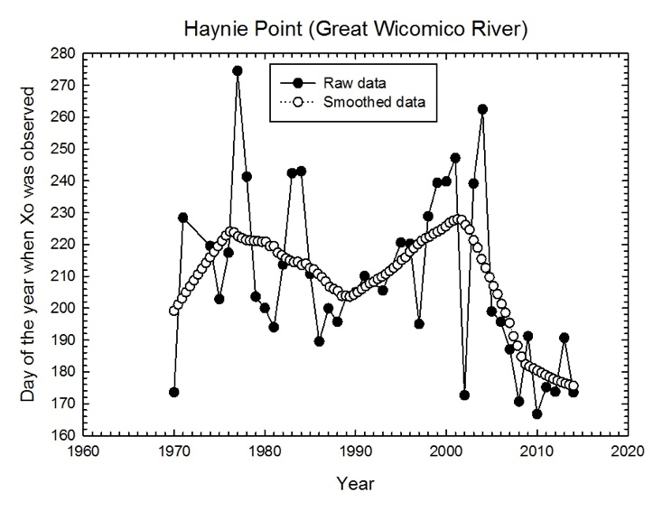
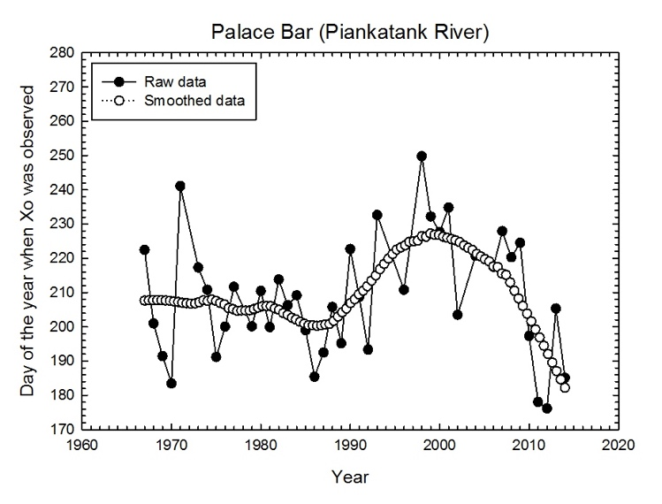
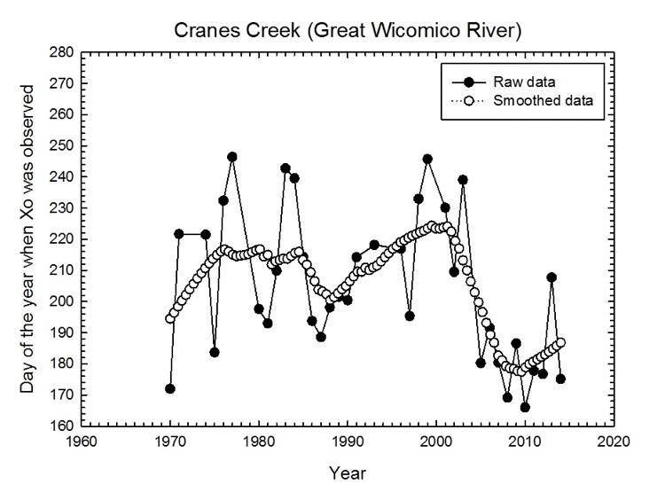
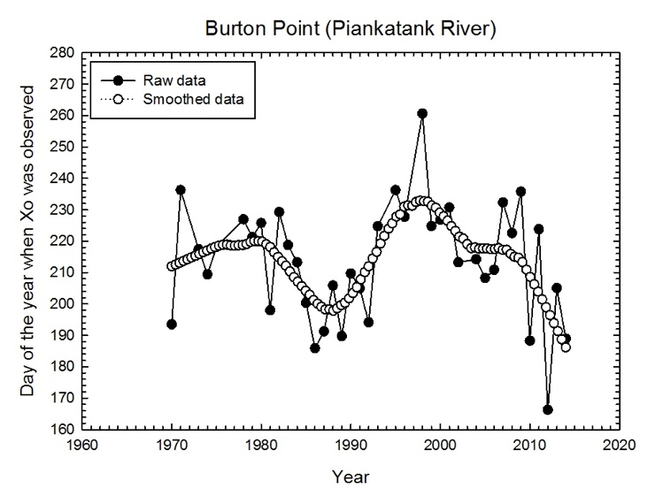
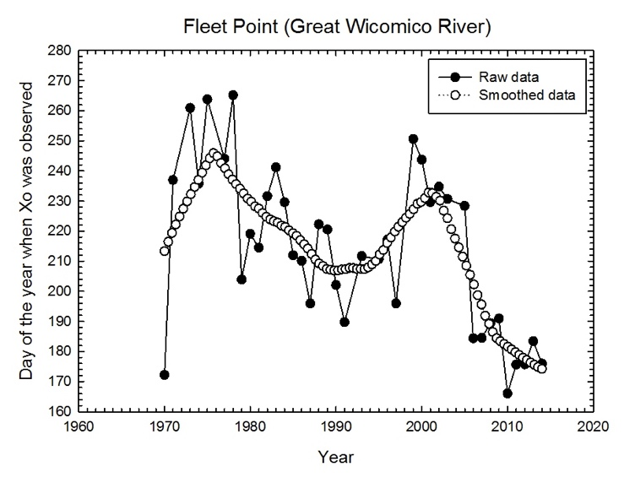

Slide 17
Plots of Cumulative Spat Density (recruitment as portrayed in prior graphic) versus YOY, by river, illustrate an order of magnitude increase in early post recruit mortality in 2004-2005 – in three independent systems! This is environmentally coordinated …. A climate driven signal?

Slide 18
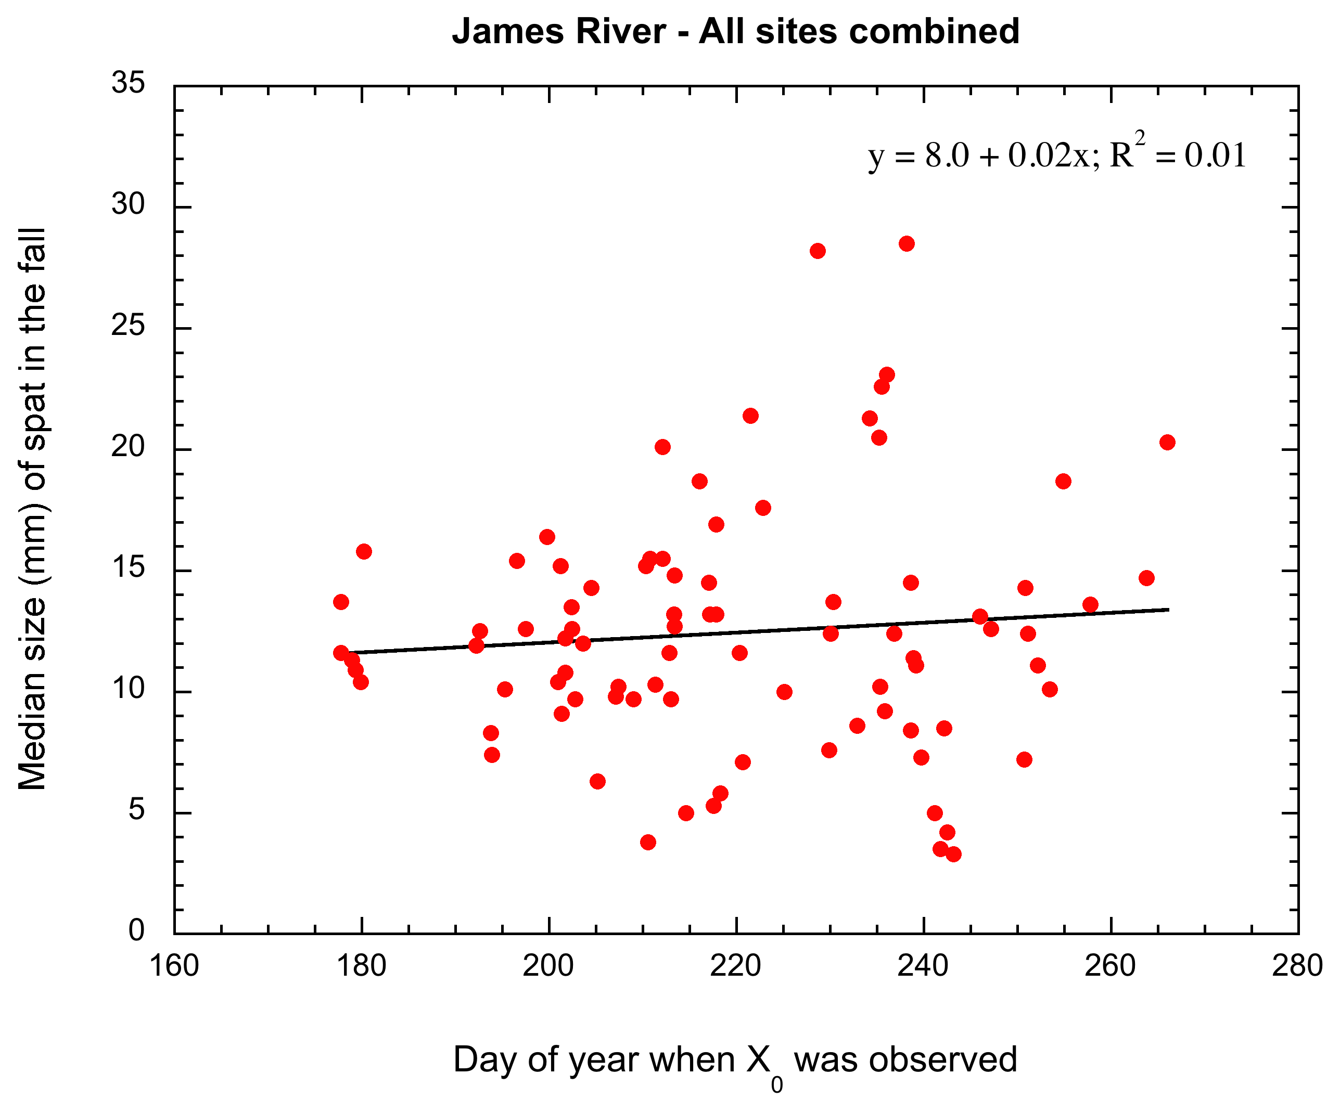
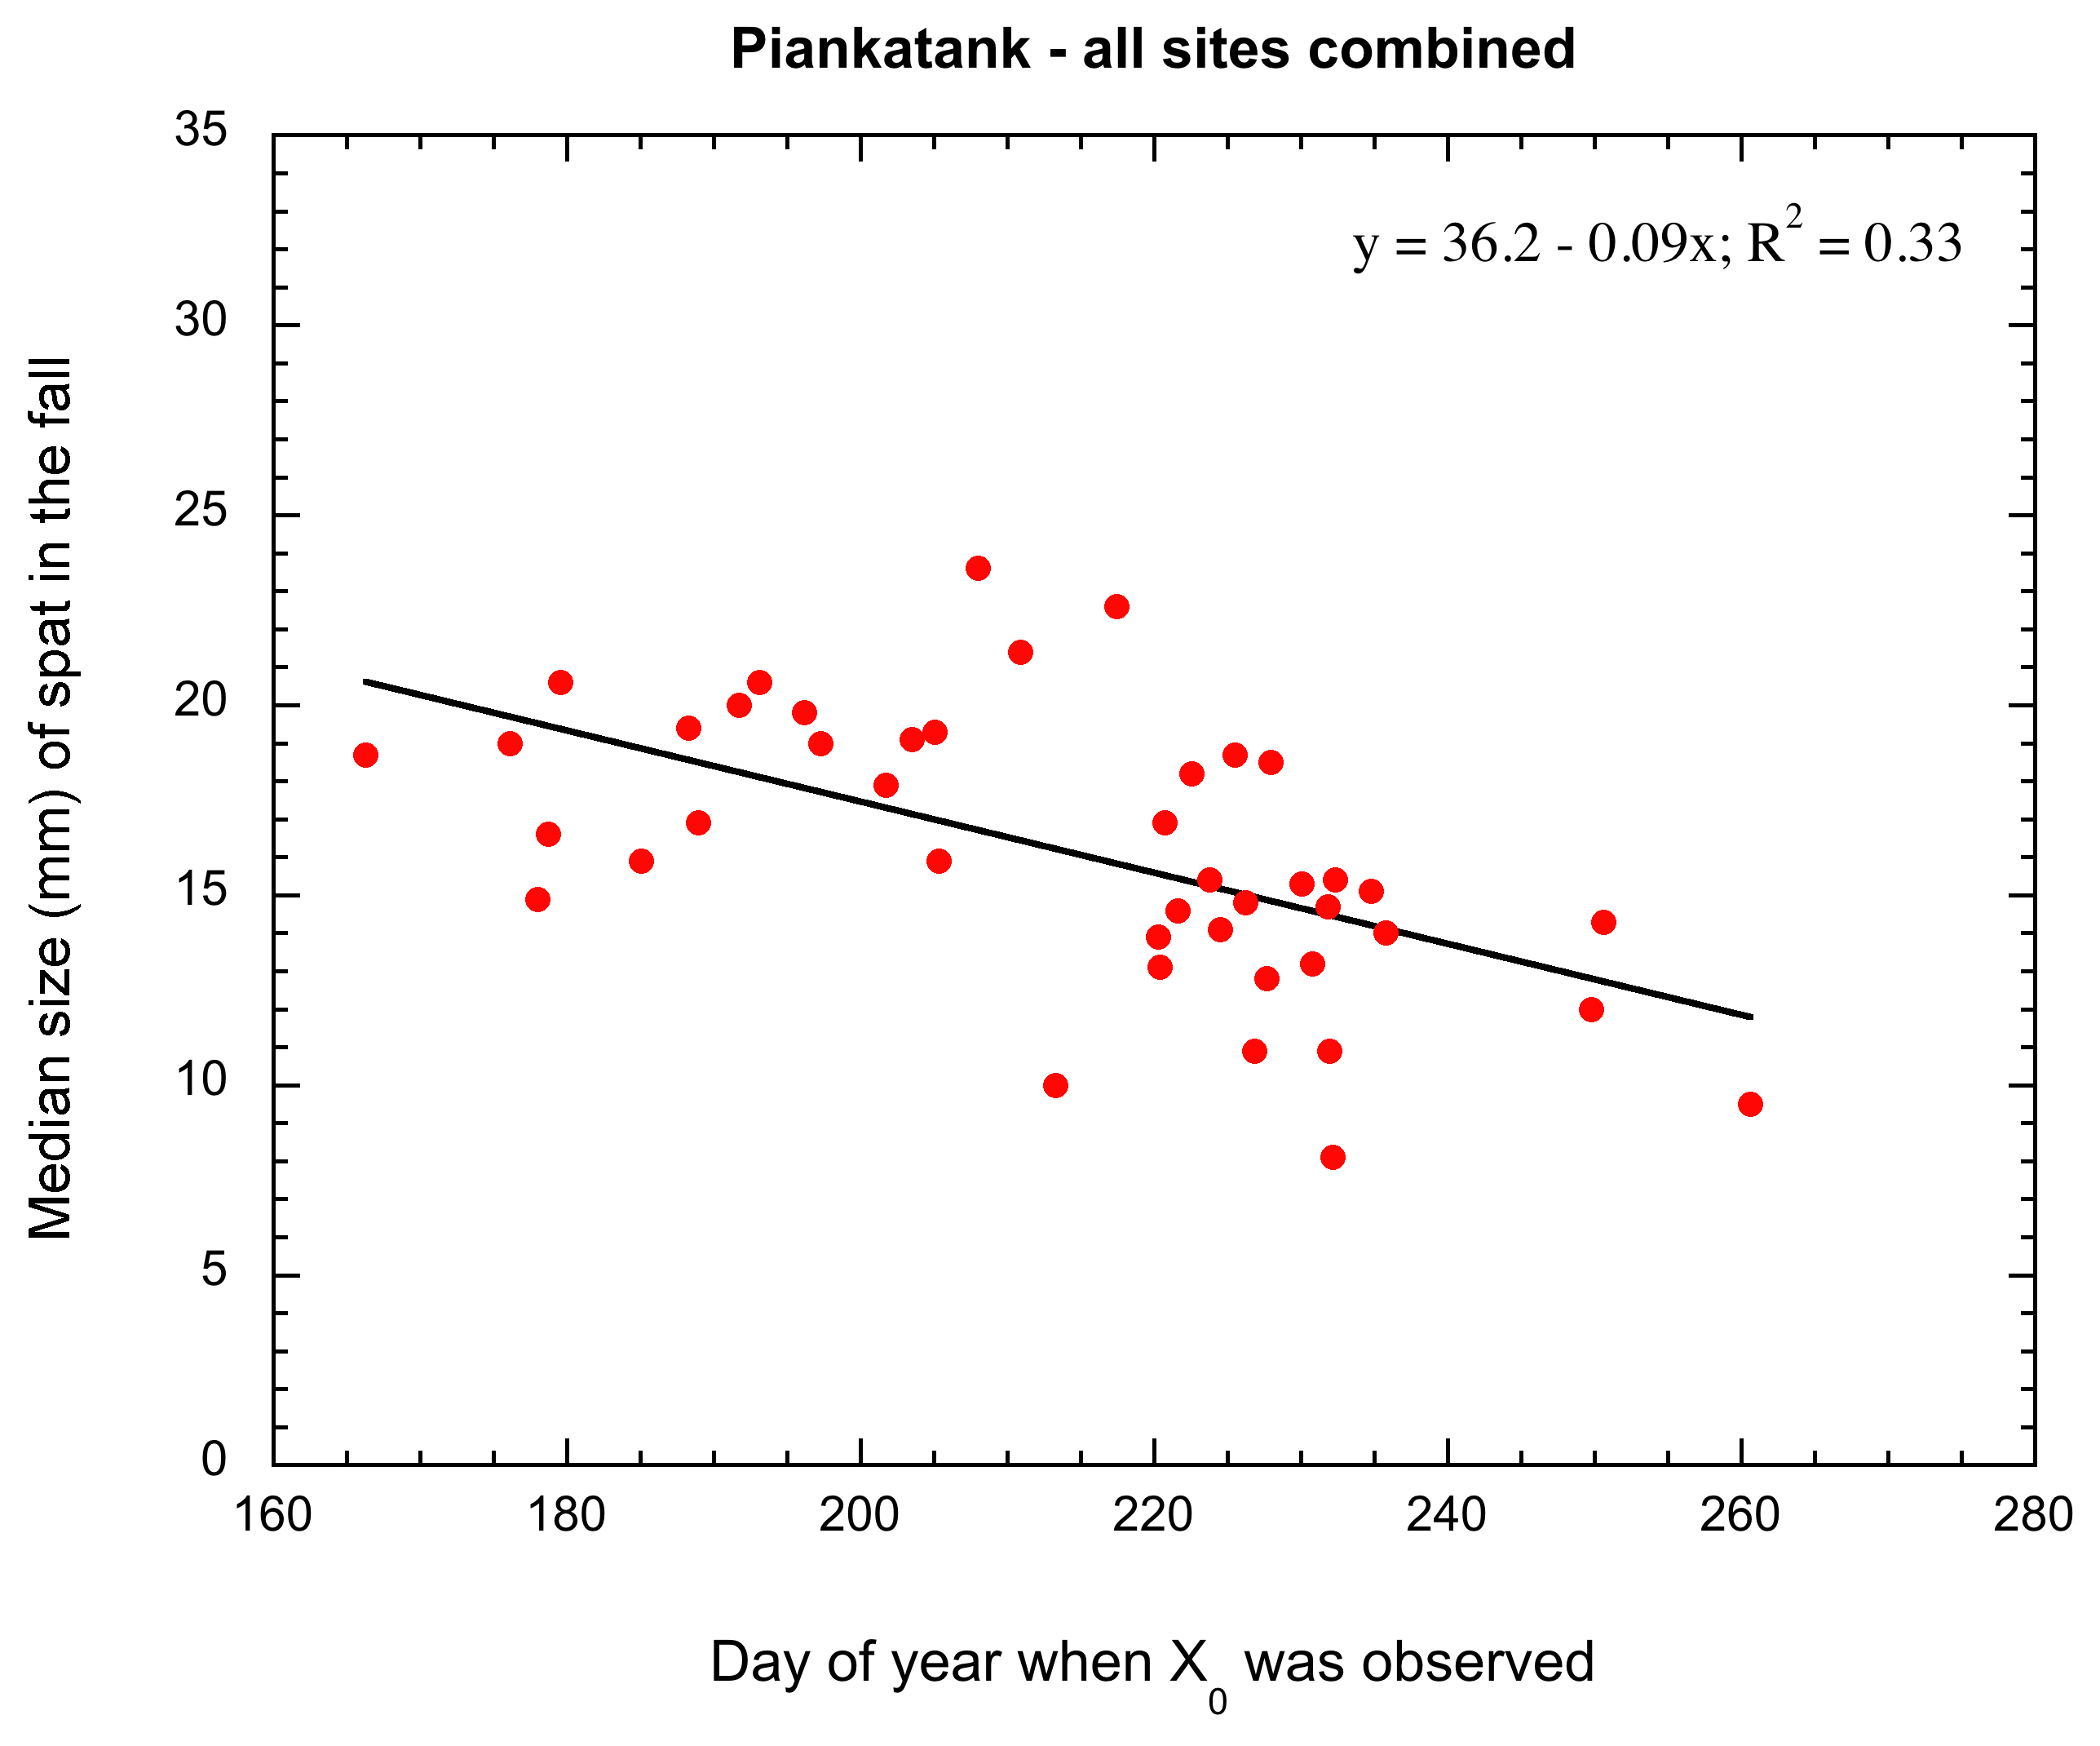
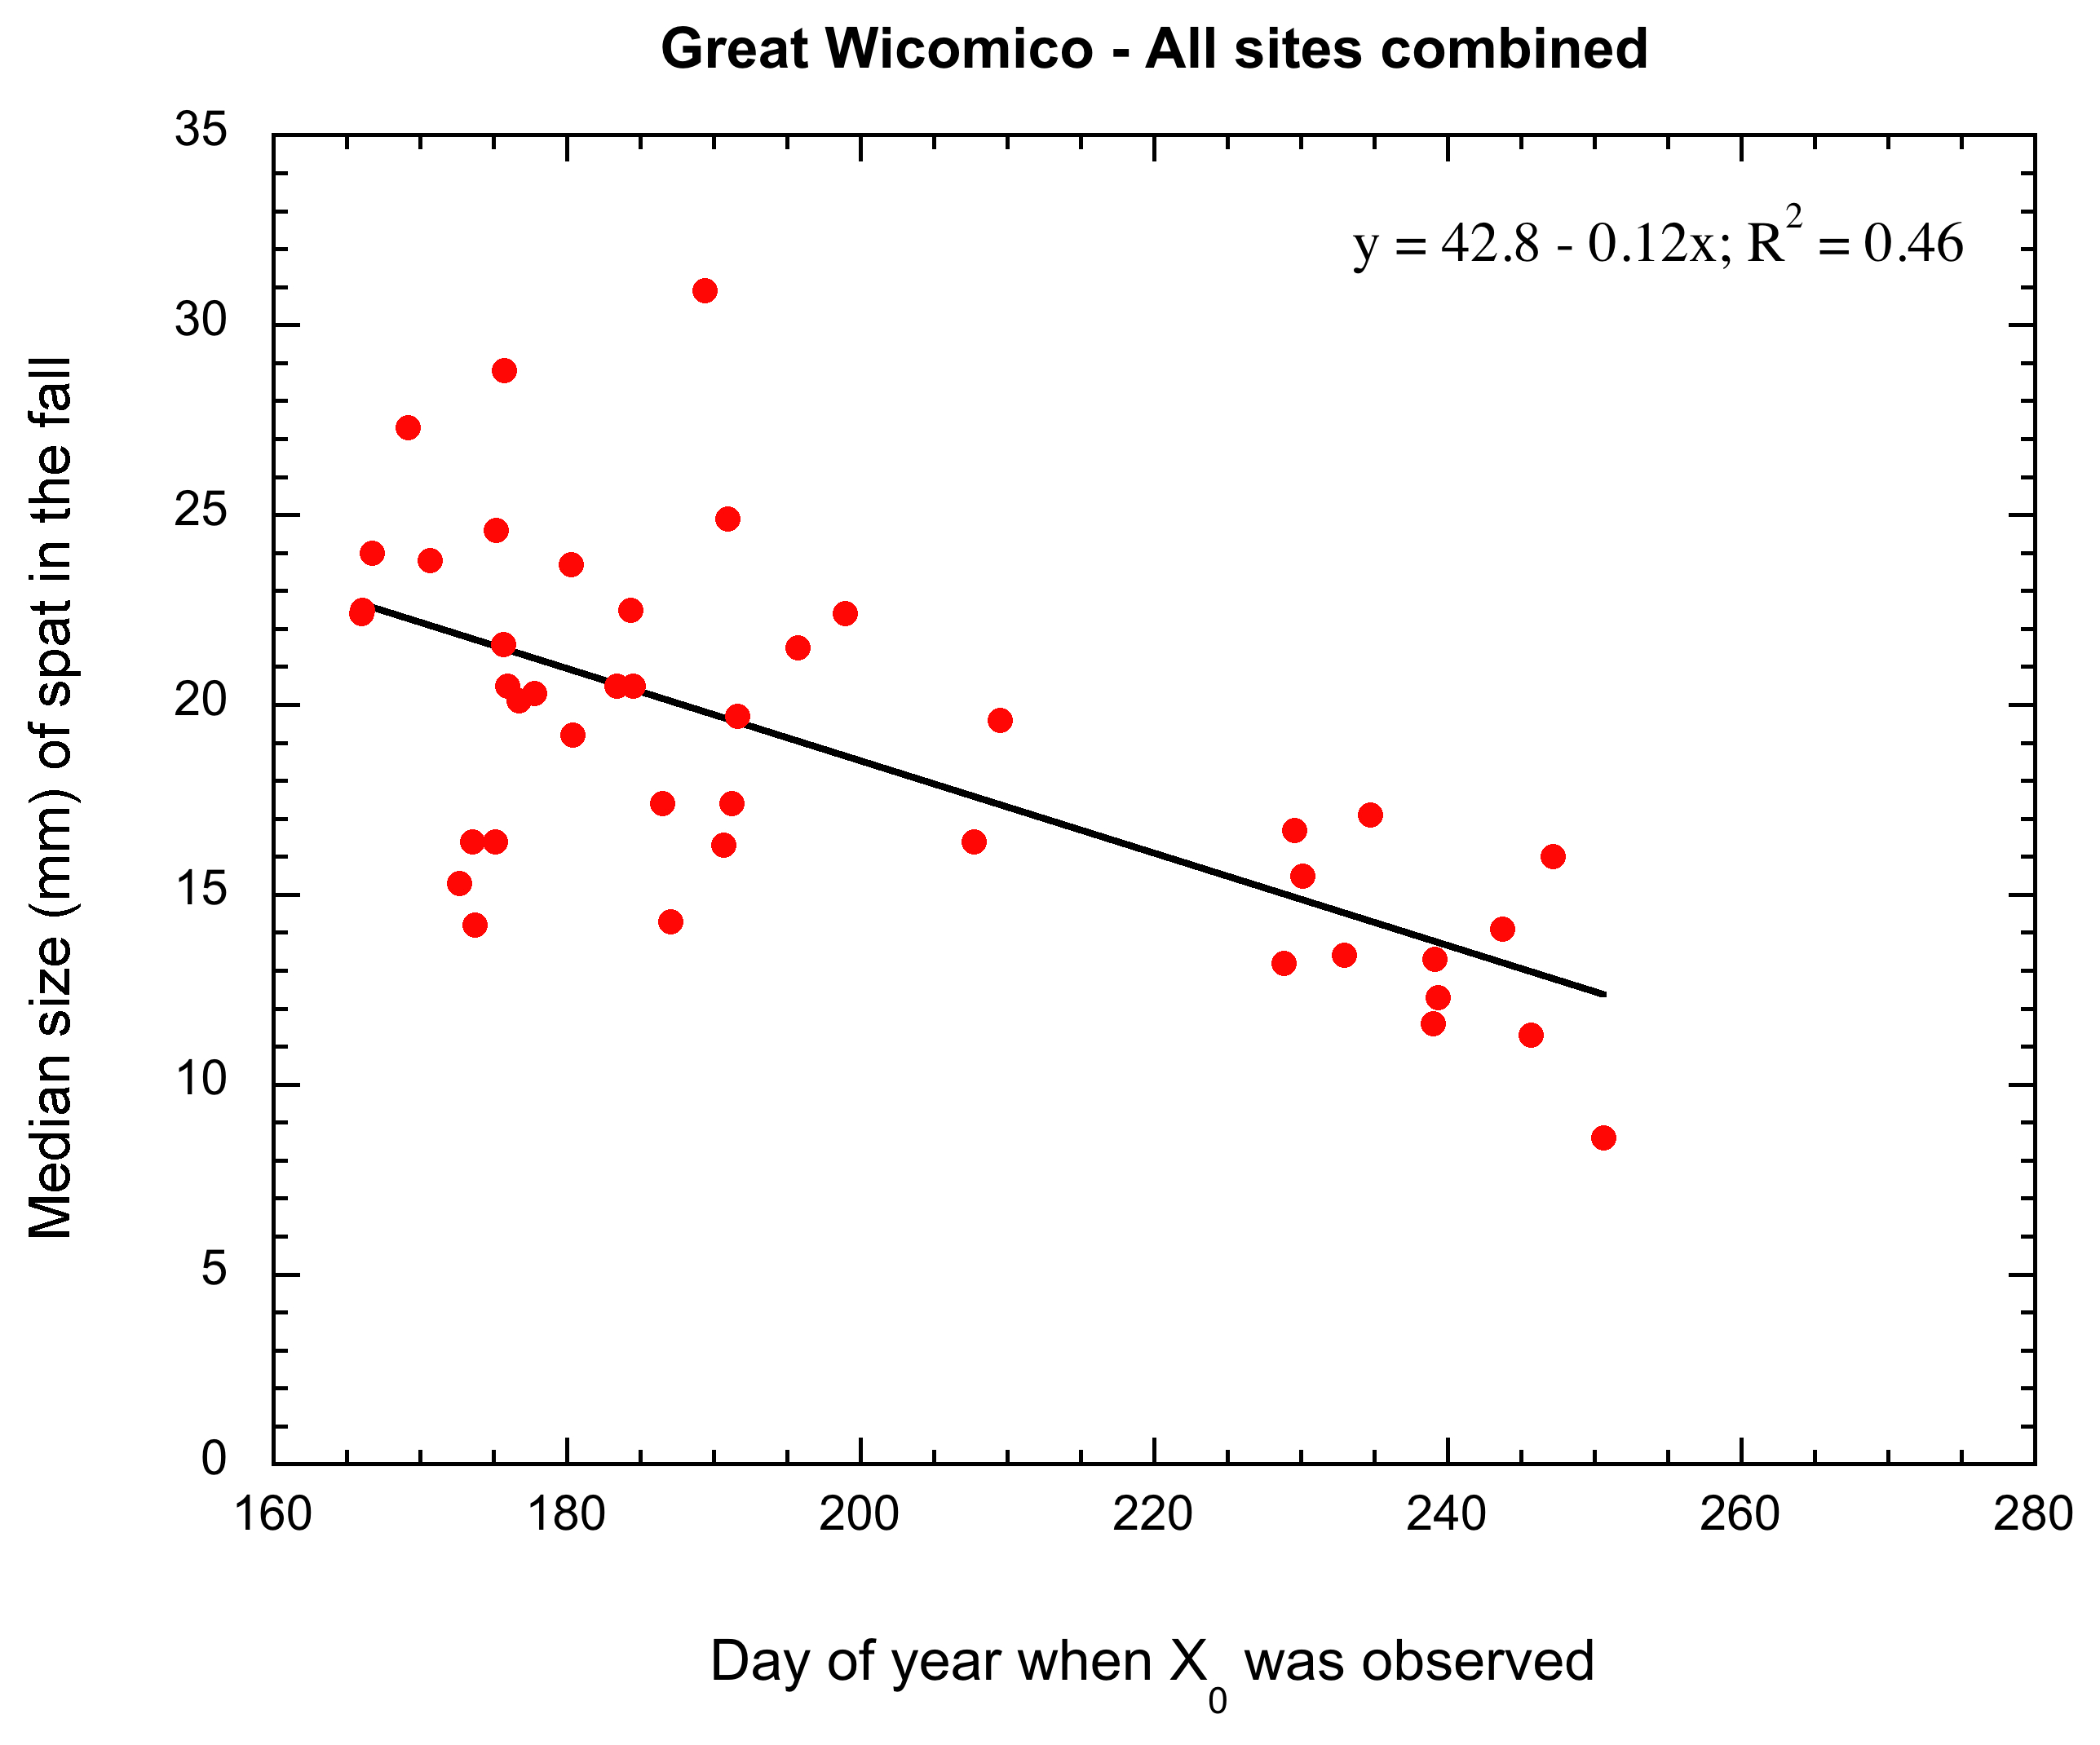
1998-2015 data: in the James River there is no relationship between Xo and the median length of YOY in the fall – the system is moderated by size and watershed influences…. By contrast there is a stronger trend in the small watershed systems of the Great Wicomico and the Piankatank Rivers.

Slide 19
New Questions On Disease, Reproduction and Demographics
Will continued Dermo intensification outpace oysters’ ability to adapt/respond?
Or will increased disease equate to increased pressure to evolve genuine disease resistance (rather than tolerance)?
And what about MSX: increasingly warm and eutrophic Chesapeake Bay is increasingly favorable for MSX?
Will the recent trend toward disease resistance continue, or will MSX reemerge as a major threat?
Will the truncation/retraction of the formerly extended recruitment period continue?
What are the implications of increased post recruit mortality?
What are the implications of increasing YOY median size?
What drives these trends in terms of environmental and biological interactions and what are the end points?
What are the implications of all of the above on adult growth, longevity and eventual contribution to the underlying shell pool?
Can we proactively manage it (even in part)?

Slide 20
Oysters, shell and processes; can we proactively manage them?
Addition process , loss processes
Fishing mortality, F, with loss of shell
Recruitment, R,
and growth:
S/R relationship
Live oyster population characterized
by density and demographics
Natural mortality, M, including disease adds shell to exposed pool
Substrate enhances recruitment
Replenishment, r
Exposed shell layer (brown shell)
– substrate for recruitment
Sea level rise: 3.5mm/y
Shell loss: 30%/y
So the shell (gross) production rate must serve a reef accretion rate of 4.55 mm/y or 4.55 L/m²/y (10L = 1 cm thick layer). Between 20-50% of this volume is shell, ≈ 2.5-6 kg wet shell /m²/y.
Loss to burial, B
Loss to biological
degradation and
chemical dissolution, D,
salinity dependent
Reef structure - buried shell
mixed with sediment

Slide 21
#1. Natural reef with accretion, no F, no r, shell accretes
As M>(B+D), system stable over extended periods.
Fishing mortality, F, with loss of shell
Recruitment, R,
and growth:
S/R relationship
Live oyster population characterized
by density and demographics
Natural mortality, M, adds
shell to exposed pool
Substrate enhances recruitment
Exposed shell layer (brown shell)
– substrate for recruitment
Replenishment, r
Loss to burial, B
Loss to biological
degradation and
chemical dissolution, D,
salinity dependent
Reef structure - buried shell
mixed with sediment

Slide 22
#2. Natural reef, no F, no r, but increased M due to disease.
Decreased oyster longevity, lower shell addition rate to
exposed layer, no accretion as M<(B+D), system fails.
Fishing mortality, F, with loss of shell
Recruitment, R,
and growth:
S/R relationship
Live oyster population characterized
by density and demographics
Natural mortality, M, including disease adds shell to exposed pool
Decreased substrate enhancement
Exposed shell layer (brown shell)
– substrate for recruitment
Replenishment, r
Loss to burial, B
Loss to biological
degradation and
chemical dissolution, D,
salinity dependent
Reef structure - buried shell
mixed with sediment

Slide 23
#3. Natural reef, no F, increased M (disease). Decreased oyster
longevity, lower shell addition rate to exposed layer, offset by
CONTINUAL replenishment until M=(B+D), system stable.
Fishing mortality, F, with loss of shell
Recruitment, R,
and growth:
S/R relationship
Live oyster population characterized
by density and demographics
Natural mortality, M, including disease adds shell to exposed pool
Increased substrate enhancement
Exposed shell layer (brown shell)
– substrate for recruitment
Replenishment, r
Loss to burial, B
Loss to biological
degradation and
chemical dissolution, D,
salinity dependent
This is the reality
of sanctuaries!
Reef structure - buried shell
mixed with sediment

Slide 24
#4. Overfishing, no disease, no r, but F removes shell such
That M<(B+D), system fails as substrate disappears.
Fishing mortality, F, with loss of shell
Recruitment, R,
and growth:
S/R relationship
Live oyster population characterized
by density and demographics
Natural mortality, M, adds shell to exposed pool
Decreased substrate enhancement
Exposed shell layer (brown shell)
– substrate for recruitment
Replenishment, r
Loss to burial, B
Loss to biological
degradation and
chemical dissolution, D,
salinity dependent
Reef structure - buried shell
mixed with sediment

Slide 25
#5. Natural reef, no r, but with fishing, F, and increased M (disease).
Decreased oyster longevity in those not fished, lower shell addition
rate to exposed layer, no accretion as M<(B+D), system fails.
Fishing mortality, F, with loss of shell
Recruitment, R,
and growth:
S/R relationship
Live oyster population characterized
by density and demographics
Natural mortality, M, including disease adds shell to exposed pool
Decreased substrate enhancement
Exposed shell layer (brown shell)
– substrate for recruitment
Replenishment, r
Loss to burial, B
Loss to biological
degradation and
chemical dissolution, D,
salinity dependent
Reef structure - buried shell
mixed with sediment

Slide 26
#6. Natural reef, limited fishing, F, and increased M (disease).
Decreased oyster longevity, lower shell addition rate to exposed layer
balanced by CONTINUAL replenishment until M=(B+D), system stable.
Fishing mortality, F, with loss of shell
Recruitment, R,
and growth:
S/R relationship
Live oyster population characterized
by density and demographics
Natural mortality, M, including disease adds shell to exposed pool
Continual substrate enhancement
Exposed shell layer (brown shell)
– substrate for recruitment
Replenishment, r
Loss to burial, B
Loss to biological
degradation and
chemical dissolution, D,
salinity dependent
This is the reality
of fisheries!
Reef structure - buried shell
mixed with sediment

Slide 27
Shell budget scenarios: long term observations in VA.
Scenario # | 1 | 2 | 3 | 4 | 5 | 6
Disease | - | + | + | - | + | +
Overfishing | - | - | - | + | - | -
Fishing | - | - | - | - | + | +
Repletion | - | - | + | - | - | +
Stable?* | Y | N | Y | N | N | Y
* Stability Y or N dependent on an improved understanding of population dynamics in a climate driven moving baseline scenario, which, as we can see, is a moving target!
Scenario #6 applies everywhere in VA except a limited number of reefs in James River which
exhibit very high recruitment to offset impact of reduced longevity on shell supply. All other
systems require varying levels of shell replenishment to maintain substrate cover.
(http://www.vims.edu/research/units/labgroups/molluscan_ecology/vorhf/shell/status_shell_substrate/index.php.)

Slide 28
Concluding thoughts and future needs
While the effects of warming in isolation are of modest concern, the effects of warming and/or as yet undefined changes in salinity and/or changing environment (anthropogenic toxins, chemistry, HAB, microbiota and more) on the dynamic oyster-parasite system of Chesapeake Bay are uncertain.
The baselines of an equilibrium situation with respect to recruitment, growth and mortality of live oysters, and the fate of shell as a substrate, chemical moderator, structural component of epifaunal habitat, and foundation of reefs in general are all moving, not necessarily in a linear manner.
We do not know which of the complex climate drivers versus non climate drivers dominate the observed movement, and we are unable, at this time, to predict where this movement will end.
Notes:
Roger: two points to encompass what we talked about. Feel free to shorten or rewrite as necessary—just wanted you to have these laid out in full so they were clear to you

