Slide 1
Runoff in a Changing Climate: Climate-Model Choice Matters, and So Does PET Choice
P. C. D. Milly, USGS
Workshop on
“The Development of Climate Projections for Use in Chesapeake Bay Program Assessments”
Scientific and Technical Advisory Committee, Chesapeake Bay Program
Annapolis, MD
7 March 2016

Slide 2
Based on Table 7 of Najjar et al. (2009)

Slide 3
Observed
Runoff
Multi-Model
Median

Slide 4
The global pattern of historical (20th century) runoff trends was reproduced skillfully by a multi-climate-model ensemble, more skillfully than by the most skillful single climate model (Milly et al., 2005).
OBSERVED TREND
MODELED TREND

Slide 5
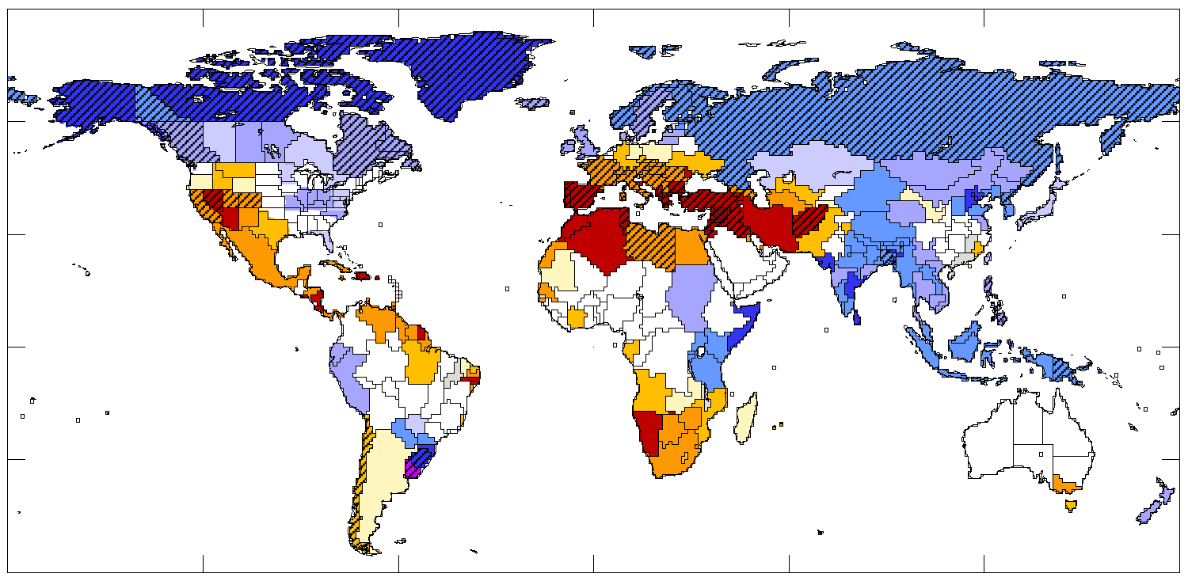
Model-Projected Changes in Annual Runoff, 2041-2060 Percentage change relative to 1900-1970 baseline. Any color indicates that >66% of models agree on sign of change; diagonal hatching indicates >90% agreement.
-40 -20 -10 -5 -2 2 5 10 20 40
(After Milly, P.C.D., K.A. Dunne, A.V. Vecchia, Global pattern of trends in streamflow and water availability in a changing climate, Nature, 438, 347-350, 2005.)

Slide 6
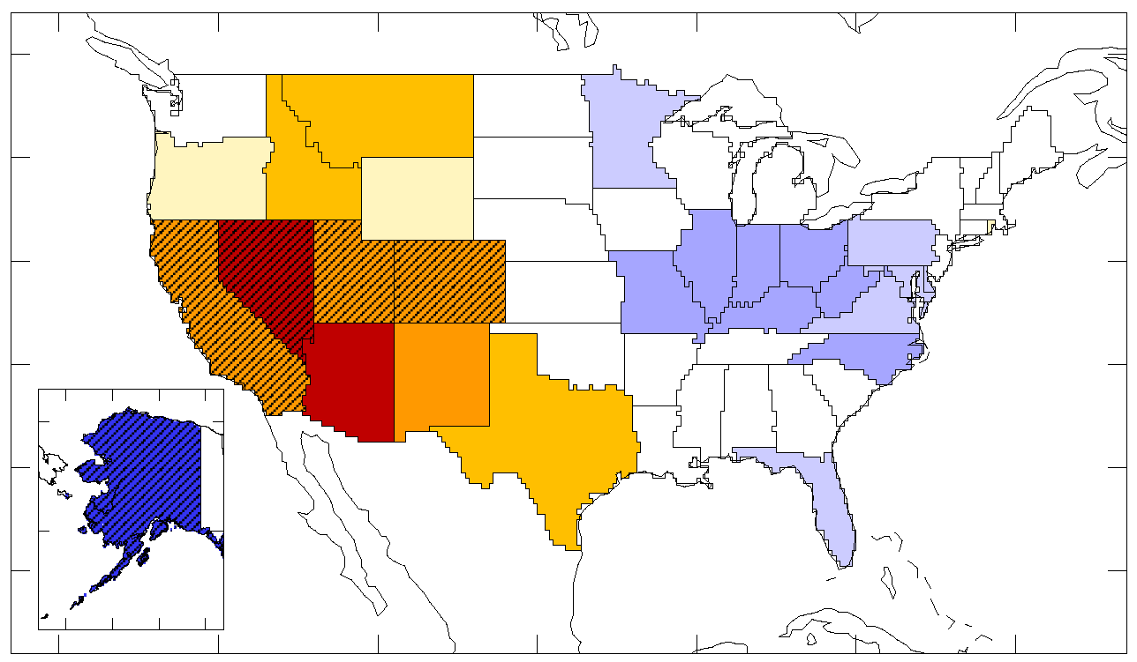
Model-Projected Changes in Annual Runoff, 2041-2060 Percentage change relative to 1900-1970 baseline. Any color indicates that >66% of models agree on sign of change; diagonal hatching indicates >90% agreement.
-40 -20 -10 -5 -2 2 5 10 20 40
(After Milly, P.C.D., K.A. Dunne, A.V. Vecchia, Global pattern of trends in streamflow and water availability in a changing climate, Nature, 438, 347-350, 2005.)

Slide 7
Based on Table 7 of Najjar et al. (2009)

Slide 8
“Offline” Hydrologic Modeling
projected hydrology
climate model
projected climate change
downscaling and bias correction
downscaled
climate change
hydrologic model
projected hydrology

Slide 9
Downscaling and Bias Correction
projected hydrology
climate model
projected climate change
downscaling and bias correction
P
downscaled
climate change
PET model
projected PET change
hydrologic model
projected hydrology

Slide 10
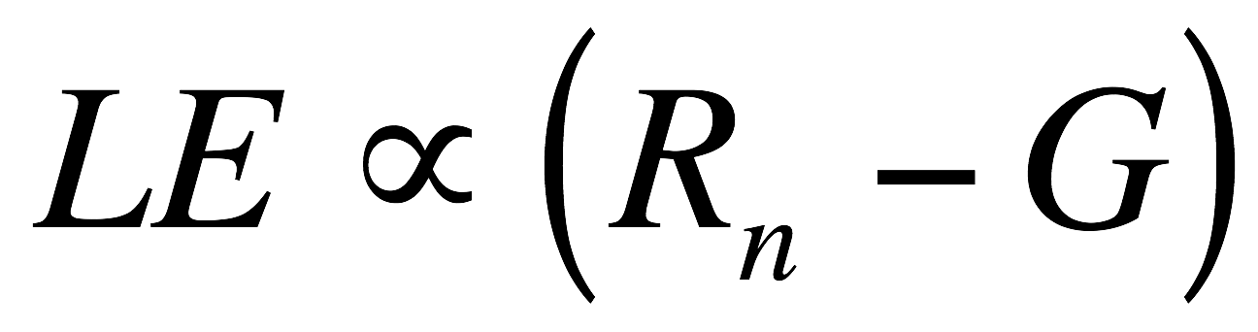
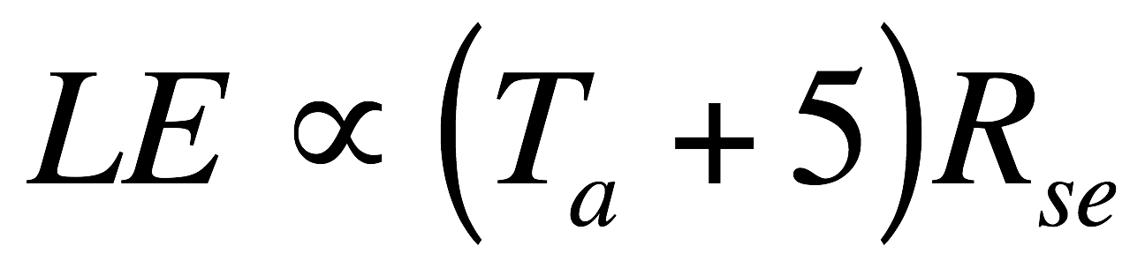
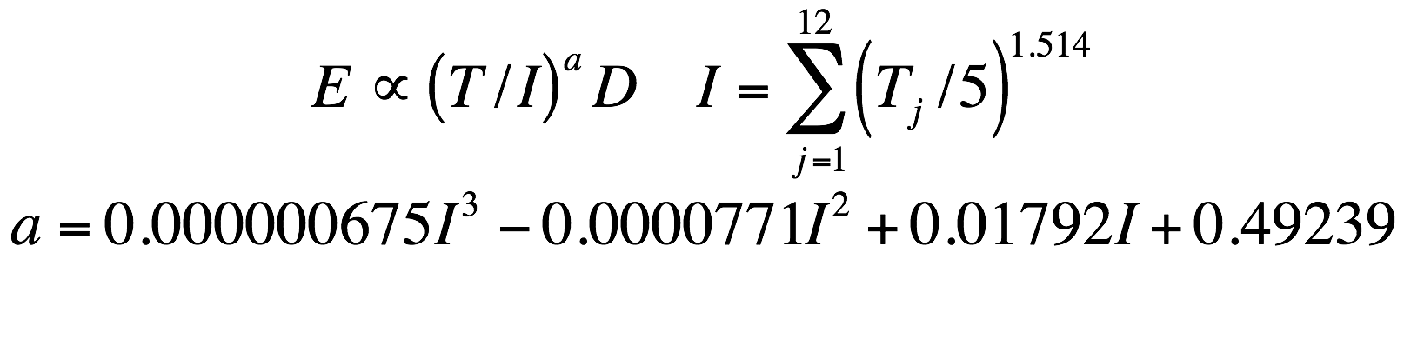
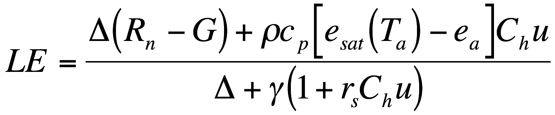
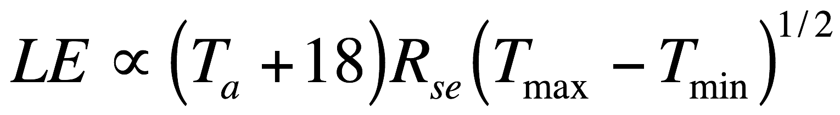
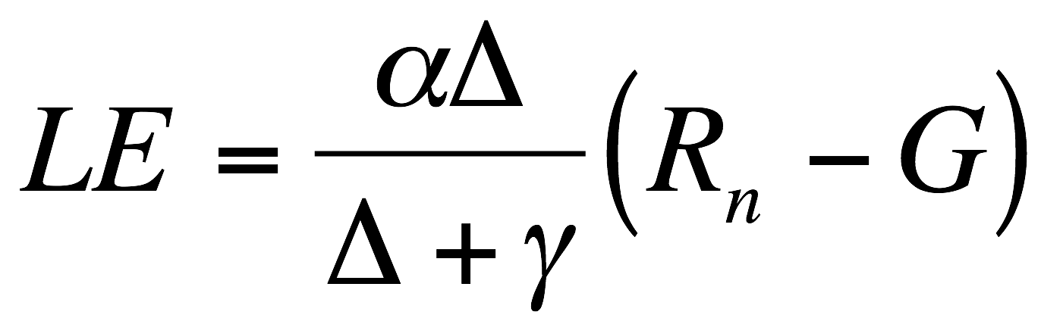
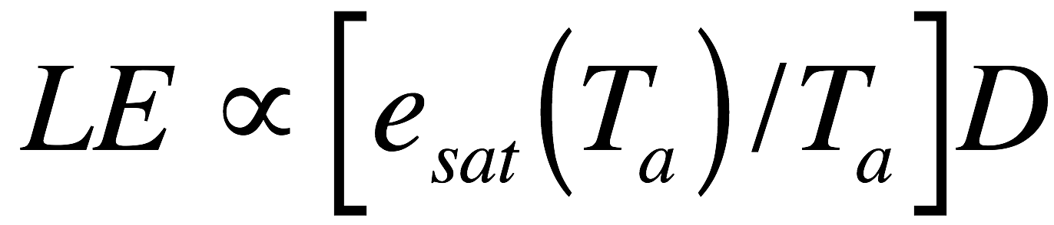
Some PET Methods Used in Offline Climate-Change Studies
Name | Equation
Penman-Monteith
Priestley-Taylor
“Energy-Only”
Samani-Hargreaves
Oudin
Hamon
Thornthwaite

Slide 11
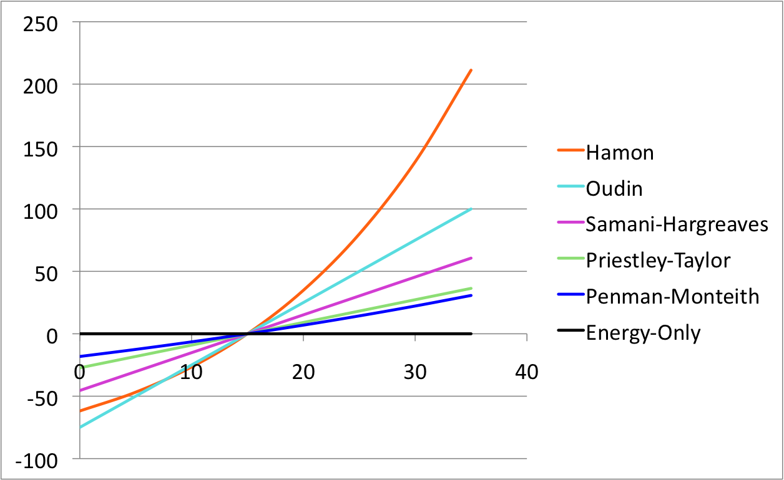
Typical Temperature Dependence of PET, Radiation Being Held Constant
Relative Change in PET, Percent
Temperature

Slide 12
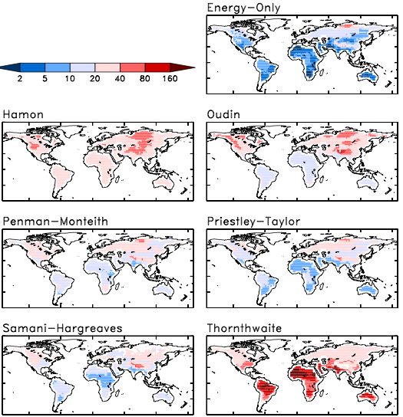
% Change in Annual PET, RCP8.5, 2081-2100

Slide 13
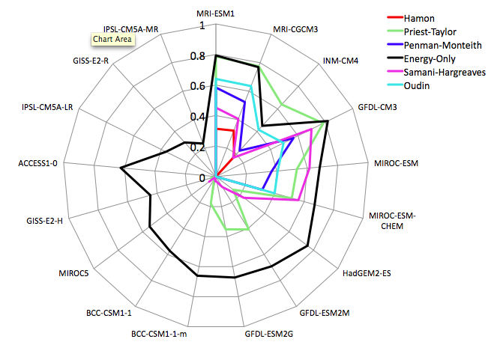
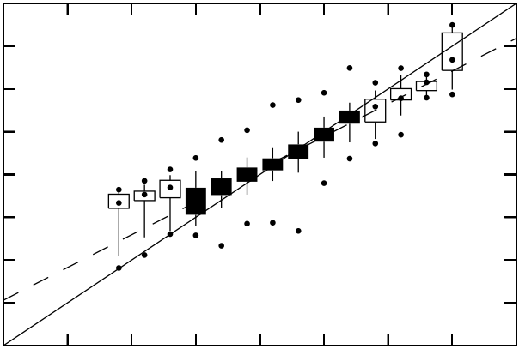



Skill for Change in PET
GFDL-ESM2G Energy-Only PET

Slide 14
Exaggeration of Change in PET by Standard Methods Average over all non-water-stressed gridcell-months

Slide 15
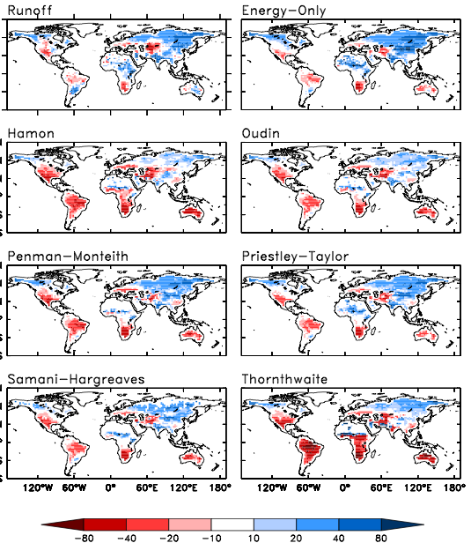
Change of Runoff: Climate Model and Budyko/PET Runoff (%)

Slide 16
Based on Table 7 of Najjar et al. (2009)

Slide 17
Summary
To estimate historical Susquehanna R. basin (SRB) runoff, the use of the median across many climate models is more accurate than the use of most individual models or small collections thereof.
Similarly, a many-model ensemble was more skillful than any single model in reproducing global pattern of 20th century streamflow trends.
A large number of climate models is needed to obtain a stable estimate of future SRB runoff change.
Variation in past estimates of SRB runoff change is significantly affected by at least two factors:
Use of different climate models.
Use of different hydrologic models, especially PET formulations.
Offline estimates of runoff change based on empirical PET estimates are generally biased low relative to runoff changes in climate models themselves.
Use of a more process-based approach to PET in “offline” hydrologic modeling of climate change requires surface radiation.
Climate models produce their own runoff, and this is a useful source of climate-change information.

