Slide 1




Behavior Change Triumphs and Challenges

Slide 2
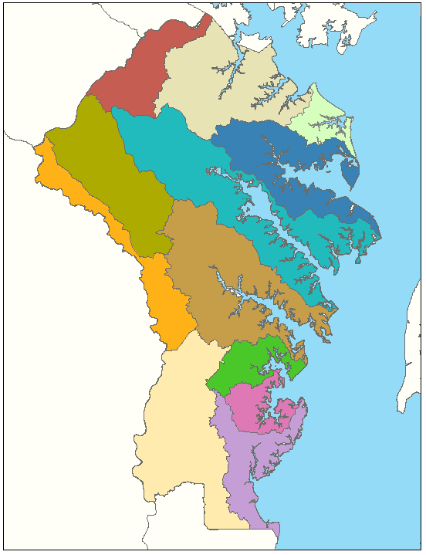
Anne Arundel County
Watershed Summary
12 watersheds
354 sub-watersheds
35 sub-watersheds with >30% impervious area
75 sub-watersheds with 20% - 30% impervious area

Slide 3
HOW: Network Resources to Build Capacity and Provide Support
Identify citizens within communities who are capable of and willing to act as Master Watershed Stewards.
Educate an army of Master Watershed Stewards on relevant Bay issues to engage, empower and coordinate communities to take action.
Support Master Watershed Stewards with a consortium of support professionals and resources as they carry out education and restoration initiatives.

Slide 4
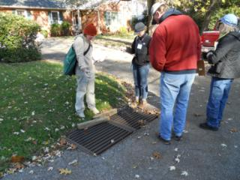
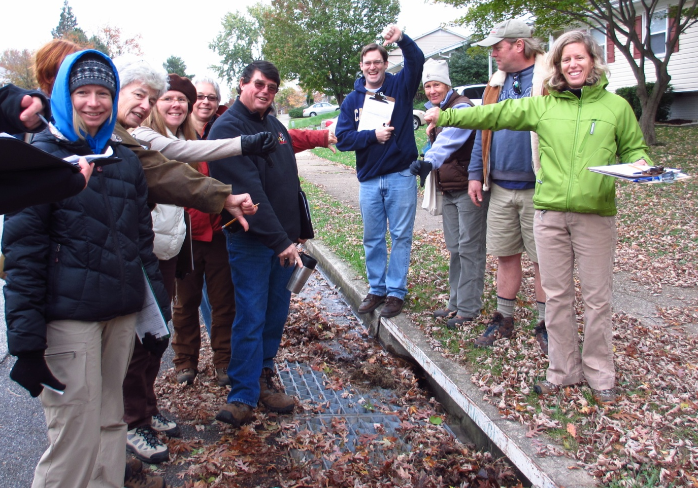
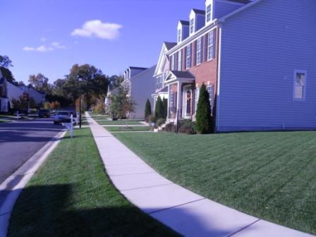
What do Master Watershed Stewards do?
Assess Their Neighborhood

Slide 5
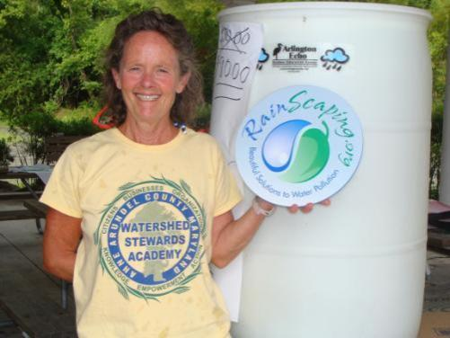
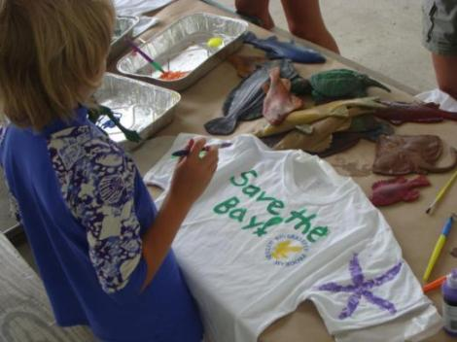
What do Master Watershed Stewards do?
Educate and Engage their Community
Over 130 presentations and outreach events were held, reaching over 10,000 people

Slide 6

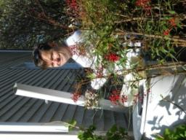
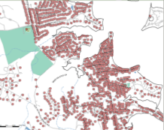
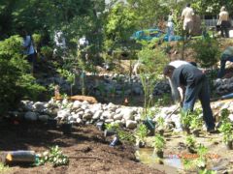
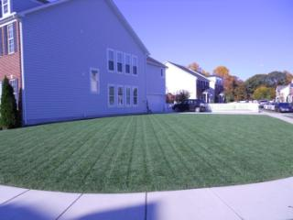
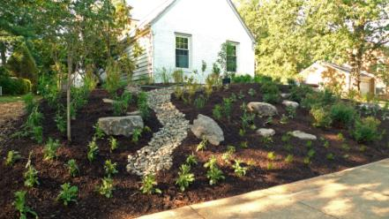
What do Master Watershed Stewards do?
Coordinate Action
Reduce Pollutants
RainScape

Slide 7
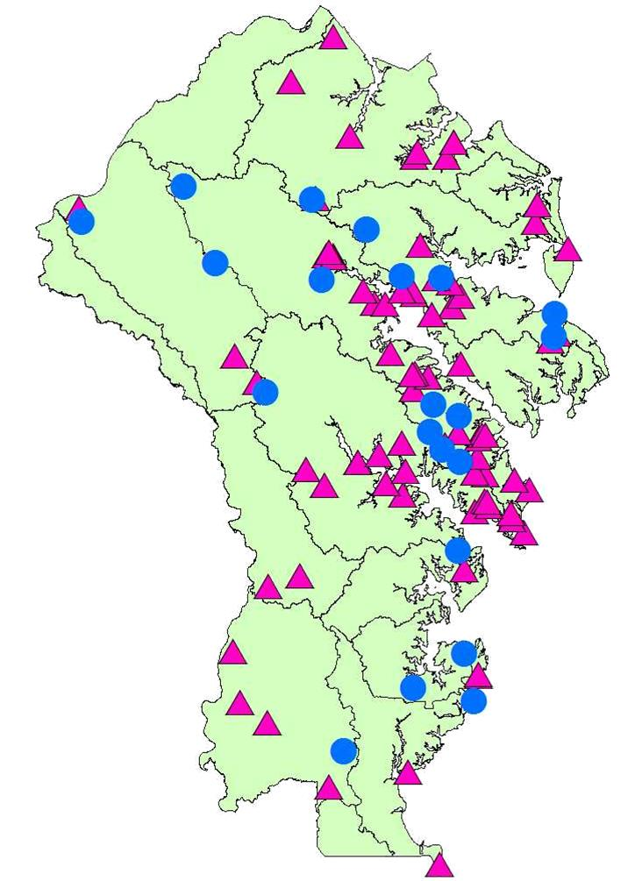
Master Watershed Stewards: 2013 Accomplishments
400,000 sf restoration installed
5,000 native plants and trees planted
2,000 volunteers engaged
10,000 people reached with direct outreach and education
Some behavior changes are very hard to measure.

Slide 8
WSA Behavior Change Successes
Intensive Training
Technical Assistance
Networking and Support

Slide 9
Why do people change their behavior?
They learn something which changes their attitudes and beliefs.
What’s in it for me? Economic Self Interest.
They perceive the benefits outweigh the barriers.
They feel their actions will have a real and positive effect on a greater good.
Notes:
Tell My bag story

Slide 10
Giving people more information does not always result in a behavior change…
Community Based Social Marketing

Slide 11
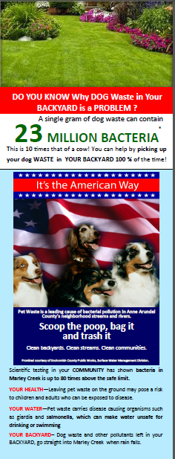
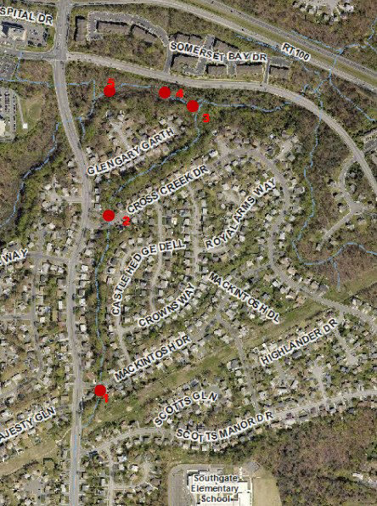

Slide 12
Adapted from Everett Rogers, Jay Kassirer, Mike Rothschild, Dave Ward, Kristen Cooley
Notes:
This slide demonstrates the problem we have and why we are spreading the social marketing word.
We typically allocate a disproportionate amount of resources for the smallest groups.
We try education, and when that doesn’t work, we create laws and spend money and time enforcing them.

Slide 13
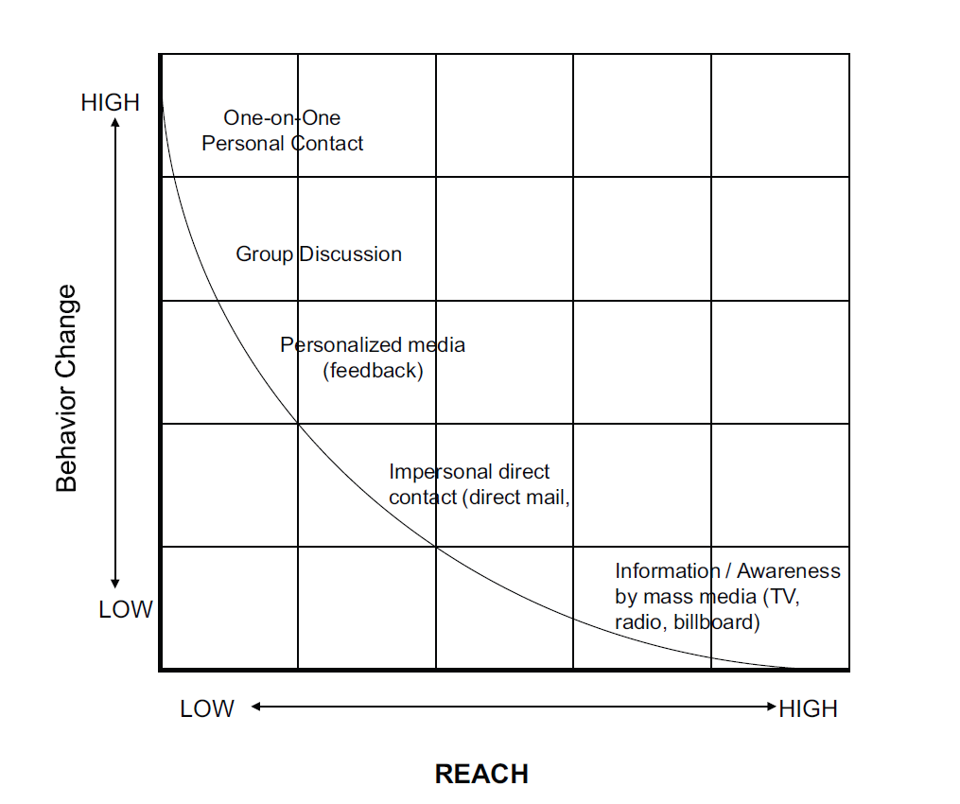
Source: Schultz, P.W. May 2010. Social Marketing: A Community-Based Approach.
Presentation prepared for the USEPA, RCC Web Academy. May 20, 2010.

Slide 14
WSA Lessons Learned
Focus on ONE behavior
Identify the right audience and learn all you can about them – resist the urge to advocate.
Technical assistance is a MUST
1 on 1 conversations are extremely effective
Focus on the “Help Me”s
It takes a long time and many contacts to change behavior.

