Slide 1
CBP Partnership’s
BMP Verification Review Panel’s Findings and Recommendations to Date
CBP Scientific and Technical Advisory Committee
December 3, 2013 Meeting
Dana York, Chair
CBP Partnership’s BMP Verification Review Panel

Slide 2
Verification Definition
The CBP Partnership has defined verification as:
“the process through which agency partners ensure practices, treatments, and technologies resulting in reductions of nitrogen, phosphorus, and/or sediment pollutant loads are implemented and operating correctly.”
1. CBP BMP Verification Principles. December 5, 2012.

Slide 3
CBP Verification Principles
Practice Reporting
Scientific Rigor
Public Confidence
Adaptive Management
Sector Equity

Slide 4
Verification Tools Provided
The following have been provided by the Panel to the six workgroups, BMP Verification Committee, and seven jurisdictions:
BMP Verification Program Design Matrix
Jurisdictional BMP Verification Program Development Decision Steps for Implementation
State Verification Protocol Components Checklist
Panel’s Comments on Workgroup’s Protocols

Slide 5
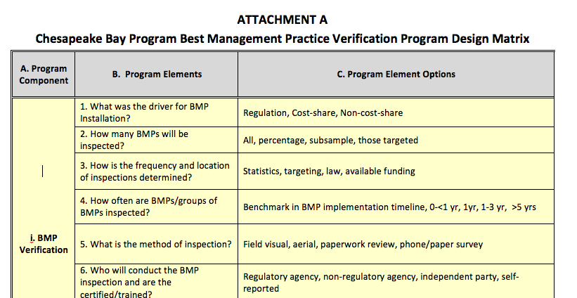
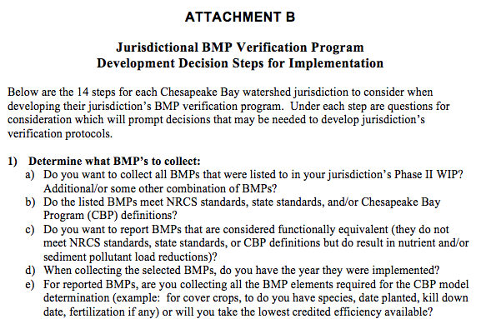
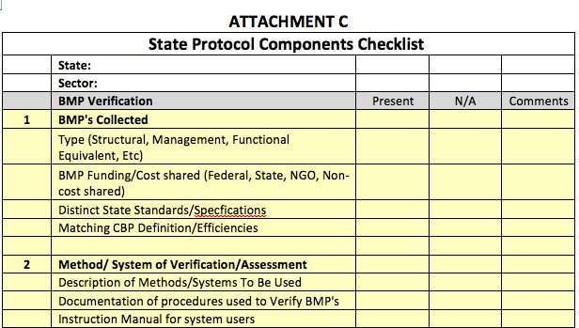
Verification Tools

Slide 6
Transparency
Panel recommends the Partnership be transparent about addressing transparency
Supports strengthened addendum to existing public confidence verification principle
Recommends independent verification/validation for aggregated data to ensure transparency is maintained
Supports commitment to make reported BMP data publically accessible while conforming to legal privacy restrictions

Slide 7
Federal Cost Shared Practices
Panel recommends the following for ensuring full access to federal cost shared practices:
Consistent, comprehensive 1619 data sharing agreements in place between NRCS and each of the six states
Request state access to NRCS Chesapeake Bay CEAP information

Slide 8
Ensuring Full Credit
Panel recommends the following for ensuring full credit for federal cost shared practices:
NRCS and FSA agreements to ensure their national reporting systems collect the additional data needed by states to receive full credit for federal cost shared practices at highest level of pollutant load reduction efficiency
  Examples—collecting information on: buffer width and location relative to local streams; animal types: and the timing, type of seed, and method of planting cover crops

Slide 9
Crediting Non-cost Shared Practices
Panel recommends Partnership adoption of procedures for defining functional equivalent practices and associated verification protocols
Recommends providing jurisdictions with clear guidance for setting up verification methods for crediting non-cost shared practices as functionally equivalent
Recommends establishing distinct practice standards/definitions within existing and future CBP approved BMP definitions

Slide 10
Addressing Data Credibility
Panel recommends the following to address and continually assure data credibility:
Formal adoption of jurisdiction specific procedures for eliminating doubling counting within each jurisdiction’s BMP verification program
Formal jurisdictions’ commitment to cleaning up their historical BMP data to the greatest extent possible
Data validation, using independent reviewers, of all external data provided to the Partnership for use in the Partnership’s model and other decision support tools

Slide 11
Expectations for Workgroups
Focus on providing the jurisdictions’ guidance, not detailed protocols
Use the urban stormwater workgroup’s narrative as a model to follow
Use the verification program design matrix in developing guidance for:
  BMP verification
  Data validation
  BMP performance

Slide 12
Expectations for Workgroups
Challenged workgroups to:
  Aim high
  Group practices, verification options
  Define how to verify and at what frequency
  Address inspection frequency for functional equivalents
  Provide guidance on intensity of verification choices
  Confirm cross walks between CBP approved BMPs and federal (e.g., NRCS)/state (e.g., stormwater regs) practice design standards
  Establish practice life spans

Slide 13
Expectations for Jurisdictions
Use state protocol checklist as guide for Panel’s expectations during review of the jurisdictional verification programs
Address certification/training of verifiers in their verification programs
Aim high or explain why
Prioritize verification towards priority practices
More intense on-site review of BMPs potentially results in less intensive spot-checking
Build in time for continuous improvement early on

Slide 14
Expectations for Committee
Ensure adoption of consistent nomenclature and accepted definitions for:
  Independent Review
  External Independent Review
See page 6 of the Panel Recommendations document for the Panel’s recommended detailed definitions drawn from wording used by the National Academy of Sciences, U.S. Environmental Protection Agency, and U.S. Army Corps of Engineers in their conduct of reviews.

Slide 15
Expectations for Committee
Seek to strengthen the jurisdictions’ ability to verify CBP defined BMPs:
  Assure BMP’s have distinct definitions/standards to verify against
  Build consideration of verification into BMP expert panel process
Further strengthen commitment to transparency
Provide functional equivalent guidance
Treat cost-shared and non cost-shared practices the same in terms of applying privacy restrictions

Slide 16
Expectations for Committee
Provide partners with access to statistical design expertise
Work with STAC to develop and implement a longer term process of collection, analyzing and using scientific evidence to assist in quantifying the performance of BMPs

Slide 17
BMP Verification Life Cycle
BMP no longer present/functional, removed from database
OR
BMP
installed,
verified, and reported through state NEIEN node
Functional equivalent spot check
Verification
BMP verified/
upgraded
with new technology
Spot check
BMP gains efficiency
BMP lifespan ends – re-verify
BMP Performance
Data Validation
Independent data validation
BMP nears end of life span
BMP fully functional
BMP performance metrics collected
BMP performance metrics collected

Slide 18
Illustration of Diversity of Verification Approaches Tailored to Reflect Practices
Sector | Inspected | Frequency | Timing | Method | Inspector | Data Recorded | Scale
Stormwater | All | Statistics | <1 year | Monitoring | Independent | Water quality data | Site
 | Percentage | Targeting | 1-3 yrs | Visual | Regulator | Meets Specs | Subwatershed
 | Subsample | Law | 3-5 yrs | Aerial | Non-Regulator | Visual functioning | County
 | Targeted | Funding | >5 yrs | Phone Survey | Self | Location | State
Agriculture | All | Statistics | <1 year | Monitoring | Independent | Water quality data | Site
 | Percentage | Targeting | 1-3 yrs | Visual | Regulator | Meets Specs | Subwatershed
 | Subsample | Law | 3-5 yrs | Aerial | Non-Regulator | Visual functioning | County
 | Targeted | Funding | >5 yrs | Phone Survey | Self | Location | State
Forestry | All | Statistics | <1 year | Monitoring | Independent | Water quality data | Site
 | Percentage | Targeting | 1-3 yrs | Visual | Regulator | Meets Specs | Subwatershed
 | Subsample | Law | 3-5 yrs | Aerial | Non-Regulator | Visual functioning | County
 | Targeted | Funding | >5 yrs | Phone Survey | Self | Location | State

Slide 19
Progress Since Last Spring
March 13 BMP Verif. Committee review of all 8 framework components; not ready for prime time
July 1 workgroups deliver draft verif. protocols
July 15 delivery of draft verif. framework document
Aug 28-29 Panel meeting
Sept-Oct Panel works on suite of tools, recommendations
Oct 31, Nov 1 Panel conf calls to reach agreement
Nov 19 distribution of Panel recommendations

Slide 20
Completing the Framework
Dec 10 BMP Verif. Committee meeting focused on briefing on Panel findings and recommendations
Dec 13 Workgroup chairs, coordinators briefed on Panel findings and recommendations via conf call
Feb 3 delivery of six workgroups’ final verification guidance to Panel, Committee members
March 3 Panel and Committee members complete their review of workgroups’ revised verif. guidance
March/April Joint Panel/Committee meeting to finalize the basinwide BMP verification framework and all its components

Slide 21
Framework Review Process
April-August 2014
  CBP Water Quality Goal Implementation Team
  CBP Habitat Goal Implementation Team
  CBP Fisheries Goal Implementation Team
  CBP Scientific and Technical Advisory Committee
  CBP Citizen Advisory Committee
  CBP Local Government Advisory Committee
  CBP Management Board

Slide 22
Framework/Programs Approval
Framework Approval
  Sept/Oct 2014: Principals’ Staff Committee
Review of Jurisdictions’ Proposed Verification Programs
  Fall 2014/Winter 2015: Jurisdictions complete program development
  Spring/Summer 2015: Panel reviews jurisdictional programs, feedback loop with jurisdictions
Approval of Jurisdictions’ Proposed Verification Programs
  Fall/Winter 2015: Panel recommendations to PSC for final approval

Slide 23
Evolving Panel Role
Teaming up with BMP Verification Committee in spring 2014 for joint review of all components of the basinwide verification framework
Reviewing the jurisdictions’ draft BMP verification programs, providing feedback to jurisdictions, reviewing revised programs, and then making recommendations to the Principals’ Staff Committee

Slide 24
Bottom-Line Messages
Lands coverage: jurisdictions will more accurately define lands covered by practices, account for progress, explain monitoring trends
Future WIP implementation: more accurately determine where new practices are needed to meet milestone commitments and WIP goals

Slide 25
Bottom-Line Messages
Future funding: more accurately estimate cost-sharing, capital investments, financing, and technical assistance needed to meet milestone commitments and WIP goals
Societal Benefits: providing credit to the wide array of implementers—from households to farmers to watershed organizations to municipalities—working to restore local streams, rivers, and the Bay

Slide 26
Dana York
Chair
Chesapeake Bay Program Partnership’s
BMP Verification Review Panel
410-708-6794
dyork818@yahoo.com
http://www.chesapeakebay.net/groups/group/bmp_verification_review_panel

