Slide 1
Chesapeake Bay Program
Incorporation of Lag Times into the Decision Process
Gary Shenk
10/16/12

Slide 2
Chesapeake Bay Program
Does Not Incorporate Lag Times into the Decision Process

Slide 3
No Lag in Model or TMDL
The goal of the TMDL and the Watershed Implementation Plans is to have practices in place by 2025 that will eventually lead to meeting the water quality standards
Watershed model scenario mode:
  The long-term annual average loads given land use, land management, BMPs, point sources, atmospheric deposition, etc at steady state.

Slide 4
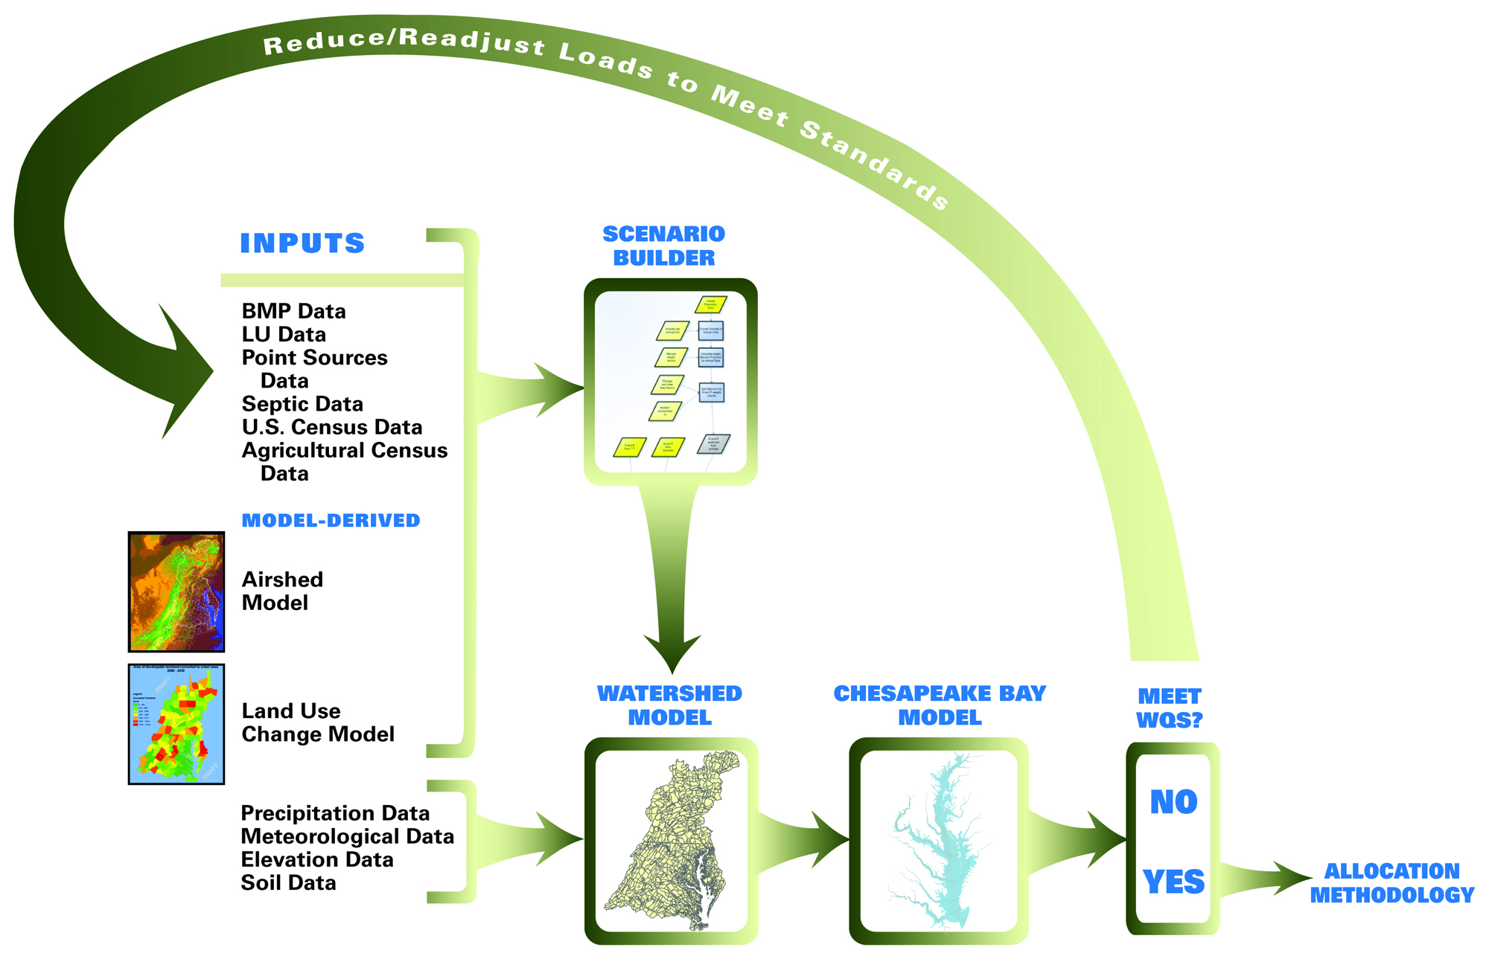
Chesapeake Bay Partnership Models

Slide 5
How the Watershed Model Works
Calibration Mode
Annual, monthly, or
daily values of
anthropogenic factors:
Land Use Acreage
BMPs
Fertilizer
Manure
Tillage
Crop types
Atmospheric deposition
Waste water treatment
Septic loads
Hourly or daily
values of
Meteorological
factors:
Precipitation
Temperature
Evapotranspiration
Wind
Solar Radiation
Dew point
Cloud Cover
Daily flow, nitrogen,
phosphorus, and
sediment compared
to observations
over 21 years
HSPF

Slide 6
Each segment consists of 30 separately-modeled land uses:
How the Watershed Model Works
Regulated Pervious Urban
Regulated Impervious Urban
Unregulated Pervious Urban
Unregulated Impervious Urban
Construction
Extractive
Combined Sewer System
Wooded / Open
Disturbed Forest
Corn/Soy/Wheat rotation (high till)
Corn/Soy/Wheat rotation (low till)
Other Row Crops
Alfalfa
Nursery
Pasture
Degraded Riparian Pasture
Afo / Cafo
Fertilized Hay
Unfertilized Hay
  Nutrient management versions of the above
Plus: Point Source and
Septic Loads, and
Atmospheric
Deposition Loads
Each calibrated to nutrient and
Sediment targets
6

Slide 7
Two Separate Segmentation Schemes
A land use within a land segment has the same inputs
  atmospheric deposition
  fertilizer
  manure
  precipitation
Land segmentation driven by availability of land use data
Land segments determined by
  County lines
  Rainfall Variances
  Federal / Non-Federal

Slide 8
Land Simulation – 1 Acre
4 completely mixed soil layers
Surface
Interflow
Lower Zone
Ground Water

Slide 9
Storages can Build up in the landscape
Trees
Denitrification
Roots
Leaves
Nitrate
Atmospheric Deposition
Export
Solution
Particulate
Particulate
Ammonia
Labile
Refractory
Organic N
Organic N
Export
Export
Export
Export
Export
Export
Adsorbed
Solution
Solution
Ammonia
Labile
Refractory
Organic N
Organic N

Slide 10

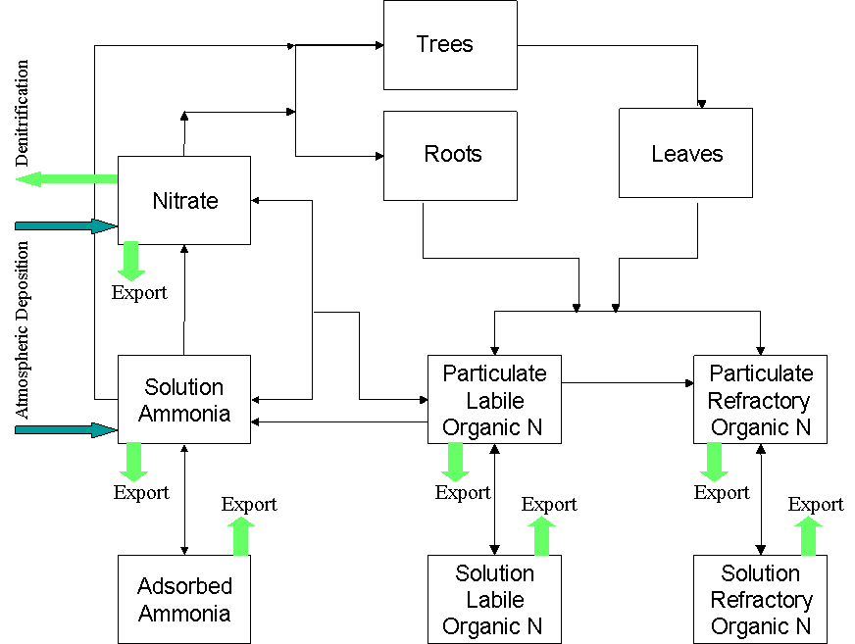
How the Watershed Model Works
Fertilizer
Manure
Atmospheric deposition
Precipitation
}
Management filter
Runoff
Hydrology
submodel
Sediment
submodel
Phosphorus
submodel
River
hourly
Nitrogen
submodel

Slide 11
Scale in Phase 5 - Sediment
Edge of Field
Expected loads from one acre
BMP Factor
Land Acre Factor
Edge of Stream
60-100 sq miles
Delivery Factor
Scour/
Deposition
In Stream Concentrations
Notes:
For any particular watershed, the single simulated acre is multiplied by the number of acres of that land use in the watershed.
The different types of land uses are added together to get the total load to the stream.
The stream then has some scour and deposition depending on the velocity of the water

Slide 12
Phase 5 river segmentation
A river segment gathers inputs from the watershed and has one simulated river
Consistent criteria over entire model domain
  Greater than 100 cfs
    or
  Has a flow gage

Slide 13
How the Watershed Model Works
Scenario Mode
Constant values of
anthropogenic factors:
Land Use Acreage
BMPs
Fertilizer
Manure
Tillage
Crop types
Atmospheric deposition
Waste water treatment
Septic loads
Hourly or daily
values of
Meteorological
factors:
Precipitation
Temperature
Evapotranspiration
Wind
Solar Radiation
Dew point
Cloud Cover
Run for 1984-2000
Average 1991-2000
For ‘flow-normalized average annual loads’
HSPF

Slide 14

Nitrogen Loads Delivered to the Chesapeake Bay By Jurisdiction
Point source loads reflect measured discharges while nonpoint source loads are based on an average-hydrology year
Phase 4.3 Data
333.9
289.9
281.1
277.7
275.1
270.2
266.3
262.9
261.9
260.7
184.4
183.1
175
14

Slide 15
Lag Time
Calibration – the WSM is calibrated to observed data, so including important lagged processes would improve calibration
Validation of predictions – if the WSM is predicting changes in nutrient loads that are not seen in the monitoring data, would lags help to explain the difference.
Communication – When will the Chesapeake Bay respond to management actions

