Slide 1
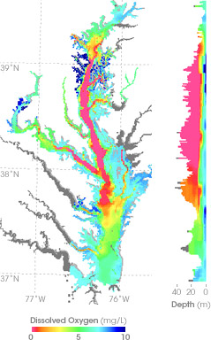
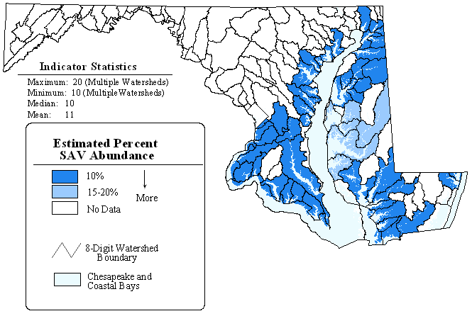
Changing Emphases
Almost since its inception, emphasis by the EPA Bay Program has been moving up the tributaries and into shallow water.
In response, the resolution of the CBEMP has increased by an order of magnitude, from 4,000 to 50,000 cells.
Minimum depth represented on the grid has decreased from 3.7 m to 2 m.
Circa 1983 – Focus on hypoxia in the deep trench of the bay and major tributaries.
2010 – Focus on shallow water and living resources. Water clarity and SAV are especially important.

Slide 2
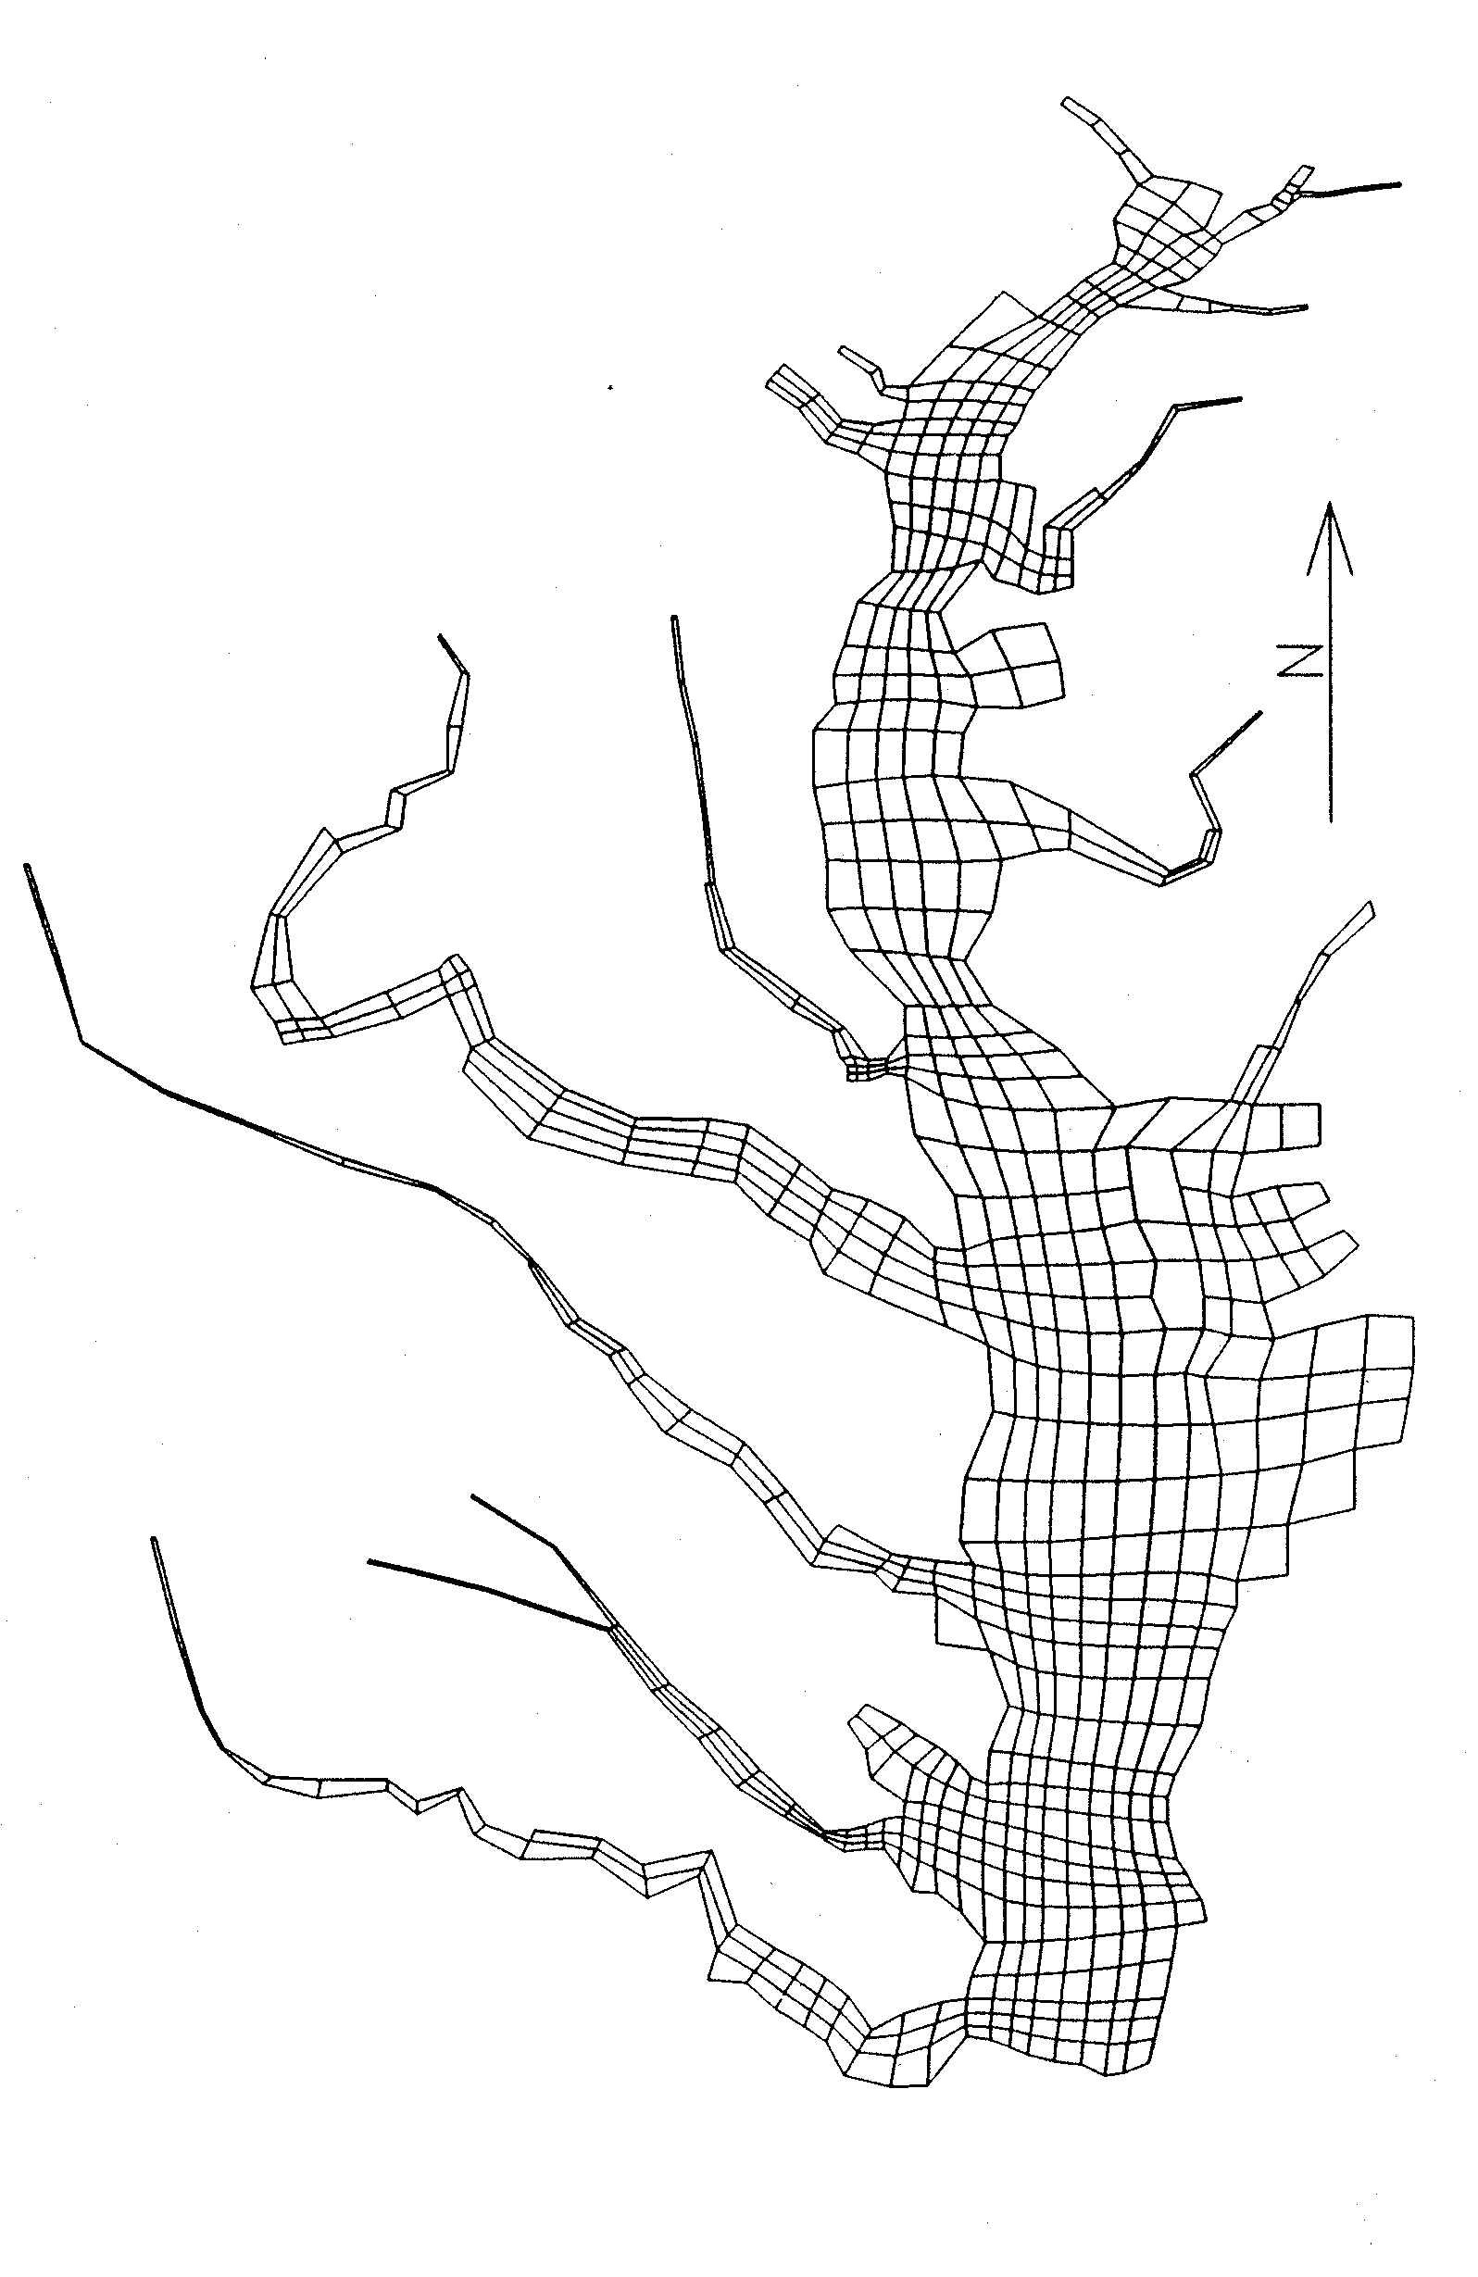
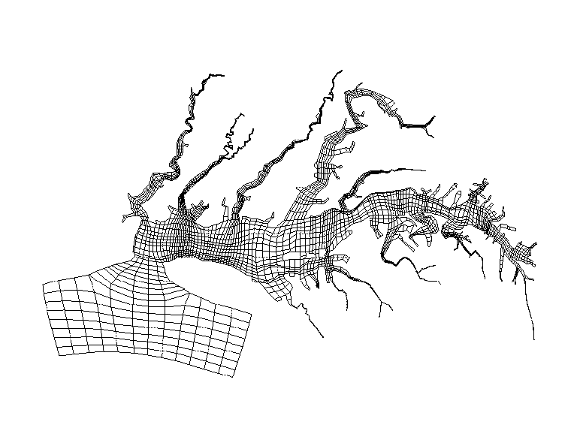
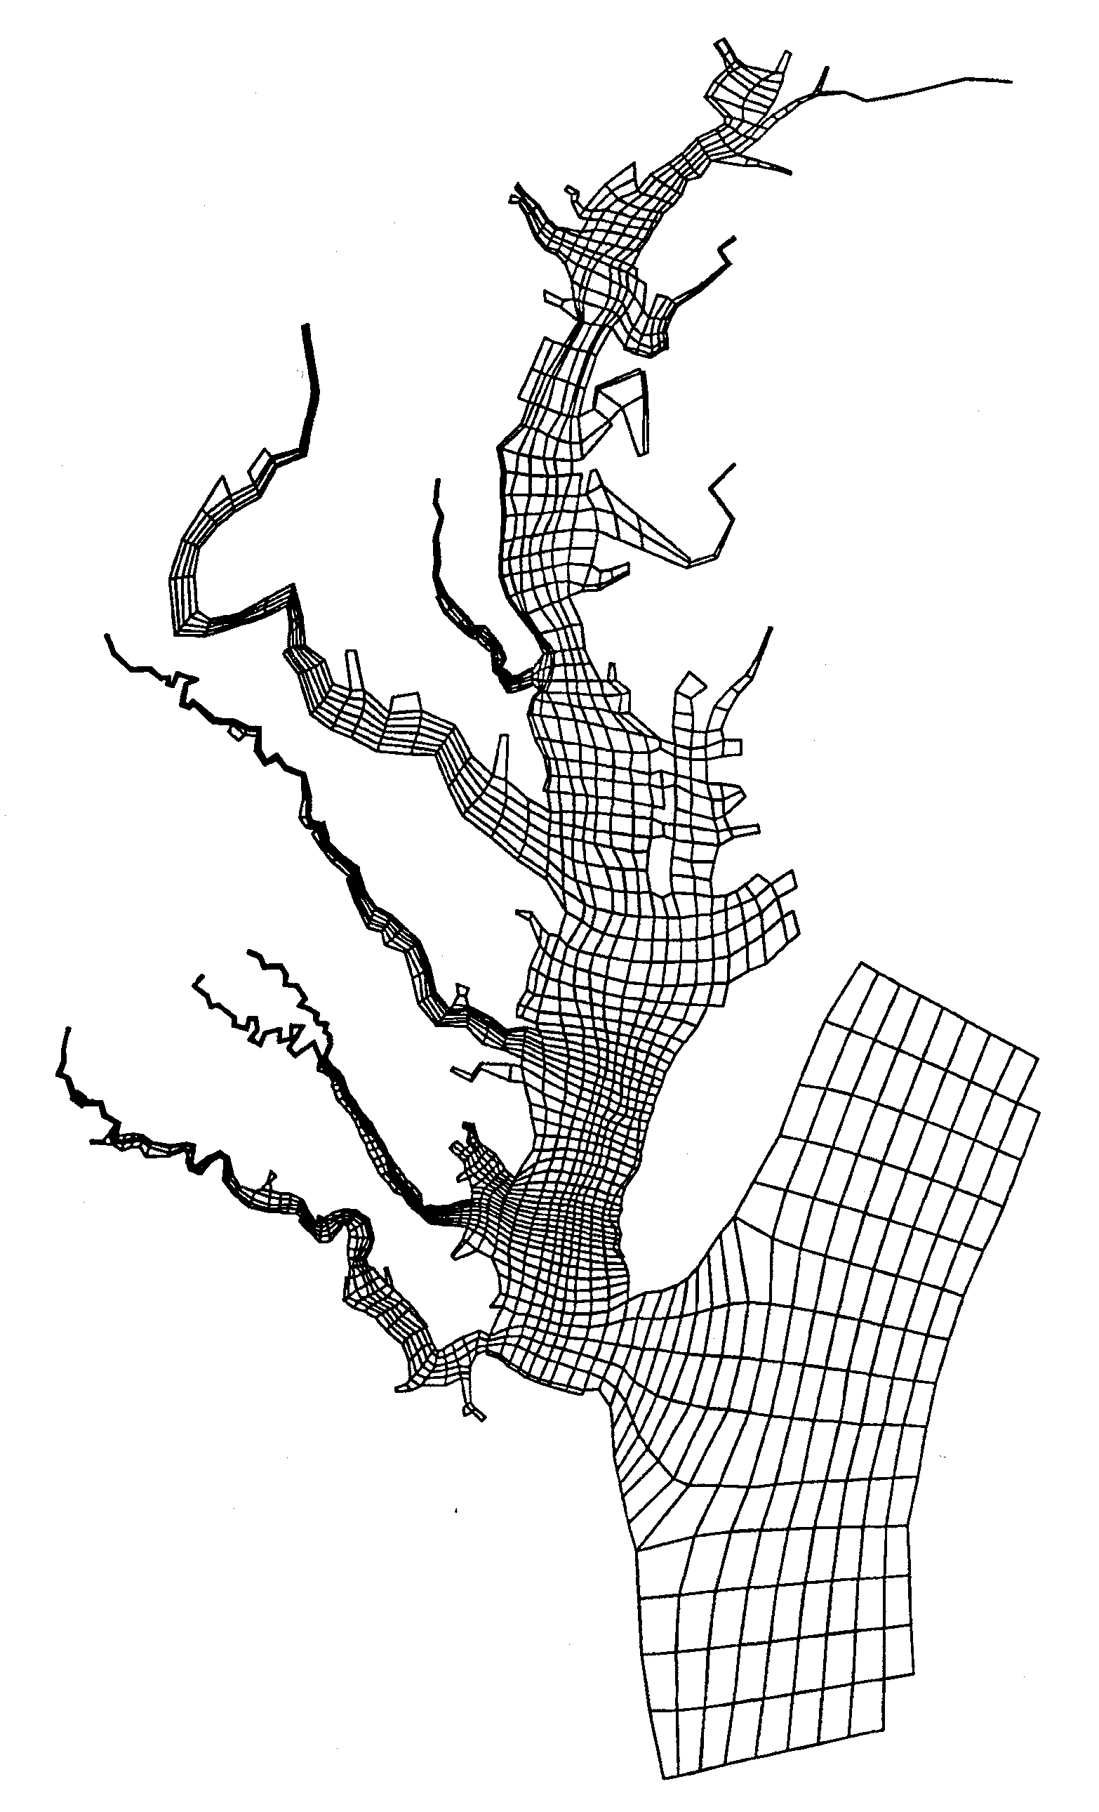
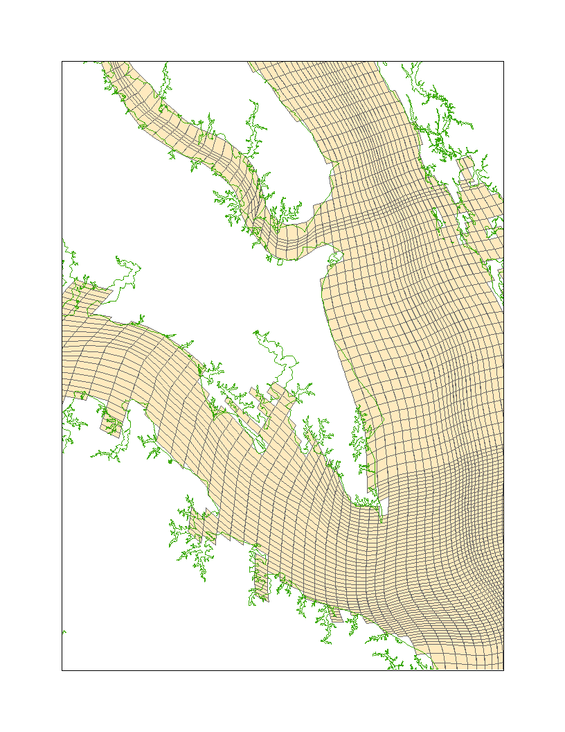
4,000 Cells
12,000 Cells
10,000 Cells
Multiple Model Grids
50,000 Cells

Slide 3
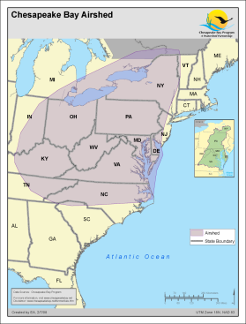
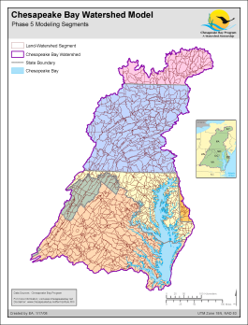
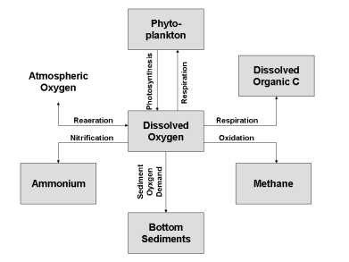
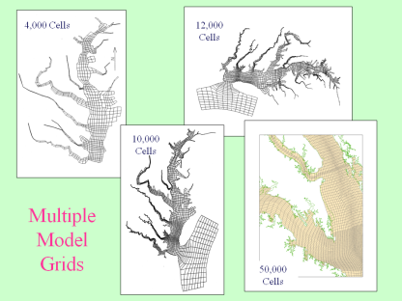
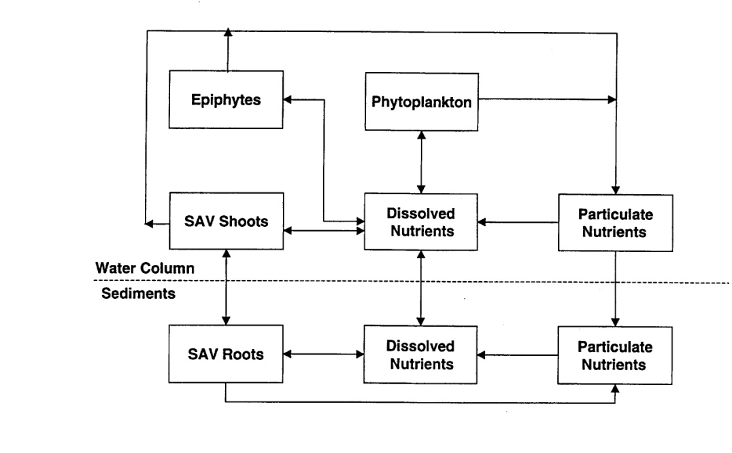
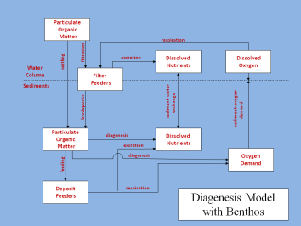
Regional
Atmospheric
Deposition
Model
Watershed
Model
Eutrophication
Model
Hydrodynamic
Model
SAV
Component
Benthos
Component
The CBEMP

Slide 4
We’ve Hit the Limit with CH3D
The present grid consists of 50,000 cells ≈ 1,000 m x 250 m x 2 m
Difficult to fit shoreline with quadrilateral cells.
Problems with increasing resolution in shallow water while resolving entire bay from head to mouth.
No wetting and drying (dynamic adaptation to shoreline).

Slide 5
Solution: The Living Resource Ribbon Model (LRRM)
Model only the area between the shoreline and the 2 or 3 m contour.
Interface with existing model (or an alternate) for deeper water.
Retain existing water column kinetics.
Renewed focus on shallow water processes:
Wetting and drying.
Wetlands.
Suspended solids.
SAV.

Slide 6
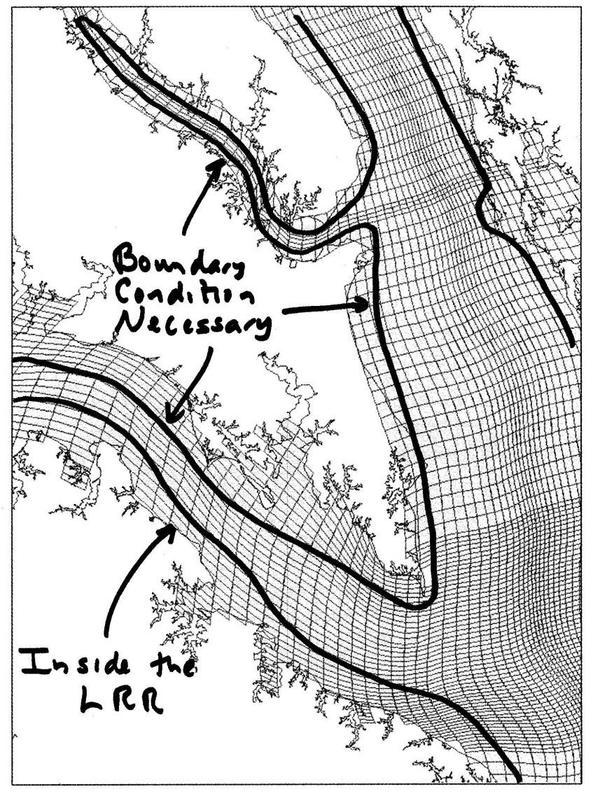
Challenges
Can we run the LRRM alone? What model or algorithms will provide forcing along the open boundary?
Will we run into computational or other problems along the lengthy open boundary?
Another option is to run one system-wide hydrodynamic model with emphasis in shallow water.

Slide 7
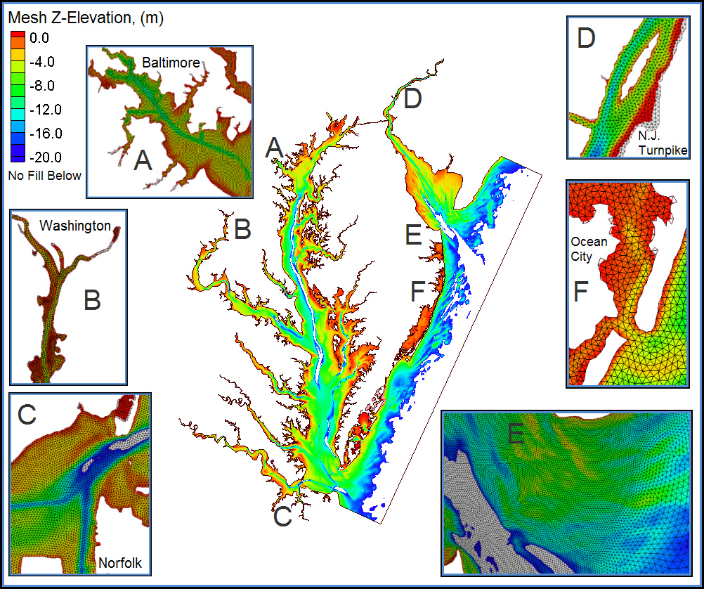
Hydrodynamic Model Options – ADH
Unstructured grid, mass balance at nodes.
Triangular mesh conforms to complicated shorelines.
Wetting and drying.
Initial application to Chesapeake Bay commenced.
Coupling to ICM commenced.
Element count = 1,065,811
Node count = 560,770
Bay element size = 220m edges,
area = 22,160 sq-m

Slide 8
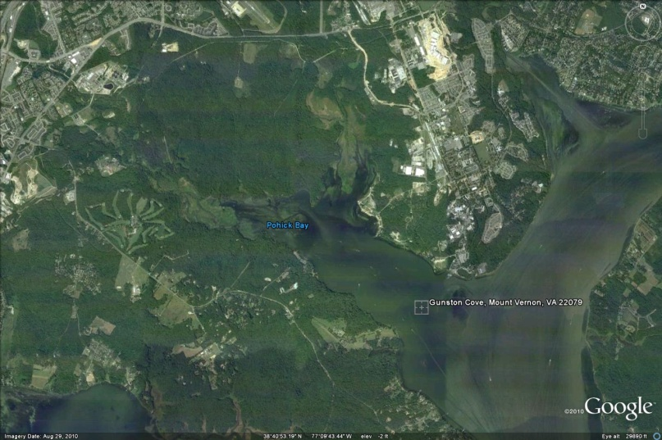
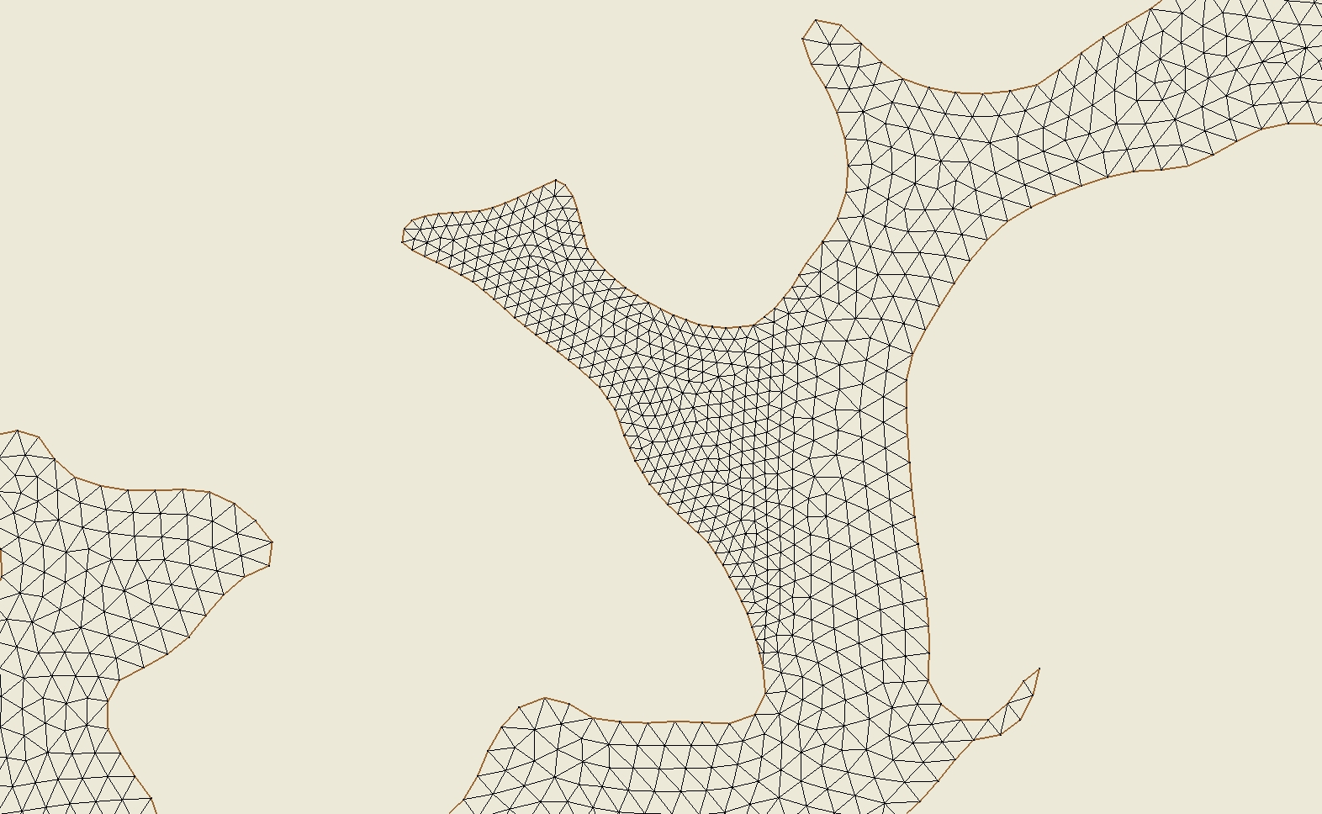
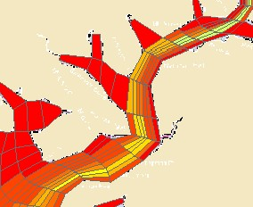

Slide 9
Hydrodynamic Model Options – FV-COM
Unstructured grid, mass balance in volumes.
Triangular mesh conforms to complicated shorelines.
Wetting and drying.

Slide 10
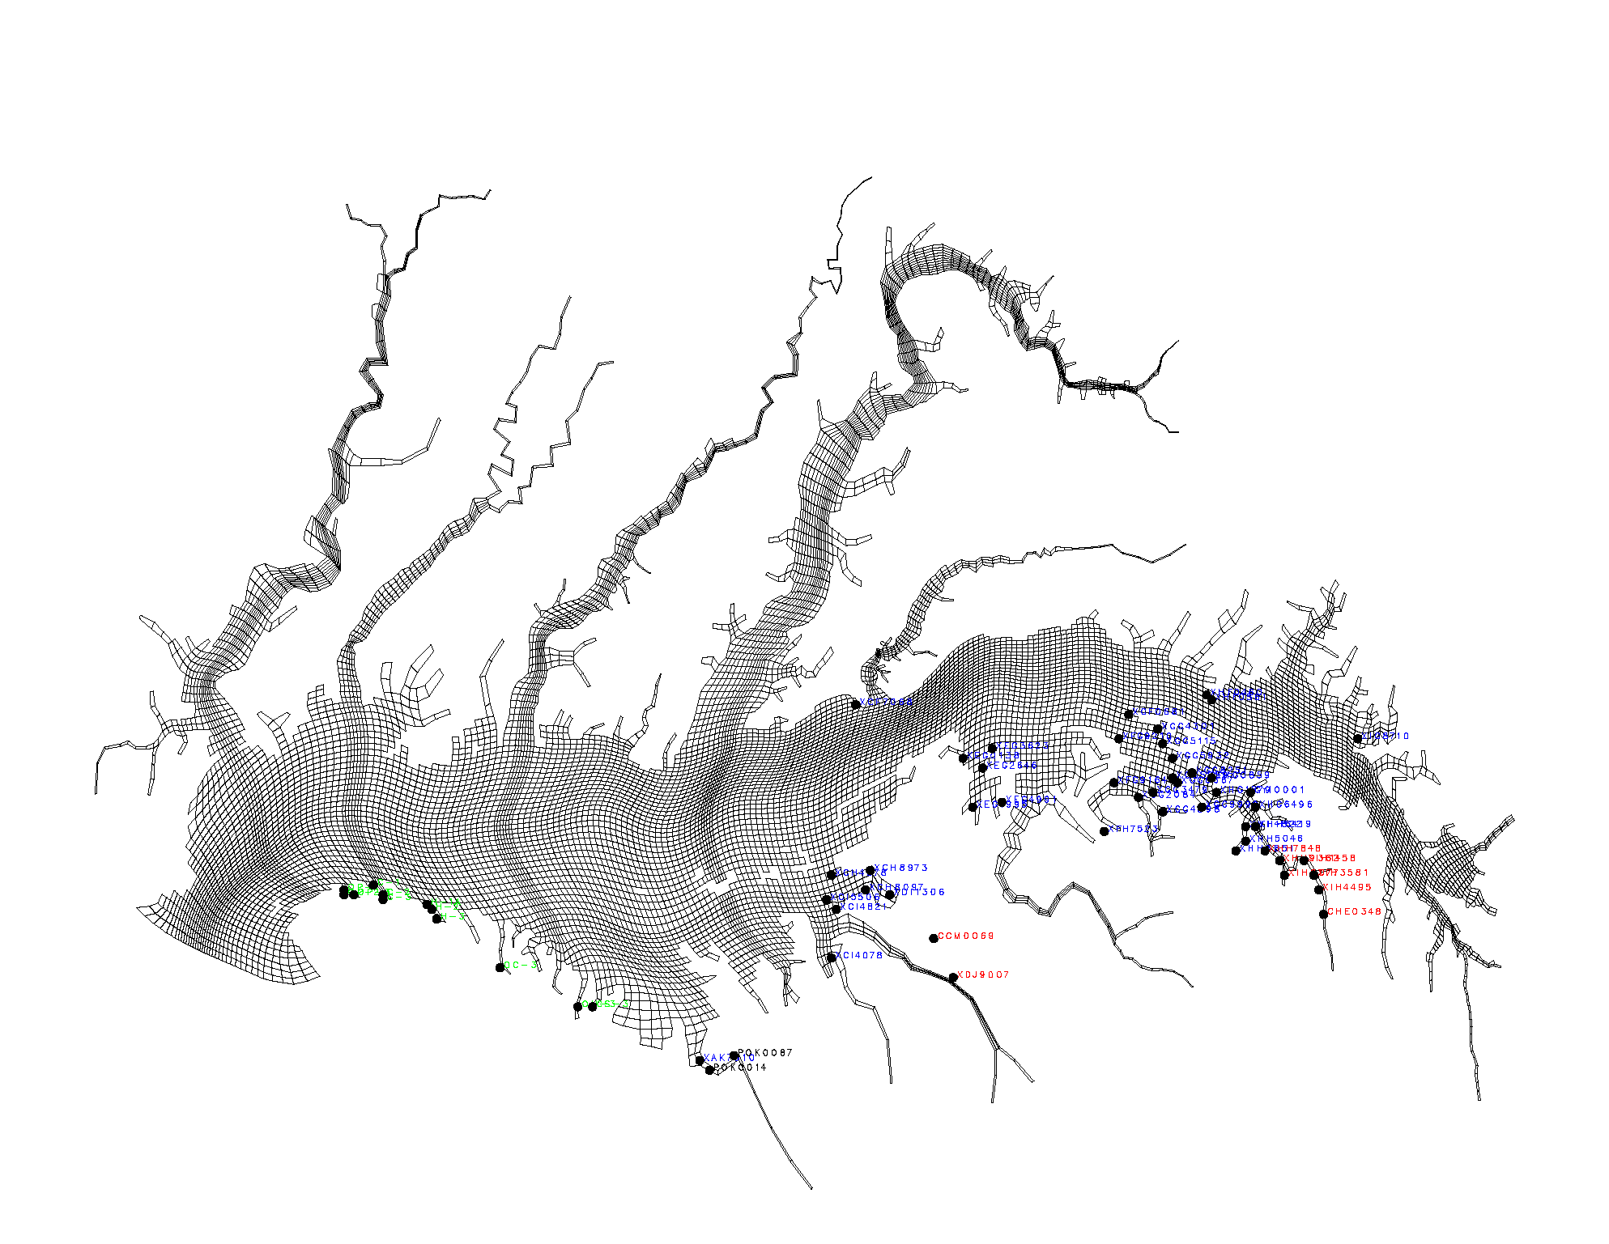

Slide 11
We need resolution but it’s not clear how much of our problem is resolution and how much is lack of understanding.

Slide 12
Overview
Revised model ready to go by December 2015
Reassessment of Phase III Watershed Implementation Plans in 2017
Retain present CH3D/ICM for the mainstem bay and open-water regions
They are operational and function well
Replacement with a different model configuration will likely entail recalibration, software development etc.
Emphasize development of a separate shallow-water model that will interface with CH3D/ICM
The Living Resource Ribbon out to 3m depth contour
Propose to employ the Corps’ ADH model with ICM

Slide 13
The Living Resource Ribbon
Divide the bay system into shoreline reaches for application of LRR
Efficiency is enhanced if we don’t do the entire bay shoreline in one application
Do our reaches encompass the entire bay shoreline or fewer regions of high interest?
How does a reach like the upper James River fit into the ribbon concept?
Apply to Multiple Reaches
Are regional calibrations feasible? Resource and data constraints.
What is the data extent? Do we have data in reaches and sub-reaches? If not, is it worth calibrating?
Shallow-water monitoring data
Application period

Slide 14
Can we do the entire bay shoreline in one ribbon?
If not, how many reaches do we attempt?
The number of shallow water embayments is fractal. How many do we try to calibrate?
What to do about embayments/reaches where there is no data?
Should we focus in on a couple of high-importance/problem areas?

Slide 15
Wetlands and Shallow Water Component
Empirical or simplified models of wetland processes
Respiration, nutrient exchange, burial of solids, nutrients
Beach and Shoreline Processes
Resuspension of solids and POC?
Shoreline erosion
Revisit waves in small creeks?
Interface with LRR model, bay model
Optical modeling

Slide 16
Oysters and Menhaden
Examine their role on the present grid
Calibration
Allocation conditions
Compare to previous calculations. Determine differences, if any, and their origins
Oysters and the Living Resource Ribbon
Do we incorporate oysters in the LRR model?
Update reef location and biomass
The previous work was all about restoration to historic distribution
Role of aquaculture

Slide 17
The Living Resource Ribbon
Select one or two initial areas for test of concept, feasibility
Gunston Cove or Gunpowder River
Test ADH/ICM package currently under development
Develop software links to CH3D, ICM, WSM
Flux or concentration boundary conditions?
Sediment resuspension
Submerged aquatic vegetation
Benthic algae
Resuspension of POC, PON, POP

