Slide 1
Exploring the Environmental Effects of Shale Gas Development in the Chesapeake Bay Watershed
A Workshop by
Chesapeake Bay
Scientific and Technical Advisory Committee

Slide 2
STAC Steering Committee Members
Charles Abdalla (PSU)
Brian Benham (VPI)
Randy Chambers (College of William and Mary)
Natalie Gardner (CRC)
Kurt Gottschalk (USFS)
Robert Howarth (Cornell)
Matthew Johnston (CRC)
Kelly Maloney (USGS)
Denice Wardrop (PSU)

Slide 3
Workshop Objectives
To review and synthesize the research available regarding shale gas development’s environmental effects
To identify the environmental effects that shale gas development will pose to the Chesapeake Bay Watershed relative to Chesapeake Bay water quality
To identify and prioritize future research needs relative to shale gas development and Chesapeake Bay water quality

Slide 4
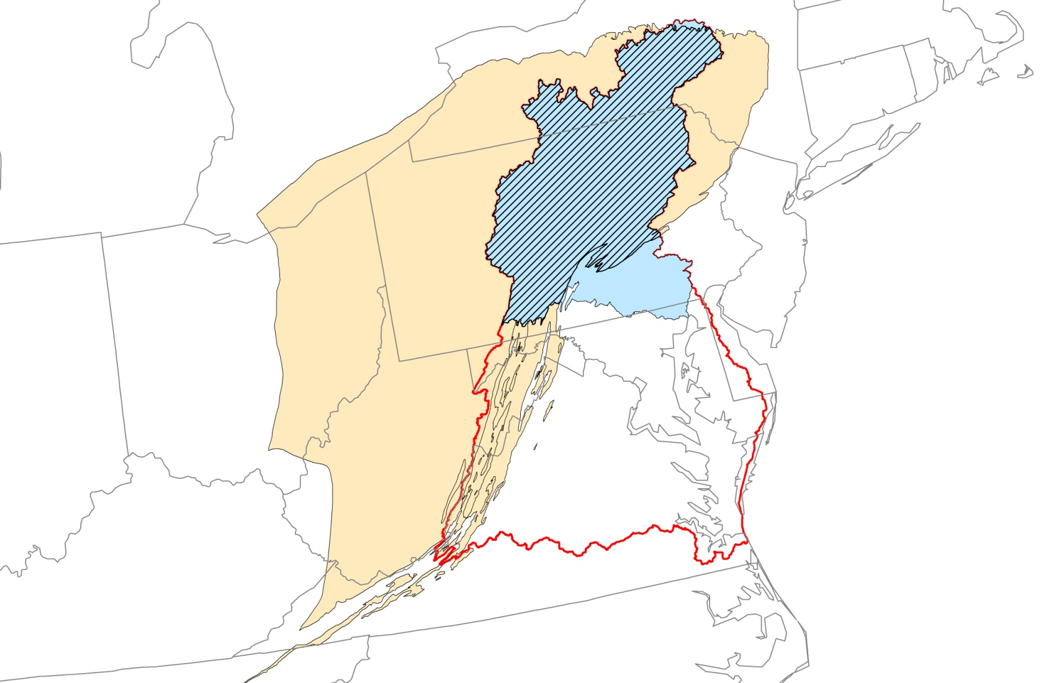
Why Chesapeake Bay and STAC?
Marcellus shale is 43% of the Chesapeake Bay watershed and
85% of the Susquehanna River watershed
Map and data prepared by Randy Chambers

Slide 5
Agenda
Several summary presentations to help the group have some common knowledge
Two breakout groups to discuss questions and prepare reports to group
Land based effects group
Water quantity and quality effects group
Breakout groups report to whole group with discussion
Discussion and assignments for report writing

Slide 6
Water Quantity and Quality Questions
What are the potential effects on Chesapeake Bay TMDL pollution reduction efforts?
How effective are BMPs at reducing water quality and quantity effects?
What are the high priority research needs for quantifying shale gas development effects on Chesapeake Bay water quality?

Slide 7
Land Based Effects Questions
How does the shale gas development infrastructure affect land cover/use and indirectly water quality and quantity via cummulative effects?
What are the potential effects on Chesapeake Bay TMDL pollution reduction efforts?
How effective are BMPS at reducing those effects?
What are the high priority research needs for quantifying shale gas development effects on Chesapeake Bay waqter quality?

Slide 8
Effects versus Impacts
Effects = change due to action, objective measureable change in status (i.e. structure, function) of some environmental or socioeconomic factor in response to an activity or other cause
Impacts = strong influence of effects, applying some of type of value system to the effects status change to provide an interpretation of those changes (i.e. positive, negative, neutral), or using socioeconomic analysis (i.e. cost-benefit, willingness to pay) to provide information for value judgments

Slide 9
Workshop Products
The report will summarize the state-of-the-science regarding environmental effects of shale gas development
The report will identify and prioritize specific research gaps

Slide 10
Questions?

