Slide 1
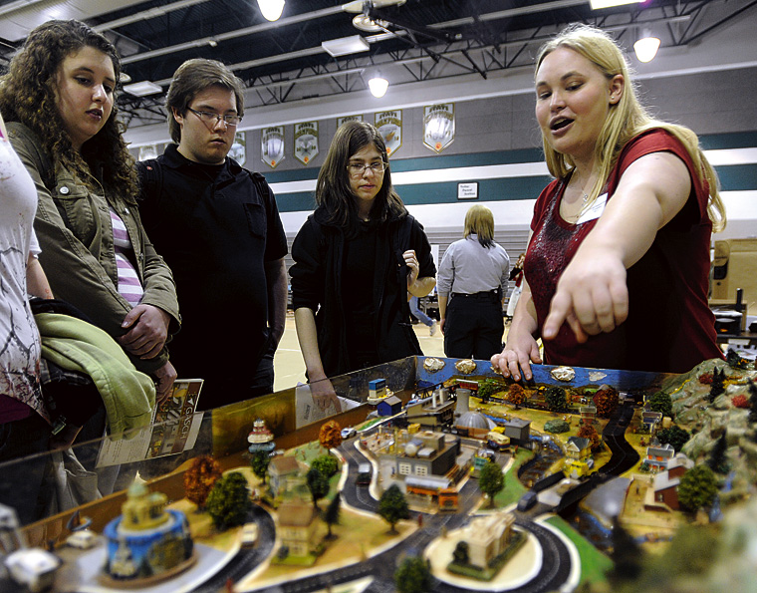
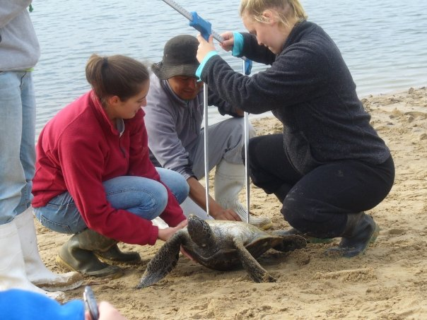
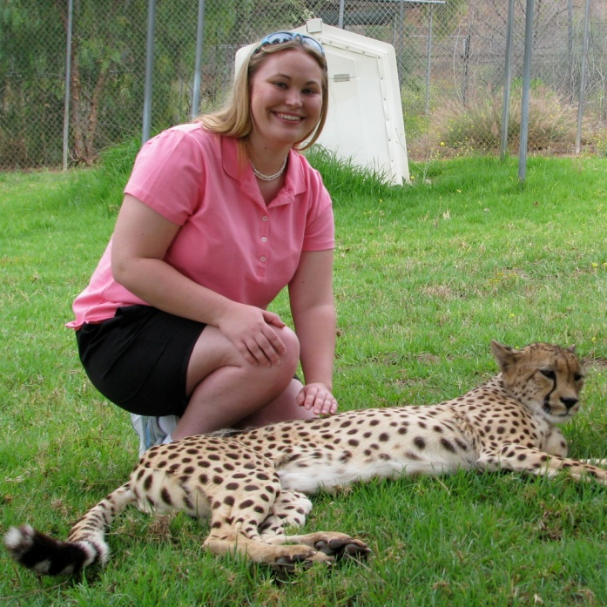
CRC Staffer Update
Sarah Brzezinski
Fostering Chesapeake Stewardship GIT 5

Slide 2
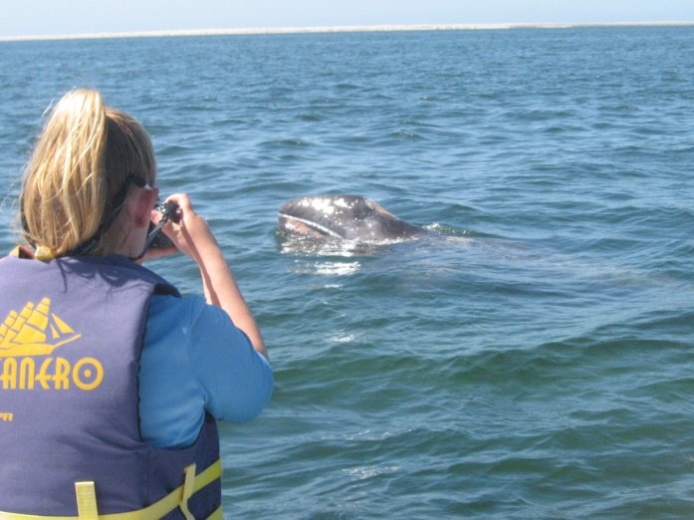
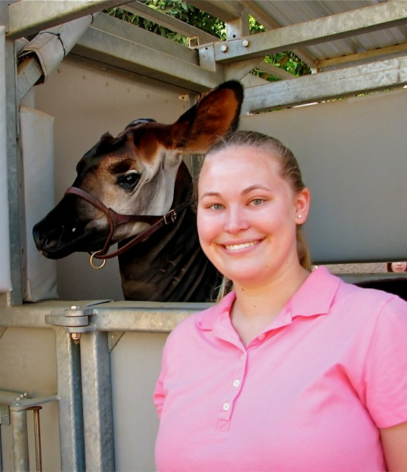
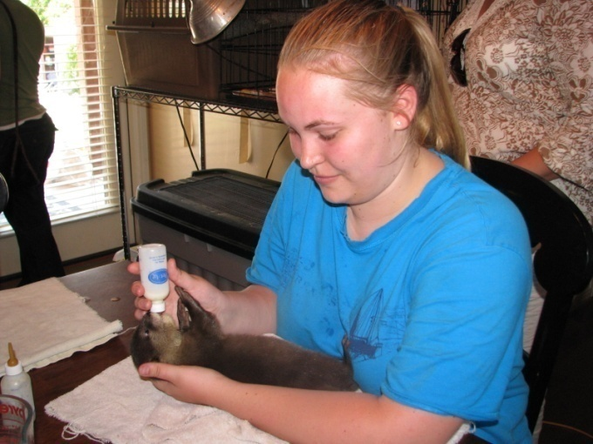
Personal Background
Dickinson College
  B.S. Environmental Science
  Biology minor
Study Abroad at:
  SFS Mexico
  University of Queensland
Employment:
  SD Zoo Behavioral Biology
  CBF Education Intern
  Animal Hospital, Vet Clinics

Slide 3

Citizens’ Advisory
Committee
Chesapeake Executive Council
Principals’ Staff Committee
Independent
Evaluator
Local Government
Advisory Committee
Scientific & Technical
Advisory Committee
Management Board
Communications
Workgroup
Science,
Technical
Analysis,
& Reporting
Goal Implementation Teams
Sustainable
Fisheries
Habitats
Water
Quality
Healthy
Watersheds
Partnering,
Leadership,
Management
Foster Chesapeake Stewardship GIT 5
Education
Workgroup
Chesapeake
Conservation
Corps
Master
Watershed
Stewards
Land
Conservation
Priorities
Public
Access
Planning
GIT Leadership
Chair John Maounis National Park Service
Vice Chair Kristin Saunders Evans MD Dept of Natural Resources
Coordinator Amy Handen National Park Service
Staffer Sarah Brzezinski Chesapeake Research Consortium
Notes:
3
3

Slide 4
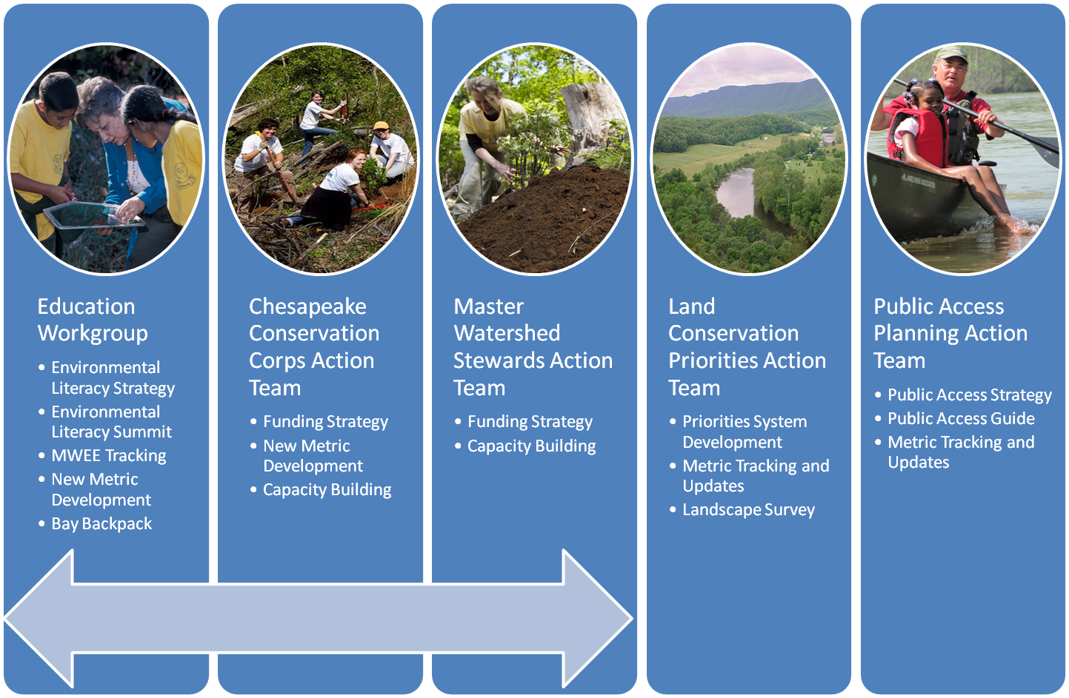
Fostering Chesapeake Stewardship GIT 5
Expand Citizen Stewardship Supporting Strategy
Conserve Land and Increase
Public Access Goal

Slide 5

Mid-Atlantic Elementary and Secondary Environmental Literacy Strategy:
  http://chesapeakebay.noaa.gov/images/stories/hottopics/midatldraftelstrategy.pdf

Slide 6
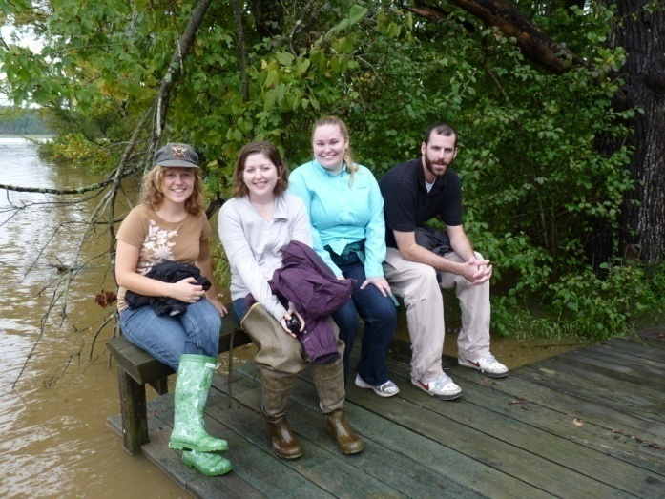
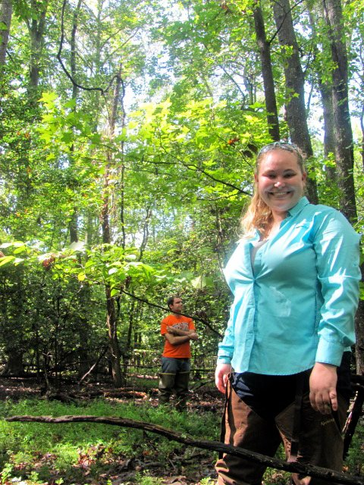
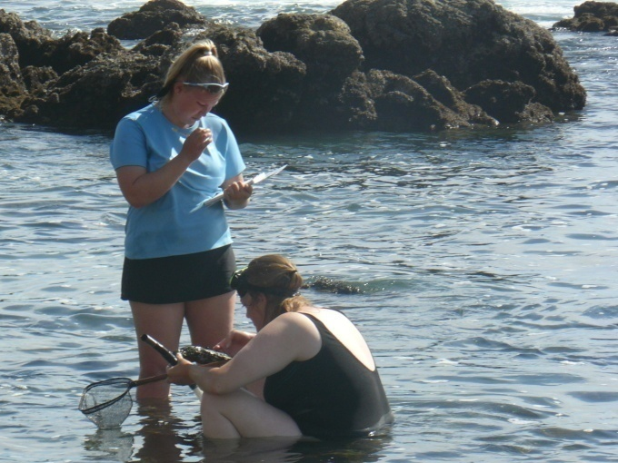
Professional Development
Environmental Ed
  MAEOE Conference
  Regional Roundtables
  Mid-Atlantic Environmental Literacy Summit
Biological Sciences
  Marine Mammals Conf
  MD Streams Symposium
  Chesapeake Watershed Forum

Slide 7
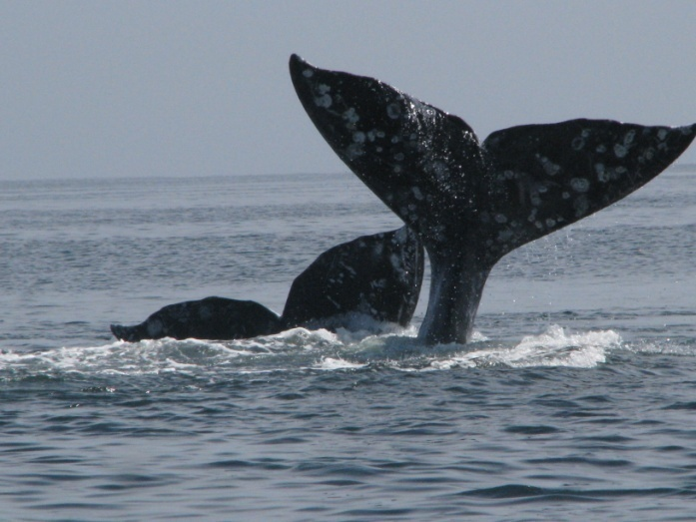
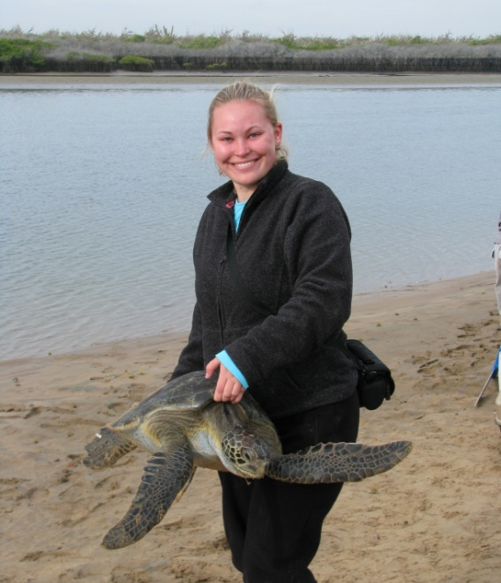
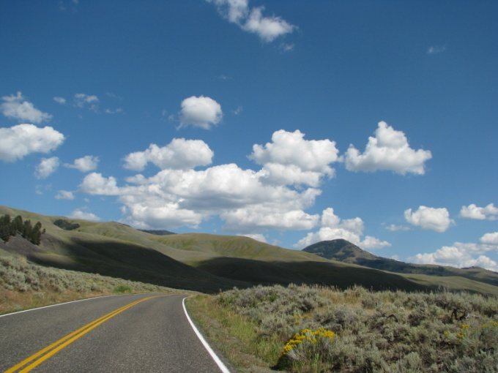
The Road Ahead
Graduate School
  Zoology, ecology, or marine biology
  Conservation of marine mammals, reptiles, birds
Pursue a career that combines research and education
Explore the world at home and abroad

Slide 8
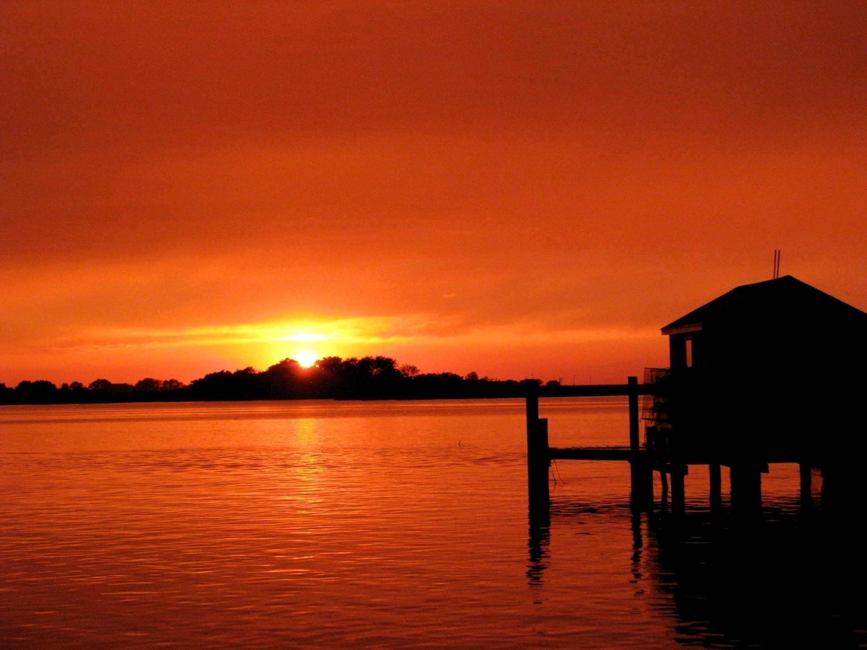
Questions?
Sarah Brzezinski
410-260-2494
Sarah_Brzezinski@partner.nps.gov
Smith Island

