Slide 1
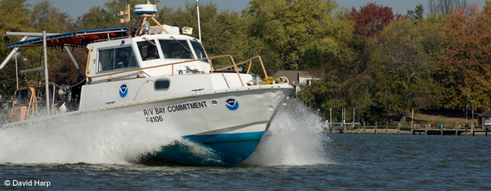

NCBO Science: Current and Future Efforts
Michael Ford
Acting Ecosystem Science Manager
NOAA Chesapeake Bay Office

Slide 2
Background
Focus, and a New Dialog
Toward a well-targeted scientific portfolio
Responsiveness to mandates by embracing innovation and the best of the scientific community
Emphasis on analysis through in-house and external capacities – get the results out there
Looking forward to a robust, two-way conversation with STAC to answer science and technical questions facing NCBO and its partners

Slide 3
Ecosystem Science at NCBO
My background & the ecosystem science manager role
Within the Ecosystem Science (ES) Branch:
Buoy observations, integrated observations
Habitat assessment, bottom characterization
Ecosystem modeling
Satellite remote sensing
SYNTHESIS, INTEGRATION
ES strives to work in concert with Fisheries Science Research Program grants (~$1.5M)
ES connects with Coastal and Living Marine Resources, Environmental Literacy Branches at NCBO to enhance science to application and broader impacts of the work

Slide 4
Vision
NCBO believes that an inter-disciplinary approach at multiple scales is the best strategy for Bay issues
NOAA characteristics
Diverse capabilities (e.g., satellite observations)
Bay-wide, regional, shelf scale activities
Partners as collaborators, co-PIs
Carrying this vision to 2012 projects

Slide 5
Current Efforts
Pre- and Post-Restoration Habitat Assessment
Oyster focus
Integrated Observations
Evolution of CBIBS
Incident Response Success
Hurricane Irene, Tropical Storm Lee

Slide 6
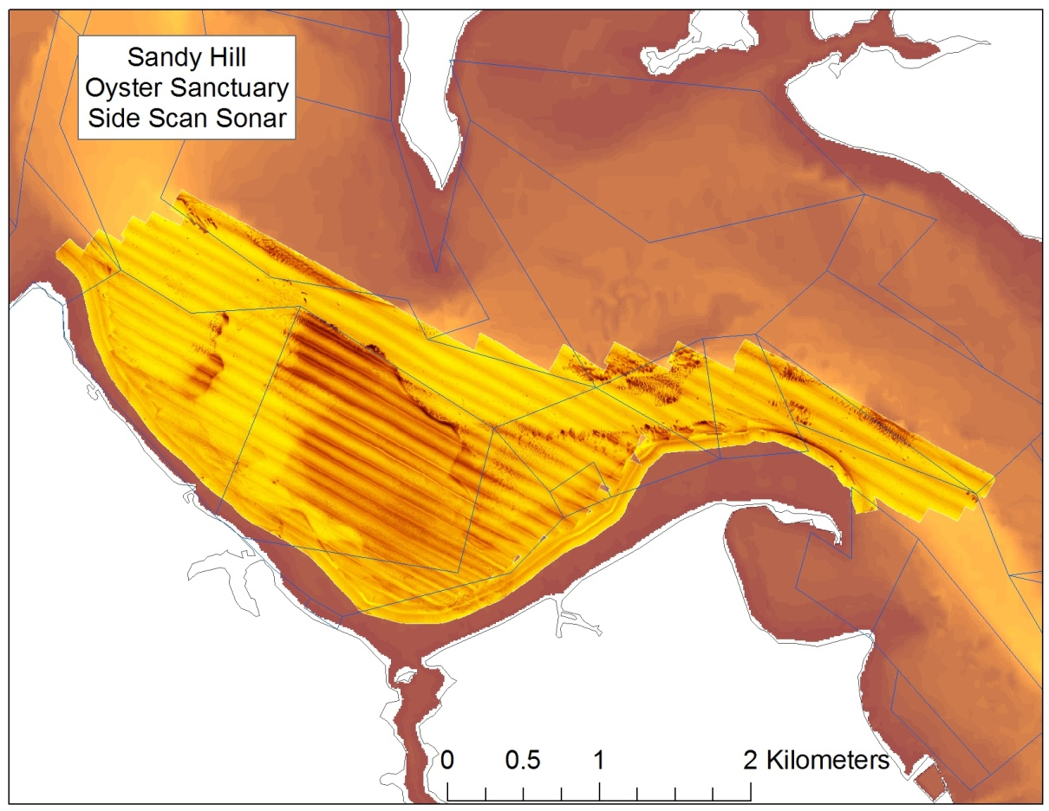
Figure 1 The image shows a side scan sonar survey over a layer of bathymetry on Sandy Hill in the Choptank River by Maryland Geological Survey. I
n the side scan image, darker shades represent hard, coarse bottom (e.g., shell); lighter shades represent fine, soft bottom (e.g., silts). Data courtesy of Maryland Geological Survey.

Slide 7
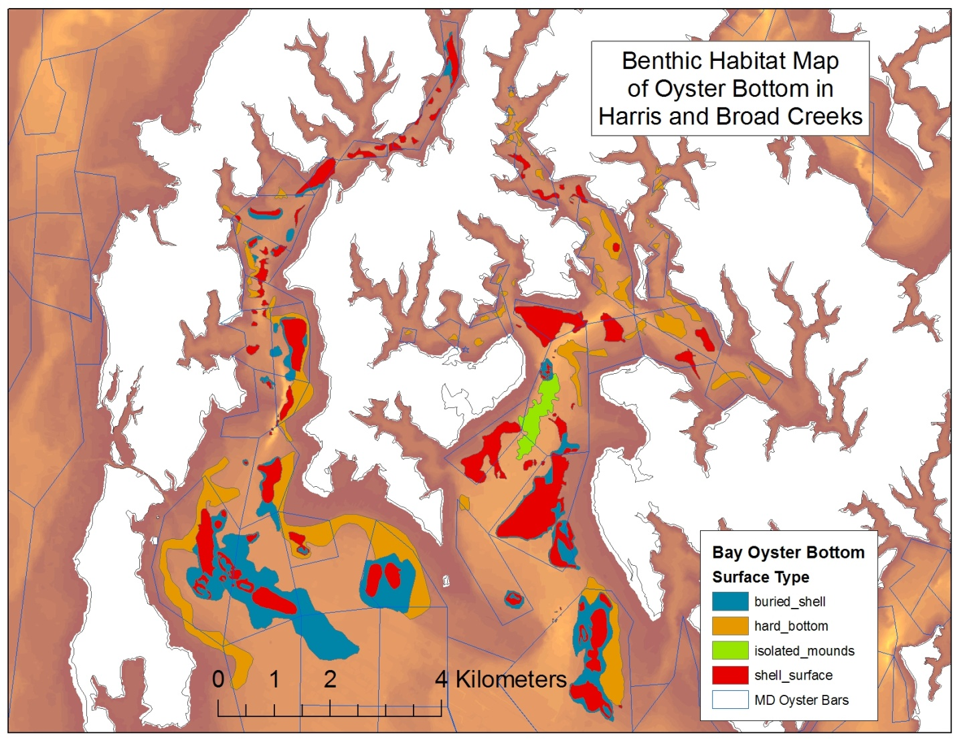
Figure 2. The image depicts a GIS polygon layer of oyster bottom surface type which is a product of the Broad Scale assessment. Data courtesy of Maryland Geological Survey.

Slide 8
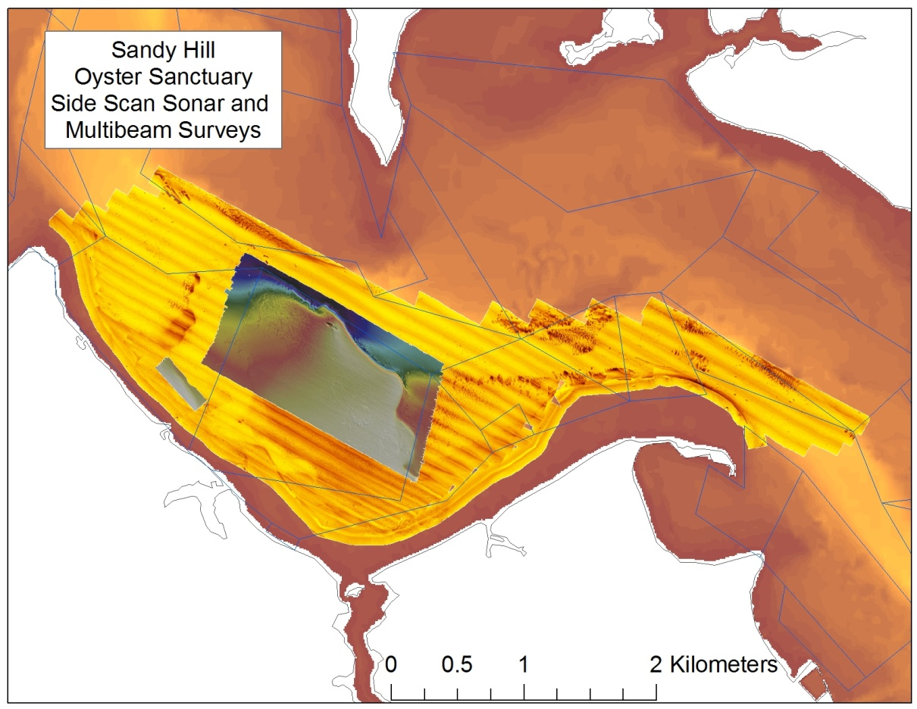
Figure 3 This image shows a multibeam bathymetric survey over a portion of the side scan sonar survey. The purple/blue represents deeper water (15m). T
he gray/white represents the more shoal water (3m). Multibeam data courtesy of NCBO Habitat Assessment Team.

Slide 9
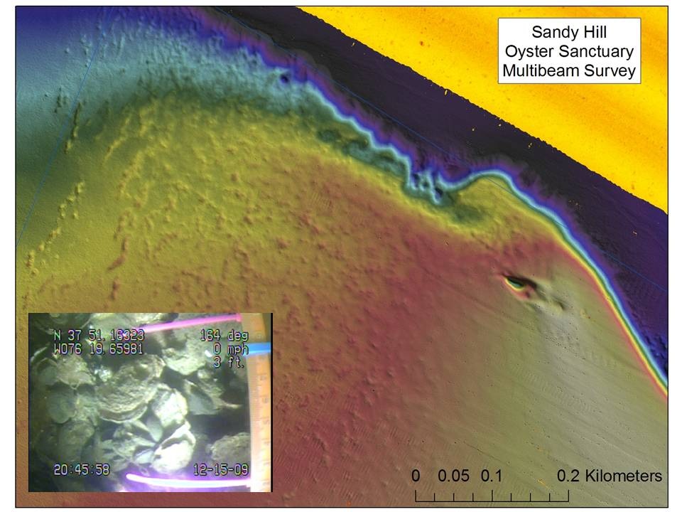
Figure 4 Multibeam surface of oyster habitat created with 0.5m grid of soundings with video groundtruth inset. Photo courtesy of NCBO Habitat Assessment Team.

Slide 10
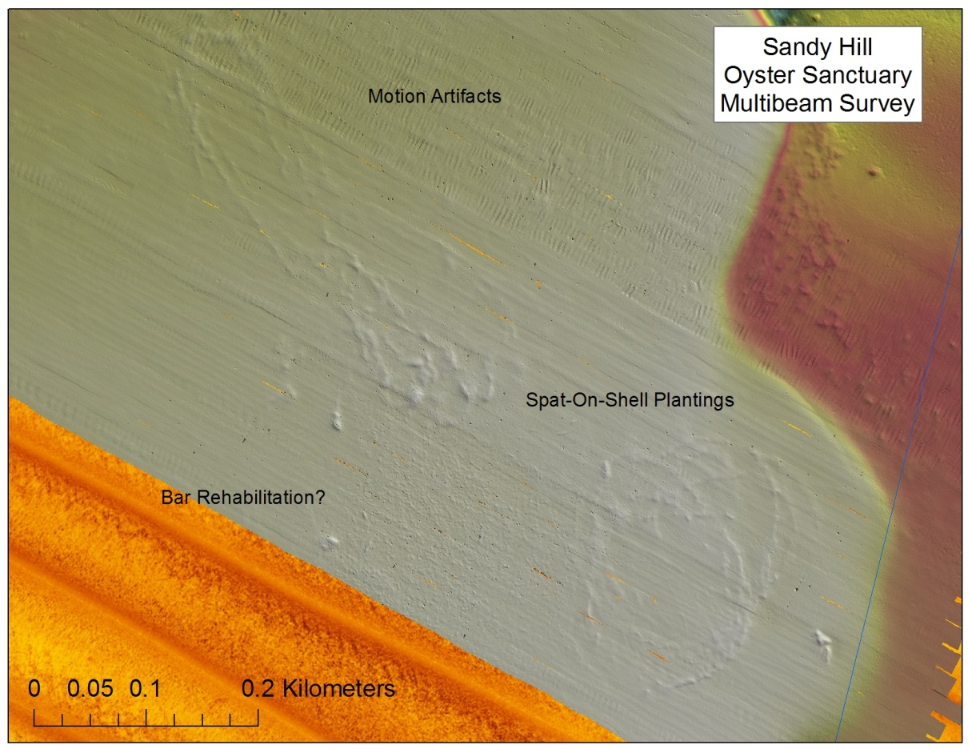

Slide 11
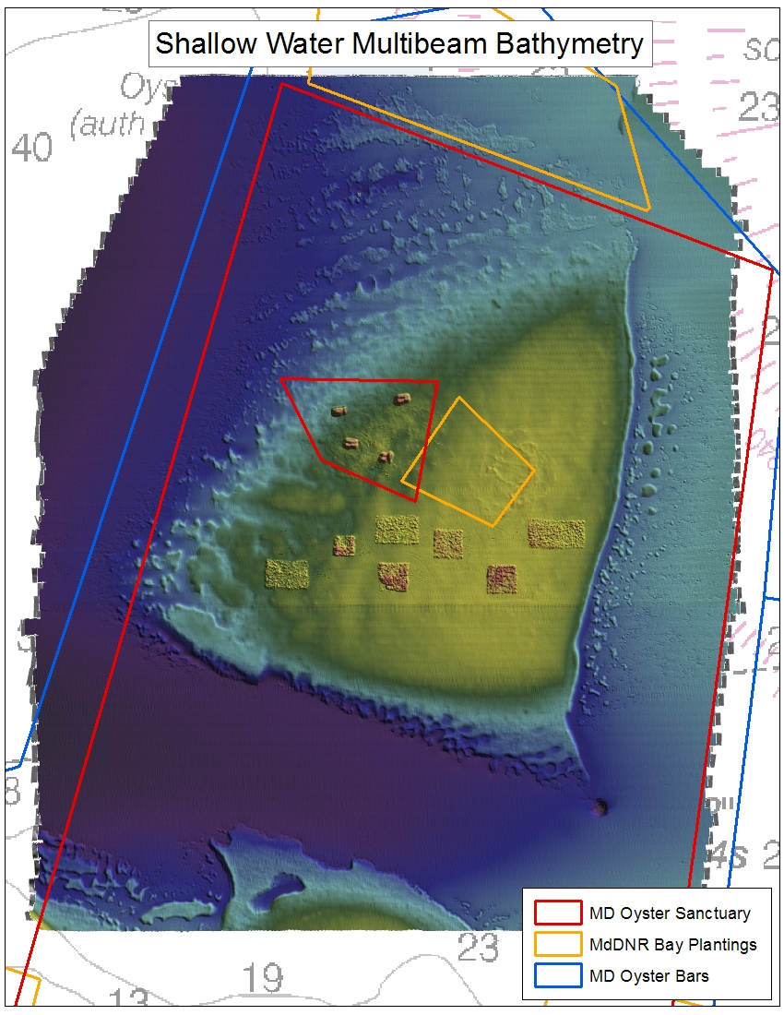
Notes:
Cook Point Oyster Bar, Choptank River
Demonstration of our data from multi-beam sonar

Slide 12
Integrated Habitat Assessment
Pre- and Post-Restoration Habitat Assessment
Guiding information for oyster restoration
Synchronized with states, agencies to provide side-scan (broad), multi-beam (fine), video, and direct population assessments (spatially-explicit demographics) to support oyster restoration
Following consistent process to characterize bottom habitat
Present application is for guiding oyster reef restoration

Slide 13
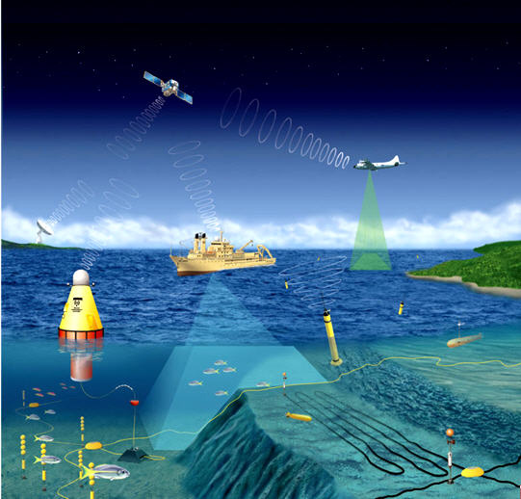
Design for Integrated Ocean
Observations: Not too far from
reality.
As we work,
We ask ourselves ‘Are we
making the best use of
our observatories? ‘

Slide 14
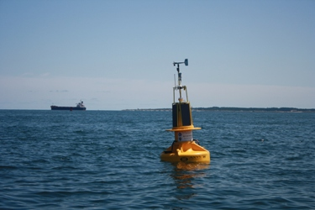
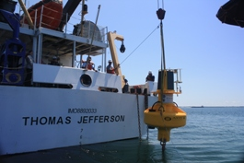
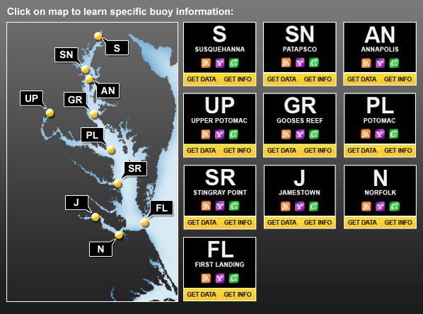
Launch of 10th and ‘final’ buoy in the array
Perhaps a shift from construction to
Synthesis and analysis.
Preparing methods to engage science community
as well as public to use buoy datasets

Slide 15
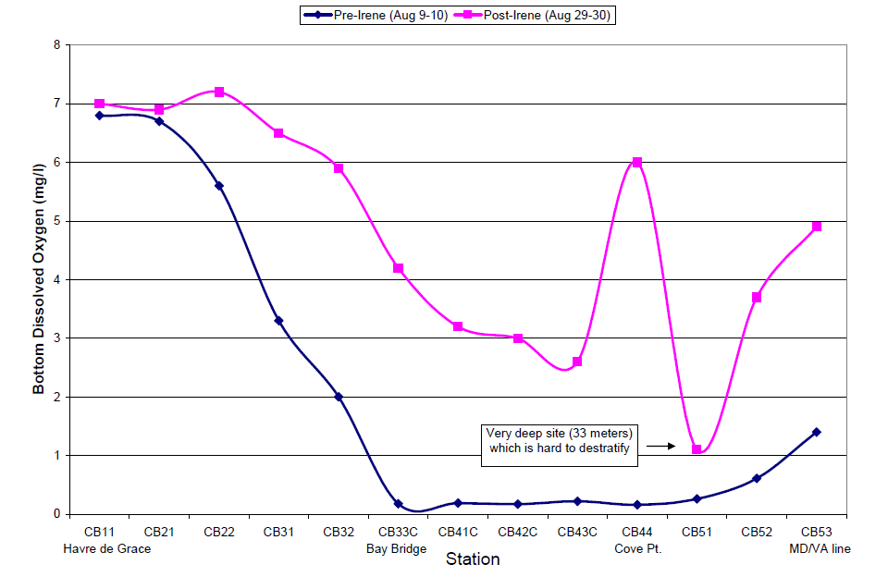
Example: DNR surveys are a consistent mainstay of observations invaluable to the
community

Slide 16
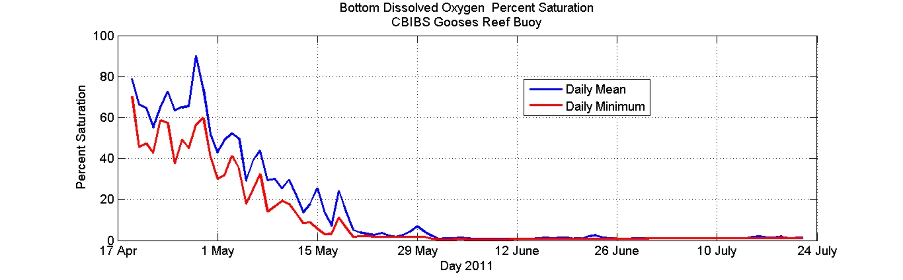
Starting to enjoy and utilize the benefits of continuous data streams for
hypoxia (above) and other key parameters throughout the season

Slide 17
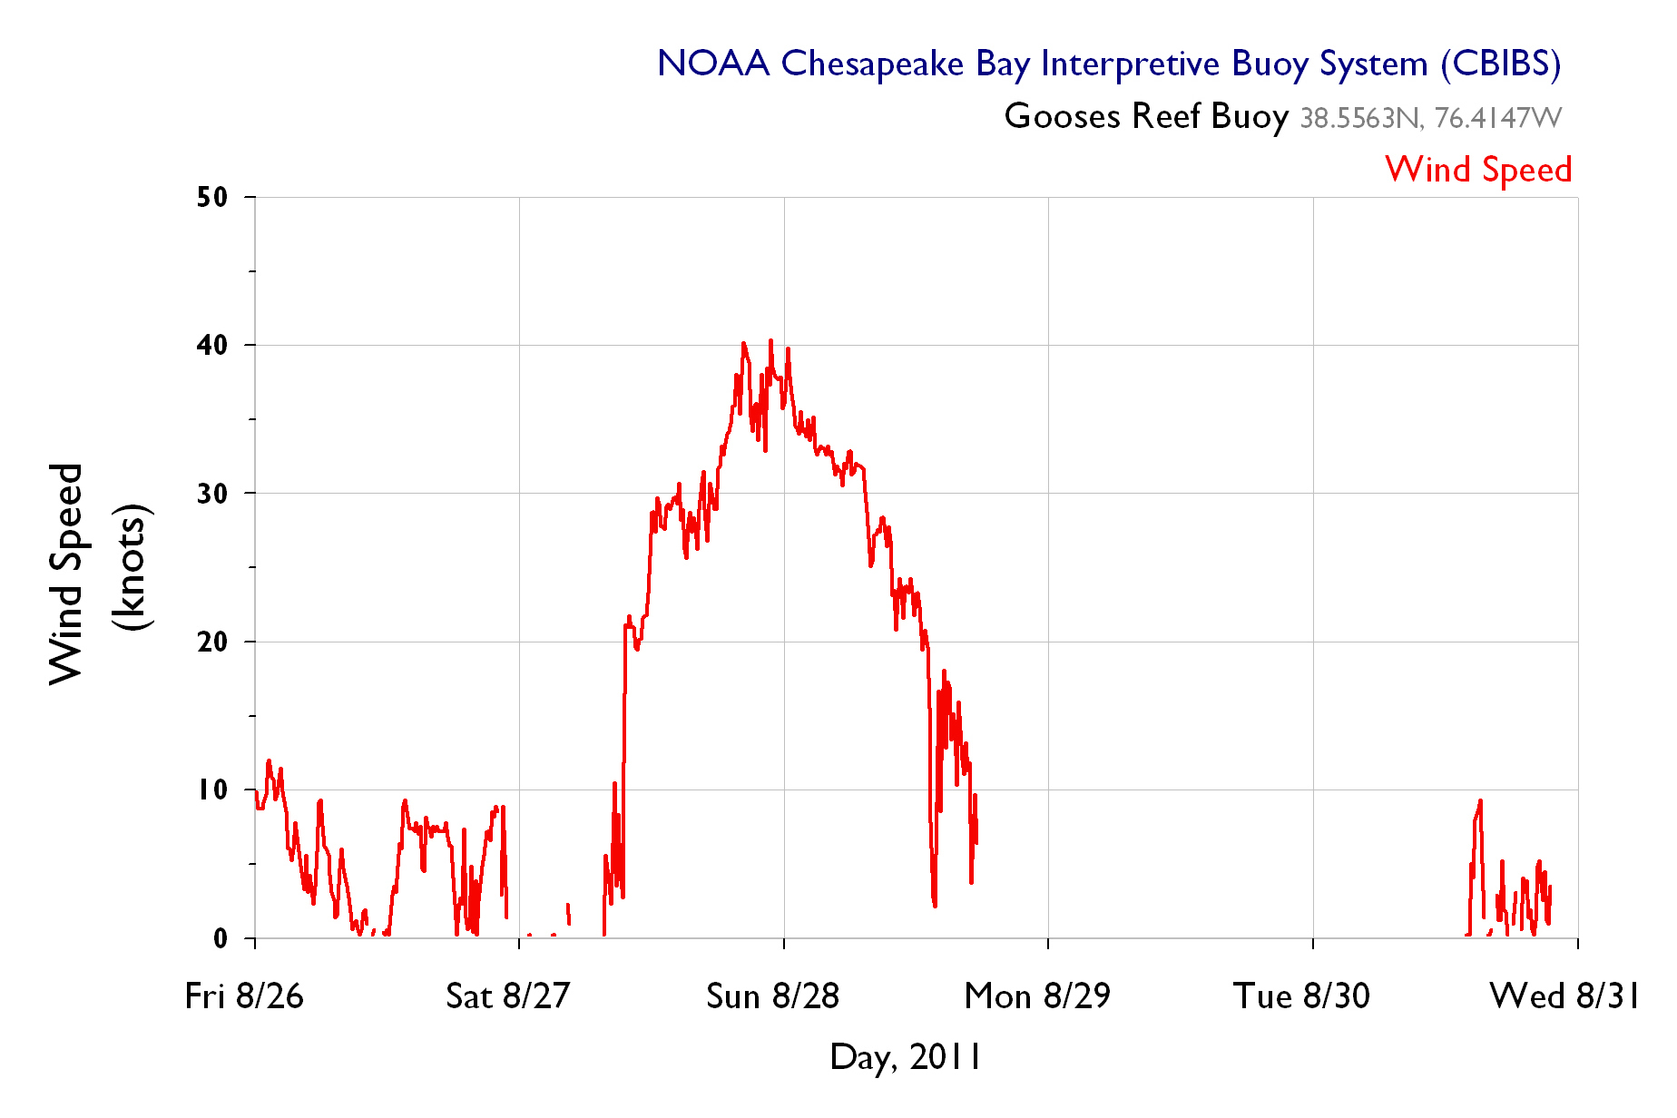

Slide 18
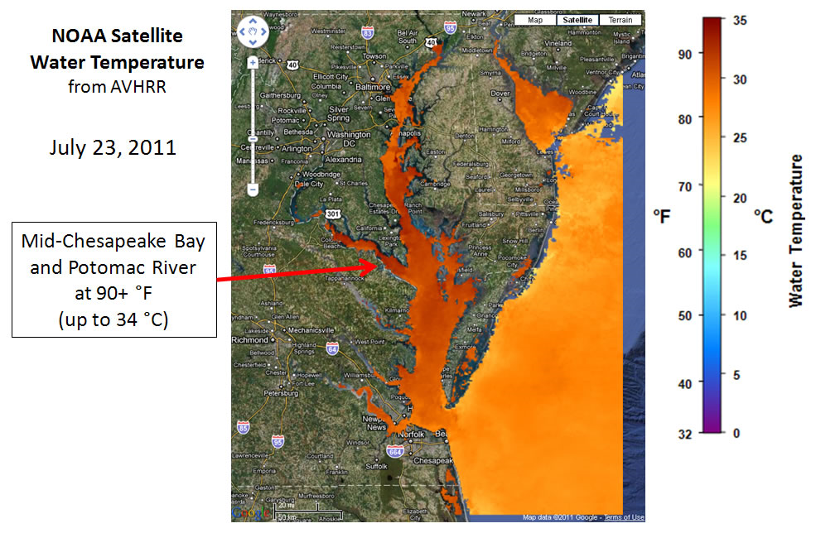

Slide 19
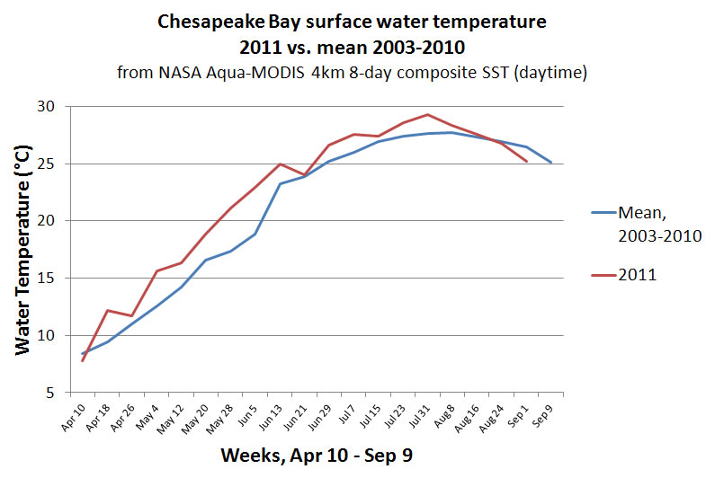
Moving toward expressing changes in Bay Conditions along with the best
baseline to provide anomaly detection. Year after year, our story should
become richer and richer.

Slide 20
Observations
Evolution
With the 10th buoy launched, no new stations are planned – attention to perfecting O&M, data streams
Satellites, buoys, in situ work used to analyze Bay conditions and publish to web, etc. as the season progressed (salinity, sediment, chl a, oxygen)
Maintained and expanded connections with other parts of NOAA, NASA to improve performance of satellite image products, in situ sampling

Slide 21
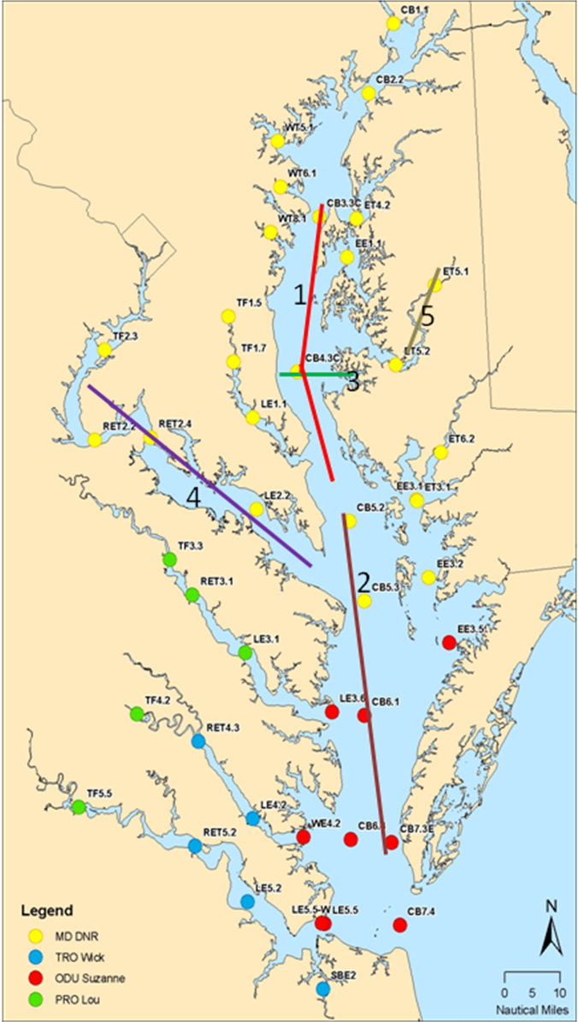
Parameters to be measured at each station include:
Instrument-based
CTD (yields temperature, salinity, depth), pH, chlorophyll, dissolved oxygen, and turbidity) – [NOAA and others]
Light spectra over the whole water column - hyperspectral -[NASA]
Water sample (bottle or pumped) -based
Nutrients [UMD]
Primary Production, Respiration [UMD]
Phytoplankton (algal) pigments, dissolved organic, carbon, particulate organic carbon [UMD, NASA]
Phytoplankton DNA, phytoplankton size spectra [UMD]
Source tracking with fluorescence indicators and stable isotopes.
Bacteria samples [UMD]
Net tow-based
Plankton collection with nets [UMD – HPL]

Slide 22
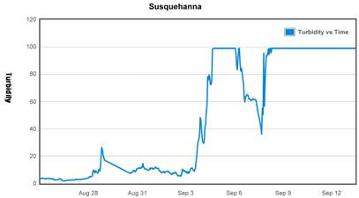

Slide 23
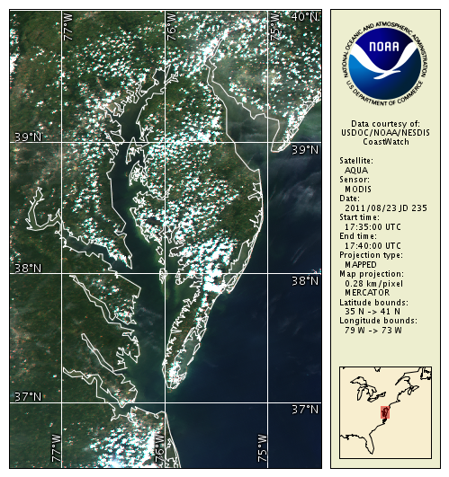

Slide 24
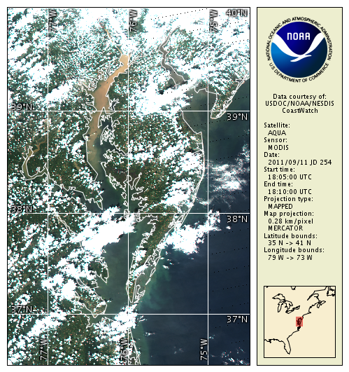

Slide 25
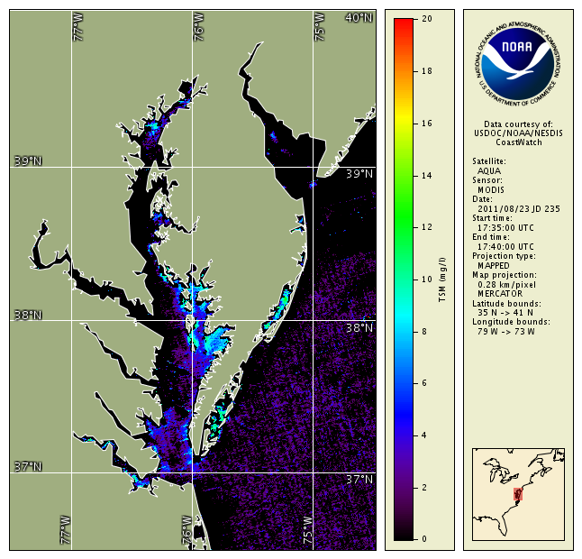

Slide 27
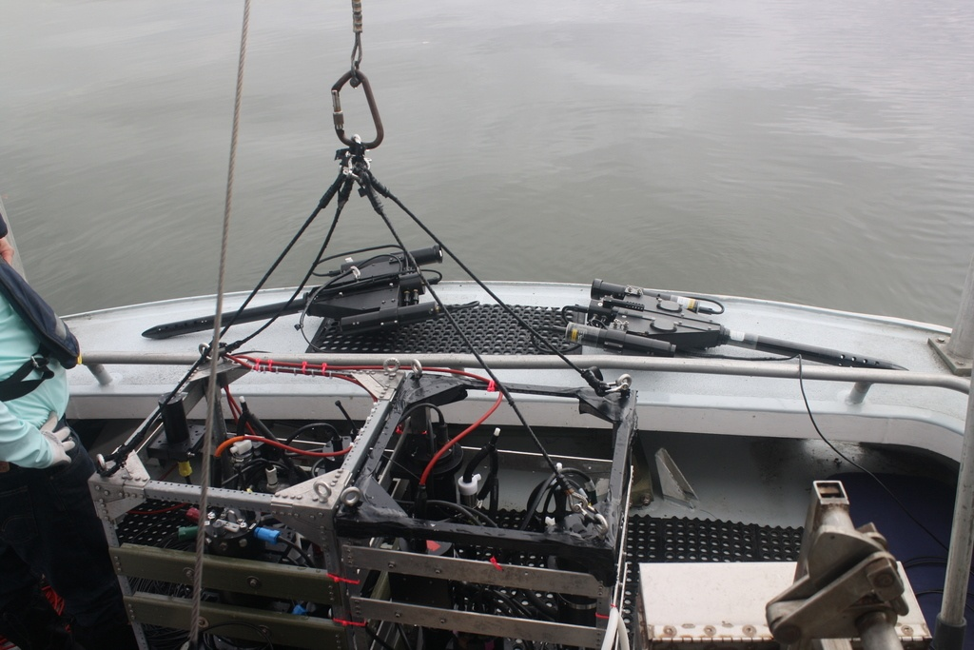

Slide 28
Future Efforts and Key Questions

Slide 29
Routine Updates to Bay Conditions
Future effort to synthesize
information on a regular effort
to describe changes in context.
temperature
salinity
chlorophyll
dissolved oxygen
turbidity
etc.
Shift to improve the ‘dialog’ with our stakeholders by adding a synthetic characterization
of conditions – the most basic (and realistic) step toward ecological forecasting

Slide 30
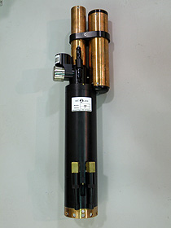
Synchrony in DO
With EPA, USGS, and
other partners NCBO
looks to integrate
continuous DO
measurements into
mainstream Bay indicators,
calculations.
linking non-tidal, tidal
systems
data integration under
CBP enterprise
Executive Order Goal 2012
Starting with DO and quickly moving to ancillary measurements and beyond, this effort
should be a step toward open interagency, cross-partner collaboration

Slide 31
Ecosystem-level thinking – oysters, etc.
Moving beyond simple pre-
restoration mapping and
into comparative studies/
analyses for oysters, etc.
Restored versus ‘un-restored’
Ecosystem services – ecological (processes) & human
interactions.
Scale
Relationship to fisheries
What works and why

Slide 32
The Gap – Chesapeake Bay Plankton
Restart the plankton survey
Update information for ecological thinking, models, connecting the primary productivity to upper trophic levels.
Getting at the impacts of changes in coastal oceanography we can now see clearly
Smart cruises – more comprehensive sampling for all partners
Genomic, microbial, phytoplankton, optics, jellyfish, jellyfish, jellyfish

Slide 33
The Gap – Chesapeake Bay Plankton
Some key questions need attention:
What is the management utility of a zooplankton survey throughout the Bay? – a clear articulation of the application to the management community - toward a business case.
How will the community ensure separate sample processing labs are being comparable?
Regional plankton processing center established
Survey design

Slide 34
Michael Ford
michael.ford@noaa.gov

