Slide 1
Chesapeake Bay Oyster Metrics Workgroup
Report Summary
Presented by
Mark Luckenbach
(with some apologies to the rest of the group)

Slide 2
Background
Executive Order 13508: Strategy for Protecting and Restoring the Chesapeake Bay Watershed
Oyster Outcome: Restore native oyster habitats and populations in 20 tributaries by 2025
Oyster Metrics Workgroup convened by Chesapeake Bay Program Sustainable Fisheries Goal Implementation Team

Slide 3
Charge to the workgroup:
The specific charge to the group was to:
to develop common bay-wide restoration goals, success metrics and monitoring and assessment protocols,
that include progress toward achieving a sustainable oyster population that ultimately will provide increased levels of ecosystem services.
However, we were to do this only for sanctuary reefs; our charge specifically excluded reefs under other forms of management and fisheries-specific metrics.

Slide 4
Workgroup composition
NOAA Restoration Center, Stephanie Westby (Chair)
Maryland Department of Natural Resources, Eric Weissberger
Maryland Oyster Recovery Partnership, Steve Allen
Potomac River Fisheries Commission, A.C. Carpenter
Virginia Marine Resources Commission, James Wesson
U. S. Army Corps of Engineers, Angela Sowers
University of Maryland, Kennedy Paynter
Virginia Institute of Marine Science, Mark Luckenbach

Slide 5
Setting Goals or Targets
The oyster populations in the Bay have undergone a dramatic regime shift.
Oyster Population or
Ecological Function
Overarching goal: Restore a large oyster population, capable of supporting a sustainable fishery and providing valued ecosystem services throughout much of the Bay.
Conditions
Implicit in the goal of restoring 20 tributaries is the notion that working on a tributary scale will be necessary to achieve sufficiently large changes in oyster populations.
Seems like a good idea.
However, it is untested and not entirely consistent with existing data.
Notes:
The crucial fact remains, however, that oyster populations in the Bay have undergone a dramatic regime shift over the past half century and that high natural mortality rates associated with disease, predation and siltation, along with negative shell budgets in many areas, pose significant challenges to achieving a greatly expanded oyster population.

Slide 6
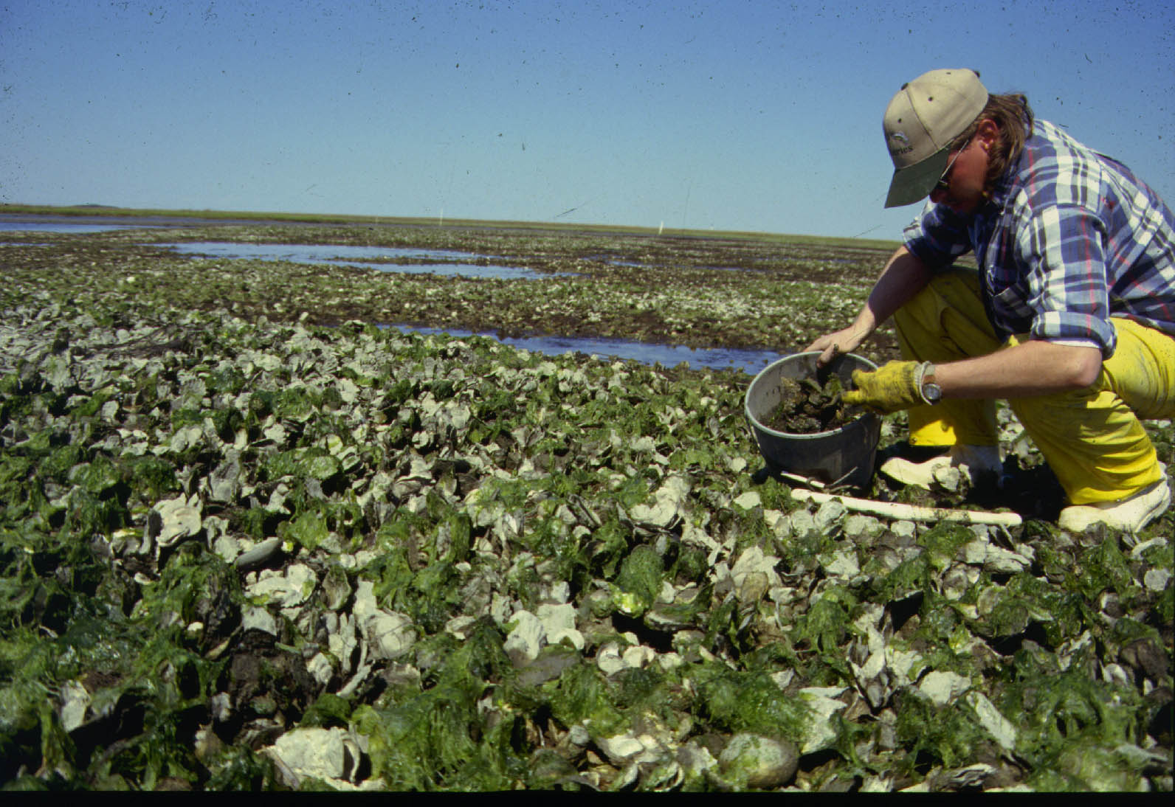
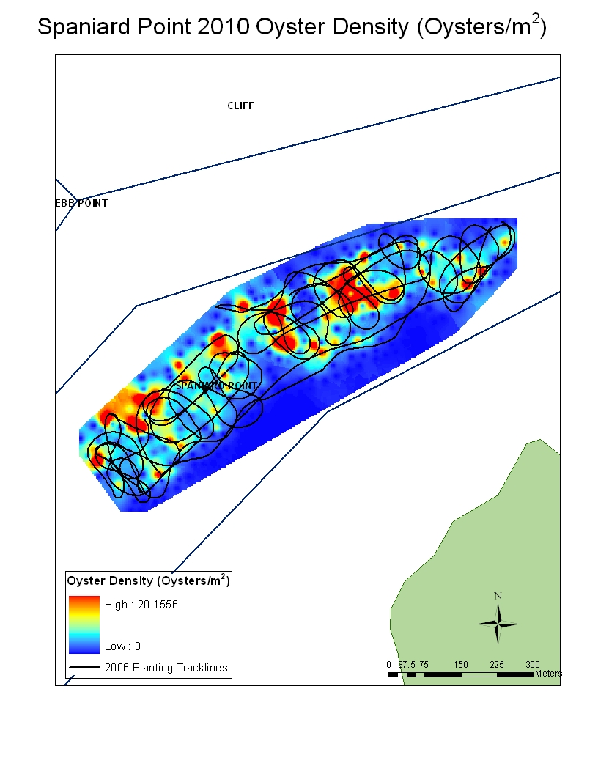
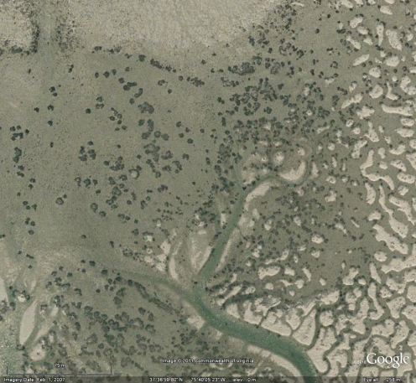
What constitutes a restored reef?
How many oysters?
What size oysters?
How many year classes?
How long must it persist?
How much of the bar must be covered in oysters?
We know this value cannot be 100%, but how much should it be?

Slide 7
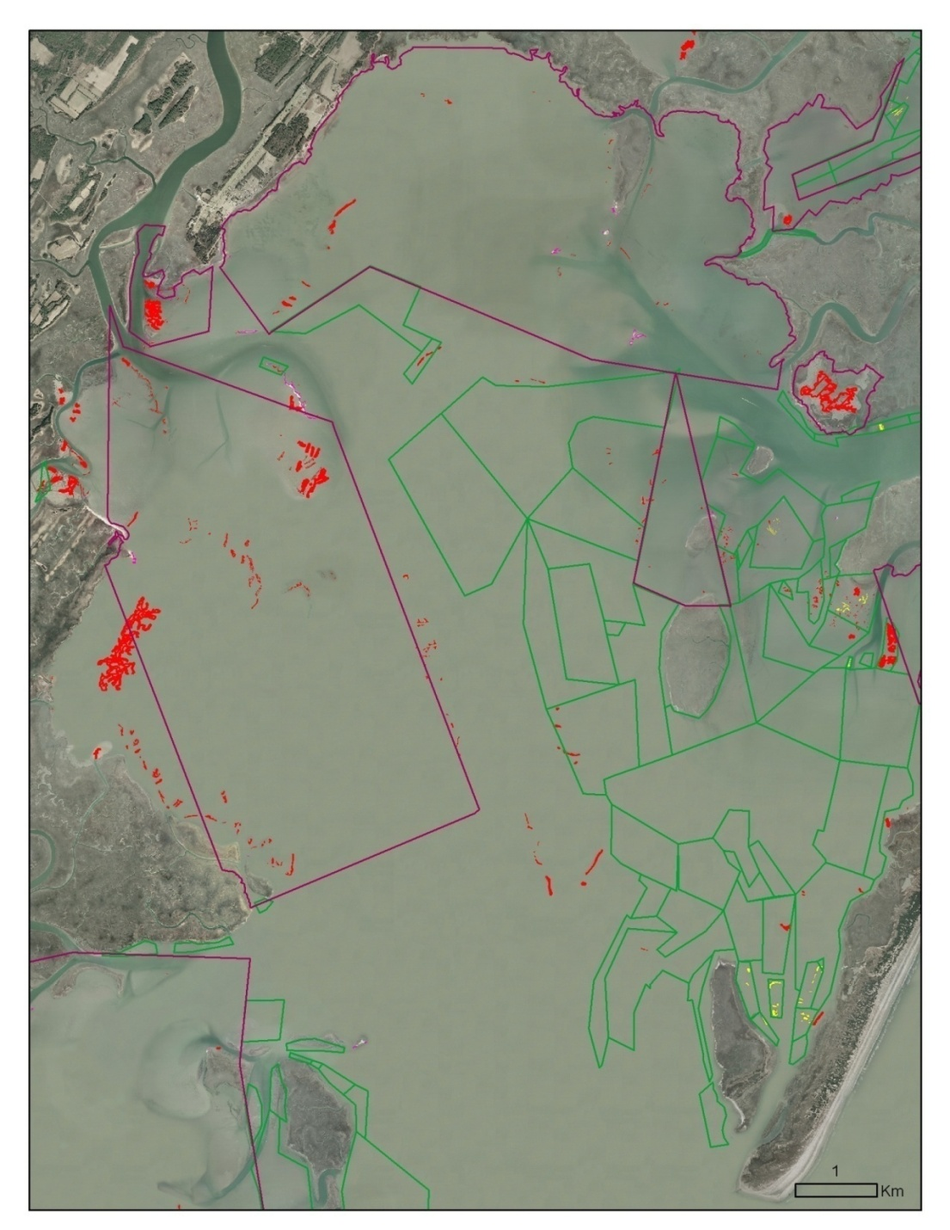
What constitutes a restored tributary?
Contains a restored reef or two?
A given percentage of historical oyster bars has been restored?
We’ve done all we can do?
Or, does it mean that we have actually affected a state change and that oyster populations have been restored to historical abundances in that tributary?

Slide 8
What is the timeframe for judging success?
Months, years, decades?
In the lower Bay recruitment varies dramatically from year-to-year. So, does disease pressure.
In tributaries where hatchery oysters are used for restoration, how long do we wait to observe enhanced natural recruitment?
The difficulty here is that true success can only be judged over longer periods of time, but shorter-term assessments are required.

Slide 9
Functional vs Operational Goals?
The ultimate goals of oyster restoration are functional
- a greatly enhanced oyster population
- increased ecosystem services
- a sustainable fishery
Practical constraints of oyster restoration require that we define operational goals
- how much shell or spat-on-shell to plant in an area
- how many reefs in an tributary
- oyster abundance after a few years
How well the operational goals work to meet the functional goals will have to be evaluated over time.
Notes:
Meeting operational targets does not, of course, ensure functional success of the restoration. The reality exists, however, that it may not be possible to determine functional success until several years after the initial restoration activity. The ultimate goal of restoring a reef is that it will persist as part of a larger self-sustaining population, with new substrate accruing or keeping pace with shell loss and providing desired ecosystem services.

Slide 10
Reef level targets
A firm basis for establishing density and age structure targets is lacking.
The workgroup tentatively recommends that a density of 50 adult oysters/m² and 50 grams dry weight /m² containing at least 2 year classes, and covering at least 30% of the reef area provides a reasonable operational target for reef-level restoration.
The workgroup recommends a minimum threshold for a successful reef as 15 grams dry weight/m² containing at least two year classes, and covering a minimum 30% of the reef area.
Notes:
However, even reefs with much lower densities than this target may still be viable, provide some level of ecosystem services, and could serve as spat settlement substrate in out years. Thus, for the purpose of consistently tracking progress toward the E.O. goal

Slide 11
Tributary-level targets
We lack both a theoretical and empirical basis for determining the operational target that would achieve our functional goals.
The workgroup suggests that an operational target of restoring a 50 -100% of currently restorable oyster habitat represents a reasonable target for tributary-level restoration.
We recommend that this be pursued in tributaries for which currently restorable bottom minimally meets the ACOE targets related to the percent of historical bottom.
Notes:
We considered both Army Corps’ working goal of a percentage of historical Baylor or Yates grounds and the practical constraints of what bottom is restorable under current conditions.

Slide 12
Assessment protocols
We were charged with developing consistent, bay-wide monitoring and assessment protocols, but note that different restoration approaches can have different monitoring needs.
Our recommendations include quantitative estimates of oyster density, size and shell accretion/degradation.
- where current, high resolution maps of the bottom are available, a stratified random sampling scheme is most efficient (with respect to sample size; $$?)
- where not, a simple random sampling is equally as good, as long as a sufficient number of samples have been taken.

Slide 13
Assessment protocols
Minimally, assessments of the oysters on restored reefs should occur prior to restoration and at 1, 3 & 6 years post restoration.
Where possible, monitoring should be conducted to answer specific questions relevant to adaptive management decisions.

Slide 14
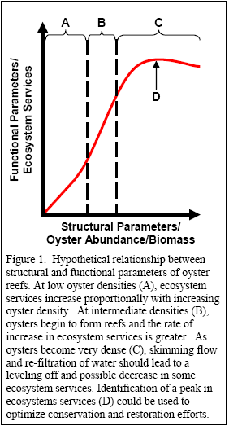
Assessment protocols
Assessing the ecological function and ecosystem services provided by restored oyster reefs should not be accomplished through monitoring other ecosystem components on the reef, but through the development of experimentally-derived relationships with oyster abundance or biomass.

Slide 15
Editorial comments (Luckenbach only)
The overall goal of “restoring” oyster populations in 20 tributaries by 2025 is a political, not a science-based, goal.
2. The concept that sufficient restoration within a tributary can result in a regime shift in the oyster population is a reasonable hypothesis, but it is untested.
The focus on sanctuary reefs alone in tributary-level restoration fails to take account of other actions that may affect recovery of wild populations, such as improved fisheries management and aquaculture. Moreover, the effects of sanctuary reefs will likely extend beyond the sanctuaries themselves.

Slide 16
Editorial comments (Luckenbach only)
4. The process worked. Genuine engagement by the agencies with a willingness to work through differences of mission and historical approaches yielded a very positive result.

