Slide 1
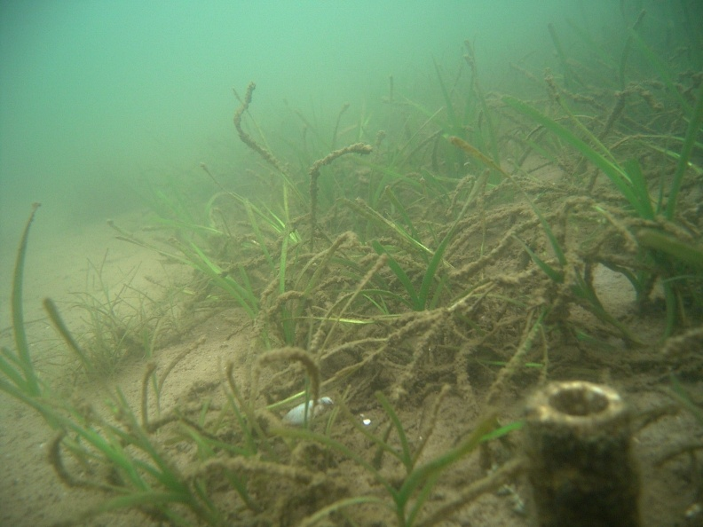
Evaluation of the Effectiveness of SAV Restoration Approaches in the Chesapeake Bay
Response to a program review requested of STAC by the SAV Workgroup
Lee Karrh
3/27/2012

Slide 2
Brief Background On Review
Baywide SAV goal of 185,000 acres
Primarily achieved through water quality improvements
Strategy to Accelerate the Protection and Restoration of Submerged Aquatic Vegetation in the Chesapeake Bay called for 1,000 acres of DIRECT restoration to augment or “kick-start” recovery

Slide 3
Brief programmatic results
We met 15% of our direct restoration goal (~150 acres) from 2003 to 2008
  No long-term survival in most areas
  Good survival in the Potomac, 2004 to 2010
  Some excellent long-term survival in areas from plantings prior to the 2003 to 2008 time
    James and York Rivers, 1990s to present
    Long Creek (near mouth of Back River, MD), 1998 to present
    Shallow Creek (near mouth of Patapsco River), 1999 to present

Slide 4
Request to STAC
The SAV workgroup requested a review through STAC, who established a Review Committee. STAC defined the following needs which were accepted by the RC:
Develop criteria to define successful direct SAV restoration over short- and long- timeframes.
Evaluate the effectiveness of direct restoration to accelerate SAV recovery and protection through activities like seeding and transplanting.
Provide guidance on the desirability of continuing to employ direct SAV restoration and, if appropriate, how to improve its cost-effectiveness, probability of success, and potential for improved scientific understanding

Slide 5
Members of the Review Panel
STAC Members:
Mark Luckenbach, Eastern Shore Laboratory, Virginia Institute of Marine Science
Lisa Wainger, Chesapeake Biological Laboratory, University of Maryland
Don Weller, Smithsonian Environmental Research Center, Smithsonian Institution
Non-STAC Members (RC):
Susan Bell, Department of Integrative Biology, University of South Florida
Mark Fonseca, National Ocean Service, NOAA
Ken Heck, Dauphin Island Sea Lab, University of South Alabama
Hilary Neckles, Patuxent Wildlife Research Center, USGS
Mike Smart, Research and Development Center, USACOE
Chris Pickerell, Cornell Cooperative Extension of Suffolk County

Slide 6
Evaluation of success was broken into different components
Operational success;
  Acres planted
Functional success
  Sustainability of restored beds
  SAV reproduction
  provision of fish and shellfish habitat
  water quality improvement capacity (e.g., filtering by seagrass) , and wave attenuation.
Programmatic success
  successful implementation of adaptive management
    knowledge gained from monitoring applied to management outcomes
    implementation of an iterative process that feeds this knowledge back into management decisions.

Slide 7
Results from RC
Operationally successful
  Acres planted commensurate with funding
Functionally UNsuccessful
  Majority of planted areas did not persist
    Exceptions in the James, York and Potomac Rivers
Programmatically a mixed bag
  A tremendous amount of knowledge was gained
  Some adaptive management applied
  Room for improvement in AM.

Slide 8
Recommendations
Discontinue efforts aimed at widespread direct restoration of SAV until environmental conditions improve
Continue targeted restoration efforts, both to establish viable beds and to further understand site selection criteria
Develop SAV restoration strategies that are responsive to climate change
Incorporate full adaptive management into restoration decision making
Build on the successful research into restoration techniques

Slide 9
SAV Workgroup Response
Yep

Slide 10
Ok, a little more detail
We concur with the RC’s findings using the “operational, functional and programmatic” evaluations
  We developed the capacity to perform restoration on the scale of 10’s of hectares per year
  There was low persistence in planted areas (<10% of sites), although there was some long-term (>5 years) persistence and expansion in a few locations
  The program produced numerous technical notes and peer-reviewed articles that defined how to improve large-scale SAV restoration and identified key research needs
    the SAVWG learned the difficulty in managing adaptively when it takes 3 to 5 years to assess success of restoration efforts whereas funding occurs on annual cycles

Slide 11
Outcomes from the Workgroup perspective
We feel that the below is a very relevant finding not only to our work, but to restoration in general
“Executive leadership and institutional structures should support iterations of restoration, evaluation, and learning that include flexibility to adjust restoration targets and reallocate efforts and funds as knowledge is gained.”
This level of support was lacking in our original efforts, the short duration of funding didn’t allow for “closing the loop” on adaptive management or to transfer knowledge gained to other species

Slide 12
Outcomes continued, knowledge needs ID’ed by the review
Identifying the synergistic and cumulative effects on SAV of multiple stressors (temperature, salinity, turbidity, dissolved oxygen, sediments, waves and currents)
Quantifying SAV response to extreme events and habitat conditions
Determining SAV response to climate change
Developing SAV habitat requirements specific to restoration, by species and planting unit type (seed, whole plant, other propagule)
Examine the feedback effects of existing beds on physical and chemical SAV growth conditions

Slide 13
Research Agenda framework
“SWEET SPOT” provides;
Understanding why beds persist over time
Opportunities for direct restoration OR
Explains the end of life as we know it
This drives the
ecosystem services
that SAV can provide

Slide 14
To break it out into specific research topics
Multiple Stressors/Facilitators
  SAV community had made a stab at this with the “Percent Light at Leaf” model which incorporated multiple water quality parameters
  What are other synergistic parameters?
    e.g. Temperature/turbidity/DO on eelgrass
    Shoreline/watershed impacts
    Freshets (increase turbidity, but can encourage germination (Ailstock))

Slide 15
Extreme events
  Most of our habitat requirements have dealt with chronic water quality conditions during the growing season
  Develop thresholds for intensity and duration of extreme events
    How fresh is too fresh for how long
    Change “fresh” to “salty”, “hot”, “cold”, “turbid”
  Can we predict or assign a probability to an extreme event?
  Time-lags between the event and the biological response?
  Critical periods (i.e TS Agnes in June, TS Lee in September)
Influence of Global Change on these stressors (all the above; chronic, multiple and acute)
    Heat bad for eelgrass, good for others?
    Who is favored with inundation?

Slide 16
From the above, we hope to get to refined habitat requirements for SAV
  Explain observed patterns in abundance and communities
  Use in siting restoration projects
    Physical habitat
    Water quality
    Difference between “Persistence habitat requirements” and “Restoration habitat requirements”
    Influence of seed banks
    Successional processes in restored beds

Slide 17
Quantify the ecosystem services provided by SAV (not part of the review conclusions)
  TMDL implications
  Fisheries/wildlife benefits
  Biogeochemical Processes
    What happens to the biogeochemistry of an area when you gain (e. g. The Flats) or lose (Tangier Sound) SAV

