Slide 1

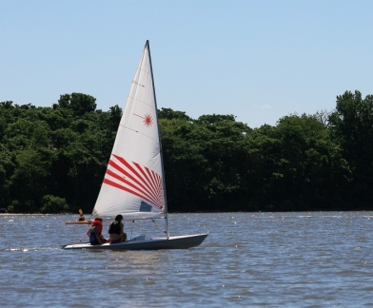
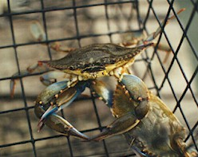
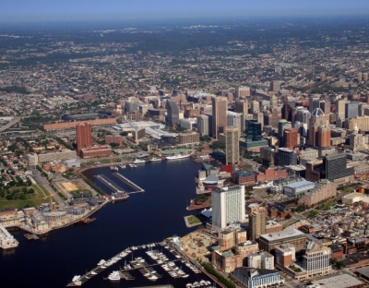
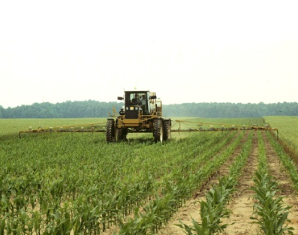
Social Science Research and Chesapeake Bay Restoration: Workshop Report
Social Science Workshop Steering Committee

Slide 2
Workshop Goals
The objective of the workshop was to identify priority needs for social science research to meet Chesapeake Bay restoration goals.
Recognition that 1) human dimensions need to be better integrated into efforts to restore ecosystem function, reduce pollution, and manage the sustainable use of natural resources, and 2) our understanding of the impacts of these human dimensions on restoration requires a combination of social science approaches.

Slide 3
Phase 1: Self Study
Characterize the social, political, cultural value (both qualitative and quantitative) of ecosystem services.
Behavior change research. (Motives and obstacles to attitudes of protection and restoration, and to individual behavior change; By sector, stakeholder group, etc.)
Need to educate and inform what the social sciences can do to help Bay restoration. Need to build a constituency for social science research (thus we need to understand what users think social science research can do); little understanding of what different social sciences can provide that is useful for Bay restoration.

Slide 4



Phase II: CBP_TheInterview Process
12 key-informants
3 interviewers
45 – 60min semi-structured interviews
8 questions
30 pages of notes
1 qualitative data analysis program

Slide 5
What questions were asked?
Date, name, current position/occupation?
How many years involved in Chesapeake Bay restoration work?
Do you have examples of how social science research has played an important role in advancing Bay restoration? Do you have any examples that are not Chesapeake Bay related?
In your opinion, what Bay restoration priorities should be addressed from a social science perspective? Why is the social science perspective important?
What do you think are the constraints to generating and utilizing more social science research in Bay restoration efforts?
Any other thoughts or suggestions on the role of social science research in supporting Bay restoration?

Slide 6
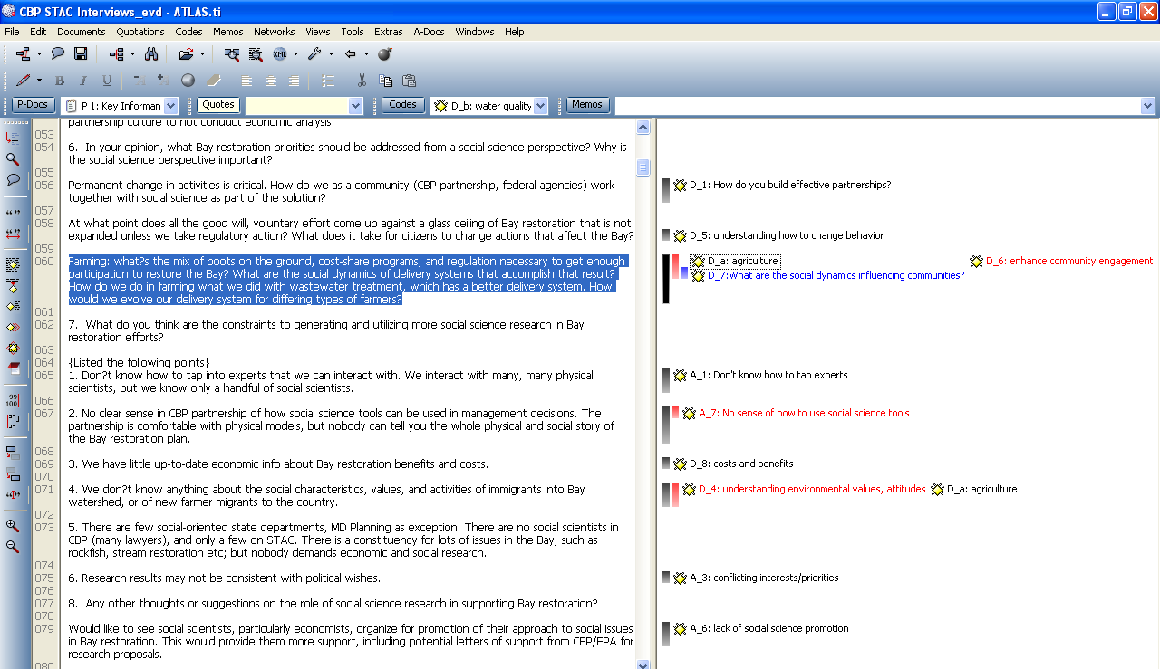
A Sample of Atlas.ti Coding

Slide 7
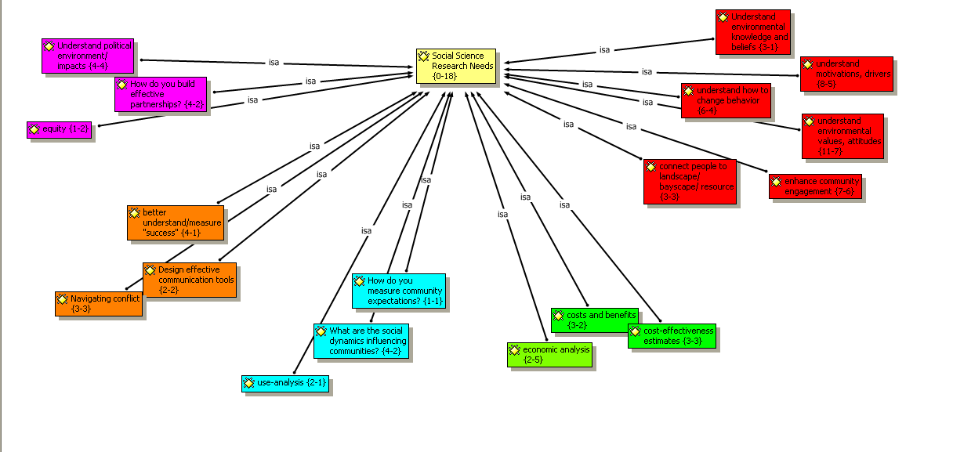
Results: Social Science Research Needs
Behavior Change Research

Slide 8
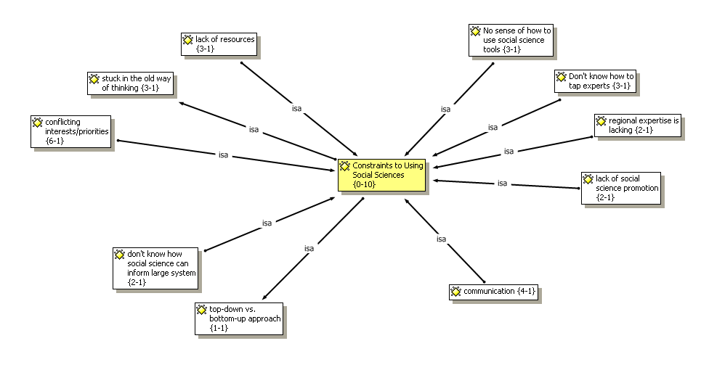
Results: Constraints
Lack of access to tools and Research

Slide 9
Phase III: March 10th Workshop
Well attended: 70 participants
Results of CBP Key Informant Interviews
Panel 1: Social Science and Understanding Individual Behavior Change
Panel 2: Social Science and Understanding Group, Community & Organization Change
Break out Groups:
short list of participant-derived questions from morning panels
identify a programmatic problem and determine how social sciences can and should be incorporated to enhance identified program or policy.
identify related high priority social science research needs.
identify short, intermediate, and long-term goals for integrating social science research into Chesapeake Bay restoration programs and policies.

Slide 10
Group B Output
Management Problems/Challenges:
Need widespread behavior change
CBP GITS need effective management structures/networks/decision-making tools
Regulatory vs. cooperative/voluntary approaches to achieve goals
How can social science inform the paths of least resistance (or most effectiveness) to activate goals?
Need social science monitoring strategy to inform strategies
Management steps/action items:
Produce guidance for CBP management team on social science
Apply economic models/case studies to blue crab management challenges
Increase capacity of social science in CBP decision making process
How can social science design policies
Next Steps:
Focus on how existing knowledge can inform policy/programs to increase effectiveness
Define an issue, bring in social science team, develop strategy, implement it!
Social science review and comment of WIPs

Slide 11
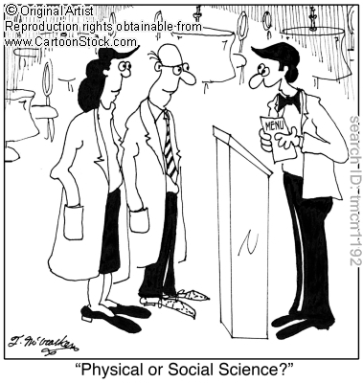
Thanks!

