Slide 1

Climate Change & Chesapeake Bay
A STAC Workshop Report

Slide 2
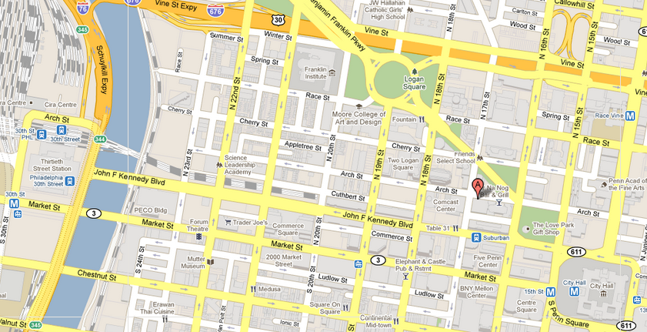
STAC Workshop
March 15-16th, EPA Region 3 Offices
1650 Arch Street, Philadelphia, PA
33 core participants

Slide 3
Steering Committee
Chris Pyke (US Green Building Council)
Kevin Sellner (Chesapeake Research Consortium)
Marel Raub (Chesapeake Bay Commission), Denice Wardrop (Pennsylvania State University)
Raymond Najjar (Pennsylvania State University)
Skip Stiles (Wetlands Watch)
Mark Bennett (USGS)
Matthew Johnston (Chesapeake Research Consortium)

Slide 4
Purpose & Scope
STAC has repeatedly identified the need to consider climate change in the operations and decision-making processes of the Partnership
Little tangible progress has occurred (despite high-level gains)
STAC convened the workshop to envision an effective, state-of-the-art response to climate change

Slide 5
2006 Initial (informal) request from the Bay Program
2008 Climate Change and Chesapeake Bay report
2010 Najjar et al. Updated literature review
2009 Interim STAC climate change workshop
2011 STAC climate change workshop, Philadelphia, PA

Slide 6
Speakers
Jim McElfish (ELI)
Todd La Porte (GMU)
Scott Phillips (USGS)
Skip Stiles (Wetlands Watch)
Glen Abrams (City of Philadelphia)
Zoe Johnson (MD DNR)
Chris Pyke (USGBC)
Debra Ballen (IBHS)
Joe Manko (PENNVEST)
Denice Wardrop (PSU)
Susan Julis (PSU)
Lewis Linker (EPA)
Dana Dolan (GMU)
Raymond Najjar (PSU)
Rich Batiuck (EPA)

Slide 7
Conclusions
Embed climate change in Bay Program decision making
Focus on solutions to specific problems
Identify and prioritize vulnerabilities and opportunities for adaptation
Build capacity
Research priorities

Slide 8
Next Steps
On-going:
PSU/USGS/EPA watershed modeling
Next:
Integrate with estuarine model
WIP-focused decision assessment
Develop professional education curriculum

Slide 9


