Slide 1
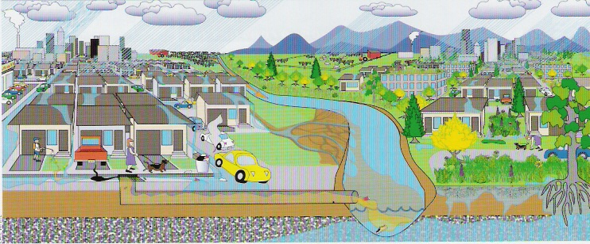
Exemplary Strategies to Protect and Restore Urban Watersheds: Preparing for the Chesapeake Bay TMDL and Watershed Implementation Plans
David Sample
Ted Graham
Chris Pyke
Rick Keister
Workshop Summary
Presentation to the
Chesapeake Bay STAC
Meeting, June 7-8, 2011
Source: http://myecoproject.org/get-involved/pollution/stormwater-runoff/.

Slide 2
Top 10 Questions from Workshop
What authority do you use in your SW programs?
What is your viewpoint with respect to the Bay nutrient TMDL?
What has been your experience with local (non Bay) TMDLs?
How is your program funded?
What is the extent of planned retrofit activity?
What critical needs exist for your program to survive/thrive?
Where do you see the program going in the next 10 years?
How important is the local political climate in building effective programs?
What role should local elected officials play in implementing new requirements or new programs?
What are the most significant barriers to overcome in order to get public acceptance for strong and innovative stormwater management programs?

Slide 3
Major Findings/Discussion Results

Slide 4
Specific Recommendations
Much interest in continued work in areas:
  Identify “economies of scale” in LID implementation
  Issues of BMP failure and maintenance are related, more data needs to be collected and analyzed
  Identify strategies that create successful stormwater management programs AND identify barriers to these
  Create a “Chesapeake Bay for Idiots” series of educational opportunities (CAC)
Actively participate in Phase II WIP process
Continued STAC-LGAC workshops

Slide 5
Short Term Next Steps
Potential Workshops/Research Areas:
Connecting Bay TMDL, Local TMDLs, Phase II WIPs, MS4 Permits and Local Watershed Plans
Retrofitting LID and ESD into Ultra-Urban Areas, monitoring effectiveness
Economics of Stormwater Management
  Investigating Operation and Maintenance Requirements and Costs for LID & ESD
  What are the secondary (non water quality) benefits of LID and ESD?
Using watershed models (scale?) to equitably assign wasteload allocations (WLAs) for MS4s

Slide 6
Long Term Next Steps
Potential Workshops/Research Areas:
The other side of “cost-effectiveness”: Can stormwater management improve and maintain water quality and or help meet standards?
Developing sustainable funding and implementation pathway for watershed protection in suburban settings
Use of stormwater monitoring as part of an adaptive management strategy for local governments
Anticipating climate change impacts in local stormwater management programs
Upcoming (non STAC) workshop: Improving SW BMP selection: Making decisions under uncertainty, June 28, 2011, MWCOG (Mid Atlantic Water Program)

