Slide 1
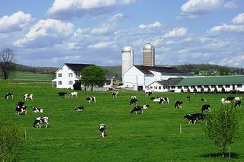
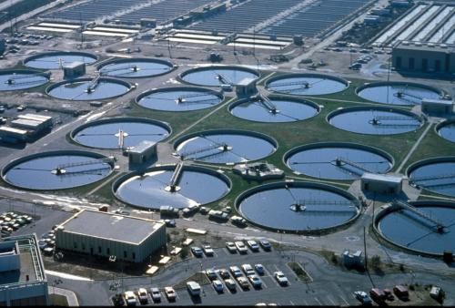
A Multistate Water Quality Trading Tool for the
Chesapeake Bay
Mindy Selman
STAC
June 7, 2011

Slide 2
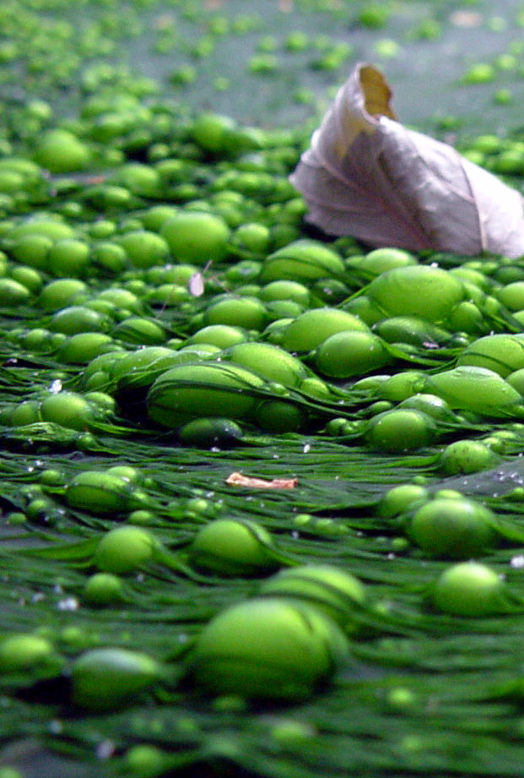
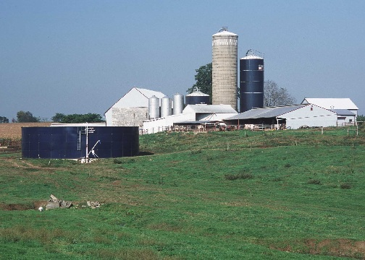
Goal
Build a single multistate WQT platform (NutrietnNet) that will accommodate:
Interstate trading
Unique elements of state programs

Slide 3
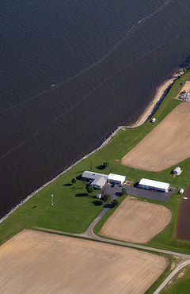
Benefits
Align infrastructure
Facilitate trades
Standard basis for determining credits
Facilitate updates

Slide 4
Tool Components
Multistate registry
Marketplace
Farm Profit Calculator
Calculation tool that integrates NTT
Interactive farm-level mapping

Slide 5
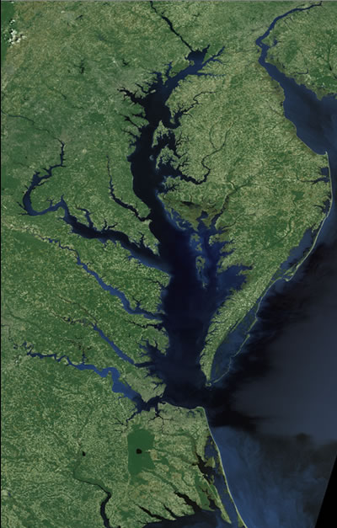
Development Challenges
State programs in flux (WV and VA)
No state program (DE)
Accomodating different state approaches
  e.g. baseline (practice vs. performance)
Vision of Interstate trading

Slide 6
Challenges to Reciprocity
Trading ratios
Baselines
  Stringency
Certification/Verification
Types of projects credited (e.g. manure export)

Slide 7
Project Implications
Certainty programs
  Use tool to assess baseline conditions
National NTT application
  Ecosystem markets
  Conservation programs

Slide 8

Thank You
Mindy Selman mindy.selman@wri.org

