Slide 1
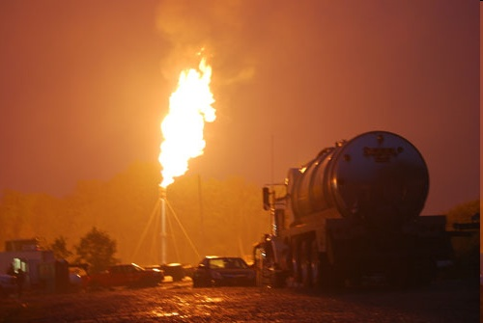

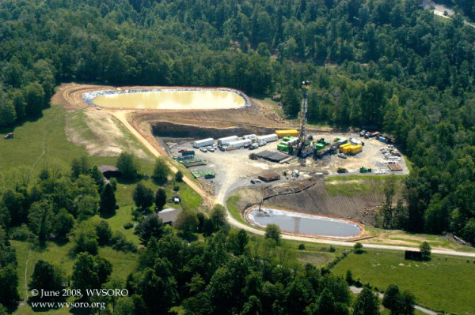
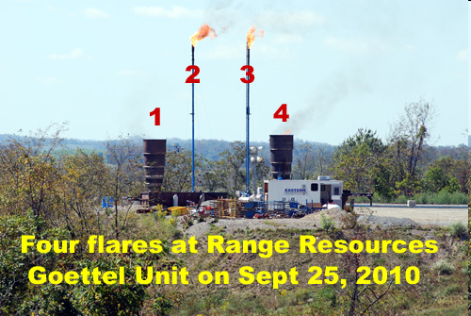
Greenhouse Gas Emissions from Shale Gas: Is this a “Clean” Fuel?
Bob Howarth
Cornell University
Scientific & Technical Advisory Committee
Chesapeake Bay Program
Annapolis, MD
June 8, 2011

Slide 2
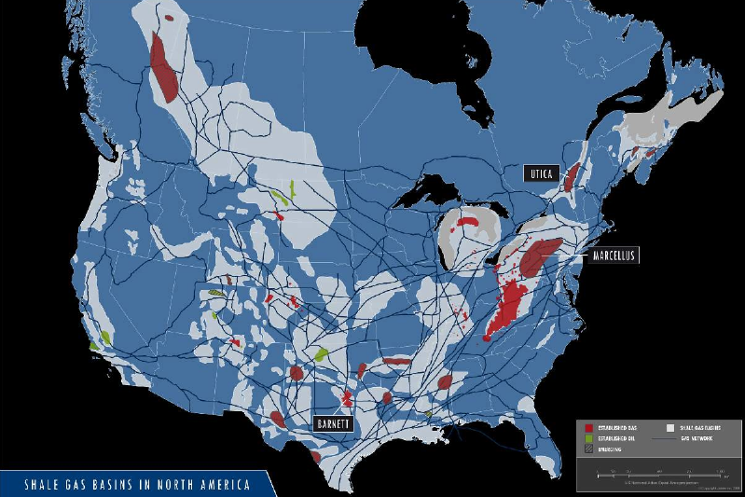
Shales hold a lot of natural gas (methane), but very dispersed, not economical using traditional technology…… Within last 4-13 years, horizontal drilling and high-volume, slick-water hydraulic fracturing (“hydrofracking”).
Source: JUNEX -- http://www.searchanddiscovery.com/documents/2009/80073marcil/ndx_marcil.pdf

Slide 3
Unconventional extraction of gas from shale formations is new, and is being promoted globally by U.S. government and industry
Argentina
Australia
Canada
China
Denmark
Germany
India
Poland
South Africa

Slide 4
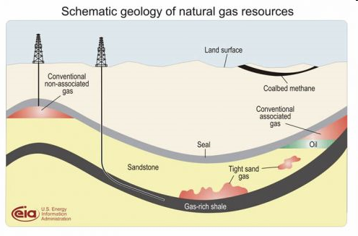

Slide 5
Hydraulic fracturing has been used to increase flows from conventional gas formations for decades….. But relatively small amounts of water used (< 300 m³).
Hydraulic fracturing for shale gas is new: past 13 years in Texas, past 3-4 years in Pennsylvania.
For hydraulic fracturing in shales, large volumes of fluid used for each well
(60,000 m³ and more).
Often have 6 to 16 lateral wells per each surface site (so up to 960,000 m³ of fluid per site).
Large volume and long horizontal wells require additives to reduce friction of the water (slick water). Additives also added to prop fractures open (“sand,” plastics), perforate well casing, prevent bacterial growth, and other purposes.
A large volume of hydrofracking fluids comes back to surface in first few weeks of drilling.

Slide 6
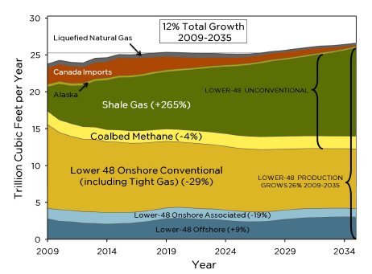
Predicted sources of natural gas for the United States
Hughes (2011), based on EIA/DOE annual energy outlook

Slide 7
“From a CO₂ emissions standpoint, [shale gas] is 60 percent cleaner than coal”
“60 Minutes” on CBS Television on November 14, 2010 made essentially same statement
Many others….

Slide 8
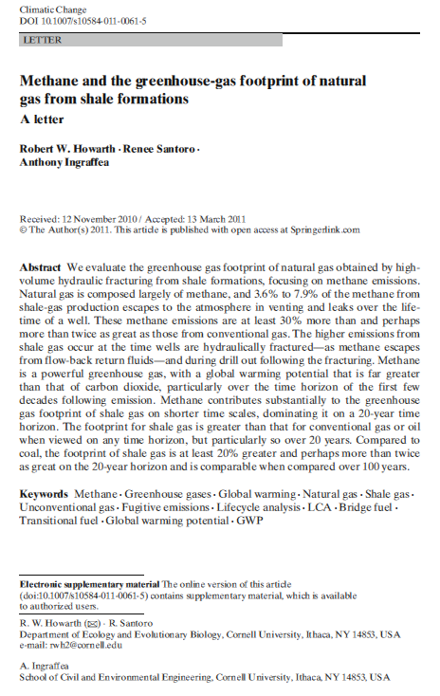

First comprehensive analysis of greenhouse gas emissions from shale gas (including non-peer-reviewed).
Published April 12, 2011.

Slide 9
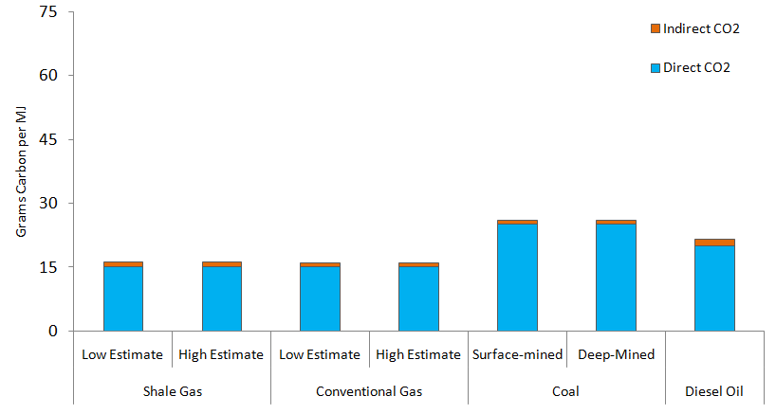
Direct carbon dioxide emissions during combustion of fossil fuels plus indirect carbon dioxide emissions
Howarth et al. (2011)

Slide 10
Methane emissions – the Achilles’ heel of shale gas
Natural gas is mostly methane.
Methane is 2nd most important gas behind human-increased global warming.
Methane is much more potent greenhouse gas than carbon dioxide, so even small leaks matter.

Slide 11
Methane is vented and leaked:
during initial flow-back period
routinely and continuously at the well site
during liquid unloading
during gas processing
during transmission, storage, and distribution

Slide 12
We used the best available data to estimate methane venting and leaks:
Peer-reviewed publications, when available.
EPA report from November 30, 2010.
GAO (2010) report.
American Petroleum Institute (2009) report.
archived PowerPoint presentations from EPA & industry, financial disclosure reports, etc.

Slide 13
Table 1. Methane emissions from flow-back fluids and initial production rates for 5 unconventional wells.
______________________________________________________________________________
Basin Methane Methane Initial gas Life-time Flow-back
emission during emission per production production emissions
flow-back day during upon well of well as % of (10³ m³) flow-back completion (10⁶ m³) life-time (10³ m³ d⁻¹) (10³ m³ d⁻¹) production
______________________________________________________________________________
Haynesville (LA) 6,800 680 640 210 3.2%
Barnett (TX) 370 41 37 35 1.1%
Piceance (CO) 710 79 57 55 1.3%
Uinta (UT) 255 51 42 40 0.6%
Den-Jules (CO) 140 12 11 ? ?
_______________________________________________________________________________
(Howarth et al. 2011)

Slide 14
Table 1. Methane emissions from flow-back fluids and initial production rates for 5 unconventional wells.
______________________________________________________________________________
Basin Methane Methane Initial gas Life-time Flow-back
emission during emission per production production emissions
flow-back day during upon well of well as % of (10³ m³) flow-back completion (10⁶ m³) life-time (10³ m³ d⁻¹) (10³ m³ d⁻¹) production
______________________________________________________________________________
Haynesville (LA) 6,800 680 640 210 3.2%
Barnett (TX) 370 41 37 35 1.1%
Piceance (CO) 710 79 57 55 1.3%
Uinta (UT) 255 51 42 40 0.6%
Den-Jules (CO) 140 12 11 ? ?
_______________________________________________________________________________
(Howarth et al. 2011)

Slide 15
Table 1. Methane emissions from flow-back fluids and initial production rates for 5 unconventional wells.
______________________________________________________________________________
Basin Methane Methane Initial gas Life-time Flow-back
emission during emission per production production emissions
flow-back day during upon well of well as % of (10³ m³) flow-back completion (10⁶ m³) life-time (10³ m³ d⁻¹) (10³ m³ d⁻¹) production
______________________________________________________________________________
Haynesville (LA) 6,800 680 640 210 3.2%
Barnett (TX) 370 41 37 35 1.1%
Piceance (CO) 710 79 57 55 1.3%
Uinta (UT) 255 51 42 40 0.6%
Den-Jules (CO) 140 12 11 ? ?
_______________________________________________________________________________
Limited data, poor documentation (Powerpoint slides from EPA workshops).
We have chosen to use the mean emission percentage of 1.6%
(Howarth et al. 2011)

Slide 16
Sources of methane leaks (as percentage of life-time total production):
Conventional Gas Shale Gas
Initial drilling & completion 0.01% 1.9%
1.6% from flow-back fluids, plus 0.3% from drill-out following hydraulic fracturing (0.6% equally likely, but we are being conservative).
Source: EPA (2010) plus numerous industry reports and presentation.

Slide 17
Sources of methane leaks (as percentage of life-time total production):
Conventional Gas Shale Gas
Initial drilling & completion 0.01% 1.9%
Routine leaks & emissions at well site 0.3 to 1.9% 0.3 to 1.9%
0.3% reflects use of best technology
Note that routine leaks and emissions occur continuously over 7-10 year life-time of the well, contrasting with the initial drilling and completion leaks that occur in just a few weeks.
Source for routine leaks and emissions at well = GAO (2010)

Slide 18
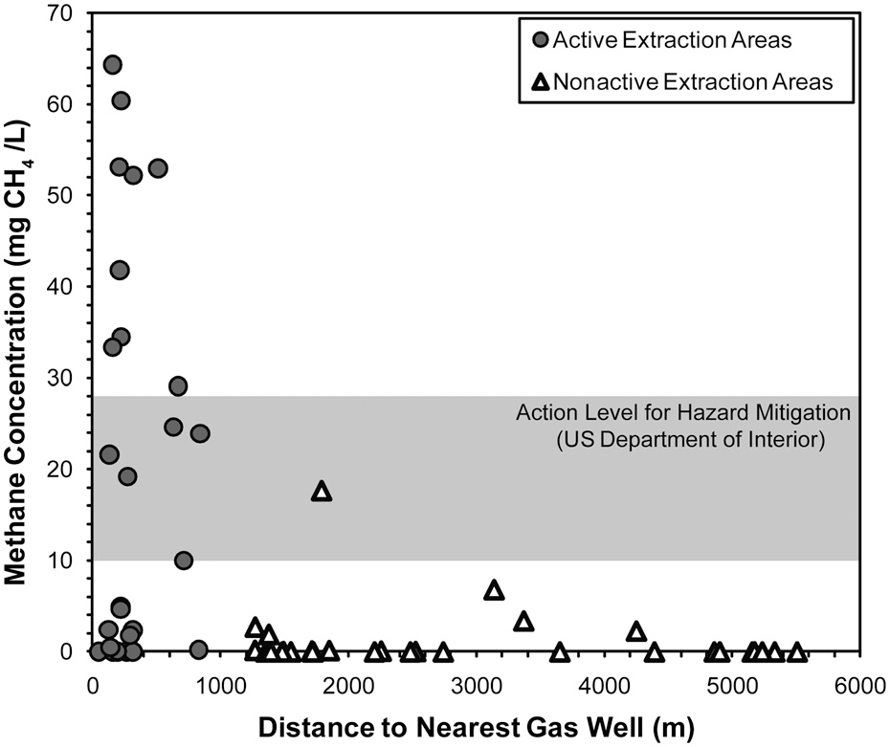
Osborn et al. (2011) – widespread methane contamination in drinking water wells near gaswells in Marcellus shale

Slide 19

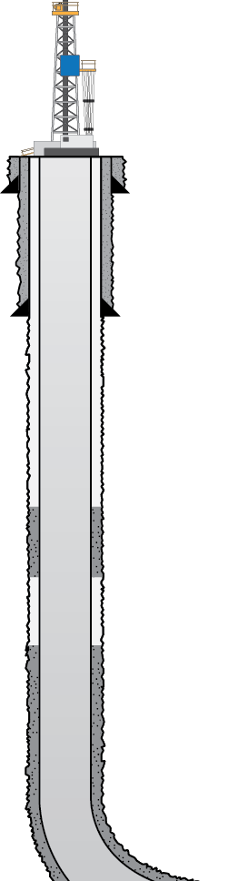


GOOD MECHANICAL INTEGRITY
CONDUCTOR PIPE
FRESH WATER AQUIFER ZONE
SURFACE CASING
PRODUCTION CASING
SHALLOW PRODUCING ZONE
INTERMEDIATE PRODUCING ZONE
TARGET PRODUCING ZONE

Slide 20

LEAK THROUGH CASING
CONDUCTOR PIPE
PRESSURE
BUILDS UP
FRESH WATER AQUIFER ZONE
SURFACE CASING
PRODUCTION CASING
FORMATION
CASING
SHALLOW PRODUCING ZONE
INTERMEDIATE PRODUCING ZONE
TARGET PRODUCING ZONE

Slide 21
Sources of methane leaks (as percentage of life-time total production):
Conventional Gas Shale Gas
Initial drilling & completion 0.01% 1.9%
Routine leaks & emissions at well site 0.3 to 1.9% 0.3 to 1.9%
Venting during liquid unloading 0 to 0.26% 0 to 0.26%
Emissions during gas processing 0 to 0.19% 0 to 0.19%
____________________________
TOTAL FOR PRODUCTION
& PROCESSING
0.31 to 2.4% 2.2 to 4.3%
1.8- to 7-fold more methane leakage from shale gas during development and processing

Slide 22
Sources of methane leaks (as percentage of life-time total production):
Conventional Gas Shale Gas
Initial drilling & completion 0.01% 1.9%
Routine leaks & emissions at well site 0.3 to 1.9% 0.3 to 1.9%
Venting during liquid unloading 0 to 0.26% 0 to 0.26%
Emissions during gas processing 0 to 0.19% 0 to 0.19%
____________________________
TOTAL FOR PRODUCTION
& PROCESSING
0.31 to 2.4% 2.2 to 4.3%
But, this is only part of the story, as the gas has to be delivered stored, transported, and distributed.

Slide 23
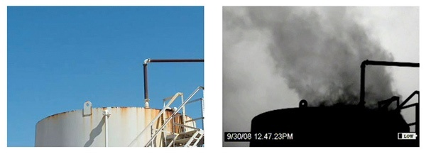
Methane (natural gas) leaks from tanks, pipelines, compressors, etc.
Naked eye
Infra-red (42)
Methane is not visible to naked eye, but can be “seen” with infra-red cameras.
23

Slide 24
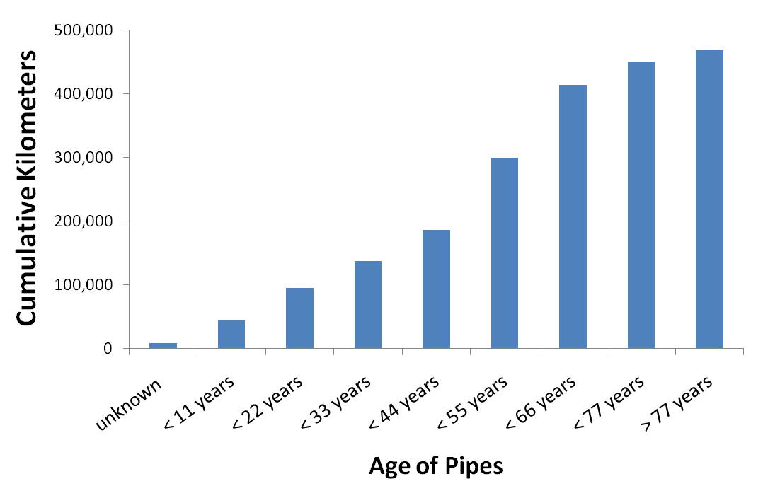
Half of the natural gas transmission pipelines in the US are more than half a century old
Sources: PHMSA 2009 Transmission Annual Data

Slide 25
Two approaches for estimating leakage during transmission, storage, and distribution
1) Direct measurements, based on measurements on Russian pipeline during last 10-15 years (Lelieveld et al. 2005 ), with extrapolations from EPA (1996) study = 1.4%

Slide 26
Two approaches for estimating leakage during transmission, storage, and distribution
1) Direct measurements, based on measurements on Russian pipeline during last 10-15 years (Lelieveld et al. 2005 ), with extrapolations from EPA (1996) study = 1.4%
2) “missing and unaccounted for gas,” based on range of values in Texas over past decade (Percival 2010) = mean value of 3.6%

Slide 27
Sources of methane leaks (as percentage of life-time total production):
Conventional Gas Shale Gas
Initial drilling & completion 0.01% 1.9%
Routine leaks & emissions at well site 0.3 to 1.9% 0.3 to 1.9%
Venting during liquid unloading 0 to 0.26% 0 to 0.26%
Emissions during gas processing 0 to 0.19% 0 to 0.19%
Transmission, storage, and 1.4 to 3.6% 1.4 to 3.6%
distribution ____________________________
Total 1.7 to 6.0% 3.6 to 7.9%

Slide 28

Urban infrastructure is old…. In Philadelphia, gas distribution pipes are 100 years old, made of un-welded iron pipe.
Gas leakage within the city is ~ 3%.
Chris Kimmerle, Executive Director, Philadelphia Gas Commission, pers. comm, April 19, 2011

Slide 29
How do our methane emission estimates compare with others from the peer-reviewed literature?

Slide 30
How do our methane emission estimates compare with others from the peer-reviewed literature?
There are no other peer-reviewed papers on methane emissions from shale gas….
The only current and credible report, from EPA on November 30, 2010, was not peer-reviewed. Our estimates are broadly consistent with this EPA report.

Slide 31
How do our methane emission estimates compare with others from the peer-reviewed literature?
2) We can compare our estimates for conventional gas with 2 other peer-reviewed papers
Howarth et al. (2011) = 1.7% to 6%
Hayhoe et al. (2002), “best estimate” = 3%
(range of 0.7% to 10%)
Jamarillo et al. (2007) = 1.1%
(based entirely on EPA 1996 report; in 2010, EPA greatly increased these estimates)

Slide 32
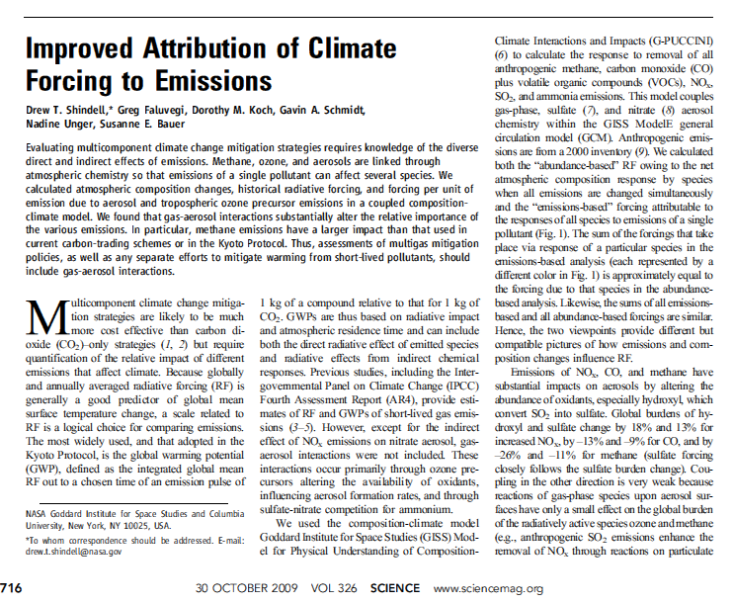
Methane is far greater in its global warming potential than is carbon dioxide
105-fold, compared over 20-year period following emission.
33-fold, compared over 100-year period following emission.

Slide 33
Converting methane to global warming potential equivalents, in terms of CO₂
IPCC (1995) considered only 100-year time frame;
GWP = 21
(used in all previous peer-reviewed studies, although Hayhoe et al. 2002 and Lelieveld et al. 2005 emphasized need for shorter horizons).
IPCC (2007); GWP for 100-year horizon = 25
GWP for 20-year horizon = 72
Shindell et al. (2009), Science: GWP for 100-year = 33
GWP for 20-year = 105

Slide 34
Greenhouse gas footprint of shale gas and other fossil fuels
(20-year analysis; methane given in CO2 equivalents,
assuming Global warming Potential = 105)
Grams carbon per MJ of energy
(Howarth et al. 2011)

Slide 35
Greenhouse gas footprint of shale gas and other fossil fuels
(100-year analysis; methane given in CO2 equivalents,
assuming Global warming Potential = 33)
Grams carbon per MJ of energy
(Howarth et al. 2011)

Slide 36
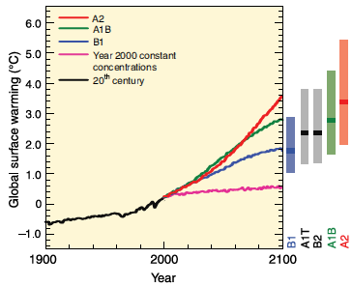
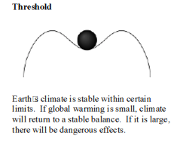
Existing models for global warming potential (GWP) of methane only support analysis at 20-year and 100-year integrated time scales.
Both are important. But shorter time focus critical to minimize likelihood of surpassing tipping points and moving climate system to some new, undesirable state.

Slide 37
20 year
Grams carbon per MJ of energy
100 year
Grams carbon per MJ of energy
(Howarth et al. 2011)

Slide 38
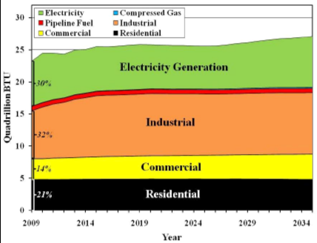
Only 30% of natural gas in the U.S. is used to generate electricity….
http://www.eia.doe.gov/forecasts/aeo/excel/aeotab_2.xls

Slide 39
Efficiency of use of natural gas for most uses (including transportation) is very similar to that of oil or coal.
For electricity, natural gas gains some efficiency over coal….
But even for electricity, GHG footprint for shale gas is similar to or worse than that for coal.
Emissions from generating electricity
(g C-CO₂ equivalents/kWatt-hr, 20-year integration)
Current average plant Best technology
Coal 280 220
Shale gas 320-560 270-460
(Hughes 2011)

Slide 40
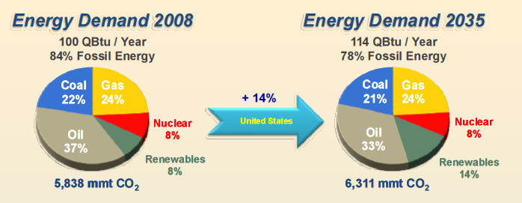
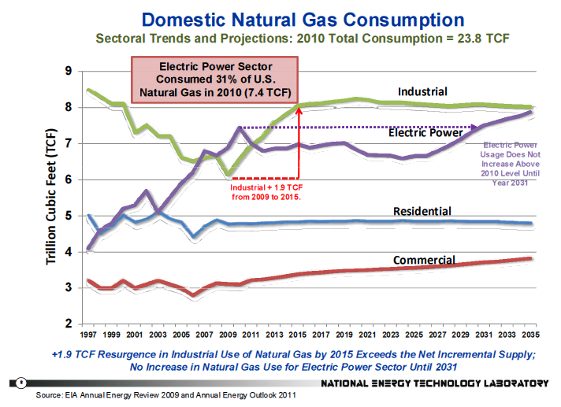
Very modest growth in use of both coal and natural gas predicted…. NOT replacement of coal by natural gas.
Annual Energy Outlook (2011) , Energy Information Agency, U.S. Department of Energy

Slide 41
How does natural gas fit into the national greenhouse gas inventory?

Slide 42
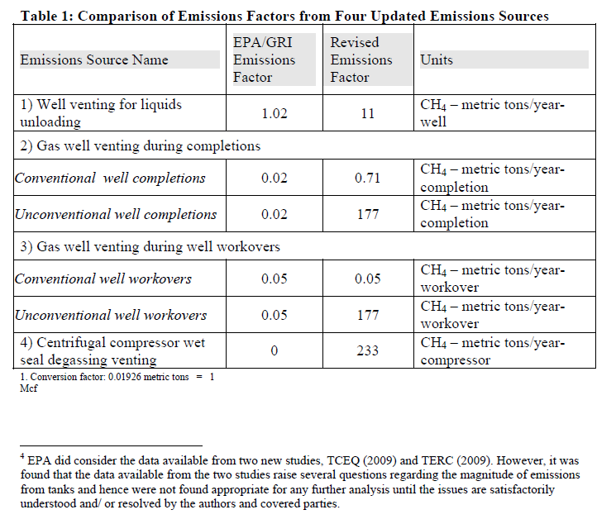
Update by US EPA on methane emissions from gas (Nov. 30, 2010):
1996
Nov. 2010

Slide 43
U.S. Greenhouse gas inventory
(Tg CO₂ equivalents per year, 2008 base year)
        Old estimate New estimate
        (2010 analysis) (2011 analysis)
        Total net GHG emissions 5,916 6,020
        Methane emissions 568 677
        (percent of total) (9.6%) (11%)
        Methane from natural gas 97 212
        (percent of total) (1.6%) (3.5%)
Based on EPA (2011), using methane global warming potential = 21
Data from: http://www.epa.gov/climatechange/emissions/usinventoryreport.html

Slide 44
U.S. Greenhouse gas inventory
(Tg CO2 equivalents per year, 2008 base year)
        Old estimate New estimate
        (2010 analysis) (2011 analysis)
        Total net GHG emissions 5,916 6,020
        Methane emissions 568 677
        Methane from natural gas 97 212
Equal to 3.1% leakage of all natural gas production, well within our range of 1.7% to 6% for conventional gas
Based on EPA (2011), using methane global warming potential = 21
Data from: http://www.epa.gov/climatechange/emissions/usinventoryreport.html

Slide 45
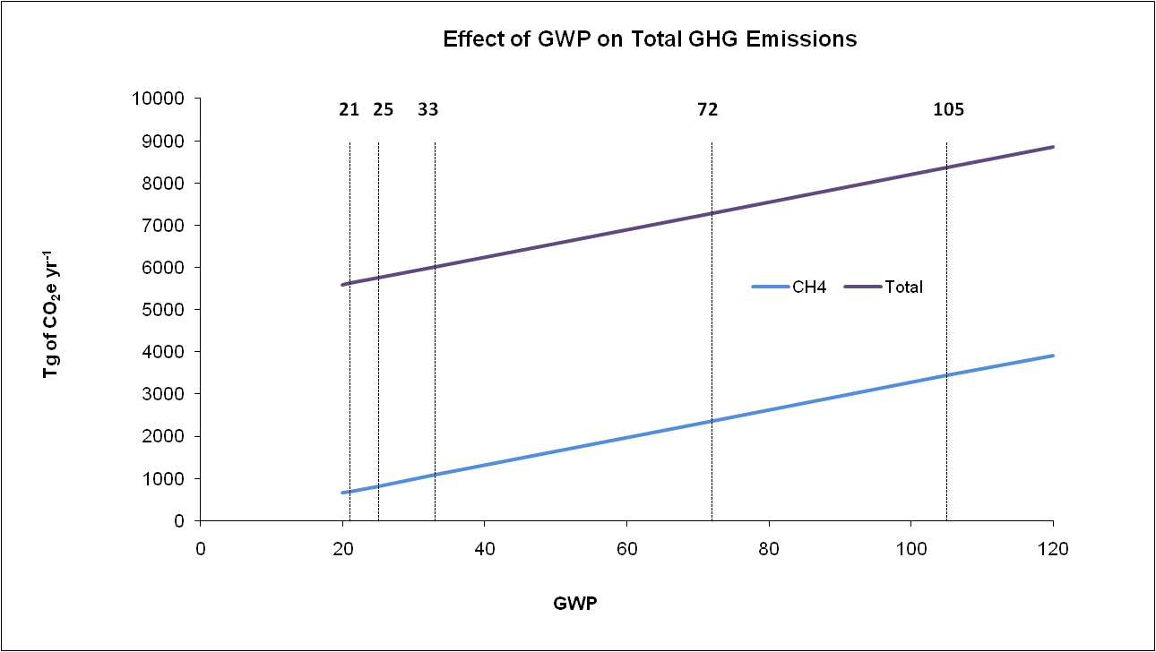
Influence of Global Warming Potential (GWP) on U.S. estimation of net emissions of all greenhouse gases and methane emissions
Net total emissions
methane emissions
Global warming potential
Shindell et al. (2009), 100-year
Shindell et al. (2009), 20-year
IPCC (1996), 100-year, used by EPA (2011)
IPCC (2007), 20-year
IPCC (2007), 100-year
Emissions data from EPA (2011)

Slide 46
The greenhouse gas footprint of natural gas will increase as conventional gas is further replaced by shale gas and other unconventional gas….
Using DOE (2011) projections for shale gas development and 20-year integrated GWP, the increased use of shale gas will increase the entire greenhouse gas footprint for the US by up to 9% by 2035 (with no increase in available gas or energy).

Slide 47
Funding from Cornell University and from the Park Foundation.
Thanks to my co-authors, Renee Santoro and Tony Ingraffea.

Slide 49

Jacobson and Delucchi 2009

Slide 50
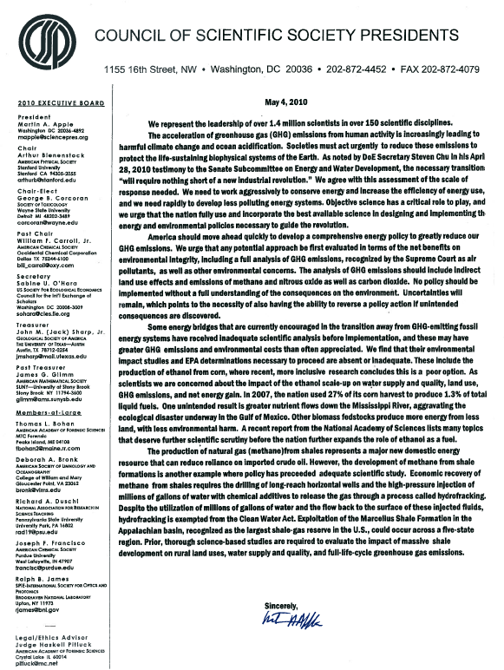
“The acceleration of greenhouse gas (GHG) emissions from human activity is increasingly leading to harmful climate change and ocean acidification. Societies must act urgently to reduce these emissions to protect the life-sustaining biophysical systems of the Earth.”
“……the necessary transitions will require nothing short of a new industrial revolution.”
“……..some energy bridges that are currently encouraged in the transition away from GHG-emitting fossil energy systems have received inadequate scientific analysis before implementation, and these may have greater GHG emissions and environmental costs than often appreciated.”
“…. …the development of methane from shale formations is another example where policy has preceeded adequate scientific study.”

Slide 51
Only 30% of natural gas in the U.S. is used to generate electricity….
U.S. Department of Energy (2011)

Slide 52
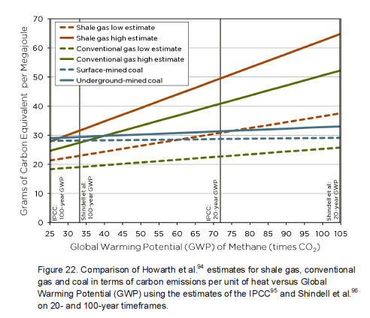
Hughes (2011)

Slide 53
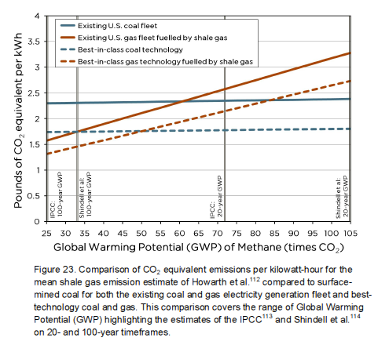
Hughes (2011)

Slide 54
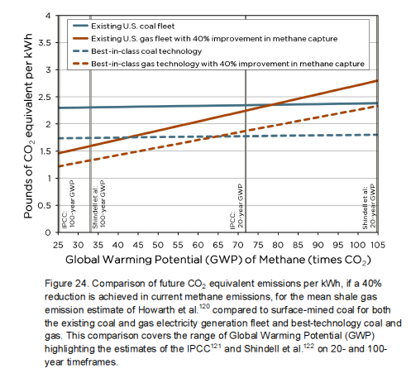
Hughes (2011)

Slide 55
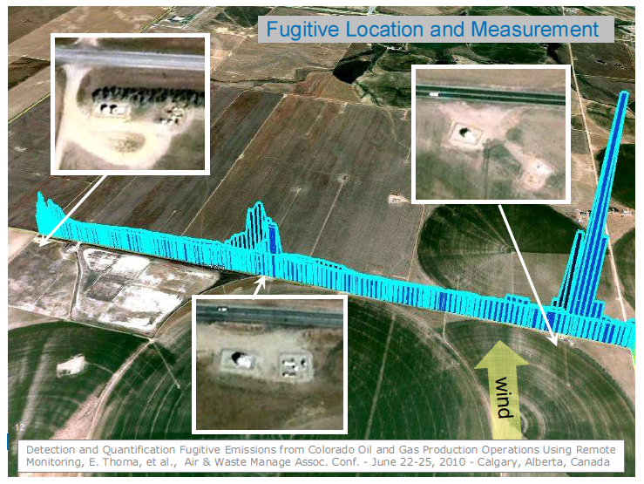
Eben Thoma, March 2010, EPA workshop presentation

Slide 56
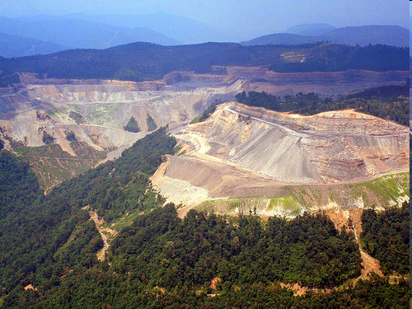
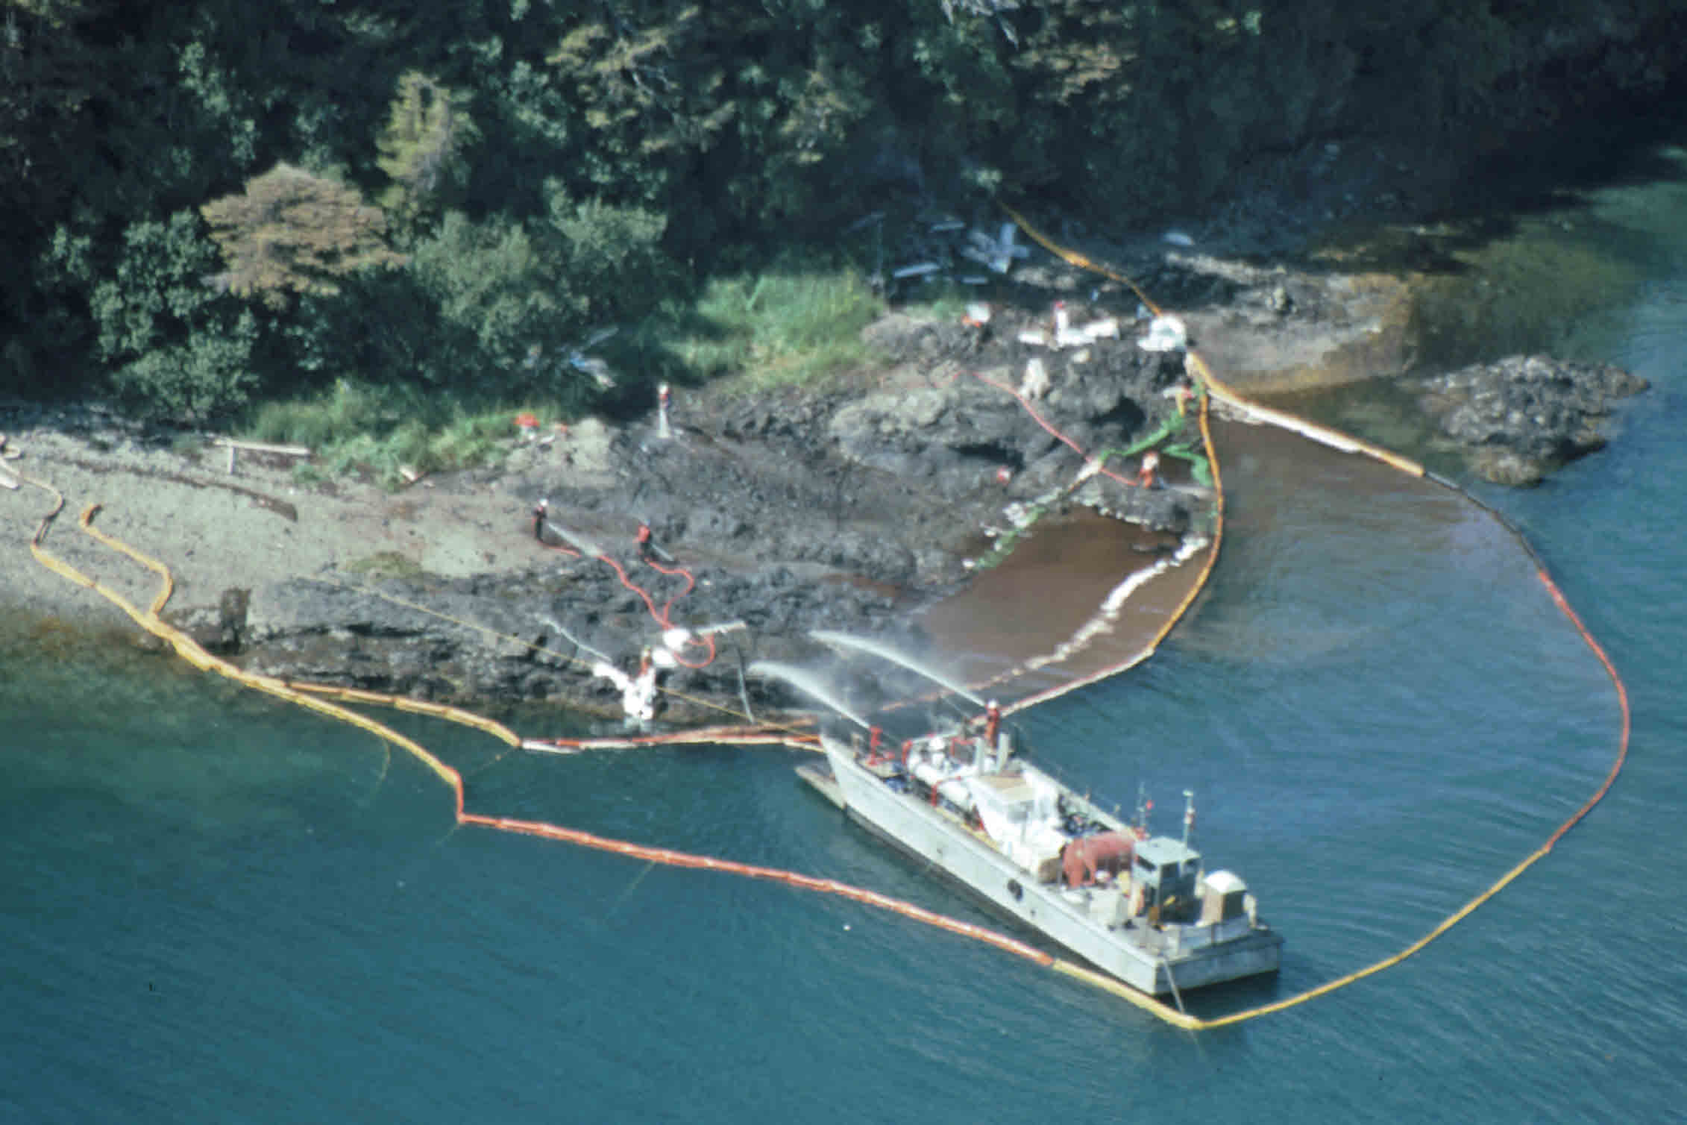
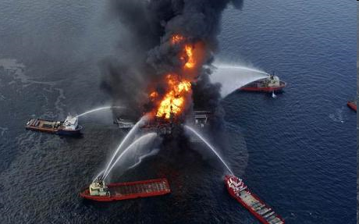
I am not advocating for more coal or oil, but rather to recognize full environmental costs of all fossil fuels, and to move to a truly green, renewable future as quickly as possible.

