Slide 1
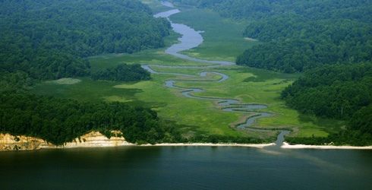
Crediting the Maintenance of Healthy Watersheds
A STAC Workshop Proposal from the Maintain Healthy Watersheds GIT
Mark Bryer, TNC, GIT Chair
Mike Fritz, EPA, GIT Coordinator
Anna Stuart Burnett, CRC, GIT Staffer

Slide 2
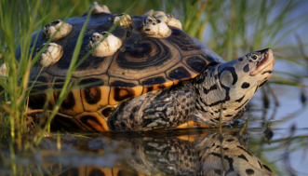

In March GIT 4 Asked STAC to:
Engage in scoping
Consider a path forward at the June STAC meeting
Reserve funding

Slide 3
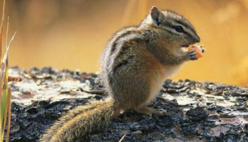
May 31st STAC Scoping Workshop Output
Concept 1: A BMP Conservation Premium
Question for STAC: Is there a scientific basis for recognizing a higher efficiency rating for some BMPs based on the assurance that they will remain in place in perpetuity? Or must additional factors beyond protection in perpetuity be coupled with the BMP, such as the BMP’s landscape position?

Slide 4
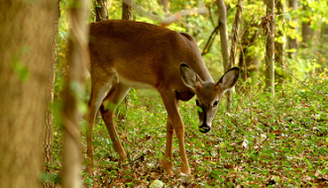

STAC Scoping Workshop Output
Concept 2: New Math for Risk Reduction at the Landscape Scale
Question for STAC: Is there an alternative way of addressing future growth scenarios that provides for recognition of, among other strategies, the load-limiting function of resource land preservation?

Slide 5
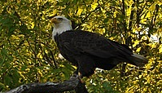
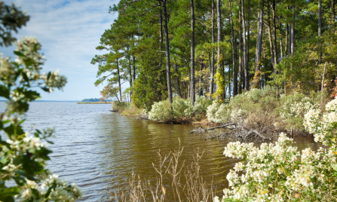
STAC Scoping Workshop Output
Concept 3: Watershed-scale Practices
Question for STAC: Can landscape/ watershed-scale functions, critical land use thresholds, and land use planning practices (including resource land preservation) be identified for use in the existing Bay TMDL accounting framework?

Slide 6
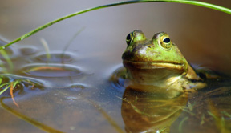
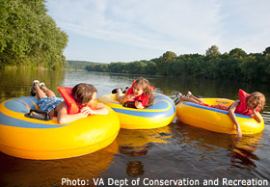
“The Ask”
We have highlighted three opportunities
  Help us refine these opportunities into a question for a STAC workshop this fall
Work with us over the summer
Assign a STAC member to work with us
  Greg Garman, others

